Slide 1

Course Introduction
CS 110 - Introduction to Programming
William Clements
© 2018 Brigham Young University–Idaho

Slide 2
Class Objectives
Successful graduates for CSE 110 will:
be able to use programming building blocks (variables, conditionals, loops, files) to accomplish meaningful tasks in a variety of domains.
have confidence that they can be successful in programming and in learning more about it.

Slide 3
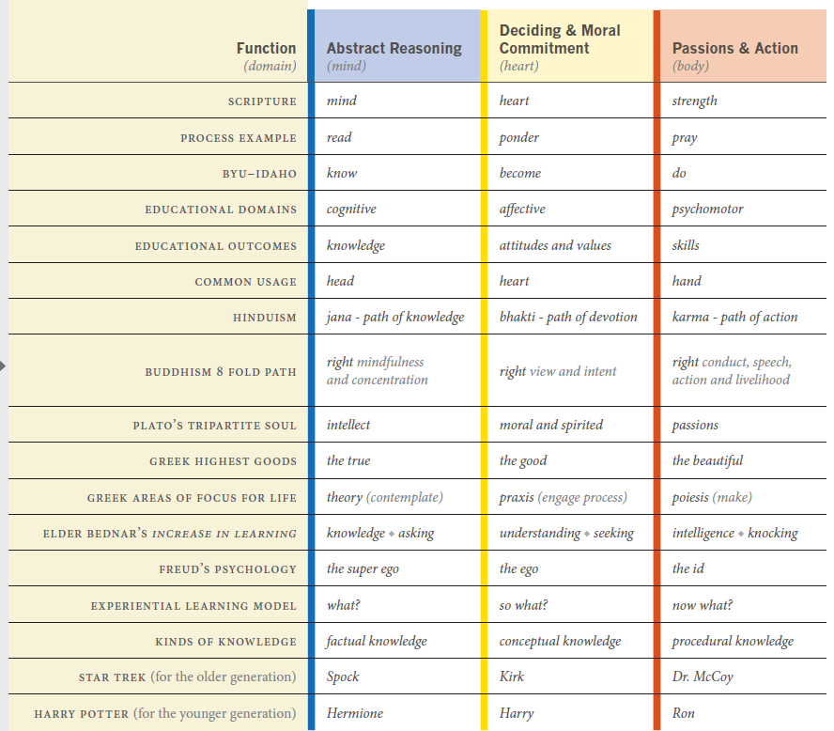
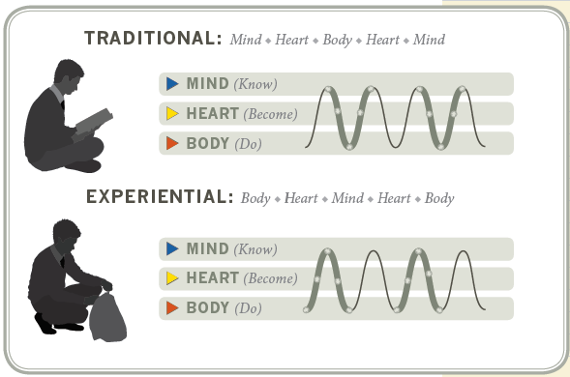
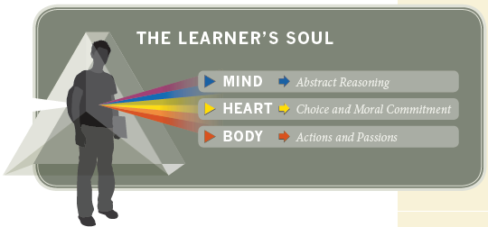
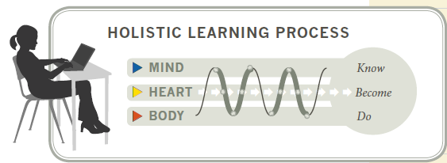
Learning @ BYU

Slide 4
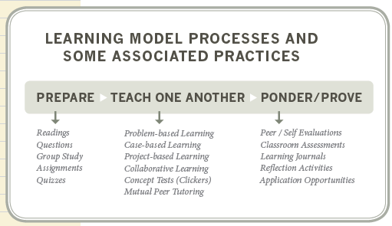
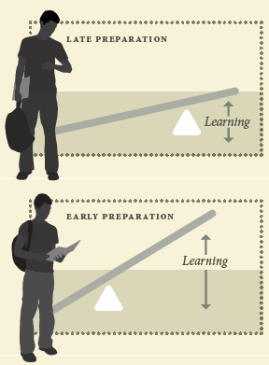
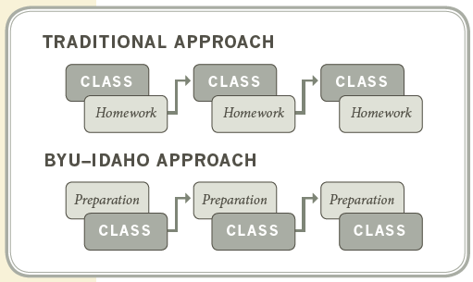
Learning @ BYU

Slide 5
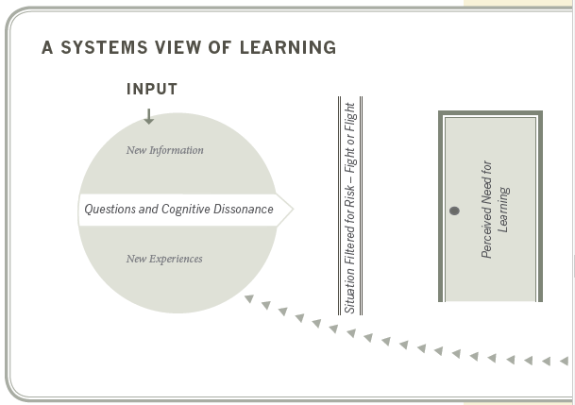
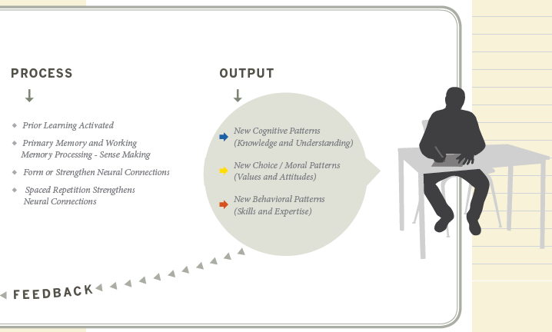
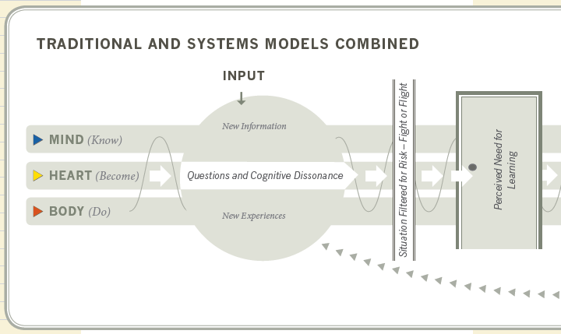
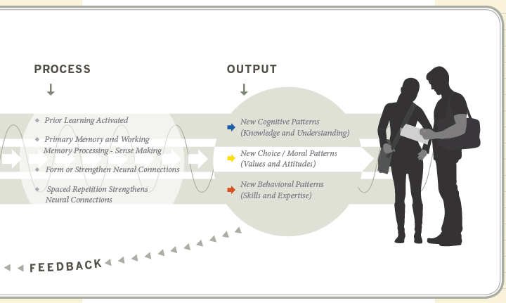
Learning @ BYU

Slide 6
Who bears the responsibility for learning?
For the Instructor
For the Student

Slide 7
Syllabus
Found in iLearn

Slide 8

Course Organization
Each lesson is organized as follows:
Prepare:
Preparation Material—Links will be provided to videos and reading material that should be completed individually prior to moving on to the rest of the lesson.
Checkpoint 15%—A small individual programming assignment designed to help you practice the mechanics of the reading.
Teach:
Team Activity 15%—A 1-hour programming activity to be completed with 3–5 other students. Face-to-face students will complete this activity during class. Online students will arrange a synchronous video conference.
Prove:
Programming Assignment 55%—A large individual programming project. Many of these span two lessons, with a milestone deliverable coming due at the end of the first lesson.
Ponder:
Check your understanding 10%—Every other lesson will have a multiple-choice quiz to help you check your understanding of the topic.
Reflection 5%—Every other week will contain 2–3 short response questions to allow you to reflect on the things you are learning.

Slide 9
Schedule
Day | Sun | Mon | Tue | Wed | Thu | Fri | Sat
Out of Class |  | Prep, Start Chkpt |  |  | Finish Chkpt |  | Prep
In Class |  |  | Class Meet |  | Team Activity Meeting
Out of Class |  |  |  |  |  |  | Ponder Due
 |  |  |  |  | Work on Prove |  | Prove Due

Slide 10
Time Commitment
This is a 2-credit class
Expectation is that you spend 2 hours for every class hour, so for a given week: 2 class hours + (2*2 class hours) = 6 hours/week
1st Hour: Read & Watch Videos
2nd Hour: Checkpoint
3rd Hour: Class: Kahoot, Review, Q&A
4th Hour: Team Activity
5th & 6th Hour: Prove and Ponder

Slide 11
COVID-19
Safety and Quality
Learning take place in safe
At any point where safety is a concern, we will be going Remote
Quality of being taught, better than CBT.
We are wearing masks, 6 ft distance, etc.
.

Slide 12
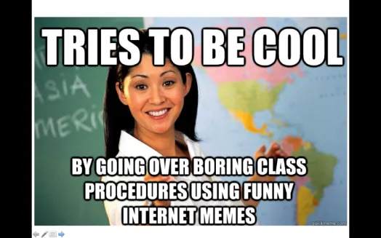
A little about me…
20+ Years experience
Masters: Univ of CO @ Denver; Bachlors; BYU-Provo; Associates: Ricks College
Worked for Northrop Grumman (TRW) for 13 years, Raytheon for 5 years
Been teaching for 8 years: Online, Hybrid, and Campus for Community Colleges of Colorado, BYU-Online, and BYU-Idaho
I love computing, I have since I saw my first for-loop fill the screen with my name.
I have moved over 20x, CA, UT, ID, MO, OK, TX, CO
Hobbies: Board Games, Family outings

Slide 13
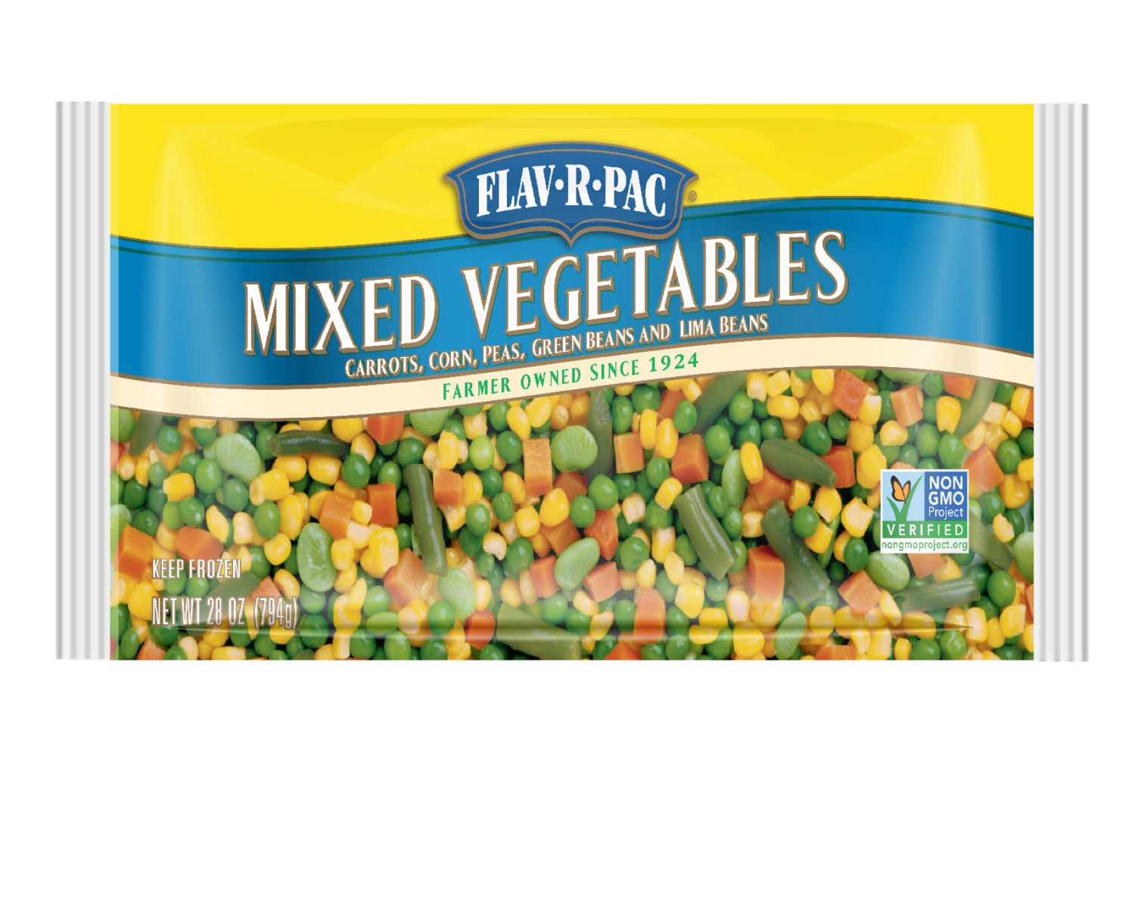
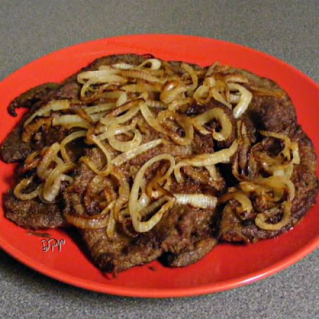
Let’s Debate -Safely
Food: Indian, Tex-mex, Italian, and everything but lima beans and liver and onions.
What food do you like? Why?
What food do you refuse to eat? Why?

Slide 14
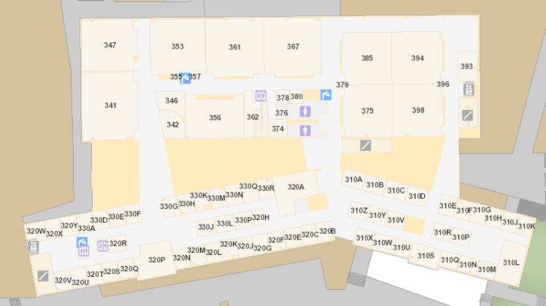
Bro Clements
William Clements
Email: ClementsW@byui.edu
Google Phone: (208) 557-4333
Office Phone: 208-496-7617
Office Rm: 320 T (Mark Twain with a T – Samuel Clemens)

Slide 15

Reasons to Learn about Computing
Computing is part of everything we do!
Solve complex problems
Make a difference in the world
Lucrative careers
Computing jobs are here to stay
Helpful in other careers
Opportunities for creativity
Both collaborative and individual
Part of well-rounded education
Without Boundaries

Slide 16
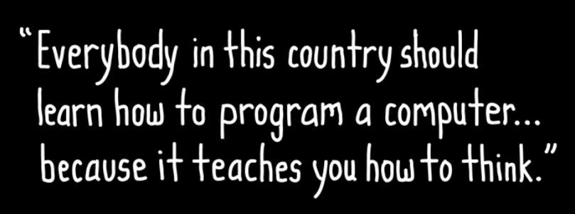

Why Learn to Code?
https://www.youtube.com/watch?v=nKIu9yen5nc

Slide 17
Discussion
What is the most important way computers influence your life?

Slide 18

Syllabus – Policies - Honor Code
You may work with your classmates, but all submitted work must be original.
The penalty for copying or plagiarizing of assignments might be one or more of the following: zero on an assignment, being asked to withdraw from the class, a failing grade in the class, or disciplinary action by the university.
Homework assignments are to be completed as scheduled.
Late work is generally not accepted. However, assignments may be rescheduled for a limited number of emergency situations if you discuss your situation with me before (not on and especially not after) the scheduled due date. There will be no routine extensions of due dates; be prepared to justify any requests for extensions.

Slide 19

Accessibility
BYU-Idaho is committed to providing a working and learning atmosphere that reasonably accommodates qualified persons with disabilities. Reasonable academic accommodations are reviewed for all students who have qualified documented disabilities. Services are coordinated with the student and instructor by BYU-Idaho Disability Services. If you need assistance or feel you have been unlawfully discriminated against on the basis of disability, you may seek resolution through established policy and procedures.
If you have any disability that may impair your ability to complete this course successfully, please contact Disability Services as soon as possible, preferably before the beginning of the semester, in order to ensure that you receive appropriate accommodations.
Disability Services Contact Information:
Phone: (208) 496-9210
Email: disabilityservices@byui.edu
Fax: (208) 496-5210
Website: http://www.byui.edu/disabilities/disability-services

Slide 20
Sexual Harassment
Treat everyone with respect...
BYU-Idaho is committed to promoting and maintaining a safe and respectful environment for the campus community. Sexual misconduct is against the law, contrary to the teachings of The Church of Jesus Christ of Latter-day Saints and the Honor Code, and inconsistent with the life and teachings of Jesus Christ, which we hope are embodied on our campus. The university prohibits sexual misconduct perpetrated by or against university students, university employees, participants in university programs, or visitors to its campus, whether the behavior occurs on or off campus.
Read about Title IX for more information.

Slide 21
Communication
MS Teams – CSE 110 – Fall 2020
https://teams.microsoft.com/l/team/19%3acdfe7c49064844deb8292d7aeb08e78d%40thread.tacv2/conversations?groupId=764a0054-ad62-4775-8b2a-ef470d2d7d99&tenantId=e6ac1d1f-d695-4ef1-91d4-94cddef8be11
Signup for Tuesday or Thursday Schedule
Zoom
Zoom: Meeting ID: 943 9216 7469 Passcode: 608544

Slide 22
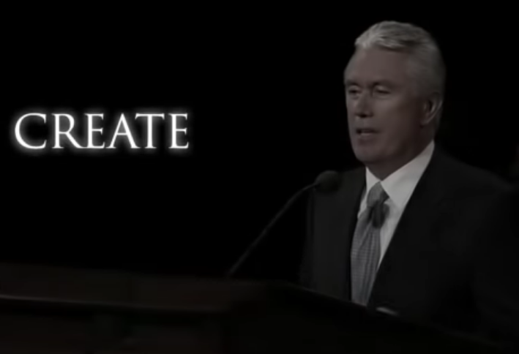
Get Creative
https://www.youtube.com/watch?v=TJC1sRJ8F0Q

Slide 23
Before Next Time…
Get Python and Visual Studio Code Installed
Get signed up for MS Teams
Download Application
Try to Finish/Submit Checkpoint 01
Download Kahoot app

Slide 24
Computing is not only Software Engineers
Notes:
Ask where they are from, what they are majoring in, who has coded before, etc. (raise hands)

Slide 25
A little about you…
Name
Major
Where are you from?
Why are you taking this course?
What do you want to be doing 8 years from now?

Slide 26
Course Format
Day | Sun | Mon | Tue | Wed | Thu | Fri | Sat
In Class |  |  | Team Activity |  | Examples Questions Dig Deeper
Out of Class | Rest and Worship | Preparation Material Work on: Checkpoint | Finish: Checkpoint | Work on weekly assignment |  |  | Due: Assignment Ponder

Slide 27
CSE 110 Course History and Genesis

