Slide 1

Course Introduction
CS 110 - Introduction to Programming
William Clements
Please make sure that you have Kahoot loaded on your machine, phone or smart device via an app or web browser.
© 2018 Brigham Young University–Idaho

Slide 2
Communication
MS Teams – CSE 110 – Fall 2020
https://teams.microsoft.com/l/team/19%3acdfe7c49064844deb8292d7aeb08e78d%40thread.tacv2/conversations?groupId=764a0054-ad62-4775-8b2a-ef470d2d7d99&tenantId=e6ac1d1f-d695-4ef1-91d4-94cddef8be11
Signup for Monday or Wednesday Schedule
Zoom
Zoom: Meeting ID: 943 9216 7469 Passcode: 608544
Must have camera’s on
Have a question post it to chat

Slide 3
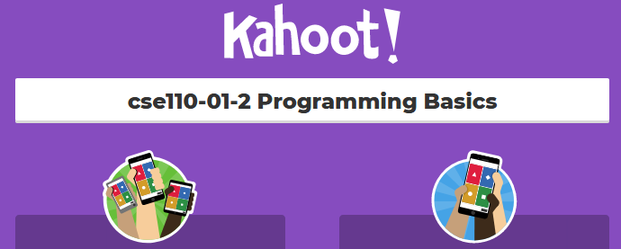
Kahoot
BYU-Idaho:: cse110
Cse110-01-2 Programming Basics

Slide 4
Python
Why
Simple to learn
Build confidence
Basic
Best practices
Interruptive Language
Function, Procedural, Object-Oriented
Human Readable, it is a foreign language
What can I build: ML/AI, web, automation
Automation: Do it once, Do it twice work out bugs, third time write a script

Slide 5
Microsoft Visual Studio
Download
Configuring Visual Studio Code (3 mins)

Slide 6
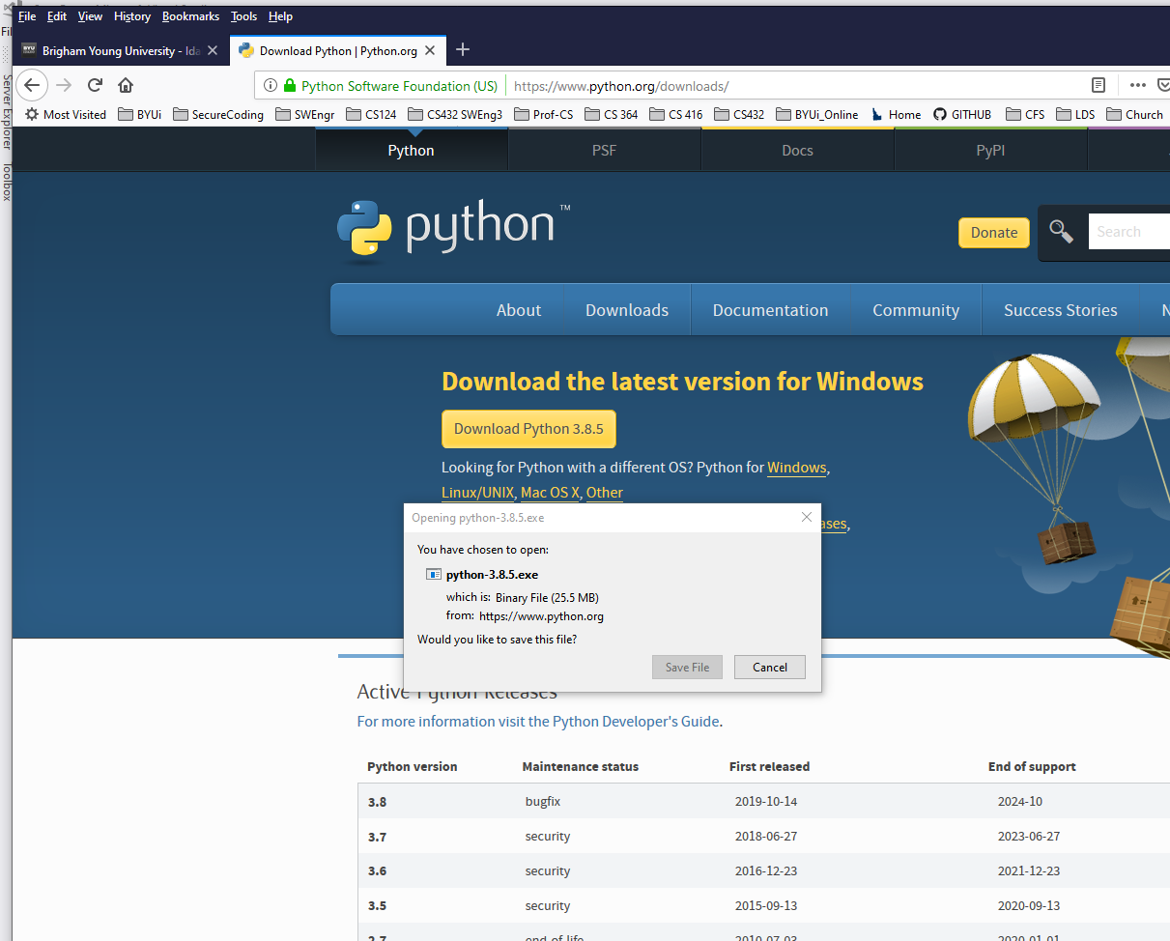
https://www.python.org/downloads/

Slide 7
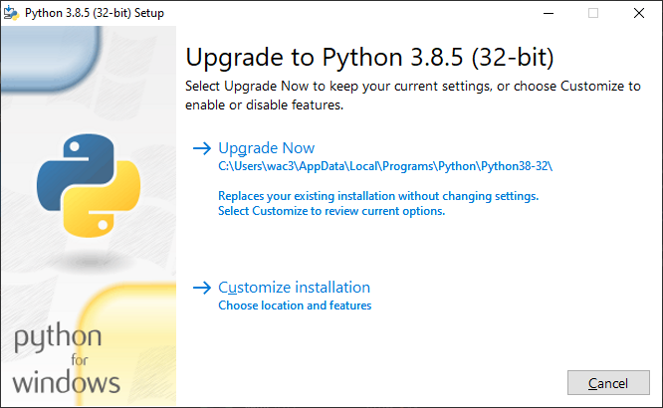
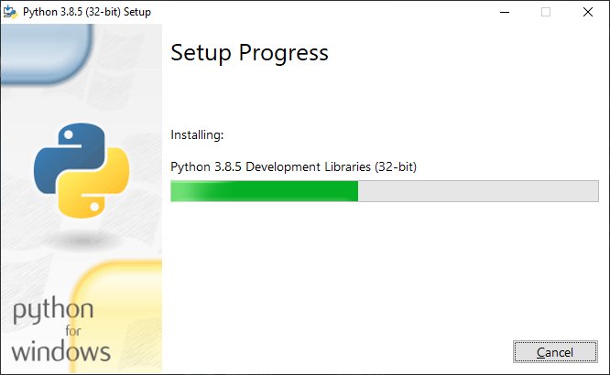
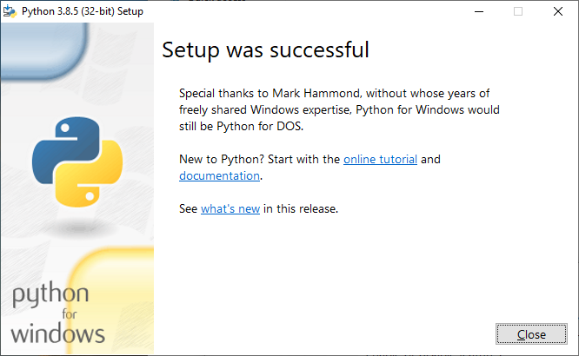

Slide 8
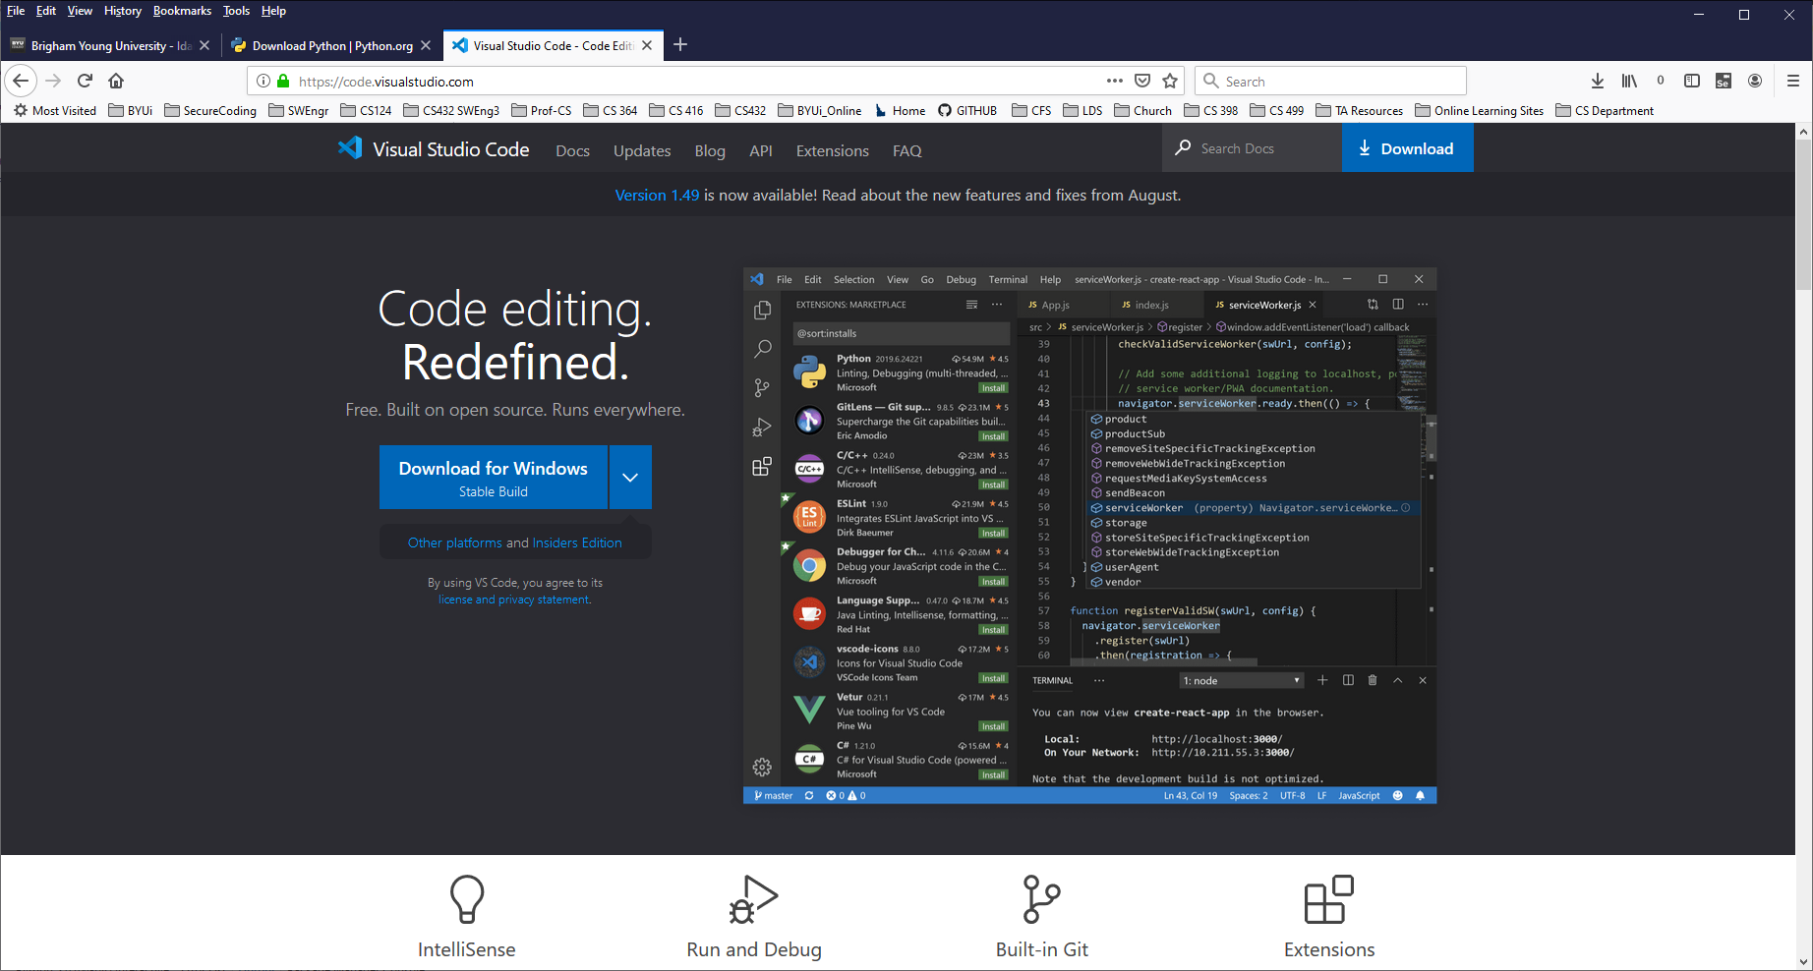
https://code.visualstudio.com/docs/?dv=win

Slide 9
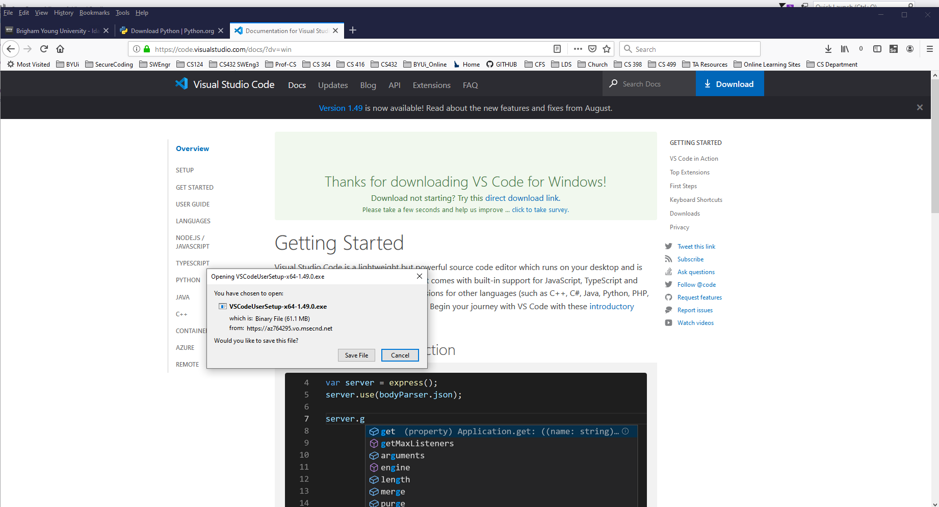

Slide 10
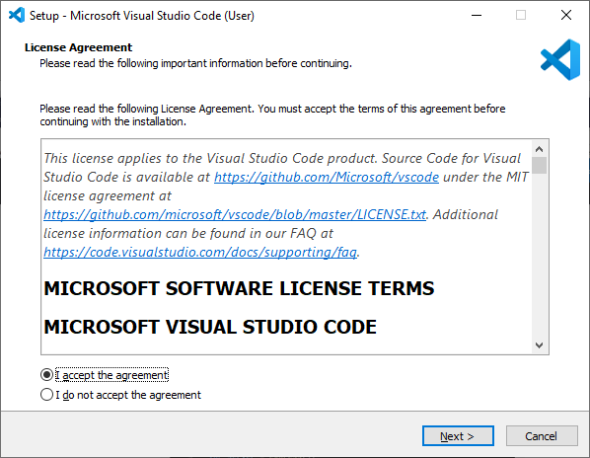
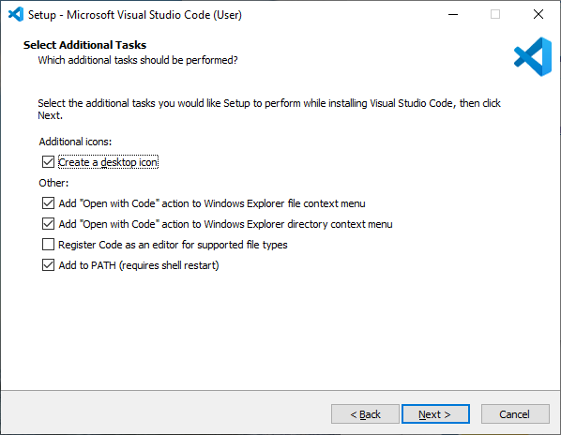
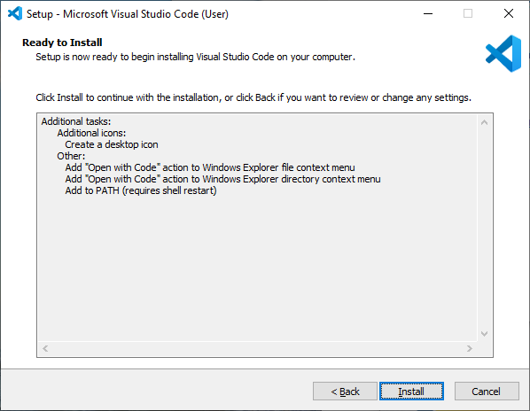
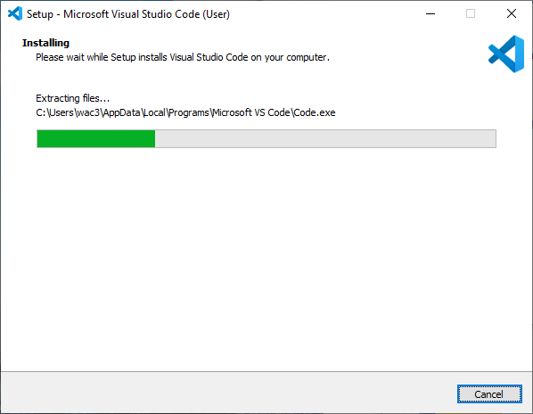
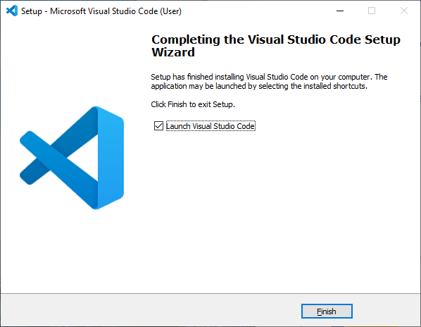

Slide 11
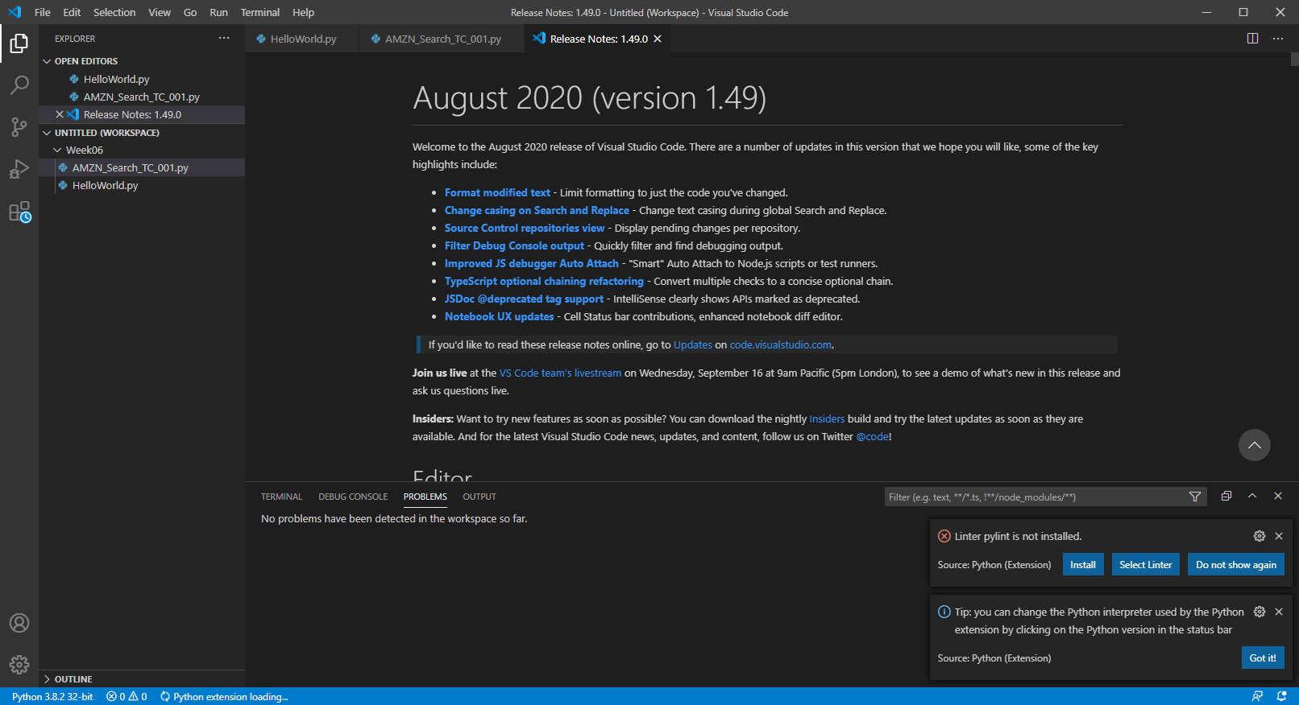
Done Install and open

Slide 12
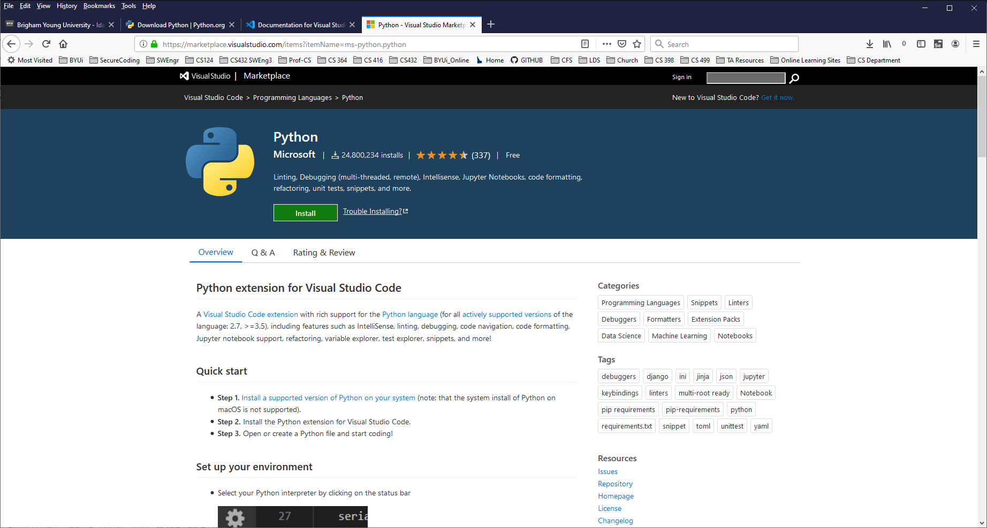
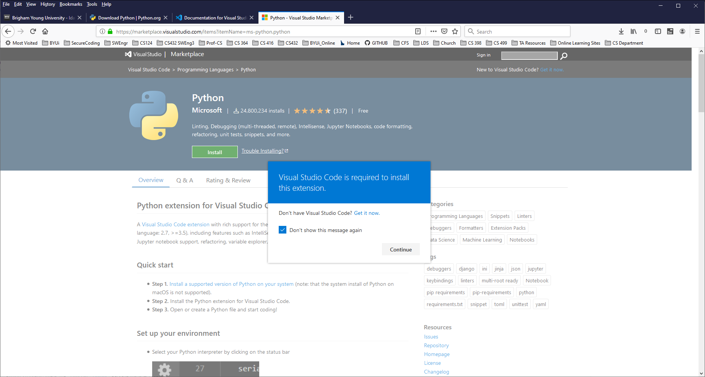
VS Code is a really fancy editor
Also know as an IDE
(Integrated Development Environment)
Also known as a CASE tool
(Computer Aided SW Engr Tool)
Install Extension let VS Code know
where to run python – Integrated part
https://marketplace.visualstudio.com/items?itemName=ms-python.python

Slide 13
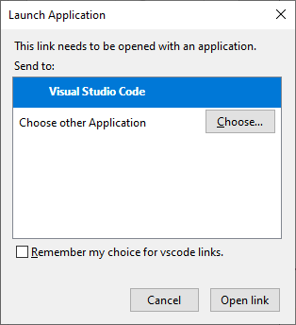

Slide 14
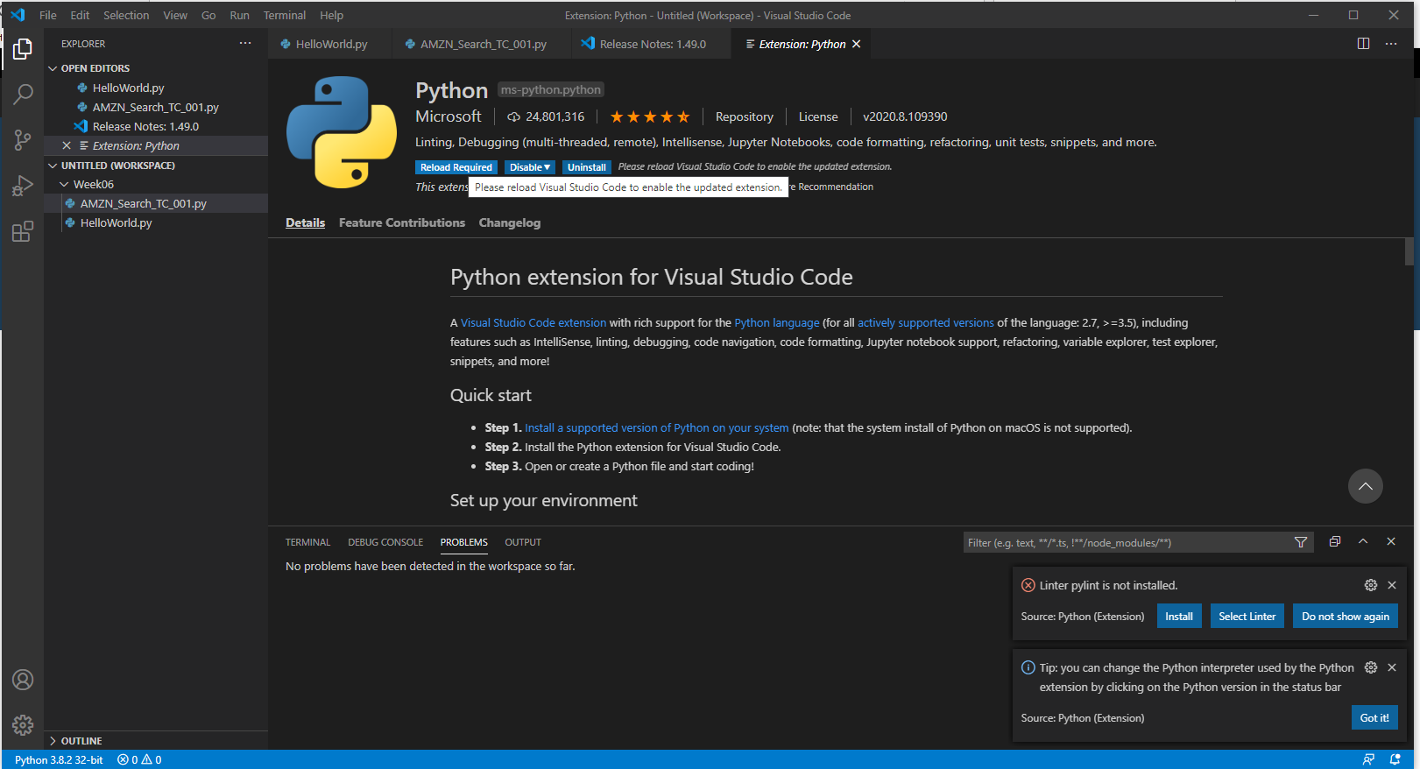
Open this tab in VS Code, click on Install

Slide 15
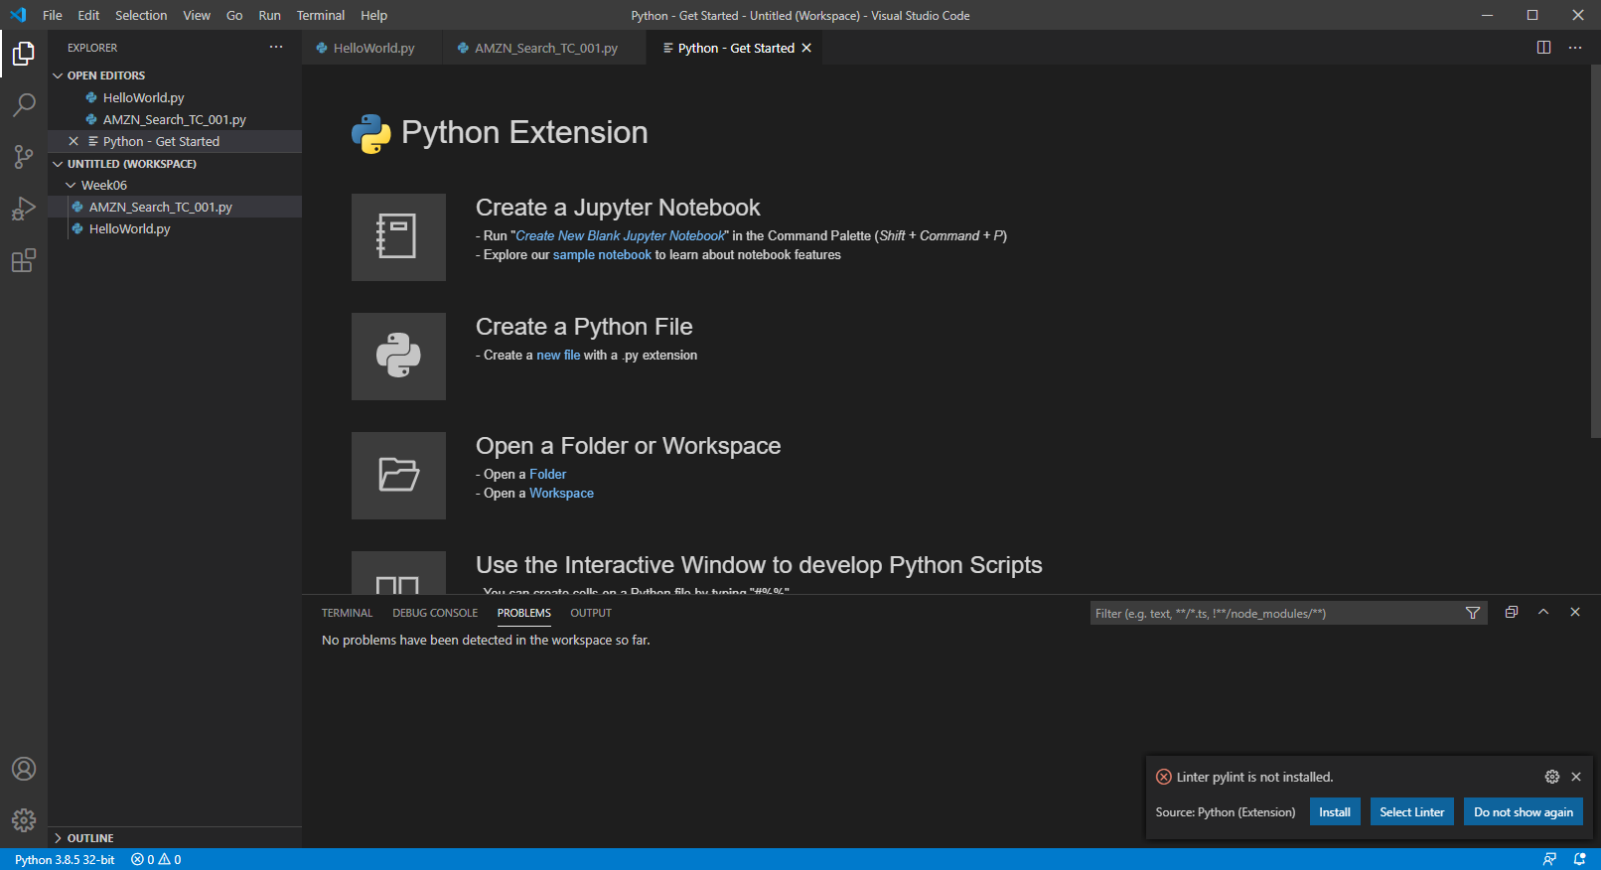
Done installing extention

Slide 16
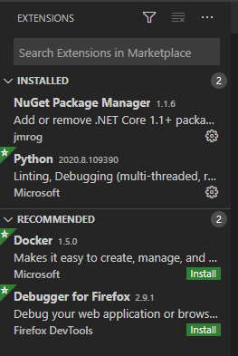
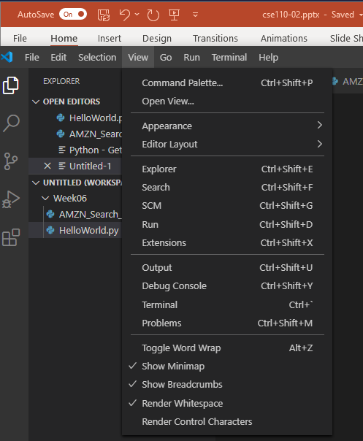
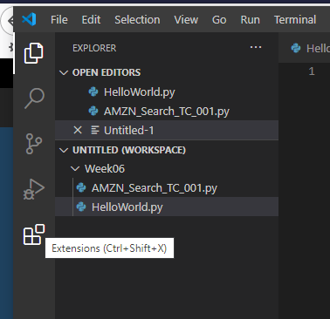
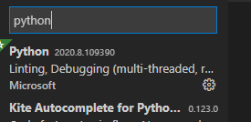
You will discover that with programming there are multiple way of doing things.
Another way of installing the extension
(The video showed an earlier version of VS Code, wanted to show that it looked different

Slide 17
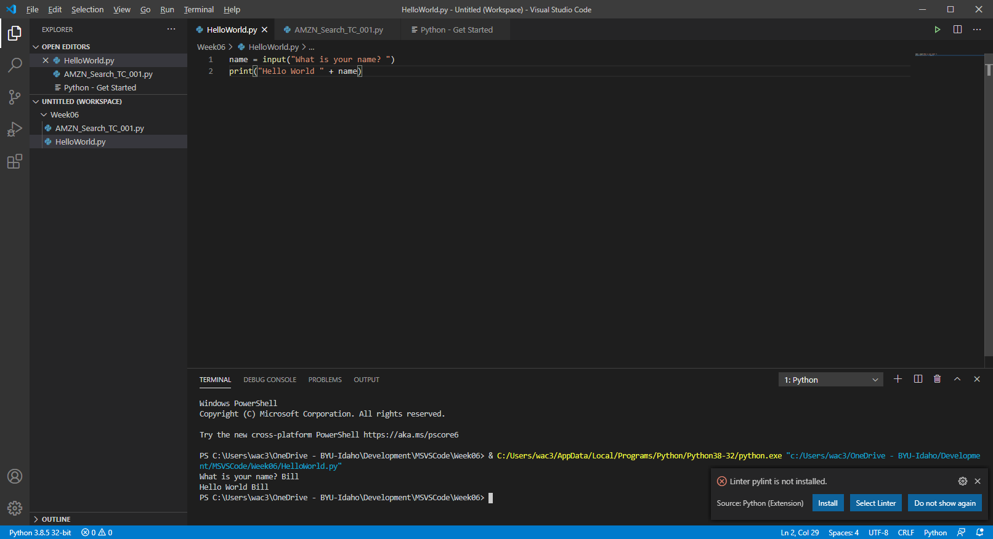
Clicked on HelloWorld.py tab, click arrow to run
Runs in terminal

Slide 18
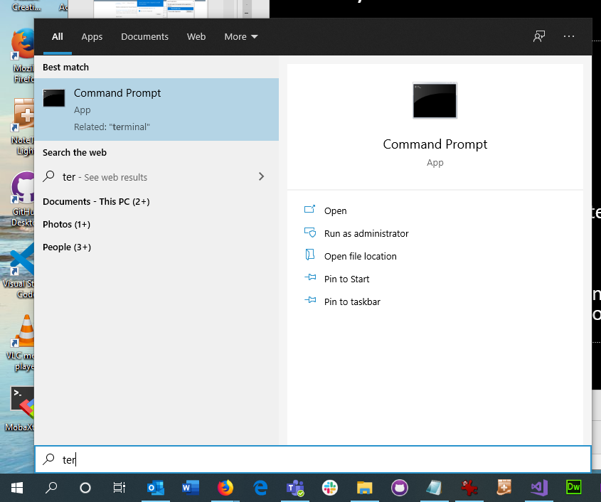
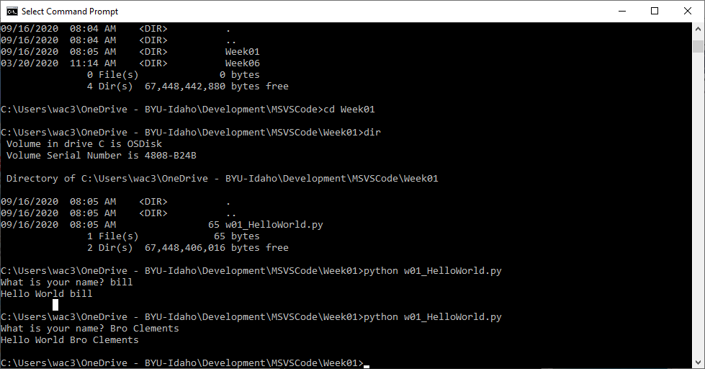

Slide 19
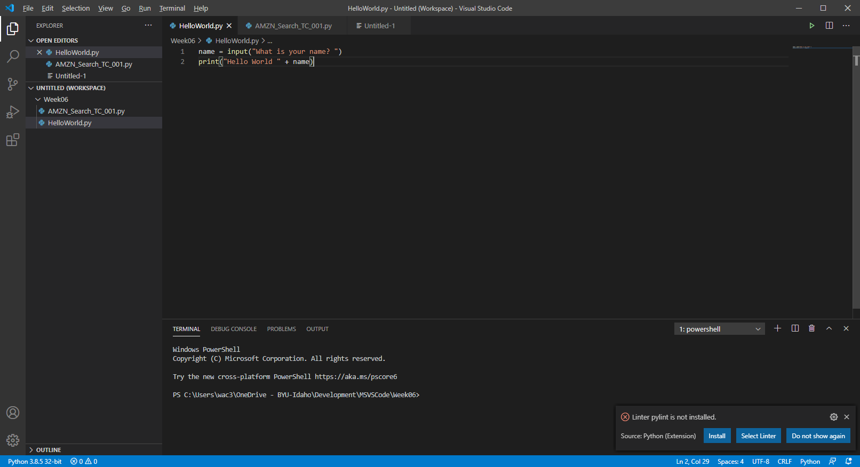
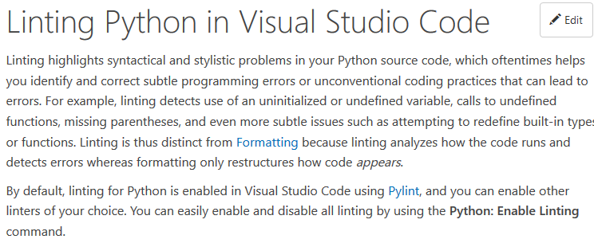

Slide 20
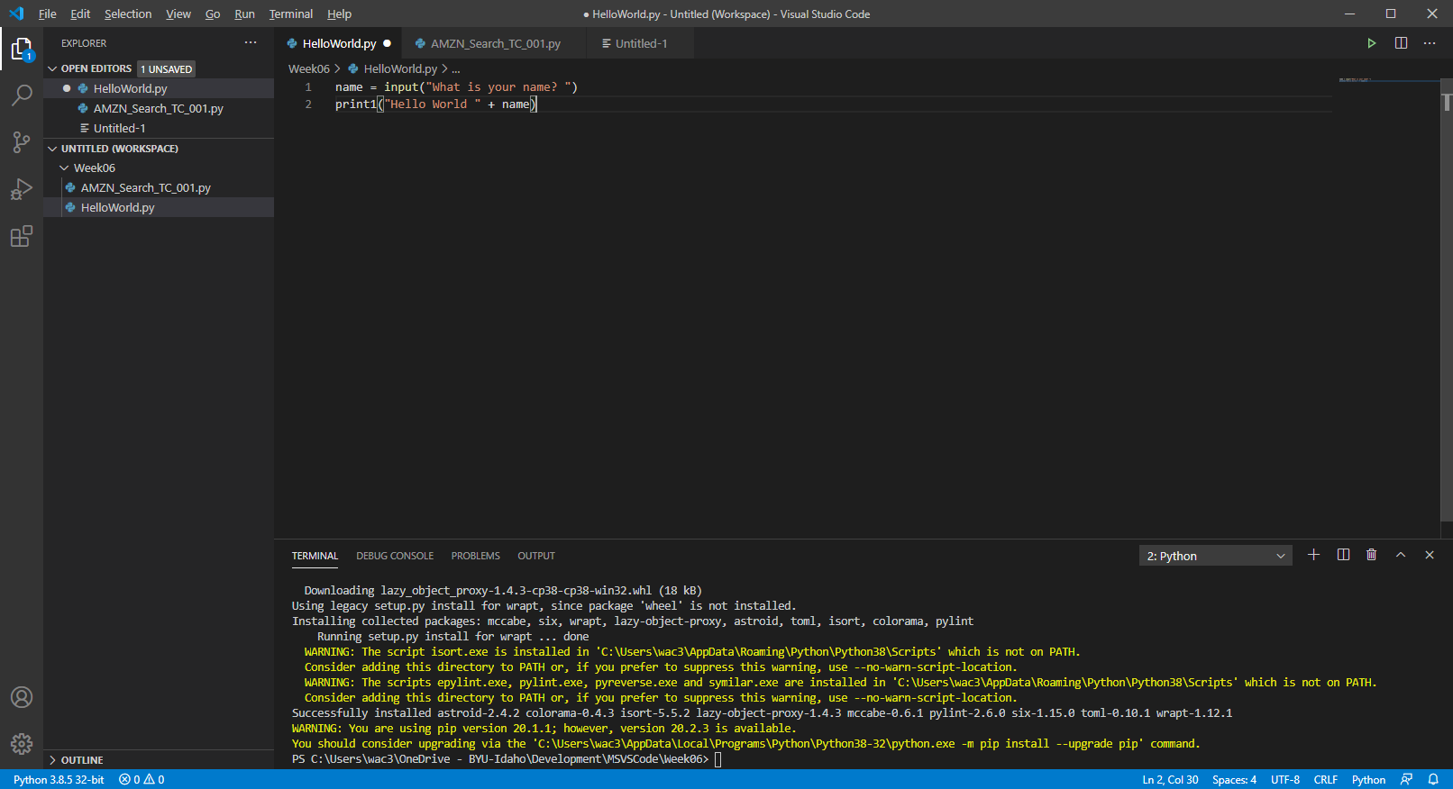
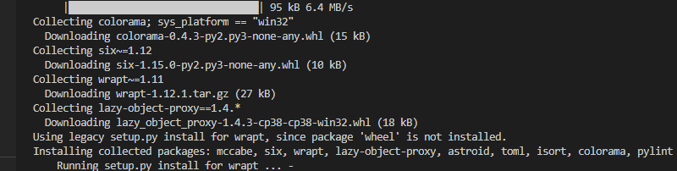
Will install using pip, a script that install python libraries

Slide 21
Python Code
Using print
print(‘Hello World’)
print(“Hello World”)
new line: print(), \n, (Roman Zero, Can of nothing)
Useful for debugging
Input function
name = input(‘Please enter your name’)
print name
Using code comments
Part of the code that is only meant for other programmers to help understand the purpose, design, etc of the code.
# for single or end of line
“”” – 3-double quote, begin and end

Slide 22
Checkpoint
Work on as individuals or with partner
Turn in different code. Variable names are should be different.
Hello World
Try programming it first, spend 1 hr or until finished
Then look the Instructor Code

Slide 23
No Team – Work on Ice Breaker
Signup for teams
3-4 member group – by Next Thursday

Slide 24
Prove – Favorite Color
Requirements
Write a program that asks a user for their favorite color
Then allows them to type in the color.
Finally program responds to them by displaying the text "Your favorite color is" followed by the color they typed.
Make it your own
Add additional question, change formatting, wording, or any thing else.
Grading 50 pts
Your opinion is required:
1 - Some attempt made 2 - Developing (but significantly deficient) 3 - Slightly deficient 4 - Meets requirements 5 - Made it your own
10 pts prompts user
10 pts Responds with text “Your favorite color is “
10 pts Displays user’s answers
10 pts Stores in variable between prompt and display
3.5 pts Make it your own
6.5 pts Comments in code (Name, project name, date)

