Slide 1
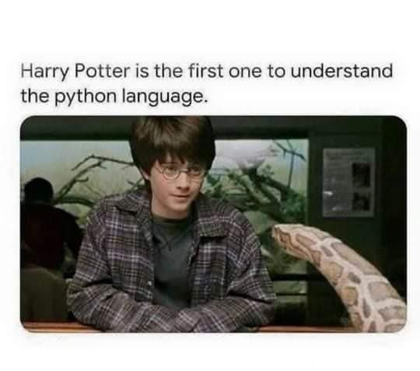
Variables and Expressions CS 110 - Introduction to Programming
Brother W. Clements

Slide 2

Prepare
Kahoot Quiz: cse110-03-2 Variables and Expressions

Slide 3
Prepare
Questions about
Data Types
Numbers (int vs float)
Operator + (addition vs concatenate)
Strings (convert: str
Print formatting
Printing mixed types
Converting types
int, float, str
Expressions
Operator | Symbol | Example | Result
Add | + | 3 + 4 | 7
Subtract | - | 3 - 4 | -1
Multiply | * | 3 * 4 | 12
Divide | / | 15 / 4 | 3.75
Divide and drop remainder | // | 15 // 4 | 3
Remainder or Modulus | % | 25 % 7 | 4
Exponent (To the power of) | ** | 3 ** 4 | 81

Slide 4
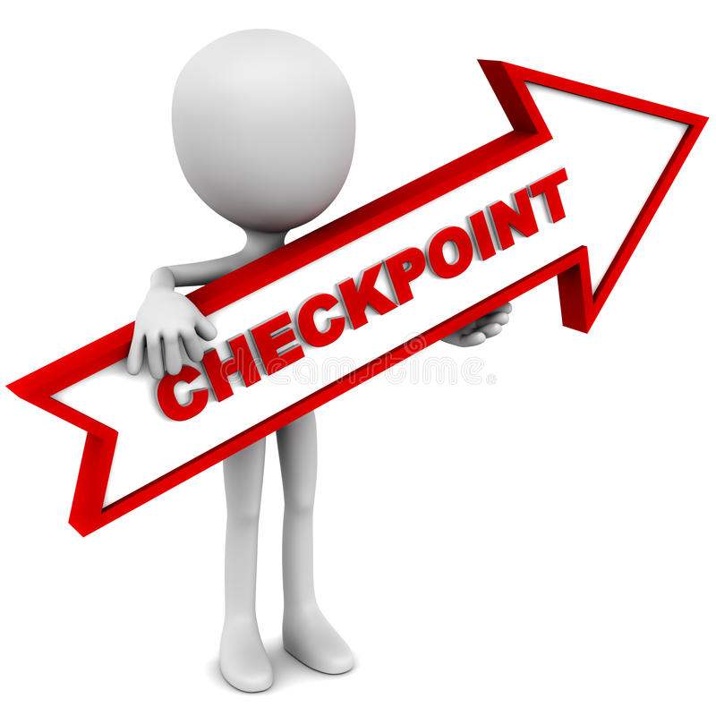
Checkpoint
How old are you? 25
On your next birthday, you will be 26
How many egg cartons do you have? 3
You have 36 eggs
How many cookies do you have? 18
How many people are there? 8
Each person may have 2.25 cookies
Steps
Read instructions
Attempt coding the problem for 1 hour
Look at the Instructor code after 1 hour or when done.
Include in notes, what you learned from the instructor's code
Test It:
1. Q1: 25 -> 26; Q3:3->36
2. Q1: 18 -> 19 & 59 -> 60
3. Q2: 5-> 60; 0->0
4. Q3: Figure out sample set

Slide 5
Teach: Team Activity
Meet and setup a video call, share screen
Overview
Make sure that your program can appropriately handle decimal values as well as whole numbers.
Square—The area is the length of a side squared.
Rectangle—The area is the length multiplied by the width.
Circle—The area is Pi (you can use 3.14) multiplied by the radius squared.
Core requirements
Stretch Challenge
Math pi
Single length: square, circle, volume
Cm^2 and m^2 : 100cm:1m
Teacher Solution
Submission
In notes tell me what you learned from the teacher solutions.
What is the length of a side of the square? 3.5
The area of the square is: 12.25
What is the length of rectangle? 6
What is the width of the rectangle? 7.5
The area of the rectangle is: 45.0
What is the radius of the circle? 8.2
The area of the circle is: 211.1336
What is the length of a side of the square? 5
The area of the square is: 25.0
What is the length of rectangle? 6
What is the width of the rectangle? 7
The area of the rectangle is: 42.0
What is the radius of the circle? 5
The area of the circle is: 78.5

Slide 6
Prove
What is the price of a child's meal? 4.50
What is the price of an adult's meal? 9.00
How many children are there? 4
How many adults are there? 2
What is the sales tax rate? 6
Subtotal: $36.00
Sales Tax: $2.16
Total: $38.16
What is the payment amount? 40
Change: $1.84
What is the price of a child's meal? 2.25
What is the price of an adult's meal? 6.99
How many children are there? 2
How many adults are there? 1
What is the sales tax rate? 4
Subtotal: $11.49
Sales Tax: $0.46
Total: $11.95
What is the payment amount? 20
Change: $8.05
Overview
Program the following:
Ask the user for the following:
The price of a child's meal (floating point)
The price of an adult's meal (floating point)
The number of children (integer)
The number of adults (integer)
The sales tax rate (floating point)
Calculate: Subtotal, Tax, Total
Prompt payment and provide change
Make it your own
Submission
Upload program (the .py file) to the assignment
Submission Comment: What you think you did and 1-2 sentences justify your that describes your effort
1 = Some attempt made, 2 = Developing (but significantly deficient), 3 = Slightly deficient, 4 = Meets requirements, 5 = Made it your own

