Slide 1
Week 11: Functional Programming
W. Clements
CSE 111: Programming with Functions

Slide 2
Overview
Prepare: Reading, Video
Checkpoint
Teach: Class Activity
Prove: Milestone
Ponder: Check your understanding

Slide 3
Review

Slide 4
11 Prepare: Functional Programming
https://byui-cse.github.io/cse111-course/lesson11/prepare.html
Procedural programming
CSE 110, 111
Chaining variables and functions
Declarative programming - what needs to be done
Examples: XML, HTML, SQL
Functional programming
Stateless, function passing, nested functions
Concepts¶
Passing a Function into another Function
Nested Functions
Lambda Functions
Example - Map and Filter¶
Example - Sorting a Compound List¶

Slide 5
11 Checkpoint: Functional Programming
Purpose
Problem Statement¶
Reinforce in your mind the concept that a function can be passed as an argument into another function.
Phone numbers in the U.S. are often stored as ten digits and two dashes in this format:
"ddd-ddd-dddd" where each d is a digit.
The first three digits are called the area code.
For example, for many years, 208 was the area code for all phone numbers in the state of Idaho and 801 and 435 were the two area codes for phone numbers in the state of Utah.
Some people, when entering their phone number, will not enter the area code and assume that other people will know the correct area code.

Slide 6
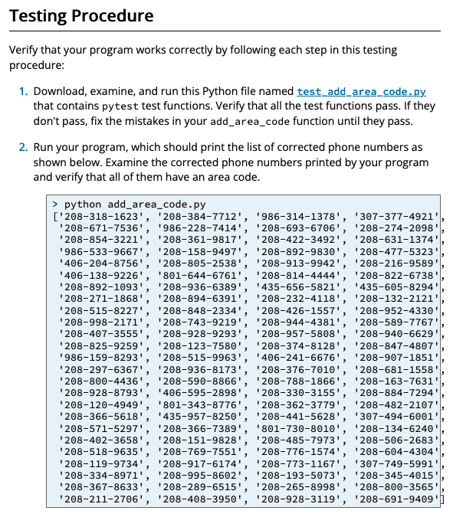
11 Checkpoint: Functional Programming
Assignment¶
Write a program named add_area_code.py that reads phone numbers from a text file. Your program must add the area code "208-" to all phone numbers that don't have an area code. Do the following:
Download these two files: phone_numbers.txt and add_area_code.py and save them in the same folder.
Open the phone_numbers.txt file in VS Code and examine the phone numbers. Notice that some of the phone numbers do not have an area code and contain only seven digits.
Open the add_area_code.py file in VS Code. Read the comments in the program and then add code to the program so that it does the following:
Reads the phone numbers in phone_numbers.txt into a list.
Adds the area code "208-" to the phone numbers that do not have an area code.
Prints the list with the corrected phone numbers.

Slide 7
11 Team Activity: Functional Programming

Slide 8
11 Team Activity: Functional Programming
Instructions¶
Purpose¶
Work as a team as explained in the instructions for the lesson 2 team activity.
Reinforce in your mind the concept that a function can be passed as an argument into another function.

Slide 9
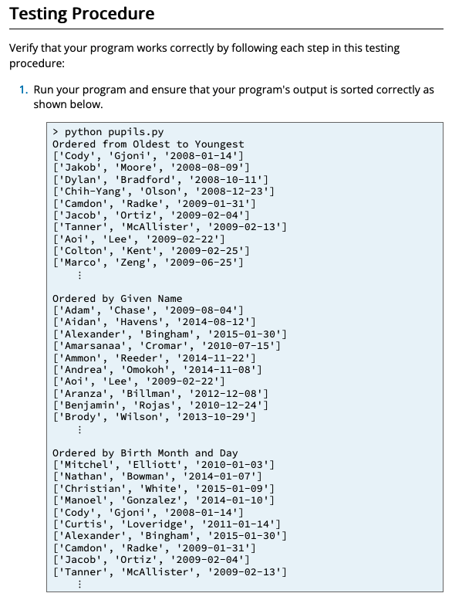
11 Team Activity: Functional Programming
Steps¶
Do the following:
Download these two files: pupils.csv and pupils.py and save them in the same folder.
Open the pupils.csv file in VS Code and notice that it has three columns: givenName, surname, and birthdate.
Open the pupils.py file in VS Code. At the bottom of the file write a function named print_list that takes a list as a parameter and prints each element of the list on a separate line. In other words, this print_list function should include a for loop that prints each element on a separate line.
Near the top of pupils.py, below the three indexes, write the main function. Inside the main function, write statements to do the following: Call the read_compound_list function to read the pupils.csv file into a list named students_list.
Write a lambda function that will extract the birthdate from a student.
Write a call to the Python built-in sorted function that will sort the students_list by birthdate from oldest to youngest.
Print the students_list by calling the print_list function.
At the bottom of the pupils.py file write a call to the main function.

Slide 10
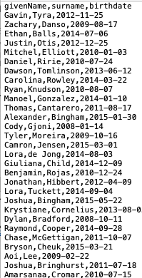
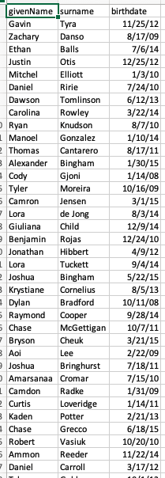
11 Team Activity: Functional Programming
Steps
Download these two files: pupils.csv and pupils.py and save them in the same folder.
Open the pupils.csv file in VS Code and notice that it has three columns: givenName, surname, and birthdate.

Slide 11
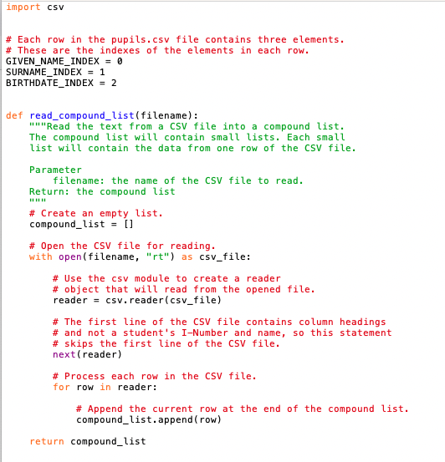
11 Team Activity: Functional Programming
Steps
Open the pupils.py file in VS Code.
At the bottom of the file write a function named print_list that takes a list as a parameter and prints each element of the list on a separate line.
In other words, this print_list function should include a for loop that prints each element on a separate line.
def print_list(listvar)

Slide 12
11 Team Activity: Functional Programming
Steps
Near the top of pupils.py, below the three indexes, write the main function.
Inside the main function, write statements to do the following: Call the read_compound_list function to read the pupils.csv file into a list named students_list.
def main()
Filename =“”
student_list = read_compound_list(filename)

Slide 13
11 Team Activity: Functional Programming
Steps
Write a lambda function that will extract the birthdate from a student.
lambda student: student[BIRTH_DATE]

Slide 14
11 Team Activity: Functional Programming
Steps
Write a call to the Python built-in sorted function that will sort the students_list by birthdate from oldest to youngest.
sorted (list, key=???

Slide 15
11 Team Activity: Functional Programming
Steps
Print the students_list by calling the print_list function
Print(sorted_list)

Slide 16
11 Team Activity: Functional Programming
Steps
At the bottom of the pupils.py file write a call to the main function.
Main()

Slide 17
11 Team Activity: Functional Programming Core Requirements¶ Summary
Core Requirements¶
Stretch Challenges¶
Your program must contain the following:
A function named print_list that takes a list as a parameter and prints the list with each element of the list on a separate line.
A function named main that calls read_compound_list and print_list.
Statements in the main function that sort the students_list by birthdate from oldest to youngest.
If your team finishes the core requirements in less than an hour, complete one or more of these stretch challenges. Note that the stretch challenges are optional.
Within the main function, replace the code that sorts the students_list by birthdate, with code that sorts the students_list by given name.
Within the main function, replace the code that sorts the students_list by birthdate, with code that sorts the students_list by birth month and day.
In other words, the code should sort the students_list by birthdate but ignore the year when a student was born.

Slide 18
11 Prove Milestone: Student Chosen Program

Slide 19
11 Prove Milestone: Student Chosen Program
Purpose¶
Prove that you can write a significant Python program that solves a real-world problem and is well organized with functions.

Slide 20
11 Prove Milestone: Student Chosen Program
Assignment
During this lesson and the next two lessons, write a Python program that you choose.
Your program must include multiple functions that each perform a single task.
You must write test functions for at least two of your program functions and run your test functions with pytest.
Ideally your program will solve a real-world problem or become a tool in a subject area that interests you, such as chemistry, physics, geography, fashion, family history, linguistics, social work, food science, carpentry, machinery, engineering, mathematics, computing, etc.
Before you begin writing your program, you must propose your program to your instructor to ensure that the program is neither too easy nor too difficult for the time remaining in this course.
If you finish your program more quickly than you or your instructor expected, and there is time remaining in this course, then choose and write another program.

Slide 21
11 Prove Milestone: Student Chosen Program
Proposal¶
To write a proposal for your program, download and save this proposal.txt file.
Open the downloaded file in VS Code.
Answer each of the questions and save your file.
CSE 111 Proposal for a Student-Chosen Program
(This is a proposal. All proposals are written with our best knowledge at the beginning of a project. As we progress from the beginning to the end of a project, we gain more knowledge, and we change some of our proposed ideas. This is part of completing any project and is fine. However, we still must write a proposal so that our teachers or supervisors know what we intend to do. Please answer each of the following questions to the best of your knowledge.)
1. What is the title of your program?
2. What real-world problem will your program address or help to solve?
3. What will you learn from developing this program?
4. What Python modules will your program use?
(Some examples are: csv, datetime, functools, matplotlib, math, pandas, pytest, random, requests, and tkinter.)
5. Will you separate your Python program into functions that each perform a single task?
(Remember that the most reusable functions don't get user input and don't print results but instead have parameters and return a result. Functions that get user input and print results are important and do useful work but are not easily reusable.)
(Remember also that it's hard to test functions that get user input and print results. It's easy to test functions that don't get user input and don't print results but instead have parameters and return a result. Therefore, you should write most of your program functions to have parameters and return a result.)
6. Will you write test functions to test at least two of your program functions?

Slide 22
Possible Programs
If you find it difficult to choose a program to write, you may choose to write one of the following programs:
A program that performs calculations that are useful in your major or hobby.
A program with a complete graphical user interface (GUI), including windows, frames, labels, text fields, and buttons.
A program that reads a text file and counts how often each word occurs in the file.
A program that reads English text from a file and converts strangely spelled words to a simpler spelling that more closely matches their pronunciation.
A program to reorganize or rename all the files in a collection of files, such as collection of Microsoft Word documents, Excel spreadsheets, music (mp3) files, pictures (jpg) files.
A program that graphically simulates the spread of a disease like the simulations in this Washington Post article.
A program that retrieves data from a a server on the internet.
A program that uses the pandas module to process a data set and produces charts that help people visualize information about the data set.
A program that retrieves data from a relational database.
A program that retrieves data from a Firebase database.
These three websites list other ideas for Python projects:
42 Exciting Python Projects for Beginners
45 Fun Python Project Ideas for Easy Learning
Python Projects for Beginners

Slide 23
Organization¶
As you develop your program, be certain to divide the program into functions.
Each function should perform a single task and be appropriately named.
Remember that the most reusable and easily testable functions don't get user input and don't print results but instead have parameters and return a result.
Functions that get user input and print results are important and do useful work but are not easily reusable and testable.
It's fine if some of the functions in your program have no parameters, return nothing, get user input, and print results, but it's bad if all of your program functions are like that.

Slide 24
Testing Procedures
My function can't be tested because it:
Calculates numbers
Processes text instead of numbers
Gets user input from a terminal
Gets user input from a GUI
Writes to a file
Reads from a file
Uses the pandas module
My code is so good that it doesn't need to be tested.
Actually, yes it can…
https://byui-cse.github.io/cse111-course/lesson11/prove.html

Slide 25
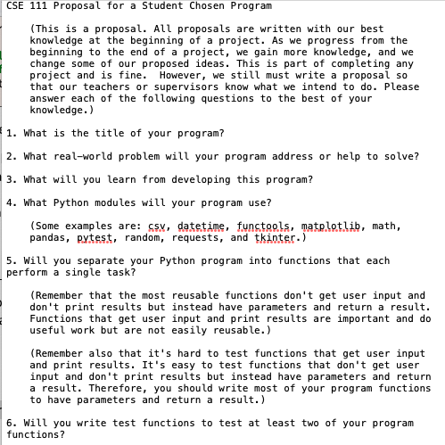
Submission¶ Lesson 11 Rubric¶
Proposal—40%:
Does your proposal adequately answer the questions in the template?
Time—50%:
Did you spend at least three hours on your proposal and program during the current lesson?
Description—10%:
Is the description of your work for this lesson complete and easily understandable?
At the end of each lesson, you will submit a description of your work. This description should follow normal English rules of spelling and grammar.
It must include the following:
The amount of time that you spent working on your program during the current lesson.
A list of the documentation that you read, the videos that you watched, and the coding experiments that you tried.
A description or list of the work that you finished on your program.

Slide 26
Lesson 12 Rubric
Functions |  | TestFunctions
Input:
 | Get_userInput() | n/a
 | createGraphpicBox | n/a
 | openNReadFile | n/a
Process
 | calculateSolution | test_calulateSolution
 | filterData | test_filterData
 | convertData | test_convertData
Output:
 | displayValue | n/a
 | writeToFile | n/a
 | updateDisplay | n/a
Time—50%:
Did you spend at least three hours on your Python program or test functions during the current lesson?
Organization—20%:
Is your program organized into multiple functions?
Does each function in your program perform just one task?
Progress—20%:
Did you complete some significant part of your program during the current week?
Description—10%:
Is the description of your work for this lesson complete and easily understandable?
Your description should include the following:
A list of the function names in your program.
A list of the test function names in your test code.
A list of the documentation that you read, the videos that you watched, and the coding experiments that you tried.
A description or list of the work that you finished on your program.
Documentation:
Additional readings
Videos
Experiments
Status:
What have done?
What are you planning?
Any road blocks?

Slide 27
Lesson 13 Rubric
Time—50%:
Did you spend at least six hours on your Python program or test functions during the current lesson?
Description—10%: I
s the description of your work for this lesson complete and easily understandable?
Your description should include the following: A list of the function names in your program.
A list of the test function names in your test code.
A list of the documentation that you read, the videos that you watched, and the coding experiments that you tried.
A description or list of the work that you finished on your program.
Python program file—25%:
Upload your Python program. Your teacher will evaluate it according to these criteria:
Your program is divided into functions and each function performs one task only.
Your program effectively uses existing Python modules such as math, random, requests, pandas, and tkinter.
Your program performs a significant real-world task.
Python test file—15%:
Upload your Python test file.
Your teacher will evaluate it according to these criteria:
Each testable program function is covered (tested) by one test function. (Some functions, especially main and those that create GUIs are difficult to test and don't need to have a corresponding test function.)
Each test function completely exercises (tests) its corresponding program function. In other words, the test function calls the program function multiple times with different arguments, including unusual or unexpected values.

Slide 28
Summary
This is Programming with functions, so I expect to see at least 4 functions:
Main
Get
Display
Calculate/Process
Two files: code and test
Comments:
Header
Function
Code
Variable Name
Start w/ your initials
Debug
Use of debug statements

