Slide 2
Week 12: Using Objects
W. Clements
CSE 111: Programming with Functions

Slide 3
Overview
Prepare: Reading, Video
Checkpoint
Teach: Class Activity
Prove: Milestone
Ponder: Check your understanding

Slide 4
12 Prepare: Using Objects
A paradigm is a way of thinking or a way of perceiving the world.
There are at least four main paradigms for programming a computer: procedural, declarative, functional, and object-oriented.
During this lesson, you will be introduced to object-oriented programming.
Procedural programming
CSE 110, 111
Chaining variables and functions
Declarative programming - what needs to be done
Examples: XML, HTML, SQL
Functional programming
Stateless, function passing, nested functions
Object-Oriented programming
??

Slide 5
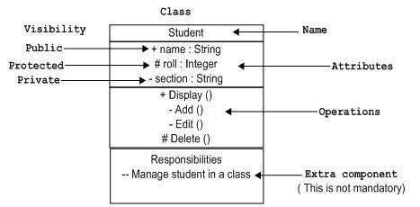
Object-Oriented Programming¶
An object is a piece of a program that contains both
data (also known as attributes) and
functions (also known as methods).
Example:
Lists
Dictionaries
Strings
dot operator (a period)
Aka: component selector

Slide 6
12 Checkpoint: Using Objects
Purpose¶
Problem Statement¶
Improve your ability to write object-oriented code.
There are several types of commands that are commonly found in object-oriented programs.
These types of commands are so common that a programmer must be able to recognize and write them.
One of these types of commands is calling the methods of an object using the dot operator (.) as shown in this template:
variable = object.method(arg1, arg2, ...)

Slide 7
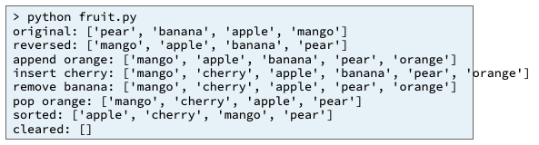

Assignment
Write a small Python program named fruit.py that demonstrates object oriented programming by modifying a list. Do the following:
Open a new blank file in VS Code and save it as fruit.py
Copy and paste this code at the top of your fruit program:
Add code to reverse and print fruit_list.
Add code to append "orange" to the end of fruit_list and print the list.
Add code to find where "apple" is located in fruit_list and insert "cherry" before "apple" in the list and print the list.
Add code to remove "banana" from fruit_list and print the list.
Add code to pop the last element from fruit_list and print the popped element and the list.
Add code to sort and print fruit_list.
Add code to clear and print fruit_list.
At the bottom of your program write a call to the main function.
Reverse_fruit_list = ?
Append_orange = ?
Insert_cherry = ?
Removed_banana = ?
Popped_orange = ?
Sorted_list = ?
Cleared_list = ?
Challenge: Add each list to a list?

Slide 8
Review List
[index]
0
1
2
Len()-1
N+1
N+2
N+2
value
value
value
value
value
value
value
listVarName
.append(value)
value
Method | Lists Description
append() | Adds an element at the end of the list
clear() | Removes all the elements from the list
copy() | Returns a copy of the list
count() | Returns the number of elements with the specified value
extend() | Add the elements of a list (or any iterable), to the end of the current list
index() | Returns the index of the first element with the specified value
insert() | Adds an element at the specified position
pop() | Removes the element at the specified position
remove() | Removes the item with the specified value
reverse() | Reverses the order of the list
sort() | Sorts the list
empty
.clear()
##
.count()
[v1,v2,..]
.extend(list)
index
.index(value)
.insert(index,value)
index
value
.remove(value)
value
value
.pop(index)
.reverse()
.sort() <
.copy()
0
1
2
Len()-1
value
value
value
value
newList

Slide 9
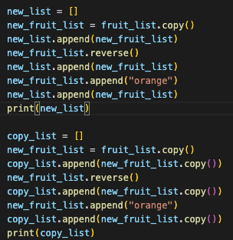
Assignment
Write a small Python program named fruit.py that demonstrates object oriented programming by modifying a list. Do the following:
Open a new blank file in VS Code and save it as fruit.py
Copy and paste this code at the top of your fruit program:
Add code to reverse and print fruit_list.
Add code to append "orange" to the end of fruit_list and print the list.
Add code to find where "apple" is located in fruit_list and insert "cherry" before "apple" in the list and print the list.
Add code to remove "banana" from fruit_list and print the list.
Add code to pop the last element from fruit_list and print the popped element and the list.
Add code to sort and print fruit_list.
Add code to clear and print fruit_list.
At the bottom of your program write a call to the main function.
Note: All lists in new_list were changed

Slide 10
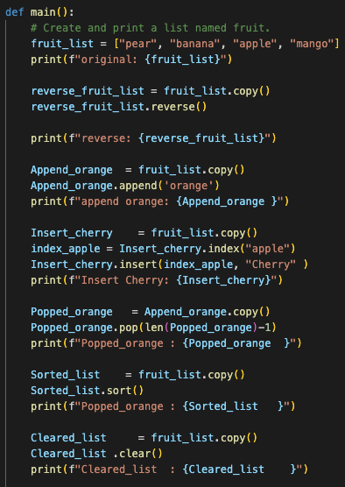
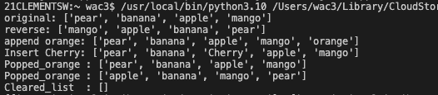
Assignment
Write a small Python program named fruit.py that demonstrates object oriented programming by modifying a list. Do the following:
Open a new blank file in VS Code and save it as fruit.py
Copy and paste this code at the top of your fruit program:
Add code to reverse and print fruit_list.
Add code to append "orange" to the end of fruit_list and print the list.
Add code to find where "apple" is located in fruit_list and insert "cherry" before "apple" in the list and print the list.
Add code to remove "banana" from fruit_list and print the list.
Add code to pop the last element from fruit_list and print the popped element and the list.
Add code to sort and print fruit_list.
Add code to clear and print fruit_list.
At the bottom of your program write a call to the main function.

Slide 11
Testing Procedure¶
Verify that your program works correctly by following each step in this testing procedure:
Run your program and ensure that your program's output is the same as the output shown below.

Slide 12
12 Team Activity: Using Objects

Slide 13
12 Team Activity: Using Objects
Instructions
Problem Statement¶
Work as a team as explained in the instructions for the lesson 2 team activity.
Almost all of the programs that you wrote for this course receive input from and print results to a terminal window.
However, most users prefer to interact with a program through a graphical user interface (GUI) that contains icons, text fields, drop-down lists, buttons, etc.
Within a GUI, the individual components (icons, text fields, etc.) are called widgets. Most libraries for creating GUIs use object oriented programming because each widget is an object with attributes and methods.

Slide 14
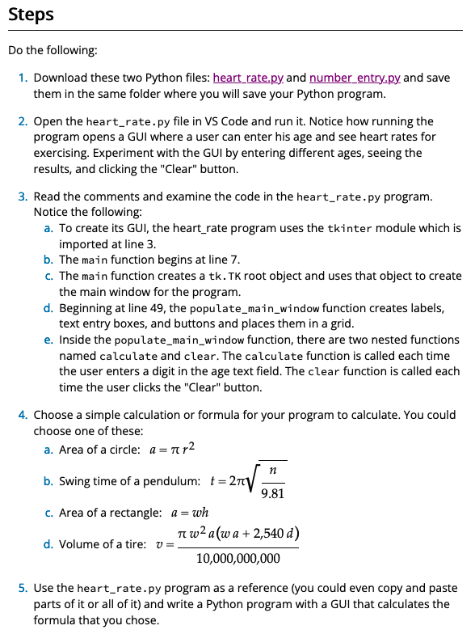
12 Team Activity: Using Objects
Assignment
As a team, write a Python program named gui.py that gets user input from a GUI, performs a simple calculation, and displays the result in a GUI.

Slide 15
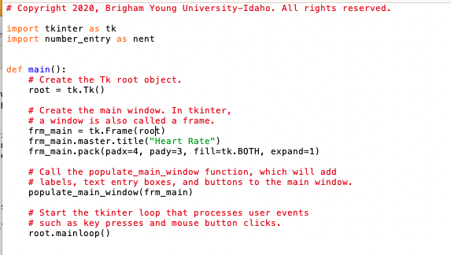

Slide 16
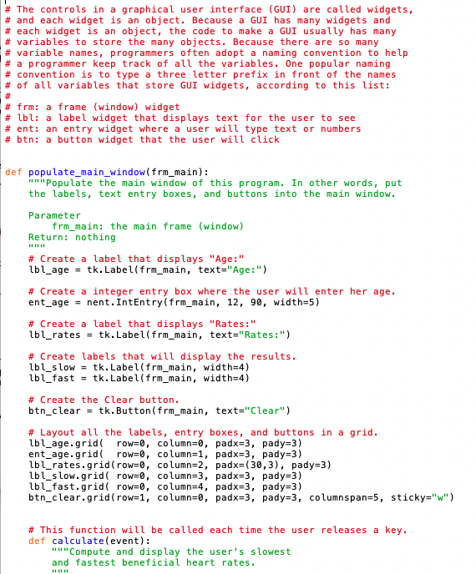
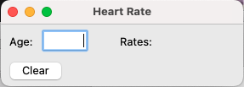
Grid
0 1 2 3 4
0
1
2
3

Slide 17
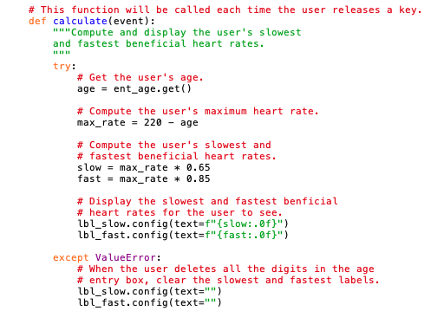
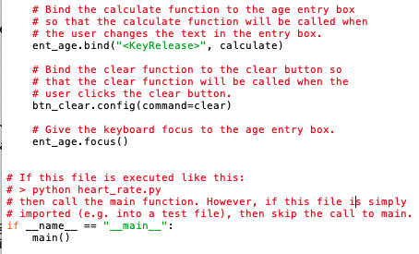
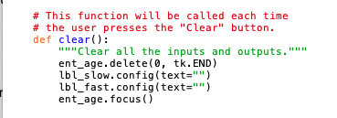
12 Team Activity: Using Objects

Slide 18
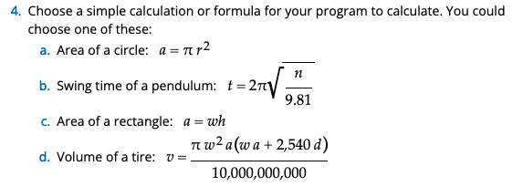
12 Team Activity: Using Objects
Core Requirements
Stretch Challenges
Your program must include a GUI that opens when you run your program.
The GUI must allow a user to enter input.
When the user enters valid input, your program must compute correct results and display those results in the GUI.
If your team finishes the core requirements in less than an hour, complete one or more of these stretch challenges. Note that the stretch challenges are optional.
Add a "Clear" button to your GUI that clears all inputs and outputs when the user clicks it.
Add a label that acts as a status bar at the bottom of your GUI. Your program should display an error message in the status bar when the user enters invalid input. Your program should clear the status bar when the user enters valid input.

Slide 19
Area of Cirle
Area of Circle Title
Radius Label: | [Radius FloatEntry]
Calculate Button
Area Label: | Area Value Label
Radius:
Calculate
Area:
Pendulum Swing Time Title
Pendulum Length Label: | [Pendulum Length FloatEntry]
Calculate Button
Time Label: | Time Label
Pendulum Swing Time
Length:
Calculate
Time:
12 Team Activity: Using Objects

Slide 20
12 Prove Milestone: Student Chosen Program

Slide 21
Lesson 12 Rubric
Time—50%:
Did you spend at least three hours on your Python program or test functions during the current lesson?
Organization—20%:
Is your program organized into multiple functions?
Does each function in your program perform just one task?
Progress—20%:
Did you complete some significant part of your program during the current week?
Description—10%:
Is the description of your work for this lesson complete and easily understandable?
Your description should include the following:
A list of the function names in your program.
A list of the test function names in your test code.
A list of the documentation that you read, the videos that you watched, and the coding experiments that you tried.
A description or list of the work that you finished on your program.
And what you have coded so far.

Slide 22
Lesson 13 Rubric
Time—50%:
Did you spend at least six hours on your Python program or test functions during the current lesson?
Description—10%: I
s the description of your work for this lesson complete and easily understandable?
Your description should include the following: A list of the function names in your program.
A list of the test function names in your test code.
A list of the documentation that you read, the videos that you watched, and the coding experiments that you tried.
A description or list of the work that you finished on your program.
Python program file—25%:
Upload your Python program. Your teacher will evaluate it according to these criteria:
Your program is divided into functions and each function performs one task only.
Your program effectively uses existing Python modules such as math, random, requests, pandas, and tkinter.
Your program performs a significant real-world task.
Python test file—15%:
Upload your Python test file.
Your teacher will evaluate it according to these criteria:
Each testable program function is covered (tested) by one test function. (Some functions, especially main and those that create GUIs are difficult to test and don't need to have a corresponding test function.)
Each test function completely exercises (tests) its corresponding program function. In other words, the test function calls the program function multiple times with different arguments, including unusual or unexpected values.

