Slide 1
Testing Functions
W. Clements
CSE 111 Program with Functions

Slide 2
Overview
Prepare: Reading, Video
Checkpoint
Teach: Class Activity
Prove: Milestone
Ponder: Check your understanding

Slide 3
05 Prepare: Testing Functions

Slide 4
05 Prepare: Testing Functions
Concepts
During this lesson, you will learn to use a more systematic approach to developing code.
Specifically, you will learn how to write test functions that automatically verify that program functions are correct.
You will learn how to use a Python module named pytest to run your test functions, and you will learn how to read the output of pytest to help you find and fix mistakes in your code.
Inefficient Testing¶
Assert Statements¶
The pytest Module¶
Comparing Floating Point Numbers¶
How to Test a Function
Separating Program Code from Test Code¶
Which Program Functions Should We Test?¶
Writing a Test Function (20 minutes)
Documentation

Slide 5
Inefficient Testing¶
During previous lessons, you tested your programs by running them, typing user input, reading the program's output, and verifying that the output was correct.
This is a valid way to test a program.
However, it is time-consuming, tedious, and error prone.
A much better way to test a program is to test its functions individually and to write separate test functions that automatically verify that the program's functions are correct.

Slide 6
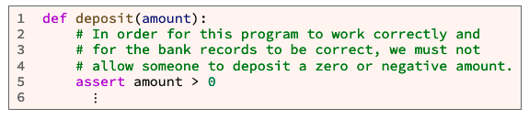
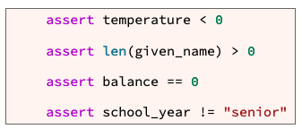
Assert Statements¶
In a computer program, an assertion is a statement that causes the computer to check if a comparison is true.
Takes a Boolean like
Branches (if)
Loops(while and for)
Except if it is false, it stops executing the function.

Slide 7
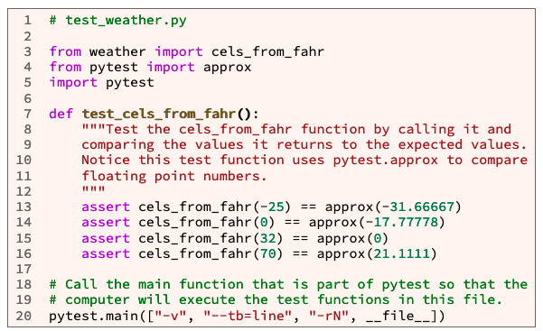
The pytest Module¶
third-party Python module
pytest was not already installed
you will need to install pytest
Pytest will tests all functions that begin with the function name test_
Example code:
It is in a seperate file than the code
from file_name import function_1, function_2, … function_N
Main is call but not defined
Main definition is in pytest module

Slide 8
05 Checkpoint: Testing Functions

Slide 9
05 Checkpoint: Testing Functions
Purpose
Assignment
Improve your ability to verify the correctness of functions by writing a test function and running it with pytest.
Write a test function that tests a previously written function. Then use pytest to run test functions.

Slide 10
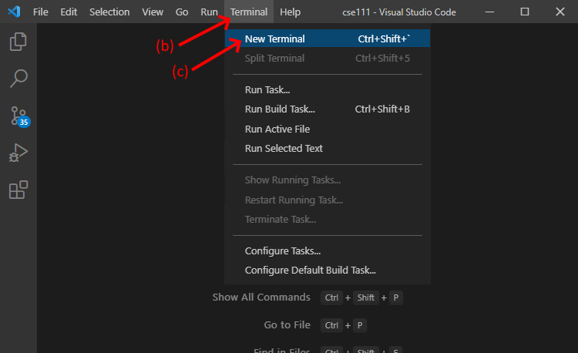
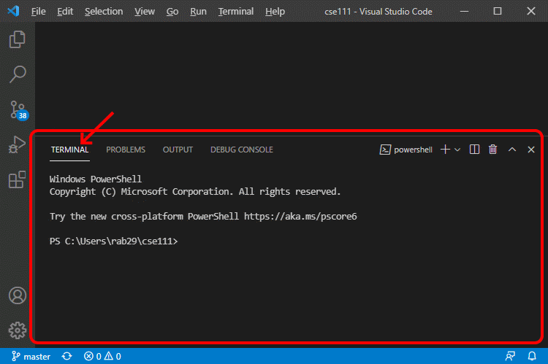
05 Checkpoint: Testing Functions
Steps¶
Open a new terminal frame in VS Code by doing the following: Open VS Code
On the menu bar for VS Code, click "Terminal"
On the menu, click "New Terminal”
This will open a terminal frame at the bottom of the VS Code window. A terminal is a window or frame where a user can type and execute computer commands.

Slide 11
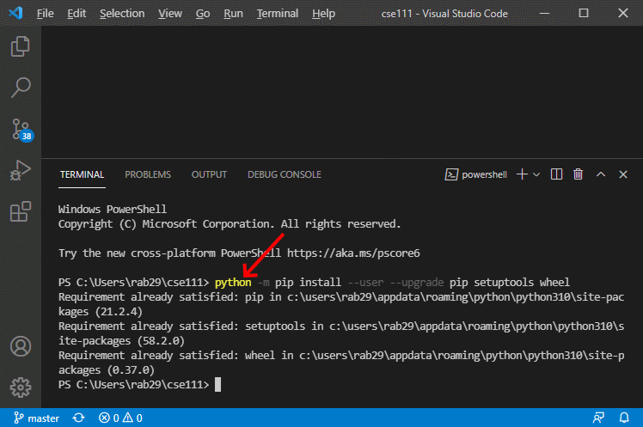
05 Checkpoint: Testing Functions
Steps
Copy and paste the following command into the terminal frame and execute the command by pressing the Enter key. This command will upgrade pip and several other parts of the Python installation modules so that pip will work correctly.
Mac OS users:
python3 -m pip install --user --upgrade pip setuptools wheel
Windows users:
python -m pip install --user --upgrade pip setuptools wheel
If your computer is running the Windows operating system, and the above command doesn't work on your computer, try the py command instead of the python command like this:
py -m pip install --user --upgrade pip setuptools wheel

Slide 12
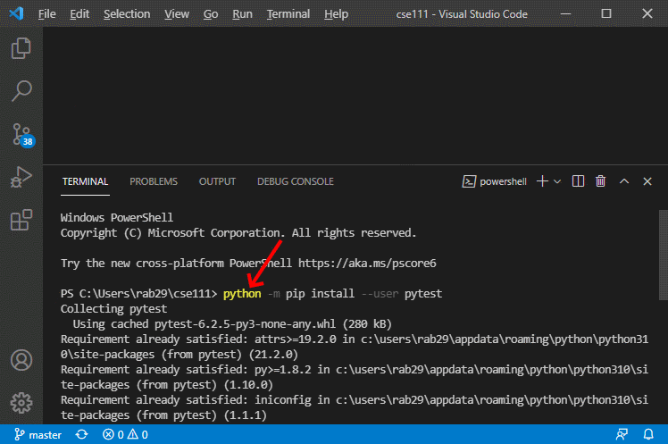
05 Checkpoint: Testing Functions
Install the pytest module by copying, pasting, and executing the following command in the terminal frame.
Mac OS users:
python3 -m pip install --user pytest
Windows users:
python -m pip install --user pytest
If your computer is running the Windows operating system, and the above command doesn't work on your computer, try the py command instead of the python command like this:
py -m pip install --user pytest

Slide 13
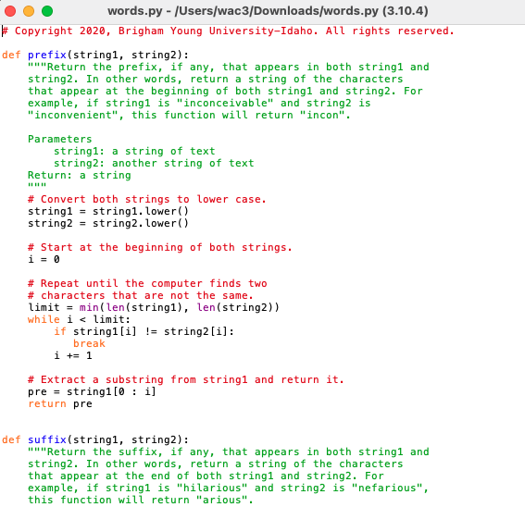
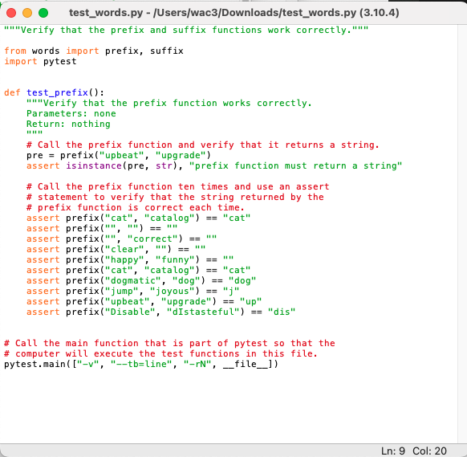
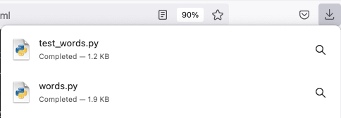
05 Checkpoint: Testing Functions
Download these two Python files: words.py and test_words.py and save them in the same folder.

Slide 14
05 Checkpoint: Testing Functions
Open the downloaded words.py file in VS Code. Notice the words.py file contains two small functions named prefix and suffix.
Notice also that each function has a documentation string (a triple quoted string immediately below a function header) that describes what the function does.
Read the documentation strings for both functions.

Slide 15
05 Checkpoint: Testing Functions
Open the downloaded test_words.py file in VS Code. In test_words.py examine the test_prefix function.
Notice that it takes no parameters and contains nine assert statements.
Each assert statement calls the prefix function and then compares the value returned from the prefix function to the expected value.

Slide 16
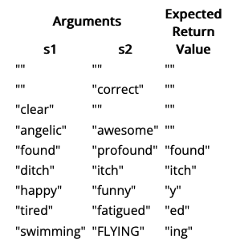
05 Checkpoint: Testing Functions
In test_words.py write a function named test_suffix that is similar to the test_prefix function.
The test_suffix function should take no parameters and contain nine assert statements that call the suffix function with these parameters:
Arguments |  | Expected Return Value
s1 | s2
"" | "" | ""
"" | "correct" | ""
"clear" | "" | ""
"angelic" | "awesome" | ""
"found" | "profound" | "found"
"ditch" | "itch" | "itch"
"happy" | "funny" | "y"
"tired" | "fatigued" | "ed"
"swimming" | "FLYING" | "ing"

Slide 17
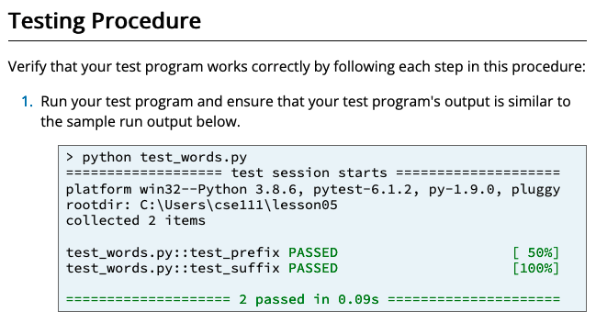
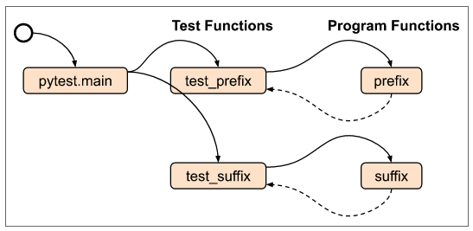
05 Checkpoint: Testing Functions
Save your test_words.py file and run it by clicking the green run icon in VS Code.

Slide 18
05 Team Activity: Testing and Fixing Functions

Slide 19
05 Team Activity: Testing and Fixing Functions
Purpose
Writing and running test functions often help a software developer find mistakes in code.
During this assignment, you will write three test functions.
Then use pytest to run the test functions and use the output of pytest to help you find and fix errors in some program functions.

Slide 20
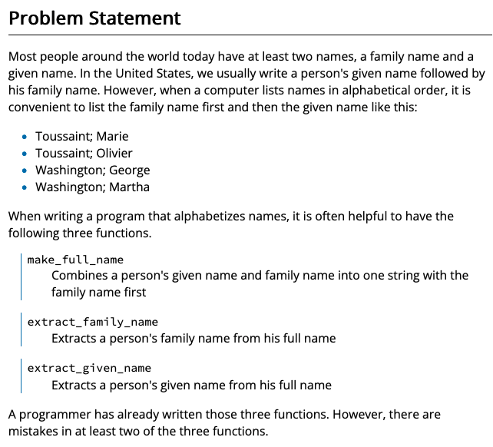
05 Team Activity: Testing and Fixing Functions
Purpose
Writing and running test functions often help a software developer find mistakes in code.
During this assignment, you will write three test functions.
Then use pytest to run the test functions and use the output of pytest to help you find and fix errors in some program functions.

Slide 21
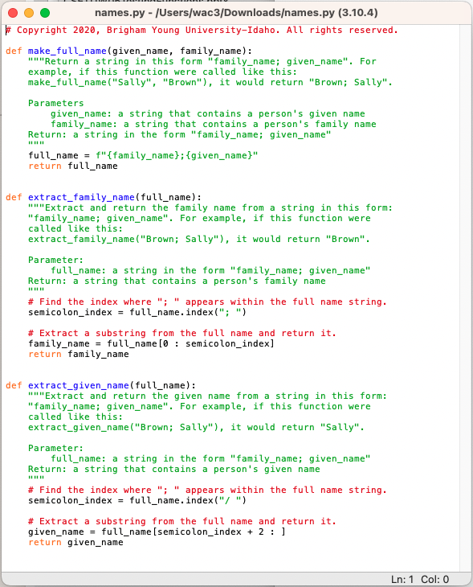
05 Team Activity: Testing and Fixing Functions
Step 1
Download the names.py Python file and save it in the same folder where you will save your Python test program.
Then open the downloaded file in VS Code. Notice that the downloaded file contains three small functions named:
make_full_name,
extract_family_name, and
extract_given_name.
Notice also that each function has a
documentation string (a triple quoted string immediately below the function header) that
describes what the function does.
Read the documentation strings for all three functions. The code in the functions may contain some mistakes.

Slide 22
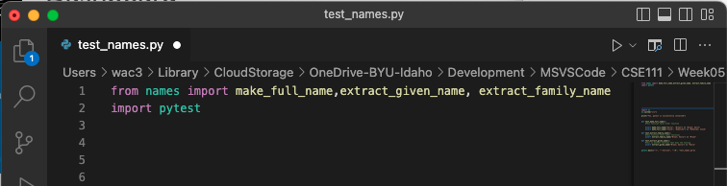

05 Team Activity: Testing and Fixing Functions
Step 2
Using VS Code, open a new Python file and copy and paste the following import statements at the top of the file. from names import
Save the file with the name test_names.py in the same folder where you downloaded and saved the names.py file.

Slide 23
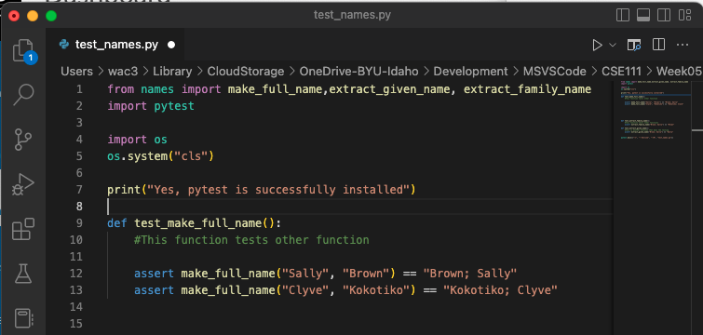
05 Team Activity: Testing and Fixing Functions
Step 3
In test_names.py, write a function
named test_make_full_name that takes no parameters.
Write assert statements inside this function to test the value returned from the make_full_name function.
If you are not sure what the make_full_name function does or how to test it, read the documentation string that is at the top of the make_full_name function in the names.py file.

Slide 24
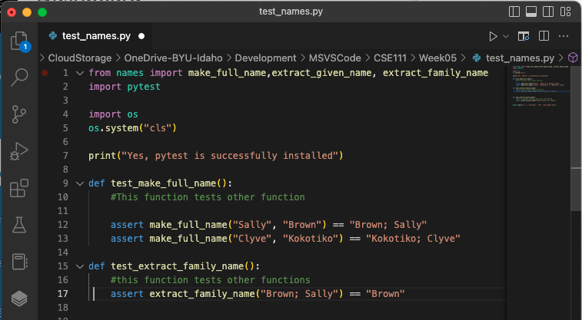
05 Team Activity: Testing and Fixing Functions
Step 4
In test_names.py write a function named
test_extract_family_name that takes no parameters.
Write assert statements inside this function to test the value returned from the extract_family_name function.

Slide 25
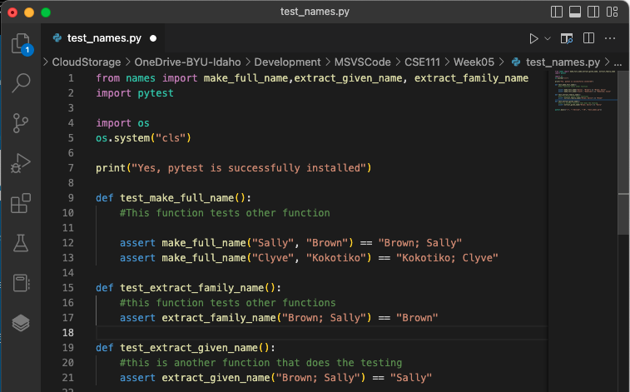
05 Team Activity: Testing and Fixing Functions
Step 5
In test_names.py write a function named
test_extract_given_name that takes no parameters.
Write assert statements inside this function to test the value returned from the extract_given_name function.

Slide 26
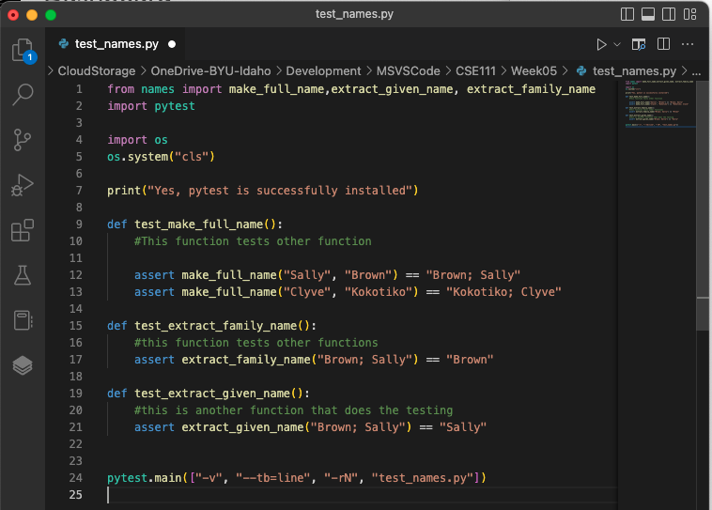

05 Team Activity: Testing and Fixing Functions
Step 6
At the bottom of your test_names.py file, write a call to the pytest.main function like this:

Slide 27
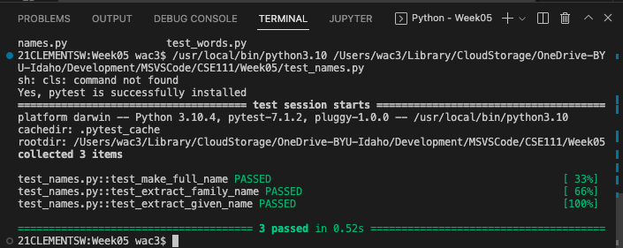
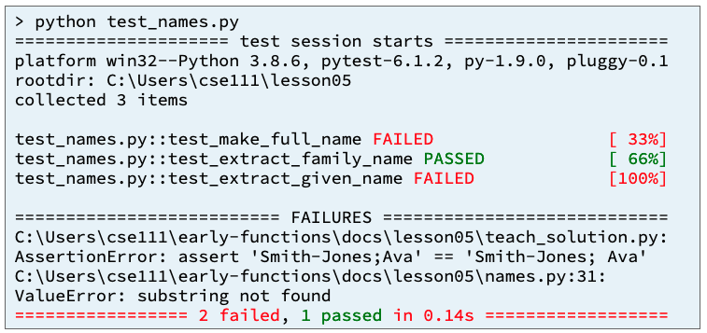
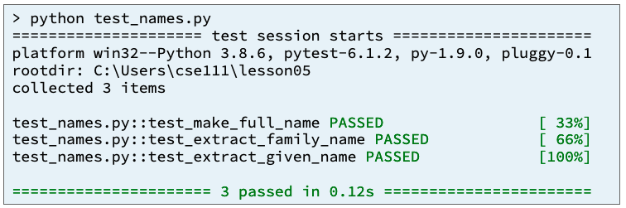
05 Team Activity: Testing and Fixing Functions
STEPS 7-9
Save your test_names.py file and run it by clicking the green run icon in VS Code.
Read the output from pytest and use the output to help you find and fix any errors that are in your test functions or the
make_full_name,
extract_family_name, and
extract_given_name functions.
Repeat steps 7 and 8 until you have found and fixed all the mistakes and your three test functions pass.

Slide 28
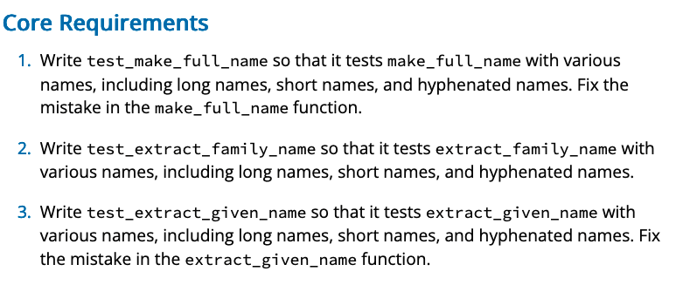
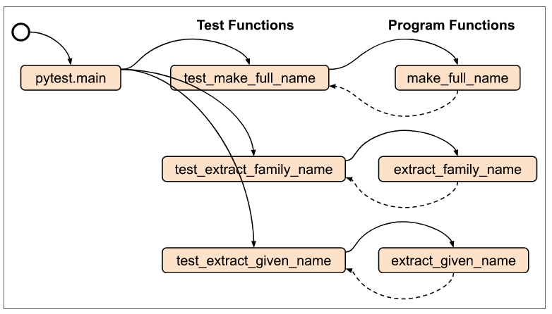
05 Team Activity: Testing and Fixing Functions
Input
Process
Output
Test_names.py
pytest.main(["-v", "--tb=line", "-rN", __file__])
test_make_full_name()
Test_extract_family_name()
Test_extract_given_name()
names.py
Given_name, family_name
Family_name
Family_name
make_full_name()
extract_family_name()
extract_given_name()

Slide 30
05 Prove Milestone: Testing and Fixing Functions

Slide 31
05 Prove Milestone: Testing and Fixing Functions
Purpose
Prove that you can write a Python program and write and run test functions to help you find and fix mistakes.

Slide 32
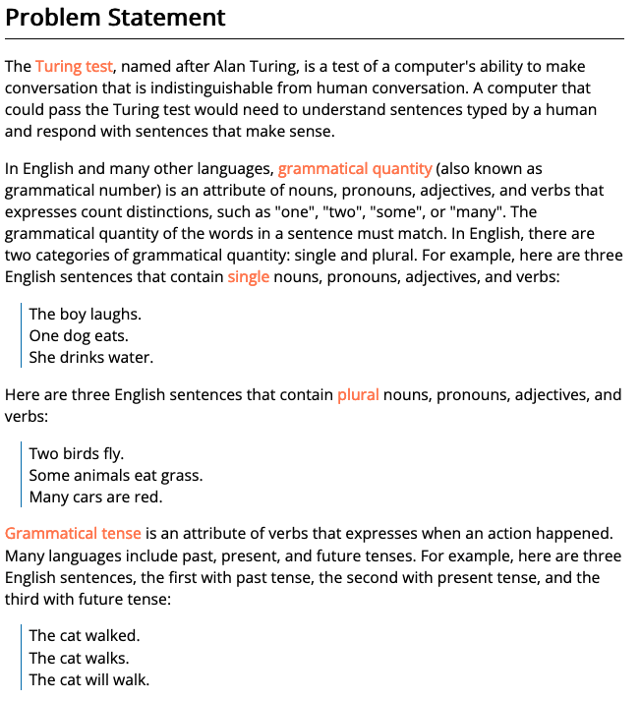
05 Prove Milestone: Testing and Fixing Functions
Purpose
Prove that you can write a Python program and write and run test functions to help you find and fix mistakes.

Slide 33
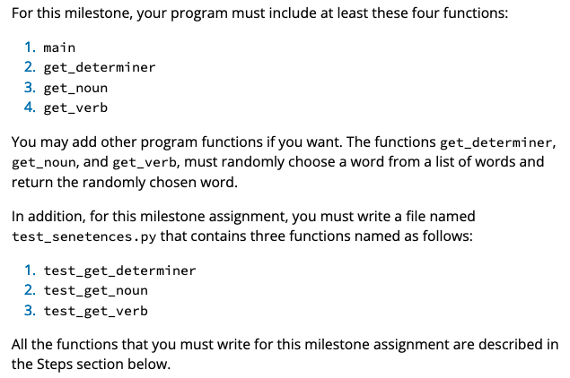
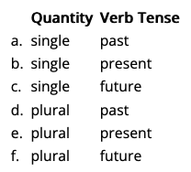
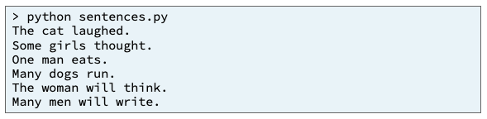
Input
Process
Output
main
quantity
quantity
birth_str
get_determiner()
get_noun()
get_verb()

Slide 34
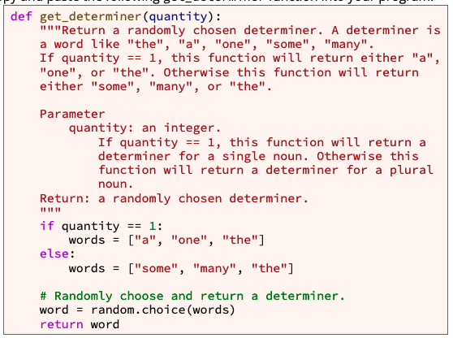
def get_determiner(quantity):
If quantity == 1
words = ["a", "one", "the"]
words = ["some", "many", "the"]
word = random.choice(words)
return word

Slide 35
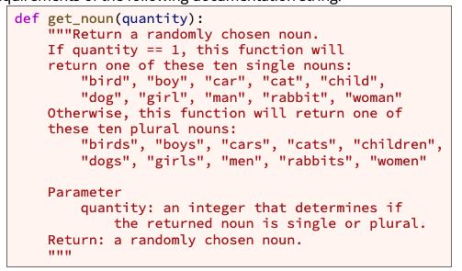
def get_noun(quantity):
If quantity == 1
words = ["bird", "boy", "car", "cat", "child", "dog", "girl", "man", "rabbit", "woman”]
words = ["birds", "boys", "cars", "cats", "children", "dogs", "girls", "men", "rabbits", "women”]
word = random.choice(words)
return word

Slide 36
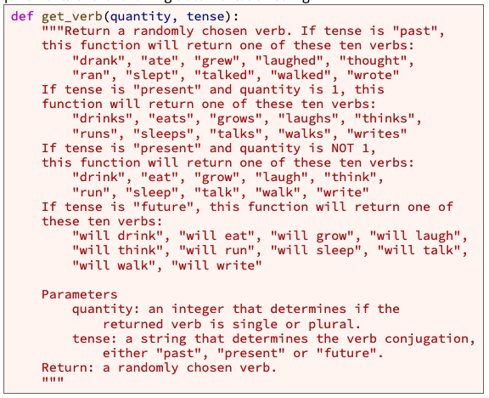
def get_verb(quantity, tense):
If tense == past
words = ["drank", "ate", "grew", "laughed", "thought", "ran", "slept", "talked", "walked", "wrote”]
If tense == future
words = ["will drink", "will eat", "will grow", "will laugh", "will think", "will run", "will sleep", "will talk", "will walk", "will write”]
If tense == present
words = ["drinks", "eats", "grows", "laughs", "thinks", "runs", "sleeps", "talks", "walks", "writes”]
If quantity == 1
Else #If quantity >1
words = ["drink", "eat", "grow", "laugh", "think", "run", "sleep", "talk", "walk", "write”]
word = random.choice(words)
return word

Slide 37
def get_sentence(quantity, tense):
Determiner = get_determiner(quantity)
noun = get_noun(quantity)
verb = get_verb(quantity, tense)
Sentence = determiner +” “ + noun + “ “ + verb
return sentence

Slide 38
Input
Process
Output
main
quantity
quantity
birth_str
get_determiner()
get_noun()
get_verb()

Slide 39
Input
Process
Output
determiner
sentence
main
noun
+
verb
quantity
tense
quantity
quantity
birth_str
get_determiner()
get_noun()
get_verb()

Slide 40
Input
Process
Output
determiner
sentence
main
noun
+
verb
quantity
tense
quantity
quantity
quantity
quantity
tense
tense
get_determiner()
get_noun()
get_verb()
get_sentence()

Slide 41
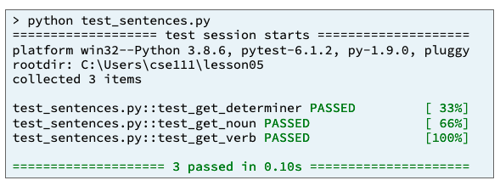

Input
Process
Output
determiner
sentence
main
noun
+
verb
quantity
tense
quantity
quantity
quantity
quantity
tense
tense
get_determiner()
get_noun()
get_verb()
get_sentence()
test_get_determiner()
test_get_noun()
test_get_verb()
test_get_sentence()

Slide 42
05 Prove Milestone: Testing and Fixing Functions
Purpose
PART 2: Test Procedure
Writing and running test functions often help a software developer find mistakes in code.
During this assignment, you will write three test functions.
Then use pytest to run the test functions and use the output of pytest to help you find and fix errors in some program functions.

Slide 43
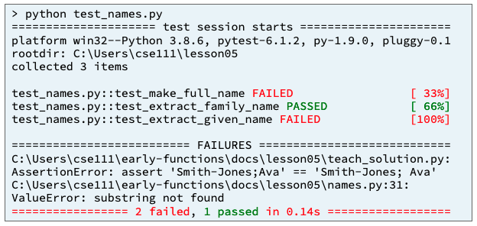
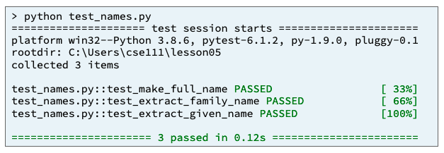
05 Prove Milestone: Testing and Fixing Functions
Assignment
As a team, write three test functions named
test_make_full_name,
test_extract_family_name, and
test_extract_given_name.
Each of the test functions will test one of three previously written program functions.
Use pytest to run the test functions and find and fix the mistakes, if any, that are in program functions.

Slide 44
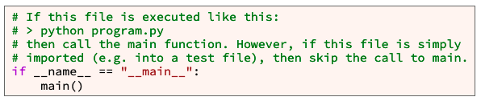
Input
Process
Output
determiner
sentence
main
noun
+
verb
quantity
tense
quantity
quantity
quantity
quantity
tense
tense
get_determiner()
get_noun()
get_verb()
get_sentence()

Slide 45
Input
Process
Output
Test_sentences.py
pytest.main(["-v", "--tb=line", "-rN", __file__])
quantity
sentences.py
quantity
quantity
quantity
tense
tense
get_determiner()
get_noun()
get_verb()
get_sentence()

Slide 46
Input
Process
Output
Test_sentences.py
pytest.main(["-v", "--tb=line", "-rN", __file__])
test_get_determiner()
test_get_noun()
test_get_verb()
test_get_sentence()
quantity
sentences.py
quantity
quantity
quantity
tense
tense
get_determiner()
get_noun()
get_verb()
get_sentence()

Slide 47
Input
Process
Output
Test_sentences.py
pytest.main(["-v", "--tb=line", "-rN", __file__])
test_get_determiner()
test_get_noun()
test_get_verb()
test_get_sentence()
sentences.py
quantity
quantity
quantity
quantity
tense
tense
get_determiner()
get_noun()
get_verb()
get_sentence()

Slide 48
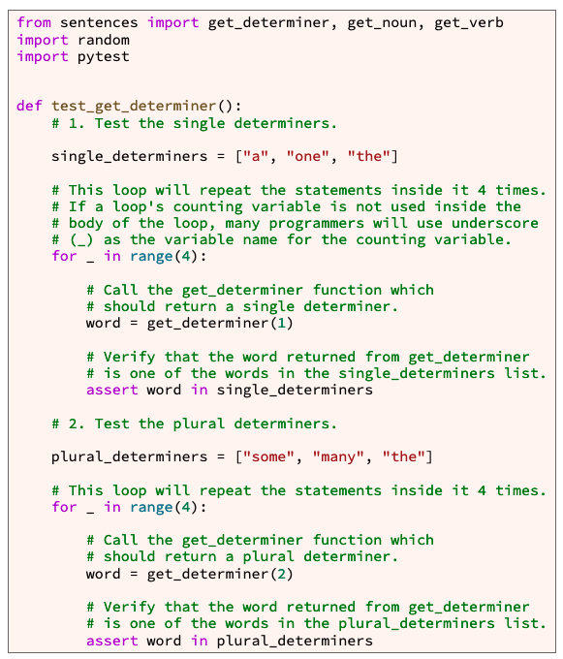
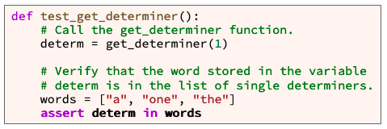
def test_get_determiner():

Slide 49
def test_get_determiner():
words = ["a", "one", "the"]
words = ["some", "many", "the"]

Slide 50
def test_get_determiner():
words = ["a", "one", "the"]
For 0-3
word = get_determiner(1)
Assert word in words
words = ["some", "many", "the"]
For 0-3
word = get_determiner(2)
Assert word in words

Slide 51
Input
Process
Output
words = ["a", "one", "the"]
For 0-3
word = get_determiner(1)
Assert word in words
words = ["some", "many", "the"]
For 0-3
word = get_determiner(2)
Assert word in words
sentences.py
quantity
get_determiner()

Slide 52
def test_get_noun (quantity):
Process
words = ["bird", "boy", "car", "cat", "child", "dog", "girl", "man", "rabbit", "woman”]
For 0-3
word = get_noun(1)
Assert word in words
words = ["birds", "boys", "cars", "cats", "children", "dogs", "girls", "men", "rabbits", "women”]
For 0-3
word = get_noun(2)
Assert word in words

Slide 53
def test_get_verb():
Process
words = ["drank", "ate", "grew", "laughed", "thought", "ran", "slept", "talked", "walked", "wrote”]
For 0-3
word = get_verb(1, “past”)
Assert word in words
words = ["will drink", "will eat", "will grow", "will laugh", "will think", "will run", "will sleep", "will talk", "will walk", "will write”]
For 0-3
word = get_noun(1, “future”)
Assert word in words
words = ["drinks", "eats", "grows", "laughs", "thinks", "runs", "sleeps", "talks", "walks", "writes”]
For 0-3
word = get_noun(1, “present”)
Assert word in words
words = ["drink", "eat", "grow", "laugh", "think", "run", "sleep", "talk", "walk", "write”]
For 0-3
word = get_noun(2, “present”)
Assert word in words

Slide 54
test_get_sentence(quantity, tense)
Process
Determiner_words = single, plural
Noun_words = single, plural
Verb_words = past, present_single, present_plural, future
Sentence = get_sentence(quantity, tense)
Words = sentence.split(“ “)
Assert word[0] in determinerwords
Assert word[1] in nounwords
Assert word[2] in verbwords

Slide 55
Input
Process
Output
Test_sentences.py
pytest.main(["-v", "--tb=line", "-rN", __file__])
test_get_determiner()
test_get_noun()
test_get_verb()
test_get_sentence()
sentences.py
quantity
quantity
quantity
quantity
tense
tense
get_determiner()
get_noun()
get_verb()
get_sentence()

Slide 57
Input
Process
Output
determiner
sentence
main
noun
+
verb
quantity
tense
quantity
quantity
quantity
quantity
tense
tense
get_determiner()
get_noun()
get_verb()
get_sentence()
test_get_determiner()
test_get_noun()
test_get_verb()
test_get_sentence()

Slide 59
END

Slide 60
Turing Test:
grammatical quantity (also known as grammatical number) is an attribute of nouns, pronouns, adjectives, and verbs that expresses count distinctions, such as "one", "two", "some", or "many".
In English, there are two categories of grammatical quantity: single and plural.
single nouns, pronouns, adjectives, and verbs
plural nouns, pronouns, adjectives, and verbs:
Many languages include past, present, and future tenses.
English sentences, the first with past tense, the second with present tense, and the third with future tense

Slide 61
Assignment
Write a Python program named sentences.py that generates simple English sentences.
During this prove milestone, you will write and test functions that generate sentences with three parts
a determiner (sometimes known as an article)
a noun
a verb
For this milestone , your program must include at least these four functions:
main
get_determiner
get_noun
get_verb
The functions get_determiner, get_noun, and get_verb, must randomly choose a word from a list of words and return the randomly chosen word.
In addition, for this milestone assignment, you must write a file named test_senetences.py that contains three functions named as follows:
test_get_determiner
test_get_noun
test_get_verb

Slide 62
Main function
Sentences.py
main
Get_noun
Get_verb
Get_determiner
Call sequence 6 times.
Quantity = [single, single, single, plural, plural, plural]
Tense = [past, present, future, past, present, future]
 | Quantity | Verb Tense
a. | single | past
b. | single | present
c. | single | future
d. | plural | past
e. | plural | present
f. | plural | future

Slide 63
Main function
What programming tools are available to you?
Branching
If
Looping
For – you know when you will end, i.e. lists, arrays
While – you know an exit criteria
Function calling
Data Structures
Primitives (variables)
Arrays
Lists
Input
Output
What do you know?
Sentence = Determiner + noun + verb
Call sequence 6 times = 6 sentences
Quantity = [single, single, single, plural, plural, plural]
Tense = [past, present, future, past, present, future]
 | Quantity | Verb Tense
a. | single | past
b. | single | present
c. | single | future
d. | plural | past
e. | plural | present
f. | plural | future

Slide 64
Main function – Top-Down Design
Sentence = Determiner + noun + verb
Architecture - Design
What do you know
Sentences.py
main
Get_noun
Get_verb
Get_determiner
Call sequence 6 times.
Quantity = [single, single, single, plural, plural, plural]
Tense = [past, present, future, past, present, future]
 | Quantity | Verb Tense
a. | single | past
b. | single | present
c. | single | future
d. | plural | past
e. | plural | present
f. | plural | future
quantity
get_determiner
Determiner
quantity
Get_noun
noun
Quantity, tense
Get_verb
verb

Slide 65
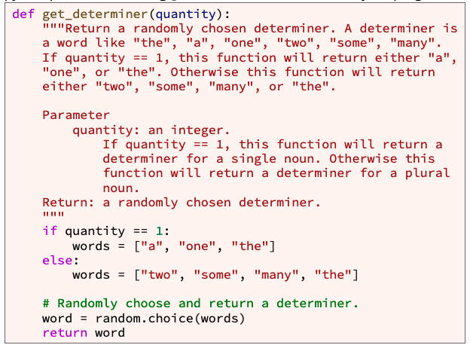
def get_determiner(quantity):
quantity
get_determiner
Determiner
What programming tools are available to you?
Branching
If
Looping
For – you know when you will end, i.e. lists, arrays
While – you know an exit criteria
Function calling
Data Structures
Primitives (variables)
Arrays
Lists
Input
Output

Slide 66
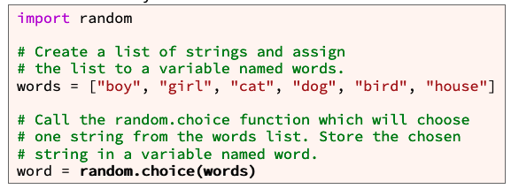
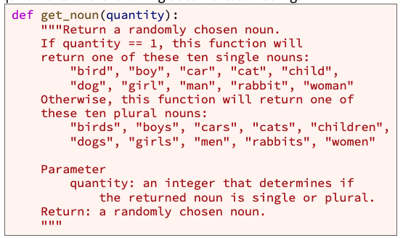
get_noun
quantity
Get_noun
noun
What programming tools are available to you?
Branching
If
Looping
For – you know when you will end, i.e. lists, arrays
While – you know an exit criteria
Function calling
Data Structures
Primitives (variables)
Arrays
Lists
Input
Output

Slide 67
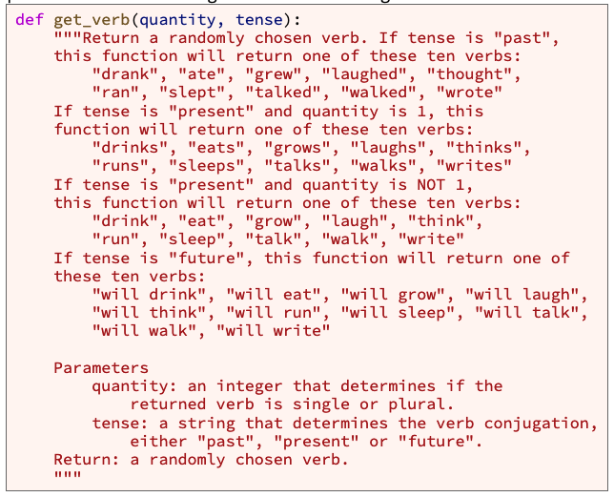
get_verb
Quantity, tense
Get_verb
verb
What programming tools are available to you?
Branching
If
Looping
For – you know when you will end, i.e. lists, arrays
While – you know an exit criteria
Function calling
Data Structures
Primitives (variables)
Arrays
Lists
Input
Output

Slide 68
Remember – Bottom-up Design
Three functions that give words
Words form sentences
Provide 6 sentences
quantity
get_determiner
Determiner
quantity
Get_noun
noun
Quantity, tense
Get_verb
verb
Sentence = Determiner + noun + verb
 | Quantity | Verb Tense
a. | single | past
b. | single | present
c. | single | future
d. | plural | past
e. | plural | present
f. | plural | future

Slide 69


Testing
Functions
test_sentences.py
Import sentences.py
test_get_determiner
provided
test_get_noun
test_get_verb
Call this at the end

Slide 70
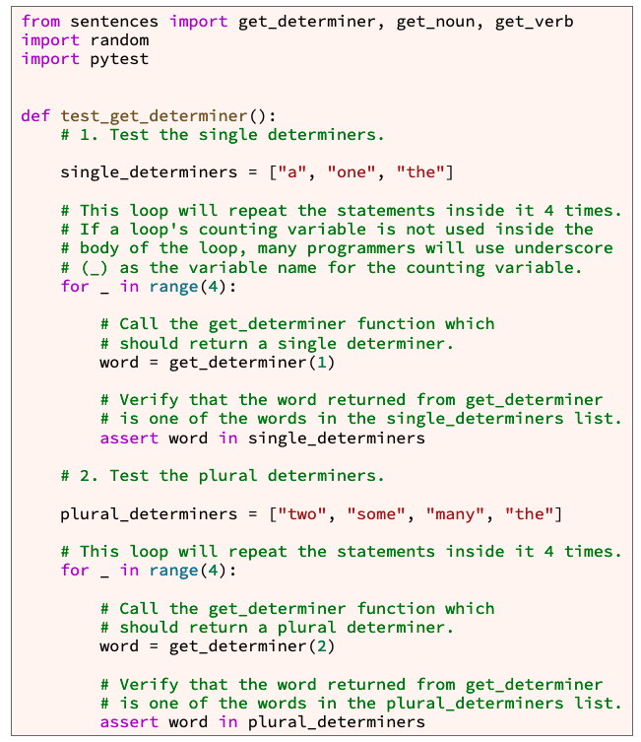
Format of Test functions
Define known output data
Define Known input data
Loop through each data point and call function
Capture results
Assert that the Result in output data

Slide 71
Format of Test functions
Define known output data
Define Known input data
Loop through each data point and call function
Capture results
Assert that the Result in output data

Slide 72
test_get_noun
Define known output data
Define Known input data
Loop through each data point and call function
Capture results
Assert that the Result in output data
Look at the function being tested for input and output info

Slide 73
test_get_verb
Define known output data
Define Known input data
Loop through each data point and call function
Capture results
Assert that the Result in output data
Look at the function being tested for input and output info

Slide 74
06 Prove Assignment
Week 05
Sentence = Determiner + noun + verb
Week 06
Sentence = Determiner + noun + verb + prepositional phrase
Prepostitional_phrase = preposition + determiner + noun
quantity
get_determiner
Determiner
quantity
Get_noun
noun
Quantity, tense
Get_verb
verb
Get_preposition
preposition
quantity
Get_prepositional_phrase
Prepositional_phrase
Determiner, noun, verb, prepositional_phrase
main
Determiner

Slide 75
Modify Main
Sentences.py
main
Get_noun
Get_verb
Get_determiner
get_prepositional_phrase
get_prepostion
get_determiner
get_noun

Slide 76
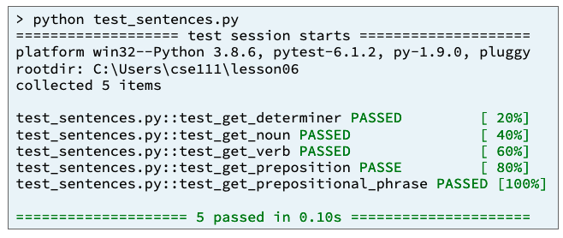
Testing
Functions
test_sentences.py
Import sentences.py
test_get_determiner
provided
test_get_noun
test_get_verb
Test_get_preposition
Test_get_prepostional_phrase
Call this at the end

