Slide 1
Troubleshooting Functions
W. Clements
CSE 111 Program with Functions

Slide 2
Overview
Prepare: Reading, Video
Checkpoint
Teach: Class Activity
Prove: Milestone
Ponder: Check your understanding

Slide 3
Schedule Due Dates
Week | Monday | Tuesday | Wednesday | Thursday | Friday | Saturday
1 10/26 |  |  | Prepare 01 |  | Ice Breaker 01 Ponder | 01 Milestone 02 Prepare
2 10/31 | L02 Checkpoint L03 Prepare | L02 Teach L02 Ponder | L02 Prove L03 Checkpoint | L03 Teach | L03 Ponder | L03 Milestone L04 Prepare
3 11/07 | L04 Checkpoint L05 Prepare | L04 Teach L04 Ponder | L04 Prove L05 Checkpoint | L05 Teach | L05 Ponder | L05 Milestone L06 Prepare
4 11/14 | L06 Checkpoint L07 Prepare | L06 Teach L06 Ponder | L06 Prove L07 Checkpoint | L07 Teach | L07 Ponder | L07 Milestone L08 Prepare
5 11/21 | L08 Checkpoint L09 Prepare | L08 Teach L08 Ponder | Thanksgiving Break |  |  | L08 Prove L10 Prepare
6 11/28 | L09 Checkpoint L10 Prepare | L09 Teach L09 Ponder | L09 Milestone L10 Checkpoint | L10 Teach | L10 Ponder | L10 Prove L11 Prepare
7 12/05 | L11 Checkpoint L12 Prepare | L11 Teach L11 Ponder | L11 Milestone L12 Checkpoint | L12 Teach | L12 Ponder | L12 Prove L14 Prepare
8 12/12 | L14 Prepare | L13 Ponder | L13 Prove L14 Prove

Slide 4
06 Prepare: Troubleshooting Functions
Concepts¶
Types of Mistakes¶
Error Messages
Print Statements¶
Test Functions
Using a Debugger¶
Summary¶

Slide 5
Types of Mistakes¶
Types Tools Messages
Syntax Compiler on line #, … error
Logic Test test_functions(): assert
Runtime ?
Debugging Print
Debugger

Slide 6
Print/Debug
Instead of adding a bunch of print statements,
Create a debug function,
Use debug instead of print
debug_flag = True
#debug_flag = False
def debug (debug_string):
if (debug_flag):
print(debug_string)

Slide 7
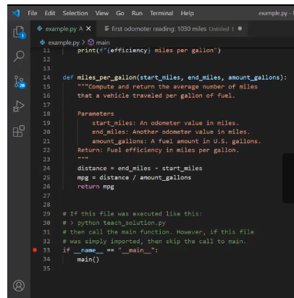
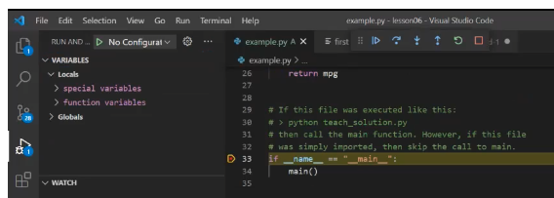
Debugger
Using the VS Code Debugger
Breakpoints
Visibles
Variables
Watch
Call Stack
Actions
|> Continue
.( Step over
\/ Step into
/\ Step out
@ Restart
[] Stop

Slide 8
06 Checkpoint: Troubleshooting Functions

Slide 9
06 Checkpoint: Troubleshooting Functions
Purpose
Assignment
Practice using the Python debugger in VS Code.
Do the following:
Download and save the example.py file.
Open example.py in VS Code.
Follow along with this video about the Python Debugger (17 minutes) from the prepare content and use the debugger in VS Code to step through the example.py program.

Slide 10
06 Checkpoint: Troubleshooting Functions
Poinder¶
As you used the debugger to step through the example.py program, did you learn anything new about Python and how functions work? Do you think the debugger could help you find mistakes in your code?

Slide 11
06 Team Activity: Troubleshooting Functions

Slide 12
06 Team Activity: Troubleshooting Functions
Purpose
Write a program with several functions. Use a debugger while writing your program or after writing it to step through your code..

Slide 13
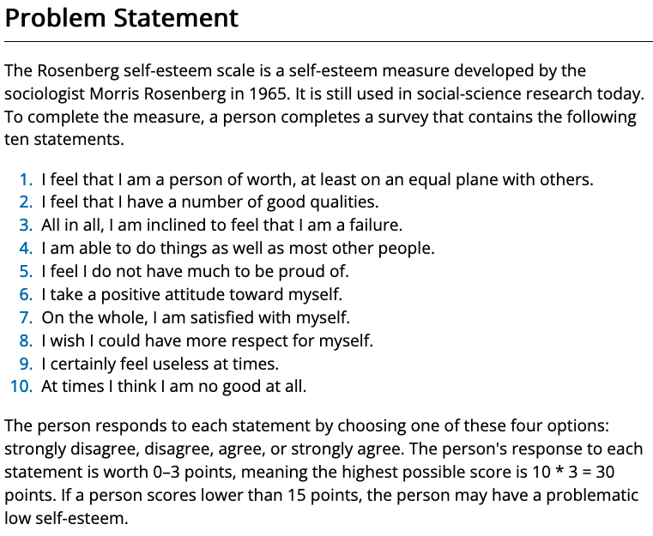
06 Team Activity: Troubleshooting Functions
Purpose
Writing and running test functions often help a software developer find mistakes in code.
During this assignment, you will write three test functions.
Then use pytest to run the test functions and use the output of pytest to help you find and fix errors in some program functions.

Slide 14
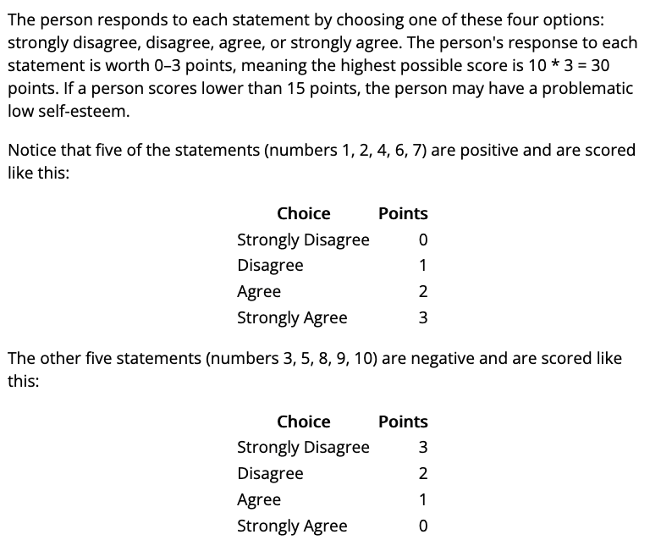
06 Team Activity: Troubleshooting Functions
Purpose
Writing and running test functions often help a software developer find mistakes in code.
During this assignment, you will write three test functions.
Then use pytest to run the test functions and use the output of pytest to help you find and fix errors in some program functions.

Slide 15
06 Team Activity: Troubleshooting Functions
Assignment
Core Requirements¶
As a team, write a Python program named esteem.py that implements the Rosenberg self-esteem scale.
Your program must ask the user to respond to each of the ten statements with D, d, a, or A which mean strongly disagree, disagree, agree, and strongly agree.
Your program must compute the score for each answer and sum and display the person's total score.
You should think about how you will separate this program into functions before you begin writing the program.
Your program prints the introductory text as shown in the Testing Procedure section below.
Your program prints each of the ten statements and gets a response from the user.
Your program computes the score for each response and sums all the scores and displays the total score.

Slide 16
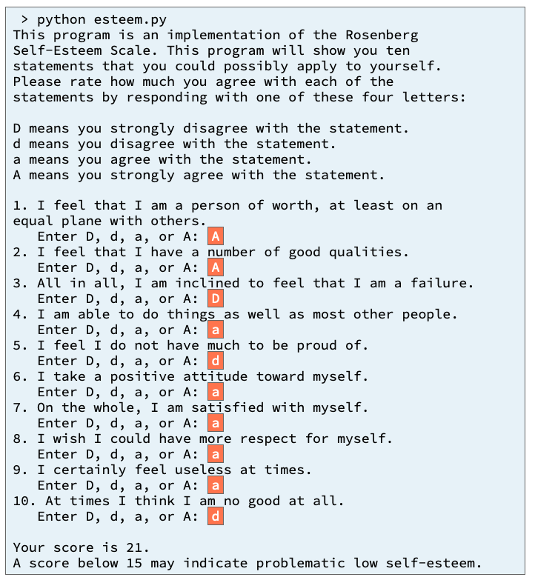
Input/Output
What do we need
What are the inputs?
What are the outputs?

Slide 17
Input/Output
What is this?
What do we need
What is this?
What are the inputs?
What are the outputs?
What is this?

Slide 18
Input/Output
What is this?
Introduction()
What do we need
What is this?
What are the inputs?
What are the outputs?
Question1()
Question2()
Question3()
…
Or
get_answers(question_list)
Return list of answers.
Compute_score() Magic happens here ===➔
What is this?
Display_results(score)

Slide 19
06 Team Activity: Troubleshooting Functions
Input
Process
Output
main
create_questsion()
Display_introduction()
Question_list
Display_score()
Get_answers()
Calculate_score()

Slide 21
06 Prove Assignment: Troubleshooting Functions

Slide 22
06 Prove Assignment: Troubleshooting Functions
Purpose
Prove that you can write a Python program and write and run test functions to help you find and fix mistakes.

Slide 23
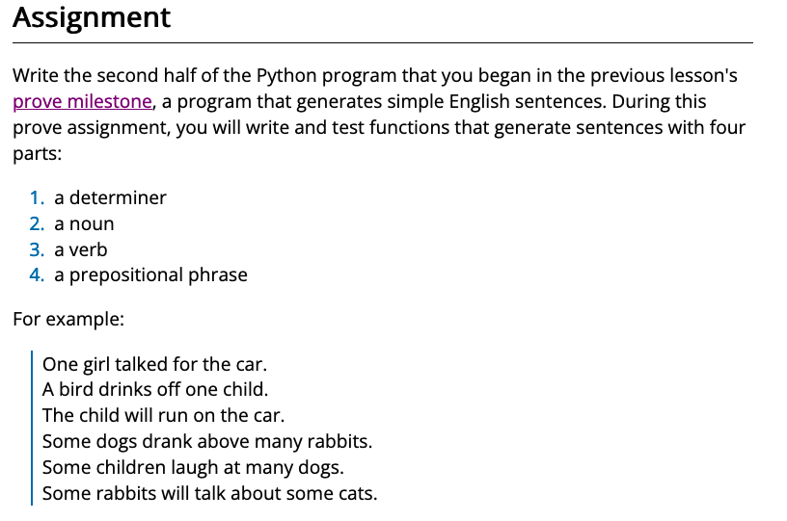
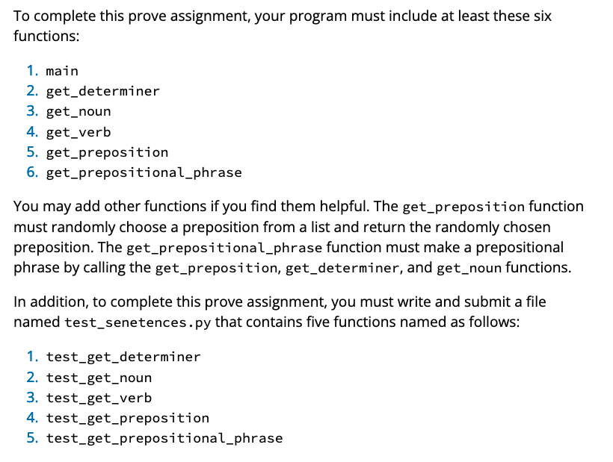
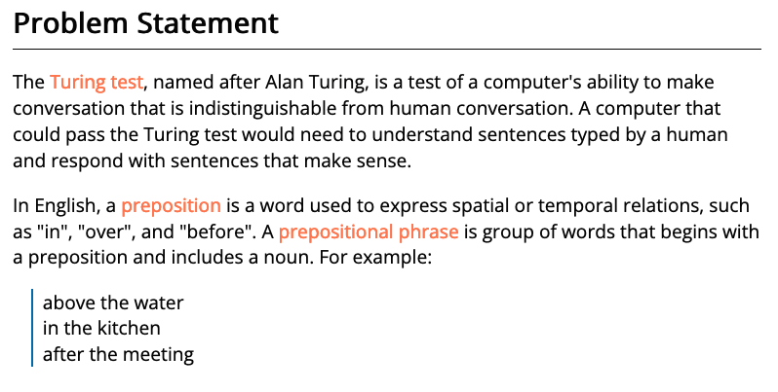
06 Prove Assignment: Troubleshooting Functions
Purpose
Prove that you can write a Python program and write and run test functions to help you find and fix mistakes.

Slide 24
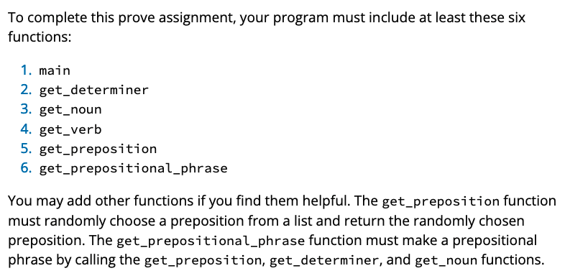
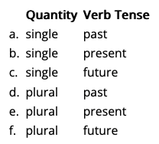
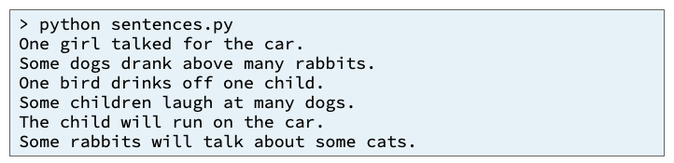
Input
Process
Output
main
quantity
quantity
quantity
birth_str
tense
get_determiner()
get_noun()
get_verb()
get_sentence()
quantity
get_preposition()
get_preposition_phrase()

Slide 25
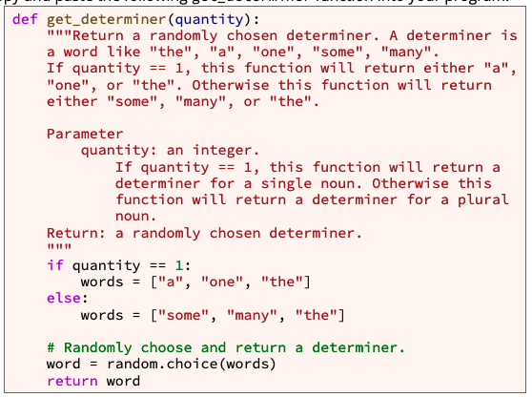
def get_determiner(quantity):
If quantity == 1
words = ["a", "one", "the"]
words = ["some", "many", "the"]
word = random.choice(words)
return word

Slide 26
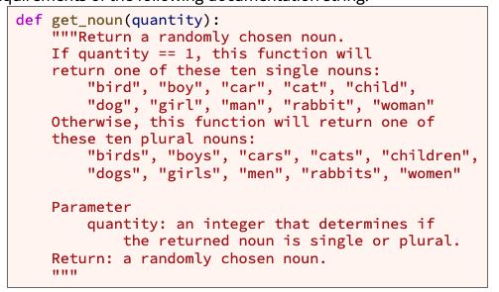
def get_noun(quantity):
If quantity == 1
words = ["bird", "boy", "car", "cat", "child", "dog", "girl", "man", "rabbit", "woman”]
words = ["birds", "boys", "cars", "cats", "children", "dogs", "girls", "men", "rabbits", "women”]
word = random.choice(words)
return word

Slide 27
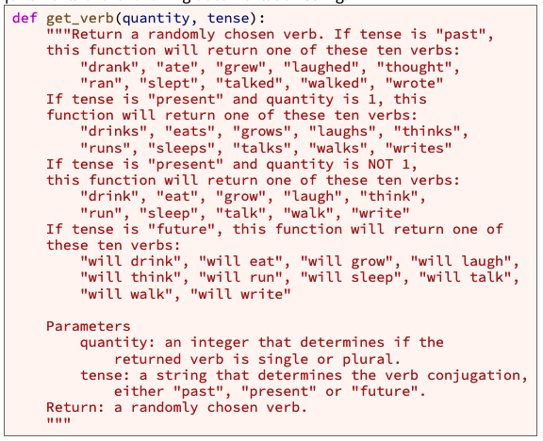
def get_verb(quantity, tense):
If tense == past
words = ["drank", "ate", "grew", "laughed", "thought", "ran", "slept", "talked", "walked", "wrote”]
If tense == future
words = ["will drink", "will eat", "will grow", "will laugh", "will think", "will run", "will sleep", "will talk", "will walk", "will write”]
If tense == present
words = ["drinks", "eats", "grows", "laughs", "thinks", "runs", "sleeps", "talks", "walks", "writes”]
If quantity == 1
Else #If quantity >1
words = ["drink", "eat", "grow", "laugh", "think", "run", "sleep", "talk", "walk", "write”]
word = random.choice(words)
return word

Slide 28
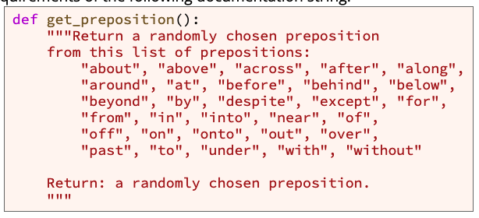
def get_preposition():

Slide 29
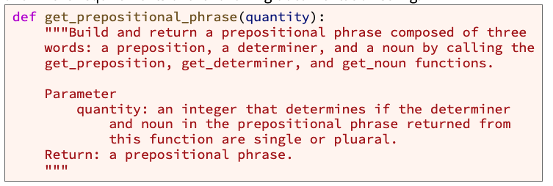
def get_prepositional_phrase(quantity):

Slide 30
def get_sentence(quantity, tense):
Determiner = get_determiner(quantity)
noun = get_noun(quantity)
verb = get_verb(quantity, tense)
Sentence = determiner +” “ + noun + “ “ + verb
return sentence

Slide 31
def get_prepositional_phrase(quantity):
preposition = get_preposition()
determiner = get_determiner(quantity)
noun = get_noun(quantity)
Prepostion_phrase = preposition +” “ + determiner + “ “ + noun
return sentence

Slide 32
def get_sentence(quantity, tense):updated
Determiner = get_determiner(quantity)
noun = get_noun(quantity)
verb = get_verb(quantity, tense)
Sentence = determiner +” “ + noun + “ “ + verb
return sentence
phrase = get_prepositional_phrase(quantity)
Sentence = determiner +” “ + noun + “ “ + verb + ” “ + phrase
return sentence

Slide 33
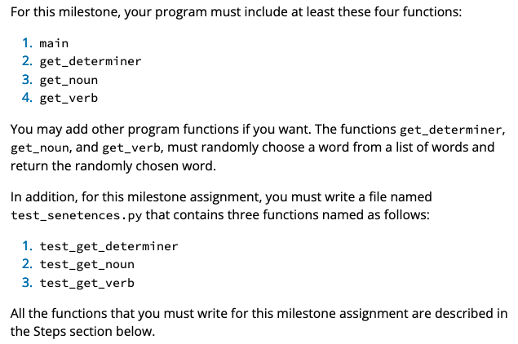
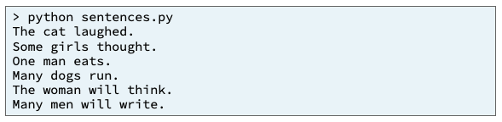
Input
Process
Output
main
quantity
quantity
birth_str
get_determiner()
get_noun()
get_verb()
quantity
get_preposition()
get_preposition_phrase()

Slide 34
Input
Process
Output
determiner
sentence
main
noun
+
verb
quantity
phrase
tense
quantity
quantity
birth_str
get_determiner()
get_noun()
get_verb()
quantity
get_preposition()
get_preposition_phrase()

Slide 35
Input
Process
Output
determiner
sentence
main
noun
+
verb
quantity
phrase
tense
quantity
quantity
quantity
quantity
tense
tense
get_determiner()
get_noun()
get_verb()
get_sentence()
quantity
get_preposition()
get_preposition_phrase()

Slide 36
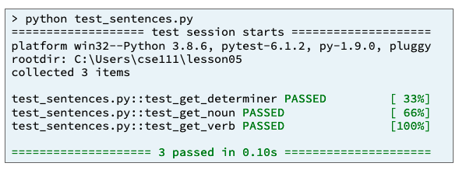

Input
Process
Output
determiner
sentence
main
noun
+
verb
quantity
tense
quantity
quantity
quantity
quantity
tense
tense
get_determiner()
get_noun()
get_verb()
get_sentence()
test_get_determiner()
test_get_noun()
test_get_verb()
test_get_sentence()

Slide 37
05 Prove Milestone: Testing and Fixing Functions
Purpose
PART 2: Test Procedure
Writing and running test functions often help a software developer find mistakes in code.
During this assignment, you will write three test functions.
Then use pytest to run the test functions and use the output of pytest to help you find and fix errors in some program functions.

Slide 38
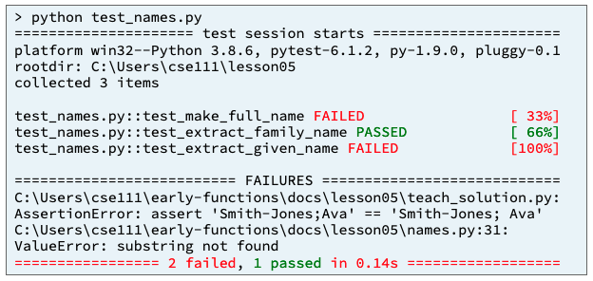
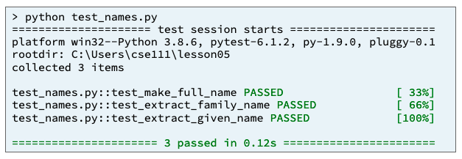
05 Prove Milestone: Testing and Fixing Functions
Assignment
As a team, write three test functions named
test_make_full_name,
test_extract_family_name, and
test_extract_given_name.
Each of the test functions will test one of three previously written program functions.
Use pytest to run the test functions and find and fix the mistakes, if any, that are in program functions.

Slide 39
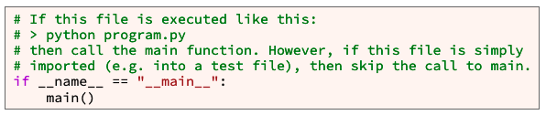
Input
Process
Output
determiner
sentence
main
noun
+
verb
quantity
tense
quantity
quantity
quantity
quantity
tense
tense
get_determiner()
get_noun()
get_verb()
get_sentence()
quantity
get_preposition()
get_preposition_phrase()

Slide 40
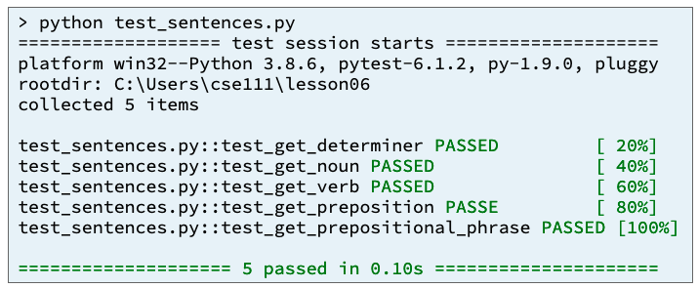
Input
Process
Output
Test_sentences.py
pytest.main(["-v", "--tb=line", "-rN", __file__])
quantity
quantity
get_preposition()
sentences.py
quantity
quantity
tense
tense
quantity
get_determiner()
get_noun()
get_verb()
get_sentence()
get_preposition_phrase()

Slide 41
Input
Process
Output
Test_sentences.py
pytest.main(["-v", "--tb=line", "-rN", __file__])
test_get_ preposition_phrase()
test_get_verb()
test_get_determiner()
test_get_noun()
test_get_sentence()
test_get_ preposition()
quantity
quantity
get_preposition()
sentences.py
quantity
quantity
tense
tense
quantity
get_determiner()
get_noun()
get_verb()
get_sentence()
get_preposition_phrase()

Slide 42
Input
Process
Output
Test_sentences.py
pytest.main(["-v", "--tb=line", "-rN", __file__])
test_get_ preposition_phrase()
test_get_verb()
test_get_determiner()
test_get_noun()
test_get_sentence()
test_get_ preposition()
quantity
quantity
get_preposition()
sentences.py
quantity
quantity
tense
tense
quantity
get_determiner()
get_noun()
get_verb()
get_sentence()
get_preposition_phrase()

Slide 43
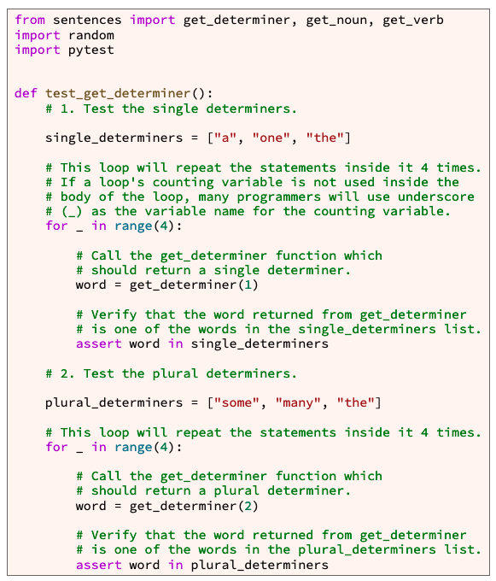
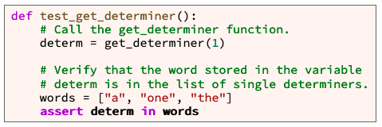
def test_get_determiner():

Slide 44
def test_get_determiner():
words = ["a", "one", "the"]
words = ["some", "many", "the"]

Slide 45
def test_get_determiner():
words = ["a", "one", "the"]
For 0-3
word = get_determiner(1)
Assert word in words
words = ["some", "many", "the"]
For 0-3
word = get_determiner(2)
Assert word in words

Slide 46
Input
Process
Output
words = ["a", "one", "the"]
For 0-3
word = get_determiner(1)
Assert word in words
words = ["some", "many", "the"]
For 0-3
word = get_determiner(2)
Assert word in words
sentences.py
quantity
get_determiner()

Slide 47
def test_get_noun (quantity):
Process
words = ["bird", "boy", "car", "cat", "child", "dog", "girl", "man", "rabbit", "woman”]
For 0-3
word = get_noun(1)
Assert word in words
words = ["birds", "boys", "cars", "cats", "children", "dogs", "girls", "men", "rabbits", "women”]
For 0-3
word = get_noun(2)
Assert word in words

Slide 48
def test_get_verb():
Process
words = ["drank", "ate", "grew", "laughed", "thought", "ran", "slept", "talked", "walked", "wrote”]
For 0-3
word = get_verb(1, “past”)
Assert word in words
words = ["will drink", "will eat", "will grow", "will laugh", "will think", "will run", "will sleep", "will talk", "will walk", "will write”]
For 0-3
word = get_noun(1, “future”)
Assert word in words
words = ["drinks", "eats", "grows", "laughs", "thinks", "runs", "sleeps", "talks", "walks", "writes”]
For 0-3
word = get_noun(1, “present”)
Assert word in words
words = ["drink", "eat", "grow", "laugh", "think", "run", "sleep", "talk", "walk", "write”]
For 0-3
word = get_noun(2, “present”)
Assert word in words

Slide 49
test_get_sentence(quantity, tense)
Process
Determiner_words = single, plural
Noun_words = single, plural
Verb_words = past, present_single, present_plural, future
Sentence = get_sentence(quantity, tense)
Words = sentence.split(“ “)
Assert word[0] in determinerwords
Assert word[1] in nounwords
Assert word[2] in verbwords

Slide 50
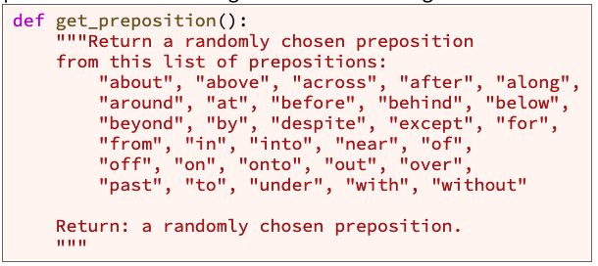
test_get_preposition

Slide 51
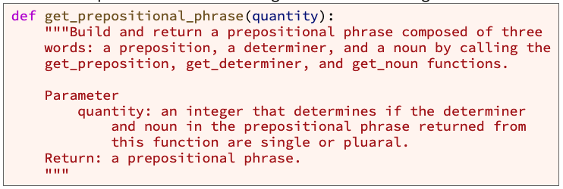
test_get_prepositional_phrase
preposition = get_preposition()
Determiner_words = single, plural
Noun_words = single, plural
determiner = get_determiner(quantity)
preposition _words = prepositions
noun = get_noun(quantity)
Prepostion_phrase = preposition +” “ + determiner + “ “ + noun
phrase = get_prepositional_phrase(quantity)
return sentence
Words = phrase.split(“ “)
Assert word[0] in preposition_words
Assert word[1] in determiner_word
Assert word[2] in noun_words

Slide 52
Input
Process
Output
Test_sentences.py
pytest.main(["-v", "--tb=line", "-rN", __file__])
test_get_ preposition_phrase()
test_get_verb()
test_get_determiner()
test_get_noun()
test_get_sentence()
test_get_ preposition()
quantity
quantity
get_preposition()
sentences.py
quantity
quantity
tense
tense
quantity
get_determiner()
get_noun()
get_verb()
get_sentence()
get_preposition_phrase()

Slide 53
Input
Process
Output
Test_sentences.py
pytest.main(["-v", "--tb=line", "-rN", __file__])
test_get_determiner()
test_get_noun()
test_get_verb()
test_get_sentence()
sentences.py
quantity
quantity
quantity
quantity
tense
tense
get_determiner()
get_noun()
get_verb()
get_sentence()

Slide 55
Input
Process
Output
determiner
sentence
main
noun
+
verb
quantity
tense
quantity
quantity
quantity
quantity
tense
tense
get_determiner()
get_noun()
get_verb()
get_sentence()
test_get_determiner()
test_get_noun()
test_get_verb()
test_get_sentence()

Slide 57
END

Slide 58
Turing Test:
grammatical quantity (also known as grammatical number) is an attribute of nouns, pronouns, adjectives, and verbs that expresses count distinctions, such as "one", "two", "some", or "many".
In English, there are two categories of grammatical quantity: single and plural.
single nouns, pronouns, adjectives, and verbs
plural nouns, pronouns, adjectives, and verbs:
Many languages include past, present, and future tenses.
English sentences, the first with past tense, the second with present tense, and the third with future tense

Slide 59
Assignment
Write a Python program named sentences.py that generates simple English sentences.
During this prove milestone, you will write and test functions that generate sentences with three parts
a determiner (sometimes known as an article)
a noun
a verb
For this milestone , your program must include at least these four functions:
main
get_determiner
get_noun
get_verb
The functions get_determiner, get_noun, and get_verb, must randomly choose a word from a list of words and return the randomly chosen word.
In addition, for this milestone assignment, you must write a file named test_senetences.py that contains three functions named as follows:
test_get_determiner
test_get_noun
test_get_verb

Slide 60
Main function
Sentences.py
main
Get_noun
Get_verb
Get_determiner
Call sequence 6 times.
Quantity = [single, single, single, plural, plural, plural]
Tense = [past, present, future, past, present, future]
 | Quantity | Verb Tense
a. | single | past
b. | single | present
c. | single | future
d. | plural | past
e. | plural | present
f. | plural | future

Slide 61
Main function
What programming tools are available to you?
Branching
If
Looping
For – you know when you will end, i.e. lists, arrays
While – you know an exit criteria
Function calling
Data Structures
Primitives (variables)
Arrays
Lists
Input
Output
What do you know?
Sentence = Determiner + noun + verb
Call sequence 6 times = 6 sentences
Quantity = [single, single, single, plural, plural, plural]
Tense = [past, present, future, past, present, future]
 | Quantity | Verb Tense
a. | single | past
b. | single | present
c. | single | future
d. | plural | past
e. | plural | present
f. | plural | future

Slide 62
Main function – Top-Down Design
Sentence = Determiner + noun + verb
Architecture - Design
What do you know
Sentences.py
main
Get_noun
Get_verb
Get_determiner
Call sequence 6 times.
Quantity = [single, single, single, plural, plural, plural]
Tense = [past, present, future, past, present, future]
 | Quantity | Verb Tense
a. | single | past
b. | single | present
c. | single | future
d. | plural | past
e. | plural | present
f. | plural | future
quantity
get_determiner
Determiner
quantity
Get_noun
noun
Quantity, tense
Get_verb
verb

Slide 63
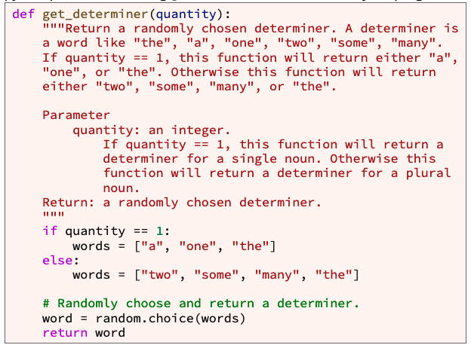
def get_determiner(quantity):
quantity
get_determiner
Determiner
What programming tools are available to you?
Branching
If
Looping
For – you know when you will end, i.e. lists, arrays
While – you know an exit criteria
Function calling
Data Structures
Primitives (variables)
Arrays
Lists
Input
Output

Slide 64
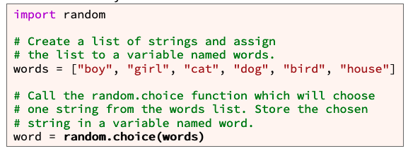
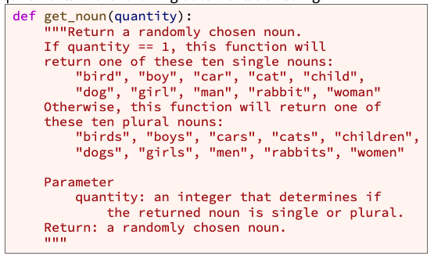
get_noun
quantity
Get_noun
noun
What programming tools are available to you?
Branching
If
Looping
For – you know when you will end, i.e. lists, arrays
While – you know an exit criteria
Function calling
Data Structures
Primitives (variables)
Arrays
Lists
Input
Output

Slide 65
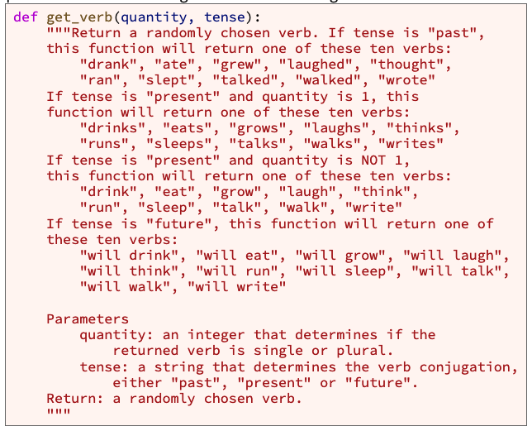
get_verb
Quantity, tense
Get_verb
verb
What programming tools are available to you?
Branching
If
Looping
For – you know when you will end, i.e. lists, arrays
While – you know an exit criteria
Function calling
Data Structures
Primitives (variables)
Arrays
Lists
Input
Output

Slide 66
Remember – Bottom-up Design
Three functions that give words
Words form sentences
Provide 6 sentences
quantity
get_determiner
Determiner
quantity
Get_noun
noun
Quantity, tense
Get_verb
verb
Sentence = Determiner + noun + verb
 | Quantity | Verb Tense
a. | single | past
b. | single | present
c. | single | future
d. | plural | past
e. | plural | present
f. | plural | future

Slide 67


Testing
Functions
test_sentences.py
Import sentences.py
test_get_determiner
provided
test_get_noun
test_get_verb
Call this at the end

Slide 68
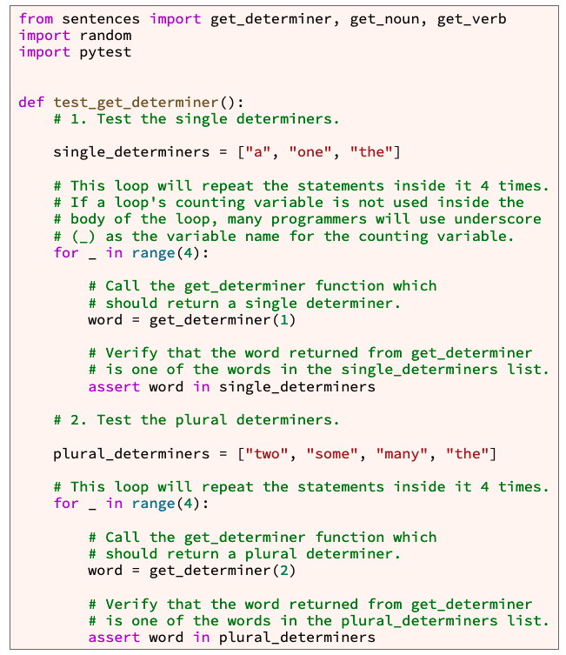
Format of Test functions
Define known output data
Define Known input data
Loop through each data point and call function
Capture results
Assert that the Result in output data

Slide 69
Format of Test functions
Define known output data
Define Known input data
Loop through each data point and call function
Capture results
Assert that the Result in output data

Slide 70
test_get_noun
Define known output data
Define Known input data
Loop through each data point and call function
Capture results
Assert that the Result in output data
Look at the function being tested for input and output info

Slide 71
test_get_verb
Define known output data
Define Known input data
Loop through each data point and call function
Capture results
Assert that the Result in output data
Look at the function being tested for input and output info

Slide 72
06 Prove Assignment
Week 05
Sentence = Determiner + noun + verb
Week 06
Sentence = Determiner + noun + verb + prepositional phrase
Prepostitional_phrase = preposition + determiner + noun
quantity
get_determiner
Determiner
quantity
Get_noun
noun
Quantity, tense
Get_verb
verb
Get_preposition
preposition
quantity
Get_prepositional_phrase
Prepositional_phrase
Determiner, noun, verb, prepositional_phrase
main
Determiner

Slide 73
Modify Main
Sentences.py
main
Get_noun
Get_verb
Get_determiner
get_prepositional_phrase
get_prepostion
get_determiner
get_noun

Slide 74
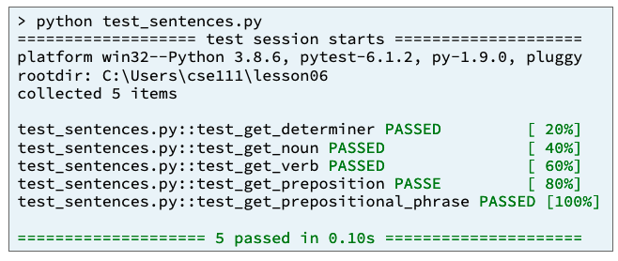
Testing
Functions
test_sentences.py
Import sentences.py
test_get_determiner
provided
test_get_noun
test_get_verb
Test_get_preposition
Test_get_prepostional_phrase
Call this at the end

