Slide 1
CSE 111
Week 02: Calling Functions
W. Clements

Slide 2
Overview
Prepare: Reading, Video
Checkpoint
Icebreaker
Teach: Class Activity
Prove: Milestone
Ponder: Check your understanding

Slide 3
What is a function?
A small set of instructions
Need to know
Arguments, parameters, signature
Optional arguments
Named arguments
Calling a function
Storing the results of a call
def functionName (params, …)
Instructions
return optional_value
Calling a function
rvalue = functionName(value, …)

Slide 4
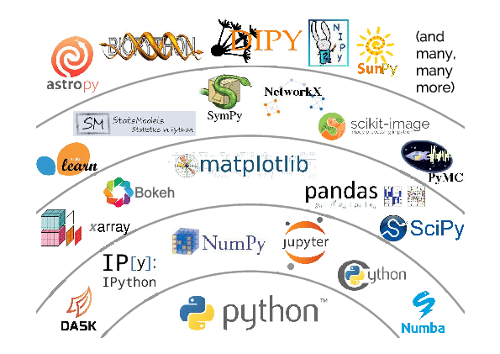
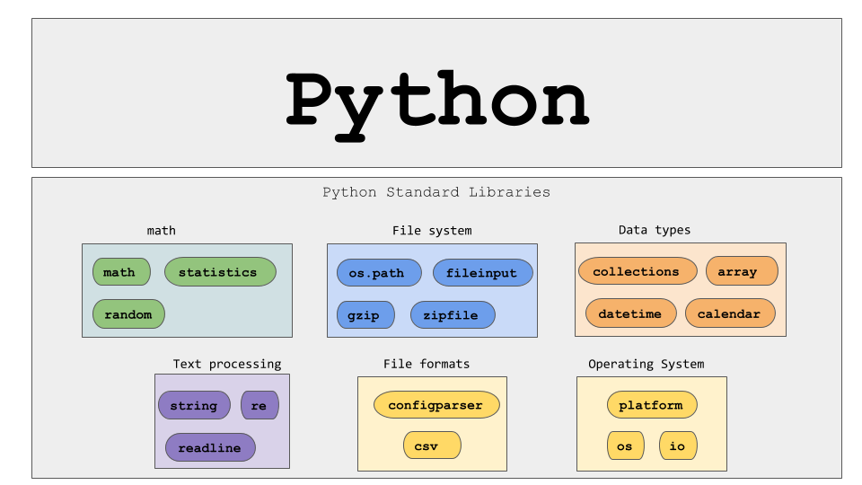
Types of Functions
Main
User-defined functions
Built-in
Standard library Functions
Third-party Functions
User-defined functions
Second-Party Functions
(Project Library)
Second-Party Functions
(Company Library)
Third-Party Functions
Standard Library Functions
Python built-in functions

Slide 5
Four ways to pass parameters
Input-only
Output-only
Processing
Update
void display(
int value);
int get();
bool isLeap(
int year);
void update( list);

Slide 6
Prepare:
https://byui-cse.github.io/cse111-course/lesson02/prepare.html
What Is a Function?¶
A function is a group of statements (computer commands) that together perform one task.
Types:
Built-in functions
Standard library functions
Third-party functions
User-defined functions
How to Call a Function¶
Optional Arguments¶
Named Arguments
How to Call a Function that Is inside a Module
How to Call a Method
How to Store a Returned Value
https://docs.python.org/3/library/functions.html
https://www.w3schools.com/python/python_functions.asp

Slide 7
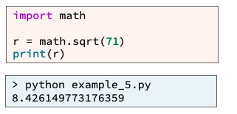
Modules
Another Python file that contains functions
You can call those functions after you have import the file.

Slide 8
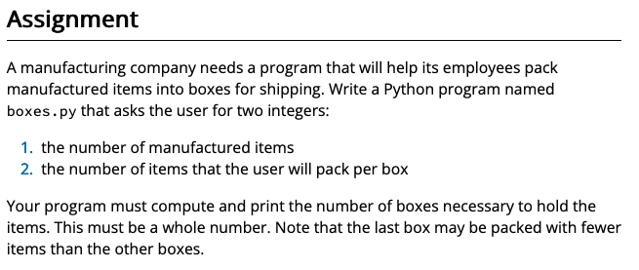
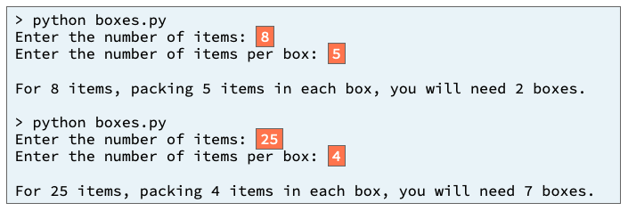
Prepare: Checkpoint 02 Checkpoint: Calling Functions
Purpose:
Check your understanding of calling built-in Python functions and functions that are in a standard Python module.
In our modern world economy, many items are manufactured in large factories, then packed in boxes and shipped to distribution centers and retail stores. A common question for employees who pack items is "How many boxes do we need?"
https://byui-cse.github.io/cse111-course/lesson02/check.html

Slide 9
Input
Process
Output
main

Slide 10
Input
Process
Output
main

Slide 11
Input
Process
Output
main
Get_items()
items
value
Get_items_per_box()
Items_per_box
value
Display_boxs()
boxes_needed = items/ items_per_box

Slide 12
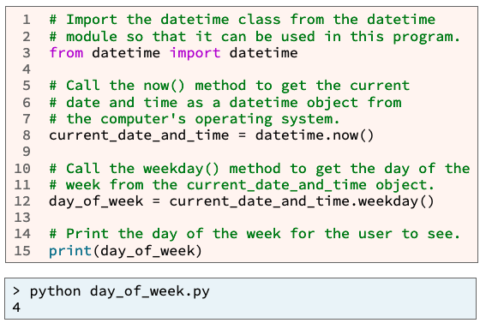
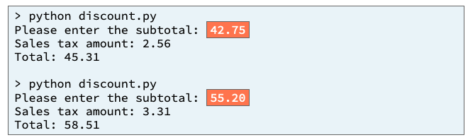
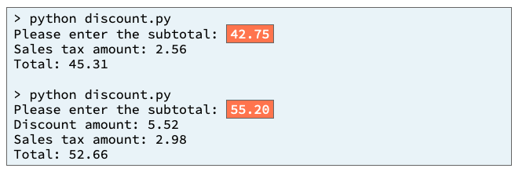
02 Team Activity: Calling Functions
https://byui-cse.github.io/cse111-course/lesson02/teach.html
Purpose:
Improve your understanding of calling built-in Python functions and calling functions and methods that are in a standard Python module.
You work for a retail store that wants to increase sales on Tuesday and Wednesday, which are the store's slowest sales days.
On Tuesday and Wednesday, if a customer's subtotal is $50 or greater, the store will discount the customer's subtotal by 10%.
Core Requirements¶
Your program asks the user for the subtotal but does not ask the user for the day of the week. Your program gets the day of the week from your computer's operating system.
Your program correctly computes and prints the discount amount if applicable.
Your program correctly computes and prints the sales tax amount and the total amount due.
Stretch Challenges
If your team finishes the core requirements in less than an hour, complete one or more of these stretch challenges. Note that the stretch challenges are optional.
Add code to your program that the computer will execute if today is Tuesday or Wednesday and the customer is not purchasing enough to receive the discount. This added code should compute and print the difference between $50 and the subtotal which is the additional amount the customer would need to purchase in order to receive the discount.
Near the beginning of your program replace the code that asks the user for the subtotal with a loop that repeatedly asks the user for a price and a quantity and computes the subtotal. This loop should repeat until the user enters "0" for the price.

Slide 13
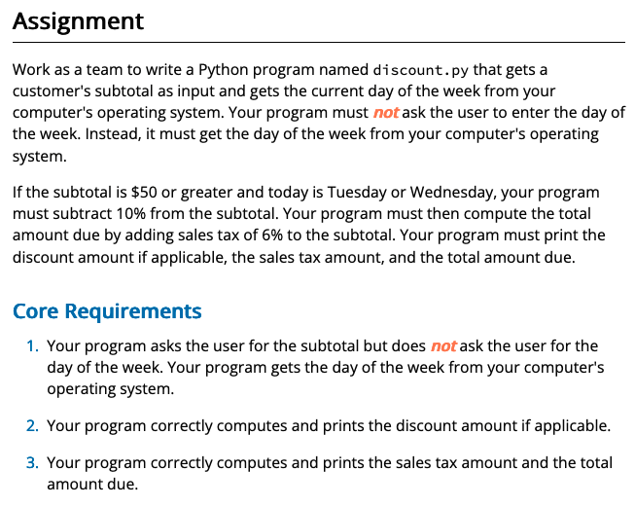
Input
Process
Output
main
?
?

Slide 14
Input
Process
Output
main
Get_subtotal()
subtotal
value
discount
display_discount_amount()
salestax
display_sales_tax()
total
display_total()

Slide 15
Input
Process
Output
main
Get_subtotal()
subtotal
value
?
discount
display_discount_amount()
salestax
display_sales_tax()
total
display_total()

Slide 16
Input
Process
Output
main
Get_subtotal()
subtotal
value
?
discount
display_discount_amount()
salestax
display_sales_tax()
total
display_total()

Slide 17
Input
Process
Output
main
Get_subtotal()
subtotal
value
if
Dayofweek == T(2)/W(3)
Or subtotal > 50
Discount_ratio = .1
discount
display_discount_amount()
Discount_ratio = 0
salestax
display_sales_tax()
dayofweek
total
display_total()

Slide 18
Input
Process
Output
main
Get_subtotal()
subtotal
value
if
Dayofweek == T(2)/W(3)
Or subtotal > 50
Discount_ratio = .1
discount
display_discount_amount()
Discount_ratio = 0
salestax
display_sales_tax()
dayofweek
total
?
display_total()

Slide 19
Input
Process
Output
main
Get_subtotal()
subtotal
value
if
Dayofweek == T(2)/W(3)
Or subtotal > 50
Discount_ratio = .1
discount
display_discount_amount()
Discount_ratio = 0
salestax
display_sales_tax()
dayofweek
total
display_total()

Slide 20
Input
Process
Output
main
Get_subtotal()
subtotal
value
if
Dayofweek == T(2)/W(3)
Or subtotal > 50
Discount_ratio = .1
discount
display_discount_amount()
Discount_ratio = 0
salestax
display_sales_tax()
dayofweek
total
display_total()
datetime
Now()
weekday()
Date_time_value
Day_ofweek

Slide 21
Input
Process
Output
main
Get_subtotal()
subtotal
value
if
Dayofweek == T(2)/W(3)
Or subtotal > 50
Discount_ratio = .1
discount
display_discount_amount()
Discount_ratio = 0
salestax
display_sales_tax()
dayofweek
total
display_total()
datetime
Now()
weekday()
Date_time_value
Day_ofweek

Slide 22
Input
Process
Output
main
Get_subtotal()
subtotal
value
if
Dayofweek == T(2)/W(3)
Or subtotal > 50
Discount_ratio = .1
Discount_ratio = 0
dayofweek
if
Discount > 0
Discount = subtotal * discount_ratio
display_discount_amount()
Salestax = .06 * (subtotal – discount)
display_sales_tax()
Total = (subtotal-discount) + salestax
display_total()
datetime
Now()
weekday()
Date_time_value
Day_ofweek

Slide 24
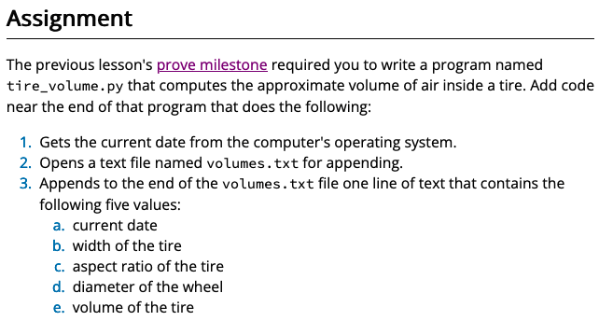
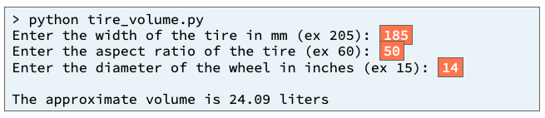
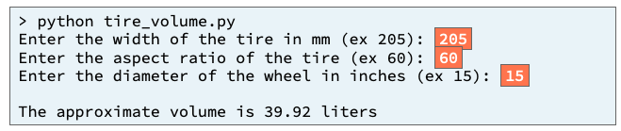
L02 Prove: Assignment 02 Prove: Calling Functions
Purpose:
Prove that you can write a Python program that calls functions and methods to get the current date and to append values to a text file.
Many companies wish to understand the needs and wants of their customers more deeply so the company can create products that fill those needs and wants. One way to understand customers more deeply is to record the values entered by customers while they are using a program and then to analyze those values. One common way to record values is for a program to store them in a file.
https://byui-cse.github.io/cse111-course/lesson02/prove.html

Slide 25
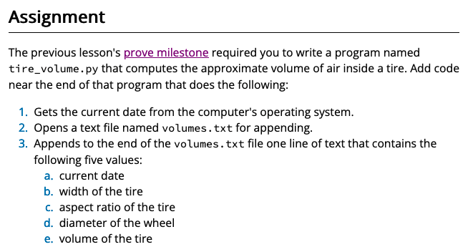
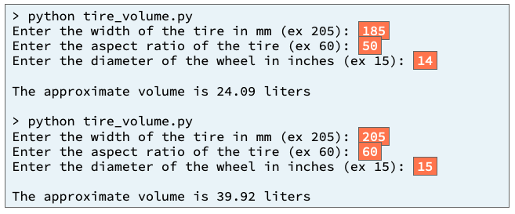
Input
Process
Output
main
Get_width()
w_width
Numerator = p1*(p2-p3)
Numerator_p1= pi*w2*a
Numerator_p2= w*a
Numerator_p3= 2540*d
value
Get_ratio()
a_ratio
value
d_diameter
Display_volume()
Get_diameter()
value
volume = numerator/10M
Previous Ponder 1

Slide 26
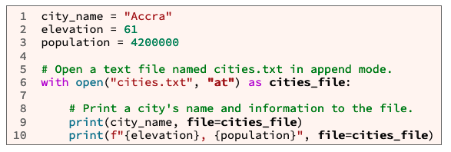
Input
Process
Output
main
Display_volume()
Get_width()
w_width
Numerator = p1*(p2-p3)
Numerator_p1= pi*w2*a
Numerator_p2= w*a
Numerator_p3= 2540*d
value
date
width
Get_ratio()
a_ratio
ratio
value
diameter
d_diameter
volume
Get_diameter()
value
volume = numerator/10M
Write_to_file()
Date_str = f"{current_date_and_time:%Y-%m-%d}"
current_date_and_time
Volume.txt
datetime
Now()
weekday()
Date_time_value
Day_ofweek

Slide 27
Input
Process
Output
main
Display_volume()
Get_width()
w_width
Numerator = p1*(p2-p3)
Numerator_p1= pi*w2*a
Numerator_p2= w*a
Numerator_p3= 2540*d
value
date
width
Get_ratio()
a_ratio
ratio
value
diameter
d_diameter
volume
Get_diameter()
value
volume = numerator/10M
Write_to_file()
Date_str = f"{current_date_and_time:%Y-%m-%d}"
current_date_and_time
Volume.txt
datetime
Now()
weekday()
Date_time_value
Day_ofweek

Slide 28
Helpful Hints
datetime.now() method
from datetime import datetime
current_date_and_time = datetime.now()
print(f"{current_date_and_time:%Y-%m-%d}")
open() function
open(filename, mode="rt")
print() function
print(*objects, sep=" ", end="\n", file=sys.stdout, flush=False)
lesson 11 prepare content from CSE 110

Slide 29
L02 Prove: Assignment 02 Prove: Calling Functions
Verify: Testing Procedures
Run with the inputs
Tire width = 185, Ratio = 50, Diameter = 14
open the volumes.txt
Verify: 2020-03-18, 185, 50, 14, 24.09
Tire width = 205, Ratio = 60, Diameter = 15
open the volumes.txt
Verify:
2020-03-18, 185, 50, 14, 24.09
2020-04-16, 205, 60, 15, 39.92

Slide 30
L02 Ponder: Reflection
Quiz Instructions
Overview
Task: Reflect on your learning.
Purpose: Promote long-term retention of the subject matter.
Notes
Each question in this bi-weekly quiz requires a short essay response.
Your instructor will carefully review each response to determine possible areas of need and support.
Please answer each question honestly and completely to help your instructor better understand your needs.
What topic from this week are you uncertain of or would like to know more about?
What accomplishment from this week are you the most proud of and why?

