Slide 1
CSE 111
Writing Functions
W. Clements

Slide 2
Overview
Prepare: Reading, Video
Checkpoint
Teach: Class Activity
Prove: Milestone
Ponder: Check your understanding

Slide 3
Prepare 03 Prepare: Writing Functions
Videos
Introducing Functions
Demonstration: Functions
Parameterized Functions
Demonstration: Parameterized Functions
Concepts
What Is a Function?¶
What Is a User-Defined Function?
How to Write a User-Defined Function¶
How to Make a User-Defined Function Reusable¶
The main User-Defined Function¶
A Complete Program with User-Defined Functions¶
What Happens When the Computer Calls a Function?¶
Call Graphs¶
Summary¶

Slide 4
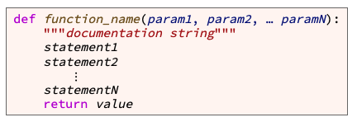
Writing Functions
variable
value
the function name
Start with letter/_, can have a-Z0-9
meaningful
keyword def (which is an abbreviation for "define")
the parameter list (with the parameters separated by commas)
Values are passed in an assigned to variable names.
header or signature
a result value is from a function
Function body

Slide 5
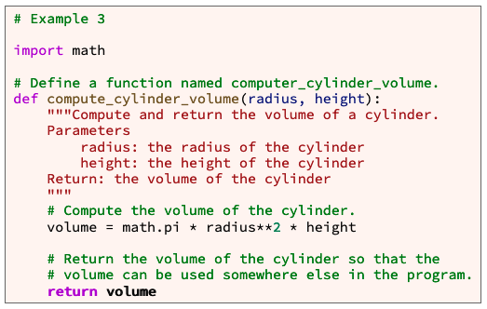
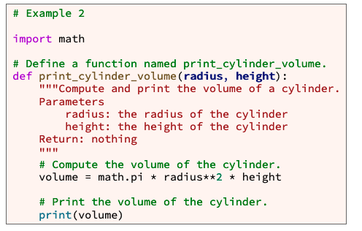
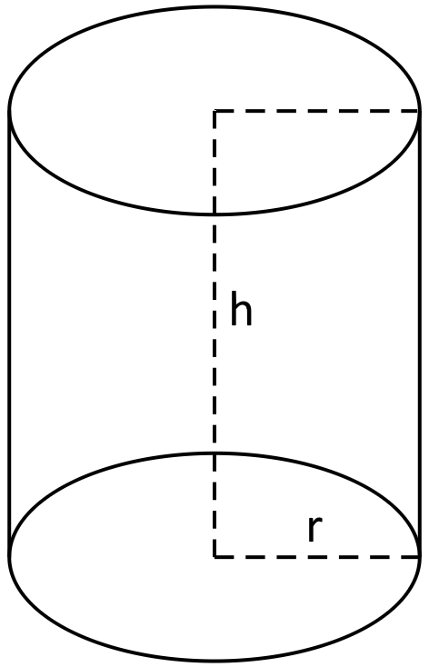
Example

Slide 6
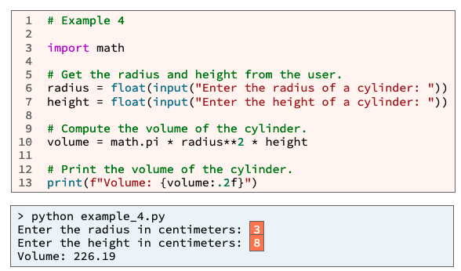
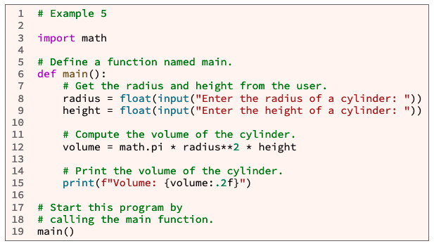
main
Why use main function?
Organization
Writing statements outside a function can lead to poor organization within a large program.
Best Practices
Professional software developers write statements inside a function whenever possible.
No more calling code from the first indentation, except for main

Slide 7
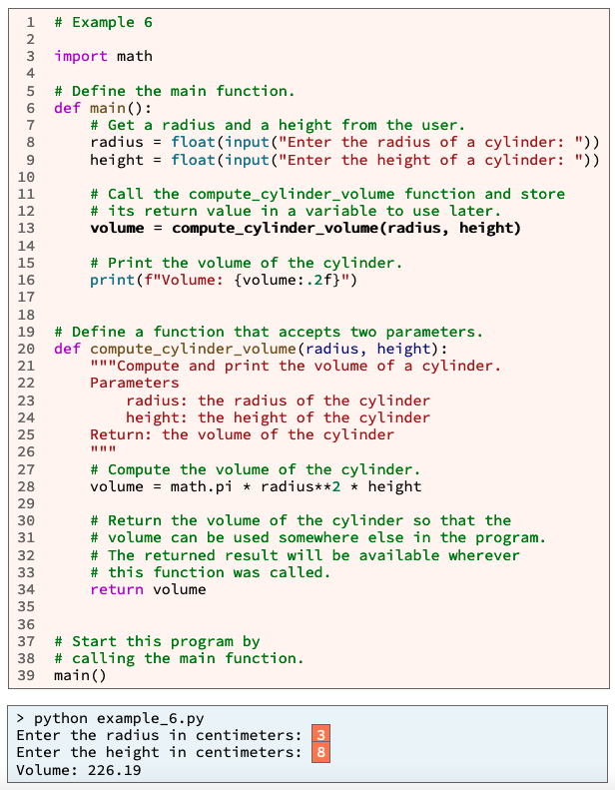
A
1
A
B
C
D

Slide 8
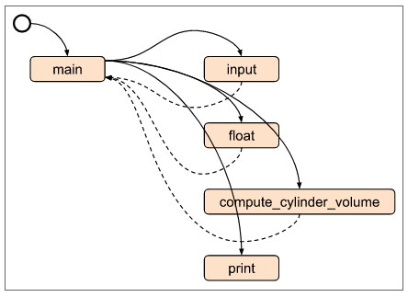
A
1. (A)Python read and compiles the entire file.
Then runs the 1st line of code with zero indentation
i.e. main()
2. Main is called.
Process of input is retrieved and converted (B, C)
3. Within main, compute_cylinder_volume() is called with two parameters.
The variables used pass in the the values they hold.
4. Those values are re-assigned to a new set of variables.
The new variables are used to process the value of volume.
5. The value from volume is return, and stored in main’s volume variable.
6. Main is finished
7. Control flow is return to the next line with no indentation.
Input
Process
Output
2
B
C
B
C
3
3
5
5
D
Value passing
6
D
4
5
Value passing
1
7
A
B
C
D

Slide 9
Summary
A function is a group of statements that together perform one task. A user-defined function is a function written by a programmer like you. To write a user-defined function, write code that follows this template:
To call a user-defined function, write code that follows this template:
def function_name(param1, param2, … paramN):
"""documentation string"""
statement1
statement2
⋮
statementN
return value
variable_name = function_name(arg1, arg2, … argN)

Slide 10
L03 Prepare: Checkpoint 03 Checkpoint: Writing Functions

Slide 11
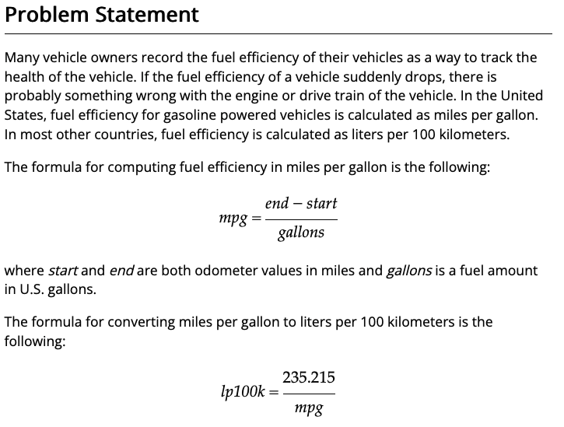
L03 Prepare: Checkpoint 03 Checkpoint: Writing Functions
https://byui-cse.github.io/cse111-course/lesson03/check.html
Purpose
Check your understanding of writing your own functions with parameters and then calling those functions with arguments.
Assignment
Write a Python program that asks the user for three numbers:
A starting odometer value in miles
An ending odometer value in miles
An amount of fuel in gallons
Your program must calculate and print fuel efficiency in both miles per gallon and liters per 100 kilometers. Your program must have three functions named as follows:
main
miles_per_gallon
lp100k_from_mpg
All user input and printing must be in the main function. In other words, the miles_per_gallon and lp100k_from_mpg functions must not call the the input or print functions.

Slide 12
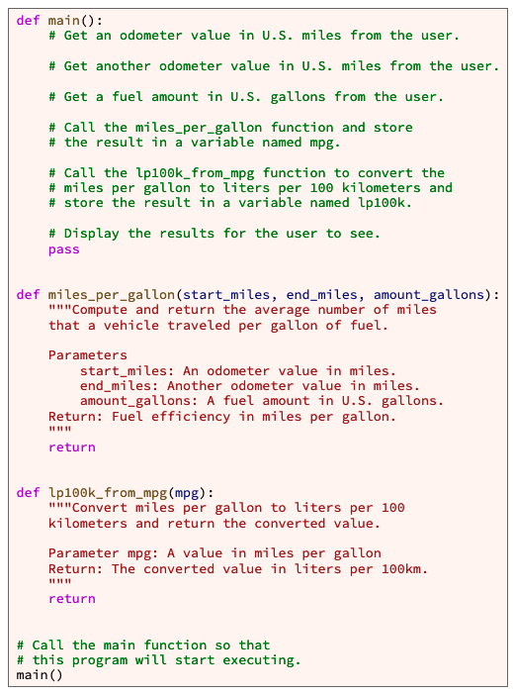
L03 Prepare: Checkpoint 03 Checkpoint: Writing Functions
Step 1: Create a new python file, add header comment block with name, date, and purpose and problem statement
Step 2: Make main() function
A. make def main(): with a print statement “Hello world”, to see if python is still working.
B. call main() from first indentation.
Step 3: Copy provide code. Your welcome!!
Look at the example output and determine order
Step 4. Work on each objective in the assignment.
Step 5. Test it.
Assignment
Write a Python program that asks the user for three numbers:
A starting odometer value in miles
An ending odometer value in miles
An amount of fuel in gallons
Your program must calculate and print fuel efficiency in both miles per gallon and liters per 100 kilometers. Your program must have three functions named as follows:
main
miles_per_gallon
lp100k_from_mpg
All user input and printing must be in the main function. In other words, the miles_per_gallon and lp100k_from_mpg functions must not call the the input or print functions.

Slide 13
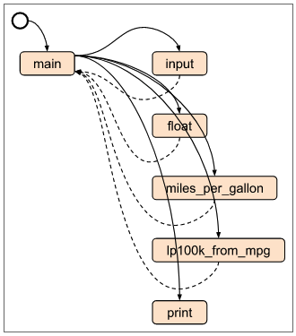
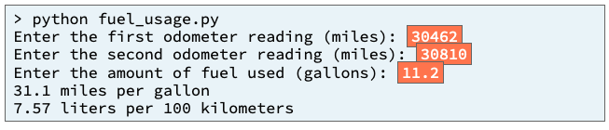
L03 Prepare: Checkpoint 03 Checkpoint: Writing Functions
Input
Process
Output
Line = values
variables

Slide 14
L03 Prepare: Checkpoint 03 Checkpoint: Writing Functions
Input
Process
Output
main
Line = values
miles_per_gallon()
lp100k_from_mpg()
variables

Slide 15
L03 Prepare: Checkpoint 03 Checkpoint: Writing Functions
Input
Process
Output
Get_start_odometer()
Get_end_odometer()
Display_miles_per_gallon()
Get_gallons()
Display_liters_per_kiloM()
main
Line = values
miles_per_gallon()
lp100k_from_mpg()
variables

Slide 16
L03 Prepare: Checkpoint 03 Checkpoint: Writing Functions
Input
Process
Output
Get_start_odometer()
Get_end_odometer()
Display_miles_per_gallon()
Get_gallons()
Display_liters_per_kiloM()
main
start_odometer
end_odometer
gallons_used
miles_per_gallon
liters_per_km
Line = values
miles_per_gallon()
lp100k_from_mpg()
variables

Slide 17
L03 Prepare: Checkpoint 03 Checkpoint: Writing Functions
Input
Process
Output
Get_start_odometer()
Get_end_odometer()
Display_miles_per_gallon()
Get_gallons()
Display_liters_per_kiloM()
main
start_odometer
end_odometer
gallons_used
miles_per_gallon
liters_per_km
Line = values
miles_per_gallon()
lp100k_from_mpg()
mpg = (end − start)/gallons
variables
lp100k = 235.215/mpg

Slide 18
L03 Prepare: Checkpoint 03 Checkpoint: Writing Functions
Input
Process
Output
Get_start_odometer()
Get_end_odometer()
Display_miles_per_gallon()
Get_gallons()
Display_liters_per_kiloM()
main
start_odometer
end_odometer
i.e.
Start_odometer = get_start_odomenter()
miles_per_gallon = miles_per_gallon(start…, end…, gallons...)
Display_miles_per_gallon(miles_per_gallon)
gallons_used
miles_per_gallon
liters_per_km
Line = values
miles_per_gallon()
lp100k_from_mpg()
mpg = (end − start)/gallons
variables
lp100k = 235.215/mpg

Slide 19
L03 Prepare: Checkpoint 03 Checkpoint: Writing Functions
Input
Process
Output
Get_start_odometer()
Get_end_odometer()
Display_miles_per_gallon()
Get_gallons()
Display_liters_per_kiloM()
main
start_odometer
end_odometer
gallons_used
def main():
start_odometer = get_start_odometer()
end_odometer = get_end_odomenter()
gallons_used = get_gallons()
miles_per_gallon = miles_per_gallon(start_o, end_o, gallon_used)
liters_per_km = lp100k_from_mpg(miles_per_gallon)
display_miles_per_gallon( miles_per_gallon)
display_liters_per_kiloM( liter_per_km)
miles_per_gallon
liters_per_km
Line = values
miles_per_gallon()
lp100k_from_mpg()
mpg = (end − start)/gallons
variables
lp100k = 235.215/mpg

Slide 20
L03 Teach: Team Activity 03 Team Activity: Writing Functions
Purpose:
Boost your understanding of writing your own functions with parameters and then calling those functions with arguments.

Slide 21
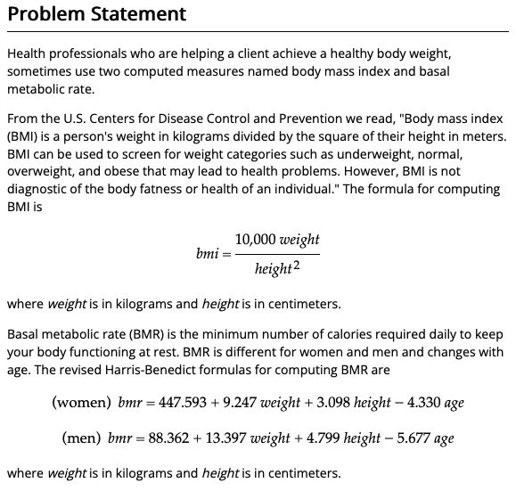
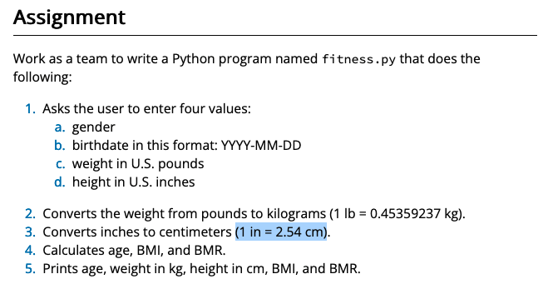
L03 Teach: Team Activity 03 Team Activity: Writing Functions
Purpose:
Boost your understanding of writing your own functions with parameters and then calling those functions with arguments.

Slide 22
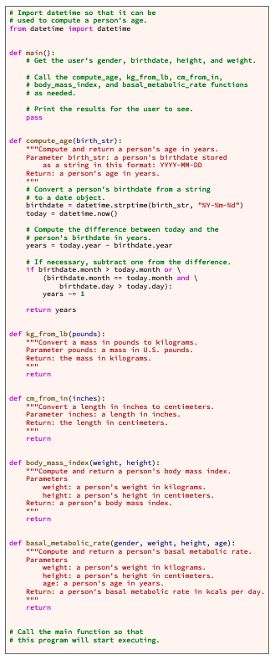
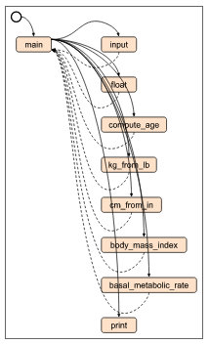
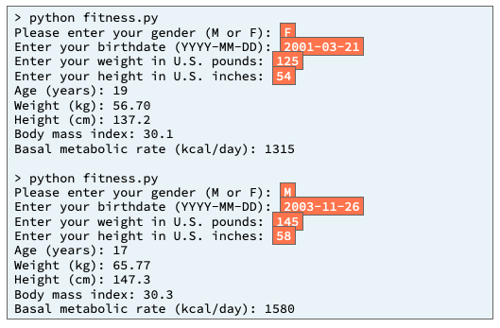
L03 Teach: Team Activity 03 Team Activity: Writing Functions
Purpose:
Boost your understanding of writing your own functions with parameters and then calling those functions with arguments.

Slide 23
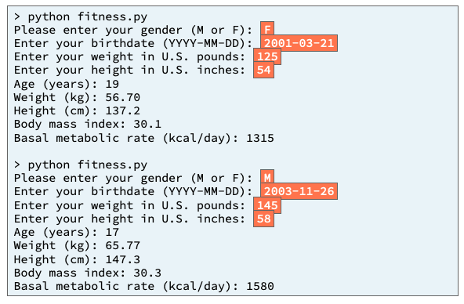
Input
Process
Output
main
Start off with the basic understanding of all programs and functions

Slide 24
What functions are being ask for?
Input
Process
Output
main
gender
weight
height
age
birth_str
pounds
inches
Weight (kg)
Height(cm)
Compute_age()
Kg_from_lb()
cm_from_in()
body_mass_index()
basal_metabolic_rate()
age
kg
cm
index

Slide 25
What does the input and output look like?
Input
Process
Output
main
Display_age()
Get_gender()
Display_weight_kg()
Get_birthday()
Display_height_cm()
Get_weight()
Display_bodymass_index()
Get_inches()
displayMetabolicRate()
gender
weight
height
age
birth_str
pounds
inches
Weight (kg)
Height(cm)
Compute_age()
Kg_from_lb()
cm_from_in()
body_mass_index()
basal_metabolic_rate()
age
kg
cm
index

Slide 26
Where are we storing the inputs and outputs?
Input
Process
Output
main
Display_age()
age
Get_gender()
gender
Weigth_kg
Display_weight_kg()
Get_birthday()
birthday
Heigth_cm
Display_height_cm()
Get_weight()
Weight_lbs
bodaymassindex
Height_inches
Display_bodymass_index()
Get_inches()
metabolicrate
displayMetabolicRate()
gender
weight
height
age
birth_str
pounds
inches
Weight (kg)
Height(cm)
Compute_age()
Kg_from_lb()
cm_from_in()
body_mass_index()
basal_metabolic_rate()
age
kg
cm
index

Slide 27
What do we not know?
Input
Process
Output
main
Display_age()
age
Get_gender()
gender
Weigth_kg
Display_weight_kg()
Get_birthday()
birthday
Heigth_cm
Display_height_cm()
Get_weight()
Weight_lbs
bodaymassindex
Height_inches
Display_bodymass_index()
Get_inches()
metabolicrate
displayMetabolicRate()
gender
weight
height
age
birth_str
pounds
inches
Weight (kg)
Height(cm)
Compute_age()
Kg_from_lb()
cm_from_in()
body_mass_index()
basal_metabolic_rate()
age
kg
cm
index
?
?
?
?
Given in provided code

Slide 28

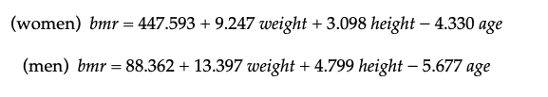
Input
Process
Output
main
Display_age()
age
Get_gender()
gender
Weigth_kg
Display_weight_kg()
Get_birthday()
birthday
Heigth_cm
Display_height_cm()
Get_weight()
Weight_lbs
bodaymassindex
Height_inches
Display_bodymass_index()
Get_inches()
metabolicrate
displayMetabolicRate()
Where can we find this information?
gender
weight
height
age
birth_str
pounds
inches
Weight (kg)
Height(cm)
Compute_age()
Kg_from_lb()
cm_from_in()
body_mass_index()
basal_metabolic_rate()
age
kg
cm
index
Given in provided code
(1 lb = 0.45359237 kg).
(1 in = 2.54 cm)

Slide 29
Algorithm
Algorithms use the same input, process, output paradigm as a program (main)
Input
pounds
Get_weight()
Kg_from_lb()
kg
“Enter your weight in U.S. pounds:"
Process
#(1 lb = 0.45359237 kg).
Kilogram = .45458237*pounds
string
⌨️
string
input()
kilogram
string
return
int
int()
int
weight
Output
return
int

Slide 30
gender
weight
height
age
Input
basal_metabolic_rate()
Algorithms use the same input, process, output paradigm as a program (main)
Output
Process
If gender
weight
Women_bmr
weight
Men_bmr
height
bmr
height
bmr
age
age
bmr
return
bmr
Output

Slide 31
gender = get_gender()
birthday = get_birthday()
weight_lbs = get_weight()
height_inches = get_inches()
age = compute_age(birthday)
weight_kg = kg_from_lb(weight_lbs)
height_cm = cm_from_in(height_inches)
bodymassindex = body_mass_index(weight_kg, height_cm)
metabolicrate = basel_metabolic_rate(gender, weight_kg, height_cm, age)
display_age(age)
display_weight_kg(weight_kg)
display_height_cm(height_cm)
display_bodymass_index(bodymassindex)
displayMetabolicRate(metabolicrate)
Now let’s connect the lines!
Input
Process
Output
main
Display_age()
age
Get_gender()
gender
Weigth_kg
Display_weight_kg()
Get_birthday()
birthday
Heigth_cm
Display_height_cm()
Get_weight()
Weight_lbs
bodaymassindex
Height_inches
Display_bodymass_index()
Get_inches()
metabolicrate
displayMetabolicRate()
gender
weight
height
age
birth_str
pounds
inches
Weight (kg)
Height(cm)
Compute_age()
Kg_from_lb()
cm_from_in()
body_mass_index()
basal_metabolic_rate()
age
kg
cm
index

Slide 32
A little more color
Input
Process
Output
main
Display_age()
age
Get_gender()
gender
Weigth_kg
Display_weight_kg()
Get_birthday()
birthday
Heigth_cm
Display_height_cm()
Get_weight()
Weight_lbs
bodaymassindex
Height_inches
Display_bodymass_index()
Get_inches()
metabolicrate
displayMetabolicRate()
gender
weight
height
age
birth_str
pounds
inches
Weight (kg)
Height(cm)
Compute_age()
Kg_from_lb()
cm_from_in()
body_mass_index()
basal_metabolic_rate()
age
kg
cm
index

Slide 33
gender = get_gender()
birthday = get_birthday()
weight_lbs = get_weight()
height_inches = get_inches()
Input
Input
Process
Output
main
Display_age()
age
Get_gender()
gender
Weigth_kg
Display_weight_kg()
Get_birthday()
birthday
Heigth_cm
Display_height_cm()
Get_weight()
Weight_lbs
bodymassindex
Height_inches
Display_bodymass_index()
Get_inches()
metabolicrate
displayMetabolicRate()
gender
weight
height
age
birth_str
pounds
inches
Weight (kg)
Height(cm)
Compute_age()
Kg_from_lb()
cm_from_in()
body_mass_index()
basal_metabolic_rate()
age
kg
cm
index

Slide 34
gender = get_gender()
birthday = get_birthday()
weight_lbs = get_weight()
height_inches = get_inches()
age = compute_age(birthday)
next
Input
Process
Output
main
Display_age()
age
Get_gender()
gender
Weigth_kg
Display_weight_kg()
Get_birthday()
birthday
Heigth_cm
Display_height_cm()
Get_weight()
Weight_lbs
bodaymassindex
Height_inches
Display_bodymass_index()
Get_inches()
metabolicrate
displayMetabolicRate()
gender
weight
height
age
birth_str
pounds
inches
Weight (kg)
Height(cm)
Compute_age()
Kg_from_lb()
cm_from_in()
body_mass_index()
basal_metabolic_rate()
age
kg
cm
index

Slide 35
gender = get_gender()
birthday = get_birthday()
weight_lbs = get_weight()
height_inches = get_inches()
age = compute_age(birthday)
weight_kg = kg_from_lb(weight_lbs)
next
Input
Process
Output
main
Display_age()
age
Get_gender()
gender
Weigth_kg
Display_weight_kg()
Get_birthday()
birthday
Heigth_cm
Display_height_cm()
Get_weight()
Weight_lbs
bodaymassindex
Height_inches
Display_bodymass_index()
Get_inches()
metabolicrate
displayMetabolicRate()
gender
weight
height
age
birth_str
pounds
inches
Weight (kg)
Height(cm)
Compute_age()
Kg_from_lb()
cm_from_in()
body_mass_index()
basal_metabolic_rate()
age
kg
cm
index

Slide 36
gender = get_gender()
birthday = get_birthday()
weight_lbs = get_weight()
height_inches = get_inches()
age = compute_age(birthday)
weight_kg = kg_from_lb(weight_lbs)
height_cm = cm_from_in(height_inches)
next
Input
Process
Output
main
Display_age()
age
Get_gender()
gender
Weigth_kg
Display_weight_kg()
Get_birthday()
birthday
Heigth_cm
Display_height_cm()
Get_weight()
Weight_lbs
bodaymassindex
Height_inches
Display_bodymass_index()
Get_inches()
metabolicrate
displayMetabolicRate()
gender
weight
height
age
birth_str
pounds
inches
Weight (kg)
Height(cm)
Compute_age()
Kg_from_lb()
cm_from_in()
body_mass_index()
basal_metabolic_rate()
age
kg
cm
index

Slide 37
gender = get_gender()
birthday = get_birthday()
weight_lbs = get_weight()
height_inches = get_inches()
age = compute_age(birthday)
weight_kg = kg_from_lb(weight_lbs)
height_cm = cm_from_in(height_inches)
bodymassindex = body_mass_index(weight_kg, height_cm)
next
Input
Process
Output
main
Display_age()
age
Get_gender()
gender
Weigth_kg
Display_weight_kg()
Get_birthday()
birthday
Heigth_cm
Display_height_cm()
Get_weight()
Weight_lbs
bodaymassindex
Height_inches
Display_bodymass_index()
Get_inches()
metabolicrate
displayMetabolicRate()
gender
weight
height
age
birth_str
pounds
inches
Weight (kg)
Height(cm)
Compute_age()
Kg_from_lb()
cm_from_in()
body_mass_index()
basal_metabolic_rate()
age
kg
cm
index

Slide 38
gender = get_gender()
birthday = get_birthday()
weight_lbs = get_weight()
height_inches = get_inches()
age = compute_age(birthday)
weight_kg = kg_from_lb(weight_lbs)
height_cm = cm_from_in(height_inches)
bodymassindex = body_mass_index(weight_kg, height_cm)
metabolicrate = basel_metabolic_rate(gender, weight_kg, height_cm, age)
next
Input
Process
Output
main
Display_age()
age
Get_gender()
gender
Weigth_kg
Display_weight_kg()
Get_birthday()
birthday
Heigth_cm
Display_height_cm()
Get_weight()
Weight_lbs
bodaymassindex
Height_inches
Display_bodymass_index()
Get_inches()
metabolicrate
displayMetabolicRate()
gender
weight
height
age
birth_str
pounds
inches
Weight (kg)
Height(cm)
Compute_age()
Kg_from_lb()
cm_from_in()
body_mass_index()
basal_metabolic_rate()
age
kg
cm
index

Slide 39
gender = get_gender()
birthday = get_birthday()
weight_lbs = get_weight()
height_inches = get_inches()
age = compute_age(birthday)
weight_kg = kg_from_lb(weight_lbs)
height_cm = cm_from_in(height_inches)
bodymassindex = body_mass_index(weight_kg, height_cm)
metabolicrate = basel_metabolic_rate(gender, weight_kg, height_cm, age)
display_age(age)
display_weight_kg(weight_kg)
display_height_cm(height_cm)
display_bodymass_index(bodymassindex)
displayMetabolicRate(metabolicrate)
next
Input
Process
Output
main
Display_age()
age
Get_gender()
gender
Weigth_kg
Display_weight_kg()
Get_birthday()
birthday
Heigth_cm
Display_height_cm()
Get_weight()
Weight_lbs
bodaymassindex
Height_inches
Display_bodymass_index()
Get_inches()
metabolicrate
displayMetabolicRate()
gender
weight
height
age
birth_str
pounds
inches
Weight (kg)
Height(cm)
Compute_age()
Kg_from_lb()
cm_from_in()
body_mass_index()
basal_metabolic_rate()
age
kg
cm
index

Slide 40
def main():
gender = get_gender()
birthday = get_birthday()
weight_lbs = get_weight()
height_inches = get_inches()
age = compute_age( birthday)
weight_kg = kg_from_lb(weight_lbs)
height_cm = cm_from_in(height_inches)
bodymassindex = body_mass_index(weight_kg, height_cm)
metabolicrate = basel_metabolic_rate(gender, weight_kg, height_cm, age)
display_age(age)
display_weight_kg(weight_kg)
display_height_cm(height_cm)
display_bodymass_index(bodymassindex)
displayMetabolicRate(metabolicrate)
Data Flow Diagram
Input
Process
Output
main
Display_age()
age
Get_gender()
gender
Weigth_kg
Display_weight_kg()
Get_birthday()
birthday
Heigth_cm
Display_height_cm()
Get_weight()
Weight_lbs
bodaymassindex
Height_inches
Display_bodymass_index()
Get_inches()
metabolicrate
displayMetabolicRate()
gender
weight
height
age
birth_str
pounds
inches
Weight (kg)
Height(cm)
Compute_age()
Kg_from_lb()
cm_from_in()
body_mass_index()
basal_metabolic_rate()
age
kg
cm
index

Slide 41
L03 Prove: Milestone 03 Prove Milestone: Writing Functions
Purpose:
Prove that you can write functions with parameters and call those functions multiple times with arguments.

Slide 42
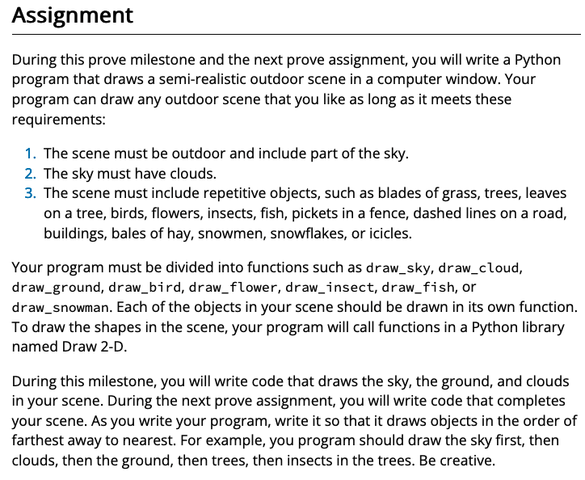
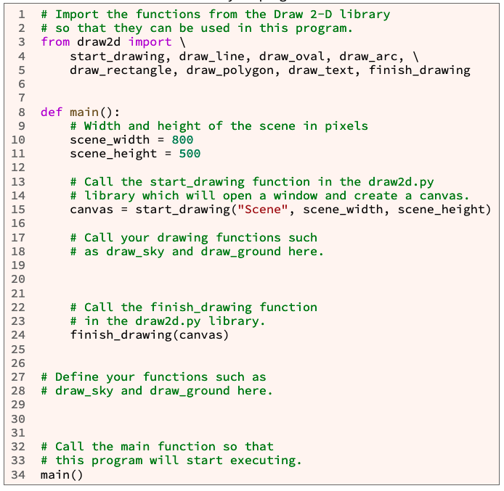
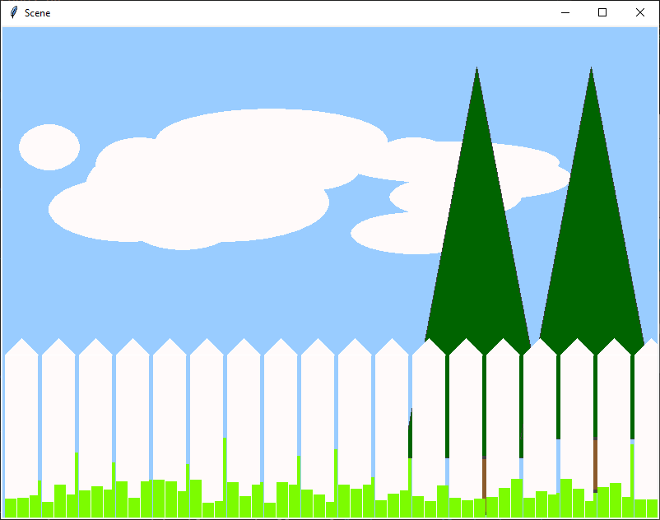
L03 Prove: Milestone 03 Prove Milestone: Writing Functions
Purpose:
Prove that you can write functions with parameters and call those functions multiple times with arguments.

Slide 43
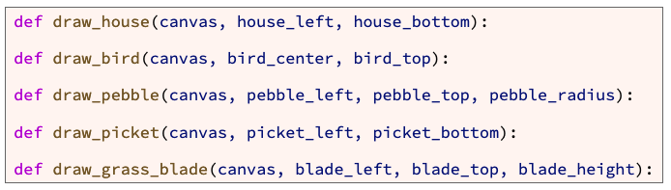
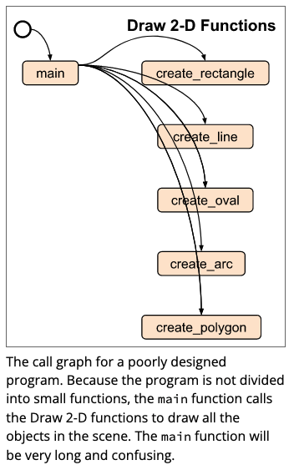
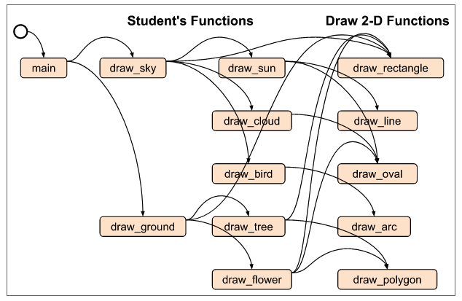
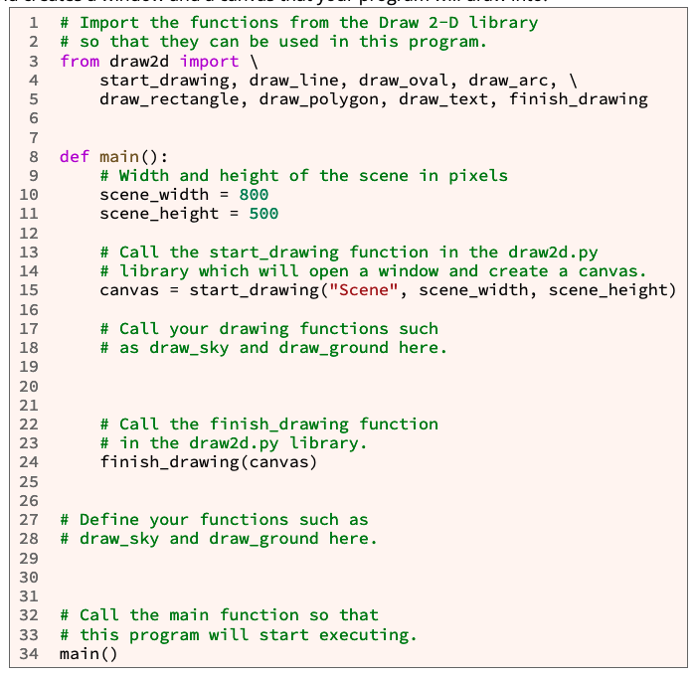
Lots of information – need to sort it out…

Slide 44
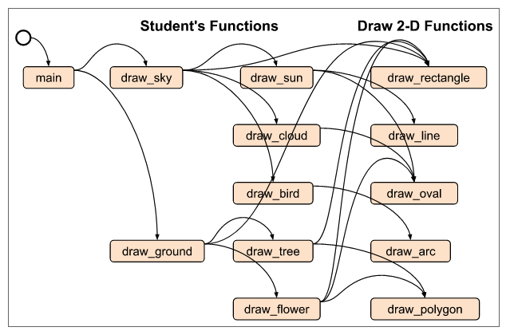
Sorting the functions
You need to provide a scene with different objects.
The assignments suggests:
Sky draw_sky
Ground draw_ground
Sun draw_sun
Clouds draw_cloud
House def draw_house(canvas, house_left, house_bottom):
Bird def draw_bird(canvas, bird_center, bird_top):
Pebble def draw_pebble(canvas, pebble_left, pebble_top, pebble_radius):
Picket (fence) def draw_picket(canvas, picket_left, picket_bottom):
Grass blades def draw_grass_blade(canvas, blade_left, blade_top, blade_height):
You can make many more.
But first let me breakdown how these are created.

Slide 45
Start with understanding the problem…
Input
Process
Output
main
Any inputs?

Slide 46
Start with understanding the problem…
Nope
Input
Process
Output
main

Slide 47
What functions do I start off with?
Nope
Input
Process
Output
main
Called from here
|<-Outside of main
Defined here

Slide 48
What is given so far in the code?
Nope
Input
Process
Output
main
“Title”
scene_width
scene_height
scene_width
canvas
scene_height
start_drawing()
finish_drawing()
canvas

Slide 49
What are the values being passed?
Nope
Input
Process
Output
main
“Title”
scene_width
scene_height
scene_width
canvas
scene_height
start_drawing()
finish_drawing()
canvas

Slide 50
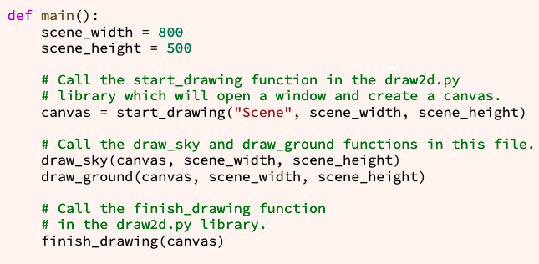
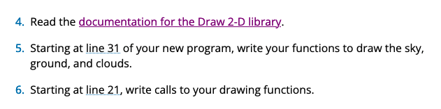
Oh, if I look I might find some more hints!
Nope
Input
Process
Output
main
“Title”
scene_width
scene_height
scene_width
canvas
scene_height
start_drawing()
finish_drawing()
canvas
canvas
canvas
scene_width
scene_width
scene_height
scene_height
https://byui-cse.github.io/cse111-course/lesson03/draw2d.html
draw_sky()
draw_ground()

Slide 51
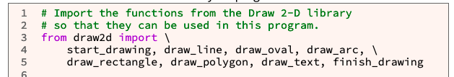
There are other functions?
Nope
Input
Process
Output
main
“Title”
scene_width
scene_height
scene_width
canvas
scene_height
start_drawing()
canvas
canvas
finish_drawing()
draw_sun()
scene_width
scene_width
canvas
draw_cloud()
scene_height
scene_height
draw_bird()
draw_sky()
draw_ground()
draw_house()
draw_tree()
draw_bird()
draw_flower()
draw_pebble()
draw_picket()
draw_grass_blade
draw2d
draw_line()
draw_arc()
draw_polygon
finish_drawing()
start_drawing()
draw_oval()
draw_rectangle
draw_text

Slide 52
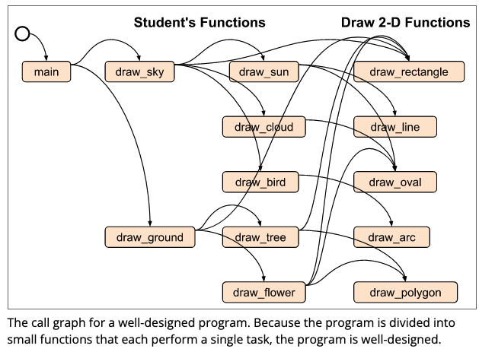
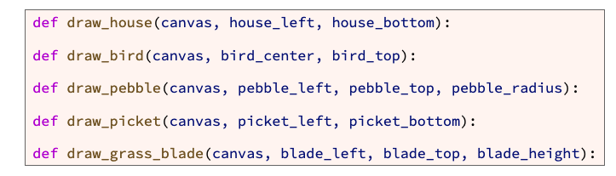
I can make functions with functions?
House
def draw_house(canvas, house_left, house_bottom):
Rectangles and Triangle (polygon)
Bird
def draw_bird(canvas, bird_center, bird_top):
Oval and 2 arcs
Pebble
def draw_pebble(canvas, pebble_left, pebble_top, pebble_radius):
Oval
Picket (fence)
def draw_picket(canvas, picket_left, picket_bottom):
Rectangle and triangle
Grass blades
def draw_grass_blade(canvas, blade_left, blade_top, blade_height):
Multiple triangles
Clouds
Multiple ovals, with no boarders. - white

Slide 53
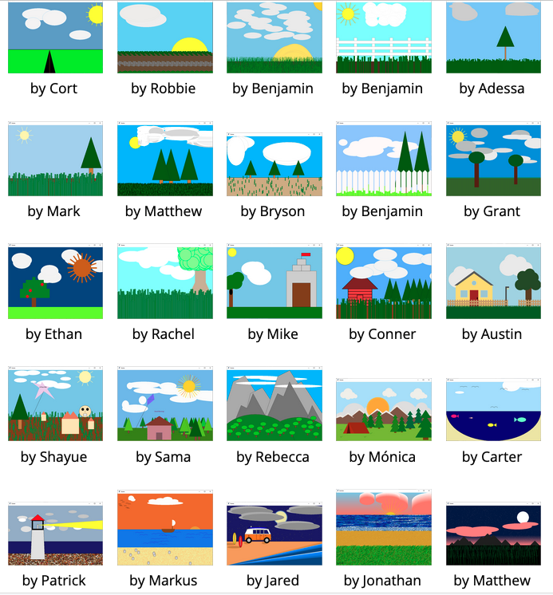
Understanding Layers, order matters
Sky (furthest)
Ground
Clouds
Trees
Fence
Grass

Slide 54
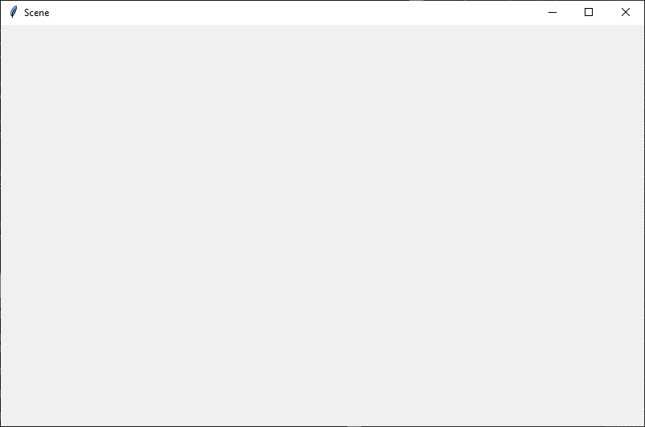
Let's talk about the graphic box.
From main, we see that the box is 800x500
(800,500)
500
(0,0)
800

Slide 55
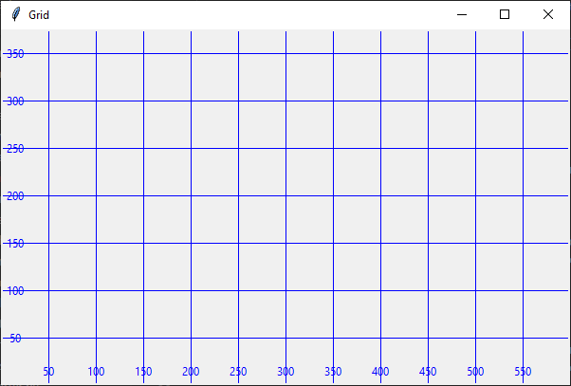
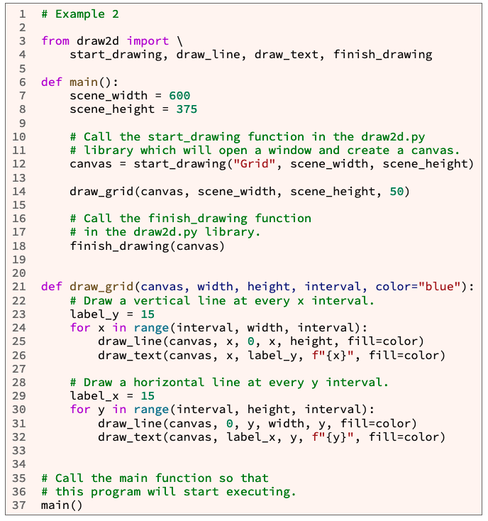
Let's talk about the graphic box.
From main, we see that the box is 800x500
(800,500)
500
(0,0)
800
https://byui-cse.github.io/cse111-course/lesson03/draw2d.html

Slide 56
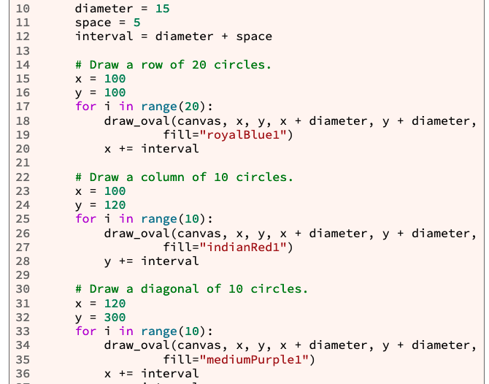
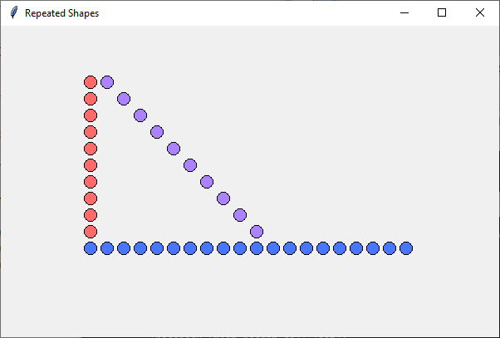
The real use of functions – multiple calls
space
diameter
Use of for loops and incrementing indexes
Good for fences
interval
(100,100)
(120, 100)
(140, 100)

Slide 57
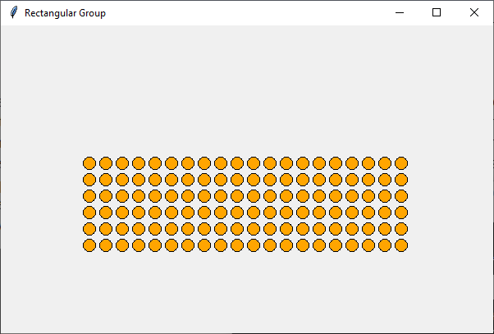
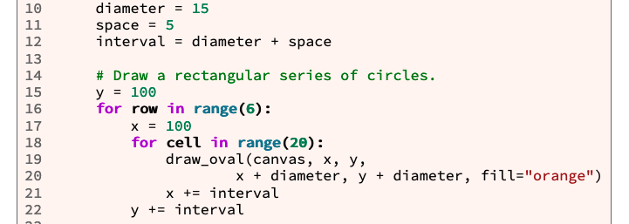
The real use of functions – multiple calls
Good for grass
(100,100)
interval
diameter
space
interval
(120, 100)
(140, 100)
(100,120)

Slide 58
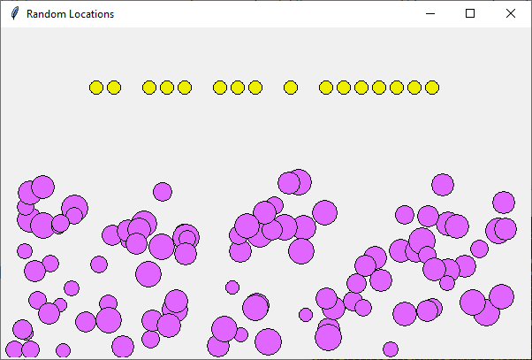
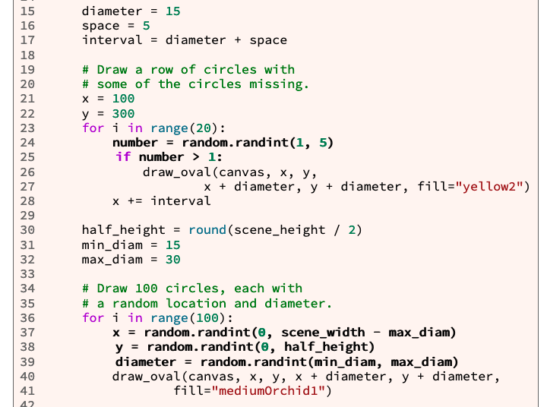
The real use of functions – multiple calls
Yellow circles are an example of skipping 1 out of 5
The purple, is example of random for both the x & y axis.
The random x should be between max_diam (not 0) and scene_x-max_diam to provide a buffer on the edges so none of the bubbles run over the edge.
Good for clouds or grass
Scene_width – diameter
Max_diameter

Slide 59
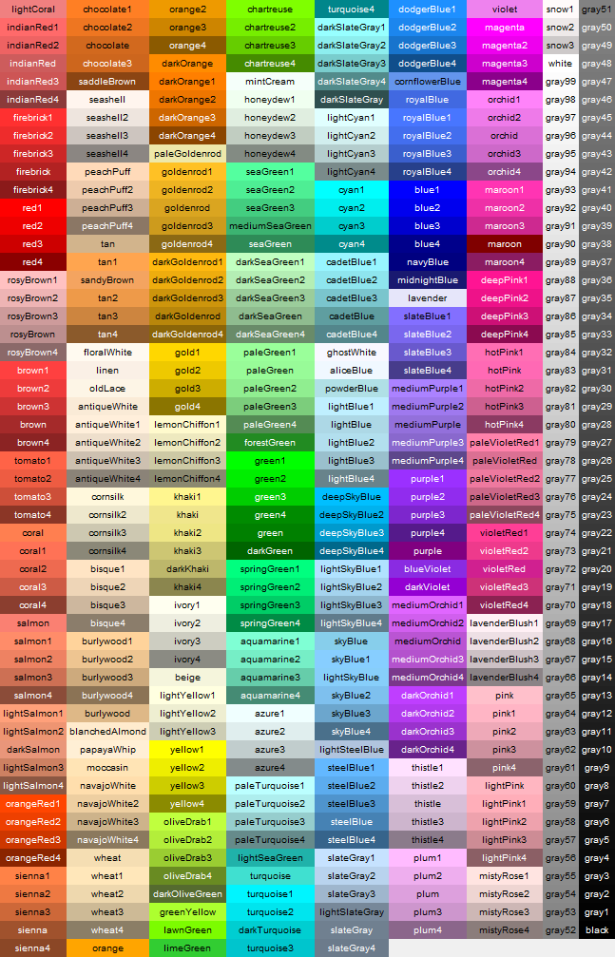
Colors

Slide 60
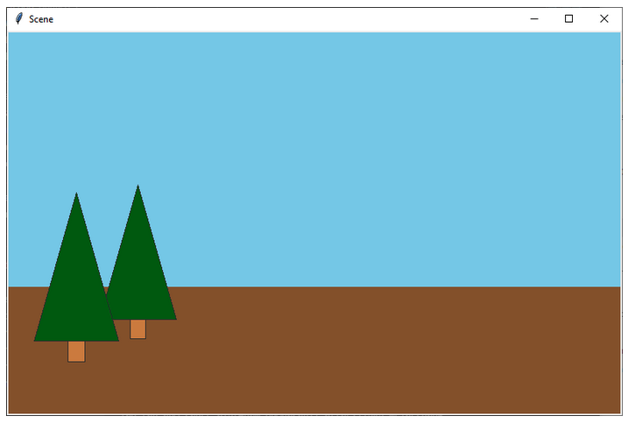
Looking at the example code
There are some aspects that already are made for you.
def draw_sky(canvas, scene_width, scene_height):
def draw_ground(canvas, scene_width, scene_height):
def draw_pine_tree(canvas, center_x, bottom, height):

Slide 61
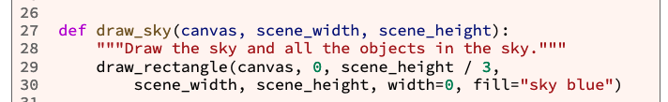
Break down of the sky
Drawing the sky
def draw_sky(canvas, scene_width, scene_height)
This takes the full scene_width and scene_height
It creates a rectangle.
From (0, height/3)
To. (width, height)
Color = “sky blue”
(800,500)
500
height/3
(0,0)
800

Slide 62
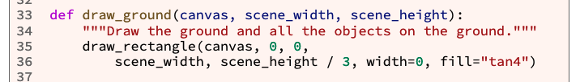
Break down of the ground
Drawing the ground
def draw_ground(canvas, scene_width, scene_height):
This also takes the full scene_width and scene_height
It creates a rectangle.
From (0, 0)
To. (width, height/3)
Color = “brown”
This function also calls pine_trees.
(800,500)
500
height/3
(0,0)
800

Slide 63
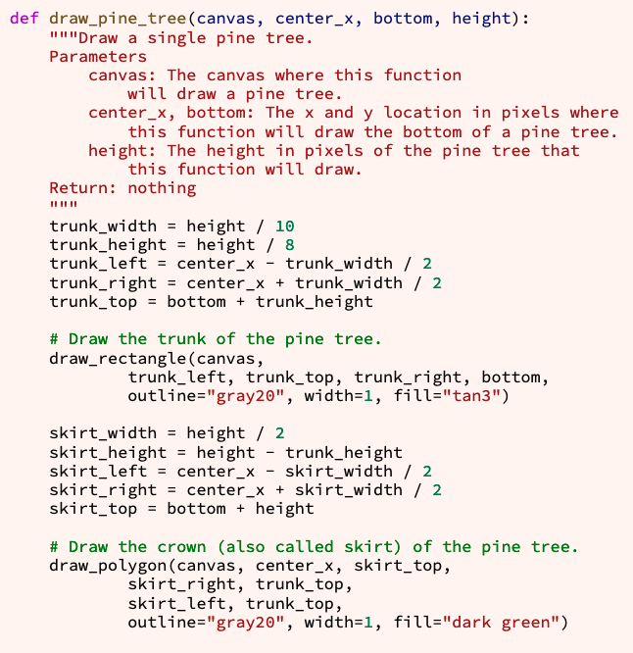
Let's talk about the pine tree.

Slide 64
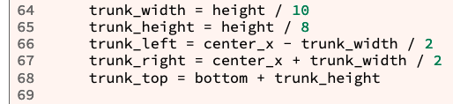
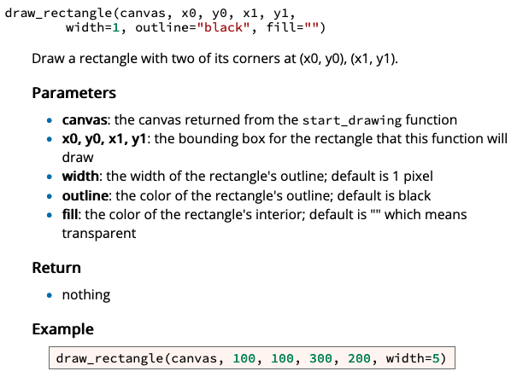

Let's talk about the pine tree.
Drawing the pine tree - truck
def draw_pine_tree(canvas, center_x, bottom, height):
This does not take canvas width and height, but instead is center
Y1=Trunk_top =
Bottom+
trunk_height
draw_rectangle(canvas, x0, y0, x1, y1, width=1, outline="black", fill="")
x1, y1
(x1, y1)
X1= trunk_left = center – trunk_width/2
Trunk_height=
Height/8
x1 = trunk_left
y1 = trunk_top
x0 = trunk_right
y0 = bottom
height
x0, y0
X0 =trunk_right=
center + trunk_width/2
(center_x, bottom) =(0,0)
(x0, y0)
Trunk_width= height/10

Slide 65
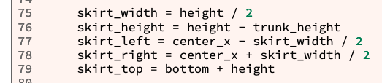


Let's talk about the pine tree.
Y0=Skirt_top =
Bottom+
skirt_height
(x0, y0)
Skirt_height = height – trunk_height
Drawing the pine tree - skirt
def draw_pine_tree(canvas, center_x, bottom, height):
This does not take canvas width and height, but instead is center
X1= Skirt_right =
center_x+ trunk_width/2
draw_polygon(canvas, x0, y0, x1, y1, x2, y2, … xn, yn, width=1, outline="black", fill="")
Skirt_width = height/2
(x0, y0)
x0 = center_x
y0 = skirt_top
x1 = skirt_right
y1 = trunk_top
x2= skirt_left,
y2 = trunk_top
(x2, y2)
(x1, y1)
Y1=Y2=Trunk_top =
Bottom+
trunk_height
X2=Skirt_left =
center_x - trunk_width/2
height
Trunk_height =
Height/8
(center_x, bottom)
(x2, y2)
(x1, y1)
(0,0)

Slide 66
L03 Ponder: Check Your Understanding
Overview
Task: Demonstrate your knowledge of writing and calling functions in Python.
Purpose: Help you reinforce your knowledge of writing and calling functions in programs.
Instructions: Complete the following quiz.
What is the Python keyword that begins a function definition?
Within a function header, for example: def basal_metabolic_rate(gender, weight, height, age): The variables that appear within parentheses are called what?
Within a function call, for example: rate = basal_metabolic_rate("F", w, h, years) The values that appear within parentheses are called what?
Given this function header: def compute(x, y, z): And this code to call that function: x = 7 result = compute(3, 2, x) Within the function compute, what value will be stored in the parameter x ?
What is wrong with the following function definition? (x3)
Within a function, what does the keyword return do? (Select all that apply.)
Which of the following is a tkinter function that can draw a line?
Which of the following is a tkinter function that can draw a circle?

