Slide 1
CSE 111 Week 01
W. Clements

Slide 2
Overview
Prepare
Setup & Review
Checkpoint
Icebreaker
Teach: Class Activity
Prove: Milestone
Ponder: Check your understanding

Slide 3
Syllabus
Found in iLearn

Slide 4

Course Organization
Each lesson is organized as follows:
Prepare:
Preparation Material—Links will be provided to videos and reading material that should be completed individually prior to moving on to the rest of the lesson.
Checkpoint 15%—A small individual programming assignment designed to help you practice the mechanics of the reading.
Teach:
Team Activity 20%—A 1-hour programming activity to be completed with 3–5 other students. Face-to-face students will complete this activity during class. Online students will arrange a synchronous video conference.
Prove:
Programming Assignment 50%—A large individual programming project. Many of these span two lessons, with a milestone deliverable coming due at the end of the first lesson.
Ponder:
Check your understanding 10%—Every other lesson will have a multiple-choice quiz to help you check your understanding of the topic.
Reflection 5%—Every other week will contain 2–3 short response questions to allow you to reflect on the things you are learning.

Slide 5
Schedule Due Dates
Week | Monday | Tuesday | Wednesday | Thursday | Friday | Saturday
1 10/26 |  |  | Prepare 01 |  | Ice Breaker 01 Ponder | 01 Milestone 02 Prepare
2 10/31 | L02 Checkpoint L03 Prepare | L02 Teach L02 Ponder | L02 Prove L03 Checkpoint | L03 Teach | L03 Ponder | L03 Milestone L04 Prepare
3 11/07 | L04 Checkpoint L05 Prepare | L04 Teach L04 Ponder | L04 Prove L05 Checkpoint | L05 Teach | L05 Ponder | L05 Milestone L06 Prepare
4 11/14 | L06 Checkpoint L07 Prepare | L06 Teach L06 Ponder | L06 Prove L07 Checkpoint | L07 Teach | L07 Ponder | L07 Milestone L08 Prepare
5 11/21 | L08 Checkpoint L09 Prepare | L08 Teach L08 Ponder | Thanksgiving Break |  |  | L08 Prove L10 Prepare
6 11/28 | L09 Checkpoint L10 Prepare | L09 Teach L09 Ponder | L09 Milestone L10 Checkpoint | L10 Teach | L10 Ponder | L10 Prove L11 Prepare
7 12/05 | L11 Checkpoint L12 Prepare | L11 Teach L11 Ponder | L11 Milestone L12 Checkpoint | L12 Teach | L12 Ponder | L12 Prove L14 Prepare
8 12/12 | L14 Prepare | L13 Ponder | L13 Prove L14 Prove

Slide 6
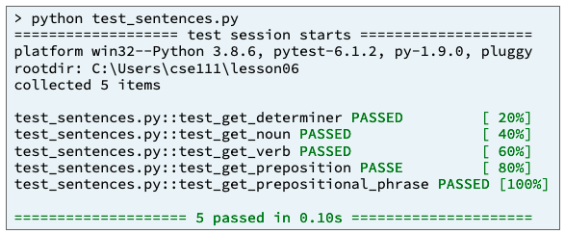
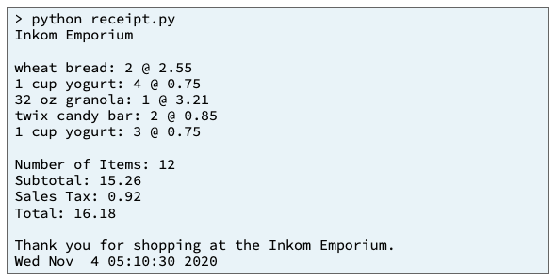
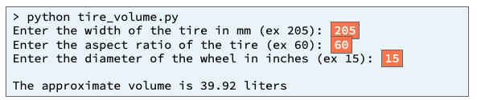
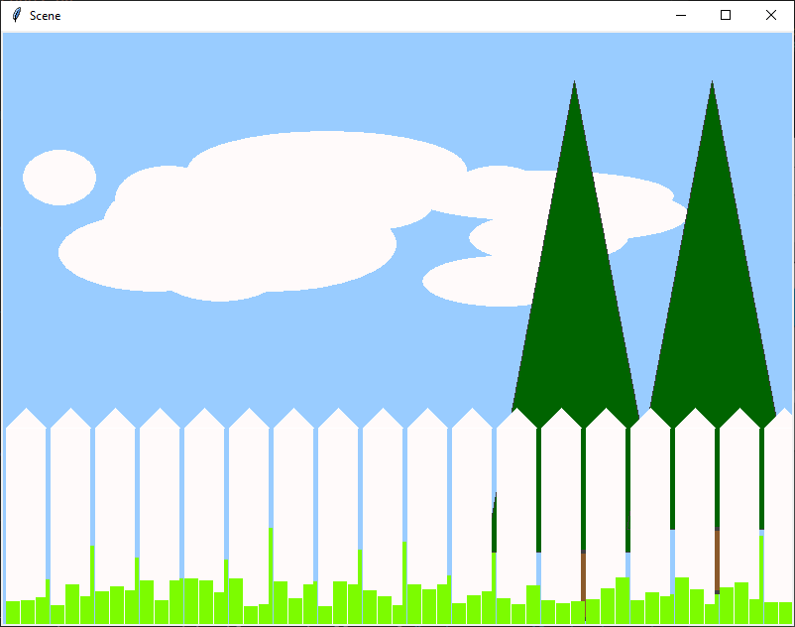
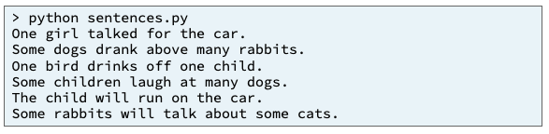
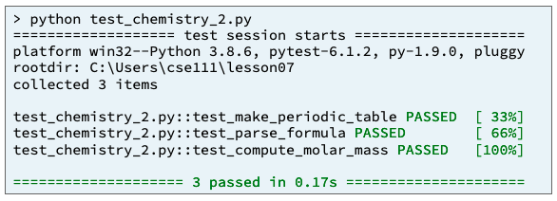
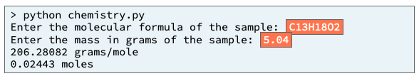
Preview of Projects
Sentence Program
Receipt Program
Inventory Program
Picture Program
Chemistry Program
Student Chosen Program
solves a real-world problem
useful in your major or hobby.
https://byui-cse.github.io/cse111-course/lesson11/prove.html

Slide 7
Prepare
Development Environment
Videos: Introducing Python, Getting Started, Configuring MS Code
Install the Python programming language version 3.10
Install a text editor named Visual Studio Code
Create a folder named cse111 where you will save your Python programs
Download and Open sample Python program to ensure your computer is ready
Install the Microsoft Python extension inside VS Code
Run the sample Python program to ensure your computer is ready

Slide 8
Review Python
Comments
User Input
Variables
Data Types
Display Results
Operators – Arithmetic, Short, Logic
If Statement
Can of Nothing
Special Characters

Slide 9
Program
Input
Magic
(equations)
(algorithms)
(etc)
Process
Output
Str prompt
Patterns:
Var = var operator var
#:operators: +, -, *, /, //, %, **
Var = var.function()
⌨️
input(<str>
Str “”
=
Var
Strings: +, .functions()
Numbers: math
float( )
If(decimal)
int( )
bool:operators (==, <, > <=, >=)
If(whole)
If boolean:
With open(“filename”) as filereference
T-statements
F-statements
T-statements
while boolean:
Var
F-statements
+
f”. {} “
:.#f
for boolean:
If(decimal)
T-statements
str( )
F-statements
str( )
“ {} “.format(var..)
If(whole)
If(str)
📺
VarStr = input(“prompt?”)
VarF = float(VarStr)
VarI = int(VarStr
def functionname (parameters,..)
return value
Str “”
print(<str>)
“ “, \t, \n

Slide 10
Program
Input
Process
Output
Storage
Sequence
(Order)
Selection
(Branching)
Iteration
Variable
(int, str, float)
Prompt User
(string)
Variable
(int, str, float)
Input
Process
Output
conditions
+
=Input(string)
==, <, <=, >, >=, !=, in
If decimal
str()
⌨️
💾
Int/float operators
If number
str()
Set values
Check condition
one choice
if boolean:
while boolean:
with open(filename) as file_variable:
+,-,*,/,//,%,**
2 choices
if boolean:
else:
for boolean:
String operators
Set values
while exitvar == True
Update exit
f”. {} “
for var in list:
+, .functions()
If decimal
float()
3+ choices
if boolean:
elif: Boolean:
else:
lists operators
“{}“.format(var..)
If number
int()
List
For
print
[.,.], [i], in, len(), range
string
print(<str>)
Storage
Sequence (Coupling/Cohesion)
Selection (Branching)
Iteration (Loops)
Def functions()
📺

Slide 11
How to program?
Understand the Problem (Data Transformation)
Have I read the entire assignment?
What are the inputs?
Looking at the examples, what test data is being used?
What are the outputs?
What is the output from the program producing?
How do inputs become outputs?
Do I understand the path of transformation that is occuring?
What programming tools (vocabulary) do I know to figure out the What and How?
From the example, do I understand the architecture of the program?
Do you know which vocabulary should be used?
And in which order?

Slide 12
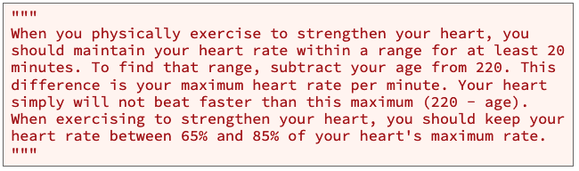
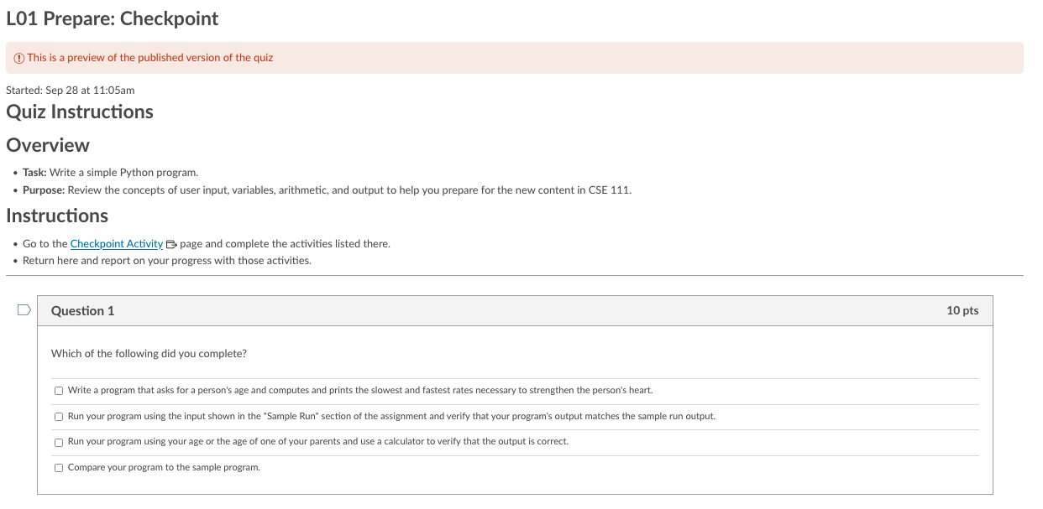

Checkpoint
Purpose: Write a Python program that gets input from a user, uses variables, performs arithmetic, and displays results for the user to see.
Pattern: Get input, process input, display output

Slide 13
Icebreaker
MS Teams
Install MS Teams or use Web
Getting into MS Teams
Only byui.edu account
Link and Acceptance
General channel
Introduction channel
Introduction channel
Introduce yourself there. Feel free to include a picture, where you're from, interesting or odd information about you, etc.
In addition to introducing yourself, briefly share a time in your life where you had to overcome a challenge—particularly one where you didn't think you could succeed (for example learning a language, taking a difficult class, starting a new job, learning a new technology, etc.) What was the challenge?
How did you overcome it?
What did you learn from that experience?
How can you apply those lessons learned to your experience in this course?
Make comments on others’ posts.

Slide 14
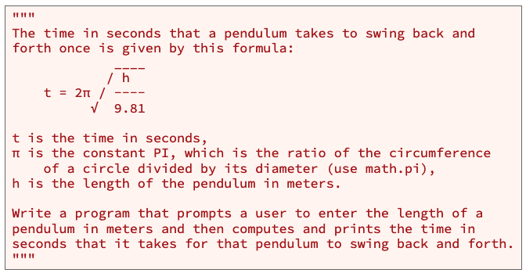
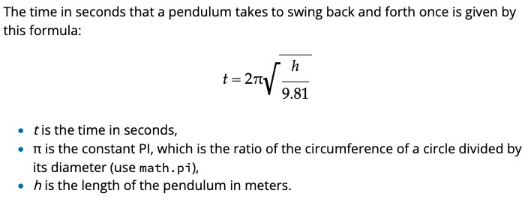

Teach: Class Activity 01 Class Activity: Review Python
Purpose: Write a Python program that gets input from a user, uses variables, performs arithmetic using the math module, and displays results for the user to see.
Problem Statement

Slide 15
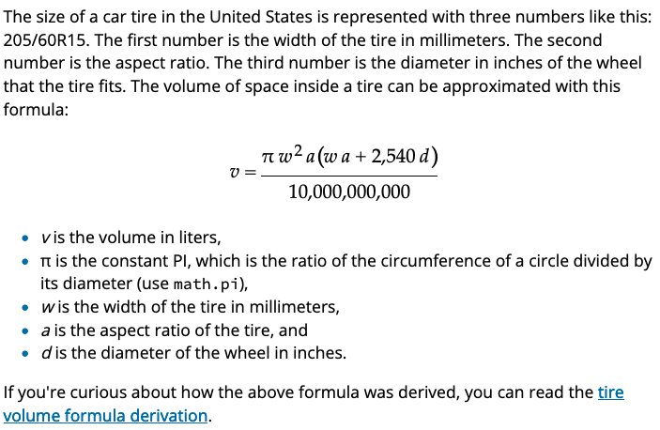
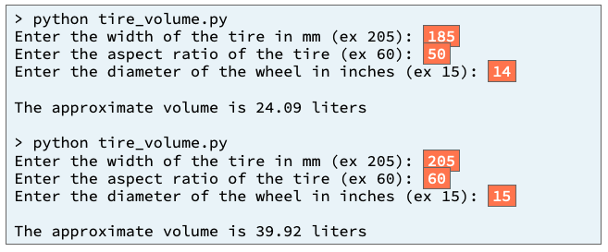
Prove: Milestone 01 Prove Milestone: Review Python
Purpose: Prove that you can write a Python program that gets input from a user, performs arithmetic, and displays results for the user to see.
Problem Statement

Slide 16
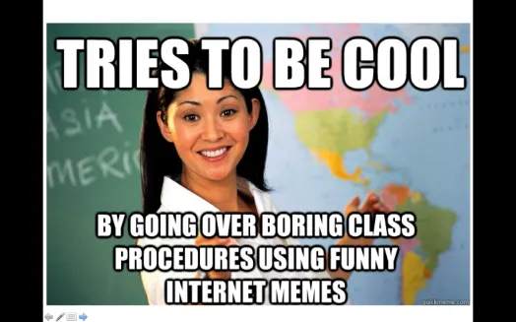
A little about me…
20+ Years experience
Masters: Univ of CO @ Denver; Bachlors; BYU-Provo; Associates: Ricks College
Worked for Northrop Grumman (TRW) for 13 years, Raytheon for 5 years
Been teaching for 8 years: Online, Hybrid, and Campus for Community Colleges of Colorado, BYU-Online, and BYU-Idaho
I love computing, I have since I saw my first for-loop fill the screen with my name.
I have moved over 20x, CA, UT, ID, MO, OK, TX, CO
Hobbies: Board Games, Family outings

Slide 17
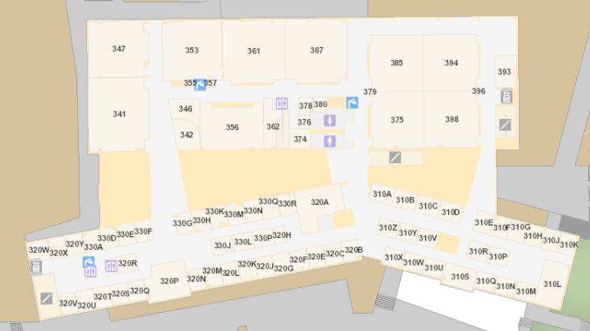
Bro Clements
William Clements
Email: ClementsW@byui.edu
Google Phone: (208) 557-4333
Office Phone: 208-496-7617
Office Rm: 320 T (Mark Twain with a T – Samuel Clemens)

Slide 18

Syllabus – Policies - Honor Code
You may work with your classmates, but all submitted work must be original.
The penalty for copying or plagiarizing of assignments might be one or more of the following: zero on an assignment, being asked to withdraw from the class, a failing grade in the class, or disciplinary action by the university.
Homework assignments are to be completed as scheduled.
Late work is generally not accepted. However, assignments may be rescheduled for a limited number of emergency situations if you discuss your situation with me before (not on and especially not after) the scheduled due date. There will be no routine extensions of due dates; be prepared to justify any requests for extensions.

Slide 19

Accessibility
BYU-Idaho is committed to providing a working and learning atmosphere that reasonably accommodates qualified persons with disabilities. Reasonable academic accommodations are reviewed for all students who have qualified documented disabilities. Services are coordinated with the student and instructor by BYU-Idaho Disability Services. If you need assistance or feel you have been unlawfully discriminated against on the basis of disability, you may seek resolution through established policy and procedures.
If you have any disability that may impair your ability to complete this course successfully, please contact Disability Services as soon as possible, preferably before the beginning of the semester, in order to ensure that you receive appropriate accommodations.
Disability Services Contact Information:
Phone: (208) 496-9210
Email: disabilityservices@byui.edu
Fax: (208) 496-5210
Website: http://www.byui.edu/disabilities/disability-services

Slide 20
Sexual Harassment
Treat everyone with respect...
BYU-Idaho is committed to promoting and maintaining a safe and respectful environment for the campus community. Sexual misconduct is against the law, contrary to the teachings of The Church of Jesus Christ of Latter-day Saints and the Honor Code, and inconsistent with the life and teachings of Jesus Christ, which we hope are embodied on our campus. The university prohibits sexual misconduct perpetrated by or against university students, university employees, participants in university programs, or visitors to its campus, whether the behavior occurs on or off campus.
Read about Title IX for more information.

Slide 21
Communication
MS Teams – CSE 110 – Fall 2020
https://teams.microsoft.com/l/team/19%3acdfe7c49064844deb8292d7aeb08e78d%40thread.tacv2/conversations?groupId=764a0054-ad62-4775-8b2a-ef470d2d7d99&tenantId=e6ac1d1f-d695-4ef1-91d4-94cddef8be11
Zoom
Zoom: Meeting ID: 943 9216 7469 Passcode: 608544

Slide 23
Program
Input
Process
Output
Storage
Sequence
(Order)
Selection
(Branching)
Iteration
Variable
(int, str, float)
Prompt User
(string)
Variable
(int, str, float)
Input
Process
Output
conditions
+
=Input(string)
==, <, <=, >, >=, !=, in
If decimal
str()
⌨️
💾
Int/float operators
If number
str()
Set values
Check condition
one choice
if boolean:
while boolean:
with open(filename) as file_variable:
+,-,*,/,//,%,**
2 choices
if boolean:
else:
for boolean:
String operators
Set values
while exitvar == True
Update exit
f”. {} “
for var in list:
+, .functions()
If decimal
float()
3+ choices
if boolean:
elif: Boolean:
else:
lists operators
“{}“.format(var..)
If number
int()
List
For
print
[.,.], [i], in, len(), range
string
print(<str>)
Storage
Sequence (Coupling/Cohesion)
Selection (Branching)
Iteration (Loops)
Def functions()
📺

Slide 24
Checkpoint
Purpose:
Problem statement
Write a Python program that gets input from a user, uses variables, performs arithmetic, and displays results for the user to see.
Pattern: Get input, process input, display output
Example Output

Slide 26
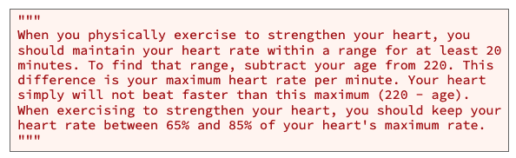

Input
Process
Output
main

Slide 27
Input
Process
Output
?
main
?

Slide 28
Input
Process
Output
main
Get_age()
?
value
?
Display_user_info()

Slide 29
Input
Process
Output
main
Get_age()
age
value
?
lower_rate
Display_user_info()
upper_rate

Slide 30
Input
Process
Output
main
Get_age()
age
value
Max_rate = 220-age
lower_rate = max_rate * .65
Display_user_info()
upper_rate = max_rate * .85

Slide 31
Input
Process
Output
main
Get_age()
age
value
Max_rate = 220-age
lower_rate = max_rate * .65
Display_user_info()
upper_rate = max_rate * .85

Slide 32
Teach: Class Activity 01 Class Activity: Review Python
Purpose: Write a Python program that gets input from a user, uses variables, performs arithmetic using the math module, and displays results for the user to see.

Slide 33
Teach: Class Activity 01 Class Activity: Review Python
Purpose: Write a Python program that gets input from a user, uses variables, performs arithmetic using the math module, and displays results for the user to see.
Problem Statement

Slide 34
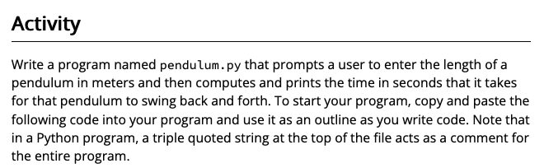
Teach: Class Activity 01 Class Activity: Review Python
Purpose: Write a Python program that gets input from a user, uses variables, performs arithmetic using the math module, and displays results for the user to see.
Problem Statement
Example Output

Slide 35
Teach: Class Activity 01 Class Activity: Review Python
Purpose: Write a Python program that gets input from a user, uses variables, performs arithmetic using the math module, and displays results for the user to see.
Problem Statement
Input
Process
Output
main

Slide 36
?
Input
Process
Output
main

Slide 37
Input
Process
Output
main
?

Slide 38
Input
Process
Output
main
?
Get_length()
value
?
Display_time()

Slide 39
Input
Process
Output
main
Get_length()
length_meters
value
?
Display_time()
Time

Slide 40
Input
Process
Output
main
Get_length()
length_meters
value
?
Display_time()
Time

Slide 41
Input
Process
Output
main
Get_length()
length_meters
value
Display_time()
Time = 2π * sqrt( length / 9.81)

Slide 42
Input
Process
Output
main
Get_length()
length_meters
value
Display_time()
Time = 2π * sqrt( length / 9.81)

Slide 43
Prove: Milestone 01 Prove Milestone: Review Python
Purpose: Prove that you can write a Python program that gets input from a user, performs arithmetic, and displays results for the user to see.
Problem Statement

Slide 44
Variables needed
V – volume = numerator/10M
Pi
w – width
a – ratio
d – diameter
Numerator = p1*(p2-p3)
Numerator_p1= pi*w2*a
Numerator_p2= w*a
Numerator_p3= 2540*d

Slide 45
Prove: Milestone 01 Prove Milestone: Review Python

Slide 46
Prove: Milestone 01 Prove Milestone: Review Python
Purpose: Prove that you can write a Python program that gets input from a user, performs arithmetic, and displays results for the user to see.
Problem Statement

Slide 47
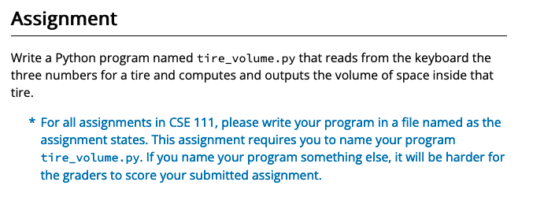
Prove: Milestone 01 Prove Milestone: Review Python
Purpose: Prove that you can write a Python program that gets input from a user, performs arithmetic, and displays results for the user to see.
Problem Statement

Slide 48
Prove: Milestone 01 Prove Milestone: Review Python
Purpose: Prove that you can write a Python program that gets input from a user, performs arithmetic, and displays results for the user to see.
Problem Statement

Slide 49
Prove: Milestone 01 Prove Milestone: Review Python
Purpose: Prove that you can write a Python program that gets input from a user, performs arithmetic, and displays results for the user to see.
Problem Statement

Slide 50
Prove: Milestone 01 Prove Milestone: Review Python
Purpose: Prove that you can write a Python program that gets input from a user, performs arithmetic, and displays results for the user to see.
Problem Statement
Input
Process
Output
main

Slide 51
Input
Process
Output
main

Slide 52
Input
Process
Output
main

Slide 53
Input
Process
Output
main

Slide 54
Input
Process
Output
main

Slide 55
Input
Process
Output
?
main
?

Slide 56
Input
Process
Output
main
Get_width()
value
?
Get_ratio()
?
value
Display_volume()
Get_diameter()
value
volume

Slide 57
Input
Process
Output
main
Get_width()
w_width
value
Get_ratio()
a_ratio
value
d_diameter
Display_volume()
Get_diameter()
value
volume

Slide 58
Input
Process
Output
main
Get_width()
w_width
?
value
Get_ratio()
a_ratio
value
d_diameter
Display_volume()
Get_diameter()
value
volume =

Slide 59
Input
Process
Output
main
Get_width()
w_width
value
Volume = Numerator/10M
Numberator = part1* (part2 + part3)
NumeratorPart1 = pi * (w**2) * a
NumeratorPart2 = w * a
NumeratorPart3 = 2540 * d
Get_ratio()
a_ratio
value
d_diameter
Display_volume()
Get_diameter()
value
volume = numerator/10M

Slide 60
Input
Process
Output
main
Get_width()
w_width
Numerator = p1*(p2-p3)
Numerator_p1= pi*w2*a
Numerator_p2= w*a
Numerator_p3= 2540*d
value
Get_ratio()
a_ratio
value
d_diameter
Display_volume()
Get_diameter()
value
volume = numerator/10M

Slide 61
Input
Process
Output
main
Get_width()
w_width
Numerator = p1*(p2-p3)
Numerator_p1= pi*w2*a
Numerator_p2= w*a
Numerator_p3= 2540*d
value
Get_ratio()
a_ratio
value
d_diameter
Display_volume()
Get_diameter()
value
volume = numerator/10M

