Slide 1
Week 07: Lists
W. Clements
CSE 111: Programming with Functions

Slide 2
Overview
Prepare: Reading, Video
Checkpoint
Teach: Class Activity
Prove: Milestone
Ponder: Check your understanding

Slide 3
Review
Everything in programming is
Input
Process
Output
Everything…
Let us test it?

Slide 4
Program
Input
Magic
(equations)
(algorithms)
(etc)
Process
Output
Str prompt
Patterns:
Var = var operator var
#:operators: +, -, *, /, //, %, **
Var = var.function()
⌨️
input(<str>
Str “”
=
Var
Strings: +, .functions()
Numbers: math
float( )
If(decimal)
int( )
bool:operators (==, <, > <=, >=)
If(whole)
If boolean:
With open(“filename”) as filereference
T-statements
F-statements
T-statements
while boolean:
Var
F-statements
+
f”. {} “
:.#f
for boolean:
If(decimal)
T-statements
str( )
F-statements
str( )
“ {} “.format(var..)
If(whole)
If(str)
📺
VarStr = input(“prompt?”)
VarF = float(VarStr)
VarI = int(VarStr
def functionname (parameters,..)
return value
Str “”
print(<str>)
“ “, \t, \n

Slide 5
Program
Input
Process
Output
Storage
Sequence
(Order)
Selection
(Branching)
Iteration
Variable
(int, str, float)
Prompt User
(string)
Variable
(int, str, float)
Input
Process
Output
conditions
+
=Input(string)
==, <, <=, >, >=, !=, in
If decimal
str()
⌨️
💾
Int/float operators
If number
str()
Set values
Check condition
one choice
if boolean:
while boolean:
with open(filename) as file_variable:
+,-,*,/,//,%,**
2 choices
if boolean:
else:
for boolean:
String operators
Set values
while exitvar == True
Update exit
f”. {} “
for var in list:
+, .functions()
If decimal
float()
3+ choices
if boolean:
elif: Boolean:
else:
lists operators
“{}“.format(var..)
If number
int()
List
For
print
[.,.], [i], in, len(), range
string
print(<str>)
Storage
Sequence (Coupling/Cohesion)
Selection (Branching)
Iteration (Loops)
Def functions()
📺

Slide 6
String Functions
Code | Result
words = "the cat IN THE hat" | the cat IN THE hat
words.capitalize() | The cat in the hat
words.title() | The Cat In The Hat
words.upper() | THE CAT IN THE HAT
words.lower() | the cat in the hat
words.count("t") | 3
words.lower().count("t") | 4
one = “Milk” two = “Bread” print(“1.”+one+” 2.”+two); | 1.Milk 2.Bread
print(“{} & {} ”.format(one, two)) | Milk & Bread
print(“{1} & {0} & {1} ”.format(one, two)) | Bread & Milk & Bread
print(f”1.{one} & 2.{two}”) | 1.Milk & 2.Bread

Slide 7
07 Prepare: Lists and Repetition
Concepts¶
Lists¶
Repetition¶
range function¶
break statement¶
while loop¶
Compound Lists¶
Values and References
Pass by Value and Pass by Reference
Rationale for Pass by Reference
Tutorials¶
Summary

Slide 8
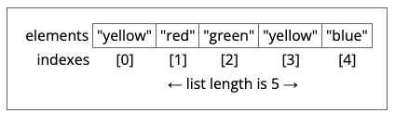
Concepts: Lists
Listvar = [ value, value, …]
List functions
Insert
Naming of Lists
Collection of items
Plural Noun
Output of a list
print (listvar[n]) #value
print (listvar) #[value, value, …]
Method | Lists Description
append() | Adds an element at the end of the list
clear() | Removes all the elements from the list
copy() | Returns a copy of the list
count() | Returns the number of elements with the specified value
extend() | Add the elements of a list (or any iterable), to the end of the current list
index() | Returns the index of the first element with the specified value
insert() | Adds an element at the specified position
pop() | Removes the element at the specified position
remove() | Removes the item with the specified value
reverse() | Reverses the order of the list
sort() | Sorts the list

Slide 9
List
Method | Lists Description
append() | Adds an element at the end of the list
clear() | Removes all the elements from the list
copy() | Returns a copy of the list
count() | Returns the number of elements with the specified value
extend() | Add the elements of a list (or any iterable), to the end of the current list
index() | Returns the index of the first element with the specified value
insert() | Adds an element at the specified position
pop() | Removes the element at the specified position
remove() | Removes the item with the specified value
reverse() | Reverses the order of the list
sort() | Sorts the list
##
.count()
.clear()
listVarName
empty
.insert(value, index
.remove(value)
index
value
.pop(index)
value
index#
.index(value)
index
listVarName
0
1
2
Len()-1
.extend()
value
value
value
value
N+1
N+2
N+2
value
[index]
value
value
value
.sort() <
.reverse()
.copy()
0
1
2
Len()-1
value
value
value
value
newList
.append(value)
value

Slide 10
How to convert types
Which ones automatically converted?
Add | int | float | string | list
int | +
float |  | +
string |  |  | +
List |  |  |  | ?

Slide 11
Concepts: Repetition
Branching
If
If…elif…else
Repetition
for var in listvar:
for i in range(10)
for i in range(len(listvar))
break – stop loop
while Boolean:
exitvar = value
while exitvar :
#update exit variable strategy

Slide 12
Let’s look at for loops
Studentnames = [“John”, “Sue”, “Frank”, “Joe”]
for name in studentnames:
print(f”{name}”)
rangeofvalues = range(5)
for value in rangeofvalues :
print(“f{name})

Slide 13
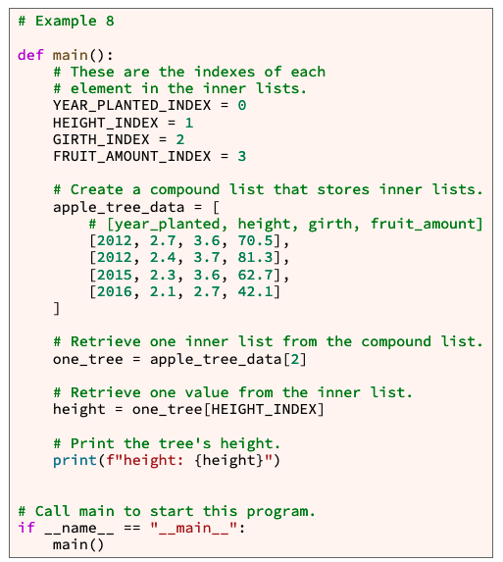
Compound Lists
A List that contains a list.
Create
apple_tree_data = [ # [year_planted, height, girth, fruit_amount] [2012, 2.7, 3.6, 70.5], [2012, 2.4, 3.7, 81.3], [2015, 2.3, 3.6, 62.7], [2016, 2.1, 2.7, 42.1] ]
Read/Access
Year = apple_tree_data[1][0]
Write
apple_tree_data[1][1] = 2013

Slide 14
Concepts: Values and References¶
The computer assigns values to variables differently based on their data type.
Native value types
Int, float, string, boolean
References
A list is a special type of variable
The variable is a reference, stores the location of the values, as there is more than one.

Slide 15
Pass by Value and Pass by Reference
The fact that the computer
copies the value of some data types (boolean, integer, float) and
copies the reference for other data types (list and other large data types) has important implications for passing arguments into functions.
Def function (parameter, …)
If it a native type, then pass-by-value.
If it is a complex type, like a list, then it is passed as a reference.
Let’s talk about program Stack and program Heap, to better understand.

Slide 16
Ok?
What about strings?
Pass-by-value or pass-by-reference
What about returning a list?
Pass-by-value/return-by-value? | Pass-by-reference/return-by-value?
Checkpoint: Pass_args.py

Slide 17
07 Checkpoint: Lists

Slide 18
07 Checkpoint: Lists
Purpose
Reinforce your understanding that
numbers are passed to a function by value and
lists are passed to a function by reference.

Slide 19
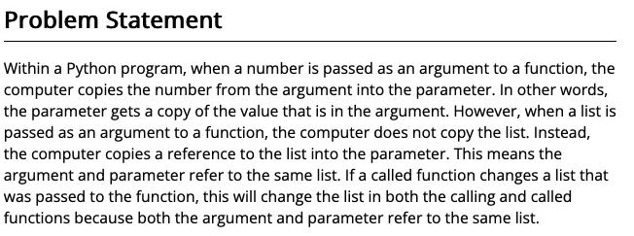
07 Checkpoint: Lists
Purpose
Reinforce your understanding that
numbers are passed to a function by value and
lists are passed to a function by reference.

Slide 20
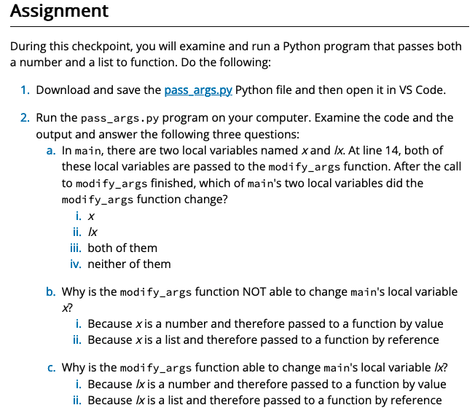
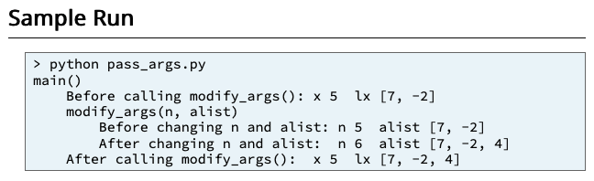
07 Checkpoint: Lists
Purpose
Reinforce your understanding that
numbers are passed to a function by value and
lists are passed to a function by reference.

Slide 21
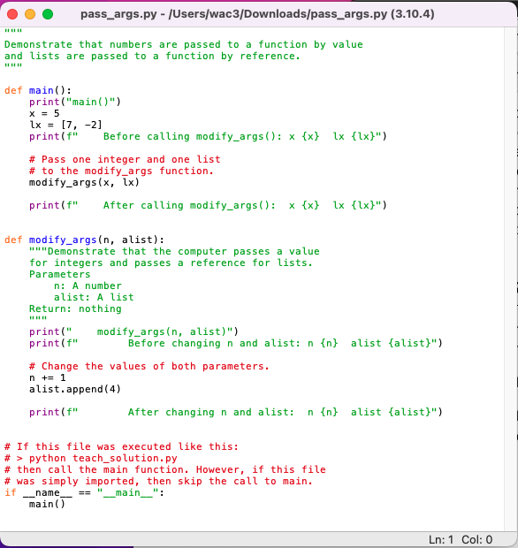
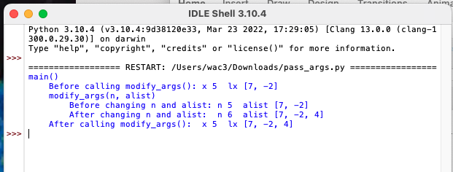

Slide 22
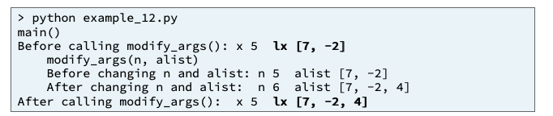
Before calling modify_args(): x 5 lx [7, -2]
Input
Process
Output
main
After calling modify_args(): x 5 lx [7, -2, 4]
x
lx = [7 , -2]
modify_args(n, alist)
lx = [7 , -2, 4]
Before changing n and alist: n 5 alist [7, -2]
x
lx
modify_args(x, lx)
After changing n and alist: n 6 alist [7, -2, 4]
modify_args(x, lx)
lx = [7 , -2, 4]

Slide 23
07 Team Activity: Lists

Slide 24
07 Team Activity: Lists
Purpose
There are a few details about writing and calling functions in Python that, if you understand, will help you be a more effective programmer.
These details include default parameter values and pass by reference.
As a team during this activity, you will write and call a function that demonstrates both default parameter values and pass by reference.

Slide 25
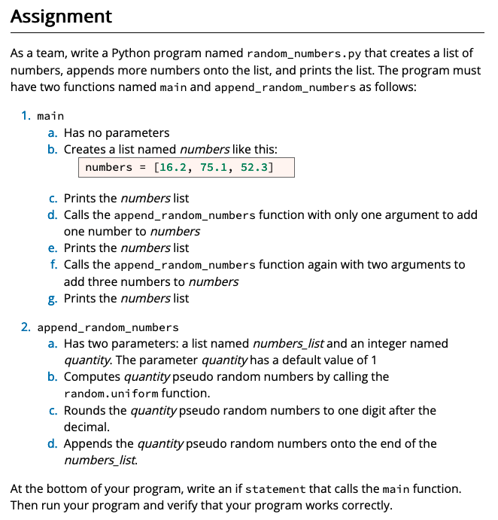
07 Team Activity: Lists
Purpose
There are a few details about writing and calling functions in Python that, if you understand, will help you be a more effective programmer.
These details include default parameter values and pass by reference.
As a team during this activity, you will write and call a function that demonstrates both default parameter values and pass by reference.

Slide 26
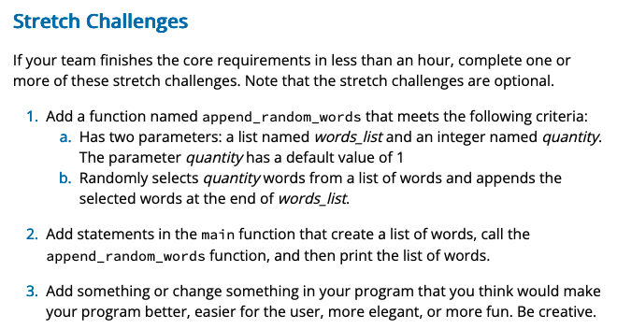
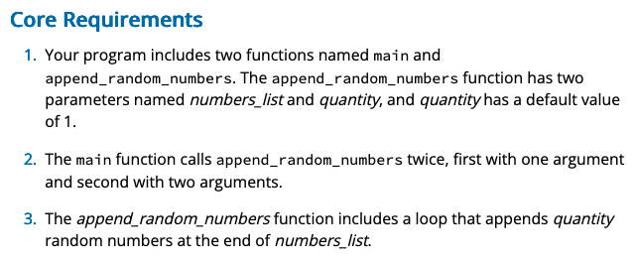
07 Team Activity: Lists

Slide 27
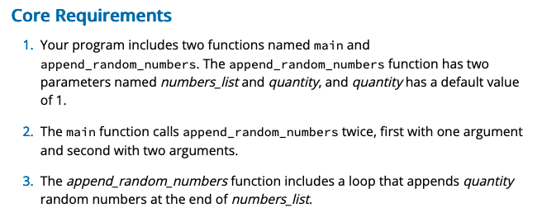
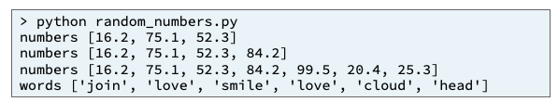
Input
Process
Output
main
numbers = [16.2, 75.1, 52.3]
printnumbers()
Numbers_list
quantity
append_random_numbers()
Random
Random_number
Numbers_list.append(random_number)
uniform

Slide 28
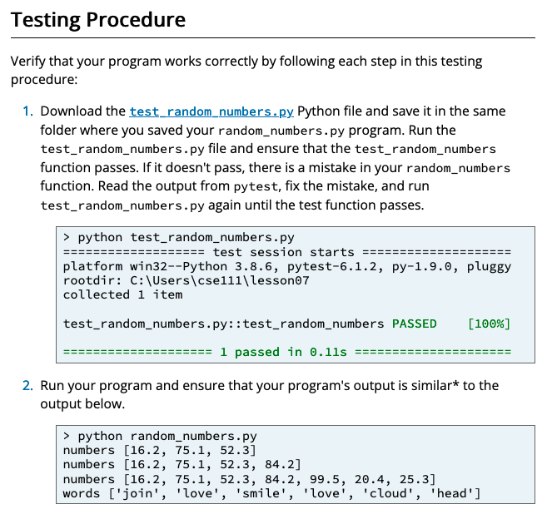

Slide 29
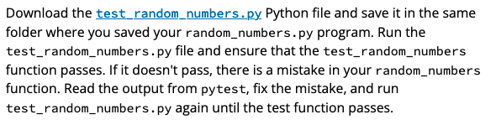
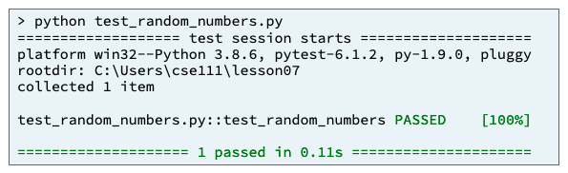
Input
Process
Output
test_random_numbers.py
pytest.main(["-v", "--tb=line", "-rN", __file__])
test_append_random_numbers()
random_numbers.py.py
Numbers_list
quantity
append_random_numbers()

Slide 31
07 Prove Milestone: Lists
https://byui-cse.github.io/cse111-course/lesson07/prove.html

Slide 32
07 Prove Milestone: Lists
Purpose
Prove that you can write a Python program that creates and uses a compound list.
https://byui-cse.github.io/cse111-course/lesson07/prove.html

Slide 33
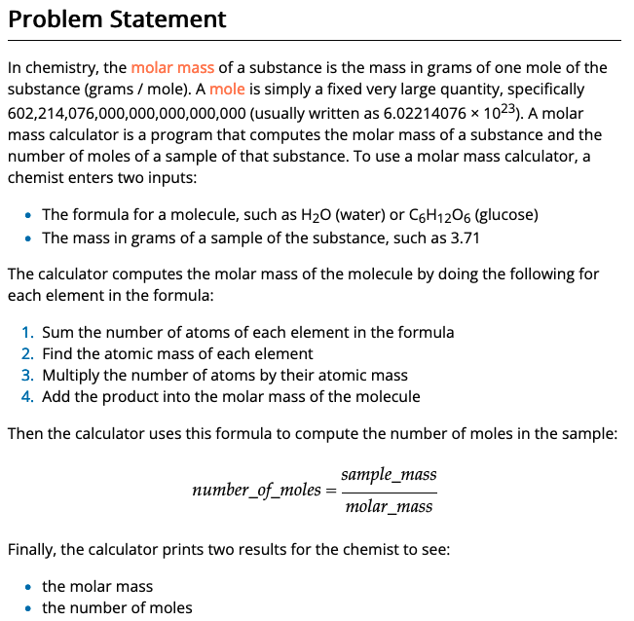
07 Prove Milestone: Lists
Purpose
Prove that you can write a Python program that creates and uses a compound list.
https://byui-cse.github.io/cse111-course/lesson07/prove.html

Slide 34
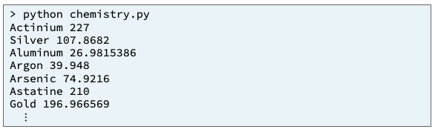
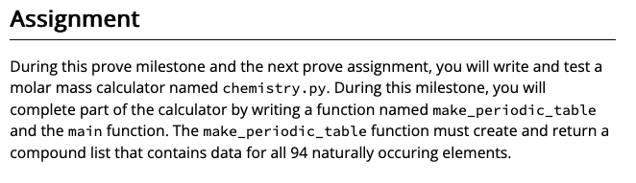
Input
Process
Output
main

Slide 35
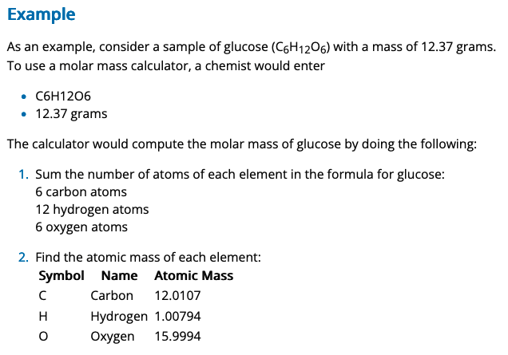
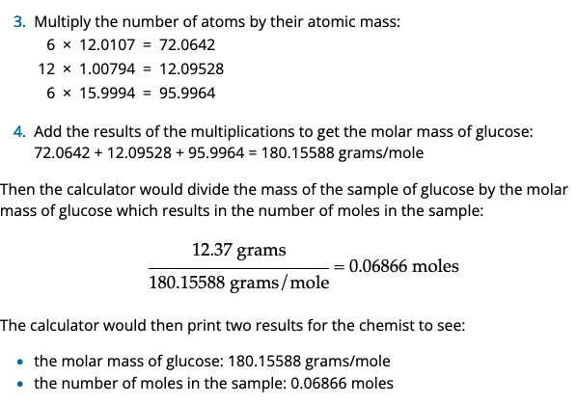

Slide 36
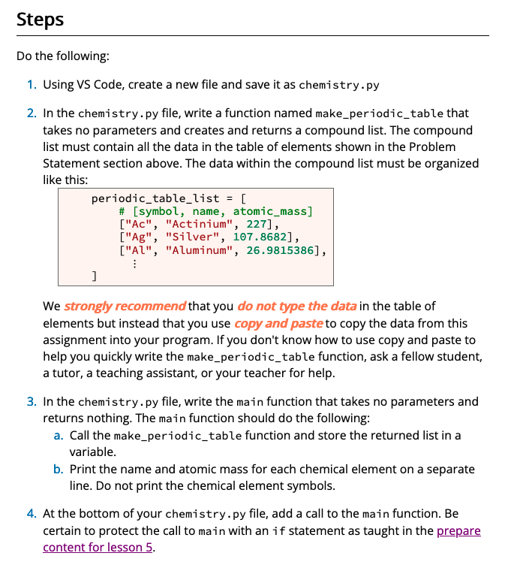
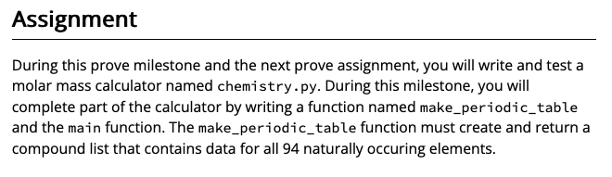

Slide 37
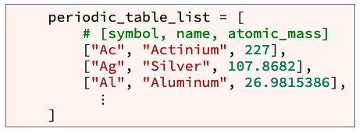
Input
Process
Output
chemistry.py
main
Symbol
name
Atomic_mass
Returned_list
make_periodic_table()
periodic_table_list = [ # [symbol, name, atomic_mass]
print_element()

Slide 38
Input
Process
Output
chemistry.py
main
Periodic table
Symbol
name
Atomic_mass
make_periodic_table()
periodic_table_list = [ # [symbol, name, atomic_mass]
print_element()
if __name__ == "__main__":
main()

Slide 39
Input
Process
Output
chemistry.py
if __name__ == "__main__":
main()
Periodic table
Symbol
name
Atomic_mass
make_periodic_table()
periodic_table_list = [ # [symbol, name, atomic_mass]
print_element()

Slide 40
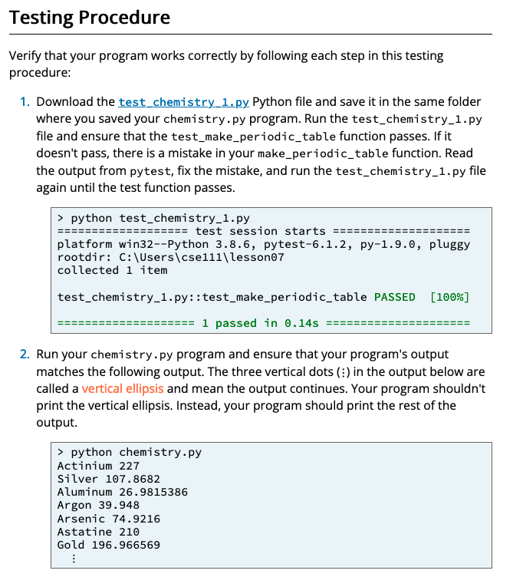

Slide 41
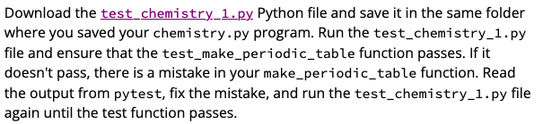
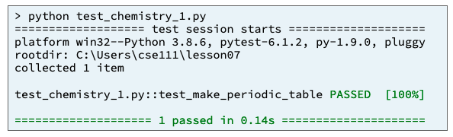
Input
Process
Output
test_random_numbers.py
pytest.main(["-v", "--tb=line", "-rN", __file__])
test_make_periodic_table()
chemistry.py
make_periodic_table()

