Slide 2
Week 13 - Student Chosen Program
W. Clements
CSE 111: Programming with Functions

Slide 3
Overview
Prepare: None
Checkpoint None
Teach: Class Activity Note
Prove: Student Chosen Project
Ponder: Check your understanding

Slide 4
13 Prove Milestone: Student Chosen Program

Slide 5
Lesson 13 Rubric
Time—50%:
Did you spend at least six hours on your Python program or test functions during the current lesson?
Description—10%: I
s the description of your work for this lesson complete and easily understandable?
Your description should include the following: A list of the function names in your program.
A list of the test function names in your test code.
A list of the documentation that you read, the videos that you watched, and the coding experiments that you tried.
A description or list of the work that you finished on your program.
Python program file—25%:
Upload your Python program. Your teacher will evaluate it according to these criteria:
Your program is divided into functions and each function performs one task only.
Your program effectively uses existing Python modules such as math, random, requests, pandas, and tkinter.
Your program performs a significant real-world task.
Python test file—15%:
Upload your Python test file.
Your teacher will evaluate it according to these criteria:
Each testable program function is covered (tested) by one test function. (Some functions, especially main and those that create GUIs are difficult to test and don't need to have a corresponding test function.)
Each test function completely exercises (tests) its corresponding program function. In other words, the test function calls the program function multiple times with different arguments, including unusual or unexpected values.

Slide 6
14 Prepare: Conclusion
Congratulations!
You successfully made it to the final lesson of CSE 111.

Slide 7
14 Prepare: Conclusion
During this course you learned to write programs organized with functions to solve significant problems in a variety of domains, which was the major outcome of this course. In addition, you learned to do the following:
Research modules, objects, and functions written by others and use them in your programs.
Write programs that can detect and recover from invalid conditions (exceptions).
Follow good practices in designing, writing, and debugging functions, including
writing each function so that it performs one task only and
writing test functions to verify that program functions are correct.
Each of these skills will transfer to other programming languages that you learn in your future.
Also, researching modules, objects, and functions written by others gave you important practice in lifelong learning.
Even though the work of this course may have been challenging at times, you showed skill in thinking analytically, breaking down problems into manageable pieces, working with others, and debugging abstract problems.
These are skills that will transfer to any field of study or career path that you choose.

Slide 8
14 Prepare: Conclusion
The final two tasks in CSE 111 are:
Write a personal reflection document.
Complete a one-question survey.
Both of these two final tasks are in I-Learn. Please find them in the Lesson 14 module and complete both of them. May you never confuse Python
tuples (,),
lists [],
sets {}, and
dictionaries {:}, and
In all seriousness, may the Lord bless all your righteous endeavors!!!

Slide 9
Review

Slide 10
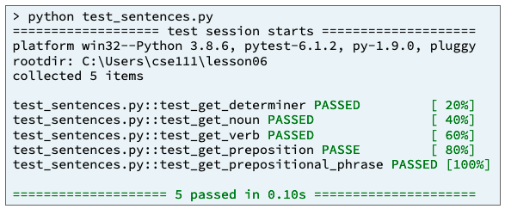
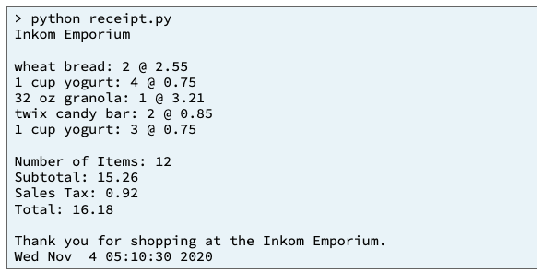
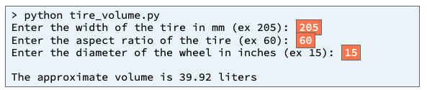
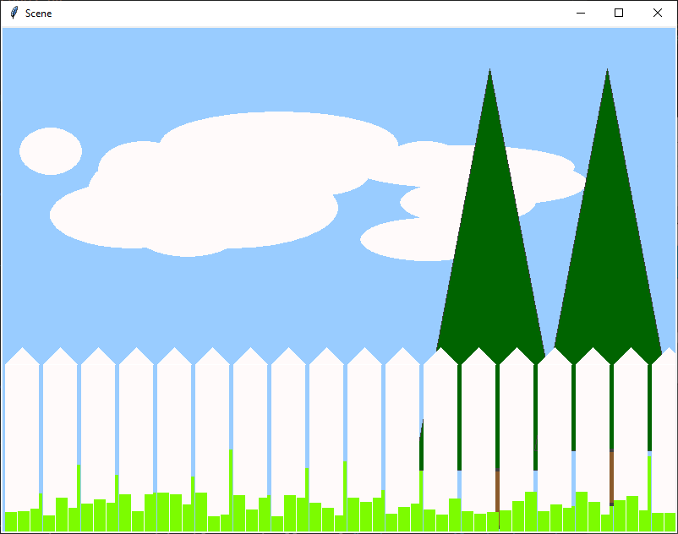
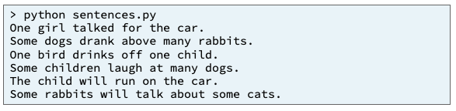
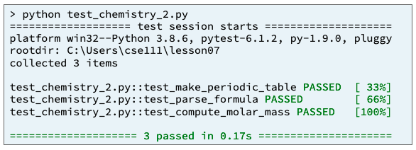
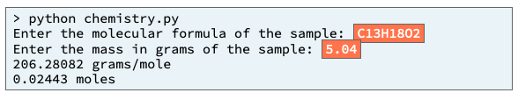
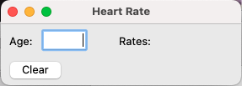
Preview of Projects
Sentence Program
Receipt Program
Inventory Program
Picture Program
Chemistry Program
Student Chosen Program
solves a real-world problem
useful in your major or hobby.
https://byui-cse.github.io/cse111-course/lesson11/prove.html

Slide 11
Input
Process
Output
main

Slide 12
Program
Input
Magic
(equations)
(algorithms)
(etc)
Process
Output
Str prompt
Patterns:
Var = var operator var
#:operators: +, -, *, /, //, %, **
Var = var.function()
⌨️
input(<str>
Str “”
=
Var
Strings: +, .functions()
Numbers: math
float( )
If(decimal)
int( )
bool:operators (==, <, > <=, >=)
If(whole)
If boolean:
With open(“filename”) as filereference
T-statements
F-statements
T-statements
while boolean:
Var
F-statements
+
f”. {} “
:.#f
for boolean:
If(decimal)
T-statements
str( )
F-statements
str( )
“ {} “.format(var..)
If(whole)
If(str)
📺
VarStr = input(“prompt?”)
VarF = float(VarStr)
VarI = int(VarStr
def functionname (parameters,..)
return value
Str “”
print(<str>)
“ “, \t, \n

Slide 13
Program
Input
Process
Output
Storage
Sequence
(Order)
Selection
(Branching)
Iteration
Variable
(int, str, float)
Prompt User
(string)
Variable
(int, str, float)
Input
Process
Output
conditions
+
=Input(string)
==, <, <=, >, >=, !=, in
If decimal
str()
⌨️
💾
Int/float operators
If number
str()
Set values
Check condition
one choice
if boolean:
while boolean:
with open(filename) as file_variable:
+,-,*,/,//,%,**
2 choices
if boolean:
else:
for boolean:
String operators
Set values
while exitvar == True
Update exit
f”. {} “
for var in list:
+, .functions()
If decimal
float()
3+ choices
if boolean:
elif: Boolean:
else:
lists operators
“{}“.format(var..)
If number
int()
List
For
print
[.,.], [i], in, len(), range
string
print(<str>)
Storage
Sequence (Coupling/Cohesion)
Selection (Branching)
Iteration (Loops)
Def functions()
📺

Slide 14
Review String Functions
Code | Result
words = "the cat IN THE hat" | the cat IN THE hat
words.capitalize() | The cat in the hat
words.title() | The Cat In The Hat
words.upper() | THE CAT IN THE HAT
words.lower() | the cat in the hat
words.count("t") | 3
words.lower().count("t") | 4
one = “Milk” two = “Bread” print(“1.”+one+” 2.”+two); | 1.Milk 2.Bread
print(“{} & {} ”.format(one, two)) | Milk & Bread
print(“{1} & {0} & {1} ”.format(one, two)) | Bread & Milk & Bread
print(f”1.{one} & 2.{two}”) | 1.Milk & 2.Bread

Slide 15
Review List
[index]
0
1
2
Len()-1
N+1
N+2
N+2
value
value
value
value
value
value
value
listVarName
.append(value)
value
Method | Lists Description
append() | Adds an element at the end of the list
clear() | Removes all the elements from the list
copy() | Returns a copy of the list
count() | Returns the number of elements with the specified value
extend() | Add the elements of a list (or any iterable), to the end of the current list
index() | Returns the index of the first element with the specified value
insert() | Adds an element at the specified position
pop() | Removes the element at the specified position
remove() | Removes the item with the specified value
reverse() | Reverses the order of the list
sort() | Sorts the list
empty
.clear()
##
.count()
[v1,v2,..]
.extend(list)
index
.index(value)
.insert(index, value)
index
value
.remove(value)
value
value
.pop(index)
.reverse()
.sort() <
.copy()
0
1
2
Len()-1
value
value
value
value
newList

Slide 16
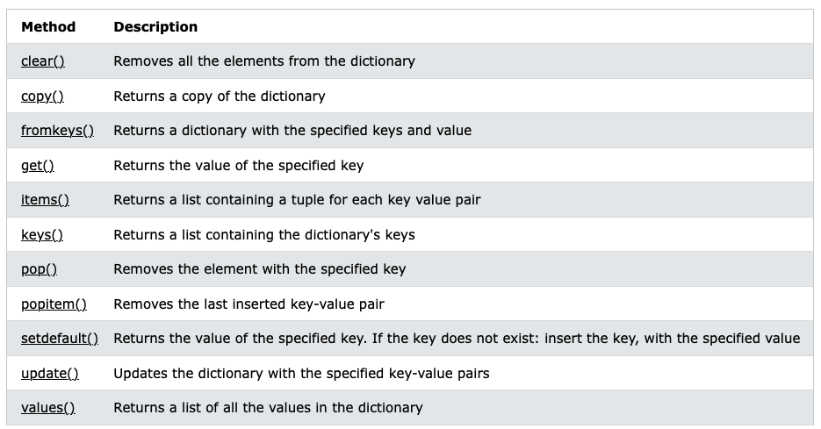
.copy()
key1
key2
Key3
Len()-1
Dictionary
value
newdictVar
value
value
value
[key1, key3, key n]
.fromkeys(listkeys, values)
key1
Key3
Len()-1
value
value
value
[key]
dictionaryVar
key1
key2
Key3
Len()-1
value
value
value
value
.clear()
empty
value
.get(key)
[(key,value), (), ()..]
.items()
[key1, key2, …]
.keys()
value
.pop()
value
.popitem(key)
value
.setdefault(key, defaultvalue)
.update({(key1, newvalue),…})
[value, value, …]
.values()

Slide 17
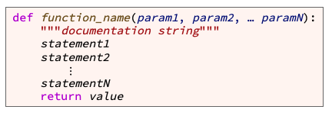
Writing Functions
variable
value
the function name
Start with letter/_, can have a-Z0-9
meaningful
keyword def (which is an abbreviation for "define")
the parameter list (with the parameters separated by commas)
Values are passed in an assigned to variable names.
header or signature
a result value is from a function
Function body

Slide 18
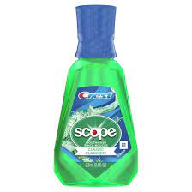
Summary
Life of a variable
C: Where is it created?
R: When is it updated?
U: When is it read?
D: When is it deleted?
Declaring
Calling
CRUD
Default Parameters
Keep it simple
def function_name(param1, param2, … paramN):
"""documentation string"""
statement1
statement2
⋮
statementN
return value
variable_name = function_name(arg1, arg2, … argN)
def arc_length(radius, degrees=360):
length = arc_length(3.5)

Slide 19
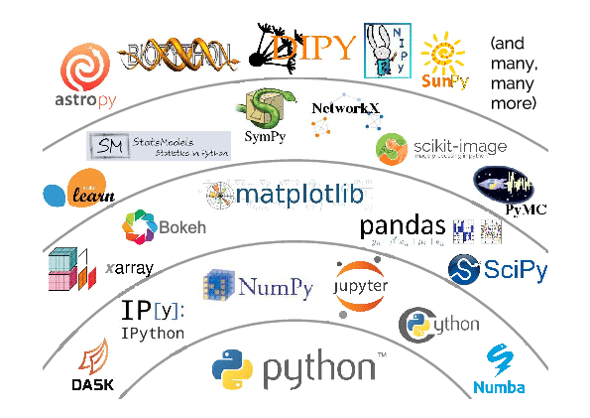
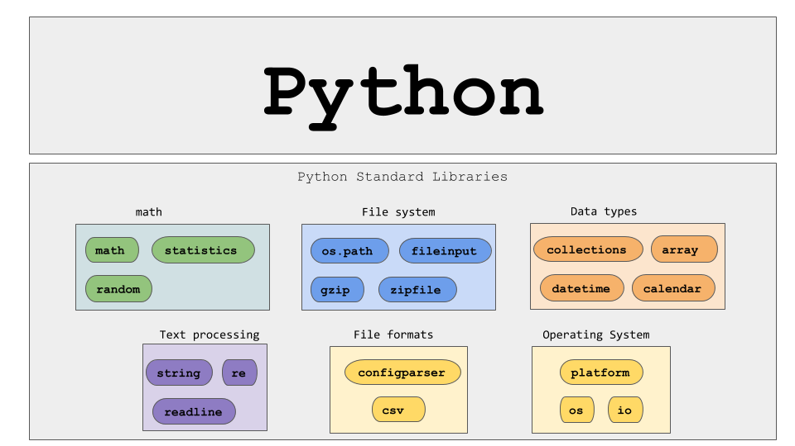
Types of Functions
Main
User-defined functions
Built-in
Standard library Functions
Third-party Functions
User-defined functions
Second-Party Functions
(Project Library)
Second-Party Functions
(Company Library)
Third-Party Functions
Standard Library Functions
Python built-in functions

Slide 20




Four ways to pass parameters
Output-only
Input-only
Processing
Update
display(
int value)
getvaluetwo():
return 2
isLeap(year):
return !year%4
update(list):
list.append(3)
Value

Slide 21
Input
Process
Output
main
Input-only
Processing
Update
Output-only
getvaluetwo():
return 2
isLeap(year):
return !year%4
update(list):
list.append(3)
display(
int value)
Value

Slide 22
Example - Sorting a Compound List
https://byui-cse.github.io/cse111-course/lesson11/prepare.html
Additional Documentation
If you wish to learn even more details about functional programming, the following articles contain reference documentation for functional programming in Python.
Python map function
Python filter function
Python reduce function
Python functools module
A thorough tutorial about lambda functions
Remember function types
Summation
Map
Filter

Slide 23
Patterns
Filter Pattern
Cumulative/Reduce
Sum/Product/Checksum
Unfiltered_list = [1,2,3,4,5,6,7,8,9,10]
Filtered_list = [] #starts off empty
Tally_variable = 0
for value in unfiltered_list
for value in unfiltered_list
#update tally_variable
Tally_variable += 1
#if filter criteria
If value % 2:
Filtered_list.append(value)
# filtered_list now contains [1,3,5,7,9]
Print(filtered_list)
#tally_variable has cumulative data
Print(tally_variable)

Slide 24
Map/Transform
This can be in a dictionary or a list.
Input_list = [1,2,3,4,5,6,7,8,9,10]
Output_list = [] #starts off empty
for input_value in Input_list
Output_value = calc (input_value)
Output_list. Append(output_value)
# Output_list now contains [2, 4, 6, 8,…]
Print(Output_list )

Slide 25
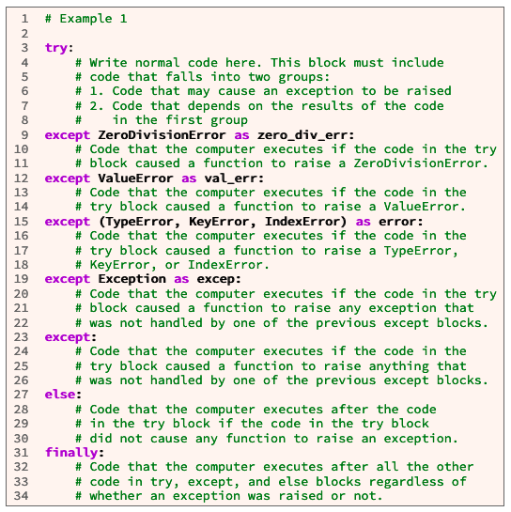
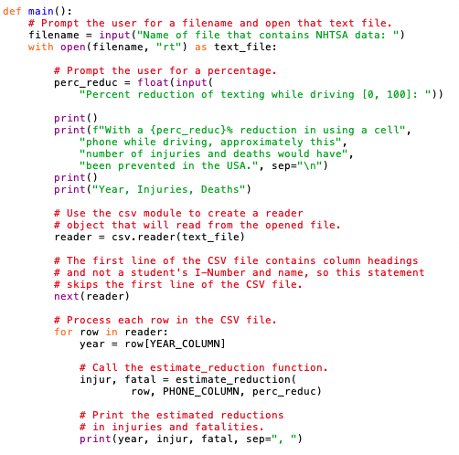
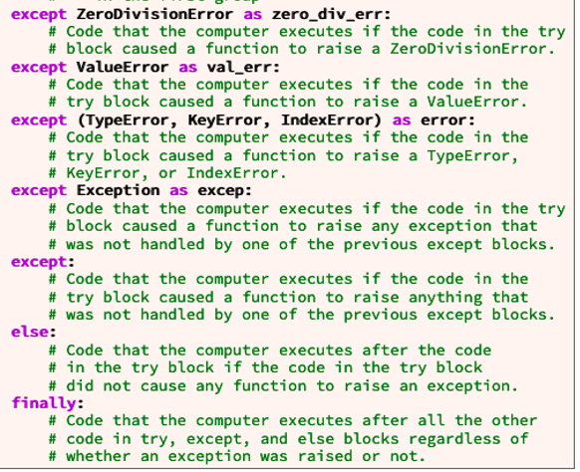
try:
# Write normal code here. This block must include
# code that falls into two groups:
# 1. Code that may cause an exception to be raised
# 2. Code that depends on the results from the code
# in the first group
except ZeroDivisionError as ex:
# Code that the computer executes if the code in the
# try block caused a ZeroDivisionError to be raised.
except ValueError as ex:
# Code that the computer executes if the code in
# the try block caused a ValueError to be raised.
except (TypeError, KeyError, NameError) as ex:
# Code that the computer executes if the code in the try
# block raised a TypeError, KeyError, or NameError.
except Exception as ex:
# Code that the computer executes if the code in the
# try block caused any exception to be raised that was
# not handled by one of the previous except blocks.
except:
# Code that the computer executes if the code in the
# try block caused anything to be raised that was
# not handled by one of the previous except blocks.
else:
# Code that the computer executes after the code
# in the try block if the code in the try block
# did not raise any exceptions.
finally:
# Code that is executed after all the other code in
# try, except, and else blocks regardless of whether # an exception was raised or not.
Try
catch

Slide 26
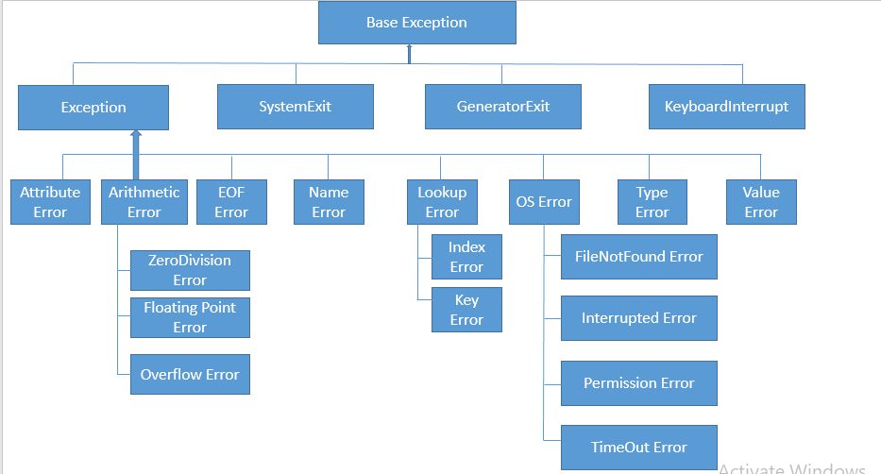
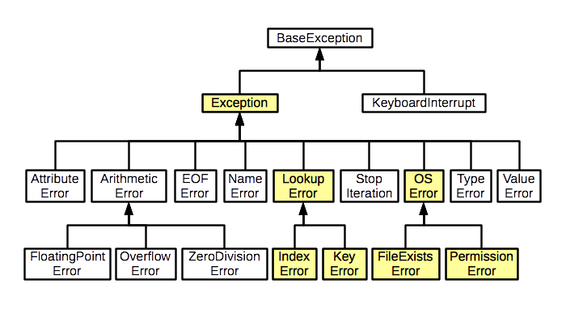
Error Type

Slide 27
Input Function
def askUserforInteger():
flag = True
while (flag):
try:
str_value = input(“Enter Whole Number”)
value = int(str_value)
except ValueError:
print(“Please enter an Whole Number, i.e. 10”)
else:
flag = False
return value

Slide 28
Input Function
def askUserforFloat():
flag = True
while (flag):
try:
str_value = input(“Enter Number”)
value = float(str_value)
except ValueError:
print(“Please enter an float”)
else:
flag = False
return value

Slide 29
Input Function
def askUserforFloat():
flag = True
while (flag):
try:
str_value = input(“Enter a Decimal Number”)
if str_value.isdecimal():
raise ValueError
value = float(str_value)
except ValueError:
print(“Please enter a Decimal Number (#.#), i.e.: 1.5”)
else:
flag = False
return value

Slide 30
Input Function
def askUserforString():
flag = True
while (flag):
try:
str_value = input(“Enter a Word”)
if str_value.isalpha():
raise ValueError
except ValueError:
print(“Please enter word, not a number”)
else:
flag = False
return value

Slide 31
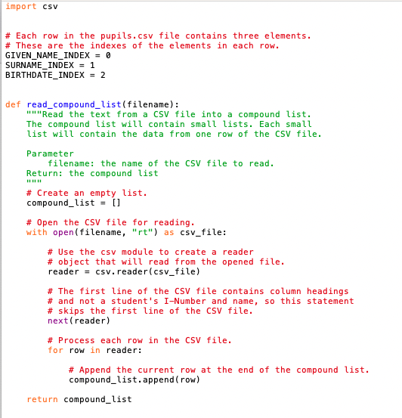

Slide 32
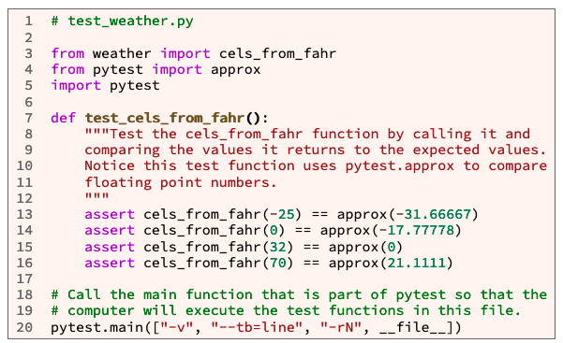
The pytest Module¶
third-party Python module
pytest was not already installed
you will need to install pytest
Pytest will tests all functions that begin with the function name test_
Example code:
It is in a seperate file than the code
from file_name import function_1, function_2, … function_N
Main is call but not defined
Main definition is in pytest module

Slide 33
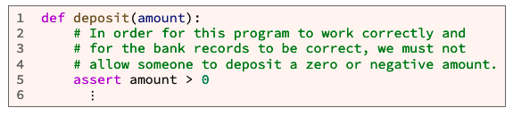
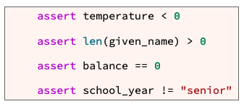
Assert Statements¶
In a computer program, an assertion is a statement that causes the computer to check if a comparison is true.
Takes a Boolean like
Branches (if)
Loops(while and for)
Except if it is false, it stops executing the function.

Slide 34
Print/Debug
Instead of adding a bunch of print statements,
Create a debug function,
Use debug instead of print
debug_flag = True
#debug_flag = False
def debug (debug_string):
if (debug_flag):
print(debug_string)

Slide 35
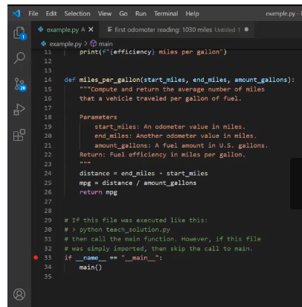
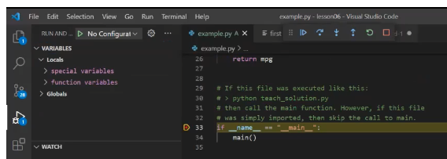
Debugger
Using the VS Code Debugger
Breakpoints
Visibles
Variables
Watch
Call Stack
Actions
|> Continue
.( Step over
\/ Step into
/\ Step out
@ Restart
[] Stop

Slide 36
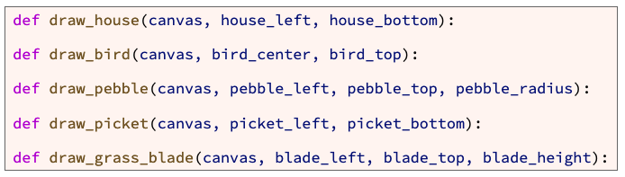
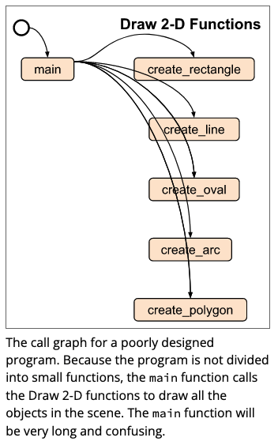
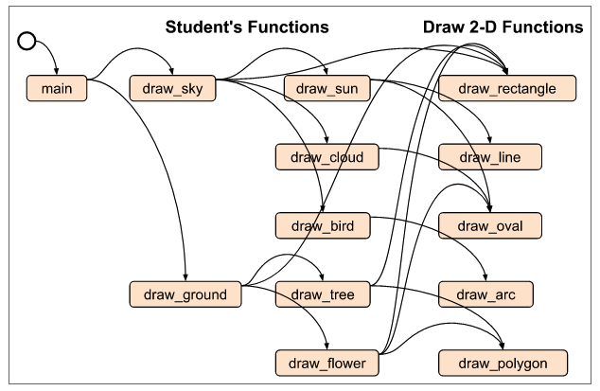
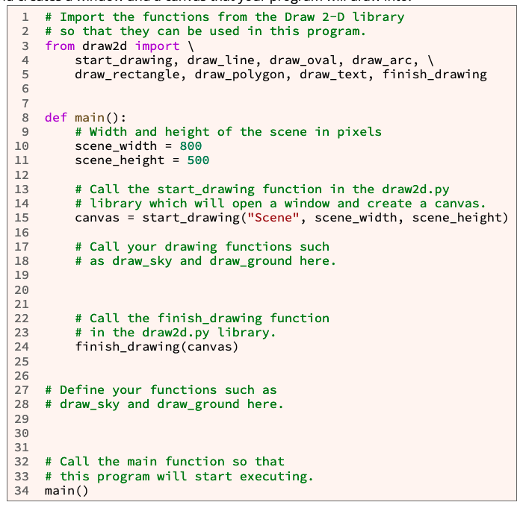
Lots of information – need to sort it out…

Slide 37
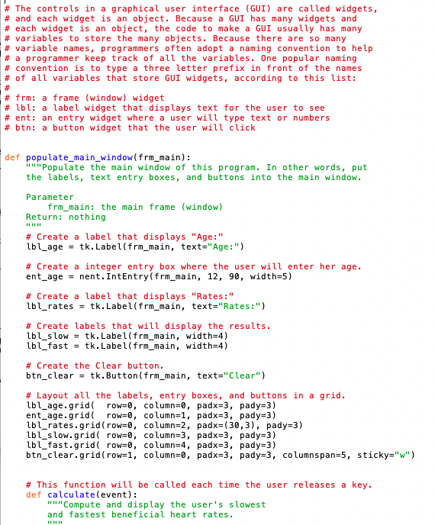
Grid
0 1 2 3 4
0
1
2
3

Slide 38
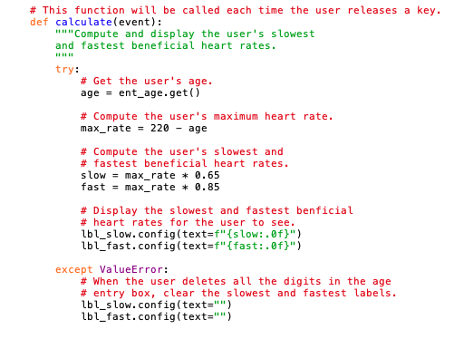
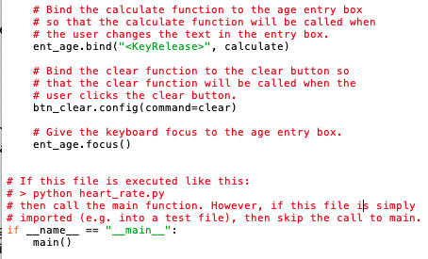
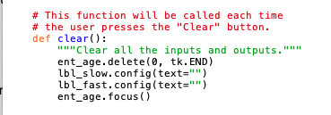
12 Team Activity: Using Objects

