Slide 1
Week 08: Dictionaries
W. Clements
CSE 111: Programming with Functions

Slide 2
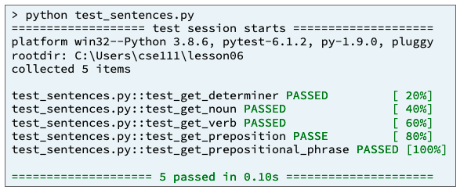
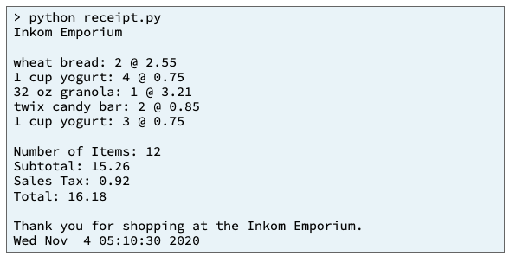
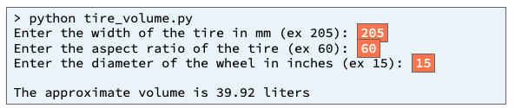
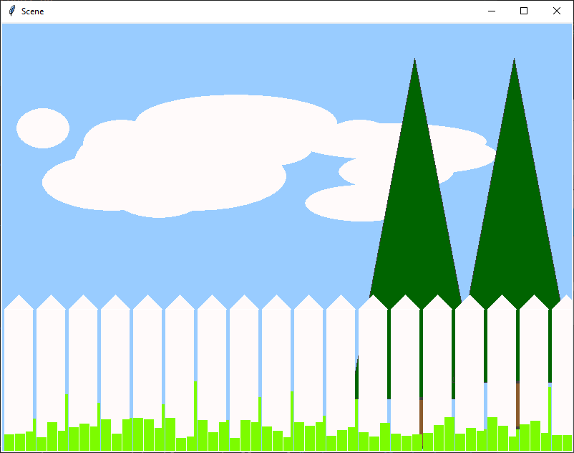
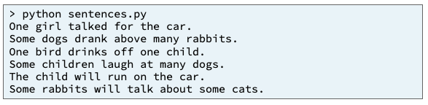
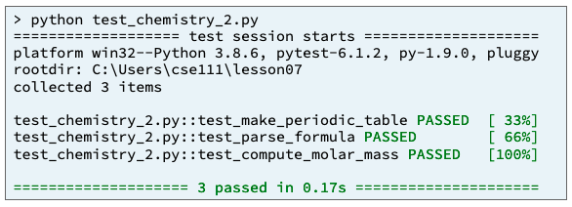
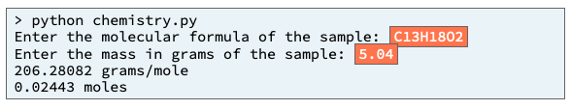
Preview of Projects
Sentence Program
Receipt Program
Inventory Program
Picture Program
Chemistry Program
Student Chosen Program
solves a real-world problem
useful in your major or hobby.
https://byui-cse.github.io/cse111-course/lesson11/prove.html

Slide 3
Overview
Prepare: Reading, Video
Checkpoint
Teach: Class Activity
Prove: Milestone
Ponder: Check your understanding

Slide 4
Review String Functions
Code | Result
words = "the cat IN THE hat" | the cat IN THE hat
words.capitalize() | The cat in the hat
words.title() | The Cat In The Hat
words.upper() | THE CAT IN THE HAT
words.lower() | the cat in the hat
words.count("t") | 3
words.lower().count("t") | 4
one = “Milk” two = “Bread” print(“1.”+one+” 2.”+two); | 1.Milk 2.Bread
print(“{} & {} ”.format(one, two)) | Milk & Bread
print(“{1} & {0} & {1} ”.format(one, two)) | Bread & Milk & Bread
print(f”1.{one} & 2.{two}”) | 1.Milk & 2.Bread

Slide 5
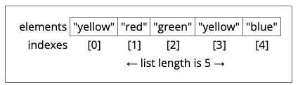
Review Concepts: Lists
Listvar = [ value, value, …]
List functions
insert
Output of a list
print (listvar[n]) #value
print (listvar) #[value, value, …]
Method | Lists Description
append() | Adds an element at the end of the list
clear() | Removes all the elements from the list
copy() | Returns a copy of the list
count() | Returns the number of elements with the specified value
extend() | Add the elements of a list (or any iterable), to the end of the current list
index() | Returns the index of the first element with the specified value
insert() | Adds an element at the specified position
pop() | Removes the element at the specified position
remove() | Removes the item with the specified value
reverse() | Reverses the order of the list
sort() | Sorts the list

Slide 6
Review List
[index]
0
1
2
Len()-1
N+1
N+2
N+2
value
value
value
value
value
value
value
listVarName
.append(value)
value
Method | Lists Description
append() | Adds an element at the end of the list
clear() | Removes all the elements from the list
copy() | Returns a copy of the list
count() | Returns the number of elements with the specified value
extend() | Add the elements of a list (or any iterable), to the end of the current list
index() | Returns the index of the first element with the specified value
insert() | Adds an element at the specified position
pop() | Removes the element at the specified position
remove() | Removes the item with the specified value
reverse() | Reverses the order of the list
sort() | Sorts the list
empty
.clear()
##
.count()
[v1,v2,..]
.extend(list)
index
.index(value)
.insert(value, index
index
value
.remove(value)
value
value
.pop(index)
.reverse()
.sort() <
.copy()
0
1
2
Len()-1
value
value
value
value
newList

Slide 8
Review 07 Prepare: Lists and Repetition
Concepts¶
Lists¶
Repetition¶
range function¶
break statement¶
while loop¶
Compound Lists¶
Values and References
Pass by Value and Pass by Reference
Rationale for Pass by Reference
Tutorials¶
Summary

Slide 9
Review Concepts: Repetition
Branching
If
If…elif…else
Repetition
for var in listvar:
for i in range(10)
for i in range(len(listvar))
break – stop loop
while Boolean:
exitvar = value
while exitvar :
#update exit variable strategy

Slide 10
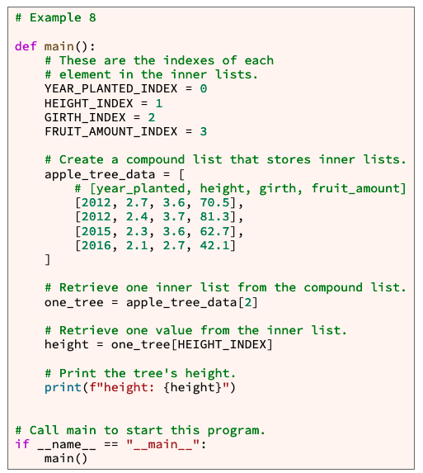
Review Compound Lists
A List that contains a list.
Create
apple_tree_data = [ # [year_planted, height, girth, fruit_amount] [2012, 2.7, 3.6, 70.5], [2012, 2.4, 3.7, 81.3], [2015, 2.3, 3.6, 62.7], [2016, 2.1, 2.7, 42.1] ]
Read/Access
Year = apple_tree_data[1][0]
Write
apple_tree_data[1][1] = 2013

Slide 11
Review Concepts: Values and References¶
The computer assigns values to variables differently based on their data type.
Native value types
Int, float, string, boolean
References
A list is a special type of variable
The variable is a reference, stores the location of the values, as there is more than one.

Slide 12
Review Pass by Value and Pass by Reference
The fact that the computer
copies the value of some data types (boolean, integer, float) and
copies the reference for other data types (list and other large data types) has important implications for passing arguments into functions.
Def function (parameter, …)
If it a native type, then pass-by-value.
If it is a complex type, like a list, then it is passed as a reference.
Lets talk about program Stack and program Heap, to better understand.

Slide 13
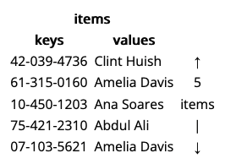
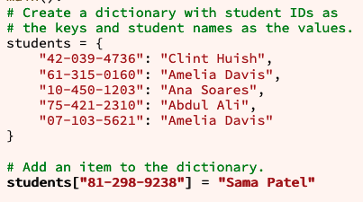
08 Prepare: Dictionaries
A Python program can store many items in a dictionary.
Each item in a dictionary is a key value pair.
Each key within a dictionary must be unique. In other words, no key can appear more than once in a dictionary.
Values within a dictionary do not have to be unique.

Slide 14
Dictionary
Key | Value
Create a dictionary
mydictionary = { key : value }
Key are unique values
Value return associated value
Update a dictionary
Read: print(mydictionary[key]) Update: mydictionary[key] = value
Either create a new key or
Update a current key
Examples of real-life dictionaries:
Key chain
Card deck
Account numbers
Social Security number
Student number (iNumber)
Street address
File name

Slide 15
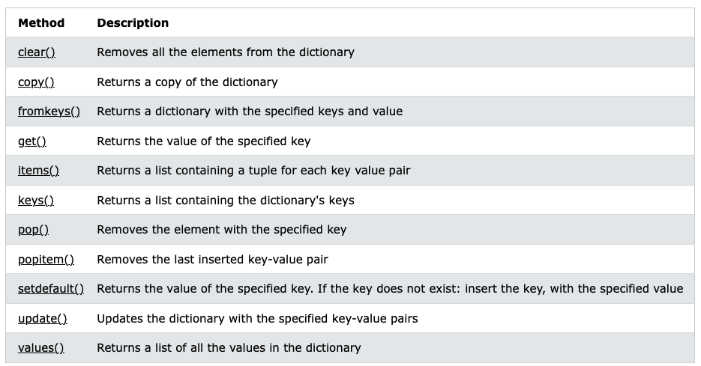
.copy()
key1
key2
Key3
Len()-1
newdictVar
value
value
value
value
[key1, key3, key n]
.fromkeys(listkeys, values)
key1
Key3
Len()-1
value
value
value
[key]
dictionaryVar
key1
key2
Key3
Len()-1
value
value
value
value
.clear()
empty
value
.get(key)
[(key,value), (), ()..]
.items()
[key1, key2, …]
.keys()
value
.pop()
value
.popitem(key)
value
.setdefault(key, defaultvalue)
.update({(key1, newvalue),…})
[value, value, …]
.values()

Slide 16
Inception Time
I can put if statements in while loops
Checking for correct input from a user
CSE 110 Shopping cart
I can put while loops inside while loops
Dang
I can put for loops inside while loops, inside if statements
I can put list inside lists
I can put dictionaries inside lists
I can put lists inside dictionaries.

Slide 17
07 Checkpoint: Lists

Slide 18
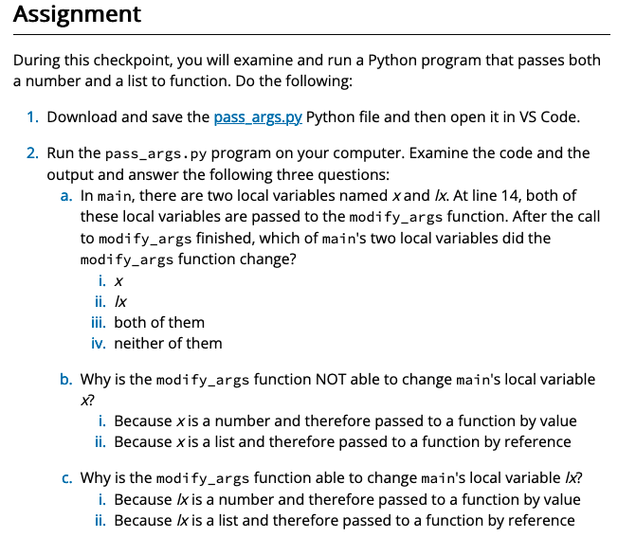
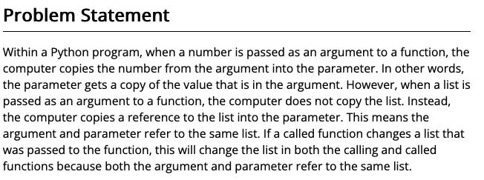
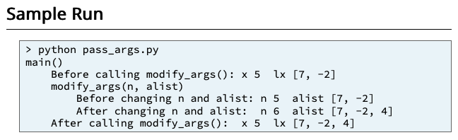
07 Checkpoint: Lists
Purpose
Reinforce your understanding that numbers are passed to a function by value and lists are passed to a function by reference.

Slide 19
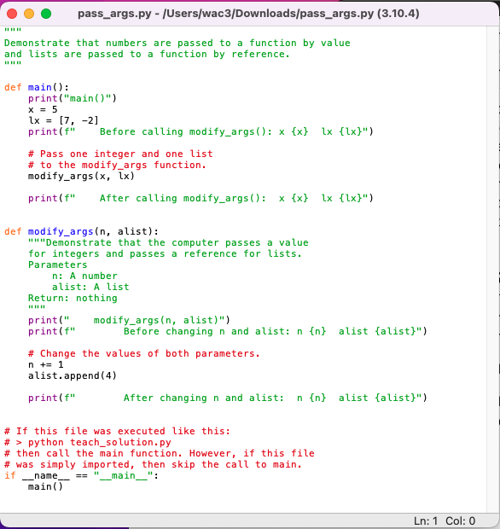
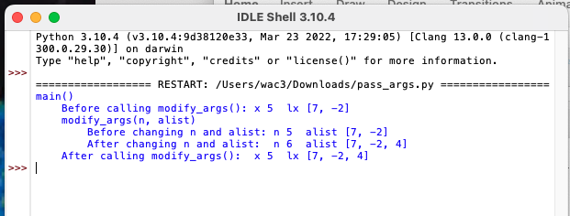

Slide 20
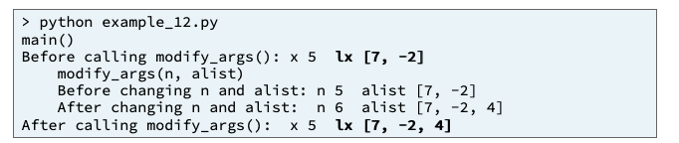
Before calling modify_args(): x 5 lx [7, -2]
Input
Process
Output
main
After calling modify_args(): x 5 lx [7, -2, 4]
x
lx = [7 , -2]
modify_args(n, alist)
lx = [7 , -2, 4]
Before changing n and alist: n 5 alist [7, -2]
x
lx
modify_args(x, lx)
After changing n and alist: n 6 alist [7, -2, 4]
modify_args(x, lx)
lx = [7 , -2, 4]

Slide 21
08 Team Activity: Dictionaries

Slide 22
08 Team Activity: Dictionaries
Problem Statement¶
The Church of Jesus Christ of Latter-day Saints uses lots of computer technology to collect and store family history data, including data about individuals and marriages.
Interestingly, the data about individuals must be stored separately from the data about marriages because some individuals get married multiple times.
However, in order to make the data understandable to people, when a person views marriage data, a program must combine the marriage data and the individual data.

Slide 23
08 Team Activity: Dictionaries
Core Requirements¶
Stretch Challenges¶
Within your program, the print_death_age function must print the name and age at death for each person in the people dictionary.
The count_genders function must count and print the number of males and the number of females in the people dictionary.
The print_marriages function must print the following for each marriage in the marriages dictionary:
The name and age in the wedding year of the husband
The year of the wedding
The name and age in the wedding year of the wife
If your team finishes the core requirements in less than an hour, complete one or more of these stretch challenges. Note that the stretch challenges are optional.
Add code to the print_death_age function that prints the birth year and death year for each person.
Add to your program a function named count_marriages that counts and prints the number of marriages that each person had in his or her lifetime. According to the data, who married the most times?

Slide 24
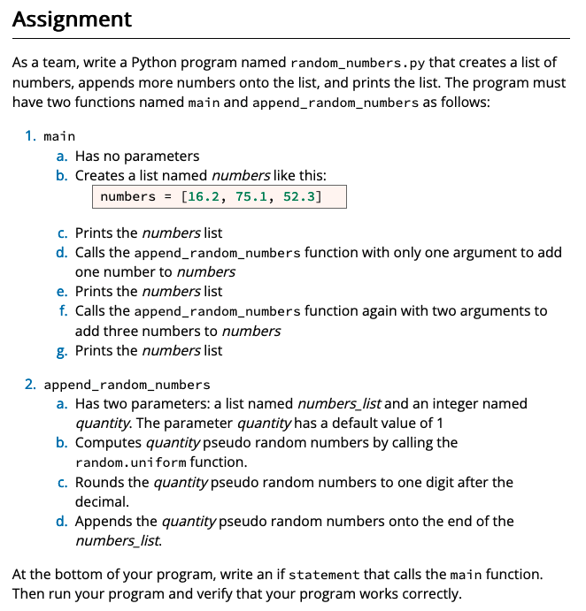
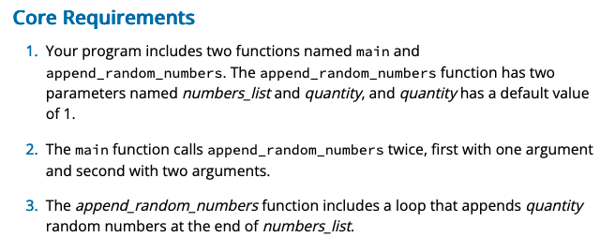
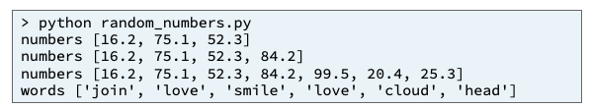
Input
Process
Output
Family_history.py
main
people_dict
people_dict
print_death_age()()
marriages_dic
people_dict
marriages_dic
people_dict
count_genders()
print_marriages()
08 Team Activity: Dictionaries

Slide 25
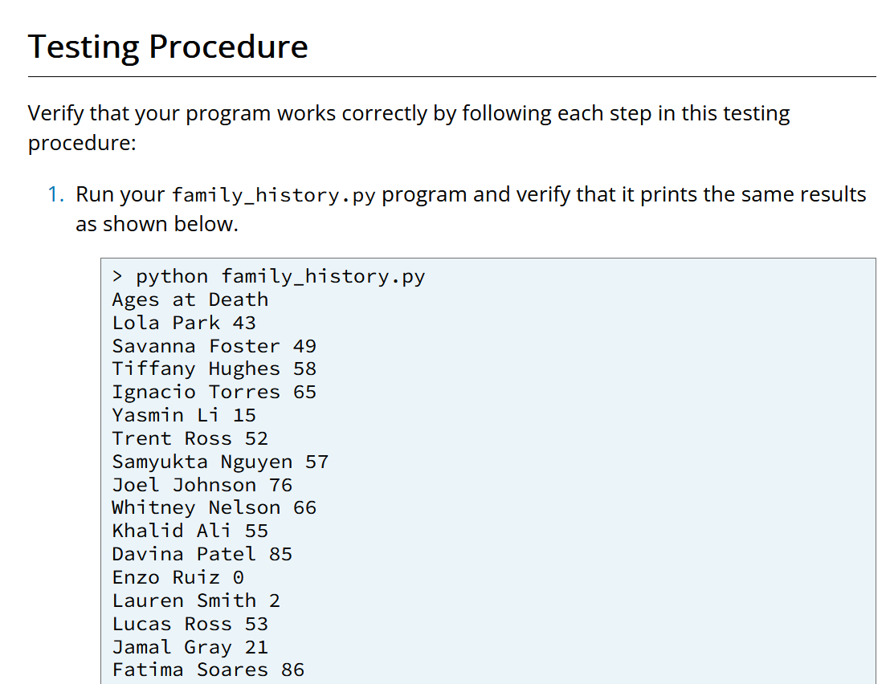
08 Team Activity: Dictionaries

Slide 26
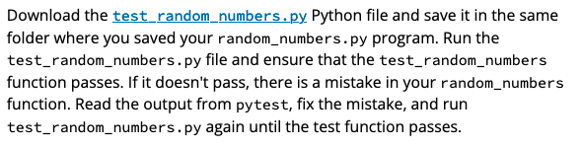
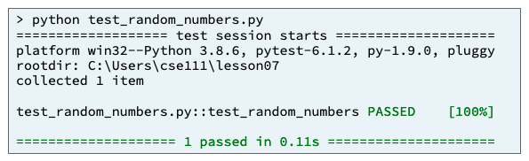
Input
Process
Output
test_random_numbers.py
pytest.main(["-v", "--tb=line", "-rN", __file__])
test_append_random_numbers()
random_numbers.py.py
Numbers_list
quantity
append_random_numbers()
08 Team Activity: Dictionaries

Slide 27
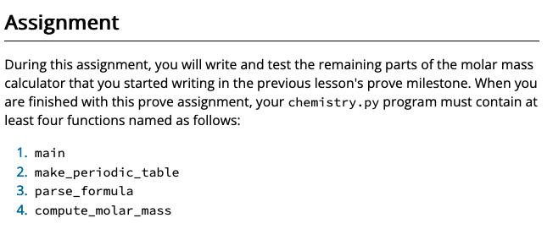
08 Prove Milestone: Dictionaries
Purpose
Prove that you can write a Python program that creates and uses a compound list.
https://byui-cse.github.io/cse111-course/lesson08/prove.html

Slide 28
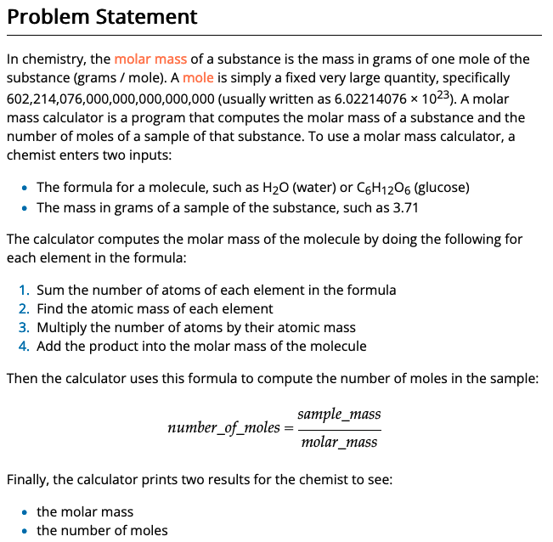
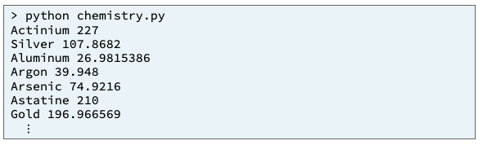
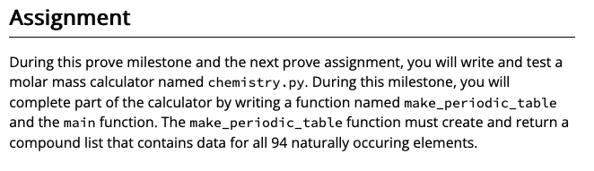
Input
Process
Output
main

Slide 29
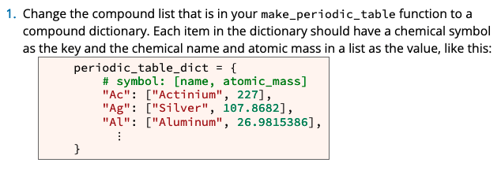

Slide 30
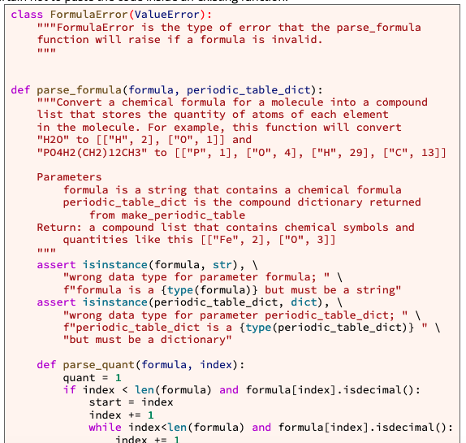
Step 2
Copy and paste the following Python code into your chemistry.py program. Be certain not to paste the code inside an existing function.
The code that you pasted includes a FormulaError cla
ss and a function named parse_formula. Both of them are complete and work correctly, and you should not change them.
The parse_formula function converts a chemical formula for a molecule, such as "C13H16N2O2" (melatonin), into a compound list, such as [["C", 13], ["H", 16], ["N", 2], ["O", 2]].
In the code that you pasted, this compound list is known as a symbol_quantity_list because it contains the symbols of chemical elements and the quantity of each element that appears in a chemical formula.

Slide 31
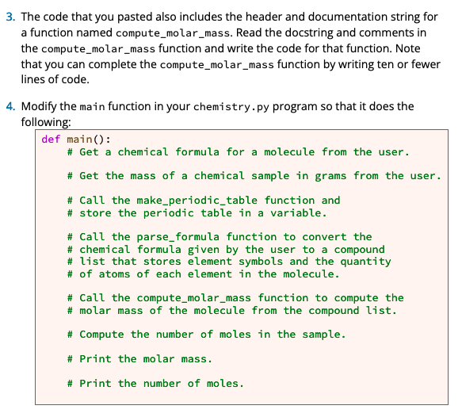

Slide 32
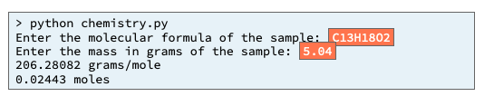

Slide 33
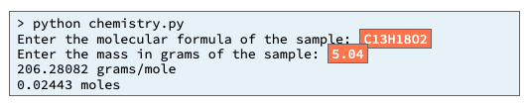
Input
Process
Output
chemistry.py
main
Returned_list
make_periodic_table()
periodic_table_list = [ # [symbol, name, atomic_mass]
print_element()

Slide 34
Input
Process
Output
chemistry.py
main
Periodic table
parse_formula()
make_periodic_table()
periodic_table_list = [ # [symbol, name, atomic_mass]
compute_molar_mass()
print_element()

Slide 35
Input
Process
Output
chemistry.py
main
Print_moles
formula
mass
Periodic table
Molar_mass
Formula_list
parse_formula()
make_periodic_table()
periodic_table_list = [ # [symbol, name, atomic_mass]
compute_molar_mass()

Slide 36
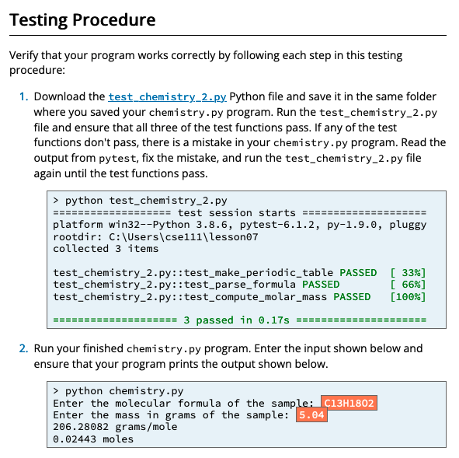

Slide 37
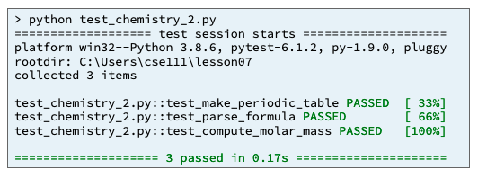
Input
Process
Output
test_random_numbers.py
pytest.main(["-v", "--tb=line", "-rN", __file__])
test_make_periodic_table()
chemistry.py
make_periodic_table()
parse_formula()
compute_molar_mass()

