Slide 1
Week 09: Working with functions and files
W. Clements
CSE 111: Programming with Functions

Slide 2
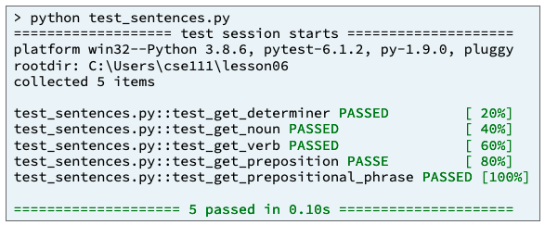
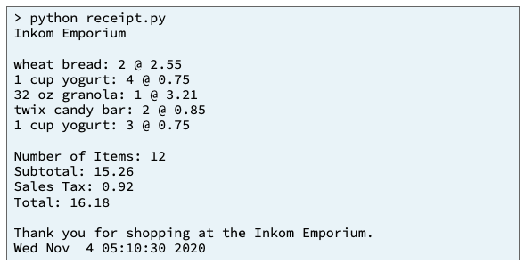
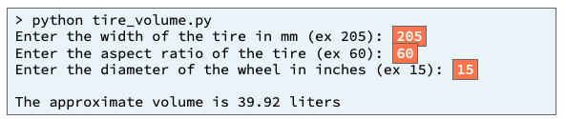
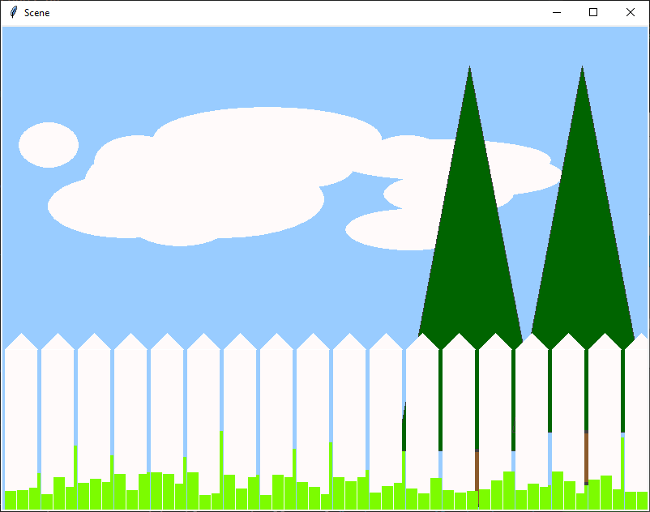
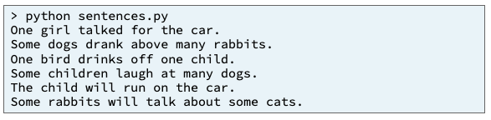
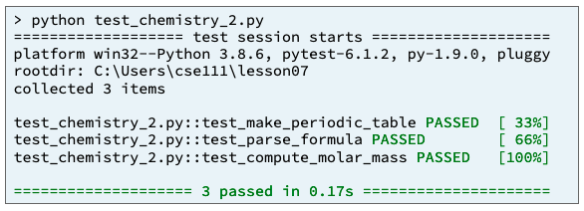
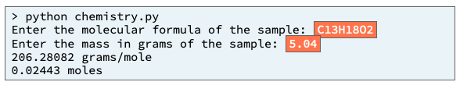
Preview of Projects
Sentence Program
Receipt Program
Inventory Program
Picture Program
Chemistry Program
Student Chosen Program
solves a real-world problem
useful in your major or hobby.
https://byui-cse.github.io/cse111-course/lesson11/prove.html

Slide 3
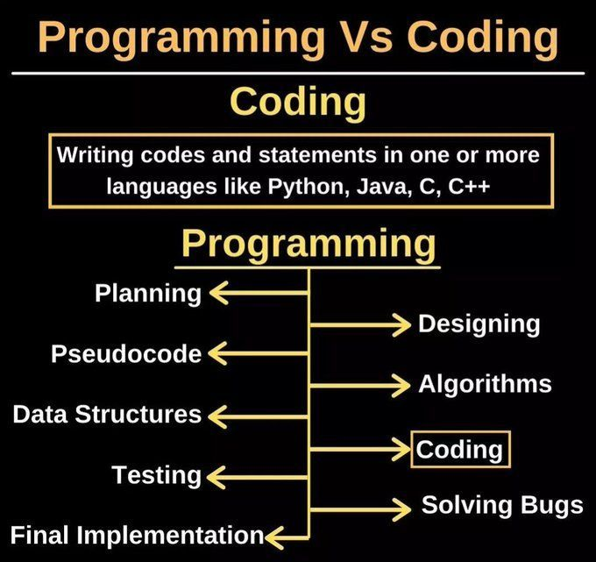

Slide 4
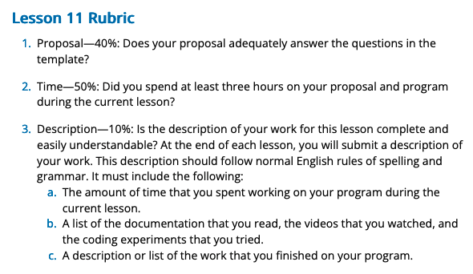
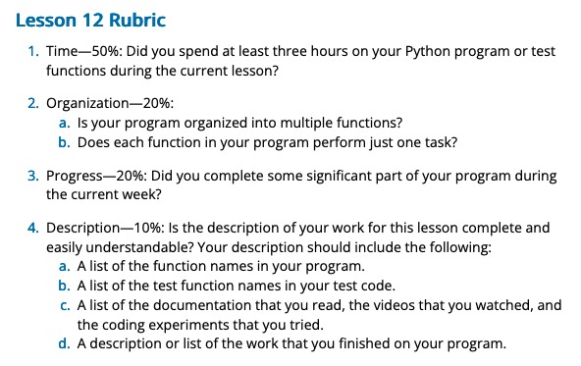
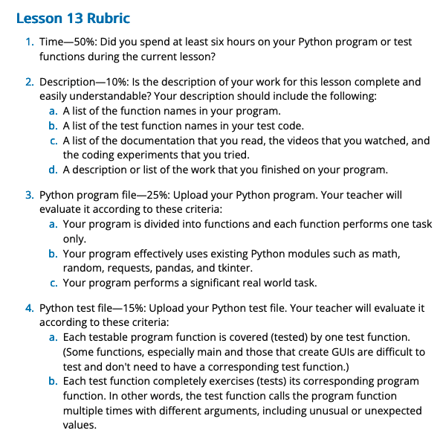
Start thinking about a project (Next Week)
What will need to be included in your project:
One of each of the three function types:
Input functions – function that return values
Output functions – functions that use parameters values
Process functions – functions that use both parameters and return values
Data Structures
Use list, dictionary or maps
Input/Output
Retrieve information from the user
Read from a file
Output information to the user
Test code file that tests the functions.
Use of library/packages: tkinter or kivy,pandas/csv,pillow/graphics,etc

Slide 5
myProject requirements
Input
Process
Output
Get_from_a_file
myproject.py
main
students.csv
message
File_data
Output_results
Get_from_user()
userdata
Students, inumber
Calculate_algorithm
modules.py
pytest.py
main

Slide 6
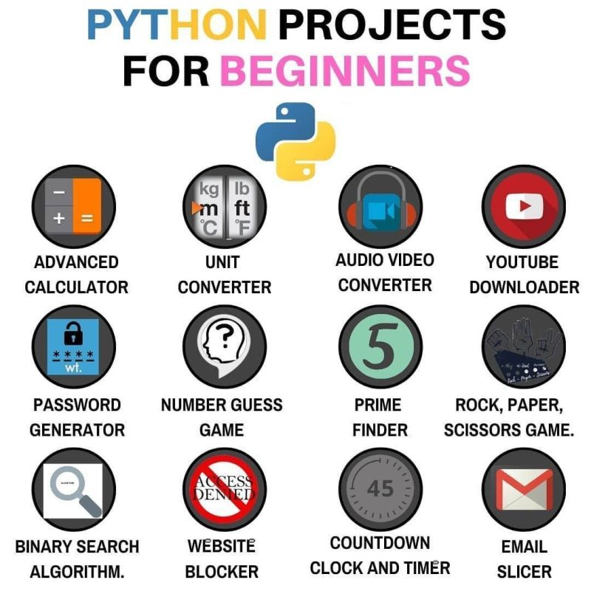
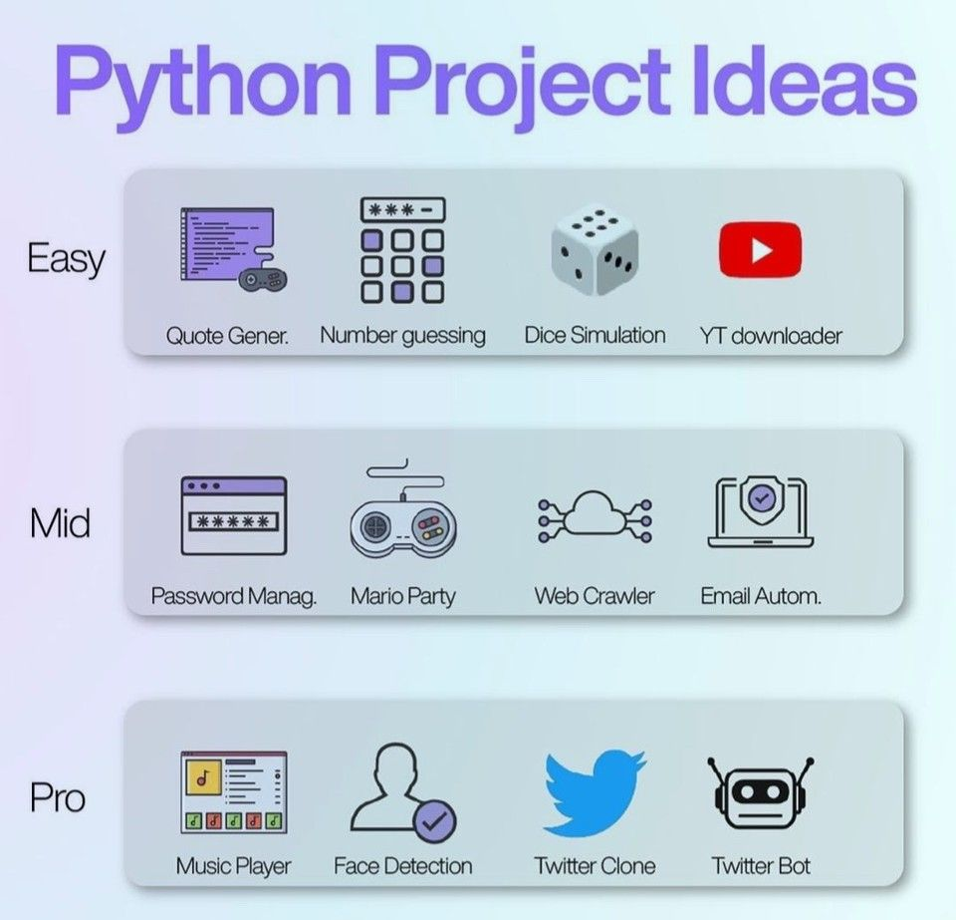
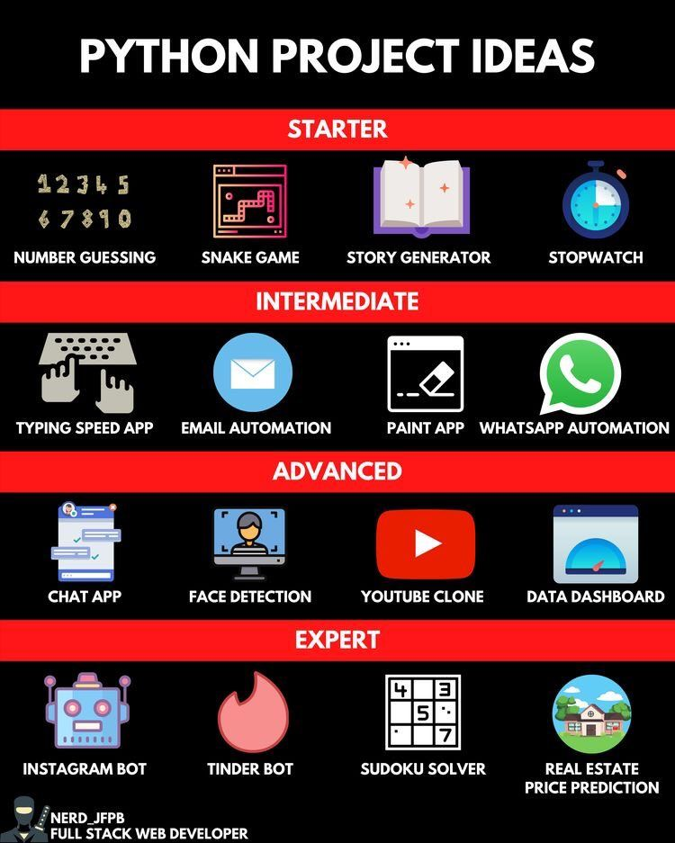
Choosing a project

Slide 7
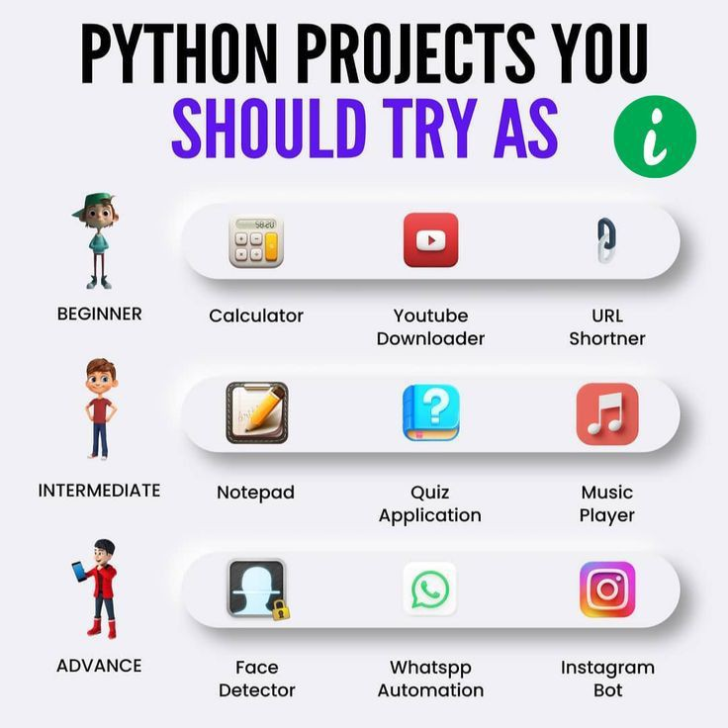
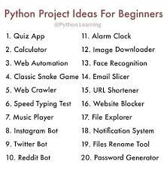
Here are 10 simple Python projects for beginners to build:
Odd or Even?
Guessing the Number
Horoscope
Rock Paper Scissors
Hangman
Acronym
Password Generator
Word Count
Pong Game
Tic Tac Toe
https://mikkegoes.com/python-projects-for-beginners/

Slide 8
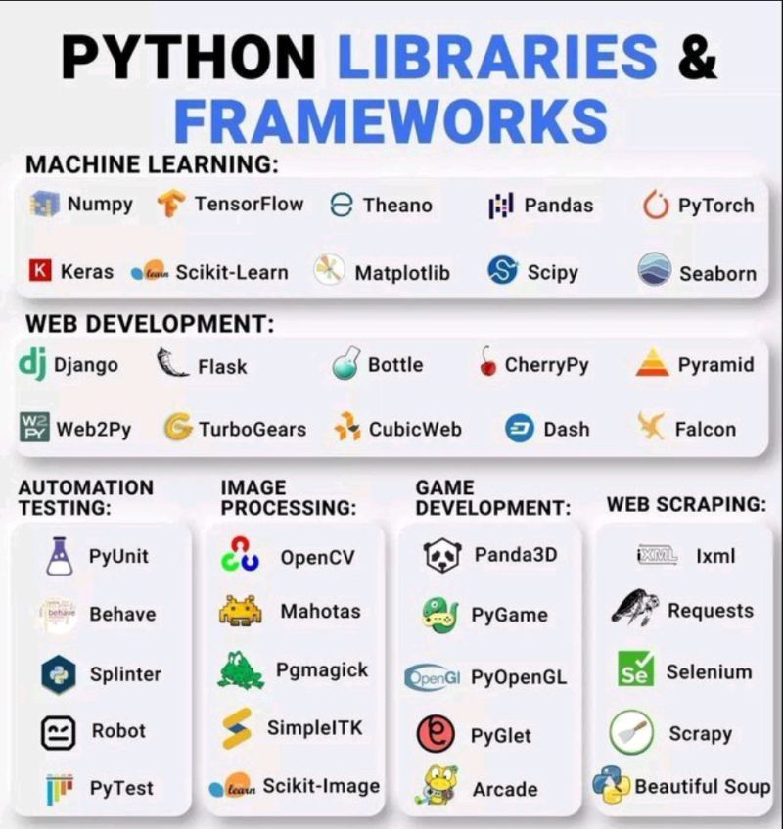
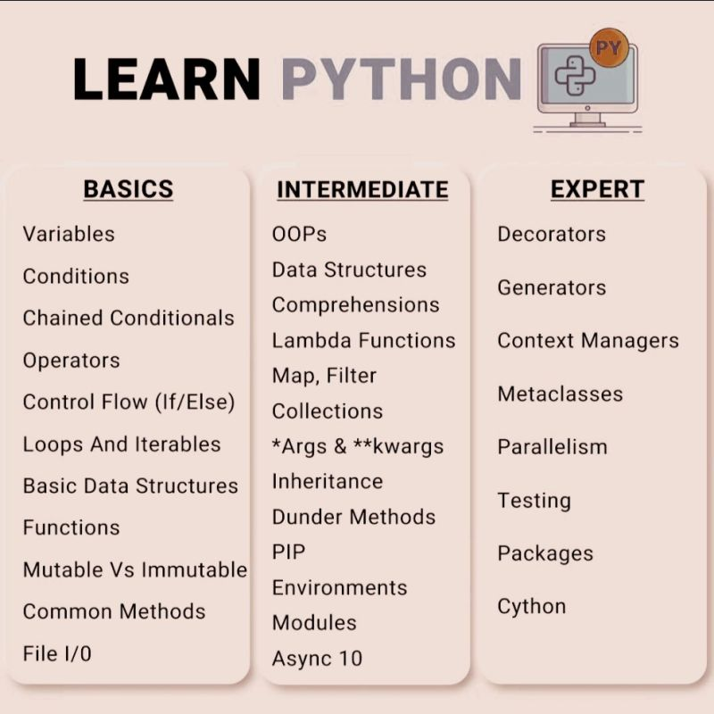

Slide 9
Overview
Prepare: Reading, Video
Checkpoint
Teach: Class Activity
Prove: Milestone
Ponder: Check your understanding

Slide 10
Review
Week 02: Calling
Week 06: Trblst Functions
Week 3: Writing functions
Week 2:Calling
Week 4: Parameter setting
Week 4: Optional values
Week 3: Writing functions
Week 4: Optional values
Week 4: Function design
Week 4: Scope
Week 06: Troubleshooting
import modules
DEBUGFLAG = FALSE
DEBUGFLAG = TRUE
def debug(stringvar):
if debugflag:
print(stringvar)
def main():
byvalue = 2
byreference = [2,3,4]
returnvalue = myfunction( byvalue, byreference)
savedvalue = myfunction(byreference, passbyvalue = byvalue)
nextvalue = myfuction(byreference)
“””
Purpose:
Variables:
“””
def myfunction (
passbyvalue = <defaultvalue>, passbyref):
# Good Functions
# 1. Understandable
# 2. Single task
# 3. Short (<20 lines)
# 4. Few decision points (branches and loops)
# 5. Reusable
assert parameters
debug (“Error message”)
return rvalue
if __name__ == "__main__":
main()
import pytest
import mypythonfile
def Test_myfunction():
checkvalue = myfunction()
assert checkvalue ?? Knownvalue
pytest.main(["-v", "--tb=line", "-rN", __file__])
Week 02: Calling
Week 05
Week 05

Slide 11
Review
Types
immutable: int, float, string, Boolean
Week 07: Pass-by-value
mutable: list, dictionary(Week 08)
Week 07: Pass-by-reference
Function paradigms (week 11)
Procedural (chain, steps)
Declarative (what, not how)
Functional (stateless)
Passing, nested, lamba functions
Debugger: (Week 6)
Breakpoint
Start, Step-over, Step-in
Error Types (Week 10)
TypeError
ValueError
IndexError
KeyError
FileNotFound
PermissionError

Slide 12
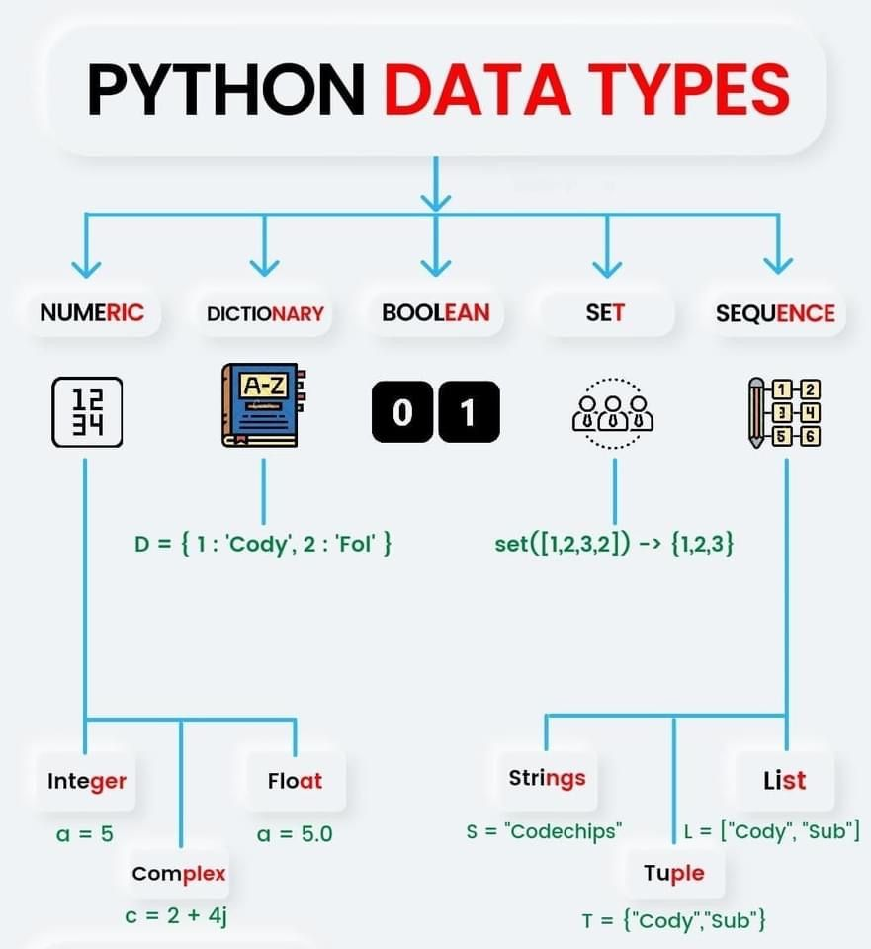

Slide 13
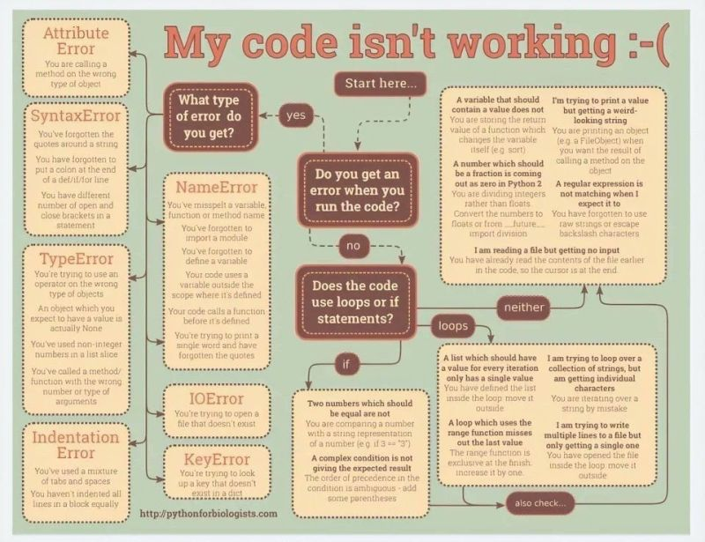

Slide 14
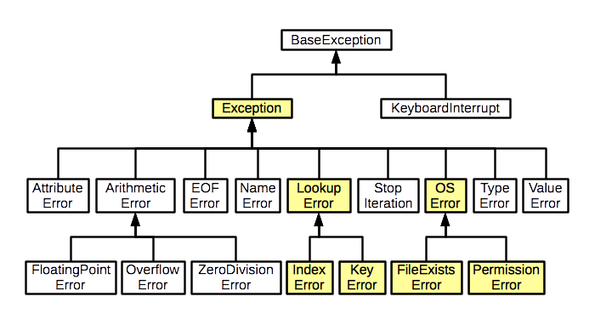
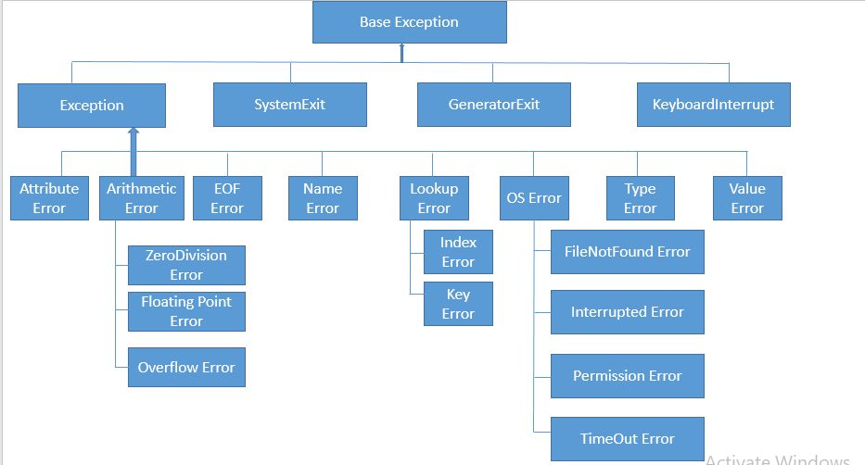
Error Type (Week 10)

Slide 15
Prepare
https://byui-cse.github.io/cse110-course/lesson11/prove.html
https://byui-cse.github.io/cse111-course/lesson09/prepare.html
Text Files
CSV Files
Processing Each Row in a CSV File
Reading a CSV file into a Compound List
Reading a CSV file into a Compound Dictionary

Slide 16
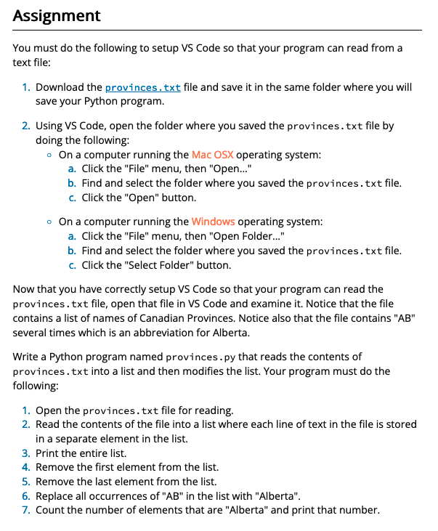
Checkpoint
Purpose
Check your understanding of text files and lists by writing a program that reads the contents of a text file into a list and then changes some of the values in the list.
https://byui-cse.github.io/cse111-course/lesson09/check.html

Slide 17
Team Activity: CSV Files
Problem
Assignment
A common task for many knowledge workers is to use a number, key, or ID to find information about a person.
For example,
a knowledge worker may use a phone number or e-mail address as a key to find (or look up) additional information about a customer.
During this activity, your team will write a Python program that uses a student's I-Number to look up the student's name.
Download the students.csv file and save it in the same folder where you will save your Python program. Open the file in VS Code and examine it. Notice that the I-Numbers and names in the file are separated by a comma. Notice also that the I-Numbers are stored in the file without any dashes between the digits.
As a team, write a Python program named students.py that has at least two functions named main and read_dict. You must write the read_dict function with one of the following two headers and documentation strings. Choose the header that makes the most sense to you.

Slide 18
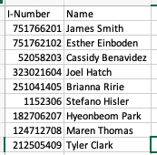
Team Activity: CSV Files
Core Requirements¶
Stretch Challenges
Your program must do the following:
Open the students.csv file for reading, skip the first line of text in the file because it contains only headings, and read the other lines of the file into a dictionary. The program must store each student I-Number as a key and each I-Number name pair or each name as a value in the dictionary.
Get an I-Number from the user, use the I-Number to find the corresponding student name in the dictionary, and print the name.
If a user enters an I-Number that doesn't exist in the dictionary, your program must print the message, "No such student" (without the quotes).
If your team finishes the core requirements in less than an hour, complete one or more of these stretch challenges. Note that the stretch challenges are optional.
Add code to remove dashes from the I-Number that the user enters. This will allow the user to enter I-Numbers with dashes or without dashes and still allow the computer to search in the dictionary.
When a user enters an I-Number, your program should ensure it is a valid I-Number.
If there are too few digits in the I-Number, your program should print, "Invalid I-Number: too few digits" (without the quotes).
If there are too many digits in the I-Number, your program should print, "Invalid I-Number: too many digits" (without the quotes).
If the given I-Number contains any characters besides digits and dashes, your program should output "Invalid I-Number" (without the quotes).
Add something or change something in your program that you think would make your program better, easier for the user, more elegant, or more fun. Be creative.

Slide 19
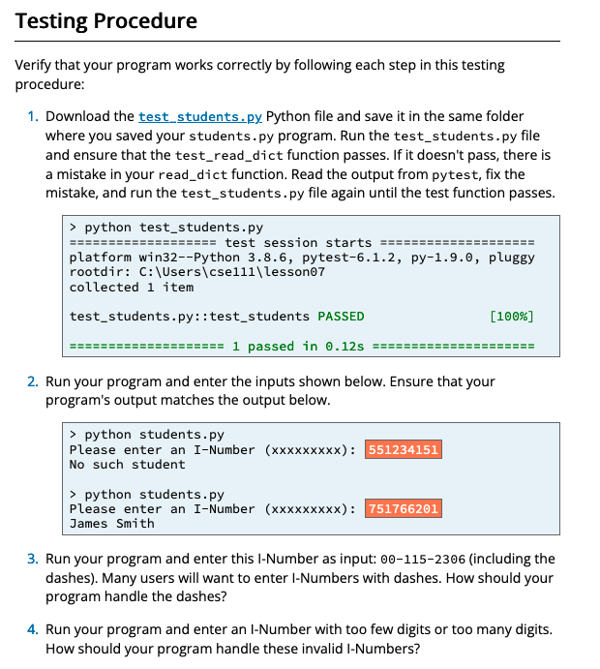
Team Activity: CSV Files

Slide 20
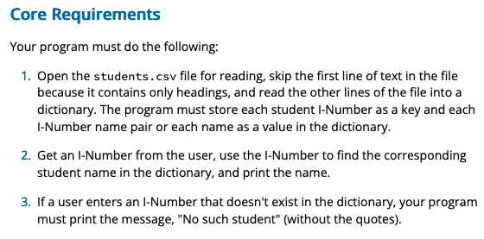
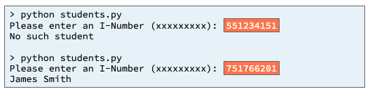
students.csv
I-number
Name
Key, Value
inumber
Input
Process
Output
get_students()
Students.py
main
students.csv
message
students
Print_name
get_inumber()
inumber
Students, inumber
determine_name

Slide 21
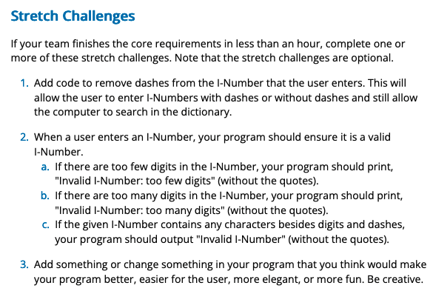
students.csv
I-number
Name
Key, Value
inumber
Input
Process
Output
get_students()
Students.py
main
students.csv
message
students
inumber
Print_name
get_inumber()
validate
inumber_dashremoved
inumber
Students, inumber
Remove_dashes
determine_name

Slide 22
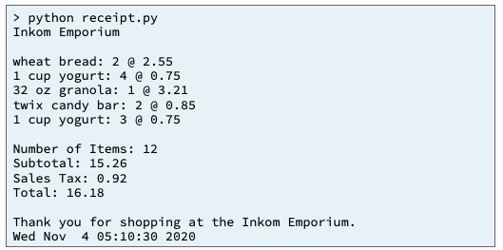
09 Prove Milestone: Text Files
Purpose¶
Problem Statement¶
Prove that you can write a Python program that reads CSV files and creates, populates, and uses a dictionary.
A local grocery store subscribes to an online service that enables its customers to order groceries online.
After a customer completes an order, the online service sends a CSV file that contains the customer's requests to the grocery store.
The store needs you to write a program
that reads the CSV file and
prints to the terminal window a receipt
that lists the purchased items and
shows the subtotal,
the sales tax amount, and
the total.
https://byui-cse.github.io/cse111-course/lesson09/prove.html

Slide 23
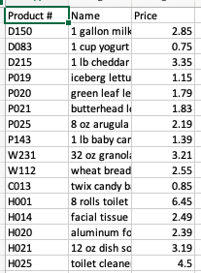
09 Prove Milestone: Text Files
Products.csv
Request.csv
(PK)Product#
Product#
Name
Quantity
Price
Steps
dictionary
Download both of these files: products.csv and request.csv and save them in the same folder where you will save your Python program.
Open the products.csv file in VS Code and examine it. Notice that each row in this file contains three values separated by commas: a product number, a product name, and a retail price.
Also, notice that each product number in the products.csv file is unique.
This means that your program can read the products.csv file into a dictionary and use the product numbers as keys in the dictionary.

Slide 24
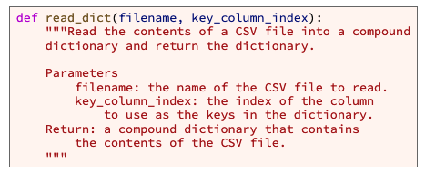
09 Prove Milestone: Text Files
Steps
In VS Code, create a new file and save it as receipt.py in the same folder where you saved the products.csv and request.csv files.
In receipt.py, write a function named read_dict that will open a CSV file for reading and use a csv.reader to read each row and populate a compound dictionary with the contents of the products.csv file.
The read_dict function must have this header and documentation string:
Recall that each item in a dictionary has a key and a value. Each item in the products dictionary must have a product number as the key and a list with the product number, product name, and price as the value as shown in the following table.
Products
Key | Value
"D150" | ["D150", "1 gallon milk", 2.85]
"D083" | ["D083", "1 cup yogurt", 0.75]
"P143" | ["P143", "1 lb baby carrots", 1.39]
"W231" | ["W231", "32 oz granola", 3.21]
"W112" | ["W112", "wheat bread", 2.55]
"C013" | ["C013", "twix candy bar", 0.85]
⋮ | ⋮

Slide 25
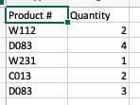
09 Prove Milestone: Text Files
Products.csv
Request.csv
(PK)Product#
Product#
Name
Quantity
Price
dictionary
Open the request.csv file in VS Code and examine it.
Notice that each row contains only two values,
a product number and a quantity.
Notice also that product number D083 appears twice in the file.
It appears twice because the customer who created the order in the request.csv file added four yogurts to his order and then later added three more yogurts to his order.
Because product numbers may appear multiple times in the request.csv file, your program must not read the contents of request.csv into a dictionary.

Slide 26
09 Prove Milestone: Text Files
Products.csv
Request.csv
(PK)Product#
Product#
Name
Quantity
Price
dictionary
list
6. In your receipt.py program, write another function named main that does the following: Calls the read_dict function and stores the compound dictionary in a variable named products_dict.
Prints the products_dict.
Opens the request.csv file for reading.
Skips the first line of the request.csv file because the first line contains column headings.
Uses a loop that reads and processes each row from the request.csv file. Within the body of the loop, your program must do the following for each row:
Use the requested product number to find the corresponding item in the products_dict.
Print the product name, requested quantity, and product price.
Because product number D083 appears twice in the request.csv file, your program must not read the request.csv file into a dictionary.
Recall that each key in a dictionary is unique. If your program reads the request.csv file into a dictionary, when your program reads line 3 of the request.csv file, your program will put a request for four yogurts into the dictionary.
Then when your program reads line 6 of the request.csv file, your program will replace the request for four yogurts with a request for three yogurts.
In other words, if your program reads the request.csv file into a dictionary, your program will think that the customer ordered only three yogurts instead of the seven (4 + 3) that he ordered.
Therefore, your program must not read the request.csv file into a dictionary but should instead read and process each row similar to example 3 in the prepare content for this lesson.

Slide 27
09 Prove Milestone: Text Files
Steps
At the bottom of your receipt.py file, add a call to the main function. Be certain to protect the call to main with an if statement as taught in the prepare content for lesson 5.
if __name__ == "__main__":
main()

Slide 28
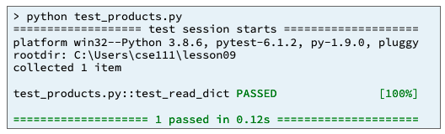
09 Prove Milestone: Text Files
Testing Procedure¶
Download the test_products.py file and save it in the same folder where you saved your receipt.py program.
Run the test_products.py file and ensure that the test_read_dict function passes.
If it doesn't pass, there is a mistake in your read_dict function.
Read the output from pytest, fix the mistake, and run the test_products.py file again until the test function passes.

Slide 29
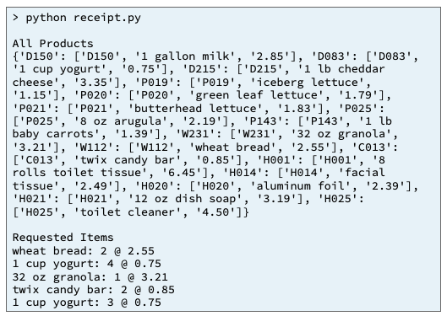
Run your program and verify that it prints the products dictionary and requested items as shown in the sample output below.

Slide 30
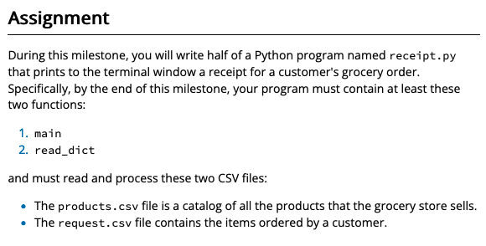
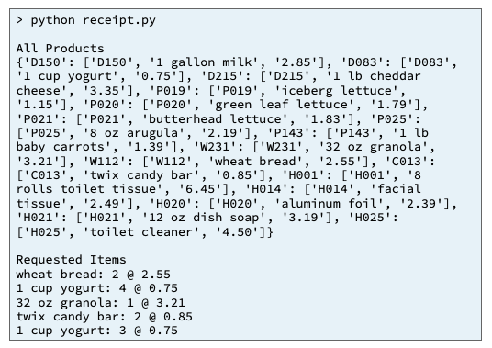
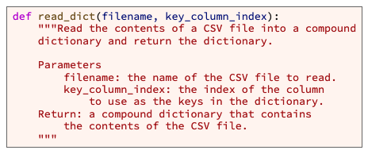
Products.csv
Request.csv
(PK)Product#
Product#
Name
Quantity
Price
dictionary
list
Input
Process
Output
get_products()
receipt.py
main
products.csv
Products_dict
message
Print_receipt()
get_requests()
requests
requests.csv
filename, key_column_index
read_dictionary
Requests, products
determine_receipt

Slide 31
function
4
3
Create read_products function
Main (receipt.py)
File
Create code file
Filename= products.csv
dictionary
products
Read_products
Filename=request.csv, products
4
File (*.csv)
products.csv
Columns: Product#, Product Name, Product Price
Read columns into dictionary
products (dictionary)
[key= product#] = list[product name(0), product price(1)]
Process_request
1
6
Read columns into dictionary
Download
File (*.csv)
request.csv
Columns: Product#, Product Quantity
requests (dictionary)
[key= Product#] = quantity
2
1
7
Loop through requests, and query products info to print receipt
Examine columns
Download
For request in requests:
quantity = requests[request]
name = products[request][0]
price = products[request][1]
print (name, quantity, prices)
5
Examine columns

