Slide 1
Testing Functions
W. Clements
CSE 111 Program with Functions

Slide 2
Overview
Prepare: Reading, Video
Checkpoint
Teach: Class Activity
Prove: Milestone
Ponder: Check your understanding

Slide 3
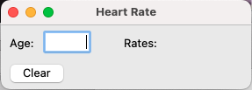
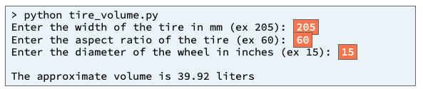
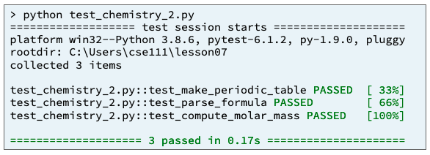
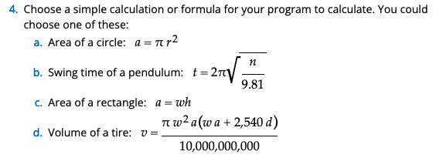
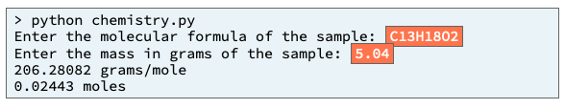
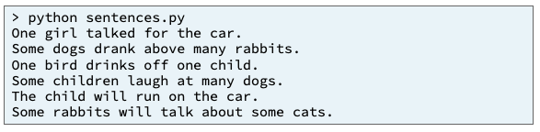
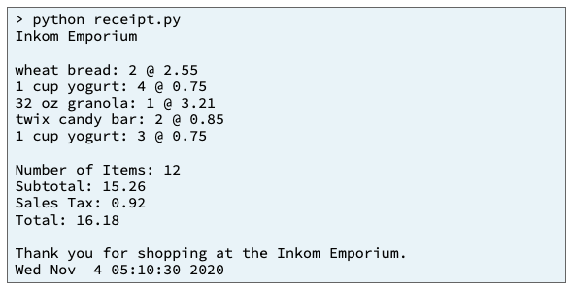
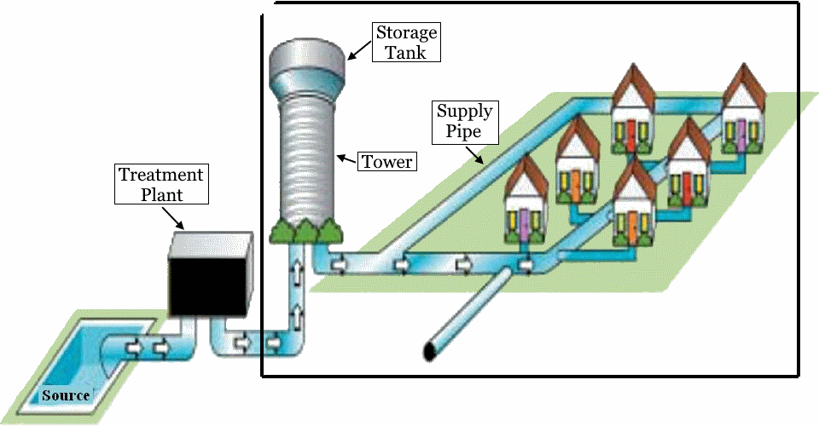
Preview of Projects
Chemistry Program
Heart Rate & Physics Equation
Inventory Program
Sentence Program
Receipt Program
Student Chosen Program
solves a real-world problem
Water Distribution Program
useful in your major or hobby.
https://byui-cse.github.io/cse111-course/lesson11/prove.html

Slide 4
05 Prepare: Testing Functions

Slide 5
05 Prepare: Testing Functions
Concepts
During this lesson, you will learn to use a more systematic approach to developing code.
Specifically, you will learn how to write test functions that automatically verify that program functions are correct.
You will learn how to use a Python module named pytest to run your test functions, and you will learn how to read the output of pytest to help you find and fix mistakes in your code.
Inefficient Testing¶
Assert Statements¶
The pytest Module¶
Comparing Floating Point Numbers¶
How to Test a Function
Separating Program Code from Test Code¶
Which Program Functions Should We Test?¶
Writing a Test Function (20 minutes)
Documentation

Slide 6
Inefficient Testing¶
During previous lessons, you tested your programs by running them, typing user input, reading the program's output, and verifying that the output was correct.
This is a valid way to test a program.
However, it is time-consuming, tedious, and error prone.
A much better way to test a program is to test its functions individually and to write separate test functions that automatically verify that the program's functions are correct.

Slide 7
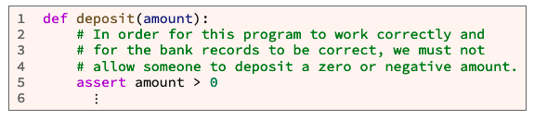
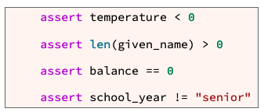
Assert Statements¶
In a computer program, an assertion is a statement that causes the computer to check if a comparison is true.
Takes a Boolean like
Branches (if)
Loops(while and for)
Except if it is false, it stops executing the function.

Slide 8
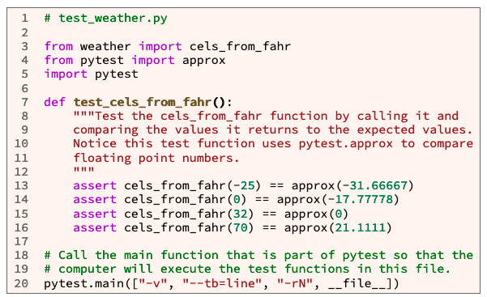
The pytest Module¶
third-party Python module
pytest was not already installed
you will need to install pytest
Pytest will tests all functions that begin with the function name test_
Example code:
It is in a seperate file than the code
from file_name import function_1, function_2, … function_N
Main is call but not defined
Main definition is in pytest module

Slide 9
05 Checkpoint: Testing Functions

Slide 10
05 Checkpoint: Testing Functions
Purpose
Assignment
Improve your ability to verify the correctness of functions by writing a test function and running it with pytest.
Write a test function that tests a previously written function. Then use pytest to run test functions.

Slide 11
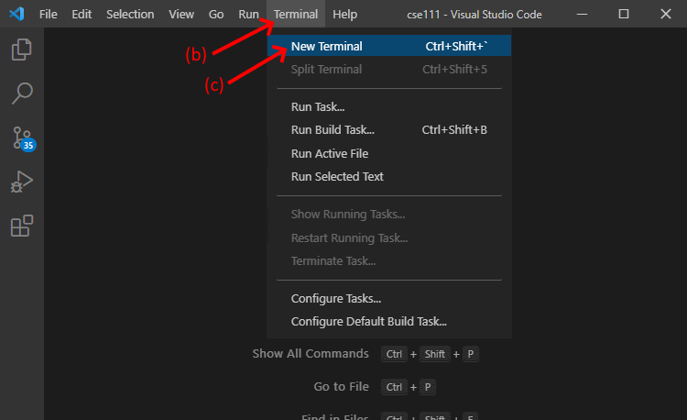
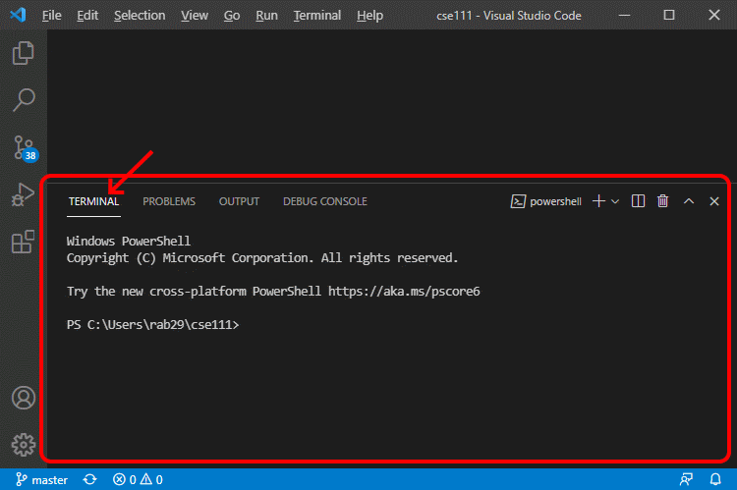
05 Checkpoint: Testing Functions
Steps¶
Open a new terminal frame in VS Code by doing the following: Open VS Code
On the menu bar for VS Code, click "Terminal"
On the menu, click "New Terminal”
This will open a terminal frame at the bottom of the VS Code window. A terminal is a window or frame where a user can type and execute computer commands.

Slide 12
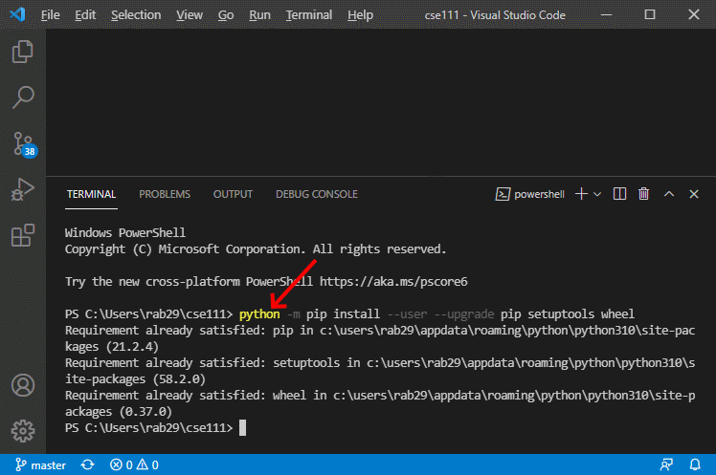
05 Checkpoint: Testing Functions
Steps
Copy and paste the following command into the terminal frame and execute the command by pressing the Enter key. This command will upgrade pip and several other parts of the Python installation modules so that pip will work correctly.
Mac OS users:
python3 -m pip install --user --upgrade pip setuptools wheel
Windows users:
python -m pip install --user --upgrade pip setuptools wheel
If your computer is running the Windows operating system, and the above command doesn't work on your computer, try the py command instead of the python command like this:
py -m pip install --user --upgrade pip setuptools wheel

Slide 13
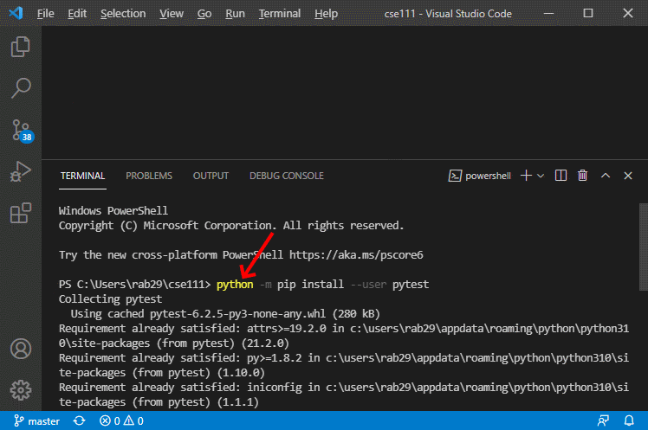
05 Checkpoint: Testing Functions
Install the pytest module by copying, pasting, and executing the following command in the terminal frame.
Mac OS users:
python3 -m pip install --user pytest
Windows users:
python -m pip install --user pytest
If your computer is running the Windows operating system, and the above command doesn't work on your computer, try the py command instead of the python command like this:
py -m pip install --user pytest

Slide 14
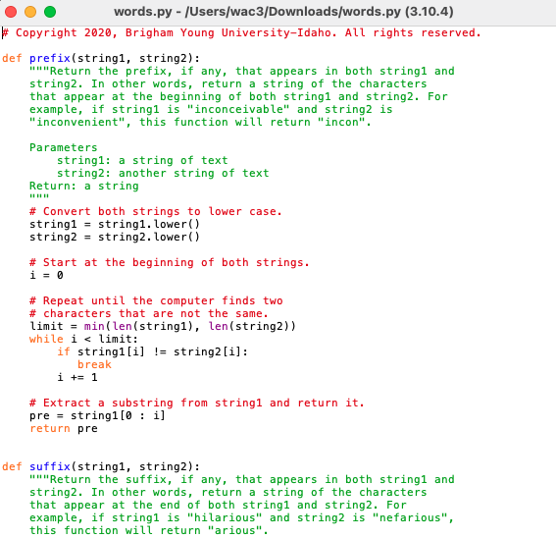
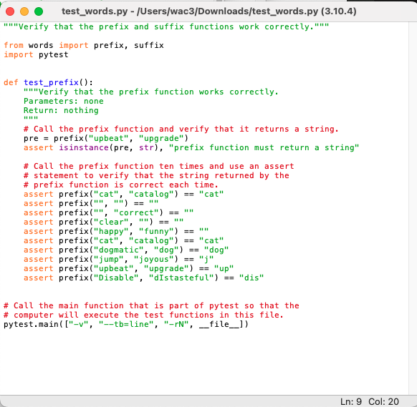
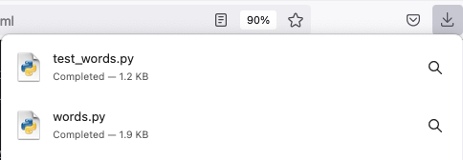
05 Checkpoint: Testing Functions
Download these two Python files: words.py and test_words.py and save them in the same folder.

Slide 15
05 Checkpoint: Testing Functions
Open the downloaded words.py file in VS Code. Notice the words.py file contains two small functions named prefix and suffix.
Notice also that each function has a documentation string (a triple quoted string immediately below a function header) that describes what the function does.
Read the documentation strings for both functions.

Slide 16
05 Checkpoint: Testing Functions
Open the downloaded test_words.py file in VS Code. In test_words.py examine the test_prefix function.
Notice that it takes no parameters and contains nine assert statements.
Each assert statement calls the prefix function and then compares the value returned from the prefix function to the expected value.

Slide 17
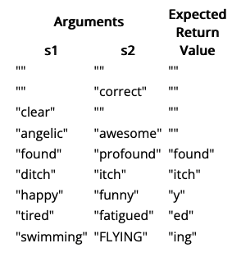
05 Checkpoint: Testing Functions
In test_words.py write a function named test_suffix that is similar to the test_prefix function.
The test_suffix function should take no parameters and contain nine assert statements that call the suffix function with these parameters:
Arguments |  | Expected Return Value
s1 | s2
"" | "" | ""
"" | "correct" | ""
"clear" | "" | ""
"angelic" | "awesome" | ""
"found" | "profound" | "found"
"ditch" | "itch" | "itch"
"happy" | "funny" | "y"
"tired" | "fatigued" | "ed"
"swimming" | "FLYING" | "ing"

Slide 18
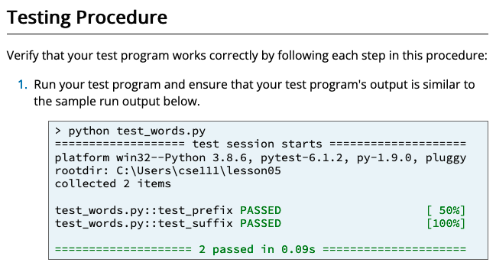
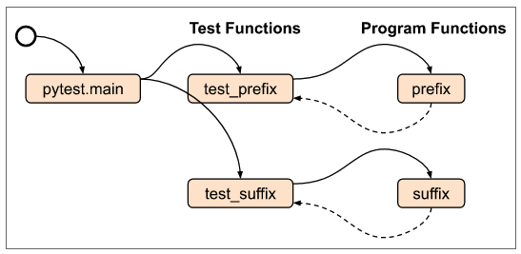
05 Checkpoint: Testing Functions
Save your test_words.py file and run it by clicking the green run icon in VS Code.

Slide 19
05 Team Activity: Testing and Fixing Functions

Slide 20
05 Team Activity: Testing and Fixing Functions
Purpose
Writing and running test functions often help a software developer find mistakes in code.
During this assignment, you will write three test functions.
Then use pytest to run the test functions and use the output of pytest to help you find and fix errors in some program functions.

Slide 21
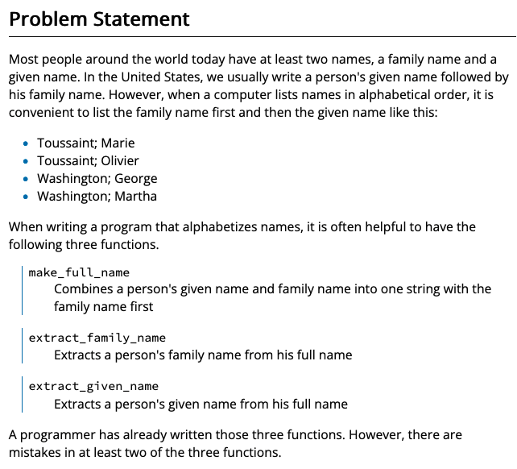
05 Team Activity: Testing and Fixing Functions
Purpose
Writing and running test functions often help a software developer find mistakes in code.
During this assignment, you will write three test functions.
Then use pytest to run the test functions and use the output of pytest to help you find and fix errors in some program functions.

Slide 22
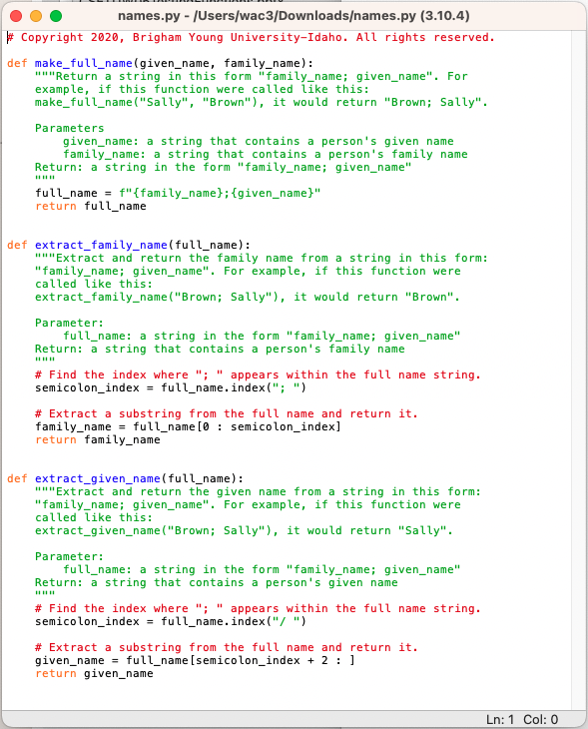
05 Team Activity: Testing and Fixing Functions
Step 1
Download the names.py Python file and save it in the same folder where you will save your Python test program.
Then open the downloaded file in VS Code. Notice that the downloaded file contains three small functions named:
make_full_name,
extract_family_name, and
extract_given_name.
Notice also that each function has a
documentation string (a triple quoted string immediately below the function header) that
describes what the function does.
Read the documentation strings for all three functions. The code in the functions may contain some mistakes.

Slide 23
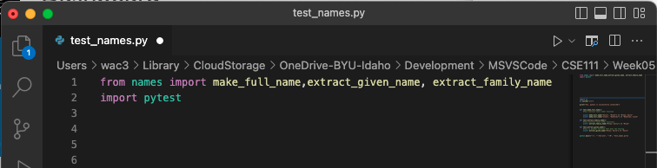

05 Team Activity: Testing and Fixing Functions
Step 2
Using VS Code, open a new Python file and copy and paste the following import statements at the top of the file. from names import
Save the file with the name test_names.py in the same folder where you downloaded and saved the names.py file.

Slide 24
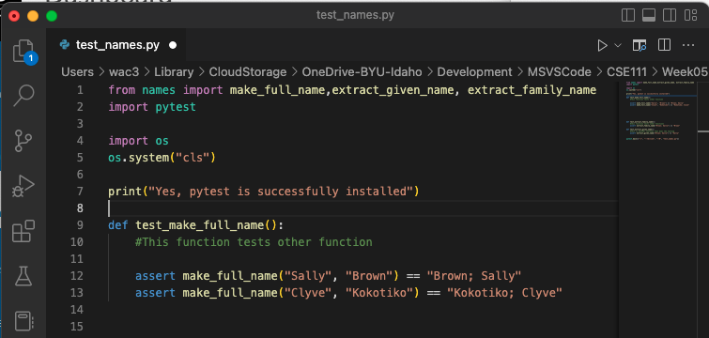
05 Team Activity: Testing and Fixing Functions
Step 3
In test_names.py, write a function
named test_make_full_name that takes no parameters.
Write assert statements inside this function to test the value returned from the make_full_name function.
If you are not sure what the make_full_name function does or how to test it, read the documentation string that is at the top of the make_full_name function in the names.py file.

Slide 25
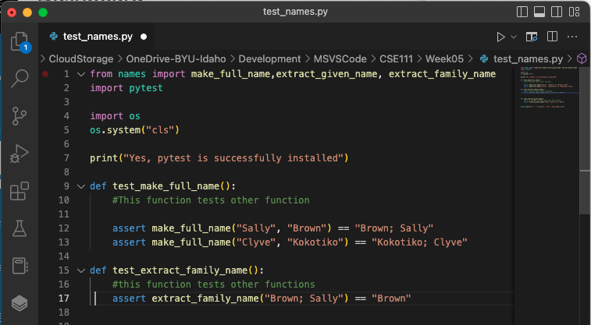
05 Team Activity: Testing and Fixing Functions
Step 4
In test_names.py write a function named
test_extract_family_name that takes no parameters.
Write assert statements inside this function to test the value returned from the extract_family_name function.

Slide 26
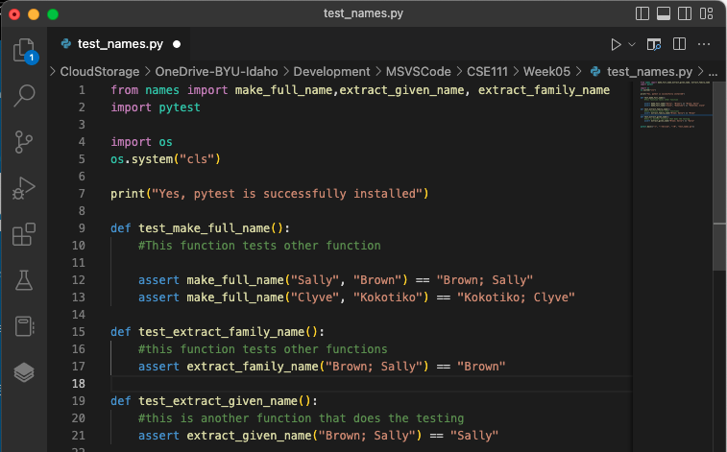
05 Team Activity: Testing and Fixing Functions
Step 5
In test_names.py write a function named
test_extract_given_name that takes no parameters.
Write assert statements inside this function to test the value returned from the extract_given_name function.

Slide 27
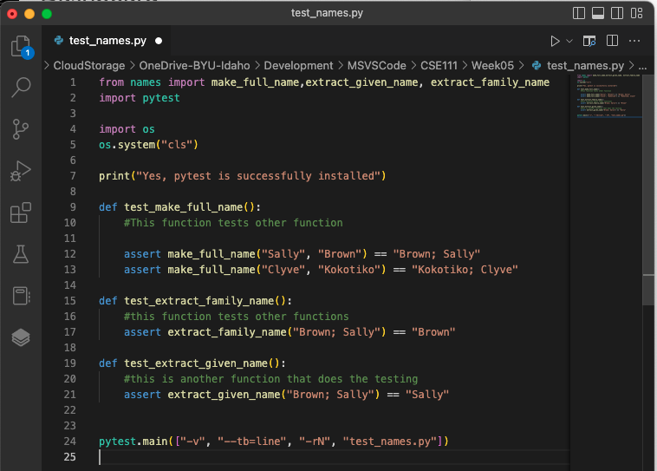

05 Team Activity: Testing and Fixing Functions
Step 6
At the bottom of your test_names.py file, write a call to the pytest.main function like this:

Slide 28
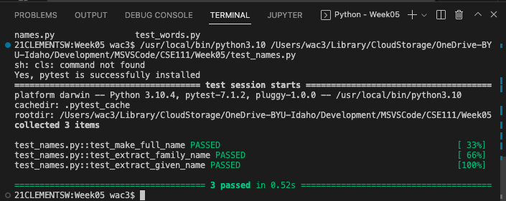
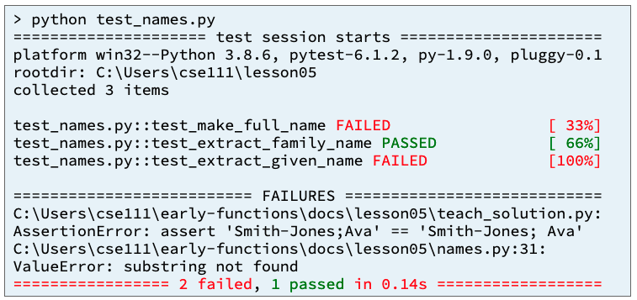
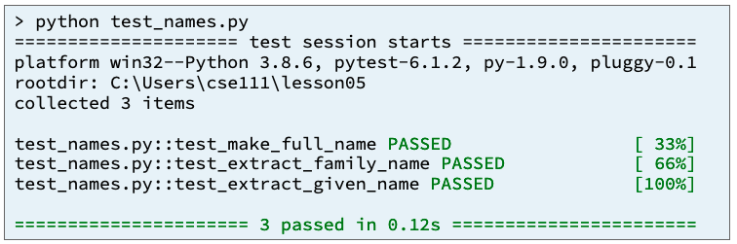
05 Team Activity: Testing and Fixing Functions
STEPS 7-9
Save your test_names.py file and run it by clicking the green run icon in VS Code.
Read the output from pytest and use the output to help you find and fix any errors that are in your test functions or the
make_full_name,
extract_family_name, and
extract_given_name functions.
Repeat steps 7 and 8 until you have found and fixed all the mistakes and your three test functions pass.

Slide 29
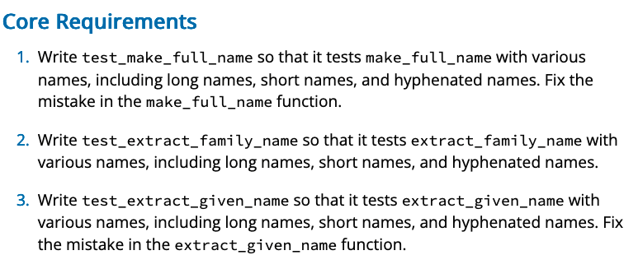
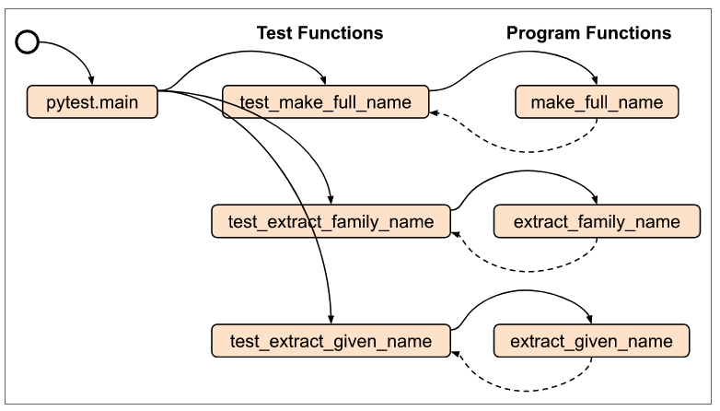
05 Team Activity: Testing and Fixing Functions
Input
Process
Output
Test_names.py
pytest.main(["-v", "--tb=line", "-rN", __file__])
test_make_full_name()
Test_extract_family_name()
Test_extract_given_name()
names.py
Given_name, family_name
Family_name
Family_name
make_full_name()
extract_family_name()
extract_given_name()

Slide 31
05 Prove Milestone: Testing and Fixing Functions

Slide 32
05 Prove Milestone: Testing and Fixing Functions
Purpose
Prove that you can write a Python program and write and run test functions to help you find and fix mistakes in your program.

Slide 33
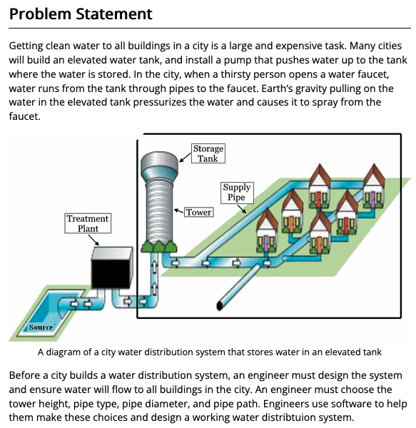
05 Prove Milestone: Testing and Fixing Functions
Purpose
Prove that you can write a Python program and write and run test functions to help you find and fix mistakes in your program.
Assignment
Write a Python program that could help an engineer design a water distribution system. During this prove milestone, you will write three program functions and three test functions as described in the Steps section below.

Slide 34
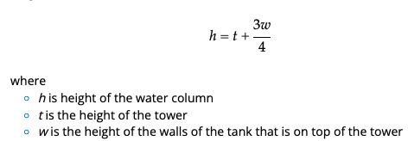
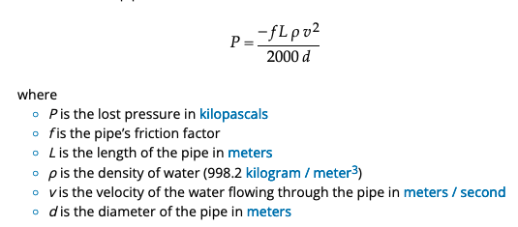
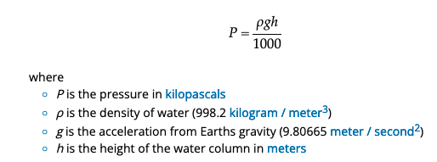
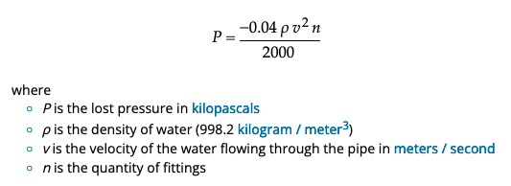
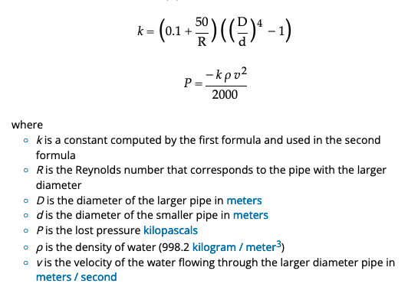
Design
water_height= water_column_height()
tank_height
Supply_loss = pressure_loss_from_pipe
tower_height
House_loss = pressure_loss_from_pipe
Tank_pressure = pressure_gain_from_water_height()
Fitting_loss = pressure_loss_from_fittings()
Reduction_loss = pressure_loss_from_pipe_reduction
Pressure = Tank_pressure + Supply_loss + Fitting_loss + Reduction_loss + House_loss

Slide 35
Design – Module 5
water_height= water_column_height()
tank_height
Supply_loss = pressure_loss_from_pipe
tower_height
Tank_pressure = pressure_gain_from_water_height()
Pressure = Tank_pressure + Supply_loss

Slide 36
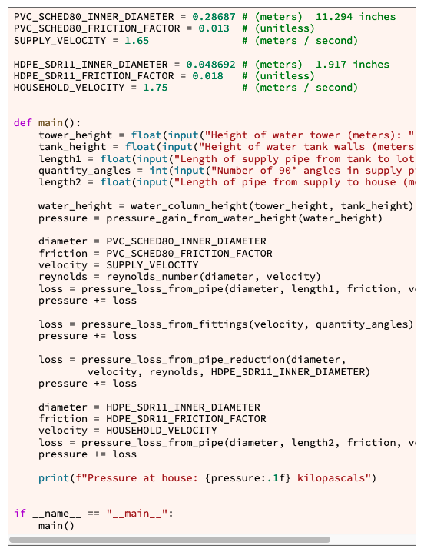
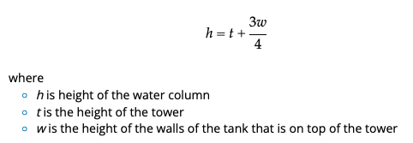
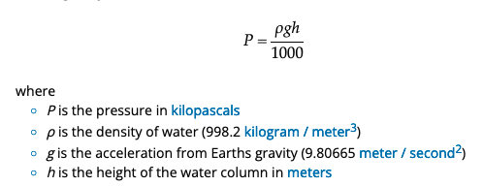
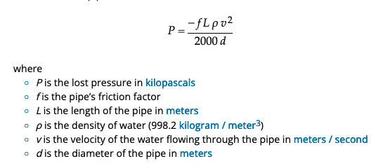
Pressure =
Tank_pressure +
Supply_loss +
Fitting_loss +
Reduction_loss +
House_loss
Input
Process
Output
water_flow.py: main
Step 1
Given in Module 6, not used right now
We are only testing these functions first
Using pytest.
pipe_diameter
pipe_length
Tower_height
friction_factor
Step 2
Tank_height
Step 5
height
Step 7
fluid_velocity
water_column_height()
pressure_gain_from_water_height()
pressure_loss_from_pipe()

Slide 37
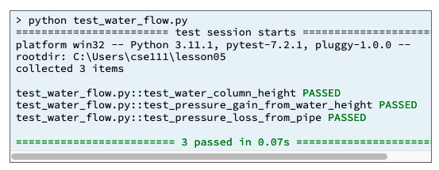
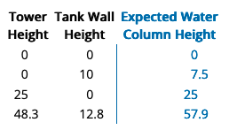
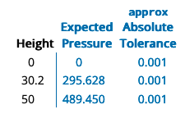
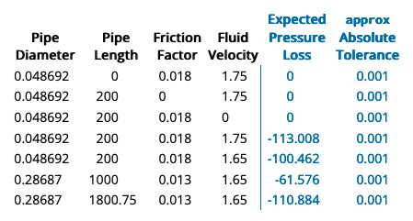
Example:
assert pressure_loss_from_fittings(1.75, 5) \
== approx(-0.306, abs=0.001)
Input
Process
Output
water_flow.py: main
Step 3
from pytest
import approx import pytest
…
# Call the main function that is part of pytest so that the
# computer will execute the test functions in this file.
pytest.main(["-v", "--tb=line", "-rN", __file__])
Step 9
Step 4
test_water_column_height()
test_pressure_gain_from_water_height()
test_pressure_loss_from_pipe()
Step 6
Step 8
water_flow.py: main
water_column_height()
pressure_gain_from_water_height()
pressure_loss_from_pipe()

