Slide 1
CSE 111
Week 02: Calling Functions
W. Clements

Slide 2
Overview
Prepare: Reading, Video
Checkpoint
Icebreaker
Teach: Class Activity
Prove: Milestone
Ponder: Check your understanding

Slide 3
Review
Input – getting information from the user
Print – displaying information to the user
Booleans and Logic Operators.
Flow control
Files

Slide 4
Program
Input
Magic
(equations)
(algorithms)
(etc)
Process
Output
Str prompt
Data/Model
Patterns:
Var = var operator var
#:operators: +, -, *, /, //, %, **
Var = var.function()
⌨️
input(<str>
Str “”
=
Var
Strings: +, .functions()
Numbers: math
float( )
If(decimal)
int( )
Process
If(whole)
bool:operators (==, <, > <=, >=)
With open(“filename”) as filereference
If boolean:
Var
T-statements
F-statements
T-statements
while boolean:
+
f”. {} “
:.#f
If(decimal)
F-statements
str( )
for boolean:
str( )
“ {} “.format(var..)
T-statements
If(whole)
F-statements
If(str)
📺
VarStr = input(“prompt?”)
VarF = float(VarStr)
VarI = int(VarStr
Str “”
print(<str>)
def functionname (parameters,..)
return value
“ “, \t, \n

Slide 5
Input
Every time you use the Input function put it in a getFunction() and return the value.
We call the function input:
var_string = input(“prompt user for information? ”)
Everything that comes in from the keyboard is a string.
If we need a number, we need to covert the string
Var_int = int(var_string)
Var_float = float(var_string)
When we start working with dealing with user error we will want to keep these variable sperate vs having them as one call
Bad programming practice:
Var_int = int (input (“prompt user”)
Var_float = float (input (“prompt user”)
Input
Str prompt
⌨️
input(<str>
Str “”
=
float( )
If(decimal)
int( )
If(whole)

Slide 6
Strings & Print
Every time you use the print function put it in a displayFunction() and pass in 1 or 2 parameters.
Everything that goes to the terminal is a string.
print(<string>)
There are three ways we can output:
Using a string
We can append string together using + operator, if we do that we need to convert ints/floats to strings, using the str function.
Using f-function i.e. f”{var}”
We can pass in any type of variable (str/int/float) in each of the {}. The f-function returns a string.
i.e. var_str = f”{var1} additional text {var2}”
Using “{}”.format(var,…)
This is similar to the f-function, in using {} but the {} are empty or have a number indicating the order of the variables that passed in to format function.
i.e. var_str = “{} – {}”.format (var1, var2)
i.e. var_str = “{2} – {1}”.format (var1, var2)
Var
+
f”. {} “
:.#f
If(decimal)
str( )
str( )
“ {} “.format(var..)
If(whole)
If(str)
📺
Str “”
print(<str>)
“ “, \t, \n

Slide 7
Logic Operators
This are functions also…
Input: 2 values
Output: True/False
Besides int/float/string variable value types, we also have Boolean.
A boolean has only two values: True and False
Typically False is 0, and every other value is True
There are specific operators that we use with Booleans
== compare two values/variables to see if they are equal
< compare two values/variables to see if the 1st is less than the 2nd
> compare two values/variables to see if the 1st is greater than the 2nd
<= 1st is less than and equal to the 2nd
>= 1st is greater than and equal to 2nd
! Changes true to false, and false to true
We also can do multiple comparisons with
and Compares two sets of operators to see if both are true, then it returns true, else false
or Compares two sets of operators to see if both are false, then it returns false, else true

Slide 8
Flow control
There are two different types of flow control:
Branching of code if/elif/else statements
Loops foreach/while
Branching
If/elif/else provide two different paths in the code.
If statement is used for single deviation
If boolean:
If/else is used for two options or one variable range.
If/elif/else is used for two or more options or multiple variable comparisons
Loops
Foreach loop is used to iterate through lists and lines in a file
i.e. for single_value in list_of_values
While loops are used when you don’t know how many types you will loop until a condition is met.
i.e. while Boolean:
These are also functions:
Input: True/False
Output: Scoped Indented code
When to use for vs while:
For: 0…n – when you know the end (n), i.e. data structures like list and dictionaries, files
While: 0…n – when you don’t know the end i.e. getting prompt from user.

Slide 9
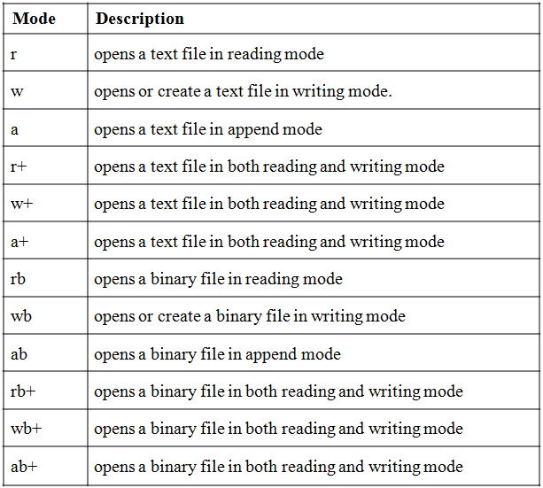

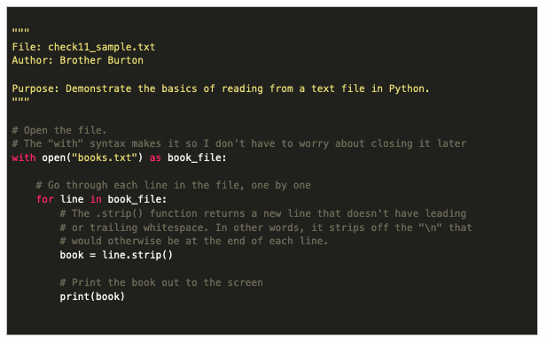
Files
You guessed it,
When you use open
And read/print you will put it in a function.
ReadFunction: return a list or dictionary
WriteFunction: takes a variables or data structures
Two types of files:
Text – ASCII letters only, file type: *.txt
Binary – most every other file, *.doc, *mov
Python uses
With in scope (no indentation)
Var = open(<file>, <mode>)
Creating new scope (indentation)
with open (<file>, <mode>) as var
Where:
<file> is a string with just the filename (*.*) if in the same directory, or specific directoy relative or absolute (dir/*.*)
<mode> is how the file will be open. r – read only, w– write/override only, a – write/append, + - read/write, b– binary, t - text
Var stores a reference to an object of the file within python. You can call methods with var much like you do with strings, lists, and dictionaries.
Typical uses are to read lines from a file like you would a list.
Remember, reading or writing to a file, values need to be converted from or to a string, much like Input/Print.
f = open("demofile2.txt", "a") f.write("Now the file has more content!") f.close()

Slide 10
Check your Understanding from last week
Translate the following algebraic expression into Python.
p = 3n − (17c²)/(r + 5))
Which of the following is correct?
p = 3n - 17(c*c) / (r + 5)
missing * between 17 and (
p = 3 * n - 17 * c * c / (r + 5)
order of operation
p = 3 * n - (17 * 2 ** c) / (r + 5)
it is c**2 not 2**c
p = 3 * n - (17 * c * c) / r + 5
+5 is not included in the denominator
Better
(3-n) – ((17*c**2)/(r+5))

Slide 11
What is a function?
A small set of instructions
Need to know
Arguments, parameters, signature
Optional arguments
Named arguments
Calling a function
Storing the results of a call
def functionName (params, …)
Instructions
return optional_value
Calling a function
rvalue = functionName(value, …)

Slide 12
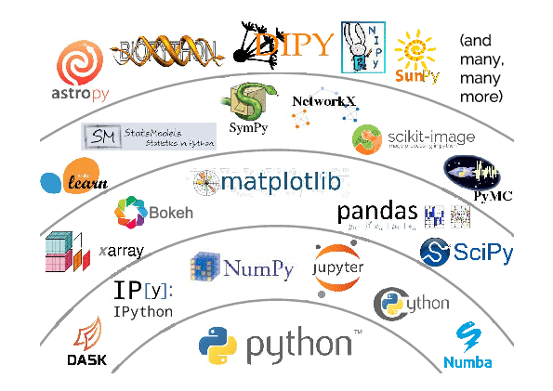
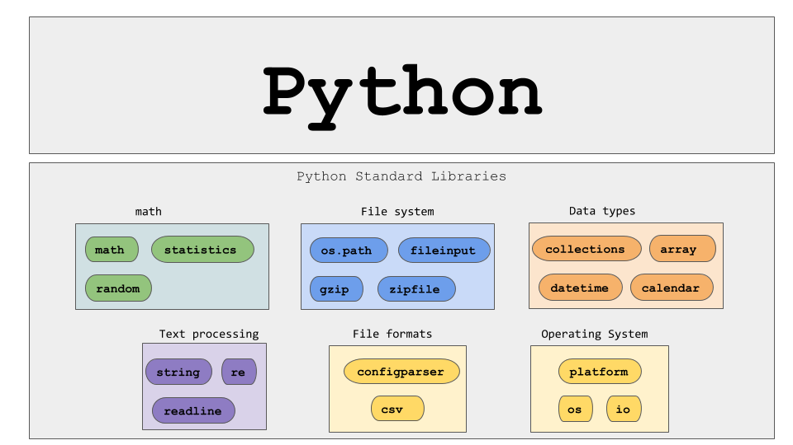
Types of Functions
Main
User-defined functions
Built-in
Standard library Functions
Third-party Functions
User-defined functions
Second-Party Functions
(Project Library)
Second-Party Functions
(Company Library)
Third-Party Functions
Standard Library Functions
Python built-in functions

Slide 13
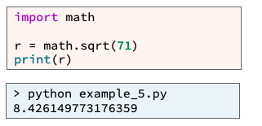
Modules
Another Python file that contains functions
You can call those functions after you have import the file.

Slide 14




Four ways to pass parameters
Output-only
Input-only
Processing
Update
display(
int value)
getvaluetwo():
return 2
isLeap(year):
return !year%4
update(list):
list.append(3)
Value

Slide 15
Understand the Problem (Data Transformation)
Have I read the entire assignment?
What are the inputs?
Looking at the examples, what test data is being used?
How do inputs become outputs?
Do I understand the path of transformation that is occurring?
What are the outputs?
What is the output from the program producing?
Input
Process
Output
main
Input-only
Processing
Update
Output-only
Keyboard
File
Try/accept
Filter
Map
Reduce
Test/assert
List
Dictionary
Display
File
Gui
Debug
Value

Slide 16
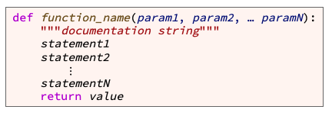
Writing Functions
variable
value
the function name
Start with letter/_, can have a-Z0-9
meaningful
keyword def (which is an abbreviation for "define")
the parameter list (with the parameters separated by commas)
Values are passed in an assigned to variable names.
header or signature
a result value is from a function
Function body

Slide 17
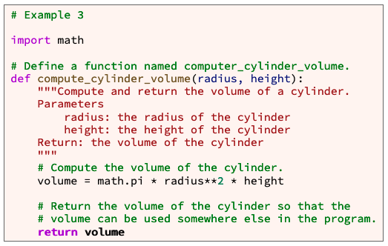
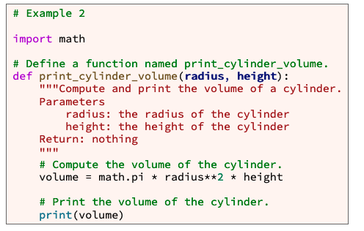
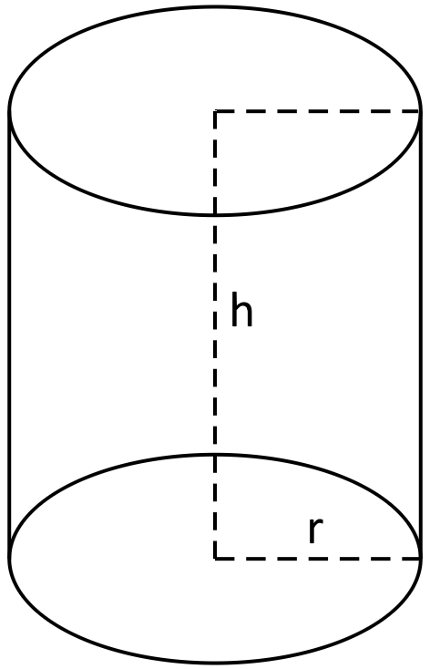
Example

Slide 18
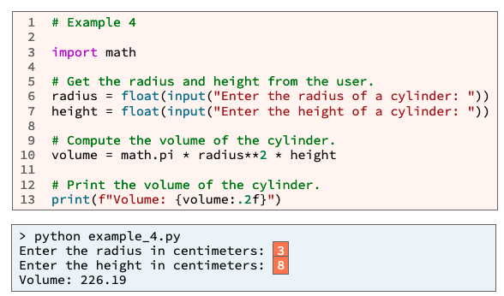
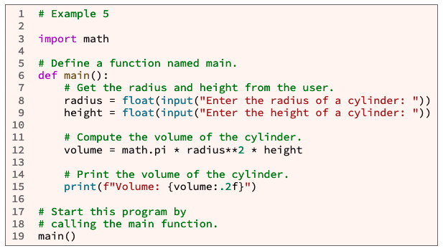
main
Why use main function?
Organization
Writing statements outside a function can lead to poor organization within a large program.
Best Practices
Professional software developers write statements inside a function whenever possible.
No more calling code from the first indentation, except for main

Slide 19
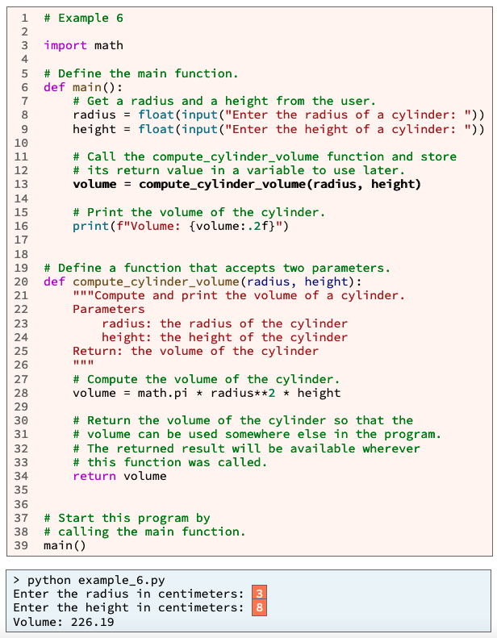
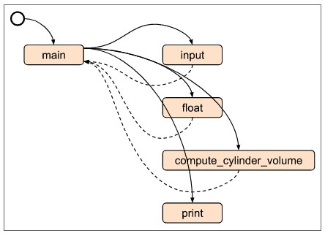
A
1. (A)Python read and compiles the entire file.
Then runs the 1st line of code with zero indentation
i.e. main()
2. Main is called.
Process of input is retrieved and converted (B, C)
3. Within main, compute_cylinder_volume() is called with two parameters.
The variables used pass in the the values they hold.
4. Those values are re-assigned to a new set of variables.
The new variables are used to process the value of volume.
5. The value from volume is return, and stored in main’s volume variable.
6. Main is finished
7. Control flow is return to the next line with no indentation.
Input
Process
Output
2
B
C
B
C
3
3
5
5
D
Value passing
6
D
4
5
Value passing
1
7
A
B
C
D

Slide 20
Prepare:
https://byui-cse.github.io/cse111-course/lesson02/prepare.html
What Is a Function?¶
A function is a group of statements (computer commands) that together perform one task.
Types:
Built-in functions
Standard library functions
Third-party functions
User-defined functions
How to Call a Function¶
Optional Arguments¶
Named Arguments
How to Call a Function that Is inside a Module
How to Call a Method
How to Store a Returned Value
https://docs.python.org/3/library/functions.html
https://www.w3schools.com/python/python_functions.asp

Slide 21
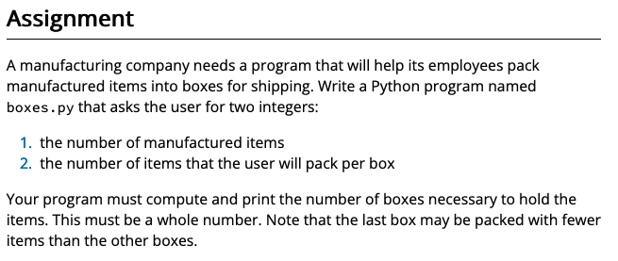
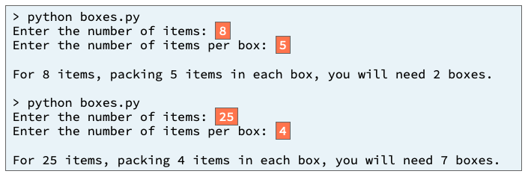
Prepare: Checkpoint 02 Checkpoint: Calling Functions
Purpose:
Check your understanding of calling built-in Python functions and functions that are in a standard Python module.
In our modern world economy, many items are manufactured in large factories, then packed in boxes and shipped to distribution centers and retail stores. A common question for employees who pack items is "How many boxes do we need?"
https://byui-cse.github.io/cse111-course/lesson02/check.html

Slide 22
Input
Process
Output
main

Slide 23
Input
Process
Output
main

Slide 24
Input
Process
Output
main
Get_items()
#
items
value
Get_items_per_box()
#
Items_per_box
value
Display_boxs()
#
boxes_needed = items/ items_per_box

Slide 25
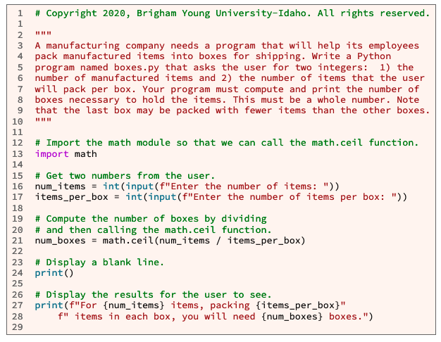
Input
Process
Output
main
Get_items()
#
items
value
Get_items_per_box()
Items_per_box
value
Display_boxs()
#
boxes_needed = items/ items_per_box

Slide 26
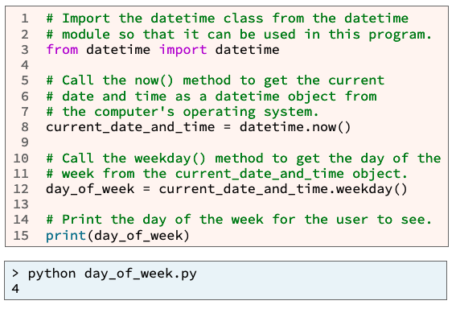
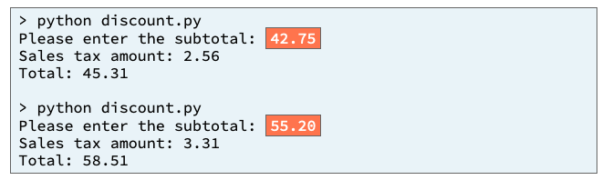
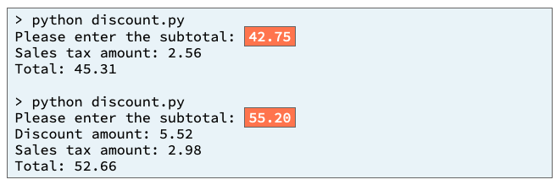
02 Team Activity: Calling Functions
https://byui-cse.github.io/cse111-course/lesson02/teach.html
Purpose:
Improve your understanding of calling built-in Python functions and calling functions and methods that are in a standard Python module.
You work for a retail store that wants to increase sales on Tuesday and Wednesday, which are the store's slowest sales days.
On Tuesday and Wednesday, if a customer's subtotal is $50 or greater, the store will discount the customer's subtotal by 10%.
Core Requirements¶
Your program asks the user for the subtotal but does not ask the user for the day of the week. Your program gets the day of the week from your computer's operating system.
Your program correctly computes and prints the discount amount if applicable.
Your program correctly computes and prints the sales tax amount and the total amount due.
Stretch Challenges
If your team finishes the core requirements in less than an hour, complete one or more of these stretch challenges. Note that the stretch challenges are optional.
Add code to your program that the computer will execute if today is Tuesday or Wednesday and the customer is not purchasing enough to receive the discount. This added code should compute and print the difference between $50 and the subtotal which is the additional amount the customer would need to purchase in order to receive the discount.
Near the beginning of your program replace the code that asks the user for the subtotal with a loop that repeatedly asks the user for a price and a quantity and computes the subtotal. This loop should repeat until the user enters "0" for the price.

Slide 27
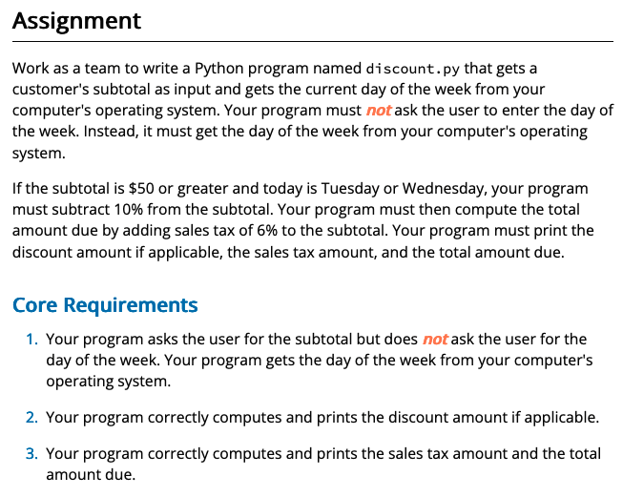
Input
Process
Output
main
Input Functions?
Variables?
Output Functions?
Processing?
As a team I want you to use the white board and determine the function you need to solve this problem.

Slide 28
Input
Process
Output
main
Get_subtotal()
#.#
subtotal
value
#.#
discount
display_discount_amount()
#.#
salestax
display_sales_tax()
#.#
total
display_total()

Slide 29
Input
Process
Output
main
Get_subtotal()
subtotal
value
?
#.#
discount
display_discount_amount()
#.#
salestax
display_sales_tax()
#.#
total
display_total()

Slide 30
Input
Process
Output
main
Get_subtotal()
subtotal
value
?
#.#
discount
display_discount_amount()
#.#
salestax
display_sales_tax()
#.#
total
display_total()

Slide 31
Input
Process
Output
main
Get_subtotal()
subtotal
value
if
Dayofweek == T(2)/W(3)
Or subtotal > 50
Discount_ratio = .1
#.#
discount
display_discount_amount()
Discount_ratio = 0
#.#
salestax
display_sales_tax()
dayofweek
#.#
total
display_total()

Slide 32
Input
Process
Output
main
Get_subtotal()
subtotal
value
if
Dayofweek == T(2)/W(3)
And subtotal > 50
Discount_ratio = .1
#.#
discount
display_discount_amount()
Discount_ratio = 0
#.#
salestax
display_sales_tax()
dayofweek
#.#
total
?
display_total()

Slide 33
Input
Process
Output
main
Get_subtotal()
subtotal
value
if
Dayofweek == T(2)/W(3)
Or subtotal > 50
Discount_ratio = .1
discount
display_discount_amount()
Discount_ratio = 0
salestax
display_sales_tax()
dayofweek
total
display_total()

Slide 34
Input
Process
Output
main
Get_subtotal()
subtotal
value
if
Dayofweek == T(2)/W(3)
Or subtotal > 50
Discount_ratio = .1
discount
display_discount_amount()
Discount_ratio = 0
salestax
display_sales_tax()
dayofweek
total
display_total()
datetime
Now()
weekday()
Date_time_value
Day_ofweek

Slide 35
Input
Process
Output
main
Get_subtotal()
subtotal
value
if
Dayofweek == T(2)/W(3)
Or subtotal > 50
Discount_ratio = .1
#.#
discount
display_discount_amount()
Discount_ratio = 0
#.#
salestax
display_sales_tax()
dayofweek
#.#
total
display_total()
datetime
Now()
weekday()
Date_time_value
Day_ofweek

Slide 36
Input
Process
Output
main
Get_subtotal()
subtotal
value
if
Dayofweek == T(2)/W(3)
Or subtotal > 50
Discount_ratio = .1
Discount_ratio = 0
dayofweek
if
Discount > 0
Discount = subtotal * discount_ratio
display_discount_amount()
Salestax = .06 * (subtotal – discount)
display_sales_tax()
Total = (subtotal-discount) + salestax
display_total()
datetime
Now()
weekday()
Date_time_value
Day_ofweek

Slide 37
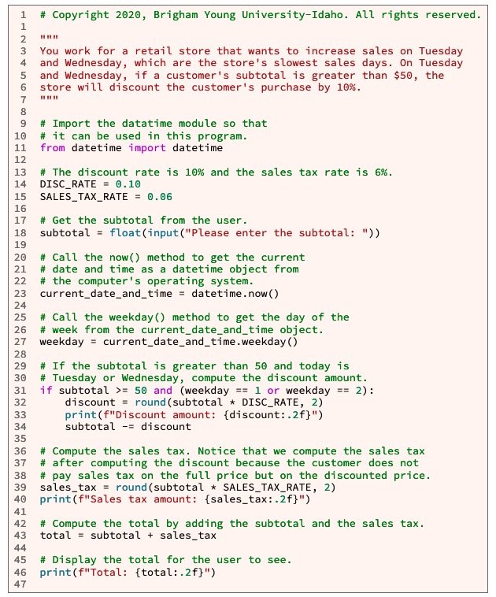
Input
Process
Output
main
Get_subtotal()
subtotal
value
if
Dayofweek == T(2)/W(3)
Or subtotal > 50
Discount_ratio = .1
Discount_ratio = 0
dayofweek
if
Discount > 0
Discount = subtotal * discount_ratio
display_discount_amount()
Salestax = .06 * (subtotal – discount)
display_sales_tax()
Total = (subtotal-discount) + salestax
display_total()
datetime
Now()
weekday()
Date_time_value
Day_ofweek

Slide 39
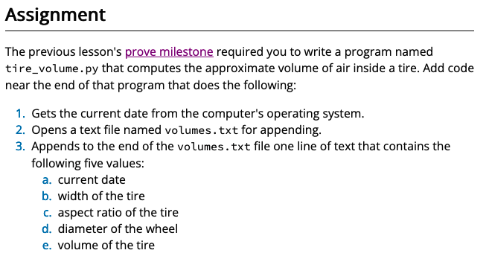
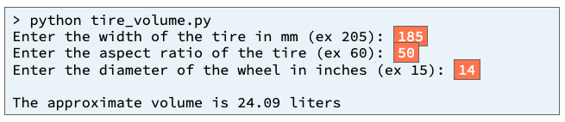
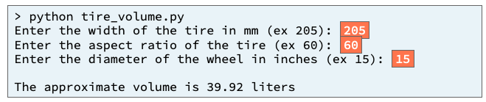
L02 Prove: Assignment 02 Prove: Calling Functions
Purpose:
Prove that you can write a Python program that calls functions and methods to get the current date and to append values to a text file.
Many companies wish to understand the needs and wants of their customers more deeply so the company can create products that fill those needs and wants. One way to understand customers more deeply is to record the values entered by customers while they are using a program and then to analyze those values. One common way to record values is for a program to store them in a file.
https://byui-cse.github.io/cse111-course/lesson02/prove.html

Slide 40
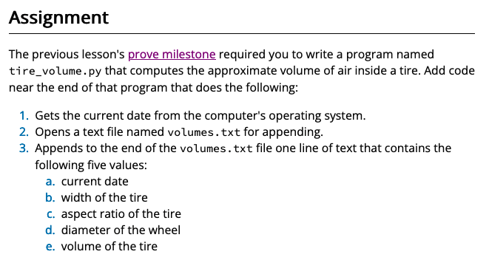
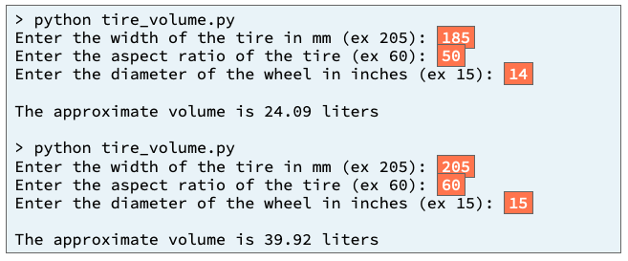
Input
Process
Output
main
Get_width()
w_width
Numerator = p1*(p2+p3)
Numerator_p1= pi*w2*a
Numerator_p2= w*a
Numerator_p3= 2540*d
value
Get_ratio()
a_ratio
value
d_diameter
Display_volume()
Get_diameter()
value
volume = numerator/10M
Previous Ponder 1

Slide 41
Input
Process
Output
main
Display_volume()
Get_width()
w_width
Numerator = p1*(p2+p3)
Numerator_p1= pi*w2*a
Numerator_p2= w*a
Numerator_p3= 2540*d
value
Get_ratio()
a_ratio
value
Get_diameter()
d_diameter
value
volume = numerator/10M
datetime
Now()
weekday()
Date_time_value
Day_ofweek

Slide 42
Input
Process
Output
main
Display_volume()
Get_width()
w_width
Numerator = p1*(p2+p3)
Numerator_p1= pi*w2*a
Numerator_p2= w*a
Numerator_p3= 2540*d
value
Get_ratio()
a_ratio
value
Get_diameter()
d_diameter
value
volume = numerator/10M
Date_str = f"{current_date_and_time:%Y-%m-%d}"
current_date_and_time
datetime
Now()
weekday()
Date_time_value
Day_ofweek

Slide 43
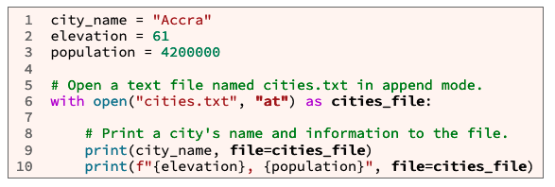
Input
Process
Output
main
Display_volume()
Get_width()
w_width
Numerator = p1*(p2+p3)
Numerator_p1= pi*w2*a
Numerator_p2= w*a
Numerator_p3= 2540*d
value
date
width
Get_ratio()
a_ratio
ratio
value
diameter
d_diameter
volume
Get_diameter()
value
volume = numerator/10M
Write_to_file()
Date_str = f"{current_date_and_time:%Y-%m-%d}"
current_date_and_time
Volume.txt
datetime
Now()
weekday()
Date_time_value
Day_ofweek

Slide 44
Input
Process
Output
main
Display_volume()
Get_width()
w_width
Numerator = p1*(p2+p3)
Numerator_p1= pi*w2*a
Numerator_p2= w*a
Numerator_p3= 2540*d
value
date
width
Get_ratio()
a_ratio
ratio
value
diameter
d_diameter
volume
Get_diameter()
value
volume = numerator/10M
Write_to_file()
Date_str = f"{current_date_and_time:%Y-%m-%d}"
current_date_and_time
Volume.txt
datetime
Now()
weekday()
Date_time_value
Day_ofweek

Slide 45
Helpful Hints
datetime.now() method
from datetime import datetime
current_date_and_time = datetime.now()
print(f"{current_date_and_time:%Y-%m-%d}")
open() function
open(filename, mode="rt")
print() function
print(*objects, sep=" ", end="\n", file=sys.stdout, flush=False)
lesson 11 prepare content from CSE 110

Slide 46
L02 Prove: Assignment 02 Prove: Calling Functions
Verify: Testing Procedures
Run with the inputs
Tire width = 185, Ratio = 50, Diameter = 14
open the volumes.txt
Verify: 2020-03-18, 185, 50, 14, 24.09
Tire width = 205, Ratio = 60, Diameter = 15
open the volumes.txt
Verify:
2020-03-18, 185, 50, 14, 24.09
2020-04-16, 205, 60, 15, 39.92

Slide 47
L02 Ponder: Reflection
Quiz Instructions
Overview
Task: Reflect on your learning.
Purpose: Promote long-term retention of the subject matter.
Notes
Each question in this bi-weekly quiz requires a short essay response.
Your instructor will carefully review each response to determine possible areas of need and support.
Please answer each question honestly and completely to help your instructor better understand your needs.
What topic from this week are you uncertain of or would like to know more about?
What accomplishment from this week are you the most proud of and why?

