Slide 1
CSE 111
Writing Functions
W. Clements

Slide 2
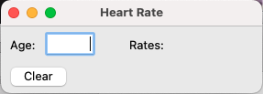
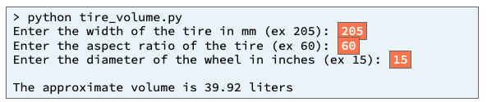
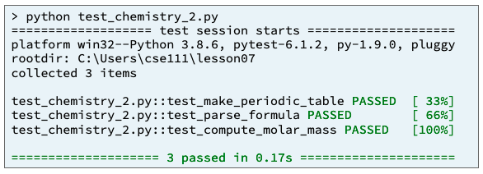
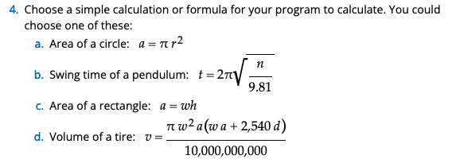
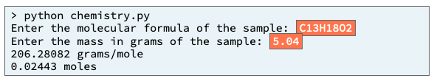
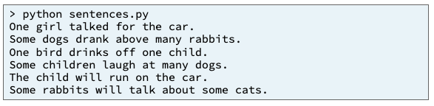
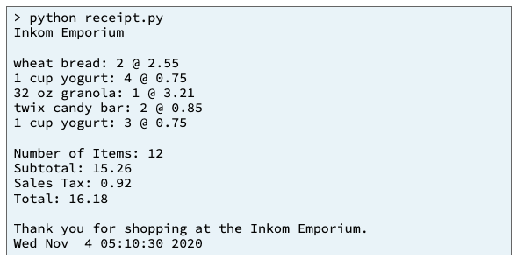
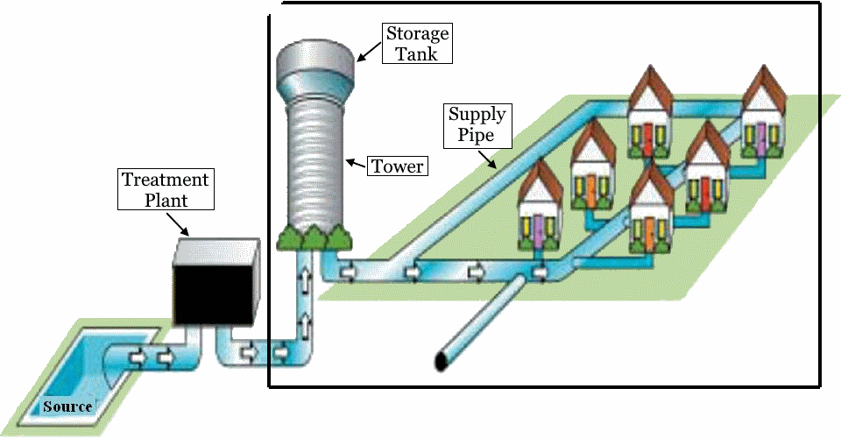
Preview of Projects – 50%
Chemistry Program
Heart Rate & Physics Equation
Inventory Program
Sentence Program
Receipt Program
Student Chosen Program
solves a real-world problem
Water Distribution Program
useful in your major or hobby.
https://byui-cse.github.io/cse111-course/lesson11/prove.html

Slide 3
Overview
Prepare: Reading, Video
Checkpoint
Teach: Class Activity
Prove: Milestone
Ponder: Check your understanding

Slide 4
Understand the Problem (Data Transformation)
Have I read the entire assignment?
What are the inputs?
Looking at the examples, what test data is being used?
How do inputs become outputs?
Do I understand the path of transformation that is occurring?
What are the outputs?
What is the output from the program producing?
Input
Process
Output
main
wac_get_function()
wac_display_function()
Python: input function
while loop
Python: print function
Process
Code
(branches and loops)
Variables
& Data Structures
Variables
& Data Structures
wac_read_function()
wac_read_function()
Python: open function
(reading) for loop
Python: open function
If list: for loop
Library Functions
math

Slide 5
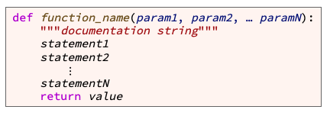
What does it look like in code?
def wac_get_function(): …
def wac_open_function(): … def wac_convert_value(p_var): …
def wac_filter_lines(p_lines): … def wac_display_function(p_converted_var): … def wac_write_function(p_filtered_list): … def main():
#input function calls
wac_var = wac_get_function()
wac_lines = wac_open_function()
#process function calls
wac_converted_var = wac_convert_value(wac_var)
wac_filtered_list = wac_filter_lines( wac_lines)
#ouput function calls
wac_display_function(wac_coverted_var)
wac_write_function( wac_filtered_list)
main()

Slide 6
Prepare 03 Prepare: Writing Functions
Videos
Introducing Functions
Demonstration: Functions
Parameterized Functions
Demonstration: Parameterized Functions
Concepts
What Is a Function?¶
What Is a User-Defined Function?
How to Write a User-Defined Function¶
How to Make a User-Defined Function Reusable¶
The main User-Defined Function¶
A Complete Program with User-Defined Functions¶
What Happens When the Computer Calls a Function?¶
Call Graphs¶
Summary¶

Slide 7
Writing Functions
variable
value
the function name
Start with letter/_, can have a-Z0-9
meaningful
keyword def (which is an abbreviation for "define")
the parameter list (with the parameters separated by commas)
Values are passed in an assigned to variable names.
header or signature
a result value is from a function
Function body

Slide 8
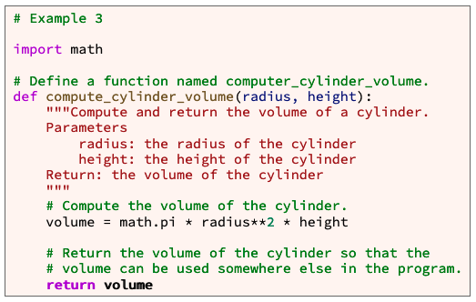
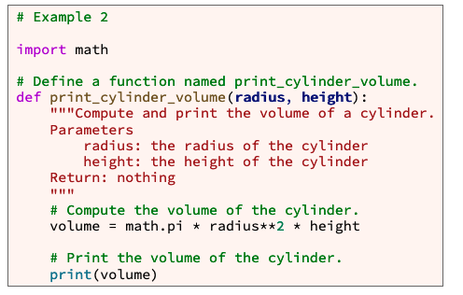
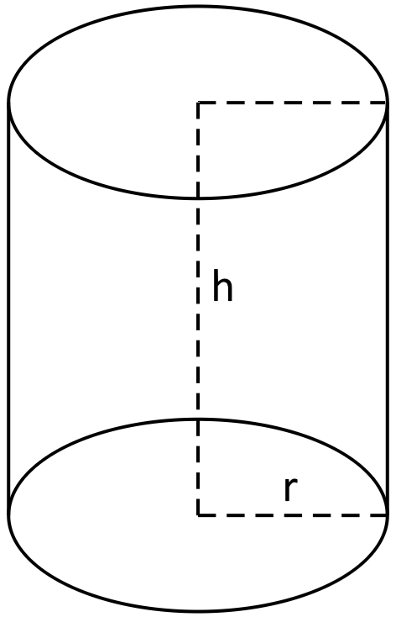
Example

Slide 9
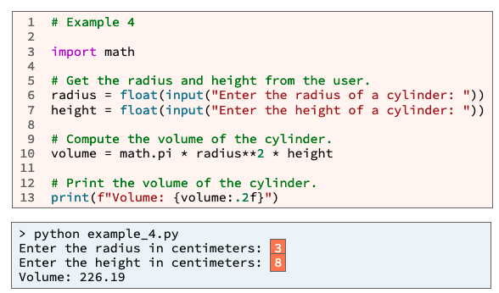
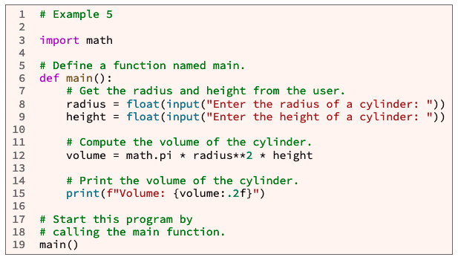
main
Why use main function?
Organization
Writing statements outside a function can lead to poor organization within a large program.
Best Practices
Professional software developers write statements inside a function whenever possible.
No more calling code from the first indentation, except for main

Slide 10
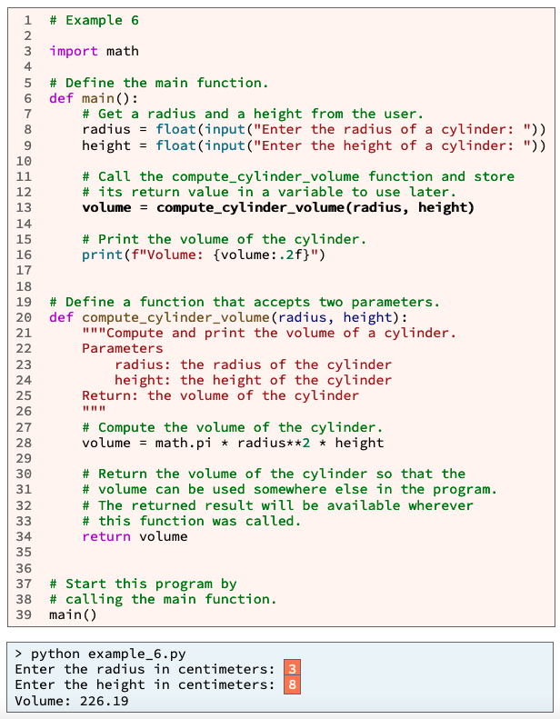
A
1
A
B
C
D

Slide 11
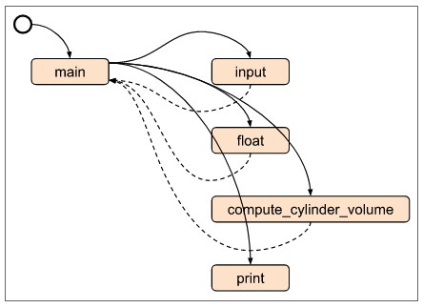
A
1. (A)Python read and compiles the entire file.
Then runs the 1st line of code with zero indentation
i.e. main()
2. Main is called.
Process of input is retrieved and converted (B, C)
3. Within main, compute_cylinder_volume() is called with two parameters.
The variables used pass in the the values they hold.
4. Those values are re-assigned to a new set of variables.
The new variables are used to process the value of volume.
5. The value from volume is return, and stored in main’s volume variable.
6. Main is finished
7. Control flow is return to the next line with no indentation.
Input
Process
Output
2
B
C
B
C
3
3
5
5
D
Value passing
6
D
4
5
Value passing
1
7
A
B
C
D

Slide 12
Summary
A function is a group of statements that together perform one task. A user-defined function is a function written by a programmer like you. To write a user-defined function, write code that follows this template:
To call a user-defined function, write code that follows this template:
def function_name(param1, param2, … paramN):
"""documentation string"""
statement1
statement2
⋮
statementN
return value
variable_name = function_name(arg1, arg2, … argN)

Slide 13
L03 Prepare: Checkpoint 03 Checkpoint: Writing Functions

Slide 14
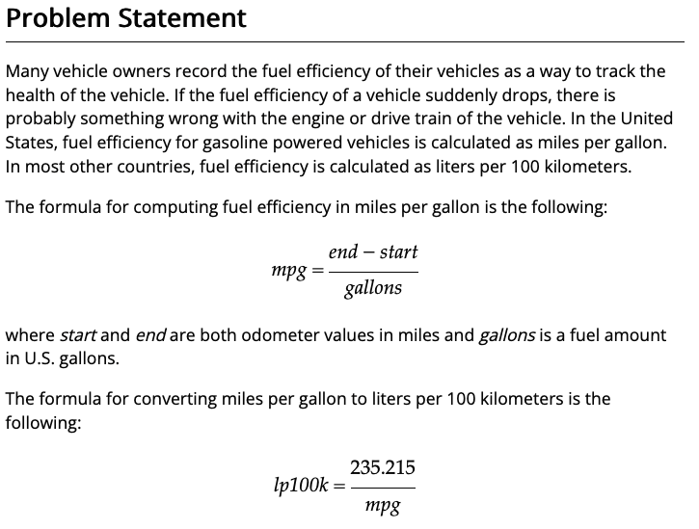
L03 Prepare: Checkpoint 03 Checkpoint: Writing Functions
https://byui-cse.github.io/cse111-course/lesson03/check.html
Purpose
Check your understanding of writing your own functions with parameters and then calling those functions with arguments.
Assignment
Write a Python program that asks the user for three numbers:
A starting odometer value in miles
An ending odometer value in miles
An amount of fuel in gallons
Your program must calculate and print fuel efficiency in both miles per gallon and liters per 100 kilometers. Your program must have three functions named as follows:
main
miles_per_gallon
lp100k_from_mpg
All user input and printing must be in the main function. In other words, the miles_per_gallon and lp100k_from_mpg functions must not call the the input or print functions.

Slide 15
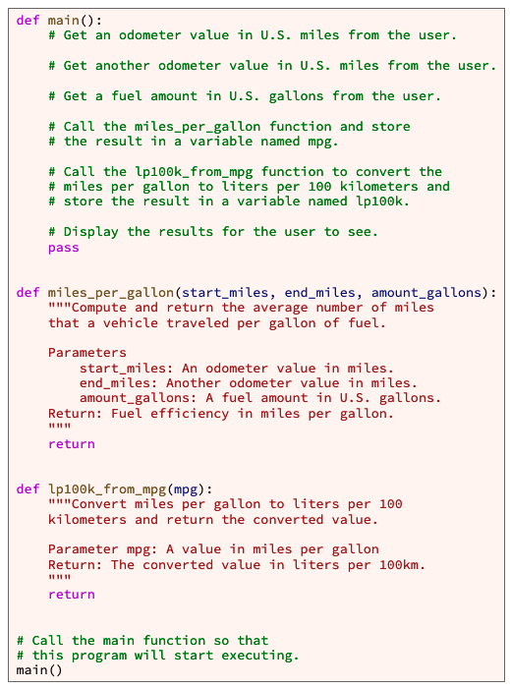
L03 Prepare: Checkpoint 03 Checkpoint: Writing Functions
Step 1: Create a new python file, add header comment block with name, date, and purpose and problem statement
Step 2: Make main() function
A. make def main(): with a print statement “Hello world”, to see if python is still working.
B. call main() from first indentation.
Step 3: Copy provide code. Your welcome!!
Look at the example output and determine order
Step 4. Work on each objective in the assignment.
Step 5. Test it.
Assignment
Write a Python program that asks the user for three numbers:
A starting odometer value in miles
An ending odometer value in miles
An amount of fuel in gallons
Your program must calculate and print fuel efficiency in both miles per gallon and liters per 100 kilometers. Your program must have three functions named as follows:
main
miles_per_gallon
lp100k_from_mpg
All user input and printing must be in the main function. In other words, the miles_per_gallon and lp100k_from_mpg functions must not call the the input or print functions.

Slide 16
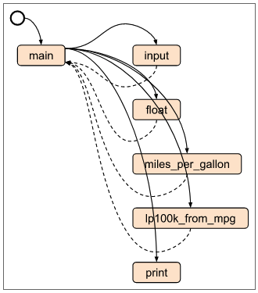
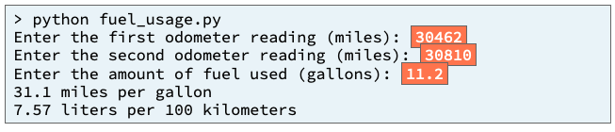
L03 Prepare: Checkpoint 03 Checkpoint: Writing Functions
Input
Process
Output
Line = values
variables

Slide 17
L03 Prepare: Checkpoint 03 Checkpoint: Writing Functions
Input
Process
Output
main
Line = values
miles_per_gallon()
lp100k_from_mpg()
variables

Slide 18
L03 Prepare: Checkpoint 03 Checkpoint: Writing Functions
Input
Process
Output
Get_start_odometer()
Get_end_odometer()
Display_miles_per_gallon()
Get_gallons()
Display_liters_per_kiloM()
main
Line = values
miles_per_gallon()
lp100k_from_mpg()
variables

Slide 19
L03 Prepare: Checkpoint 03 Checkpoint: Writing Functions
Input
Process
Output
Get_start_odometer()
Get_end_odometer()
Display_miles_per_gallon()
Get_gallons()
Display_liters_per_kiloM()
main
start_odometer
end_odometer
gallons_used
miles_per_gallon
liters_per_km
Line = values
miles_per_gallon()
lp100k_from_mpg()
variables

Slide 20
L03 Prepare: Checkpoint 03 Checkpoint: Writing Functions
Input
Process
Output
Get_start_odometer()
Get_end_odometer()
Display_miles_per_gallon()
Get_gallons()
Display_liters_per_kiloM()
main
start_odometer
end_odometer
gallons_used
miles_per_gallon
liters_per_km
Line = values
miles_per_gallon()
lp100k_from_mpg()
mpg = (end − start)/gallons
variables
lp100k = 235.215/mpg

Slide 21
L03 Prepare: Checkpoint 03 Checkpoint: Writing Functions
Input
Process
Output
Get_start_odometer()
Get_end_odometer()
Display_miles_per_gallon()
Get_gallons()
Display_liters_per_kiloM()
main
start_odometer
end_odometer
i.e.
Start_odometer = get_start_odomenter()
miles_per_gallon = miles_per_gallon(start…, end…, gallons...)
Display_miles_per_gallon(miles_per_gallon)
gallons_used
miles_per_gallon
liters_per_km
Line = values
miles_per_gallon()
lp100k_from_mpg()
mpg = (end − start)/gallons
variables
lp100k = 235.215/mpg

Slide 22
L03 Prepare: Checkpoint 03 Checkpoint: Writing Functions
Input
Process
Output
Get_start_odometer()
Get_end_odometer()
Display_miles_per_gallon()
Get_gallons()
Display_liters_per_kiloM()
main
start_odometer
end_odometer
gallons_used
def main():
start_odometer = get_start_odometer()
end_odometer = get_end_odomenter()
gallons_used = get_gallons()
miles_per_gallon = miles_per_gallon(start_o, end_o, gallon_used)
liters_per_km = lp100k_from_mpg(miles_per_gallon)
display_miles_per_gallon( miles_per_gallon)
display_liters_per_kiloM( liter_per_km)
miles_per_gallon
liters_per_km
Line = values
miles_per_gallon()
lp100k_from_mpg()
mpg = (end − start)/gallons
variables
lp100k = 235.215/mpg

Slide 23
L03 Teach: Team Activity 03 Team Activity: Writing Functions
Purpose:
Boost your understanding of writing your own functions with parameters and then calling those functions with arguments.

Slide 24
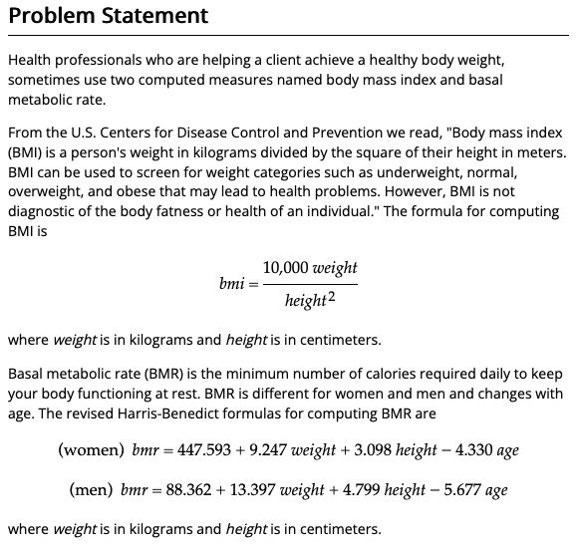
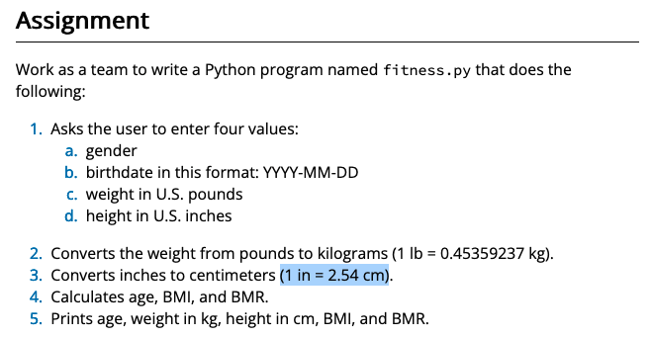
L03 Teach: Team Activity 03 Team Activity: Writing Functions
Purpose:
Boost your understanding of writing your own functions with parameters and then calling those functions with arguments.

Slide 25
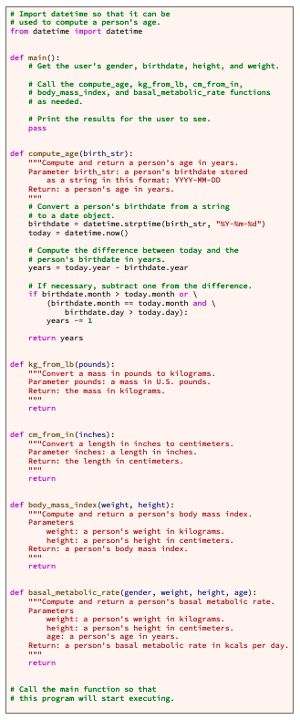
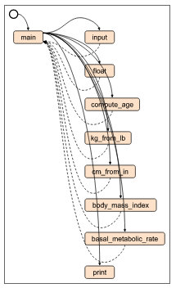
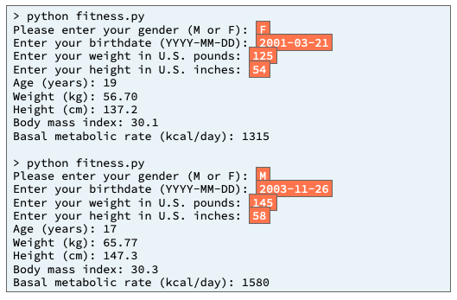
L03 Teach: Team Activity 03 Team Activity: Writing Functions
Purpose:
Boost your understanding of writing your own functions with parameters and then calling those functions with arguments.

Slide 26
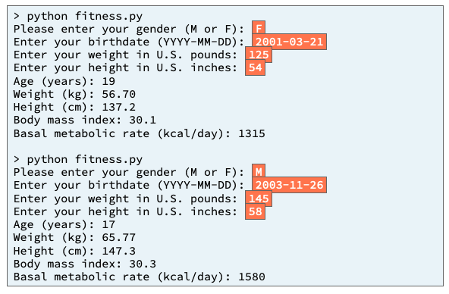
Input
Process
Output
main
Start off with the basic understanding of all programs and functions

Slide 27
What functions are being ask for?
Input
Process
Output
main
gender
weight
height
age
birth_str
pounds
inches
Weight (kg)
Height(cm)
Compute_age()
Kg_from_lb()
cm_from_in()
body_mass_index()
basal_metabolic_rate()
age
kg
cm
index

Slide 28
What does the input and output look like?
Input
Process
Output
main
Display_age()
Get_gender()
Display_weight_kg()
Get_birthday()
Display_height_cm()
Get_weight()
Display_bodymass_index()
Get_inches()
displayMetabolicRate()
gender
weight
height
age
birth_str
pounds
inches
Weight (kg)
Height(cm)
Compute_age()
Kg_from_lb()
cm_from_in()
body_mass_index()
basal_metabolic_rate()
age
kg
cm
index

Slide 29
Where are we storing the inputs and outputs?
Input
Process
Output
main
Display_age()
age
Get_gender()
gender
Weigth_kg
Display_weight_kg()
Get_birthday()
birthday
Heigth_cm
Display_height_cm()
Get_weight()
Weight_lbs
bodaymassindex
Height_inches
Display_bodymass_index()
Get_inches()
metabolicrate
displayMetabolicRate()
gender
weight
height
age
birth_str
pounds
inches
Weight (kg)
Height(cm)
Compute_age()
Kg_from_lb()
cm_from_in()
body_mass_index()
basal_metabolic_rate()
age
kg
cm
index

Slide 30
What do we not know?
Input
Process
Output
main
Display_age()
age
Get_gender()
gender
Weigth_kg
Display_weight_kg()
Get_birthday()
birthday
Heigth_cm
Display_height_cm()
Get_weight()
Weight_lbs
bodaymassindex
Height_inches
Display_bodymass_index()
Get_inches()
metabolicrate
displayMetabolicRate()
gender
weight
height
age
birth_str
pounds
inches
Weight (kg)
Height(cm)
Compute_age()
Kg_from_lb()
cm_from_in()
body_mass_index()
basal_metabolic_rate()
age
kg
cm
index
?
?
?
?
Given in provided code

Slide 31

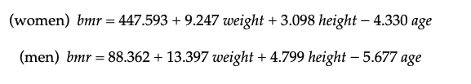
Input
Process
Output
main
Display_age()
age
Get_gender()
gender
Weigth_kg
Display_weight_kg()
Get_birthday()
birthday
Heigth_cm
Display_height_cm()
Get_weight()
Weight_lbs
bodaymassindex
Height_inches
Display_bodymass_index()
Get_inches()
metabolicrate
displayMetabolicRate()
Where can we find this information?
gender
weight
height
age
birth_str
pounds
inches
Weight (kg)
Height(cm)
Compute_age()
Kg_from_lb()
cm_from_in()
body_mass_index()
basal_metabolic_rate()
age
kg
cm
index
Given in provided code
(1 lb = 0.45359237 kg).
(1 in = 2.54 cm)

Slide 32
Algorithms
Algorithms use the same input, process, output paradigm as a program (main)
Input
pounds
Get_weight()
Kg_from_lb()
kg
“Enter your weight in U.S. pounds:"
Process
#(1 lb = 0.45359237 kg).
Kilogram = .45458237*pounds
string
⌨️
string
input()
kilogram
string
return
int
int()
int
weight
Output
return
int

Slide 33
gender
weight
height
age
Input
basal_metabolic_rate()
Algorithms use the same input, process, output paradigm as a program (main)
Output
Process
If gender
weight
Women_bmr
weight
Men_bmr
height
bmr
height
bmr
age
age
bmr
return
bmr
Output

Slide 34
gender = get_gender()
birthday = get_birthday()
weight_lbs = get_weight()
height_inches = get_inches()
age = compute_age(birthday)
weight_kg = kg_from_lb(weight_lbs)
height_cm = cm_from_in(height_inches)
bodymassindex = body_mass_index(weight_kg, height_cm)
metabolicrate = basel_metabolic_rate(gender, weight_kg, height_cm, age)
display_age(age)
display_weight_kg(weight_kg)
display_height_cm(height_cm)
display_bodymass_index(bodymassindex)
displayMetabolicRate(metabolicrate)
Now let’s connect the lines!
Input
Process
Output
main
Display_age()
age
Get_gender()
gender
Weigth_kg
Display_weight_kg()
Get_birthday()
birthday
Heigth_cm
Display_height_cm()
Get_weight()
Weight_lbs
bodaymassindex
Height_inches
Display_bodymass_index()
Get_inches()
metabolicrate
displayMetabolicRate()
gender
weight
height
age
birth_str
pounds
inches
Weight (kg)
Height(cm)
Compute_age()
Kg_from_lb()
cm_from_in()
body_mass_index()
basal_metabolic_rate()
age
kg
cm
index

Slide 35
A little more color
Input
Process
Output
main
Display_age()
age
Get_gender()
gender
Weigth_kg
Display_weight_kg()
Get_birthday()
birthday
Heigth_cm
Display_height_cm()
Get_weight()
Weight_lbs
bodaymassindex
Height_inches
Display_bodymass_index()
Get_inches()
metabolicrate
displayMetabolicRate()
gender
weight
height
age
birth_str
pounds
inches
Weight (kg)
Height(cm)
Compute_age()
Kg_from_lb()
cm_from_in()
body_mass_index()
basal_metabolic_rate()
age
kg
cm
index

Slide 36
gender = get_gender()
birthday = get_birthday()
weight_lbs = get_weight()
height_inches = get_inches()
Input
Input
Process
Output
main
Display_age()
age
Get_gender()
gender
Weigth_kg
Display_weight_kg()
Get_birthday()
birthday
Heigth_cm
Display_height_cm()
Get_weight()
Weight_lbs
bodymassindex
Height_inches
Display_bodymass_index()
Get_inches()
metabolicrate
displayMetabolicRate()
gender
weight
height
age
birth_str
pounds
inches
Weight (kg)
Height(cm)
Compute_age()
Kg_from_lb()
cm_from_in()
body_mass_index()
basal_metabolic_rate()
age
kg
cm
index

Slide 37
gender = get_gender()
birthday = get_birthday()
weight_lbs = get_weight()
height_inches = get_inches()
age = compute_age(birthday)
next
Input
Process
Output
main
Display_age()
age
Get_gender()
gender
Weigth_kg
Display_weight_kg()
Get_birthday()
birthday
Heigth_cm
Display_height_cm()
Get_weight()
Weight_lbs
bodaymassindex
Height_inches
Display_bodymass_index()
Get_inches()
metabolicrate
displayMetabolicRate()
gender
weight
height
age
birth_str
pounds
inches
Weight (kg)
Height(cm)
Compute_age()
Kg_from_lb()
cm_from_in()
body_mass_index()
basal_metabolic_rate()
age
kg
cm
index

Slide 38
gender = get_gender()
birthday = get_birthday()
weight_lbs = get_weight()
height_inches = get_inches()
age = compute_age(birthday)
weight_kg = kg_from_lb(weight_lbs)
next
Input
Process
Output
main
Display_age()
age
Get_gender()
gender
Weigth_kg
Display_weight_kg()
Get_birthday()
birthday
Heigth_cm
Display_height_cm()
Get_weight()
Weight_lbs
bodaymassindex
Height_inches
Display_bodymass_index()
Get_inches()
metabolicrate
displayMetabolicRate()
gender
weight
height
age
birth_str
pounds
inches
Weight (kg)
Height(cm)
Compute_age()
Kg_from_lb()
cm_from_in()
body_mass_index()
basal_metabolic_rate()
age
kg
cm
index

Slide 39
gender = get_gender()
birthday = get_birthday()
weight_lbs = get_weight()
height_inches = get_inches()
age = compute_age(birthday)
weight_kg = kg_from_lb(weight_lbs)
height_cm = cm_from_in(height_inches)
next
Input
Process
Output
main
Display_age()
age
Get_gender()
gender
Weigth_kg
Display_weight_kg()
Get_birthday()
birthday
Heigth_cm
Display_height_cm()
Get_weight()
Weight_lbs
bodaymassindex
Height_inches
Display_bodymass_index()
Get_inches()
metabolicrate
displayMetabolicRate()
gender
weight
height
age
birth_str
pounds
inches
Weight (kg)
Height(cm)
Compute_age()
Kg_from_lb()
cm_from_in()
body_mass_index()
basal_metabolic_rate()
age
kg
cm
index

Slide 40
gender = get_gender()
birthday = get_birthday()
weight_lbs = get_weight()
height_inches = get_inches()
age = compute_age(birthday)
weight_kg = kg_from_lb(weight_lbs)
height_cm = cm_from_in(height_inches)
bodymassindex = body_mass_index(weight_kg, height_cm)
next
Input
Process
Output
main
Display_age()
age
Get_gender()
gender
Weigth_kg
Display_weight_kg()
Get_birthday()
birthday
Heigth_cm
Display_height_cm()
Get_weight()
Weight_lbs
bodaymassindex
Height_inches
Display_bodymass_index()
Get_inches()
metabolicrate
displayMetabolicRate()
gender
weight
height
age
birth_str
pounds
inches
Weight (kg)
Height(cm)
Compute_age()
Kg_from_lb()
cm_from_in()
body_mass_index()
basal_metabolic_rate()
age
kg
cm
index

Slide 41
gender = get_gender()
birthday = get_birthday()
weight_lbs = get_weight()
height_inches = get_inches()
age = compute_age(birthday)
weight_kg = kg_from_lb(weight_lbs)
height_cm = cm_from_in(height_inches)
bodymassindex = body_mass_index(weight_kg, height_cm)
metabolicrate = basel_metabolic_rate(gender, weight_kg, height_cm, age)
next
Input
Process
Output
main
Display_age()
age
Get_gender()
gender
Weigth_kg
Display_weight_kg()
Get_birthday()
birthday
Heigth_cm
Display_height_cm()
Get_weight()
Weight_lbs
bodaymassindex
Height_inches
Display_bodymass_index()
Get_inches()
metabolicrate
displayMetabolicRate()
gender
weight
height
age
birth_str
pounds
inches
Weight (kg)
Height(cm)
Compute_age()
Kg_from_lb()
cm_from_in()
body_mass_index()
basal_metabolic_rate()
age
kg
cm
index

Slide 42
gender = get_gender()
birthday = get_birthday()
weight_lbs = get_weight()
height_inches = get_inches()
age = compute_age(birthday)
weight_kg = kg_from_lb(weight_lbs)
height_cm = cm_from_in(height_inches)
bodymassindex = body_mass_index(weight_kg, height_cm)
metabolicrate = basel_metabolic_rate(gender, weight_kg, height_cm, age)
display_age(age)
display_weight_kg(weight_kg)
display_height_cm(height_cm)
display_bodymass_index(bodymassindex)
displayMetabolicRate(metabolicrate)
next
Input
Process
Output
main
Display_age()
age
Get_gender()
gender
Weigth_kg
Display_weight_kg()
Get_birthday()
birthday
Heigth_cm
Display_height_cm()
Get_weight()
Weight_lbs
bodaymassindex
Height_inches
Display_bodymass_index()
Get_inches()
metabolicrate
displayMetabolicRate()
gender
weight
height
age
birth_str
pounds
inches
Weight (kg)
Height(cm)
Compute_age()
Kg_from_lb()
cm_from_in()
body_mass_index()
basal_metabolic_rate()
age
kg
cm
index

Slide 43
def main():
gender = get_gender()
birthday = get_birthday()
weight_lbs = get_weight()
height_inches = get_inches()
age = compute_age( birthday)
weight_kg = kg_from_lb(weight_lbs)
height_cm = cm_from_in(height_inches)
bodymassindex = body_mass_index(weight_kg, height_cm)
metabolicrate = basel_metabolic_rate(gender, weight_kg, height_cm, age)
display_age(age)
display_weight_kg(weight_kg)
display_height_cm(height_cm)
display_bodymass_index(bodymassindex)
displayMetabolicRate(metabolicrate)
Data Flow Diagram
Input
Process
Output
main
Display_age()
age
Get_gender()
gender
Weigth_kg
Display_weight_kg()
Get_birthday()
birthday
Heigth_cm
Display_height_cm()
Get_weight()
Weight_lbs
bodaymassindex
Height_inches
Display_bodymass_index()
Get_inches()
metabolicrate
displayMetabolicRate()
gender
weight
height
age
birth_str
pounds
inches
Weight (kg)
Height(cm)
Compute_age()
Kg_from_lb()
cm_from_in()
body_mass_index()
basal_metabolic_rate()
age
kg
cm
index

Slide 44
03 Prove Milestone: Testing and Fixing Functions

Slide 45
03 Prove Milestone: Testing and Fixing Functions
Purpose
Prove that you can write a Python program and write and run test functions to help you find and fix mistakes.

Slide 46
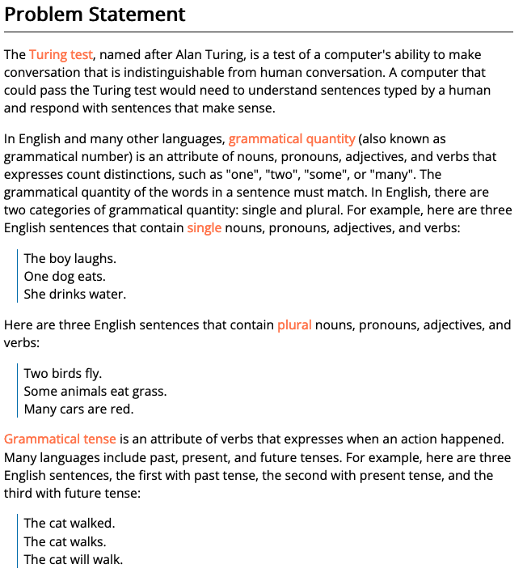
03 Prove Milestone: Testing and Fixing Functions
Purpose
Prove that you can write a Python program and write and run test functions to help you find and fix mistakes.

Slide 47
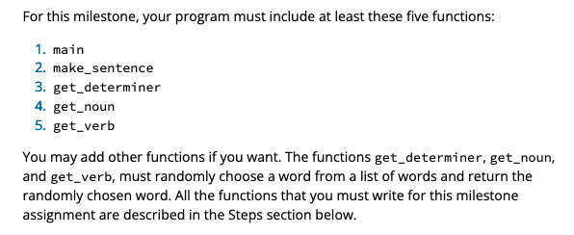
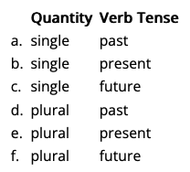
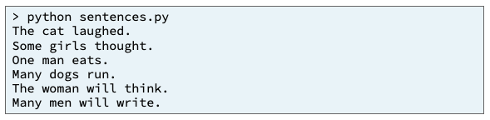
Input
Process
Output
main
quantity
quantity
birth_str
get_determiner()
get_noun()
get_verb()

Slide 48
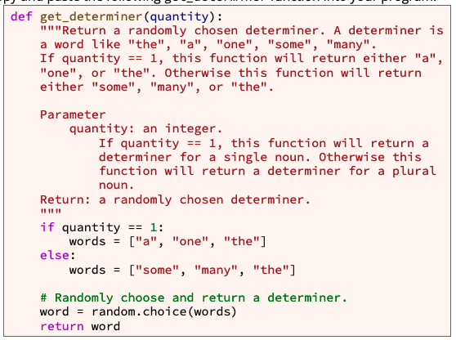
def get_determiner(quantity):
If quantity == 1
words = ["a", "one", "the"]
words = ["some", "many", "the"]
word = random.choice(words)
return word

Slide 49
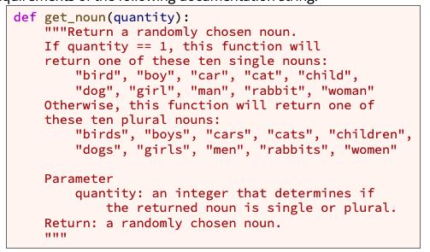
def get_noun(quantity):
If quantity == 1
words = ["bird", "boy", "car", "cat", "child", "dog", "girl", "man", "rabbit", "woman”]
words = ["birds", "boys", "cars", "cats", "children", "dogs", "girls", "men", "rabbits", "women”]
word = random.choice(words)
return word

Slide 50
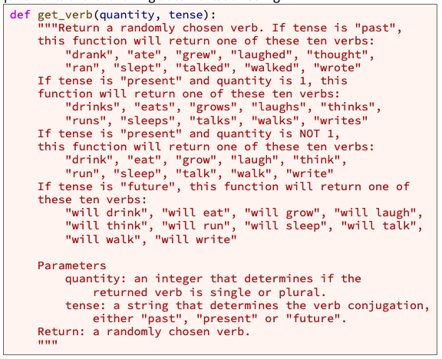
def get_verb(quantity, tense):
If tense == past
words = ["drank", "ate", "grew", "laughed", "thought", "ran", "slept", "talked", "walked", "wrote”]
If tense == future
words = ["will drink", "will eat", "will grow", "will laugh", "will think", "will run", "will sleep", "will talk", "will walk", "will write”]
If tense == present
words = ["drinks", "eats", "grows", "laughs", "thinks", "runs", "sleeps", "talks", "walks", "writes”]
If quantity == 1
Else #If quantity >1
words = ["drink", "eat", "grow", "laugh", "think", "run", "sleep", "talk", "walk", "write”]
word = random.choice(words)
return word

Slide 51
Input
Process
Output
main
quantity
quantity
birth_str
get_determiner()
get_noun()
get_verb()

Slide 52
Input
Process
Output
determiner
sentence
main
noun
+
verb
quantity
tense
quantity
quantity
birth_str
get_determiner()
get_noun()
get_verb()

Slide 53
Input
Process
Output
determiner
sentence
main
noun
+
verb
quantity
tense
quantity
quantity
quantity
tense
get_determiner()
get_noun()
get_verb()

Slide 54
Input
Process
Output
determiner
sentence
main
Quantity = [“single”, “plural”]
Or Quantity = [1,2]
noun
+
Tense = [“past”, ”present”, ”future”]
verb
Quantity?
Tense?
quantity
quantity
quantity
tense
get_determiner()
get_noun()
get_verb()

Slide 55
Input
Process
Output
determiner
sentence
main
QuantityList = [“single”, “plural”]
Or Quantity = [1,2]
noun
+
TenseList = [“past”, ”present”, ”future”]
verb
Quantity?
For Quantity in QuanityList
Tense?
For Tense in TenseList
quantity
quantity
quantity
tense
get_determiner()
get_noun()
get_verb()

Slide 56
Input
Process
Output
determiner
sentence
main
QuantityList = [“single”, “plural”]
Or Quantity = [1,2]
noun
+
TenseList = [“past”, ”present”, ”future”]
verb
quantity
For Quantity in QuanityList
tense
For Tense in TenseList
quantity
quantity
quantity
tense
get_determiner()
get_noun()
get_verb()

Slide 57
def get_sentence(quantity, tense):
Determiner = get_determiner(quantity)
noun = get_noun(quantity)
verb = get_verb(quantity, tense)
Sentence = determiner +” “ + noun + “ “ + verb
return sentence

Slide 58
Input
Process
Output
sentence
main
QuantityList = [“single”, “plural”]
Or Quantity = [1,2]
TenseList = [“past”, ”present”, ”future”]
quantity
For Quantity in QuanityList
tense
For Tense in TenseList
quantity
quantity
quantity
quantity
tense
tense
get_determiner()
get_noun()
get_verb()
get_sentence()
determiner
sentence
noun
+
verb

Slide 59
Input
Process
Output
sentence
main
QuantityList = [“single”, “plural”]
Or Quantity = [1,2]
display_sentence()
TenseList = [“past”, ”present”, ”future”]
quantity
For Quantity in QuanityList
tense
For Tense in TenseList
quantity
quantity
quantity
quantity
tense
tense
get_determiner()
get_noun()
get_verb()
get_sentence()
determiner
sentence
noun
+
verb

