Slide 1
CSE 210
Week 02
W. Clements

Slide 2
W02 Prove: Developer—C# Programming Parts 3–5
W02 Prove: Articulate—Version Control

Slide 3
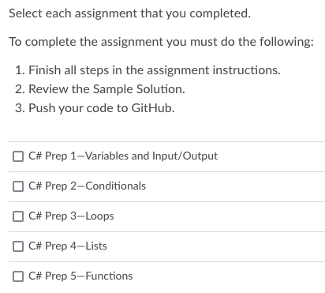
W02 Prove: Developer—C# Programming Parts 3–5
Learning Activity - C# Prep 3: Loops
Learning Activity - C# Prep 4: Lists
Learning Activity - C# Prep 5: Functions

Slide 4
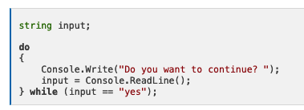
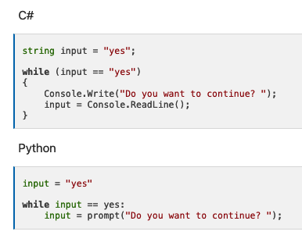
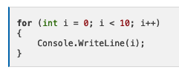



Learning Activity - C# Prep 3: Loops
https://byui-cse.github.io/cse210-course-2023/unit01/csharp-3.html
while 0…?
do-while 1…?
For 0…n
Foreach iterator
Random Numbers

Slide 5
Overview
In the Guess My Number game the computer picks a magic number, and then the user tries to guess it. After each guess, the computer tells the user to guess "higher" or "lower" until they guess the magic number.
This assignment is a little tricky, because it brings together many of the concepts you've learned in this course including loops and if statements.
Core Requirements
Start by asking the user for the magic number.
Add a loop that keeps looping as long as the guess does not match the magic number.
Instead of having the user supply the magic number, generate a random number from 1 to 100.
Stretch Challenge
Keep track of how many guesses the user has made and inform them of it at the end of the game.
After the game is over, ask the user if they want to play again.

Slide 6
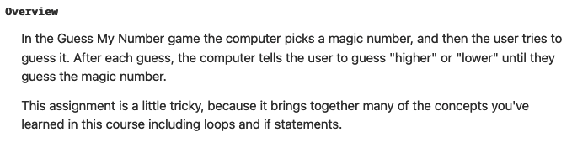
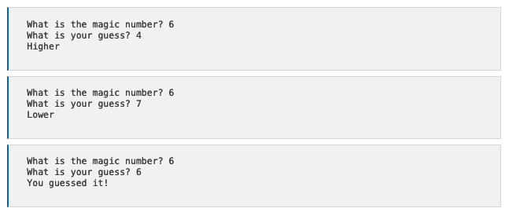
Input
Process
Output
main

Slide 7
Input
Process
Output
main
Get_magic_number()
#
Magicnumber =
value

Slide 8
Input
Process
Output
main
Get_magic_number()
#
Magicnumber =
value
W
B
flag = True
#
GuessedNumber =
Get_user_guess()
value
B
flag = False

Slide 9
Input
Process
Output
main
Get_magic_number()
#
Magicnumber =
value
W
B
flag = True
#
GuessedNumber =
if
B
GuessHigher = GuessedNumber > MagicNumber
Get_user_guess()
if
B
GuessLower = GuessedNumber < MagicNumber
value
if
B
GuessRight = GuessedNumber == MagicNumber
B
flag = False

Slide 10
Input
Process
Output
main
Get_magic_number()
#
Magicnumber =
value
W
B
flag = True
#
GuessedNumber =
if
B
GuessHigher = GuessedNumber > MagicNumber
Display_Higher()
Get_user_guess()
if
B
GuessLower = GuessedNumber < MagicNumber
Display_Lower()
value
if
B
GuessRight = GuessedNumber == MagicNumber
Display_Correct()
B
flag = False

Slide 11
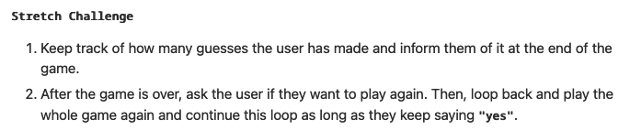
Input
Process
Output
main
Get_magic_number()
#
Magicnumber =
value
CountGuesses = 0
#
W
B
flag = True
#
GuessedNumber =
if
B
GuessHigher = GuessedNumber > MagicNumber
Display_Higher()
Get_user_guess()
value
if
B
GuessLower = GuessedNumber < MagicNumber
Display_Lower()
if
B
GuessRight = GuessedNumber == MagicNumber
Display_Correct()
B
flag = False
#
CountGuesses ++
Display_Guesses()

Slide 12
Input
Process
Output
main
Get_magic_number()
W
B
playagainflag = True
value
#
Magicnumber =
#
CountGuesses = 0
W
B
flag = True
Get_user_guess()
#
GuessedNumber =
value
if
B
GuessHigher = GuessedNumber > MagicNumber
Display_Higher()
if
B
GuessLower = GuessedNumber < MagicNumber
Display_Lower()
if
B
GuessRight = GuessedNumber == MagicNumber
Display_Correct()
B
flag = False
#
CountGuesses ++
Display_Guesses()
Get_playagain()
B
Playagainanswer
value
playagainflag = Playagainanswer == “Yes”
if
B

Slide 13




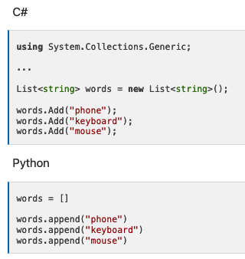
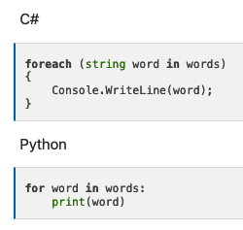
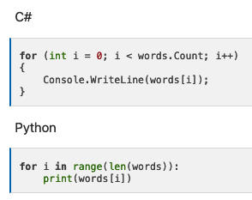
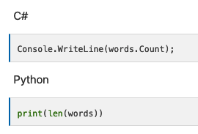
Learning Activity - C# Prep 4: Lists
https://byui-cse.github.io/cse210-course-2023/unit01/csharp-4.html
https://learn.microsoft.com/en-us/dotnet/api/system.collections.generic.list-1?view=net-5.0
Collections
Lists
Adding Items to the List
Getting the list size
Iterating through a List
Other Operations
Declare a variable vs
Instance of a variable

Slide 14
Learning Activity - C# Prep 4: Lists
Overview
Ask the user for a series of numbers, and append each one to a list. Stop when they enter 0.
Core Requirements
Compute the sum, or total, of the numbers in the list.
Compute the average of the numbers in the list.
Find the maximum, or largest, number in the list.
Stretch Challenge
Have the user enter both positive and negative numbers, then find the smallest positive number (the positive number that is closest to zero).
Sort the numbers in the list and display the new, sorted list. Hint: There are C# libraries that can help you here, try searching the internet for them.

Slide 15
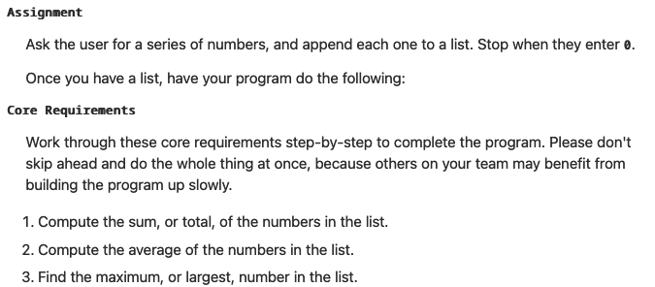
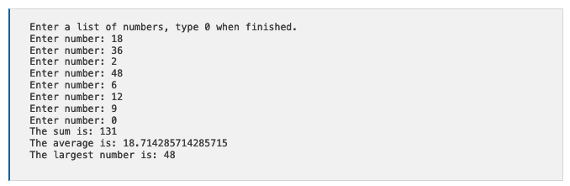
Input
Process
Output
main
[]
userNumbers<?> = new
W
B
flag = True
#
userNumber =
Get_user_number()
value
Display_Sum()
Display_Average()
Display_Largest()

Slide 16
Input
Process
Output
main
[]
userNumbers<?> = new
W
B
flag = True
#
userNumber =
Get_user_number()
if
B
stopList : userNumber == 0
value
B
flag = False
if
B
stopList : userNumber != 0
[]
userNumbers.Add(userNumber)
Display_Sum()
Display_Average()
Display_Largest()

Slide 17
Input
Process
Output
main
[]
userNumbers<?> = new
W
B
flag = True
#
userNumber =
Get_user_number()
if
B
stopList = userNumber == 0
value
B
flag = False
if
B
stopList = userNumber != 0
[]
userNumbers.Add(userNumber)
Display_Sum()
#
count =
#
sum =
#
largest =
Display_Average()
for
#
number in userNumbers
Display_Largest()
#
Count++
#
sum += number
if
B
Number > largest
#
largest = number

Slide 18
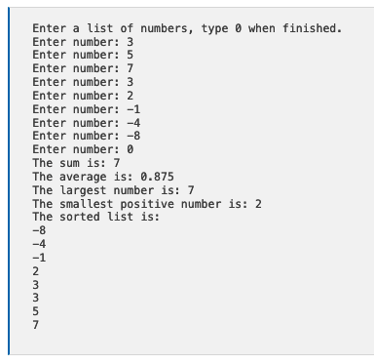
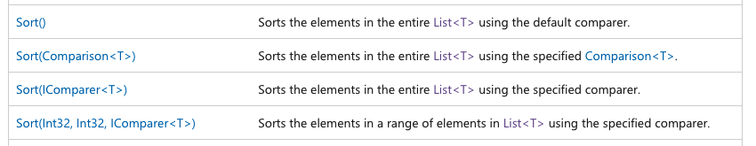
Input
Process
Output
main
[]
userNumbers<?> = new
W
B
flag = True
#
userNumber =
Get_user_number()
if
B
stopList = userNumber == 0
value
B
flag = False
if
B
stopList = userNumber != 0
[]
userNumbers.Add(userNumber)
Display_Sum()
#
count =
#
sum =
#
largest =
Display_Average()
for
B
number in userNumbers
#
smallest =
Display_Largest()
#
Count++
#
sum += number
Display_Smallest()
if
B
Number > largest
#
largest = number
Display_Sort()

Slide 19
Alternate Way
Input
Process
Output
main
[]
userNumbers<?> = new
getUserList()
#
userNumberCount =
W
B
#
userNumberSum =
#
#
userAverageNumber =
if
B
#
userLargestNumber =
B
#
userSmallestNumber =
if
B
Display_Sum()
[]
DetermineSum()
Display_Average()
DetermineAverage()
Display_Largest()
DetermineLargest()
Display_Smallest()
Get_user_number()
DetermineSmallest()
Display_Sort()

Slide 20
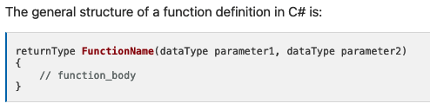
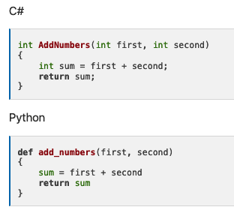
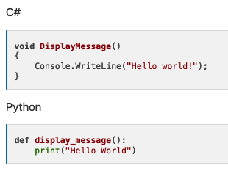
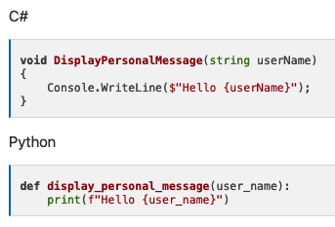
Learning Activity - C# Prep 5: Functions
https://byui-cse.github.io/cse210-course-2023/unit01/csharp-5.html
Functions
Functions vs Methods
Variable Scope

Slide 21
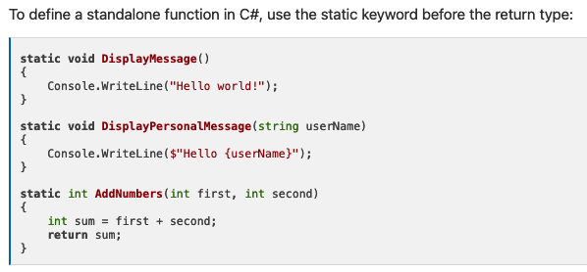
Learning Activity - C# Prep 5: Functions
Functions
Functions vs Methods
Member functions (methods)
Standalone (static)
Variable Scope

Slide 22
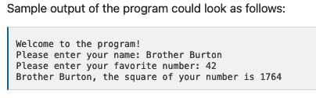
Assignment Instructions
For this assignment, write a C# program that has several simple functions:
DisplayWelcome - Displays the message, "Welcome to the Program!"
PromptUserName - Asks for and returns the user's name (as a string)
PromptUserNumber - Asks for and returns the user's favorite number (as an integer)
SquareNumber - Accepts an integer as a parameter and returns that number squared (as an integer)
DisplayResult - Accepts the user's name and the squared number and displays them.
Your Main function should then call each of these functions saving the return values and passing data to them as necessary.

Slide 23
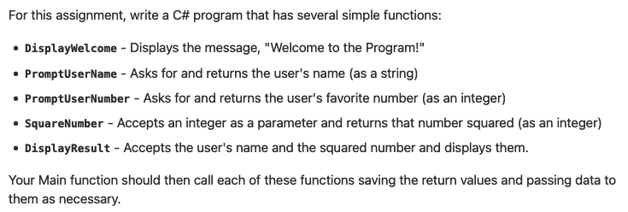
Input
Process
Output
main
PromptUserName()
PromptUserNumber()
DisplayResults()

Slide 24
Input
Process
Output
main
PromptUserName()
S
userName =
value
#
userNumber =
PromptUserNumber()
value
DisplayResults()
SquareNumber()
#
squaredNumber = userNumber * userNumber

Slide 25
Input
Process
Output
main
PromptUserName()
S
userName =
value
#
userNumber =
PromptUserNumber()
value
#
squaredNumber =
DisplayResults()
SquareNumber()
#
squaredNumber = userNumber * userNumber

Slide 26
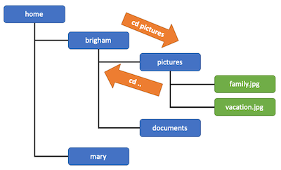
Learning Activity - Version Control (Review)
https://byui-cse.github.io/cse210-course-2023/unit01/prepare-version-control.html
Preparation Material
What is Version Control?
Read about Git and version control systems from the official GitHub documentation:
Read: About Git
Files and Folders
The File System
Moving Around in the File System
Accessing Files and Folders
Using Git
Create a new repository
Clone the repository
Making Changes
Adding Files
Committing Files
Pushing your changes to GitHub
Checking the status of your repo
A typical Workflow

Slide 27
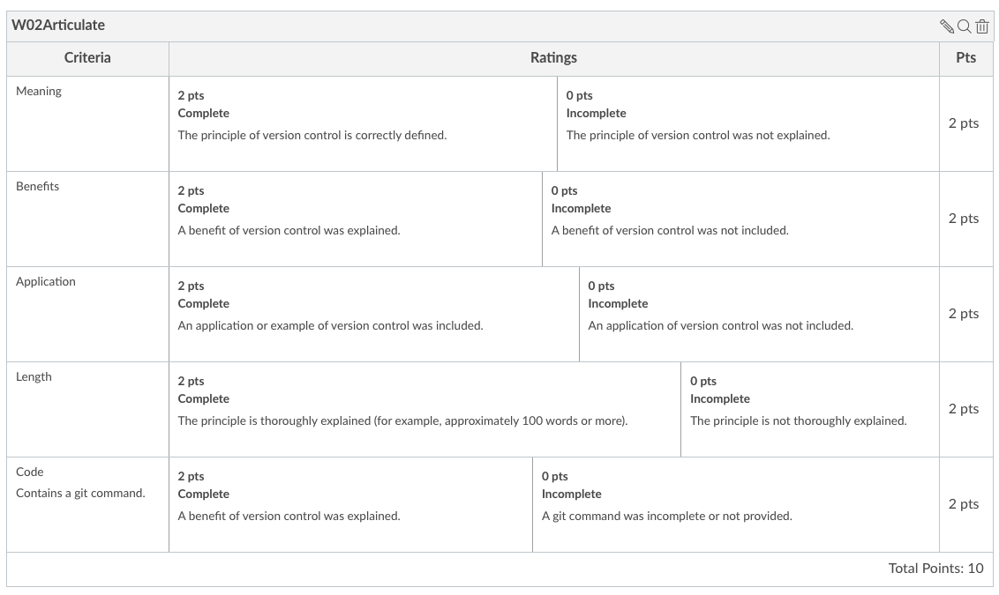
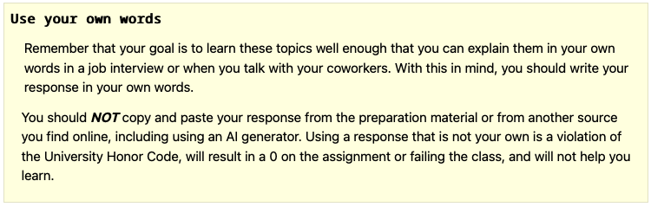
W02 Prove: Articulate—Version Control
What is version control and why is it important?
Your response must:
Explain the meaning of Version Control
Highlight a benefit of Version Control
Provide an application of Version Control
Show a command used in Version Control (for example a Git command)
Thoroughly explain these concepts (this likely cannot be done in less than 100 words)
Suggestion:
1. Create a word doc, write it there, save.
2. Copy and paste into text box

Slide 28
