Slide 1
CSE 210
Week 04 Abstraction part2
W. Clements

Slide 2
Agenda
W03 Prepare: Learning Activity
Unit 02 Develop: Journal Program
W03 Team Activity: Designer
W03 Team Activity: Participation Report
W04 Team Activity—Code Review Participation Report
W04 Prove: Developer
W04 Prove: Articulate
Schedule
Last class: Overview of Module
Complete
This week:
Design: meet with your team - complete
Start implementation - yes
Today:
Q&A: Continue implementation
Thursday:
Review
Saturday:
Prove: Developer
Prove: Articulate

Slide 3
W04 Team Activity—Code Review Participation Report Team Activity: Code Review
Overview
Agenda
Before the meeting: Verify the time, location, and lead student
Begin with Prayer
Begin the Code Review
Review the Code
Conclude
Submission

Slide 4
W04 Team Activity—Code Review Participation Report Team Activity: Code Review
Overview
Agenda
Before the meeting: Verify the time, location, and lead student
Begin with Prayer
Begin the Code Review
Review the Code
Conclude
Submission
The Lead Student should talk with the group about how things are going in their project generally.
Explain the parts that you have finished and the parts that you are still working on.
It is not expected that your project is finished or polished. This is a chance to receive feedback along the way.

Slide 5
W04 Team Activity—Code Review Participation Report Team Activity: Code Review
Overview
Agenda
Before the meeting: Verify the time, location, and lead student
Begin with Prayer
Begin the Code Review
Review the Code
Conclude
Submission
The Lead Student should share their screen and pull up code to discuss.
Begin by showing parts of the program that are complete (or nearly complete). Talk about what you were trying to accomplish and why you selected the approach you did.
Others on the team should:
Take a minute to look at the code.
Offer any compliments or suggestions.
Ask questions about anything you do not understand.
Other people can share their screen to highlight the way they approached the problem.
Next, share parts of the program that are not complete yet, or discuss areas that you have not worked on.
Others on the team should:
Talk through potential solutions.
Ask questions about anything you do not understand.
Other people can share their screen to highlight the way they approached the problem.

Slide 6
W04 Team Activity—Code Review Participation Report Team Activity: Code Review
Overview
Agenda
Before the meeting: Verify the time, location, and lead student
Begin with Prayer
Begin the Code Review
Review the Code
Conclude
Submission
A note about code sharing...
In this activity you are asked to look at each other's code, to help improve each person's program and understanding of the approach.
But keep in mind that the goal is for you to learn how to write these programs yourself, not simply to turn in a working program.
Because the goal is for you to learn to write these programs on your own, you should NOT copy and paste any code from another student or from a repository you find online.
Similarly, you should NOT look at their code and type it in directly from a picture or from what you see on your screen.
This is a violation of the University Honor Code, will result in a 0 on the assignment or failing the class, and will not help you learn.
Instead, when you get help from another person's program, you should try to understand the principle of what they are doing, and then, put their code away and work on your program.
The Lead Student should share their screen and pull up code to discuss.
Begin by showing parts of the program that are complete (or nearly complete). Talk about what you were trying to accomplish and why you selected the approach you did.
Others on the team should:
Take a minute to look at the code.
Offer any compliments or suggestions.
Ask questions about anything you do not understand.
Other people can share their screen to highlight the way they approached the problem.
Next, share parts of the program that are not complete yet, or discuss areas that you have not worked on.
Others on the team should:
Talk through potential solutions.
Ask questions about anything you do not understand.
Other people can share their screen to highlight the way they approached the problem.

Slide 7
W04 Team Activity—Code Review Participation Report Team Activity: Code Review
Overview
Agenda
Before the meeting: Verify the time, location, and lead student
Begin with Prayer
Begin the Code Review
Review the Code
Conclude
Submission
The Lead Student should share their screen and pull up code to discuss.
Begin by showing parts of the program that are complete (or nearly complete). Talk about what you were trying to accomplish and why you selected the approach you did.
Others on the team should:
Take a minute to look at the code.
Offer any compliments or suggestions.
Ask questions about anything you do not understand.
Other people can share their screen to highlight the way they approached the problem.
Next, share parts of the program that are not complete yet, or discuss areas that you have not worked on.
Others on the team should:
Talk through potential solutions.
Ask questions about anything you do not understand.
Other people can share their screen to highlight the way they approached the problem.
Coding Standards:
Comments: File, Class, Methods
Line Comments:
Variable naming: begin with initials
Class/Attributes/Variables = nouns
Values/States = adjectives
Behavior = Method(verb)

Slide 8
W04 Team Activity—Code Review Participation Report Team Activity: Code Review
Overview
Agenda
Before the meeting: Verify the time, location, and lead student
Begin with Prayer
Begin the Code Review
Review the Code
Conclude
Submission
Finish your meeting:
Discuss anything else the team would like related to the project.
Determine who will be the lead student for the next meeting.

Slide 9
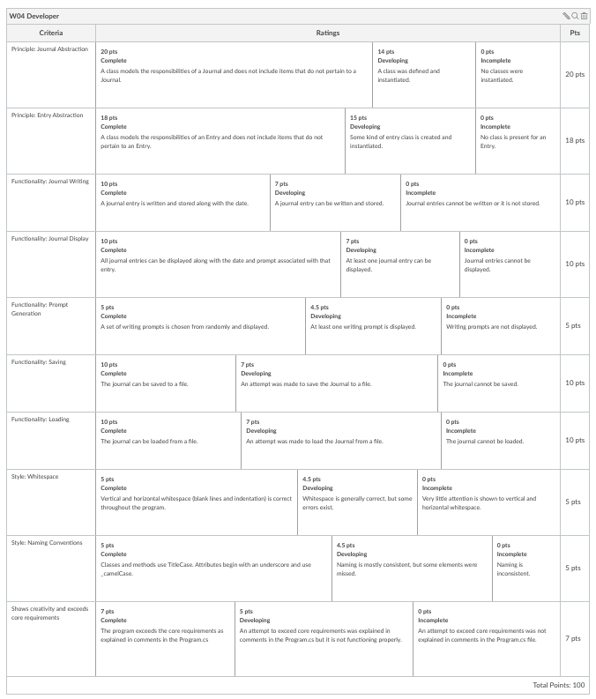
W04 Prove: Developer Unit 02 Develop: Journal Program
Purpose:
Demonstrate your ability to develop a working project using the principle of Abstraction.
Task: Complete the steps for the Abstraction Development Project.
Submission
Push your code to your GitHub repository and submit the link here.
Add an I-Learn submission comment explaining anything you did to show creativity and exceed requirements.

Slide 10
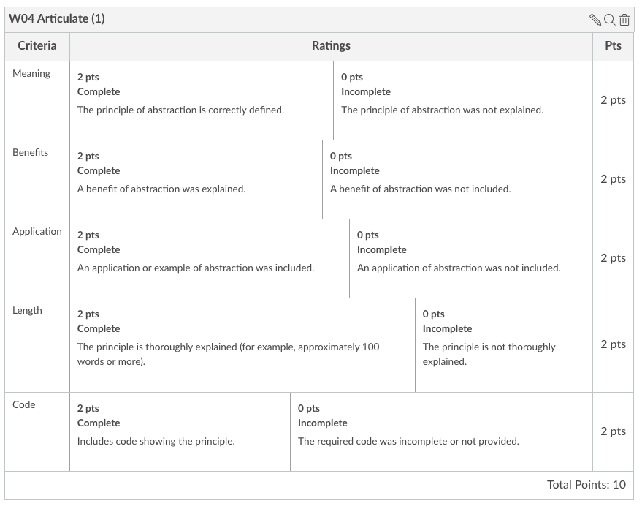
W04 Prove: Articulate Abstraction - Articulate
Overview
Articulate the principle of abstraction.
Instructions
Now that you have learned about the principle of abstraction, and designed and developed a program using it, return to I-Learn and answer the following question (the way you would in a job interview):
What is abstraction and why is it important?
Your response must:
Explain the meaning of Abstraction
Highlight a benefit of Abstraction
Provide an application of Abstraction
Use a code example of Abstraction from the program you wrote
Thoroughly explain these concepts (this likely cannot be done in less than 100 words)
Name
Date:<> © copyright all rights reserved, BYU-I CSE 210
Use your own words
Remember that your goal is to learn these topics well enough that you can explain them in your own words in a job interview or when you talk with your coworkers. With this in mind, you should write your response in your own words.
You should NOT copy and paste your response from the preparation material or from another source you find online, including using an AI generator. Using a response that is not your own is a violation of the University Honor Code, will result in a 0 on the assignment or failing the class, and will not help you learn.

