Slide 1
Week 05 Encapsulation
CSE 210
W. Clements

Slide 2
Calendar
Week 05
Tues/Today: Overview
Thurs: Design
Week 06
Tues: Coding
Thurs: Review

Slide 3
Encapsulation Learning Activity
Overview
Prepare
Why Encapsulation Matters
Using Access Modifiers
Attributes
Methods
Example
Getters and Setters
On Getters and Setters
Constructors
In Summary
Activity Instructions
Design the Classes
Start the Project
Create the Fraction class
Create the Constructors
Create the Getters and Setters
Create methods to return the representations
Sample Solution

Slide 4
Prepare
class be responsible for the details of a particular task
Functions do the actions
pushing this idea further by preventing other parts of the program from accessing those details
Why Encapsulation Matters
little silly to hide information or restrict access
If something is broken, any code that has access might be to blame.
If something needs to change, any code that has access might need to change.

Slide 5
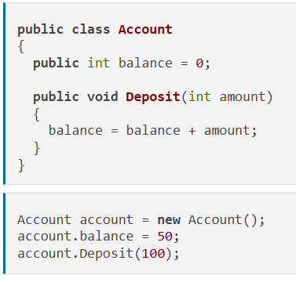
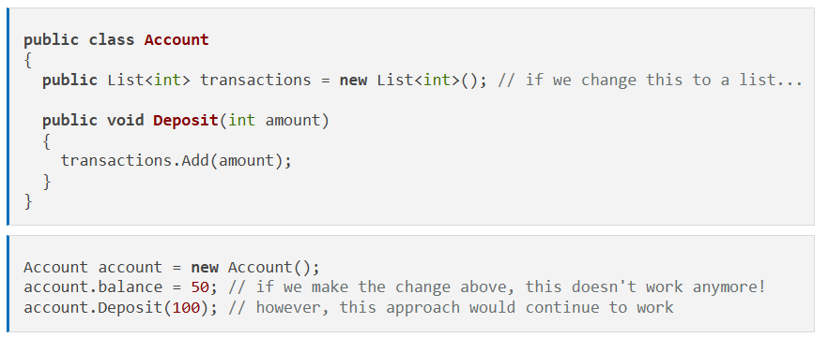
Why Encapsulation Matters
Implementation changes
Thinking more like BlockChain vs totals

Slide 6
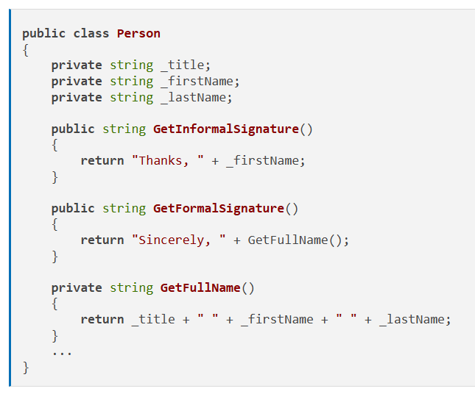
Using Access Modifiers
Attributes
Methods

Slide 7
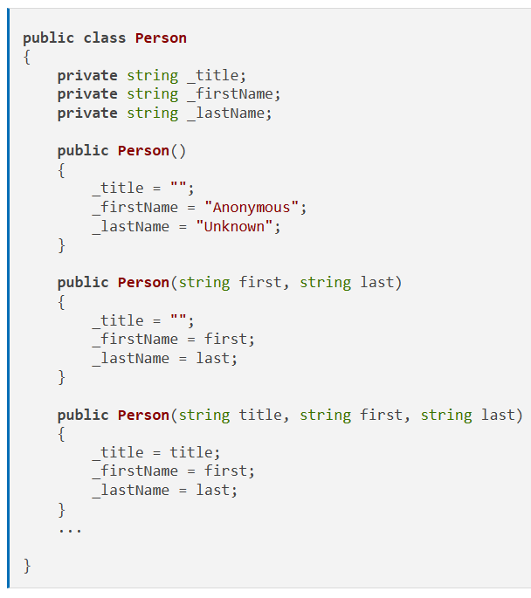
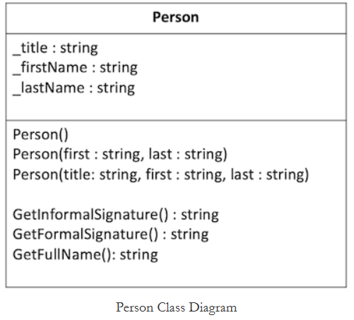
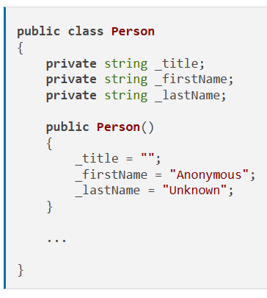
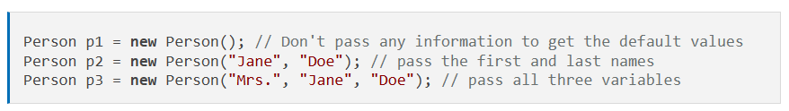
Getters and Setters
Mutable vs Immutable
On Getters and Setters
Vs
Constructors
Defaults
initialization

Slide 8
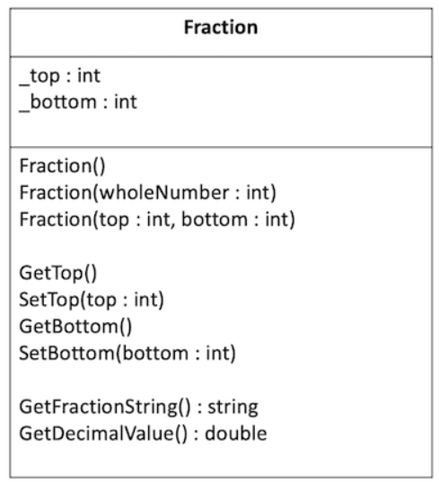
Activity Instructions
Practice the principle of encapsulation by creating classes to hold a fraction, such as 2/3.
As you recall from your Math classes, a fraction has a top number (numerator) and a bottom number (denominator).
The fraction can be expressed as two integers with a slash between them, such as 3/4 or as a decimal, such as 0.75..

Slide 9
Activity Instructions Step 1: Design the Classes
You need to create a class for a fraction that has:
Attributes for the top and bottom numbers
Constructors
Getters and setters for the top and bottom numbers
Methods to return representations of both the fractional and decimal views.

Slide 10
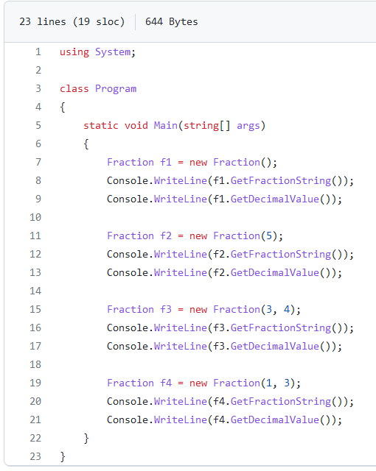
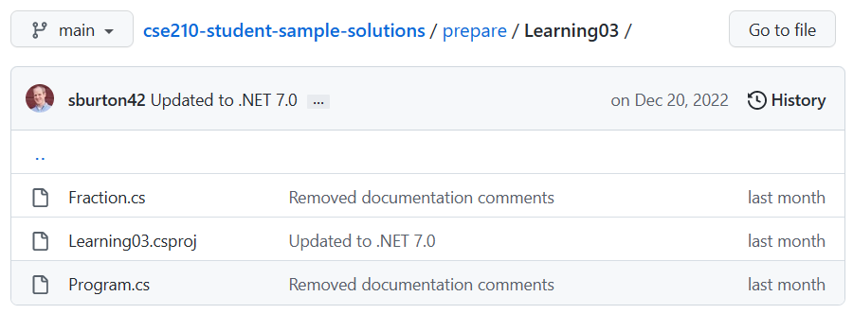
Activity Instructions Step 2: Start the Project
Open the class project in VS Code.
Navigate to the Learning03 project in the prepare folder. Find the Program.cs file, which will be your entry point for the program.
Verify that you can run the project.

Slide 11
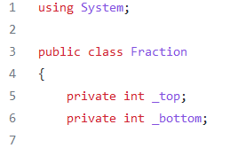
Activity Instructions Step 3: Create the Fraction class
Create a class to hold fractions.
The class should be in its own file.
The class should have two attributes for the top and bottom numbers.
Make sure the attributes are private

Slide 12
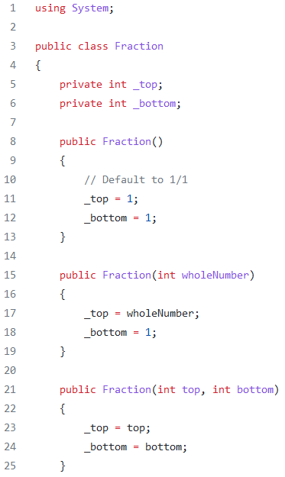
Activity Instructions Step 4: Create the Constructors
Create the following constructors:
Constructor that has no parameters that initialize the number to 1/1.
Constructor that has one parameter for the top and that initializes the denominator to 1. So that if you pass in the number 5, the fraction would be initialized to 5/1.
Constructor that has two parameters, one for the top and one for the bottom.
In your Program.cs file, verify that you can create fractions using all three of these constructors. For example, create an instance for 1/1 (using the first constructor), for 6/1 (using the second constructor), for 6/7 (using the third constructor).

Slide 13
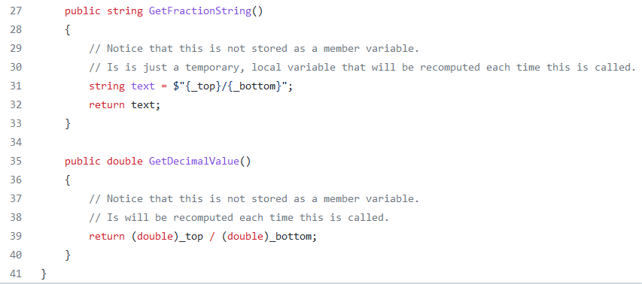
Activity Instructions Step 5: Create the Getters and Setters
Create getters and setters for both the top and the bottom values.
In your Program.cs file, verify that you can call all of these methods and get the correct values, using setters to change the values and then getters to retrieve these new values and then display them to the console.

Slide 14
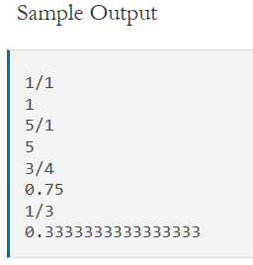
Activity Instructions Step 6: Create methods to return the representations
Create a method called GetFractionString that returns the fraction in the form 3/4.
Create a method called GetDecimalValue that returns a double that is the result of dividing the top number by the bottom number, such as 0.75.
Verify that you can call each constructor and that you can retrieve and display the different representations for a few different fractions. For example, you could try:
1
5
3/4
1/3

Slide 16
Encapsulation - Design Activity
Overview
Meet with your team and prepare a design for this week's programming assignment.
Agenda
Before the meeting: Verify the time, location, and lead student
Begin with Prayer
Discuss the Preparation Learning Activity
Review the Program Specification
Determine the classes
Define class behaviors
Define class attributes
Define Constructors
Conclude

Slide 17
Unit 03 Develop: Scripture Memorizer Overview
https://byui-cse.github.io/cse210-course-2023/unit03/develop.html
People often try to memorize poems or passages of scripture.
One of the challenges they encounter is that they want to hide the scripture while they are practicing, but they may not be able to recite the whole scripture from memory just yet.
To help solve this problem so that people can better memorize a scripture, write a program that displays the full scripture and then hides a few words at a time until the complete scripture is hidden.

Slide 18
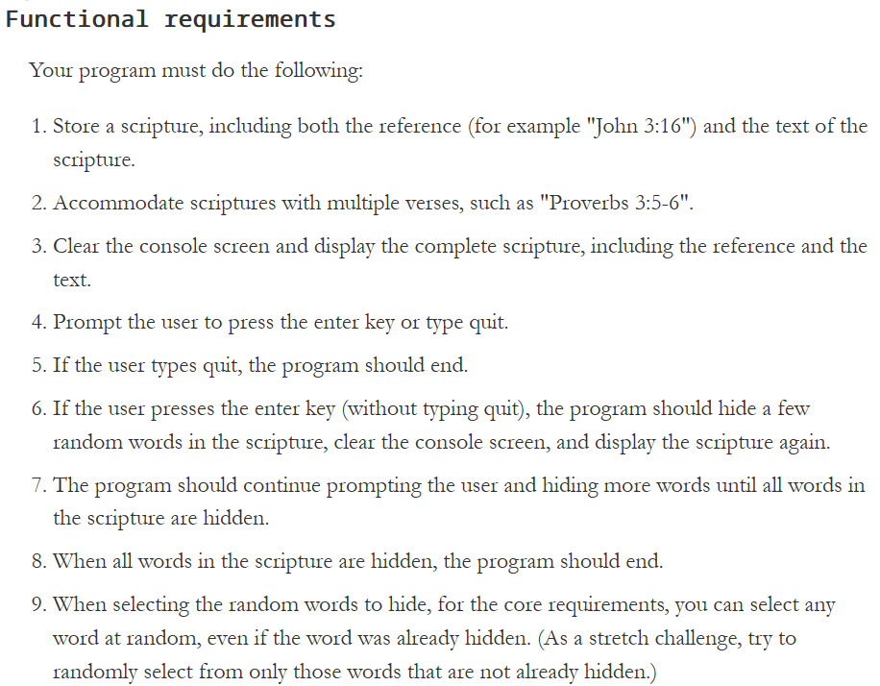
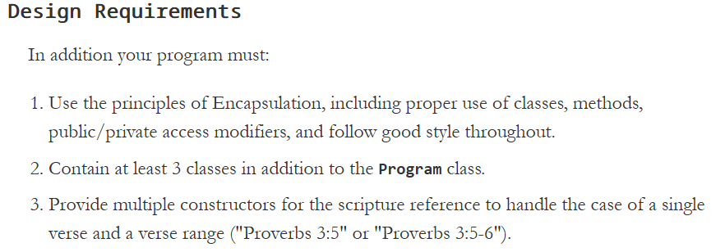
Unit 03 Develop: Scripture Memorizer Functional requirements
https://byui-cse.github.io/cse210-course-2023/unit03/develop.html
Your program must do the following:

Slide 19
Input
Process
Output
F
PromptUser()
DisplayScripture()
Word Hiding
Scripture
w
Is_running == T
Reference
Word
if
Prompt == ‘quit’
Is_running == F

Slide 20
Input
Process
Output
F
main
w
Is_running == T
PromptUser()
DisplayScripture()
DisplayScripture()
PromptUser()
if
Prompt == ‘quit’
Is_running == F
Word Hiding
Scripture
Reference
Word

Slide 21
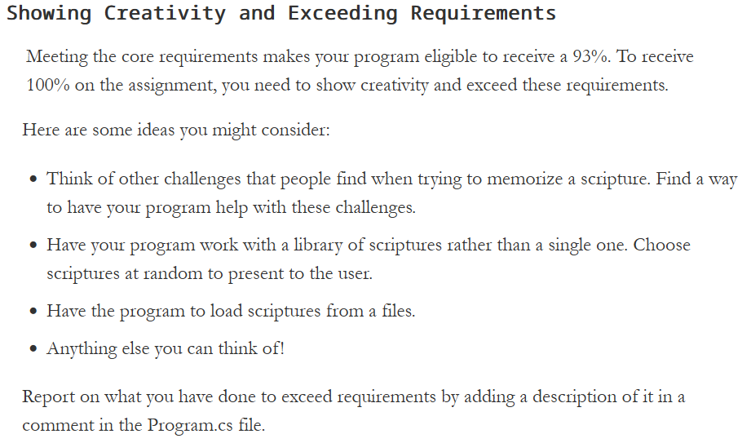
Unit 03 Develop: Scripture Memorizer Functional requirements
https://byui-cse.github.io/cse210-course-2023/unit03/develop.html

Slide 22
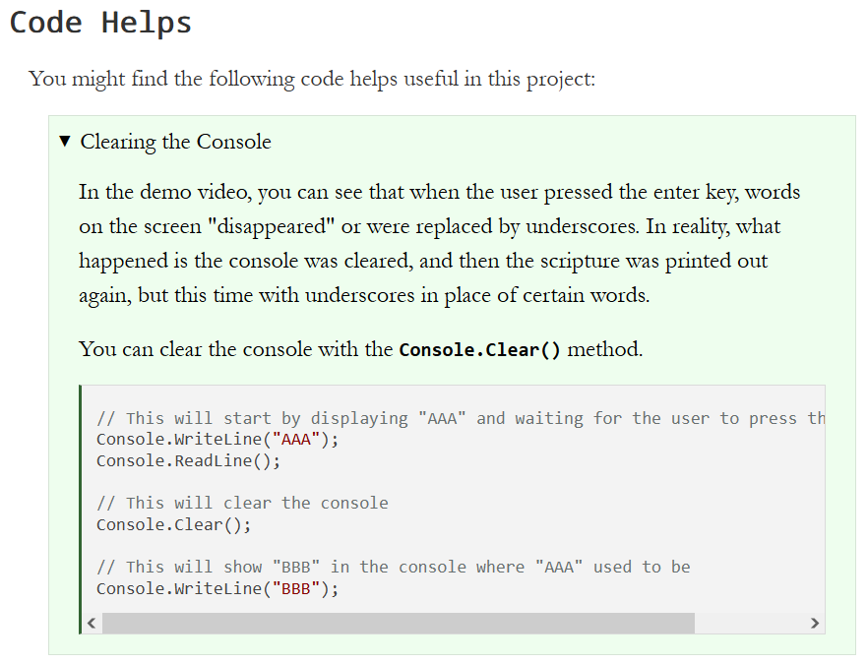
Unit 03 Develop: Scripture Memorizer
https://byui-cse.github.io/cse210-course-2023/unit03/develop.html

Slide 23
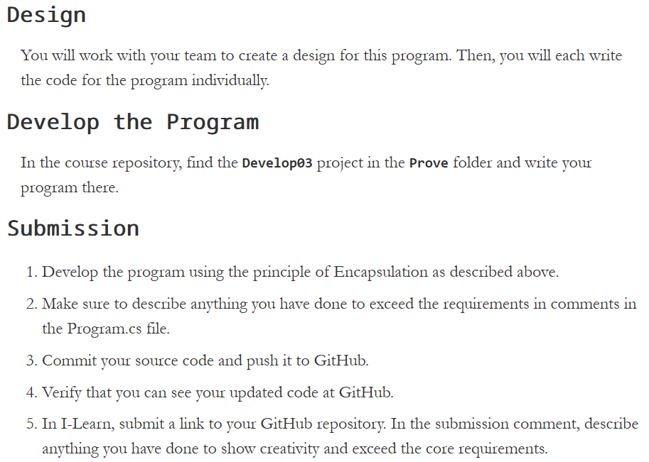
https://byui-cse.github.io/cse210-course-2023/unit03/develop.html

Slide 24
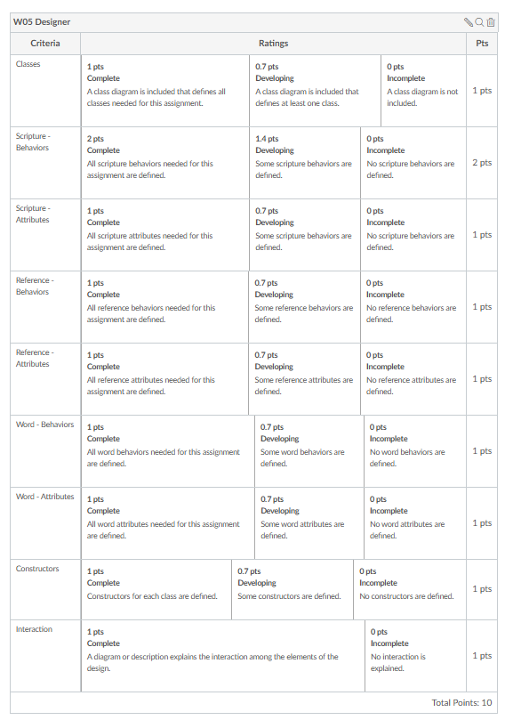

Slide 25
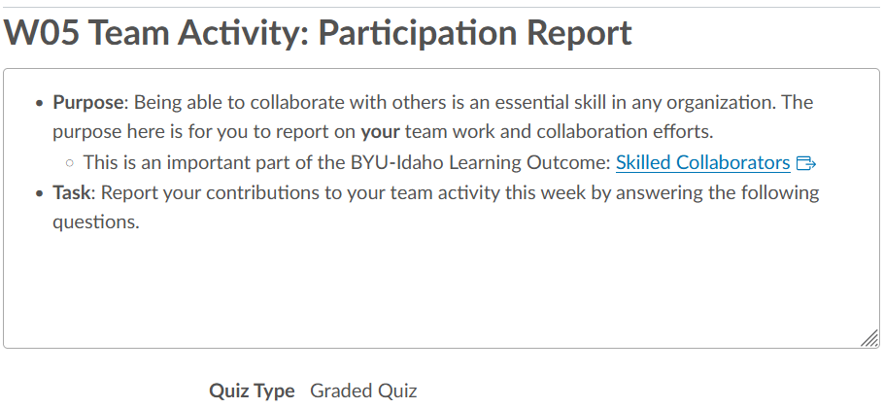
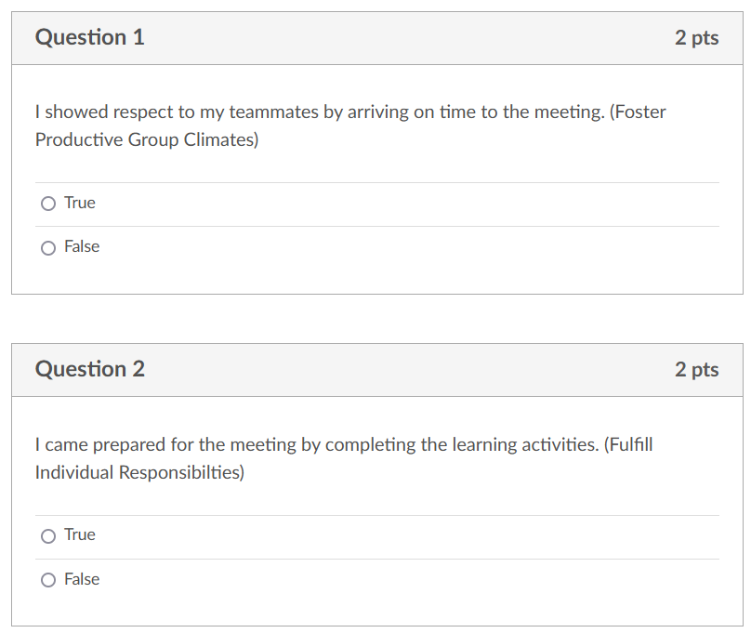
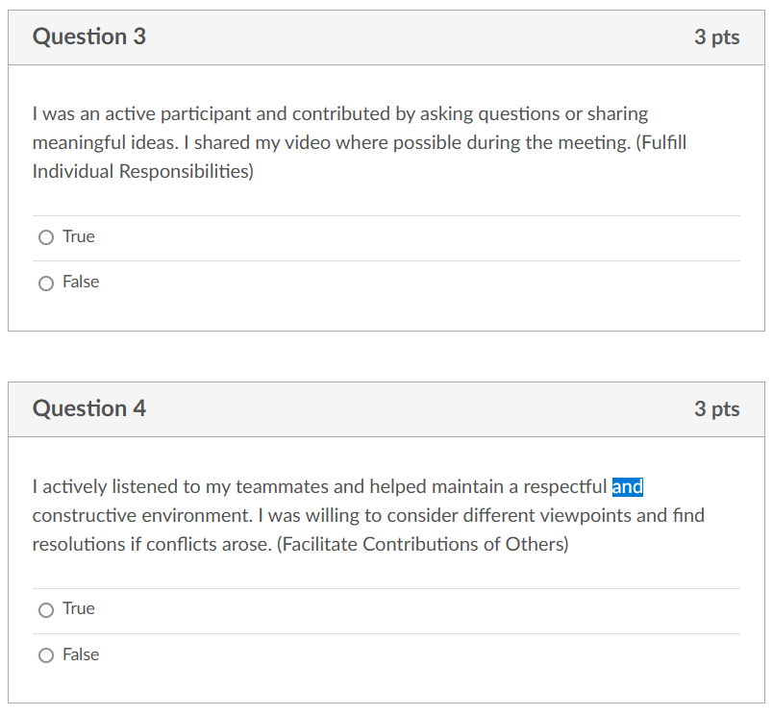

Slide 26
W06 Team Activity: Code Review Participation Report
Agenda
Before the meeting: Verify the time, location, and lead student
Begin with Prayer
Begin the Code Review
Review the Code
Conclude

Slide 27
W06 Prove: Developer
This criterion is linked to a Learning Outcome Principle: Encapsulation (information hiding)
This criterion is linked to a Learning Outcome Principle: Scripture class
This criterion is linked to a Learning Outcome Principle: Word class
This criterion is linked to a Learning Outcome Principle: Reference class
Functionality: Scripture Display A scripture is displayed.
This criterion is linked to a Learning Outcome Functionality: Word Hiding
This criterion is linked to a Learning Outcome Functionality: Program Termination
This criterion is linked to a Learning Outcome Style: Whitespace
Style: Naming Conventions Class, Method, and Attribute naming conventions are followed.
This criterion is linked to a Learning Outcome Shows creativity and exceeds core requirements

