Slide 1
Week 07 & 8 Inheritance
CSE 210
W. Clements

Slide 2
Calendar
Week 07
Tues/Today: Overview
Thurs: Design
Week 08
Tues: Coding
Thurs: Review

Slide 3
Inheritance Learning Activity
Overview
In this activity you will learn and practice the principle of Inheritance.
What is Inheritance?
Super and Base
Accessing Private Data
Video Demonstrations
A Word of Caution
In Summary
Activity Instructions
Math Assignments
Writing Assignments
Design the Classes
Start the Project
Create the base class
Create the MathAssignment class
Create the WritingAssignment class
Sample Solution

Slide 4
Object Oriented
Abstraction
Encapsulation
What does it represent?
What are its attributes?
What does it have? “HAS-A?”
Repeat for each HAS-A
What does it do?
Methods

Slide 5
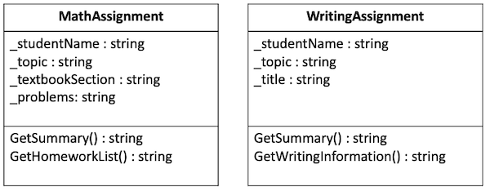
What is a class diagram vs class description
Attributes and Behavior

Slide 6
What is Inheritance?
Inheritance is the ability for one class to obtain the attributes and methods of another class directly, without having to type them. It follows the same idea of people inheriting certain characteristics from their parents.

Slide 7
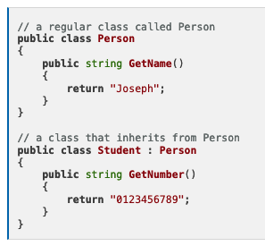
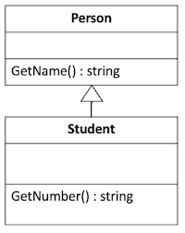

Example
Which is simpler to draw, look at, and interpret?

Slide 8
Example
Parent Class
Child Class

Slide 9
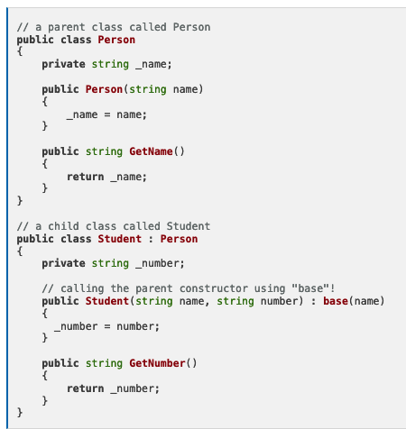
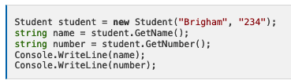
Super and Base
Output
Brigham
234

Slide 10
Super and Base
Output
Brigham
234

Slide 11
Super and Base
Output
Brigham
234

Slide 12
Super and Base
Output
Brigham
234

Slide 13
Super and Base
Output
Brigham
234

Slide 14
Super and Base
Output
Brigham
234

Slide 15
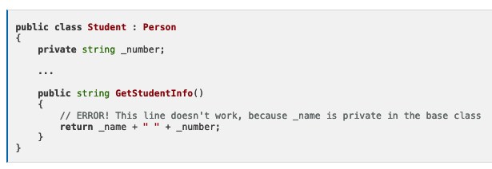
Accessing Private Data
Accessors
Private
Protected
Public
Two solutions:
Use GetName()
Return getName()+” “+ _number
Change Person:_name to protected
Instead change getName() to protected
protected

Slide 16
Review
A Class is what?
Attributes and Behaviors
What is a class without Attributes?
Interface
What is a class without Behaviors?
Structure

Slide 17
Object Oriented
Abstraction
Encapsulation
What does it represent?
Inheritance
What does it have in common?
What is it part of? “IS-A?”
What are its attributes?
What does it have? “HAS-A?”
Repeat for each HAS-A
What does it do?
Methods

Slide 18
Activity Instructions
Math Assignments
Writing Assignments
Design the Classes
Start the Project
Create the base class
Create the MathAssignment class
Create the WritingAssignment class
Sample Solution

Slide 19
Activity Instructions Consider
Math Assignments
A Math assignment may need to store the student's name, the topic (for example, "Fractions"), the textbook section (for example, "7.3"), and the problems from that section (for example, "3-10, 20-21").
The Math assignment should have a constructor that requires a value for each of the items that it stores.
The Math assignment needs to provide a method to return a summary of the assignment that contains the student's name and the topic, and it also needs to provide a method to display the Math homework list including the section number and the problems (for example, "Section 7.3 Problems 8-19").
Writing Assignments
A writing assignment may need to store the student's name, the topic (for example, "European History"), and the title of the assignment (for example, "The Causes of World War II").
The writing assignment should have a constructor that requires a value for each of the items that it stores.
The writing assignment needs to provide a method to return a summary of the assignment that contains the student's name and the topic, and it also needs to provide a method to get the writing information which consists of the title and the student's name (for example, "The Causes of World War II by Mary Waters").

Slide 20
Activity Instructions Consider
Math Assignments
A Math assignment may need to store the student's name, the topic (for example, "Fractions"), the textbook section (for example, "7.3"), and the problems from that section (for example, "3-10, 20-21").
The Math assignment should have a constructor that requires a value for each of the items that it stores.
The Math assignment needs to provide a method to return a summary of the assignment that contains the student's name and the topic, and it also needs to provide a method to display the Math homework list including the section number and the problems (for example, "Section 7.3 Problems 8-19").
Writing Assignments
A writing assignment may need to store the student's name, the topic (for example, "European History"), and the title of the assignment (for example, "The Causes of World War II").
The writing assignment should have a constructor that requires a value for each of the items that it stores.
The writing assignment needs to provide a method to return a summary of the assignment that contains the student's name and the topic, and it also needs to provide a method to get the writing information which consists of the title and the student's name (for example, "The Causes of World War II by Mary Waters").

Slide 21
Activity Instructions Step 1: Design the Classes
Math Assignments
A Math assignment may need to store the student's name, the topic (for example, "Fractions"), the textbook section (for example, "7.3"), and the problems from that section (for example, "3-10, 20-21").
The Math assignment should have a constructor that requires a value for each of the items that it stores.
The Math assignment needs to provide a method to return a summary of the assignment that contains the student's name and the topic, and it also needs to provide a method to display the Math homework list including the section number and the problems (for example, "Section 7.3 Problems 8-19").
Math Assignments
A Math assignment may need to store the student's name, the topic (for example, "Fractions"), the textbook section (for example, "7.3"), and the problems from that section (for example, "3-10, 20-21").
The Math assignment should have a constructor that requires a value for each of the items that it stores.
The Math assignment needs to provide a method to return a summary of the assignment that contains the student's name and the topic, and it also needs to provide a method to display the Math homework list including the section number and the problems (for example, "Section 7.3 Problems 8-19").

Slide 22
Activity Instructions Step 1: Design the Classes
Math Assignments
A Math assignment may need to store the student's name, the topic (for example, "Fractions"), the textbook section (for example, "7.3"), and the problems from that section (for example, "3-10, 20-21").
The Math assignment should have a constructor that requires a value for each of the items that it stores.
The Math assignment needs to provide a method to return a summary of the assignment that contains the student's name and the topic, and it also needs to provide a method to display the Math homework list including the section number and the problems (for example, "Section 7.3 Problems 8-19").
Math Assignments
A Math assignment may need to store the student's name, the topic (for example, "Fractions"), the textbook section (for example, "7.3"), and the problems from that section (for example, "3-10, 20-21").
The Math assignment should have a constructor that requires a value for each of the items that it stores.
The Math assignment needs to provide a method to return a summary of the assignment that contains the student's name and the topic, and it also needs to provide a method to display the Math homework list including the section number and the problems (for example, "Section 7.3 Problems 8-19").

Slide 23
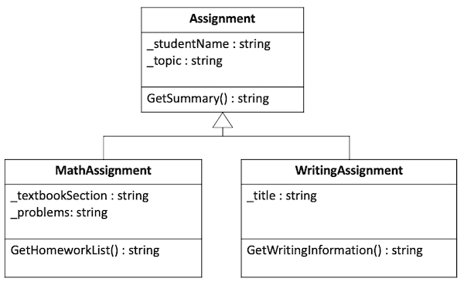
Activity Instructions Step 1: Design the Classes
Math Assignments
A Math assignment may need to store the student's name, the topic (for example, "Fractions"), the textbook section (for example, "7.3"), and the problems from that section (for example, "3-10, 20-21").
The Math assignment should have a constructor that requires a value for each of the items that it stores.
The Math assignment needs to provide a method to return a summary of the assignment that contains the student's name and the topic, and it also needs to provide a method to display the Math homework list including the section number and the problems (for example, "Section 7.3 Problems 8-19").
Math Assignments
A Math assignment may need to store the student's name, the topic (for example, "Fractions"), the textbook section (for example, "7.3"), and the problems from that section (for example, "3-10, 20-21").
The Math assignment should have a constructor that requires a value for each of the items that it stores.
The Math assignment needs to provide a method to return a summary of the assignment that contains the student's name and the topic, and it also needs to provide a method to display the Math homework list including the section number and the problems (for example, "Section 7.3 Problems 8-19").

Slide 24
Input
Process
Output

Slide 25
Everything boils down to three things:
What are the inputs?
What are the output?
How do the inputs become the outputs?
Input
Process
Output
View
Controller
View
Model

Slide 26
Everything boils down to three things:
What are the inputs?
What are the output?
How do the inputs become the outputs?
Main?
Console.readln?
Console.writeln?
?
Input
Process
Output
View
Controller
View
Model

Slide 27
Everything boils down to three things:
What are the inputs?
What are the output?
How do the inputs become the outputs?
Main?
Console.readln?
Console.writeln?
?
Input
Process
Output
View
Input Class
Controller
Main
View
Output Class
Model
Data Classes

Slide 28
Everything boils down to three things:
What are the inputs?
What are the output?
How do the inputs become the outputs?
?
Input
Process
Output
View
Input Class
Controller
Main
View
Output Class
Model
Classes

Slide 29
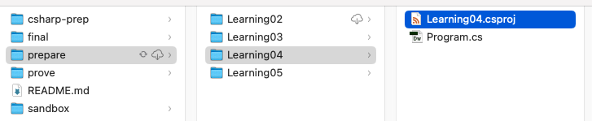
Activity Instructions Step 2: Start the Project

Slide 30
Activity Instructions Step 3: Create Base class
Begin by creating a new file and a class for your base Assignment class.
Add the attributes as private member variables.
Create a constructor for this class that receives a student name and topic and sets the member variables.
Add the method for GetSummary() to return the student's name and the topic.
Test your class by returning to the Main method in the Program.cs file.
Create a simple assignment, call the method to get the summary, and then display it to the screen.
Sample Output
Samuel Bennett - Multiplication

Slide 31
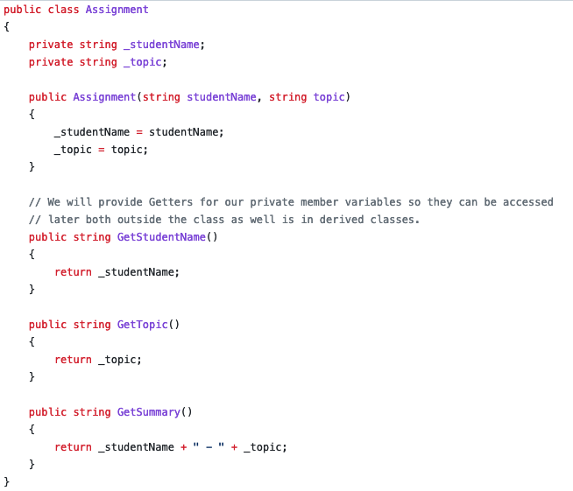
Activity Instructions Step 3: Create Base class
Begin by creating a new file and a class for your base Assignment class.
Add the attributes as private member variables.
Create a constructor for this class that receives a student name and topic and sets the member variables.
Add the method for GetSummary() to return the student's name and the topic.
Test your class by returning to the Main method in the Program.cs file.
Create a simple assignment, call the method to get the summary, and then display it to the screen.
Sample Output
Samuel Bennett - Multiplication

Slide 32
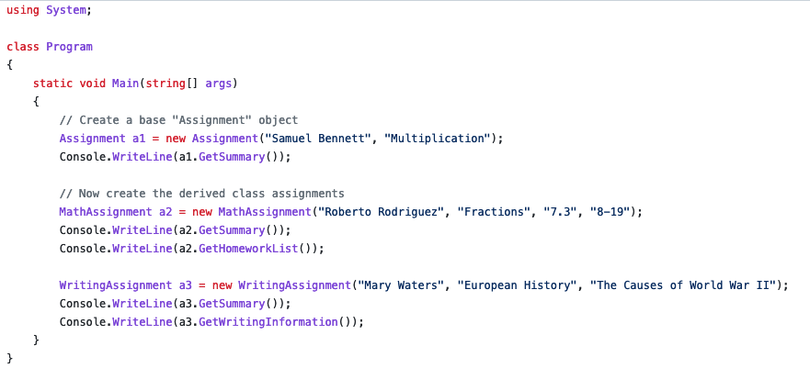
Activity Instructions Step 3: Create Base class
Begin by creating a new file and a class for your base Assignment class.
Add the attributes as private member variables.
Create a constructor for this class that receives a student name and topic and sets the member variables.
Add the method for GetSummary() to return the student's name and the topic.
Test your class by returning to the Main method in the Program.cs file.
Create a simple assignment, call the method to get the summary, and then display it to the screen.
Sample Output
Samuel Bennett - Multiplication
I would use protected here for getters

Slide 33
Activity Instructions Step 4: Create the MathAssignment class
Create a new file for the MathAssignment class.
Create this class and make sure to specify that it inherits from the base Assignment class.
Add the attributes as private member variables. Make sure that you do not create new member variables for the ones you inherited from the base class.
Create a constructor for your class that accepts all four parameters, have it call the base class constructor to set the base class attributes that way.
Add the GetHomeworkList() method.
Test your class by returning to the Main method and creating a new MathAssignment object and set its values. Make sure to test both the GetSummary() and the GetHomeworkList() methods.
Sample Output
Roberto Rodriguez - Fractions
Section 7.3 Problems 8-19

Slide 34
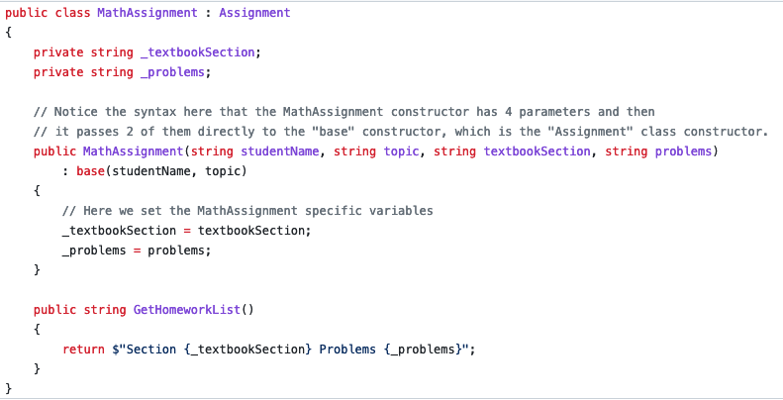
Activity Instructions Step 4: Create the MathAssignment class
Create a new file for the MathAssignment class.
Create this class and make sure to specify that it inherits from the base Assignment class.
Add the attributes as private member variables. Make sure that you do not create new member variables for the ones you inherited from the base class.
Create a constructor for your class that accepts all four parameters, have it call the base class constructor to set the base class attributes that way.
Add the GetHomeworkList() method.
Test your class by returning to the Main method and creating a new MathAssignment object and set its values. Make sure to test both the GetSummary() and the GetHomeworkList() methods.
Sample Output
Roberto Rodriguez - Fractions
Section 7.3 Problems 8-19

Slide 35
Activity Instructions Step 4: Create the MathAssignment class
Create a new file for the MathAssignment class.
Create this class and make sure to specify that it inherits from the base Assignment class.
Add the attributes as private member variables. Make sure that you do not create new member variables for the ones you inherited from the base class.
Create a constructor for your class that accepts all four parameters, have it call the base class constructor to set the base class attributes that way.
Add the GetHomeworkList() method.
Test your class by returning to the Main method and creating a new MathAssignment object and set its values. Make sure to test both the GetSummary() and the GetHomeworkList() methods.
Sample Output
Roberto Rodriguez - Fractions
Section 7.3 Problems 8-19

Slide 36
Activity Instructions Step 5: Create the WritingAssignment class
Follow the same pattern as before by creating a new file for the WritingAssignment class.
Create the class and set up the inheritance relationship.
Add the member variables and set up the constructor as you did for the MathAssignment class.
Add the GetWritingInformation() method.
Notice that this method needs to access the _studentName variable defined in the base class. Even though WritingAssignment class inherited this attribute, it is private, so you cannot access it directly in the derived class.
To get the data you need for the method you can either make the variable protected in the base class, or you can create a public GetStudentName method to return it.
Return to Main and test your new class.
Sample Output
Mary Waters - European History
The Causes of World War II by Mary Waters

Slide 37
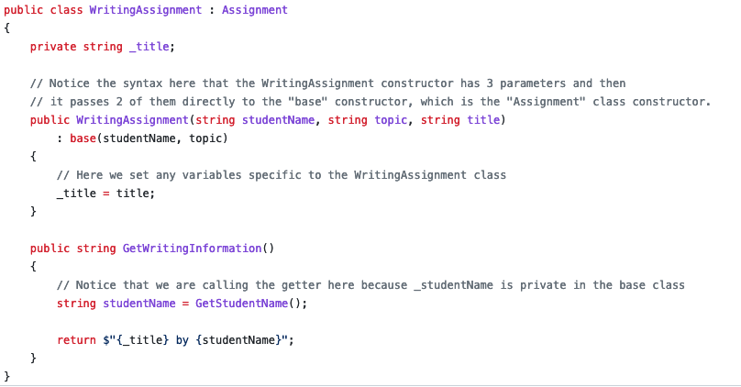
Activity Instructions Step 5: Create the WritingAssignment class
Follow the same pattern as before by creating a new file for the WritingAssignment class.
Create the class and set up the inheritance relationship.
Add the member variables and set up the constructor as you did for the MathAssignment class.
Add the GetWritingInformation() method.
Notice that this method needs to access the _studentName variable defined in the base class. Even though WritingAssignment class inherited this attribute, it is private, so you cannot access it directly in the derived class.
To get the data you need for the method you can either make the variable protected in the base class, or you can create a public GetStudentName method to return it.
Return to Main and test your new class.
Sample Output
Mary Waters - European History
The Causes of World War II by Mary Waters

Slide 38
Activity Instructions Step 5: Create the WritingAssignment class
Follow the same pattern as before by creating a new file for the WritingAssignment class.
Create the class and set up the inheritance relationship.
Add the member variables and set up the constructor as you did for the MathAssignment class.
Add the GetWritingInformation() method.
Notice that this method needs to access the _studentName variable defined in the base class. Even though WritingAssignment class inherited this attribute, it is private, so you cannot access it directly in the derived class.
To get the data you need for the method you can either make the variable protected in the base class, or you can create a public GetStudentName method to return it.
Return to Main and test your new class.
Sample Output
Mary Waters - European History
The Causes of World War II by Mary Waters

Slide 39
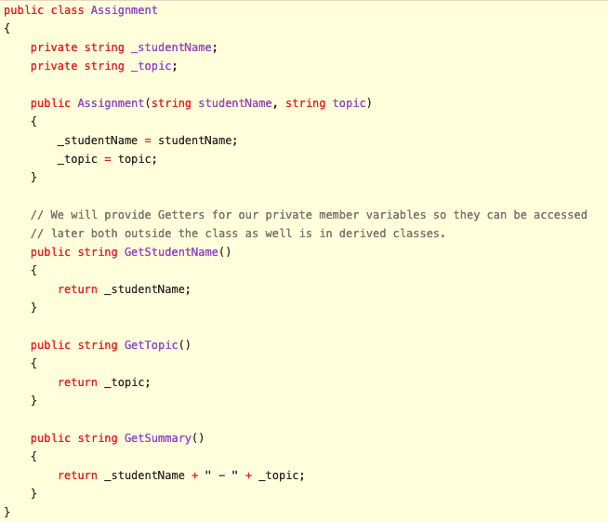

Slide 40
Cool, We have some awesome classes.
Input
Process
Output
View
Input Class
Controller
Main
View
Output Class
Model
Classes

Slide 41
Inheritance - Design Activity
Overview
Meet with your team and prepare a design for this week's programming assignment.
Agenda
Before the meeting: Verify the time, location, and lead student
Begin with Prayer
Discuss the Preparation Learning Activity
Review the Program Specification
Determine the classes
Define class behaviors
Define class attributes
Define Constructors
Conclude

Slide 42
Inheritance - Design Activity
Submission
Complete a design based on the team discussion.
Include a class diagram for each class you will need.
Include some kind of description or chart showing how the program will run or how these methods relate to one another.
You are welcome to use any drawings, diagrams, or other artifacts that you created as a team.
You might also need to create a few more on your own, based on the discussion you had with your team.
Class Diagram
Relationship Diagram
Process Flow Diagram

Slide 43
Unit 04 Develop: Mindfulness Program Problem Overview
We live in a fast-paced world full of stress and anxiety. We could each benefit from taking time for mindfulness activities where we can reflect and unwind.
Most people would agree that we should take more time to be mindful, but relatively few of us do. Think to yourself for a moment about some reasons that you think keep people from doing this. Could a program or an app help with any of these reasons?

Slide 44
Unit 04 Develop: Mindfulness Program Problem Overview
Some of the problems you considered may have included:
We forget
We get busy
We think it will take too long, so we don't start
We don't know where to begin. We know we should reflect on something but don't know what to start with.
While it may not resolve all of the issues that keep people from taking more time for reflection, a great program could help people by providing structure and prompts to guide them through various exercises.

Slide 45
Unit 04 Develop: Mindfulness Program Solution Idea
Consider an app that provides three different kinds of mindfulness opportunities. It could give some guidance and structure to users in the following activities:
The application could additional help the user keep track of the time or frequency they spend in these activities and give them gentle prompts and reminders.
Breathing Activity - Help the user pace their breathing to have a session of deep breathing for a certain amount of time. They might find more peace and less stress through the exercise.
Reflection Activity - Guide the user to think deeply, by having them consider a certain experience when they were successful or demonstrated strength. Then, prompt them with questions to reflect more deeply about details of this experience. They might discover more depth than they previously realized.
Listing Activity - Guide the user to think broadly, by helping them list as many things as they can in a certain area of strength or positivity. They might discover more breadth than they previously realized.

Slide 46
Unit 04 Develop: Mindfulness Program Specification
Write a program that provides the three activities described above. It should help them work through these activities in stages using basic forms of delay (animation or countdown).

Slide 47
Unit 04 Develop: Mindfulness Program Specification
Functional requirements
Breathing Activity
Your program must do the following:
Have a menu system to allow the user to choose an activity.
Each activity should start with a common starting message that provides the name of the activity, a description, and asks for and sets the duration of the activity in seconds. Then, it should tell the user to prepare to begin and pause for several seconds.
Each activity should end with a common ending message that tells the user they have done a good job, and pause and then tell them the activity they have completed and the length of time and pauses for several seconds before finishing.
Whenever the application pauses it should show some kind of animation to the user, such as a spinner, a countdown timer, or periods being displayed to the screen.
The interface for the program should remain generally true to the one shown in the video demo.
Provide activities for reflection, breathing, and enumeration, as described below:
The activity should begin with the standard starting message and prompt for the duration that is used by all activities.
The description of this activity should be something like: "This activity will help you relax by walking your through breathing in and out slowly. Clear your mind and focus on your breathing."
After the starting message, the user is shown a series of messages alternating between "Breathe in..." and "Breathe out..."
After each message, the program should pause for several seconds and show a countdown.
It should continue until it has reached the number of seconds the user specified for the duration.
The activity should conclude with the standard finishing message for all activities.

Slide 48
Unit 04 Develop: Mindfulness Program Specification
Reflection Activity
Reflection Activity
The activity should begin with the standard starting message and prompt for the duration that is used by all activities.
The description of this activity should be something like: "This activity will help you reflect on times in your life when you have shown strength and resilience. This will help you recognize the power you have and how you can use it in other aspects of your life."
After the starting message, select a random prompt to show the user such as:
Think of a time when you stood up for someone else.
Think of a time when you did something really difficult.
Think of a time when you helped someone in need.
Think of a time when you did something truly selfless.
After displaying the prompt, the program should ask the to reflect on questions that relate to this experience. These questions should be pulled from a list such as the following:
Why was this experience meaningful to you?
Have you ever done anything like this before?
How did you get started?
How did you feel when it was complete?
What made this time different than other times when you were not as successful?
What is your favorite thing about this experience?
What could you learn from this experience that applies to other situations?
What did you learn about yourself through this experience?
How can you keep this experience in mind in the future?
After each question the program should pause for several seconds before continuing to the next one. While the program is paused it should display a kind of spinner.
It should continue showing random questions until it has reached the number of seconds the user specified for the duration.
The activity should conclude with the standard finishing message for all activities.

Slide 49
Unit 04 Develop: Mindfulness Program Specification
Listing Activity
The activity should begin with the standard starting message and prompt for the duration that is used by all activities. The description of this activity should be something like: "This activity will help you reflect on the good things in your life by having you list as many things as you can in a certain area." After the starting message, select a random prompt to show the user such as:
Who are people that you appreciate?
What are personal strengths of yours?
Who are people that you have helped this week?
When have you felt the Holy Ghost this month?
Who are some of your personal heroes?
After displaying the prompt, the program should give them a countdown of several seconds to begin thinking about the prompt. Then, it should prompt them to keep listing items.
The user lists as many items as they can until they they reach the duration specified by the user at the beginning.
The activity them displays back the number of items that were entered. The activity should conclude with the standard finishing message for all activities.

Slide 50




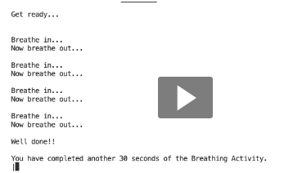

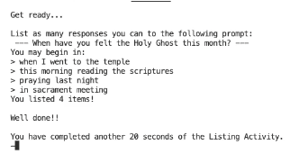

Your program must do the following:
Have a menu system to allow the user to choose an activity.
Each activity should start with a common starting message that provides the name of the activity, a description, and asks for and sets the duration of the activity in seconds. Then, it should tell the user to prepare to begin and pause for several seconds.
Each activity should end with a common ending message that tells the user they have done a good job, and pause and then tell them the activity they have completed and the length of time and pauses for several seconds before finishing.
Whenever the application pauses it should show some kind of animation to the user, such as a spinner, a countdown timer, or periods being displayed to the screen.
The interface for the program should remain generally true to the one shown in the video demo.
Provide activities for reflection, breathing, and enumeration, as described below:
Beginning Message
2
4
Starting Message
Looped Messages (1+)
Ending Message
3

Slide 51
Unit 04 Develop: Mindfulness Program Design Requirements
Simplifications
In addition your program must:
Use inheritance by having a separate class for each kind of activity with a base class to contain any shared attributes or behaviors.
Avoid duplicating code in classes where it could instead be placed in a base class.
Follow the principles of encapsulation and abstraction by having private member variables and putting related items in the same class.
For the core requirements you do not need to worry about the following:
Your program does not need to track any statistics such as how many times or how frequently the user has done an activity.
When getting random questions or prompts, you can choose a random one from the list. You don't have to worry about if it was already chosen this session, or worry about running out of prompts.

Slide 52
Unit 04 Develop: Mindfulness Program Showing Creativity and Exceeding Requirements
Meeting the core requirements makes your program eligible to receive a 93%. To receive 100% on the assignment, you need to show creativity and exceed these requirements.
Here are some ideas you might consider:
Adding another kind of activity.
Keeping a log of how many times activities were performed.
Make sure no random prompts/questions are selected until they have all been used at least once in that session.
Saving and loading a log file.
Adding more meaningful animations for the breathing (such as text that grows out quickly at first and then slows as they near the end of the breath).
Anything else you can think of!
Report on what you have done to exceed requirements by adding a description of it in a comment in the Program.cs file.

Slide 53
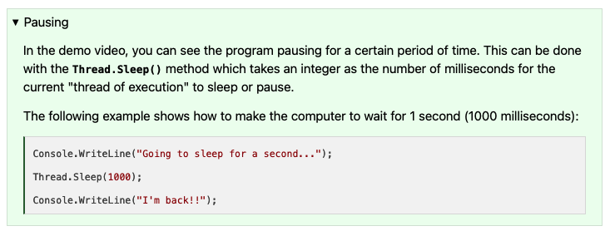
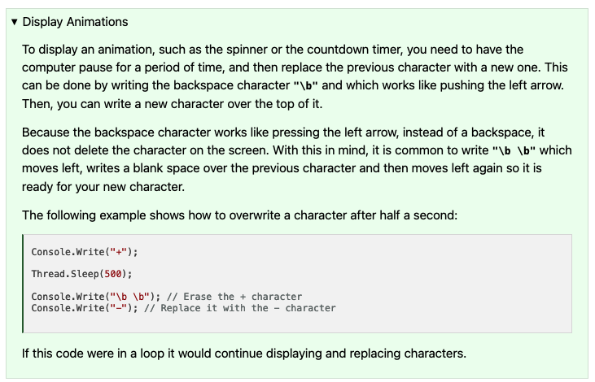
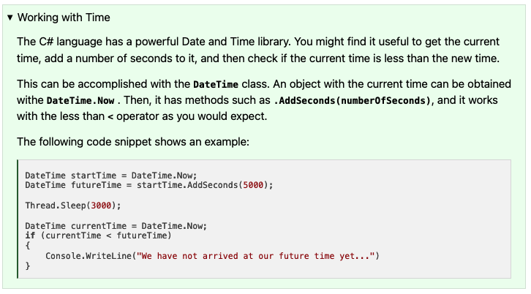

Slide 54
Design Starting Template
Input
Process
Output
View
Input Class
Controller
Main
View
Output Class
Model
Classes

Slide 55
Design Starting Template
Input
Process
Output
View
Input Class
Controller
Main
View
Output Class
View
Console
View
File
Model
Classes
View
Console
View
File
View
Parent
View
Child
View
Child
View
Child

Slide 56
Class Template
Input
Process
Output
View
Parent Attributes
Constructor
Controller
Methods
View
to_String
Model
Class Attributes
Parent Attributes

Slide 57
Class Method Template
Input
Process
Output
View
Parameters
Controller
Function Logic
View
Return Value
Model
Local Attributes
Class Attributes
Parent Attributes

Slide 58
W06 Team Activity: Code Review Participation Report
Agenda
Before the meeting: Verify the time, location, and lead student
Begin with Prayer
Begin the Code Review
Review the Code
Conclude
Checklist?

Slide 59
W06 Prove: Developer
This criterion is linked to a Learning Outcome Principle: Encapsulation (information hiding)
This criterion is linked to a Learning Outcome Principle: Scripture class
This criterion is linked to a Learning Outcome Principle: Word class
This criterion is linked to a Learning Outcome Principle: Reference class
Functionality: Scripture Display A scripture is displayed.
This criterion is linked to a Learning Outcome Functionality: Word Hiding
This criterion is linked to a Learning Outcome Functionality: Program Termination
This criterion is linked to a Learning Outcome Style: Whitespace
Style: Naming Conventions Class, Method, and Attribute naming conventions are followed.
This criterion is linked to a Learning Outcome Shows creativity and exceeds core requirements

