Slide 1
Week 9-10 Polymorphism
CSE 210
Bro Clements

Slide 2
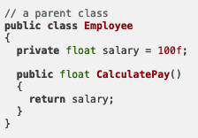
Polymorphism Learning Activity
Overview
In this activity you will learn and practice the principle of Polymorphism.
What is Polymorphism?
Polymorphism is the ability to take on many forms.
More specifically, it is the ability of a child class to change the behavior in a method inherited from a parent class.
The method name stays the same but the behavior, or the specific code to run is different.

Slide 3
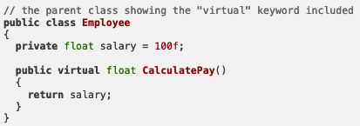
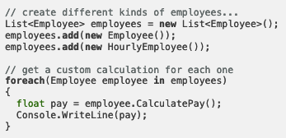
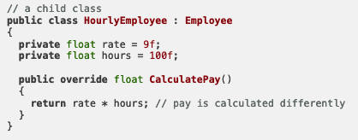
Example
100
900

Slide 4
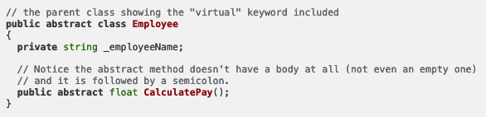
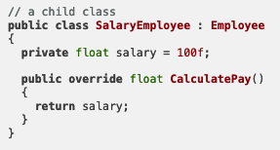
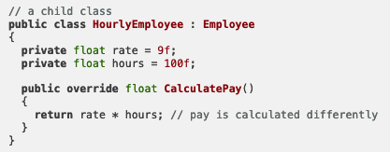
Abstract Method

Slide 5
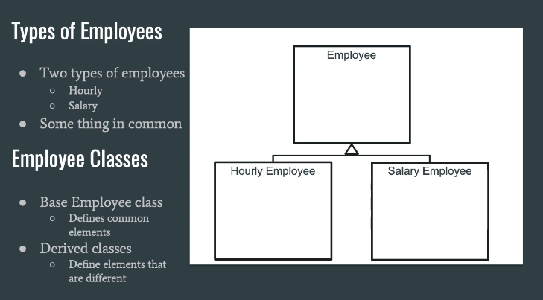
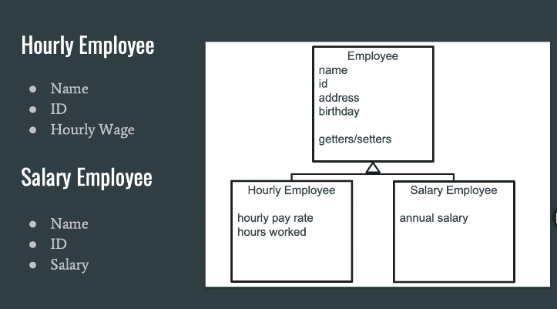
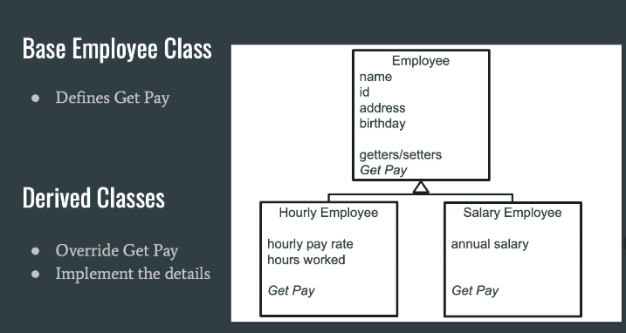

Slide 6
In Summary
Polymorphism is the fourth and crowning principle of programming with classes.
Skillful use of
abstraction,
encapsulation and
inheritance
are all required to apply polymorphism effectively.
The result is a simple but powerful mechanism for ensuring that programs are flexible and ready for change.
One of the recurring themes through all of this has been the importance of focusing on class contracts or the interface.
Identifying, defining and developing them are of prime concern for those who practice programming with classes on a regular basis.

Slide 7
Activity Instructions
Practice the principle of polymorphism by writing a program that computes the areas of different shapes cut out of pieces of paper.
For all shapes, you need to keep track of the color of the paper and then have a method to compute the area. The area should not be stored as a member variable, but instead, you should store the length of the shapes sides and then compute the area as needed.
Your program should include
squares (which store a color and a single side),
rectangles (which store a color and two sides), and a
circle (which store a color and a radius).
You should create several kinds of shapes and put them into a single list.
Then, iterate through the list and display their areas.

Slide 8
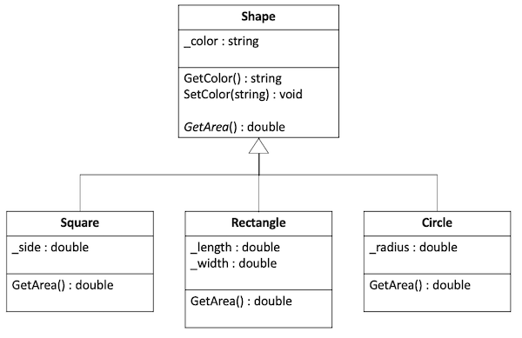
Design the Classes
Based on what you learned in inheritance, it seems reasonable to create a base shape class where you can include any responsibilities that all shapes have in common. Then you can create derived classes for the individual square, rectangle and circle shapes.
In this example all shapes have a color and a method to get the area, but the implementation of that method will be different for each kind of shape. Thus, the GetArea method should be declared in the base class, but you should override it in the derived classes.

Slide 9
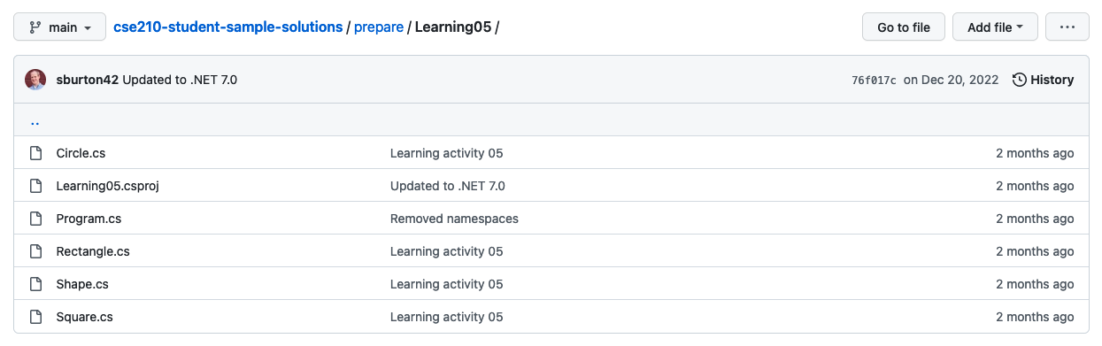
Start the Project
Open the class project in VS Code.
Navigate to the Learning05 project in the prepare folder. Find the Program.cs file, which will be your entry point for the program.
Verify that you can run the project.

Slide 10
Create the base Shape class
In a new file, create the Shape class.
Add the color member variable and a getter and setter for it.
Create a constructor that accepts the color and set its.
Create a virtual method for GetArea().

Slide 11
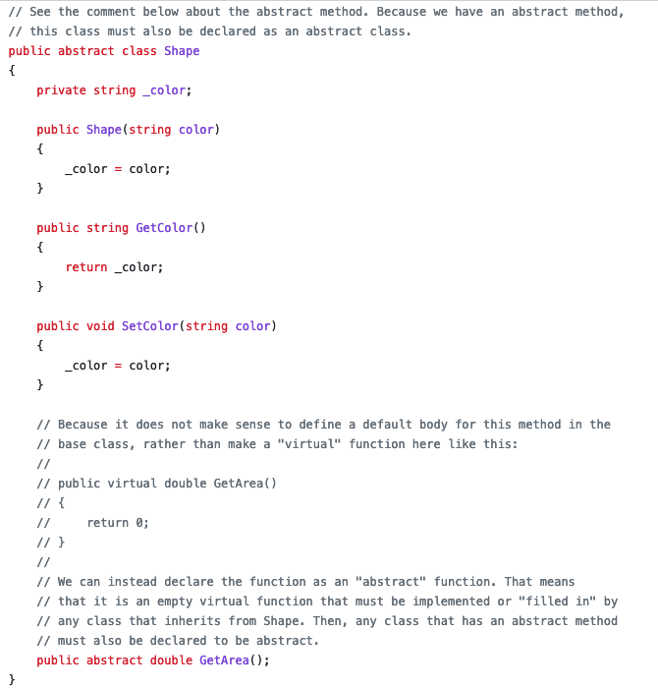
Create the base Shape class
In a new file, create the Shape class.
Add the color member variable and a getter and setter for it.
Create a constructor that accepts the color and set its.
Create a virtual method for GetArea().

Slide 12
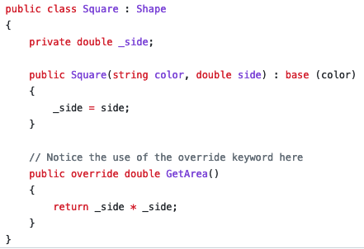
Create the Square class
In a new file, create the Square class.
Make sure this class inherits from the base class.
Create a constructor that accepts the color and the side, and then call the base constructor with the color.
Create the _side attribute as a private member variable.
Override the GetArea() method from the base class and fill in the body of this function to return the area.

Slide 13
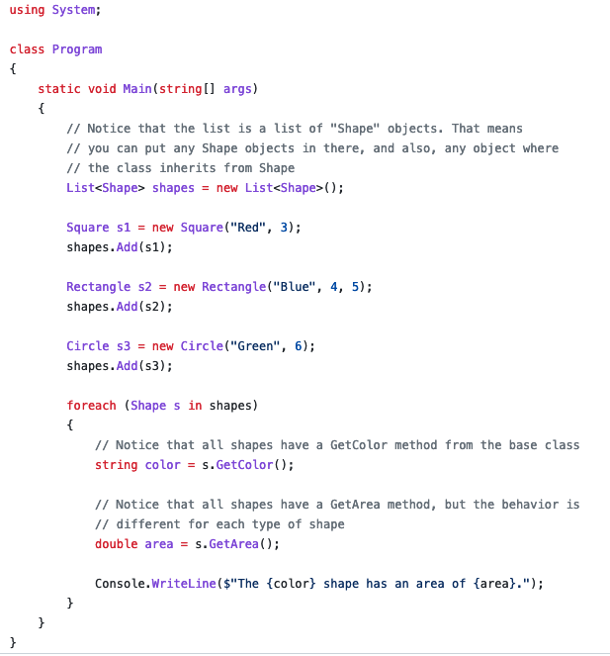
Test the Square class
Return to the Main method in Program.cs to test your code.
Create a Square instance, call the GetColor() and GetArea() methods and make sure they return the values you expect.

Slide 14
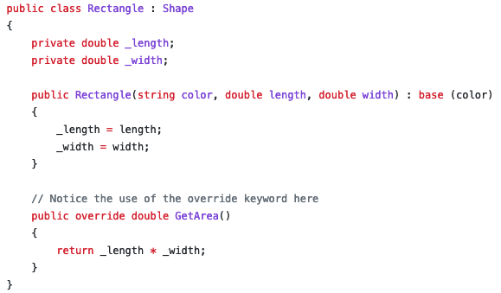
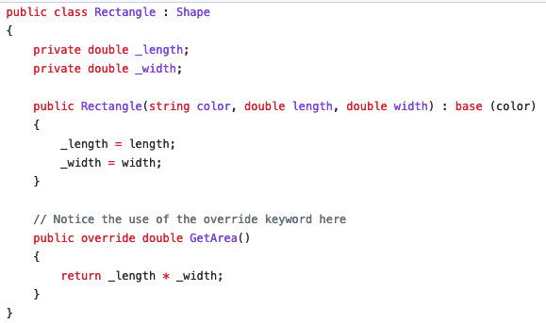
Create the Rectangle and Circle classes
Repeat the steps above for the Rectangle and Circle classes, putting them each in their own files, storing the necessary variables, and overriding the GetArea() for each.
Test these classes back in Main and make sure they work as expected.

Slide 15
Build a List
In your Main method, create a list to hold shapes (Hint: The data type should be List<Shape>).
Add a square, rectangle, and circle to this list. Iterate through the list of shapes.
For each one, call and display the GetColor() and GetArea() methods

Slide 16
Polymorphism - Design Activity
Use the following as an agenda for your team meeting. Whoever is assigned to be the lead student for this gathering should help guide the group through these steps and ask the questions listed here.
Before the meeting: Verify the time, location, and lead student
Begin with Prayer
Discuss the Preparation Learning Activity
Review the Program Specification
Determine the classes
Define class behaviors
Define class attributes
Define Constructors
Conclude
Must have design deliverables:
Class Diagrams
Behavior/Attribute Chart
Process Flow Diagram

Slide 17
Unit 05 Develop: Eternal Quest Program

Slide 18
Unit 05 Develop: Eternal Quest Program Problem Overview
Many people set goals for areas they want to improve in their lives.
These goals can be very important to help us in our growth, such as highlighted in the Church's Children and Youth program.
But despite our best intentions, we often struggle to follow through with these goals.
Think for a minute about what are the biggest challenges that keep someone from reaching the goals they have set?

Slide 19
Unit 05 Develop: Eternal Quest Program
There are many different reasons you might come up with that apply generally such as
forgetting,
not having enough time, and
programs or applications could help with many of those.
In addition to these general challenges, some that are specific to goals could include:
Many goals repeat and are never finished, such as studying the scriptures.
Many goals have to be completed a number of times before they can be finished, such as attending the temple 10 times.
While we recognize the value of our goals in the eternal sense, sometimes we need some shorter term "rewards" to help excite us along the way.

Slide 20
Unit 05 Develop: Eternal Quest Program
Gamification is the idea of turning something into a game.
It could include a number of different concepts, but often involves getting badges or awards, as you "level up" with more points.
Consider a program that keeps track of various kinds of goals that people have, which are goals in their real life,
such as studying the scriptures each day, finishing a project, or even stopping a bad habit.
This program could be set up to keep track of your progress on these goals and offer points, awards, or other celebrations to keep you encouraged to keep working.
A program like this could be more serious, and just keep track of goal progress, or it could be as funny and personal as you would want (for example, a level 13 Ninja Unicorn).
The idea is to engage the part of our brain that loves seeing these "wins" and accomplishments as we work on our goals.
No matter what the exact format is, this program could help each of us on our "Eternal Quest" of returning to be with our Father in Heaven.

Slide 21
Unit 05 Develop: Eternal Quest Program
Write an Eternal Quest program to track various kinds of goals.
Your program can include whatever kinds of "gamification" components you like, but each program should have the following base functionality.

Slide 22
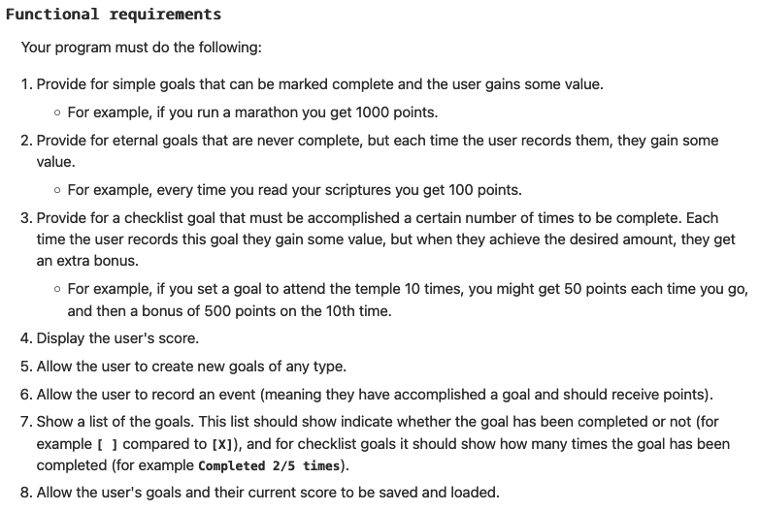

Slide 23
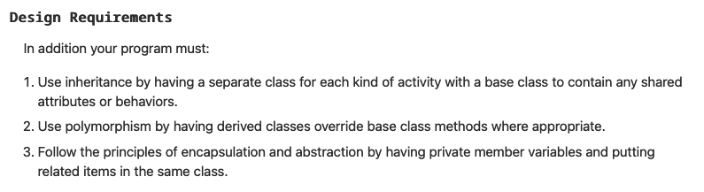
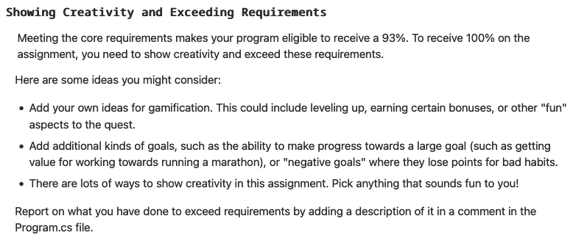

Slide 24
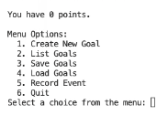
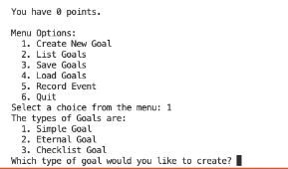






Slide 25
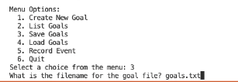
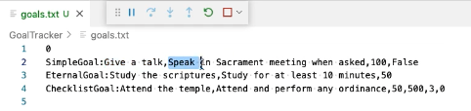





Slide 26
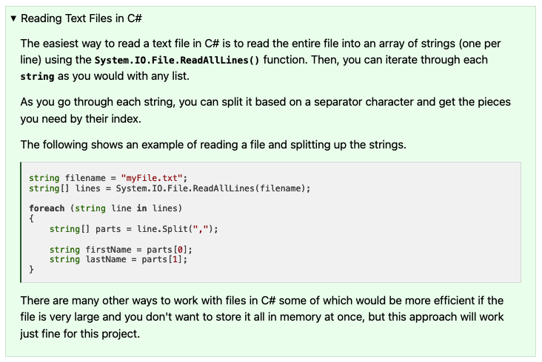

Slide 27
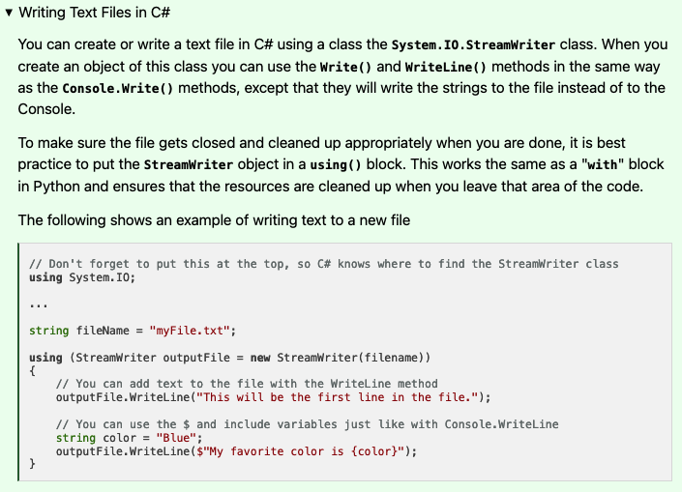

Slide 28
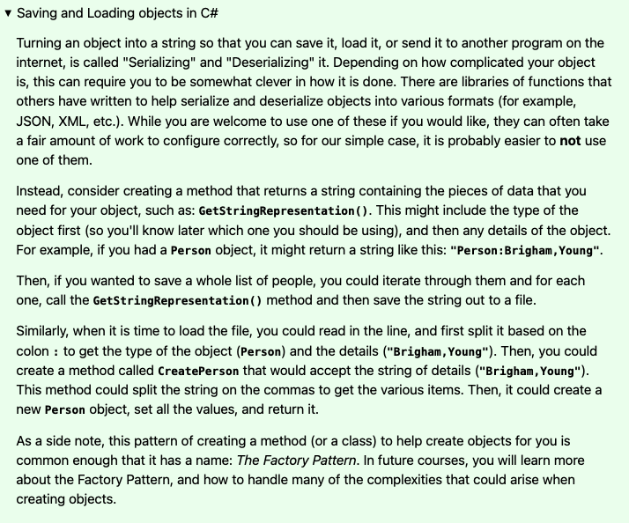

Slide 29
W06 Team Activity: Code Review Participation Report
Agenda
Before the meeting: Verify the time, location, and lead student
Begin with Prayer
Begin the Code Review
Review the Code
Conclude
Checklist?

Slide 30
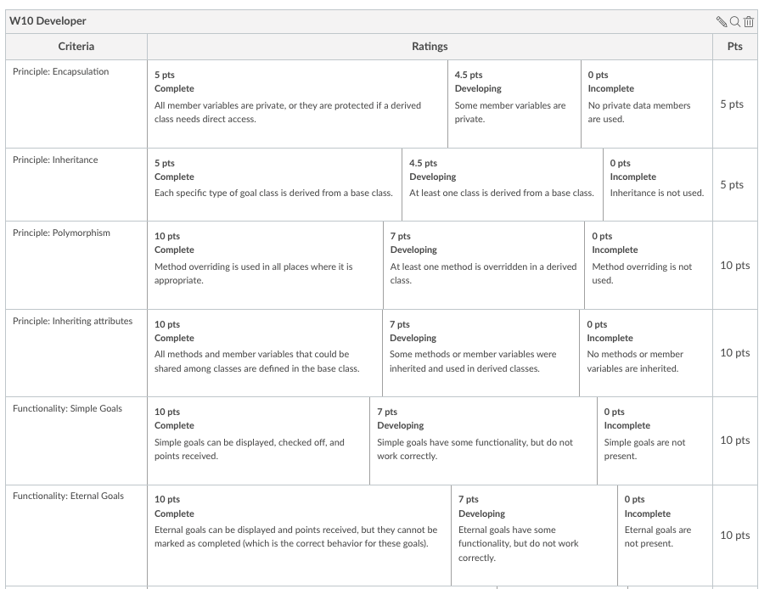
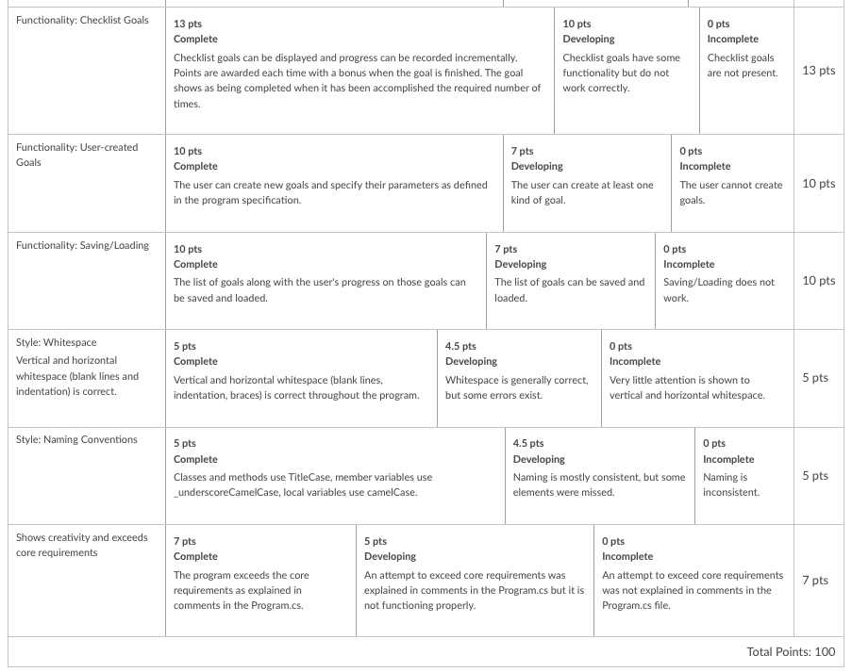

Slide 31
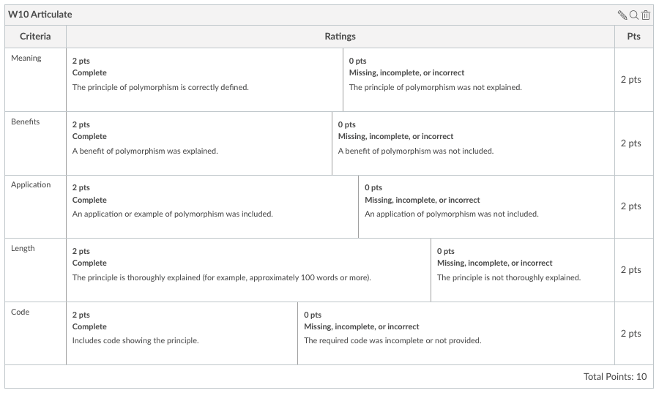
Polymorphism - Articulate
Now that you have learned about the principle of polymorphism, and designed and developed a program using it, return to I-Learn and answer the following question (the way you would in a job interview):
What is polymorphism and why is it important?
Your response must:
Explain the meaning of Polymorphism
Highlight a benefit of Polymorphism
Provide an application of Polymorphism
Use a code example of Polymorphism from the program you wrote
Thoroughly explain these concepts (this likely cannot be done in less than 100 words)

