Slide 1
Week 11 Final Project
CSE 210
W. Clements

Slide 2
Overview
W11 Prepare: Final Project Plan
W11 Team Activity: Designer
W11 Team Activity: Participation Report

Slide 3
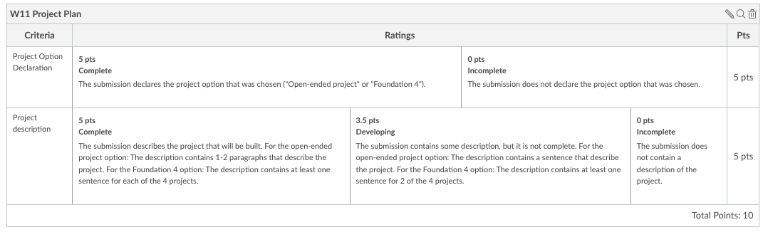
W11 Prepare: Final Project Plan
There are two versions of the final project.
One that is more open ended, and
another one that is designed to provide more detailed practice on the concepts we have discussed
The project option are you choosing ("Open-ended project" or "Foundation 4").

Slide 4
Foundation 4 Project Option
In this project, you will write four separate, smaller programs. There is one program for each of the principles of Programming with Classes:
Abstraction
Encapsulation
Inheritance
Polymorphism
https://byui-cse.github.io/cse210-course-2023/unit06/project-plan.html

Slide 5
Foundation 4 Project Option
Program 1: Abstraction with YouTube Videos
Scenario
You have been hired by a company that does product awareness monitoring by tracking the placement of their products in YouTube videos. They want you to write a program that can help them work with the tens of thousands of videos they have identified as well as the comments on them.
Program 2: Encapsulation with Online Ordering
Scenario
You have been hired to help a company with their product ordering system. They sell many products online to a variety of customers and need to produce packing labels, shipping labels, and compute final prices for billing.
https://byui-cse.github.io/cse210-course-2023/unit06/project-plan.html

Slide 6
Foundation 4 Project Option
Program 3: Inheritance with Event Planning
Scenario
You have been hired by an event planning company. They help organize and market events throughout the world. They need you to write a program to track each of these events and produce the marketing material to distribute on social media.
Program 4: Polymorphism with Exercise Tracking
Scenario
The local fitness center has hired you to write an app for their customers to track their exercise.
https://byui-cse.github.io/cse210-course-2023/unit06/project-plan.html

Slide 7
Open-ended Project Option
Program Specification
Think of a problem that people have that could be solved with programming, similar to the approach we have taken this semester. Write a program that uses the principles of Programming with Classes to help solve this problem.
You are welcome to explore and use any libraries you would like, such as graphics, networking, Web, etc. Just make sure you get a chance to show that you are using the principles of this class. (You cannot use Unity or other frameworks like that, because you won't be able to demonstrate that you know how to write the code we have learned this semester.)
Guidelines
To be eligible for full credit, your program must:
Perform an interesting task or function.
Be completely written by you (it cannot simply add to an existing project.)
Be written in C# (and not in a "low code" environment such as Unity).
Use at least 8 classes.
Demonstrate the principle of abstraction.
Classes should have specific responsibilities and collaborate with each other.
Demonstrate the principle of encapsulation.
Internal details should be private, external methods should be available for public behaviors.
Demonstrate the principle of inheritance.
Code should not be duplicated that could be place in a base class.
Demonstrate the principle of polymorphism.
Methods that are unique to a derived class should be defined in a base class, and overridden in a derived class.
https://byui-cse.github.io/cse210-course-2023/unit06/project-plan.html

Slide 8
Ideas
The 10 Best Beginner Projects for New Programmers
https://www.makeuseof.com/tag/beginner-programming-projects/
Sport Scoring Software
Inventory Management
Library Management
Budget/Finance System
Movie theater system
Hospital Management
Supermarket System
Graphic Calculator
Travel Management (Planes, Trains, Trucks)
Game: Text-based, RPG, 5-min, etc

Slide 9
Ideas
Campus Explorer (Fun or Aced)
Teamwork Management
Bug Report System
Survey System
Smart City Project
Smart Calculator (10+ functions)
Task tracking
Software Licensing Management System
Currency Converter
Scheduling/Planner
GPA calculator
Car rental system
Job Application management system
Address Book
Networking management
Media Management

Slide 11
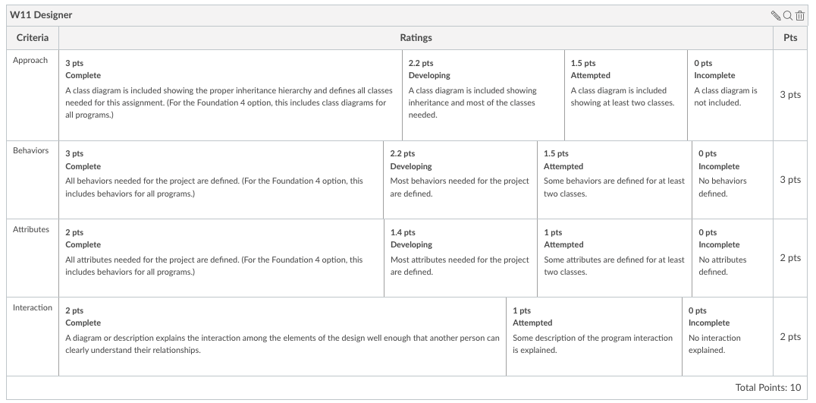
W11 Team Activity: Designer
Before the meeting: Verify the time, location, and lead student
Begin with Prayer
Discuss each person's project
Conclude
After the Meeting
Discuss each person's project
Find out which project each person is working on.
For each person that is working on an open-ended project, take a minute to discuss candidates for their programs and their responsibilities.
Then, for all those that are working on the Foundation 4 projects, start with the first program and work through each of the four programs, discussing candidates for classes and their responsibilities.

Slide 12
W11 Team Activity: Designer
Before the meeting: Verify the time, location, and lead student
Begin with Prayer
Discuss each person's project
Conclude
After the Meeting
After the Meeting
Each person should individually finish the design for their own project by doing the following:
Look at the list of classes and responsibilities your team considered for your project(s). Add any that you think are missing.
Determine the behaviors of these classes and list these as methods.
Determine the attributes these classes will need to have to support these behaviors and list them as member variables.
Include a class diagram for each class you will need.
Include some kind of description or chart showing how the program will run or how these methods relate to one another.

Slide 14
W11 Team Activity: Participation Report
I showed respect to my teammates by arriving on time to the meeting. (Foster Productive Group Climates)
I came prepared for the meeting by completing the learning activities. (Fulfill Individual Responsibilities)
I was an active participant and contributed by asking questions or sharing meaningful ideas. I shared my video where possible during the meeting. (Fulfill Individual Responsibilities)
I actively listened to my teammates and helped maintain a respectful and constructive environment. I was willing to consider different viewpoints and find resolutions if conflicts arose. (Facilitate Contributions of Others)

Slide 15
Begin with the End in Mind

Slide 16
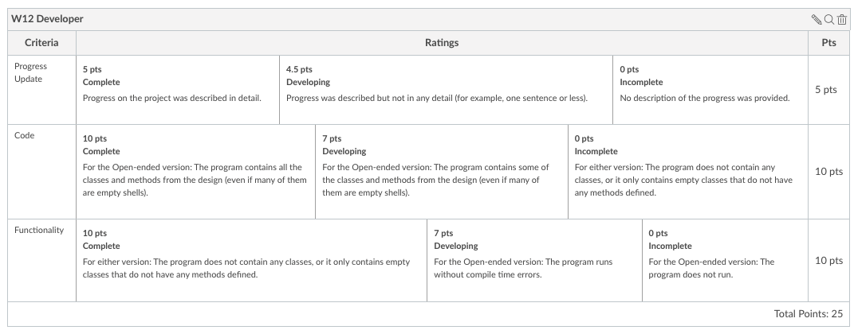
W12 Prove: Developer- Project Milestone
Final Project Milestone
Overview
The purpose of this assignment is to help you stay on track to finishing your final project.
The progress you are making will depend on which version of the final project you are working on.
Assignment Submission
In I-Learn, submit the following:
A paragraph description of which project you are working on and what you have completed thus far.
A link to your GitHub URL.
Foundation 4 Progress
If you are working on the Foundation 4 version of the project, you should complete at least the following:
Finish the Foundation Program #1 (Abstraction).
Finish the Foundation Program #2 (Encapsulation).
Open-ended Project Progress
If you are working on the open ended-project. You should complete at least the following:
Have classes created for all the classes in your design (it's ok if some of them are just empty shells at this point).
Have methods created for all the behaviors in your design (it's ok if many of these are just empty shells at this point).
Your program should be able to run without compile errors.
Your program should have some interaction that resembles the final project.

Slide 17
W12 Team Activity: Code Review Participation Report
Agenda
Before the meeting: Verify the time, location, and lead student
Begin with Prayer
Begin the Code Review
Review the Code
Conclude

Slide 18
W13 Team Activity: Final Project Demo
Overview
Meet with your team one last time to demonstrate your final project and share feedback with one another.
Agenda
Use the following as an agenda for your team meeting. Whoever is assigned to be the lead student for this gathering should help guide the group through these steps and ask the questions listed here.
Before the meeting: Verify the time, location, and lead student
Begin with prayer
Demo each person's project
Go through each person on the team. Each person should do the following when it is their turn:
Demonstrate your project running.
Show some of the code that you thought was the most interesting.
Submission
After finishing your meeting, each person needs to return to I-Learn to complete the quiz associated with this activity.
There is no code or design to submit.

Slide 19
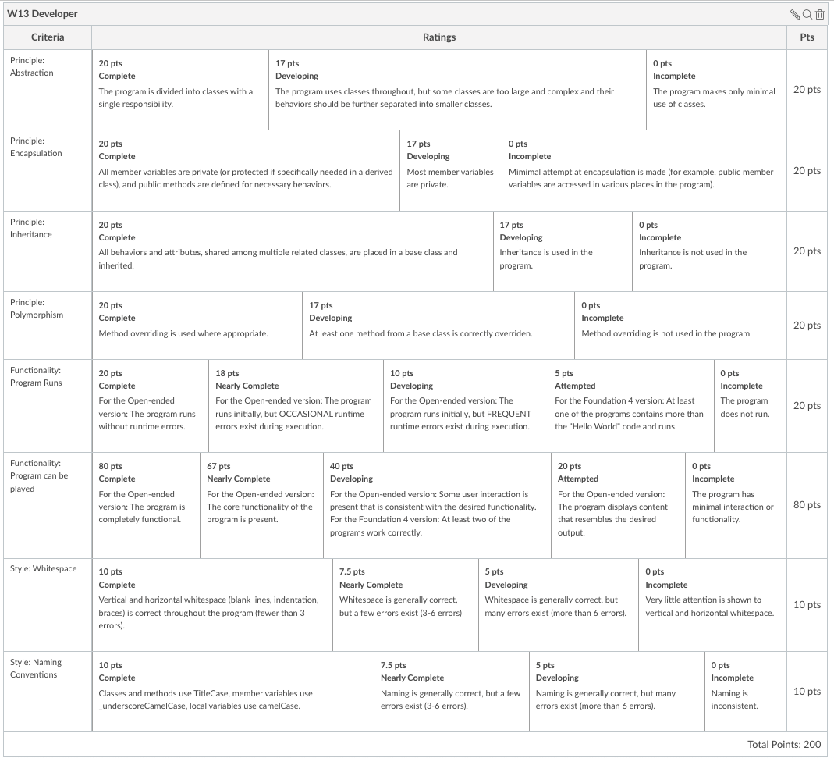
W13 Prove: Developer: Final Project
Unit 07 Develop: Final Project
Overview
Finish your final project.
Final Project specifications
For a list of the final project specifications, refer back to the Final Project Plan
Submission
Submit a link to your final project code repository.
If you have completed the open-ended project, make sure your program contains a Readme file explaining anything someone should know to use your project.

Slide 20
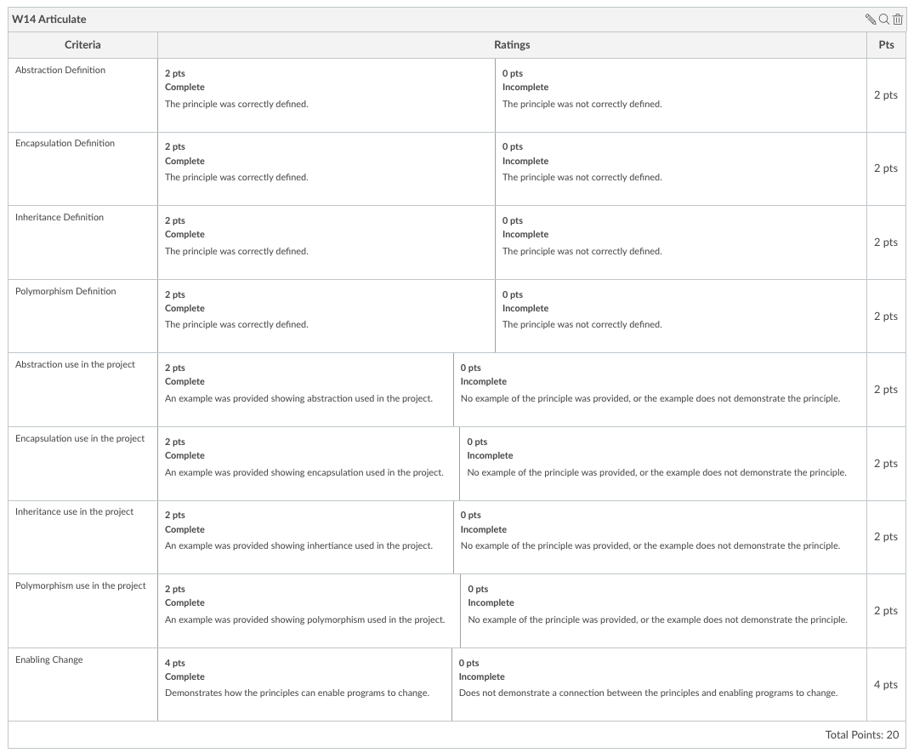
W14 Prove: Articulate
Instructions
You have now learned about each of four principles of Programming with Classes:
Abstraction
Encapsulation
Inheritance
Polymorphism
You have also used these principles to design and develop your final project. For this assignment, if you have chosen the final project option, refer back to that project. If you have chosen the "Foundation 4" option, refer back to those four programs as your final project.
As a final Articulate assignment, return to I-learn and answer the following questions (the way you would in a job interview):
Briefly define each of the 4 principles of Programming with Classes.
For each principle: Describe how each principle was used in your final project.
Overall: How did using these principles help your final project become more flexible for future changes? (Provide specific examples.)
Remember if you chose the "Foundation 4" option, those four programs are considered your final project, so you can refer to any of the code you used in those programs.
Your response must:
Explain the meaning of each principle.
Highlight how each principle was used in your final project.
Explain how these principles make your final project more flexible for changes.
Thoroughly explain these concepts (this likely cannot be done in less than 100 words)

