Slide 1
Week 01 Programming Tools
CSE 210 Programming with Classes
W. Clements
2023

Slide 2
Classroom arrangement

Slide 3
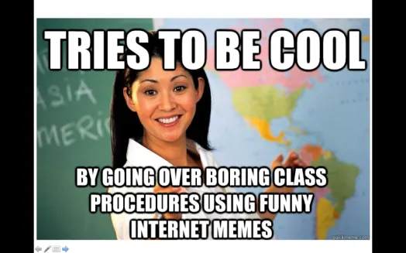
A little about me… Myth: Don’t talk to strangers
20+ Years experience
Masters: Univ of CO @ Denver; Bachlors; BYU-Provo; Associates: Ricks College
Worked for Northrop Grumman (TRW) for 13 years, Raytheon for 5 years
Been teaching for 8 years: Online, Hybrid, and Campus for Community Colleges of Colorado, BYU-Online, and BYU-Idaho
I love computing, I have since I saw my first for-loop fill the screen with my name.
I have moved over 20x, CA, UT, ID, MO, OK, TX, CO
Hobbies: Board Games, Family outings

Slide 4
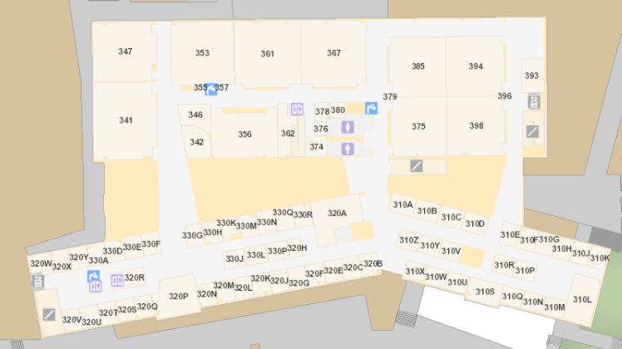
Bro Clements
William Clements
Email: ClementsW@byui.edu
Google Phone: (208) 557-4333
Office Phone: 208-496-7617
Office Rm: 320 T (Mark Twain with a T – Samuel Clemens)

Slide 5
Agenda
Syllabus
Review
Checkpoint
Team challenge

Slide 6
Syllabus
Outcomes
Text book
Technology
Organization
Grading
Late Work
Academic Honesty

Slide 7
Outcomes
Successful graduates of CSE 210 will do the following.
Converse in the concepts and vernacular of programming with classes
Qualitatively evaluate alternative programming solutions using classes
Apply a systematic approach to writing code with classes
Evaluate programs using various principles of software testing
Write meaningful programs that can effectively accommodate change

Slide 8
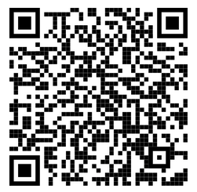
Textbook
There is no textbook for this course. Instead, I-Learn contains links to videos and web pages with the preparation material students will need.
https://byui-cse.github.io/cse210-course-2023/

Slide 9
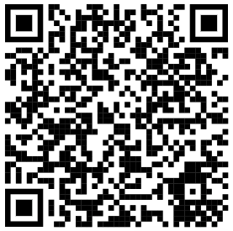
Organization
This course is organized in a sequence of modules.
In the semester version of the course, you will complete one module each week.
In the block version of the course, you will complete two modules each week.
Modules 1-5 focus on the fundamental principles of object-oriented programming.
Modules 6 focus on their application to a large, team programming project.

Slide 10
Organization
Unit 1: Introduction
Unit 2: Abstraction
Unit 3: Encapsulation
Unit 4: Inheritance
Unit 5: Polymorphism
Unit 6: Final Project
Unit 7: Conclusion

Slide 11
Organization
Unit 1: Introduction Wks 1 & 2
Unit 2: Abstraction Wks 3 & 4
Unit 3: Encapsulation Wks 5 & 6
Unit 4: Inheritance Wks 7 & 8
Unit 5: Polymorphism Wks 9 & 10
Unit 6: Final Project Wks 11 & 12
Unit 7: Conclusion Wks 13 & 14

Slide 12
Organization
Unit 1: Introduction Wks 1 & 2 Custom Greeting, Grades
Unit 2: Abstraction Wks 3 & 4 Magic Number, Avg, Square
Unit 3: Encapsulation Wks 5 & 6 Scripture Memorizer
Unit 4: Inheritance Wks 7 & 8 Mindfulness Program
Unit 5: Polymorphism Wks 9 & 10 Eternal Quest Program
Unit 6: Final Project Wks 11 & 12 Team Project
Unit 7: Conclusion Wks 13 & 14 Finish Project

Slide 13
Grading
The grading breakdown for the course is:
40%—Solo Checkpoints
40%—Team Challenges
10%—Programming Reflections
10%—Final project
Letter grades will be awarded as follows:
Percentage Range |  | Letter Grade
93% | 100.00% | A
90% | 92.99% | A−
87% | 89.99% | B+
83% | 86.99% | B
80% | 82.99% | B−
77% | 79.99% | C+
73% | 76.99% | C
70% | 72.99% | C−
67% | 69.99% | D+
63% | 66.99% | D
60% | 62.99% | D−
0% | 59.99% | F

Slide 14
Late Work
Course Policy
My Policy
Late work will be graded with a 10% penalty applied for each day that has passed since the due date, up to a maximum of 50% penalty for any given assignment.
Team challenges are not accepted late.
Instead, students should submit what they have completed by the due date for partial credit. Extenuating circumstances should be discussed with the instructor prior to the assignment due date.

Slide 15
Late Work
Course Policy
My Policy
Late work will be graded with a 10% penalty applied for each day that has passed since the due date, up to a maximum of 50% penalty for any given assignment.
Team challenges are not accepted late.
Instead, students should submit what they have completed by the due date for partial credit. Extenuating circumstances should be discussed with the instructor prior to the assignment due date.
General Rule:
You paid for the class. You do the work, you get a grade.
Life happens, get the work in.
Teamwork
As a responsible professional, you will be working on a team.

Slide 16
Academic Honesty
School and Course Policy
My Policy – Properly source your work
Students are expected to follow the university's policies for academic honesty.
Students may work with your classmates but all submitted work for projects and assignments must be original. Share ideas; do not share code! Assistance from a classmate should be on par with the help students would expect from a lab assistant.
If you work closely with another student, helping teach and learn from each other, make sure you each still write your own code, but in this case, your solutions may end up being very similar. This is completely fine, but please make sure to put a comment in your code stating that you wrote your own program, but worked closely with that person, and that is why it is similar.
Students are encouraged to use the Internet as a resource, but recognize that they should not copy and paste someone else's work as your own. Cite all sources and follow copyright laws. When in doubt, give credit and be upfront.
Do not look for or share solutions on "note sharing" internet sites.
The penalty for copying or plagiarism of assignments might be one or more of the following: a score of zero (0) on an assignment, being asked to withdraw from the class, a failing grade in the class, or disciplinary action by the University.
DO YOUR OWN WORK!!!
IF you use the internet to looks stuff up, cite your research.
Copying from one or two sources without citation is plagiarism
Using three or more sources is called research. Cite your sources.
USING CourseHero will get you nowhere but zero.
USING WIKIPEDIA is ok, but look up the resources in the citations.
All code will have:
Header comment with Name, Date, and Description
All variables will have your initials.
All code will be tested.

Slide 17
Dress and Grooming
Grievance Policy
Students are expected to follow the university's Dress and Grooming Standards
No Hats
Head, Shoulders, Knees, and Toes
Review the Academic Student Grievance Policy.

Slide 18
Student Support
Sexual Harassment
Support is available in many ways including via other class members and discussion in Slack. In addition, help is available through the university's academic support center.
BYU-Idaho is committed to promoting and maintaining a safe and respectful environment for the campus community. Sexual misconduct is against the law, contrary to the teachings of The Church of Jesus Christ of Latter-day Saints and the Honor Code and inconsistent with the life and teachings of Jesus Christ, which we hope are embodied on our campus. The university prohibits sexual misconduct perpetrated by or against university students, university employees, participants in university programs, or visitors to its campus, whether the behavior occurs on or off campus.
Click here for more information.

Slide 19
Students with Disabilities
Brigham Young University-Idaho is committed to providing a working and learning atmosphere that accommodates qualified persons with disabilities.
If you have a disability and require accommodations, please contact the Disability Services Office (208) 496-9210.
Reasonable academic accommodations are reviewed for all students who have qualified documented disabilities.
Services are coordinated with the students and instructor by the Disability Services Office.
I am flexible, Do the Work - get the grade.

Slide 20
Summary
You paid for the class.
Show respect
To the teacher Don’t copy from the internet
To your classmates Show up and participate in your team
To yourself How much is each class worth?
To your future Be prepared for your future How much is your Return on Investment? ~Avg: $100K x 40 years
The only person you can make fun of is the clown in front of the room. - Me

Slide 22
Review

Slide 23
Review Python
Comments
User Input
Variables
Data Types
Display Results
Operators – Arithmetic, Short, Logic
If Statement
Can of Nothing
Special Characters

Slide 24
Overview
Value Types
Text Type: | str
Numeric Types: | int, float, complex
Sequence Types: | list, tuple, range
Mapping Type: | dict
Set Types: | set, frozenset
Boolean Type: | bool
Binary Types: | bytes, bytearray, memoryview
None Type: | NoneType
Immutable
Mutable
##
Integers
[]
Lists
#.#
Floats
Review Materials
Syntax
Variables
Data Types
If...Else
While Loops
For Loops
Functions
Scope
Modules
Lists
Tuples
{}
$$
Strings
Sets
TF
Boolean
{:}
Dictionary
()
Tuples
I
If cond:
scope
L
elif cond:
e
else cond:
w
While cond:
scope
F
For var in []
scope
M
Import
scope

Slide 25
Program
Input
Magic
(equations)
(algorithms)
(etc)
Process
Output
Str prompt
Patterns:
Var = var operator var
#:operators: +, -, *, /, //, %, **
Var = var.function()
⌨️
input(<str>
Str “”
=
Var
Strings: +, .functions()
Numbers: math
float( )
If(decimal)
int( )
bool:operators (==, <, > <=, >=)
If(whole)
If boolean:
With open(“filename”) as filereference
T-statements
F-statements
T-statements
while boolean:
Var
F-statements
+
f”. {} “
:.#f
for boolean:
If(decimal)
T-statements
str( )
F-statements
str( )
“ {} “.format(var..)
If(whole)
If(str)
📺
VarStr = input(“prompt?”)
VarF = float(VarStr)
VarI = int(VarStr
def functionname (parameters,..)
return value
Str “”
print(<str>)
“ “, \t, \n

Slide 26
Review List
[index]
0
1
2
Len()-1
N+1
N+2
N+2
value
value
value
value
value
value
value
listVarName
.append(value)
value
Method | Lists Description
append() | Adds an element at the end of the list
clear() | Removes all the elements from the list
copy() | Returns a copy of the list
count() | Returns the number of elements with the specified value
extend() | Add the elements of a list (or any iterable), to the end of the current list
index() | Returns the index of the first element with the specified value
insert() | Adds an element at the specified position
pop() | Removes the element at the specified position
remove() | Removes the item with the specified value
reverse() | Reverses the order of the list
sort() | Sorts the list
empty
.clear()
##
.count()
[v1,v2,..]
.extend(list)
index
.index(value)
.insert(index,value)
index
value
.remove(value)
value
value
.pop(index)
.reverse()
.sort() <
.copy()
0
1
2
Len()-1
value
value
value
value
newList

Slide 27
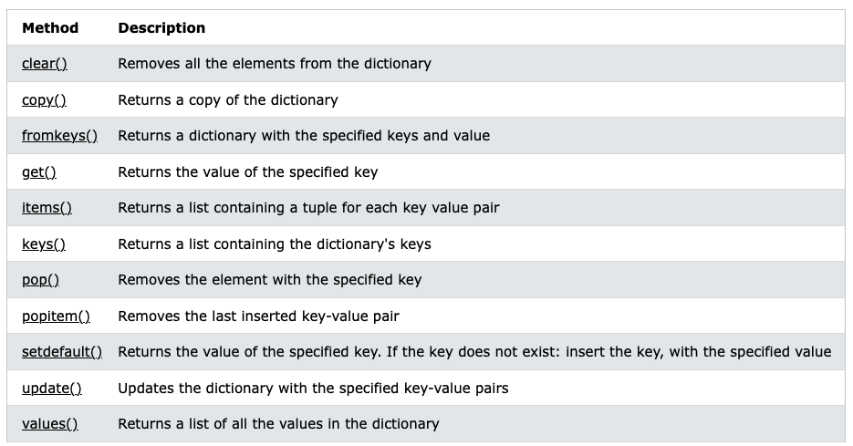
.copy()
key1
key2
Key3
Len()-1
Dictionary
value
newdictVar
value
value
value
[key1, key3, key n]
.fromkeys(listkeys, values)
key1
Key3
Len()-1
value
value
value
[key]
dictionaryVar
key1
key2
Key3
Len()-1
value
value
value
value
.clear()
empty
value
.get(key)
[(key,value), (), ()..]
.items()
[key1, key2, …]
.keys()
value
.pop()
value
.popitem(key)
value
.setdefault(key, defaultvalue)
.update({(key1, newvalue),…})
[value, value, …]
.values()

Slide 28
CSE 111: Functions
Calling Functions
Testing Functions
Lists/Dictionaries
Text Files
Handling Exceptions
Functional Programming
Using Objects

Slide 29
How do you design code?

Slide 30




Four ways to pass parameters
Output-only
Input-only
Processing
Update
display(
int value)
getvaluetwo():
return 2
isLeap(year):
return !year%4
update(list):
list.append(3)
Value

Slide 31
Input
Process
Output
main
Input-only
Processing
Update
Output-only
getvaluetwo():
return 2
isLeap(year):
return !year%4
update(list):
list.append(3)
display(
int value)
Value

Slide 32
Problem Statement
Expected Output
Instruction Givens
Processing needed
Input
Process
Output
main
getInteger
getFloat
getString
getFromFile
Processing
Update
Output-only
Filter
Map
Reduce
Data Structures
Print()
Display()
Gui

Slide 33
Input Function
def askUserforInteger():
flag = True
while (flag):
try:
str_value = input(“Enter Whole Number”)
value = int(str_value)
except ValueError:
print(“Please enter an Whole Number, i.e. 10”)
else:
flag = False
return value

Slide 34
Input Function
def askUserforFloat():
flag = True
while (flag):
try:
str_value = input(“Enter Number”)
value = float(str_value)
except ValueError:
print(“Please enter an float”)
else:
flag = False
return value

Slide 35
Input Function
def askUserforFloat():
flag = True
while (flag):
try:
str_value = input(“Enter a Decimal Number”)
if str_value.isdecimal():
raise ValueError
value = float(str_value)
except ValueError:
print(“Please enter a Decimal Number (#.#), i.e.: 1.5”)
else:
flag = False
return value

Slide 36
Input Function
def askUserforString():
flag = True
while (flag):
try:
str_value = input(“Enter a Word”)
if str_value.isalpha():
raise ValueError
except ValueError:
print(“Please enter word, not a number”)
else:
flag = False
return value

Slide 37
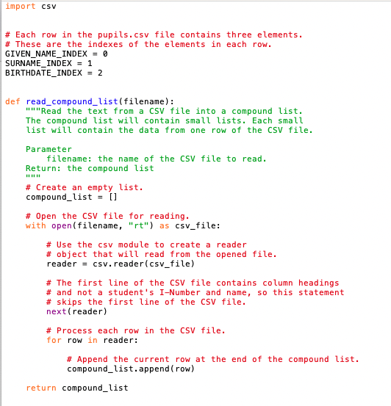

Slide 38
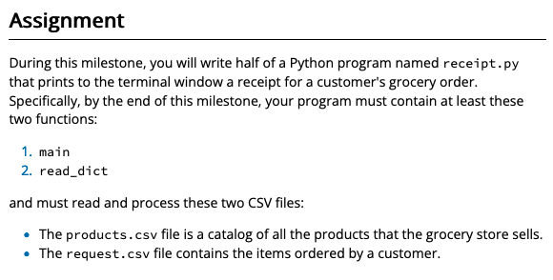
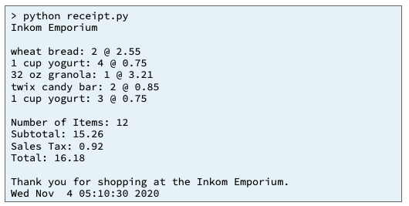
Products.csv
Request.csv
(PK)Product#
Product#
Name
Quantity
Price
dictionary
list
Input
Process
Output
get_products()
receipt.py
main
products.csv
Try
catch
Products_dict
Printables
?
Print_receipt()
requests
get_requests()
requests.csv
! ValueError
Print_errormsg()
Requests, products
Itemize_list
Requests, products
determine_receipt
datetime
Now()
weekday()
Date_time_value
Day_ofweek

Slide 39
Patterns
Filter Pattern
Cumulative/Reduce
Sum/Product/Checksum
Unfiltered_list = [1,2,3,4,5,6,7,8,9,10]
Filtered_list = [] #starts off empty
Tally_variable = 0
for value in unfiltered_list
for value in unfiltered_list
#update tally_variable
Tally_variable += 1
#if filter criteria
If value % 2:
Filtered_list.append(value)
# filtered_list now contains [1,3,5,7,9]
Print(filtered_list)
#tally_variable has cumulative data
Print(tally_variable)

Slide 40
Map/Transform
This can be in a dictionary or a list.
Input_list = [1,2,3,4,5,6,7,8,9,10]
Output_list = [] #starts off empty
for input_value in Input_list
Output_value = calc (input_value)
Output_list. Append(output_value)
# Output_list now contains [2, 4, 6, 8,…]
Print(Output_list )

Slide 41
Problem Statement
Expected Output
Instruction Givens
Processing needed
Input
Process
Output
main
getInteger
getFloat
getString
getFromFile
Processing
Update
Output-only
Filter
Map
Reduce
Data Structures
Print()
Display()
Gui

Slide 42
Problem Statement
Expected Output
Instruction Givens
Processing needed
Input
Process
Output
Control
getInteger
getFloat
getString
getFromFile
Filter (if, subset)
Reduce (sum/proc)
Map (Range-Domain)
Print()
Display()
Gui
View
View
Model

Slide 43
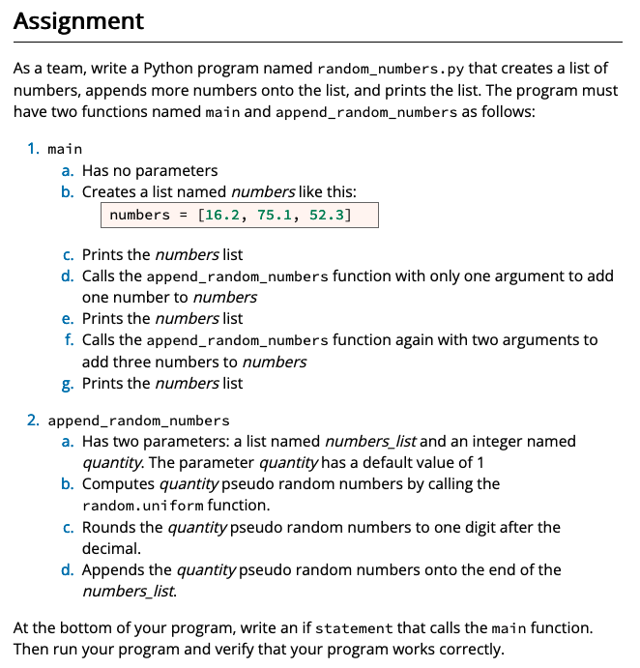
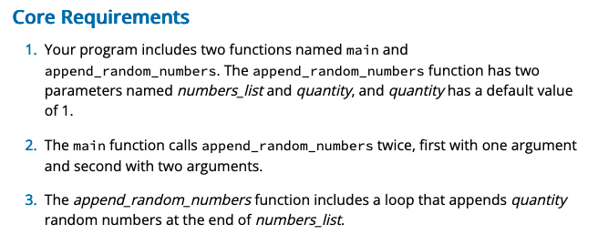
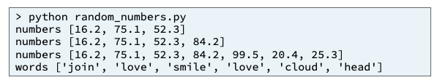
Input
Process
Output
Family_history.py
main
people_dict
people_dict
print_death_age()()
marriages_dic
people_dict
marriages_dic
people_dict
count_genders()
print_marriages()
08 Team Activity: Dictionaries

Slide 44
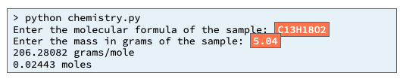
Input
Process
Output
chemistry.py
main
Print_moles
Get_formula()
formula
Get_mass()
mass
Periodic table
Molar_mass
Formula_list
parse_formula()
make_periodic_table()
periodic_table_list = [ # [symbol, name, atomic_mass]
compute_molar_mass()

Slide 45
Products.csv
Request.csv
(PK)Product#
Product#
Name
Quantity
Price
dictionary
list
Input
Process
Output
get_products()
receipt.py
main
products.csv
Try
catch
Products_dict
Printables
?
Print_receipt()
requests
get_requests()
requests.csv
! ValueError
Print_errormsg()
Requests, products
Itemize_list
Requests, products
determine_receipt
datetime
Now()
weekday()
Date_time_value
Day_ofweek

Slide 46
Problem Statement
Expected Output
Instruction Givens
Processing needed
Input
Process
Output
Control
getInteger
getFloat
getString
getFromFile
Filter (if, subset)
Reduce (sum/proc)
Map (Range-Domain)
Print()
Display()
Gui
View
View
Model

Slide 48
Unit 01:
This Week
Setup: Development Environment
Prepare: Learning Activity – Version Control
Prove: Developer –C# Programming Parts 1-2
Next Week
Prove: Developer-C# Programming Parts 3-5
Prove: Articulate – Version Control

Slide 49
Step 1: Install your tools
https://byui-cse.github.io/cse210-course-2023/unit01/prepare-tools.html
If you haven’t already, you will need to do so.
Git
VSCode
C# extension for VS Code
.Net SDK

Slide 50
Step 2: Create your own copy of the template at GitHub
Go to GitHub.com
Sign up for a new account if you do not already have one. Then, sign in.
Go to the project template repository here: https://github.com/byui-cse/cse210-student-template
Click the green "Use this template" button.
Select public for your repository so that your instructor and graders can access it.
There is only one branch in the template repository, so it doesn't matter if you include all branches or not.
Once you have finished creating your copy of the repository at GitHub, it should take you to that page with an address such as https://github.com/your-username-here/cse210-hw with your username in the address.

Slide 51
Step 3:Use Git to download your template to your computer
Open VS Code.
If your VS Code opens up to a previous project, instead of the "Get Started" page, select File -> New Window
On the VS Code Get Started page select, "Clone Git Repository".
In the file browser, select a location on your computer where you would like to store your homework for this course.
Open the cloned repository when prompted (or alternatively, click "Open..." and browse to the location of this new folder.)

Slide 52
Step 4: Run a C# Project
Once the project is open in VS Code, you can select the debug button on the left menu. (This is a play button with a little "bug" icon next to it.)
In the dropdown box at the top of the debug pane, select the "Sandbox Project" and click the green play button next to it to run it.
It should build and run your sandbox project, which displays "Hello Sandbox World!" in the terminal.

Slide 53
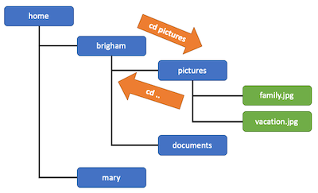
Learning Activity - Version Control
https://byui-cse.github.io/cse210-course-2023/unit01/prepare-version-control.html
Preparation Material
What is Version Control?
Read about Git and version control systems from the official GitHub documentation:
Read: About Git
Files and Folders
The File System
Moving Around in the File System
Accessing Files and Folders
Using Git
Create a new repository
Clone the repository
Making Changes
Adding Files
Committing Files
Pushing your changes to GitHub
Checking the status of your repo
A typical Workflow

Slide 54
Learning Activity - Version Control
Practice working with Git by doing the following:
Open your course project folder in VS Code.
Make a change to the README.md file such as adding your name or removing the line that says, "This is the starter code."
Add your changes to the staging area.
Commit your staged files to your local repository.
Push your changes to GitHub.
In a Web browser, navigate to GitHub.com and verify that you can see your changes in the README.md file.

Slide 55
W01 Prove: Developer—C# Programming Parts 1–2
Complete each of the following assignments:
C# Prep 1—Variables and Input/Output
C# Prep 2—Conditionals

Slide 56
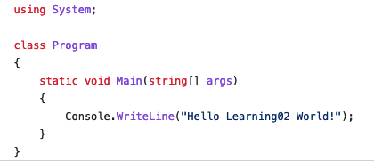
Learning Activity - C# Prep 1
https://byui-cse.github.io/cse210-course-2023/unit01/csharp-1.html
C# Language Fundamentals
Defined types
int - Integers (whole numbers, positive and negative)
string - Strings (a sequence of characters, including letters, numbers, or symbols)
float - Floating point numbers (numbers that use decimals)
double - Double precision floating point numbers (just like a float, except it takes up twice as much memory, so it can hold larger numbers or numbers with more decimal places)
bool - Boolean variables (true or false)
Input and Output
Console.Write("What is your favorite color? ");
string color = Console.ReadLine();
Curly braces define blocks
Statements end in semicolons
String Interpolation
string school = "BYU-Idaho";
Console.WriteLine($"I am studying at {school}.");

Slide 57
Problem Statement
Expected Output
Instruction Givens
Processing needed
Input
Process
Output
main
getInteger
getFloat
getString
getFromFile
Processing
Update
Output-only
Filter
Map
Reduce
Data Structures
Print()
Display()
Gui

Slide 58
Problem Statement
Expected Output
Instruction Givens
Processing needed
Input
Process
Output
Class: Main
Console.WriteLine
getInteger
getFloat
getString
getFromFile

Slide 59
Learning Activity - C# Prep 1
Getting the Project Template
If you haven't already done so, please refer to the instructions on the Development Environment Setup page to make sure that your computer is prepared for this course and that you have cloned the project template to your computer.
Open your project in VS Code.
Then, in VS Code, navigate to the csharp-prep/Prep1 folder and click on Program.cs. This is the file you will be editing for this project.
On the "Run and Debug" menu, select "C# Prep 1" from the dropdown menu and click the green play button to run the program. In the terminal window, it should display the text Hello Prep 1 World!.

Slide 60
Learning Activity - C# Prep 1
Overview
An iconic line from the James Bond movies is that he would introduce himself as "Bond, James Bond." For this assignment you will write a program that asks for your name and repeats it back in this way.
Assignment
Prompt the user for their first name. Then, prompt them for their last name. Display the text back all on one line saying, "Your name is last-name, first-name, last-name" as shown:
What is your first name? Scott
What is your last name? Burton
Your name is Burton, Scott Burton.
What is your first name? Brigham
What is your last name? Young
Your name is Young, Brigham Young.
Make sure to be precise! You should have the spacing, comma, and period appear exactly as shown in the examples.

Slide 61
Problem Statement
Expected Output
Instruction Givens
Processing needed
Input
Process
Output
Class: Main
Console.WriteLine
getInteger
getFloat
getString
getFromFile

Slide 62
An iconic line from the James Bond movies is that he would introduce himself as "Bond, James Bond." For this assignment you will write a program that asks for your name and repeats it back in this way.
What is your first name? Scott
What is your last name? Burton
Your name is Burton, Scott Burton.
What is your first name? Brigham
What is your last name? Young
Your name is Young, Brigham Young.
Prompt the user for their first name. Then, prompt them for their last name. Display the text back all on one line saying, "Your name is last-name, first-name, last-name" as shown:
Input
Process
Output
Class: Main
Console.WriteLine
getInteger
getFloat
getString
getFromFile

Slide 63
An iconic line from the James Bond movies is that he would introduce himself as "Bond, James Bond." For this assignment you will write a program that asks for your name and repeats it back in this way.
What is your first name? Scott
What is your last name? Burton
Your name is Burton, Scott Burton.
What is your first name? Brigham
What is your last name? Young
Your name is Young, Brigham Young.
Prompt the user for their first name. Then, prompt them for their last name. Display the text back all on one line saying, "Your name is last-name, first-name, last-name" as shown:
Input
Process
Output
Class: Main
getFirstName
getLastName
displaySecretAgentName
?
?
Console.WriteLine

Slide 64
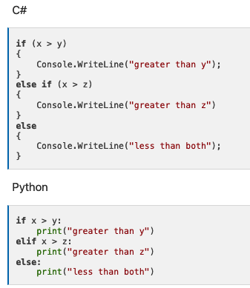
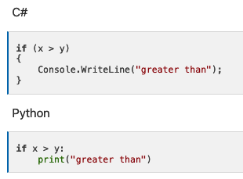
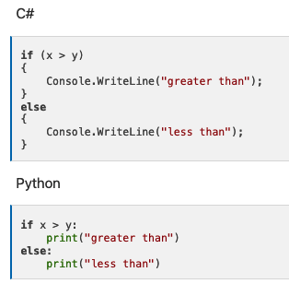
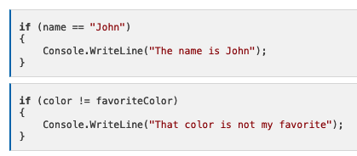
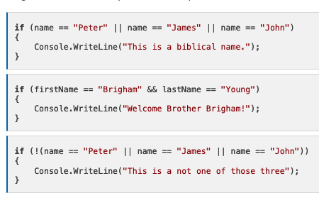


Learning Activity - C# Prep 2
https://byui-cse.github.io/cse210-course-2023/unit01/csharp-2.html
Conditionals
If Statements
Else and Else If
Operators
And, Or, and Not Operators
Variables and Types
Converting Types
Numbers to Strings

Slide 65
Learning Activity - C# Prep 2 – CSE 110/111
Overview
Write a program that determines the letter grade for a course according to the following scale:
A >= 90
B >= 80
C >= 70
D >= 60
F < 60
Assignment
Start by completing the core requirements, then when that part is complete, if you have time, see if you can complete some of the stretch challenges as well.
Please work through the requirements in order rather than jumping ahead to more complicated steps, to ensure that everyone is following the concepts.

Slide 66
Learning Activity - C# Prep 2
Core Requirements
Ask the user for their grade percentage, then write a series of if-elif-else statements to print out the appropriate letter grade. (At this point, you'll have a separate print statement for each grade letter in the appropriate block.)
Assume that you must have at least a 70 to pass the class. After determining the letter grade and printing it out. Add a separate if statement to determine if the user passed the course, and if so display a message to congratulate them. If not, display a different message to encourage them for next time.
Change your code from the first part, so that instead of printing the letter grade in the body of each if, elif, or else block, instead create a new variable called letter and then in each block, set this variable to the appropriate value. Finally, after the whole series of if-elif-else statements, have a single print statement that prints the letter grade once.

Slide 67
Problem Statement
Expected Output
Instruction Givens
Processing needed
Input
Process
Output
Class: Main
getInteger
getFloat
getString
getFromFile
Console.WriteLine

Slide 68
Learning Activity - C# Prep 2
Stretch Challenge
Add to your code the ability to include a "+" or "-" next to the letter grade, such as B+ or A-. For each grade, you'll know it is a "+" if the last digit is >= 7. You'll know it is a minus if the last digit is < 3 and otherwise it has no sign.
After your logic to determine the grade letter, add another section to determine the sign. Save this sign into a variable. Then, display both the grade letter and the sign in one print statement.
Hint: To get the last digit, you could divide the number by 10, and get the remainder. You might refer back to the preparation material for Lesson 03 to see the operators and find the one that does division and gives you the remainder.
At this point, don't worry about the exceptional cases of A+, F+, or F-.
Recognize that there is no A+ grade, only A and A-. Add some additional logic to your program to detect this case and handle it correctly.
Similarly, recognize that there is no F+ or F- grades, only F. Add additional logic to your program to detect these cases and handle them correctly.

