Slide 1

Class Bucks
https://ibelong.byui.edu/home_login
One Class Buck for each activity:
Please have your count ready when I come by.
School Resource:
Arts, Sports/Fitness, Health Srv, Points of Interest
Academic Resources:
Tutoring: Lab or Library: Tuesday, Thursday, Friday 3:30-6:30, STC375/385/394/384, CSE Volunteer Tutor Lab
Department Services
Computing Society: 5:00-5:30, STC375/385/394/384,
Forum: Thurs: 11:30
Experience:
Career Center
Work (every 4 hrs)
Networking & Informational Interviews
Personal Growth
Disciples of Christ: Church, Devo, FHE
Dating, Workshops, Books,

Slide 2
CSE 300
Week 02

Slide 3
What do you want to do in life?
Begin with the End in Mind
What do you want on your Gravestone?
I’ve got a dream (Dream bigger)
If money was not a problem?
If it was fictious? Impossible?
If time was not a problem?

Slide 4
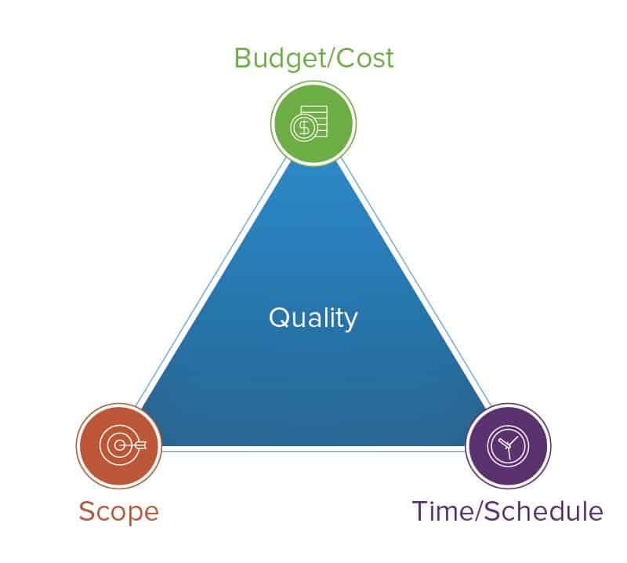
Understanding Business Hiring
3 Volunteers
Entrepreneur Business Mngr.
Fortune 500 Company Mngr.
Government Contract Mngr.
Additional Volenteer
Entrepreneur Business 3-Member Team
Fortune 500 Company 4-Member Team
Government Contract 5-Member Team
Success
Awards
Growth (%-growth): Awards, New Business, New Contracts
Attrition(%-loss): Movement, New Ideas
Budget and Schedule Impacts
Problems
Supplement and Grow team
As a Manager, I want to hire team replacements, new hires, and interns, so that my team is excited, motivated, growing, collaborating.

Slide 5



Understanding Business Hiring
As a Manager, I want to hire team replacements, new hires, and interns, so that my team is excited, motivated, growing, collaborating.
Where do I, as a Manager, go to find new people?
HR, Internet – cost money $10-40K
My Team – $0 costs
Who does your team know?
Those that were interviewed by you!

Slide 6
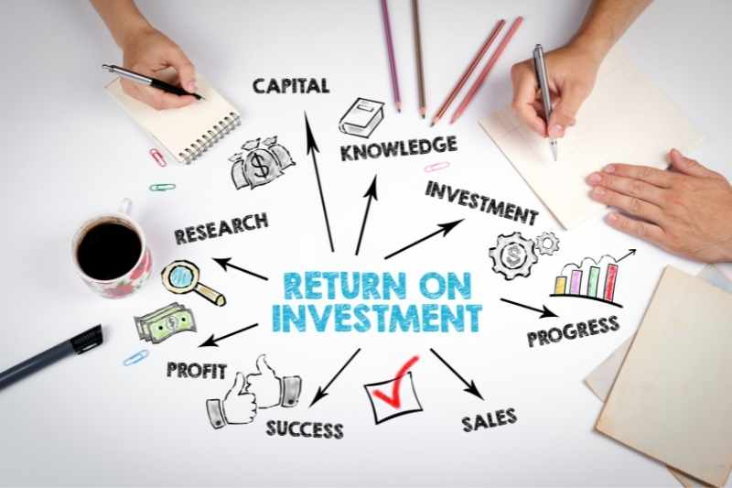
Education: Want to get a return on your investment for every single assignment?
Cost per class
Potential College Lifetime Earning
Potential High School Lifetime Earning
$2,400/sem
40 year
40 year
15 cr/sem
~100K/year
~25K/year
14 wk/sem
$4M
$1M
Difference
$11.42/class
$3M
How do you show case your efforts to get hired?
Want to get a return on your $2K or $10 and make it grow to $25K/sem cr or $1.8K/class
Publish your work!!! How, do you say?
120 cr degree
$25K/sem or ~1.8K/class

Slide 7
Assignment Quizzes
Self Assessment
Attempted
Meets Expectations 80% solution for 70% grade
Exceeds Expectations
Far Exceeds
Zero-point questions (required)
What did you attempt to do? or Please provide the requested artifacts and what actions you to took to complete the assignment.
-40 point: Missing any evidence of attempting to complete the assignment. Meaning it looks like you just quickly filled in the questions.
Please provide a summary of what you did in the assignment to exceed.
-10 points: Missing any evidence that you finished the assignment's minimum requirements.
Please provide a summary of what you did in the assignment to far exceed?
-10 points Or you are missing the additional uploaded files.
Additional evidence like upload or links
-10 points: Missing any additional evidence required as part of the assignment.

Slide 8
Assignments
Assignments
 | Wk 01: M01 | Wk2: M02 | Wk2: M03 | Wk3: M04
Confidence
 | Project List 1.0 | Project List 2.0
 | Elevator Pitch 1.0 | Elevator Pitch 2.0 | Elevator Pitch 3.0 | Elevator Pitch 4.0
 |  | Portfolium 1.0 | Interviewing 1.0 | Portfolium 2.0
Connectivity
 | Employer List 1.0 |  | Employer List 2.0 | Employer List 3.1
 | Ntwk Contact 1.0 |  | Ntwk Contact 2.0 | Ntwk Contact 3.1
 |  | Handshake 1.0 |  | Handshake 2.0
 |  | LinkedIn 1.0 |  | LinkedIn 2.0
 |  | BYUI Connect 1.0 | Info. Interview 1.0 | BYUI Connect 2.0
Professionalism
 | Resume 1.0 | Resume 2.0 (Dpt) | Resume 3.0 (V) | Resume 4.0
 | Cover Letter 1.0 | Cover Letter 2.0
 | References 1.0 | VMOCK 1.0 | Reference 2.0
 |  |  |  | Info Itnrvw Prep 2.1

Slide 9
Assignments
Assignments
 | Wk03: M05 | Wk04: M06 | Wk04: M07 | Wk05: M08
Confidence |  | Portfolio Review |  | TBD
Prj List |  | Basic Certificate |  | Project 3.0
Pitch | Elevator Pitch 5.0
Portfolio | BYUI Connect 3.0 | Portfolium 3.0 | LinkedIn 3.0 5posts
Interviewing |  | Interview 2.0 (V)
Connectivity
E. List | Employer List 3.2 | Employer List 3.3 | Employer List 3.4 | Employer List 3.5
Ntwk Cnt. List | Ntwk Contact 3.2 | Ntwk Contact 3.3 | Ntwk Contact 3.4 | Ntwk Contact 3.5
 |  |  |  | LinkedIn 5.2 20/60
Professionalism
Resume |  | Resume 5.1 | Resume 5.2 | Resume 5.3
Info. Interview | Info Interview 3.1 | Info Interview 3.2 | Info Interview 3.3 | Info Interview 3.4
Info. Interview Prep | II Prep 2.2 | II Prep 2.3 | II Prep 2.4 | II Prep 2.5

Slide 10
Assignments
Assignments
 | Wk05: M09 | Wk06: M10 | Wk06: M11 | Wk07: M12
Confidence |  | TBD x2 | TBD x2 | TBDx2
Prj List | Project List 4.0 | Life Skills | Design/Life
Pitch |  | Emotional Intell. | More to come
Portfolio
Interviewing | Interviewing 3.0 (S)
Connectivity | TBD x1 | TBD x1 | TBD x2 | TBDx2
E. List
Ntwk Cnt. List
 | LinkedIn 5.4 40/60 | LinkedIn 5.6 60/60
Professionalism |  | TBD x1 | TBD x2 | TBDx2
Resume | Resume 5.4 | Resume 5.5 | Infographics
Info. Interview | Info Interview 3.5
Info. Interview Prep

Slide 11
Assignments
Assignments
 | Wk07: M13
Confidence | Cert - Silver
Prj List
Pitch
Portfolio
Interviewing
Connectivity | TBD x1
E. List
Ntwk Cnt. List | TBDx2
Professionalism | TBDx2
Resume
Info. Interview
Info. Interview Prep

Slide 12
Week 01: Module 01 (Fri-Mon)
Project List 1.0 10 projects that you have completed
Elevator Pitch 1.0 Introduction
Employer List 1.0 List of companies you want to work for
Ntwk Contact 1.0 List of friends, family, and internship missionaries
Resume 1.0 1st Resume
Cover Letter 1.0 1st cover letter
References 1.0 List of validators

Slide 13
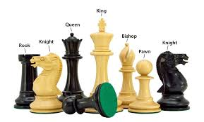
Major Playing Pieces
Resume
Avatar in the game
Education
Entry into the game
Experience
Represents your value
Projects
Represents your motivation
Soft Skills
Represents your personality

Slide 14
Major Playing Pieces
Resume
Avatar in the game
Education
Entry into the game
Experience
Represents your value
Projects
Represents your motivation
Soft Skills
Represents your personality

Slide 15
Week 02: Module 2 (Tues-Thur)
Project List 2.0 Societies, Organizations
Elevator Pitch 2.0 5 Sentences
Portfolium 1.0 Login
Handshake 1.0 Login
LinkedIn 1.0 Login
BYUI Connect 1.0 Login
Resume 2.0 (Dpt) 10 pts to resume
Cover Letter 2.0 Match to Job Posting
VMOCK 1.0 Login

Slide 16

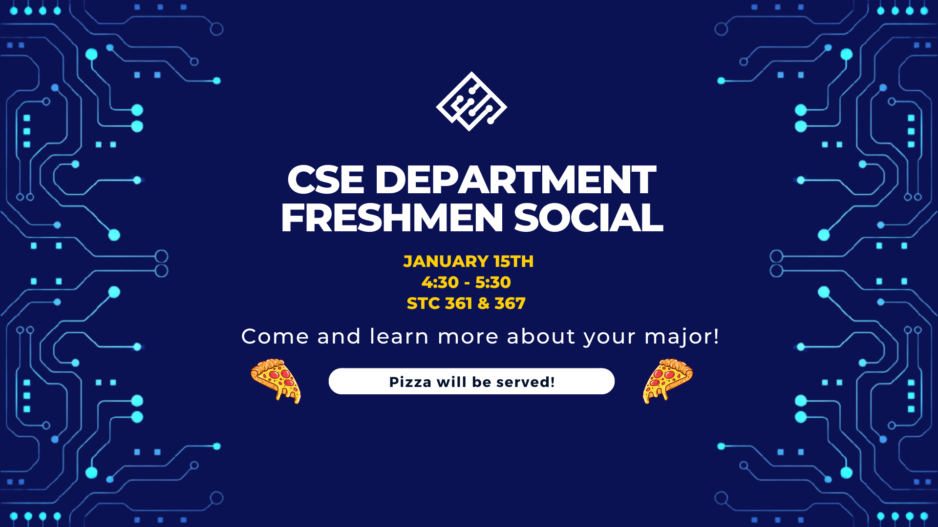
Project List 2.0 Societies, Organizations
Discover the department societies.
Attend: Wait until Wed.

Slide 17
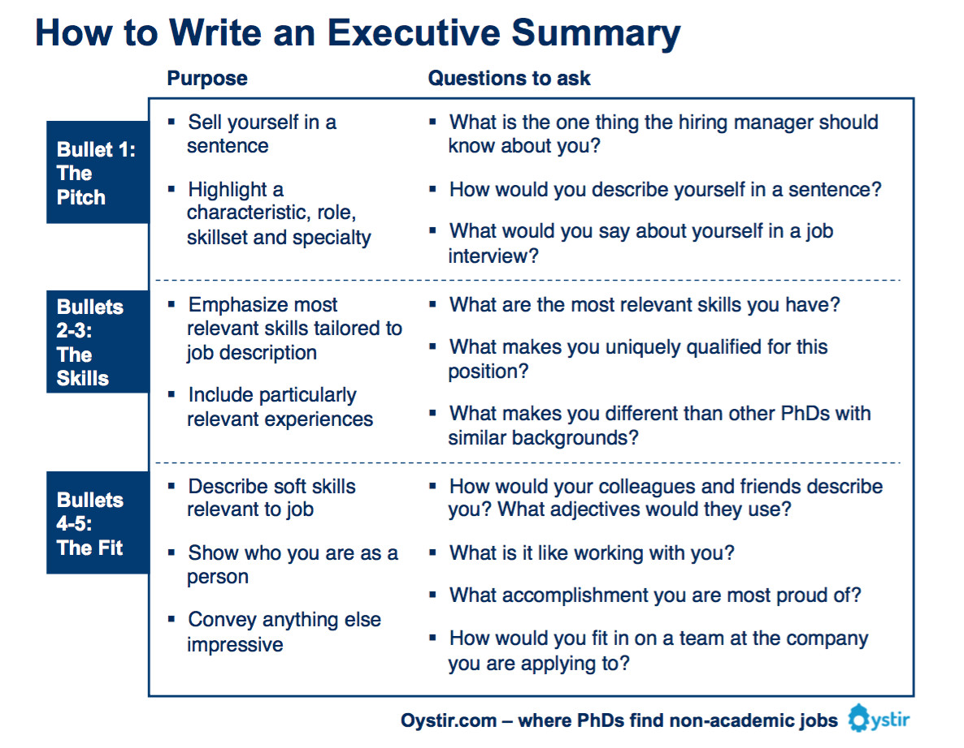
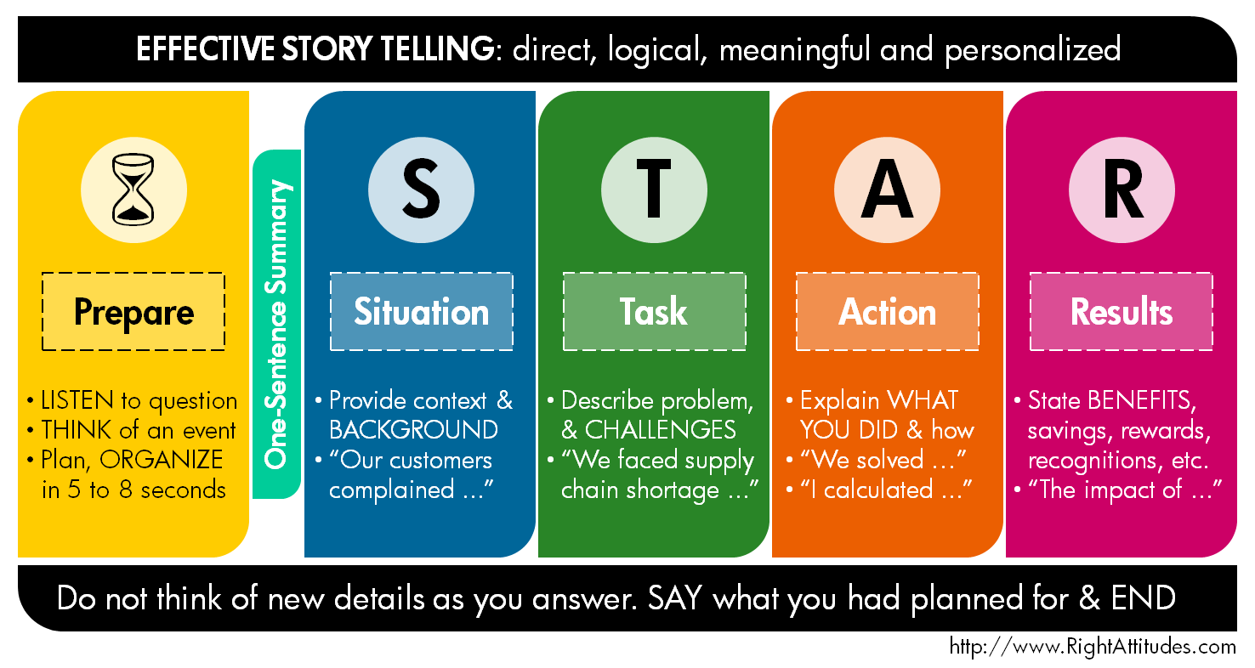
Elevator Pitch 2.0
5 Sentences
Sentence 1-3: A concise summary of your professional identity
Sentence 4-5: Why are you uniquely qualified for your ideal job?

Slide 18
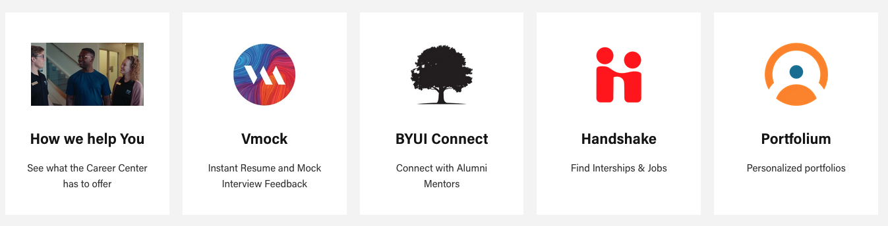

Career Center

Slide 19
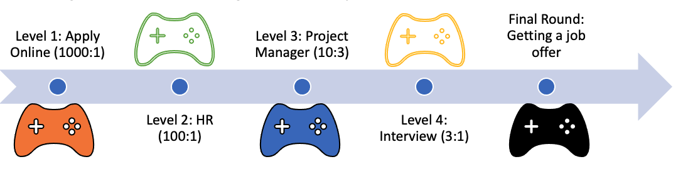




Resume Avatar
Audience
Game Levels
Online Job Board: 1000:1 odds of getting hired
The Search engine
HR Filtering: 100:1 odds of getting hired
The HR Intern
Project Manager: 10:3 odds of getting hired
Project Manager
Interview: 3:1 odds of getting hired
The Team
Job Offer Does it work for you
Employability
Collaboration
Connections
Confidence

Slide 20




End in Mind Our Graduate CS/SWE Resume
Audience
Skills Summary: Optional, list all skills found in the follow sections
Education
2-3 Certificates: Programming, Comp. Fund. + One other specialized.
Class projects: List of unique projects they completed as part of the class.
Sr. Project: Worked with or for someone to solve a significant problem.
Experience
Internship (400-500 hours/12-14 weeks FT or 200-300 PT)
Part-Time (Degree) showing casing mix of tech and soft skills.
Part-Time (Other) showing casing soft skills and leadership
Projects
Personal Projects: Encourage students to explore their passions.
Competition Projects i.e. Hackathons
Society Projects: Over 10 different societies, working in teams expand their knowledge.

Slide 21
Major Playing Piece: Resume
Experiences: 3-Bullet Summary
Projects: 3 Bullet Summary
Give you project a name
1st Line: Job Description(What)
Brief job description with technology that you learned
2nd Line: Results (How)
What did you contribute to the job, and the results (metrics- # or %)
Specific examples that you can tell a STAR Story about
3rd Line: Learned (Why)
What did you enjoy/learn from your job.
1st Line: Project Description
What does it accomplish?
2nd Line: Results
How did you do the project
3rd Line: Learned
What did you enjoy/learn from your job.
Who: Is going to read this?: Multiple audiences

Slide 22
Resume Reviews
Draft: Brainstorm all experience
Draft: Review with parents
Draft: Review with friend of family, church
Draft: Review with Career Services
Draft: Review with Department Mentor
Draft: Review with VMOCK
Draft: Review with Network
Draft: Review at job fairs
Draft: …more the better (
NOTE: Not all advice is good, consider the source (make a note, and decide for yourself)

Slide 23
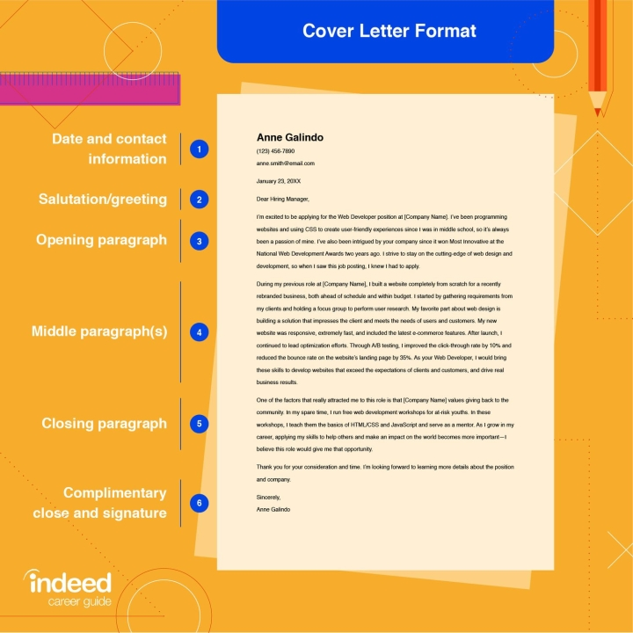
Cover letter
Bridge between job description and resume
Remember: if you are 100% qualified, you are overqualified, looking for 60-80% qualifications
Introduction
Qualify
Equivalent
Deficiencies & Plan
Hobbies/Interests/Dreams
Address the 60-80%
Address the remaining
Employability
Collaboration
Connections
Confidence

Slide 24
Upcoming

Slide 25
Week 02: Module 3 (Friday -Mon)
Elevator Pitch 3.0 VMOCK
Interviewing 1.0 About job interviewing
Employer List 2.0 List of 100 companies
Ntwk Contact 2.0 List of 100 people
Info. Interview 1.0 About Informational Interviews
Resume 3.0 (V) VMOCK
Reference 2.0 Letter of Recommendations

Slide 26
Week03: Module 04
Elevator Pitch 4.0 30-second video
Portfolium 2.0 Profile Strength
Employer List 3.1 1/5 Dossier
Ntwk Contact 3.1 Profiles
Handshake 2.0 Optimization
LinkedIn 2.0 Optimization
BYUI Connect 2.0 Optimization
Resume 4.0 Professional Review
Info Itnrvw Prep 2.1 Ask for interview

