Slide 2
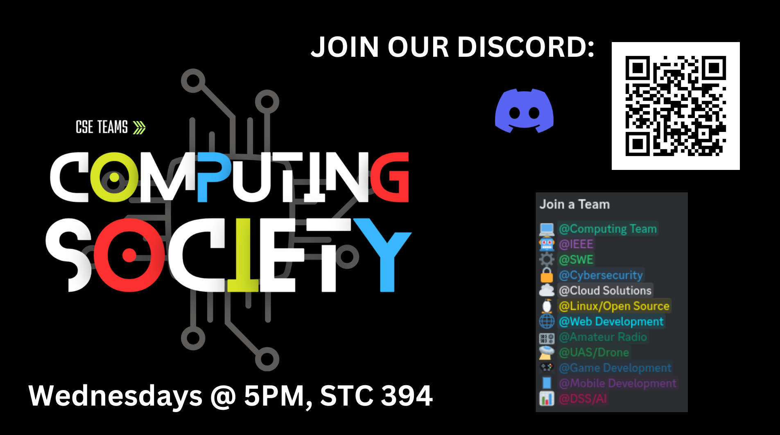
Class Bucks
https://ibelong.byui.edu/home_login
One Class Buck for each activity:
Please have your count ready when I come by.
School Resource:
Arts, Sports/Fitness, Health Srv, Points of Interest
Academic Resources:
Tutoring: Lab or Library: Tuesday, Thursday, Friday 3:30-6:30, STC375/385/394/384, CSE Volunteer Tutor Lab
Department Services
Computing Society: 5:00-5:30, STC375/385/394/384,
Forum: Thurs: 11:30
Experience:
Career Center
Work (every 4 hrs)
Networking & Informational Interviews
Personal Growth
Disciples of Christ: Church, Devo, FHE
Dating, Workshops, Books,

Slide 3
CSE 300
Module 03

Slide 4
Week 02: Module 2 (Tues-Thur): Review
Project List 2.0 Societies, Organizations
Elevator Pitch 2.0 5 Sentences
Portfolium 1.0 Login
Handshake 1.0 Login
LinkedIn 1.0 Login
BYUI Connect 1.0 Login
Resume 2.0 (Dpt) 10 pts to resume
Cover Letter 2.0 Match to Job Posting
VMOCK 1.0 Login

Slide 5
Week 02: Module 3 (Friday -Mon)
Elevator Pitch 3.0 VMOCK
Interviewing 1.0 About job interviewing
Employer List 2.0 List of 100 companies
Ntwk Contact 2.0 List of 100 people
Info. Interview 1.0 About Informational Interviews
Resume 3.0 (V) VMOCK
Reference 2.0 Letter of Recommendations

Slide 6
Week03: Module 04 (Tues-Thur): Upcoming
Elevator Pitch 4.0 30-second video
Portfolium 2.0 Profile Strength
Employer List 3.1 1/5 Dossier
Ntwk Contact 3.1 Profiles
Handshake 2.0 Optimization
LinkedIn 2.0 Optimization
BYUI Connect 2.0 Optimization
Resume 4.0 Professional Review
Info Itnrvw Prep 2.1 Ask for interview

Slide 7
Week 02: Module 3 (Friday -Mon) today:
Elevator Pitch 3.0 VMOCK
Interviewing 1.0 About job interviewing
Employer List 2.0 List of 100 companies
Ntwk Contact 2.0 List of 100 people
Info. Interview 1.0 About Informational Interviews
Resume 3.0 (V) VMOCK
Reference 2.0 Letter of Recommendations

Slide 8
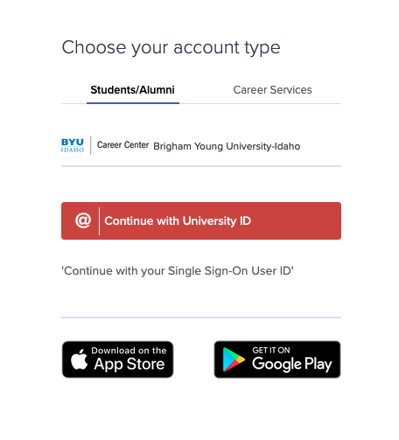
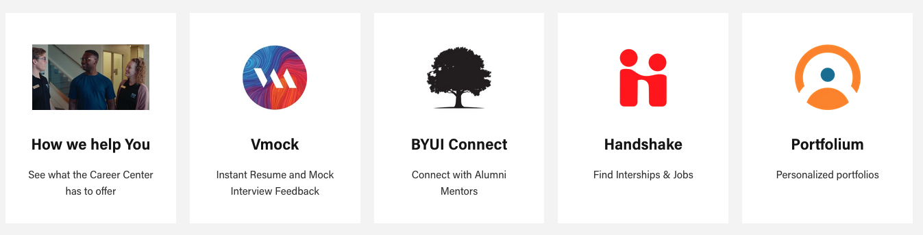
VMOCK

Slide 9
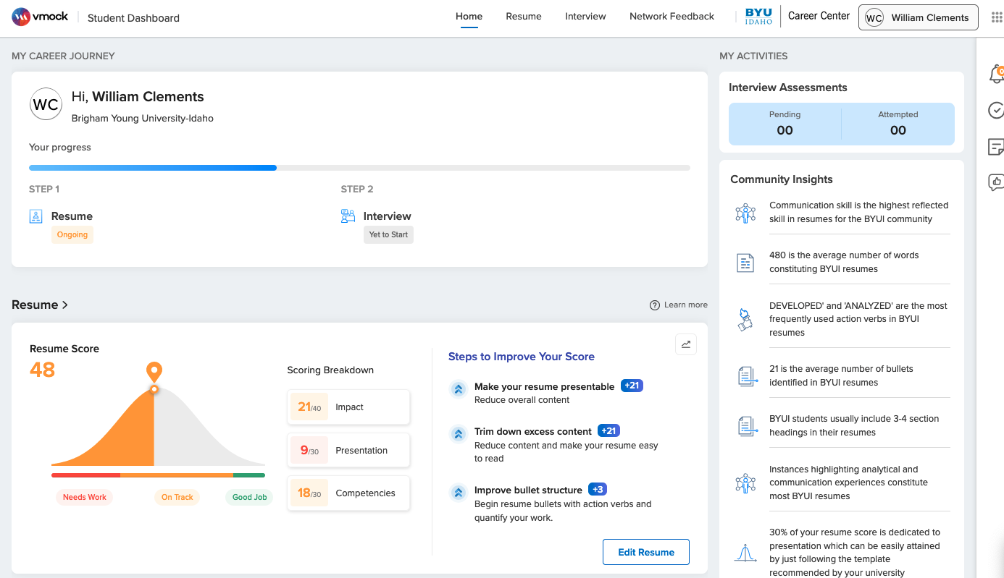
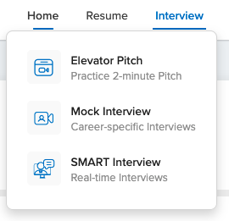
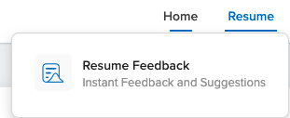
VMOCK

Slide 10
Where to start looking
for a job?
Choosing the best return on your time in finding a job.
Resources
Influencers
Job Market

Slide 11
Where to start looking
for a job?
Choosing the best return on your time in finding a job.
Resources
Influencers
The real playing field
All job opportunities
10% open jobs
10% all ready filled
80% are not published
Job Market
(c) 2024 Clements
BYU-Idaho CSE Dept

Slide 12
Where to start looking
for a job?
Choosing the best return on your time in finding a job.
Resources
Influencers
The playing field you see
Layoffs happen and affect here
All job opportunities
<< Mostly Known Least Known >>
Of those 10% open jobs – 10 :1
For every graduate there are 10 jobs
if you are looking in the right place
10% open jobs
10% all ready filled
80% are not published
Fortune 500 distribution Everyone is applying
Job Market
Typical applications distribution.
(c) 2024 Clements
BYU-Idaho CSE Dept

Slide 13


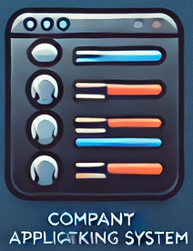






Where to start looking
for a job?
Applying to online jobs is
Frustrating & Discouraging
Odds are not in your favor
Choosing the best return on your time in finding a job.
Resources
Old Typical Path
Influencers
Don’t Start Here
Instead, Start Here
Human Resources
Online Review
AI Review
HR Review
PM Review
Team Review
Job Interviews
10000:1
10:1
1000:1
100:1
5:1
3:1
Inefficient Path: Odds to Hire
All job opportunities
<< Mostly Known Least Known >>
Of those 10% open jobs – 10 :1
For every graduate there are 10 jobs
if you are looking in the right place
10% open jobs
10% all ready filled
80% are not published
Fortune 500 distribution Everyone is applying
Job Market
Typical applications distribution.
(c) 2024 Clements
BYU-Idaho CSE Dept

Slide 14
Where to start looking
for a job?
Applying to online jobs is
A waste of time
Frustrating & Discouraging
Odd are not in your favor
Choosing the best return on your time in finding a job.
Resources
Old Typical Path
No Hiring during Thanksgiving, Christmas, and New Year
Everyone is using up those 2 weeks of vacation or working on the shopping rush
0:1 odds
Influencers
Don’t Start Here
Instead, Start Here
Human Resources
Online Review
AI Review
HR Review
PM Review
Team Review
Job Interviews
10000:1
10:1
1000:1
100:1
5:1
3:1
Inefficient Path: Odds to Hire
All job opportunities
<< Mostly Known Least Known >>
Of those 10% open jobs – 10 :1
For every graduate there are 10 jobs
if you are looking in the right place
10% open jobs
10% all ready filled
80% are not published
Fortune 500 distribution Everyone is applying
Job Market
Typical applications distribution.
(c) 2024 Clements
BYU-Idaho CSE Dept

Slide 15

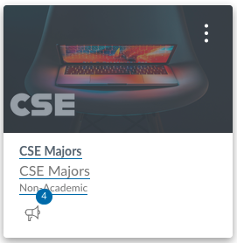




Where to start looking
for a job?
Smarter Path
5:1 Smarter
3:1 Smartest
10:1 Easiest
Efficient Path: Odds to Hire
Choosing the best return on your time in finding a job.
Instead of playing the old game, reverse the script, and be more efficient
Resources
Career Center
Handshake
Job Fairs
Department
CSE Majors
Job Board
Alumni
BYUi Connect
LinkedIn
Networking
Friends & Family
Church, Portfolio
Old Typical Path
Influencers
Don’t Start Here
Instead, Start Here
Human Resources
Online Review
AI Review
HR Review
PM Review
Team Review
Job Interviews
10000:1
10:1
1000:1
100:1
5:1
3:1
Inefficient Path: Odds to Hire
Corp University Relations
All job opportunities
<< Mostly Known Least Known >>
Of those 10% open jobs – 10 :1
For every graduate there are 10 jobs
if you are looking in the right place
10% open jobs
10% all ready filled
80% are not published
Fortune 500 distribution Everyone is applying
Job Market
Typical applications distribution.
Key: Informational Interviews
(c) 2024 Clements
BYU-Idaho CSE Dept

Slide 16
Employer List 2.0 List of 100 companies
Ntwk Contact 2.0 List of 100 people

Slide 17
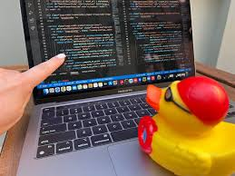


Company List
Know the company
Why?
What do you know about the company?
What makes them Special? Unique? Competitive?
What is their industry? product line? Customer?
What problem do they solve?
Helps in finding job?
Helps in finding projects?
Helps in finding contacts?

Slide 18
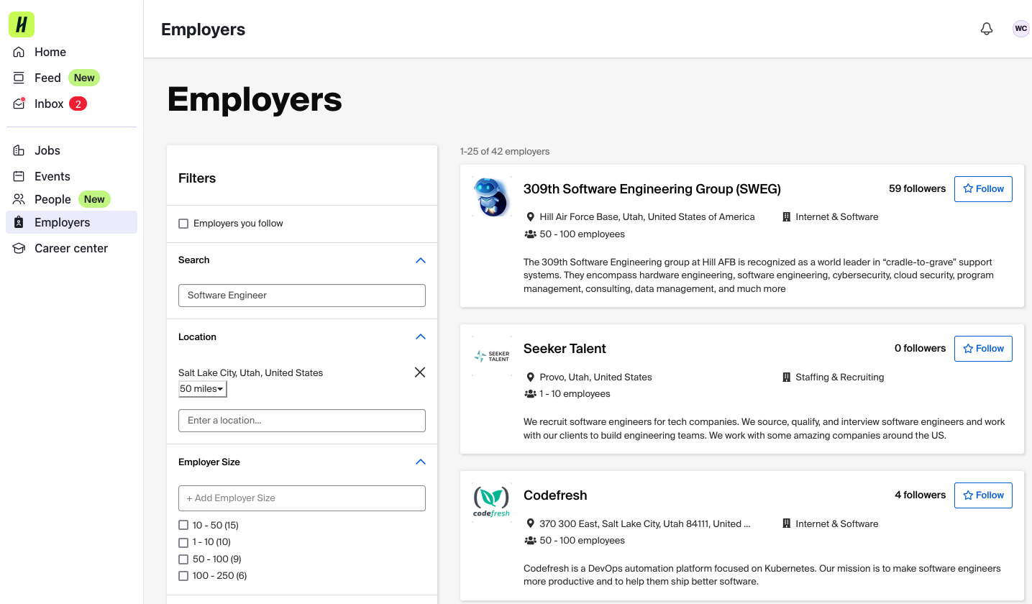

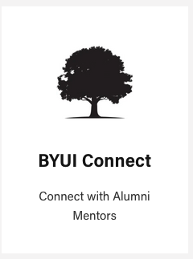
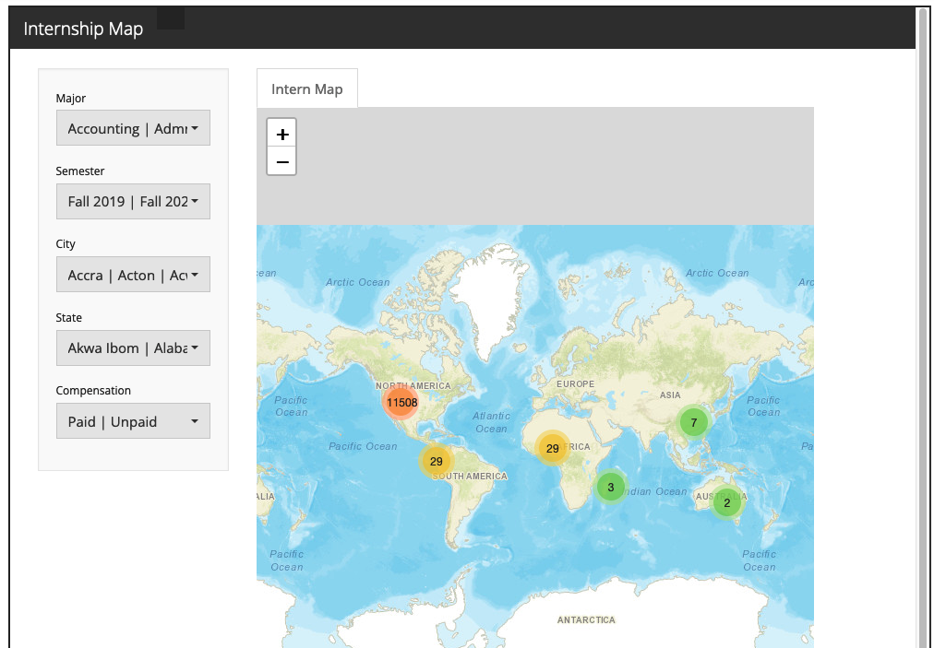
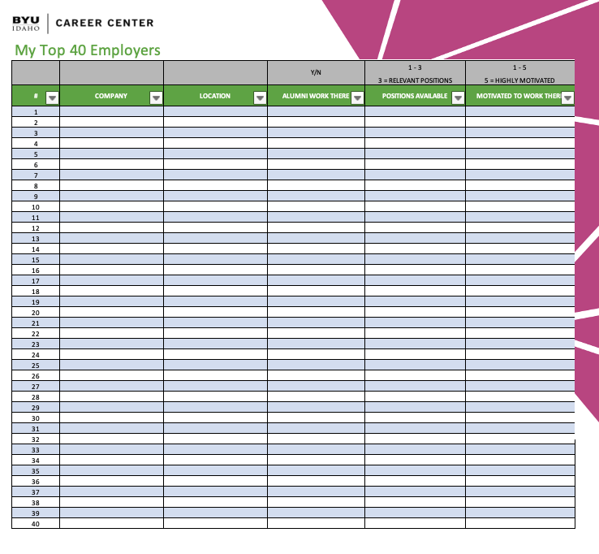
Create an Employer List
Friends and Family
CSE Majors
Handshake
BYUI Connect
Opportunities
Super Connectors
Internship Service Missionaries
Employer’s Websites and Search Engines
LinkedIn
1st Connections
Super Connectors: 500+ connections
Groups:
BYU-Idaho Computer Science and Electrical Engineering
BYU Electrical and Computer Engineering
Brigham Young University Alumni 14K Members
The BYU Network
Latter-day Saint Professionals
BYU-Pathway Worldwide Alumni & Friends
BYU-Idaho Computer Information Technology/Web Design and Development (BYUI CIT/WDD)
Brigham Young University-Idaho
BYU-Idaho Internship & Career Services
BYU-Idaho College of Business and Communication
BYU-Idaho IEEE Branch
ACM Members
LDS Entrepreneurs
https://www.byui.edu/career/past-internships

Slide 19
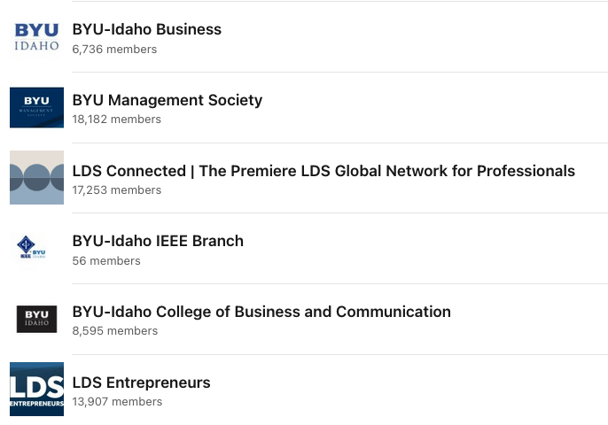
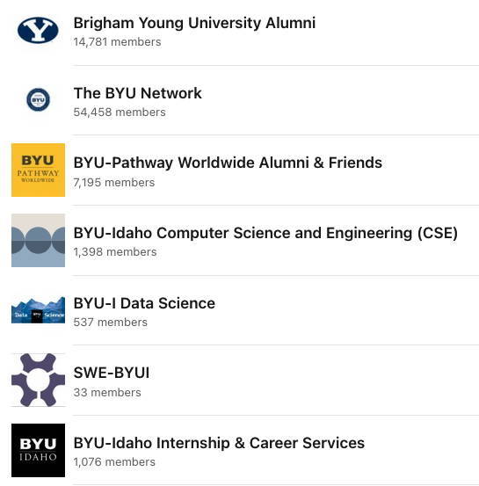
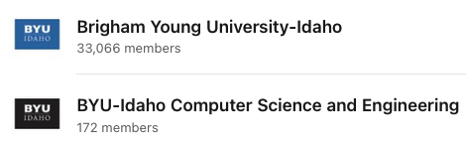


LinkedIn Groups

Slide 20

Contact List – um, Networking
Circle of Influence (Six degrees of separation)
Center:
Who do you know? Friend and Family, Church, Neighbors
1st layer
Who do they know in your industry? Look them up! (Remember Question 1)
Ask for an Interview? Who else should I talk to? (Q3)
2nd layer
Who else are you talking to?
3rd layer
Keep doing what your doing it is working!!!

Slide 21
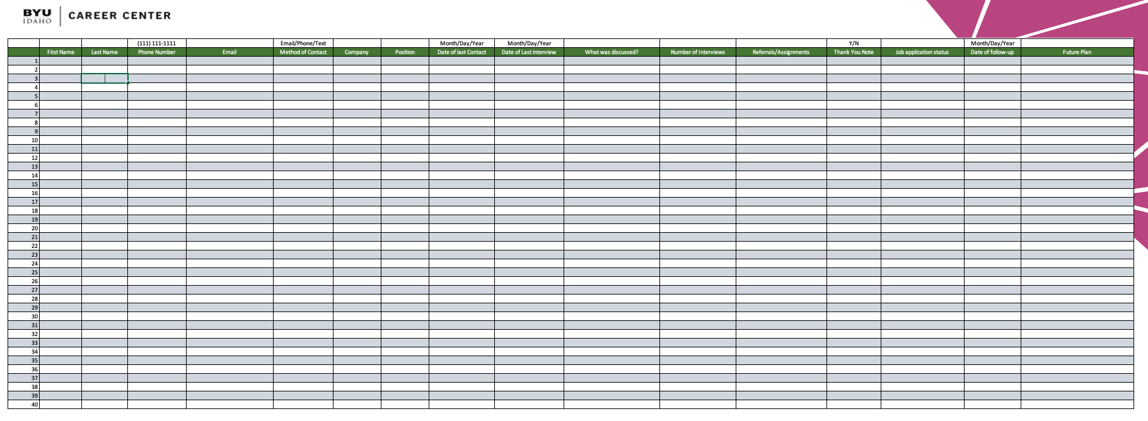
Manage your Network Contacts
Contact Info: Name, Number, Email
Method of Contact
Company Position
Date of Last Contact/Interview
Discussion Point/Notes
Number of Interviews
Referrals/Assignments
Thank you notes
Job application status
Date of follow-up
Future Plans

Slide 22
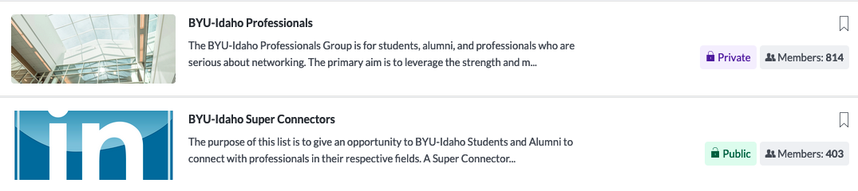
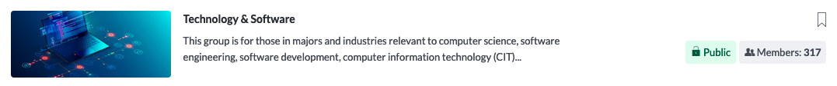
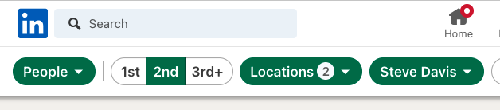
Super Connectors
https://www.byui.edu/career/

Slide 23


Informational Interviews
Information Interviews are NOT Job Interviews
You are interviewing them, do not ask for a job. (it is a by-product)
How to Plan for Ideal Informational Interview
Research a specific person
Have a learning goal in mind
Prepare questions to ask them
Do not waste their time or energy
Always write a follow-up note within 24 hours.
You should have a resume.

Slide 24
Informational Interviews
Ask for 20 minute Interview
Where: Lunch, Phone, Video chat
Why 20 minutes: psychology, 30 minutes is too much
Have an agenda (Positive, Resume, Referral)
What is life, like at your company?
What do you like best at your company?
Don’t ask what they don’t like, every company has issues. All are common: Comm, Mngt, Motivation, Pay
Could you help me out?
Review my resume. ➔ Now they have your resume, they might kick into interview mode
Recommend any tools or knowledge I might be missing? ➔ Action Item to follow-up
Who else should I talk to? ➔ Additional contacts
DO NOT ASK FOR A JOB: It would be like going to an interview, and they ask you for a job.
Follow-up
Gratitude, Updated resume, follow-up questions
Thanking them for their time, with your updated resume changes, and a follow-up question (hook).

Slide 25
Conducting Interview
Three easy types of questions to ask at every information interview
1. What do you do for your job and what do you like about it?
Follow-up with additional questions
2. Do you have any advice for me to be successful in the industry, company, or positions similar to yours.
Or
Based on what you described, could you look at my resume to see what I can improve on as a potential employee?
Three adv: Their invested in you, Copy of your capabilities, follow-up AI
3. Who else do you think I should talk too?
Summary: What do you do?, How can I do it?, Who else does it?

Slide 26
Interviews
Switching Modes…
Difference between
Informational Interviews
Vs
Job Interviews

Slide 27
Interviewing 1.0
Interviewing
Market Value
Dress and Professional
Behavioral Questions

Slide 28
Interviewing 1.0:About
Watch the following Career Center videos and provide a summary for each:
The Method Activity 4: Interviewing
Tell Me About Yourself Questions
Using STAR Model in an Interview
What is Your Greatest Weakness Question
Powerful Job Interviews: Before the Interview
Prepare to Successfully Articulate Your Value (Wall Street Strategies)
Research Your Market Value
Dress & Interact Professionally (Power of Personal Appearance, Virtual Interview Tips)
Powerful Job Interviews: Interview Videos
Interviewing Research and Preparation
Behavior-Based and Situational Questions

Slide 29
Task 2: Market Value Research
Use resources such as salary calculators, job market trends, and LinkedIn salary insights to determine your market value.
Deliverable: Prepare a one-page report detailing:
Key factors affecting your market value.
Insights from industry benchmarks.
Personal salary expectations based on research.

Slide 30
Task 4: Dress and Professional Interaction
Watch videos on professional appearance and virtual interview etiquette.
Deliverable: Create a checklist for professional attire and virtual interview setup. Include at least 10 items.

Slide 31
Task 5: Practice Behavioral Questions
Review Career Center materials on behavior-based questions. Prepare answers using the STAR model for:
A time you faced a challenging project.
A time you resolved a conflict.
A time you demonstrated leadership.

Slide 32
Info. Interview 1.0 About Informational Interviews
Task 1: Watch Career Center’s Informational Interview Advice from BYU-Idaho Students
Task 2: Watch Career Center’s Method Activity 2 Links to an external site.: Informational Interview: Why conduct an Informational Interview
Task 3: Watch Christopher Galbraith’s P2B Presentation
Task 4: Watch Informational Interviewing with Steve Dalton
Task 5: Read Career Center’s Method Activity 2 Links to an external site.: Informational Interview: Why Conduct an Informational Interview?
Task 6: Watch Career Center’s Method Activity 2 Links to an external site.: Informational Interview: Reaching out for an Interview
Task 7: Create two LinkedIn Posts
Task 8: Create an Action Plan

