Slide 1
Welcome to CSE 474 Quality Assurance
Bro Clements

Slide 2
Outcomes
By the end of the semester, each student will:
Identify the effects of Quality Assurance on Software development
Discuss the needs of Quality Assurance in Professional, Business, Security and workplace environments.
Evaluate different Quality Assurance tools and recommend which to use in a given scenario.
Assess the various uses of different Quality Assurance Methods.
Produce the different Quality Assurance Project Plans.

Slide 3
Course Overview
In this course we will explore Software Testing standards, techniques, tools, and cases
Week 01: Fundamental
Week 02:QA & Lifecycle, Methodologies, Architecture
Week 03: QA Techniques
Week 04: QA Metrics
Week 05: QA Processes
Week 06: QA Tools
Week 07: QA Attributes and Measurements
Week 08: Reviews and Audits
Week 09: QA Maturity
Week 10: Configuration management
Week 11 & 12 Risk/Mission Assurance
Week 13: Project Management
Week 14: Career Paths
Course is based off of Certified Software Quality Engineer from ASQ.org/cert
We will be applying our knowledge and skills in creating a SW QA Plan based on IEEE std.

Slide 4
Weekly expectations:
CSE 474 is a three-credit course. In a normal on-campus course, you would spend 3 hours in class and spend 2 hours per class doing assignments. That is about 9 hours per week for this class (3 hours for class and six for assignments). Depending on the week, the hours may vary.
Each week in the Prepare the hours our organized as such:
1st & 2nd Hour: Prepare Material & Quiz
3rd Hour: Class
4th & 5th Hour: Individual and Group work
6th Hour Class
7th Hour: Individual and Group work
8th Hour Class
9th Hour: Prove Assignment
Day | Sun | Mon | Tue | Wed | Thu | Fri | Sat
Out of Class | Rest and Worship | Preparation Material |  |  |  | Report on Teach Assignments | Due: Prove Ponder
In Class |  | Class Lecture |  | Class Lecture |  | Class Lecture

Slide 5
LOGISTICS
Group Work
You will work with a partner or small group to complete W02–W13 prove assignments. Everyone will be required to submit your own copy of the work with everyone’s name on it.
Late Work
Assignments must be completed as scheduled. Late work is generally not accepted. However, assignments may be rescheduled for a limited number of emergency situations if you discuss your situation with your instructor before (not on and especially not after) the scheduled due date. Be prepared to justify any requests for extensions. Simply submit a note as your assignment when you will turn in the assignment before the due date.
You are allowed to resubmit assignments for better grades. As stated before, late work is not accepted but resubmissions are, so turn something in.
Extra Credit
There is no extra credit for this course. Department policy is that extra credit distracts from the core objectives of the course. See Late Work.

Slide 6
Grades
The assignment’s requirements are set at 89%. To get 100%, you need to do a little bit of extra work. I provided some suggestions, but you can add as you see fit. You must identify what you did to in the assignment comments; otherwise, I will default it at 89%.
Prepare:
Complete Reading
Read over assignments
Do the prepare work
Teach – Team Assignments (35%)
Class Discussions, Presentations, etc
Prove- 65%
Weekly assignments completing portions of the SQAP

Slide 7
Rubric Why didn’t I get more points?
The rubric is a matrix of skills/tasks (rows) and proficiencies (columns).
You will be responsible for understanding the rubric and how you will be assessed on your assignment.
Please use it as your personal quality assurance checklist.
The grader will look at your assignment and start looking for key assessments or factors.
If they are not found, then it will be marked down to developing proficiency. The grader will then look for Good and Exceptional Proficiency, grading up from meets expectations.
There will be no scoring between proficiencies; either you got it, or you don’t.
Developing Proficiency
when you attempt to work on the step, but no key factors were found.
An Acceptable Proficiency
that you completed the steps, key factors were found, but with minimal effort, and not all elements were completed.
A Good Proficiency
that you complete the steps, key factors were found, and you provide all the elements.
An Exceptional Proficiency
that you completed the steps, key factors were found, all elements were completed, and you added your own touch to the step or added more to the assignment than what was asked.
You must provide a description in the assignment’s notes on what you did in order to get credit; otherwise, the highest will be Good

Slide 8
University Policies
https://content.byui.edu/file/d24f576f-d34b-47be-a466-d00bd4792fb6/29/universitypolicies.html
Student Honor – Grooming Professionals, Masks – Safety.
Academic Honesty – Cheating, Turn in your work, cite your research (3-4 sources)
Student Conduct – This is a safe place; the only person you can make fun of is yourself or me positively.
Sexual Harassment – respect & safety first
Students with Disabilities – Accommodations (Extra Time, Due Dates, etc)
Complaints and Grievances – Please let me know, I will be happy to work with you.
Copyright Notice – You may keep a copy but are not allowed to post it on the internet.

Slide 9
Communication
Email:
Use iLearn email system for specifics about the class
Use clementsw@byui.edu for advising and personal academic questions
Zoom
On occasion we might have class over zoom, this will be posted in the course’s announcements.
William Clements is inviting you to a scheduled Zoom meeting.
https://byui.zoom.us/j/94897961300
Meeting ID: 948 9796 1300
Code: 248650
Teams
Already setup, should be available.

Slide 10
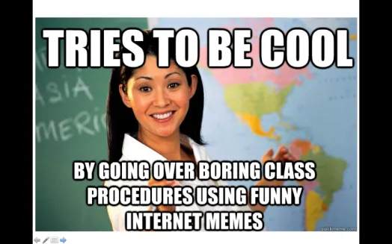
A little about YOUR Instructor…
20+ Years experience
Masters: Univ of CO @ Denver; Bachlors; BYU-Provo; Associates: Ricks College
Worked for Northrop Grumman (TRW) for 13 years, Raytheon for 5 years
Been teaching for 8 years: Online, Hybrid, and Campus for Community Colleges of Colorado, BYU-Online, and BYU-Idaho
I love computing, I have since I saw my first for-loop fill the screen with my name.
I have moved over 20x, CA, UT, ID, MO, OK, TX, CO
Hobbies: Board Games, Family outings

Slide 11
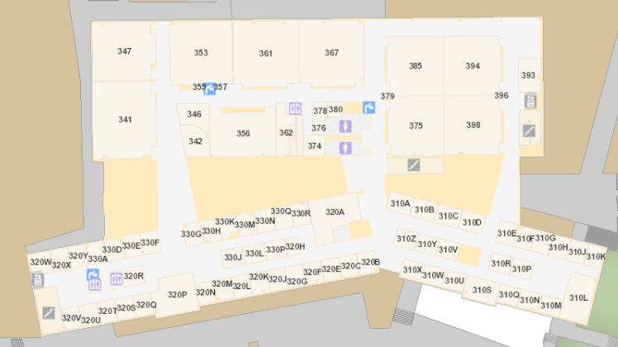
Brother Clements
William Clements
Email: ClementsW@byui.edu
Google Phone: (208) 557-4333
Office Phone: 208-496-7617
Office Rm: 320 T (Mark Twain with a T – Samuel Clemens)
Office hours: See Schedule
https://web.byui.edu/Directory/Employee/clementsw

Slide 13
This Weeks Topics & Assignments
Complete Introduction Discussion
What is SQA Certification?
Create a company flier

Slide 14
Continuous Improvement
Quality Assurances
(Built the Product Right)
Process ->
Q-Contrl/HMI
Value/Cost
Audit/Review/Std
Integrity/Sec
Testing
<- Product
Software Development
QA vs
Test vs
DevOp vs
Cont. Improvement
Support Roles (CM, DM, Code Mngr, etc)
Program/Project Manager
Development
QA-Tester
Acceptance Tester
System Tester
Integration Tester
Regression Tester
Unit Tester
(Sometime Developer)
Concept of Operations
Acceptance Test
Validation
Requirements
System Test
Verification
Architecture
Integration Test
Design
Regression Test
Implementation
Implementation
Unit Test
(Built the Right Product)
Dev Ops
Environment
Software Tools
Hardware
Network
Infrastructure
Test Zone (sandboxes)
Operation

Slide 15
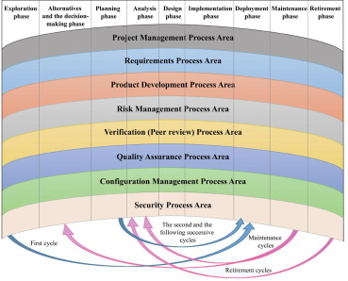
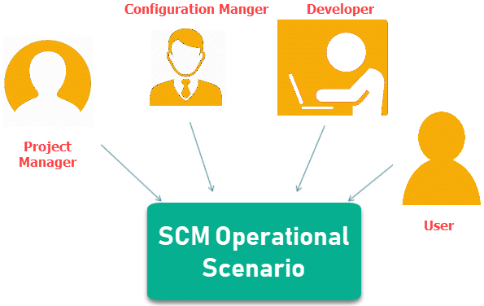
What is the difference between CM, QA, DM, PM, SE roles? (1.3)
CM – Configuration Management
QA – Quality Management
DM – Data Management
PM – Project Management
SE – System Engineer

Slide 16
What is in the SQA Certification?
The ASQ organization has published a QA Certification book of knowledge. This course’s content matches that information.
You will need to match the content found in the course with the content found in the CSQE Certification.
What percent of the CSQE is covered by this course? How did you determine that?
Submission
Provide a 1-page summary of your matching analysis and what percentage that the course covers the certification.

Slide 17
Certified Software Quality Engineer
1. General Knowledge
2. Software Quality Management
3. System and Software Engineering Processes
4. Project Management
5. Software Metrics and Analysis
6. Software Verification and Validation
7. Software Configuration Management

Slide 18
Certified Software Quality Engineer
1. General Knowledge
Benefits of SW Quality Engineering
What are the benefits of QA?
Ethical and Legal Compliance Week 12-13 Risks and Management
Standards and Models: Week 09: ISO 9001, IEEE, SEI CMM
Leadership Skills: Week 02 & 05: Organizational, Facilitation, Communication
Team Skills Week 06: Team management and Tools

Slide 19
Certified Software Quality Engineer
2. Software Quality Management
Quality Management System Week 01: Goals, Customers, Stakeholders, Outsourcing, Biz assists
Methodologies Week 13: Cost of Quality (CoQ), ROI, Week 09: Process Improvement, Corrective action, Defect Prevention
Audits Week 08: Types Week 02: Roles and Responsibilities, Process

Slide 20
Certified Software Quality Engineer
3. System and Software Engineering Processes
Life Cycles and Process Modules Week 02: Methodologies
System Architecture Week 02: Lecture 3
Requirements Engineering Week 07: Product, Data, Info, Quality, etc
Requirements Management Week 12: Change mngt, traceability
Software Analysis, Design, and Development Week 07: methods, attributes, reuse, tools
Maintenance Management Week 02: types, strategy, customer input

Slide 21
Certified Software Quality Engineer
4. Project Management
Planning, Scheduling, and Deployment Week 13: planning, WBS, deployment
Tracking and Controlling Week 09: Phases, tracking, reviews
Risk Management Week 11: methods, security, analysis

Slide 22
Certified Software Quality Engineer
5. Software Metrics and Analysis
Process and Product Measurements Week 04: Terms, metrics, integrity
Analysis and Reporting Techniques Week 09: Tools

Slide 23
Certified Software Quality Engineer
6. Software Verification and Validation Week 07
Theory V&V, evolution
Test Planning and Design Test strategies, plans, designs, tests, products, specifications, techniques, environment, tools, managements
Reviews and Inspections: Week 08. Test Execution Documents

Slide 24
Certified Software Quality Engineer
7. Software Configuration Management Week 10
Configuration Infrastructure Mngt, tools, library
Configuration Identification items, builds and baselines
Configuration Control and Status Accounting item changes, version control, CCB,
Configuration Audits
Product Release and Distribution release, deliverables, archival

Slide 25
Fundamentals
What do we know about QA?

Slide 26


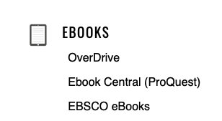
Certified Software Quality Engineer Handbook Linda Westfall
Based on the Certification
Found online
BYUI-Idaho Library: A-Z Library Database: Ebooks: Ebook Central (ProQuest)

Slide 27
Continuous Improvement
Quality Assurances
(Built the Product Right)
Process ->
Q-Contrl/HMI
Value/Cost
Audit/Review/Std
Integrity/Sec
Testing
<- Product
Software Development
QA vs
Test vs
DevOp vs
Cont. Improvement
Support Roles (CM, DM, Code Mngr, etc)
Program/Project Manager
Development
QA-Tester
Acceptance Tester
System Tester
Integration Tester
Regression Tester
Unit Tester
(Sometime Developer)
Concept of Operations
Acceptance Test
Validation
Requirements
System Test
Verification
Architecture
Integration Test
Design
Regression Test
Implementation
Implementation
Unit Test
(Built the Right Product)
Dev Ops
Environment
Software Tools
Hardware
Network
Infrastructure
Test Zone (sandboxes)
Operation

Slide 28
IEEE 730-2002 Software Quality Assurance Plan
Title Page: Date Authors Approvals
Other pages: Revision History, TOC, TOT
Sections
Purpose Week 05 (QA Process)
Reference Week 05 (QA Process)
Management Week 05 (QA Process)<-02 (QA and SW Lifecycle), 09 (Quality Maturity), 13
Documentation Week 12 (Extrinsic Risks)
Standards, Practices, Conventions, and metrics Week 04 and 14 <- 03(QA Techniques) and 04 (QA Metrics)
Software Reviews Week 08 (QA Reviews and Audits)
Test Week 07 (QA Attributes)
Problem reporting and corrective action Week 11 (Risk Management)
Tools, techniques, and methodologies Week 06 (QA Tools)
Media control Week 10 (Configuration Management)
Supplier control Week 09 (Quality Maturity)
Records collection, maintenance, and retention Week 10 (Configuration Management)
Training Week 12 (Extrinsic Risks)
Risk Management Week 11(Risk Management)
Glossary

Slide 29
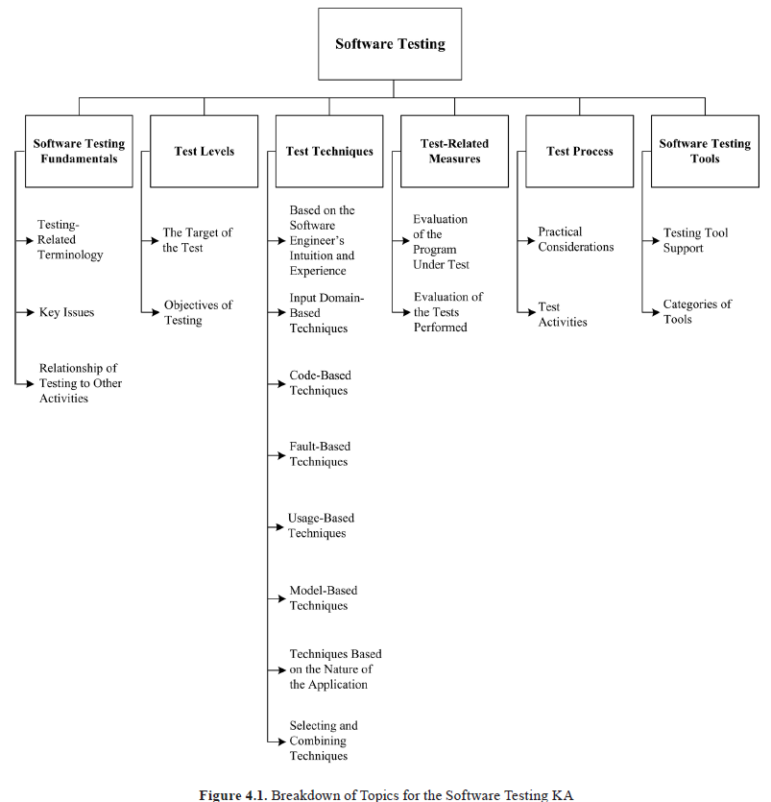
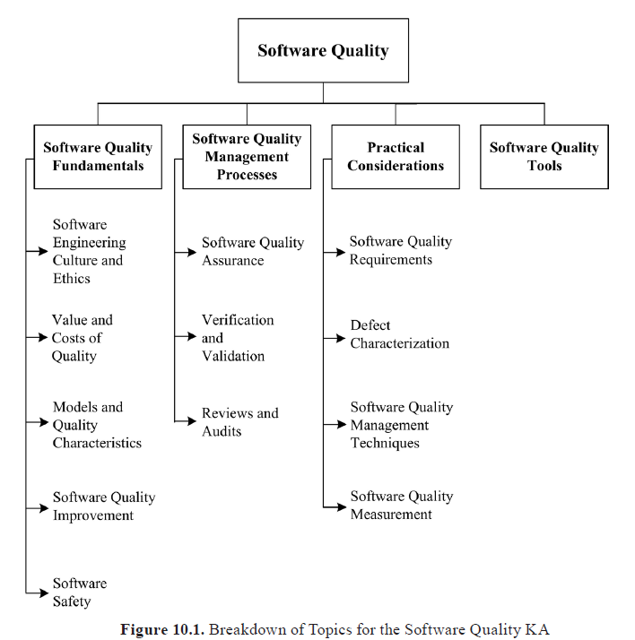
SWBoK: Testing vs QA

Slide 30
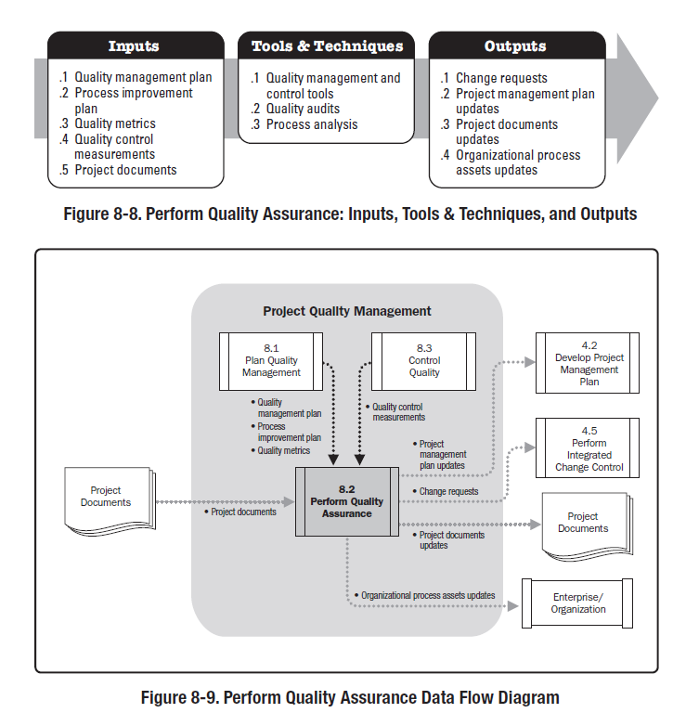
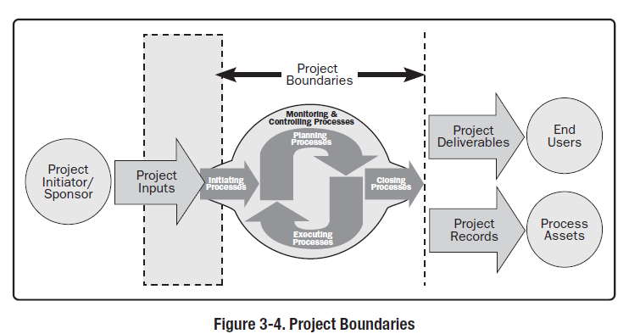
PMBoK: Quality Assurance

Slide 31
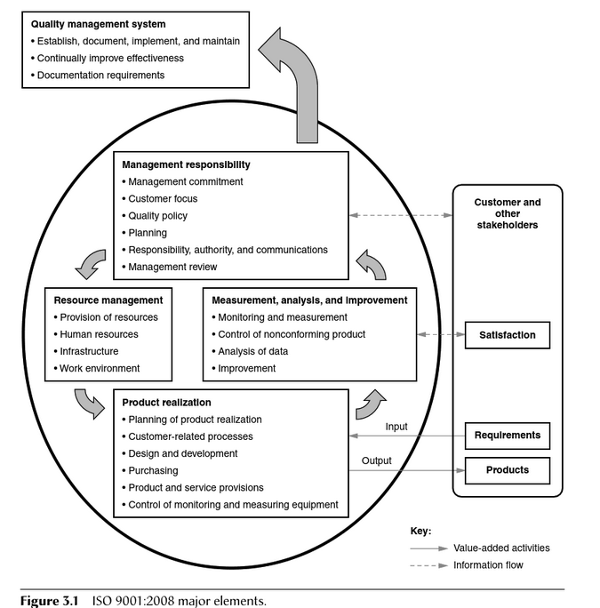
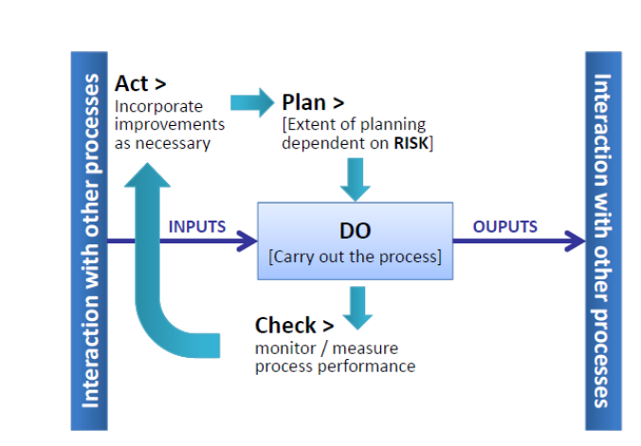
ISO 9001
Notes:
https://ebookcentral.proquest.com/lib/byui/reader.action?docID=3002591
Chapt 3 Certified Software Quality Engineer Handbook

Slide 32
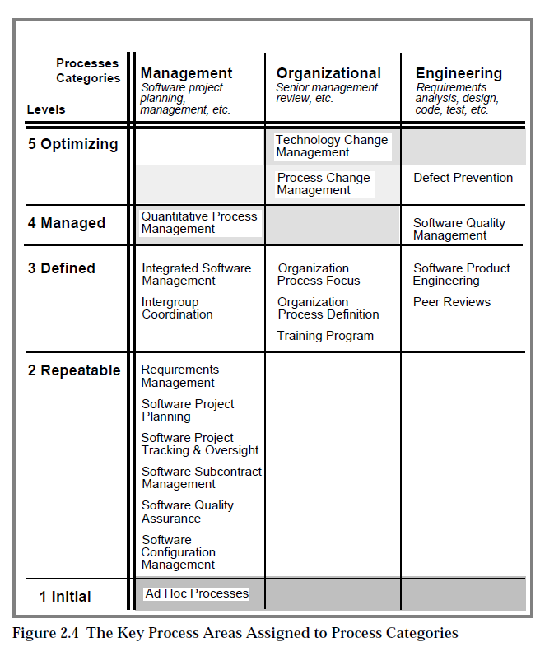
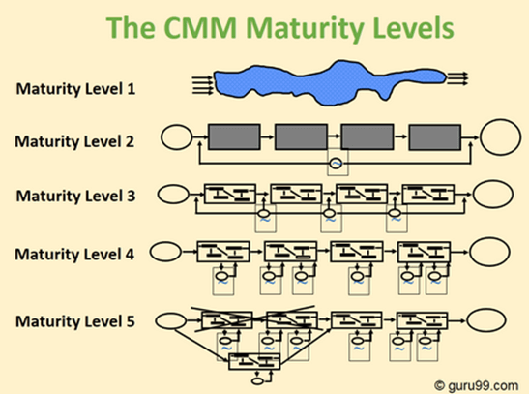
CMM
The key process areas at Level 2
Requirements Management
Software Project Planning
Software Project Tracking and Oversight
Software Subcontract Management
Software Quality Assurance
Software Configuration Management
The key process areas at Level 3
Organization Process Focus
Organization Process Definition
Training Program
Integrated Software Management
Software Product Engineering
Intergroup Coordination
Peer Reviews
The key process areas at Level 4
Quantitative Process Management
Software Quality Management
The key process areas at Level 5
Defect Prevention
Technology Change Management
Process Change Management

Slide 33
Associations, Organizations, Magazines, Web
Associations | Acc | Websites
Agile Alliance |  | https://www.agilealliance.org/
American Society for Quality | ASQ | www.asq.org
American Software Testing Qualifications Board (ASTQB) | ASTQB | https://www.istqb.org
Association for Software Testing | AST | https://www.associationforsoftwaretesting.org/
Association of Testing & Software Quality Assurance | AT*SQA | https://atsqa.org/
BCS The Charted Institute for IT |  | https://www.bcs.org
DZONE |  | https://dzone.com
International Institute for Software Testing | IIST | https://testinginstitute.com/
International Software Testing Qualifications Board | ISTQB | https://www.istqb.org/
ISO |  | https://www.iso.org
Official U.S. List of Certified Software Testers |  | https://astqb.org
OWASP™ Foundation |  | https://www.owasp.org
QA InfoTech |  | https://qainfotech.com/
QA Mentor |  | https://www.qamentor.com/
Qualcomm |  | https://www.qualcomm.com/
QualiTest |  | https://www.qualitestgroup.com
QualityLogic |  | https://www.qualitylogic.com/

Slide 34
Prove Assignment

Slide 35
Prove Assignment: Company Flier
You are creating a training flyer, poster, or 3-fold handout describing why an employee should care about Quality Assurance. Create a post on a professional networking site to provide a distribution means for your flier.
As part of C.M.M. Level 3 training, yearly competency training is a requirement for employees.
A flier must be developed and distributed to introduce employees to the upcoming required training.
Your team is assigned to create the flyer. The flier is a quick read that briefly provides the purpose, benefits, and resources needed to convince employees to take the training on Quality Assurance.

Slide 36
What Should Be Included
Purpose
Mission Statement
QA Opportunities
What you learned from the Cert
Advantages of QA
Class discussion?
Issues that it resolves
What you learned from the Cert
Create a blog post with an introduction to the flier
Portfolium, or other location
Provide a link to the flier
Extras:
Testimony, Quote, Graphic
Replies from friends

