Slide 2
Welcome to Week 06 QA Tools
CSE 474 Quality Assurance
Brother W. Clements

Slide 3
5. QA Processes
(V&V, Reviews, Audits)
8. Reviews & Audits
(Tech, Mngt., Inspection, walk-throughs, checklist)
10. Configuration Management
1. Fundamentals & Business Case for Quality Assurance
(IEEE SWBok)
9. Maturity
(CMM, Process, Product, ISO)
11. Risk/Mission Assurance
(Training, CAR, Mitigation)
6. QA Tools
(Fishbone, check, Histograms, Pareto, Scatter, Stratification)]
12. Security/ Legal/ Ethics
(Regulations, Code, Legal, Safety)
2. QA’s Role in SW Lifecycle, Methodologies,
Architecture
[Responsibilities & Roles]
7. QA Attributes
(Verification and Validation )
13 . Project Management
(CoQ, WBS, DevOps )
[VDD, Version, DM, DI]
14. Careers Path
3. QA Techniques
(Dyn, Static, and Testing)
[]
4. Quality Metrics
(Characteristic & Models)
[Measuring]
Know
Do
Become
SWE 474: Quality Assurance Class

Slide 4
Reading
Research QA Tools (est. ~1 hour)
Might want to start with: https://asq.org/quality-resources/learn-about-quality
L. Westfall Certified Software Quality Engineer Handbook, ASQ Quality Press, 2009-09-01, https://ebookcentral.proquest.com/lib/byui/detail.action?docID=3002591
Chapter 20: Analytical Techniques (pages 25)

Slide 5
Agenda
Note: We have had some comments that the students are making up the content of the course for this week.
At the surface, it can be perceived that way.
This is one of many teaching techniques found in Bloom’s taxonomy, teaching methods found here at BYU-Idaho, and part of our learning model.
The research and presentation are the summarization (Blooms level 5) of the content.
In the workplace, you will be asked to research about tools, technologies, and software, and present that information in a team or customer meeting.
The quiz questions and quiz are the assessment portion the assignment.
Research QA Tool
Provide 2-3 questions on tool
Present on Tool

Slide 6
Where is your group's presentation?
What are your sources?
What questions do you have for your presentation?
Presentations Questions Quiz?
Prove: SQAP Section 9 Tools and Techniques

Slide 7
Overview of Tools
Seven Basic Quality Tools
Cause analysis Tools
(2) Cause and Effect Diagrams (Fishbone)
Brainstorming
Nominal Group Technique
Force Field Analysis
Five Whys and Five Hows
(7) Pareto Diagrams
(3) Scatter Diagrams
Data Collection
Survey
Design of Experiments (DOE)
(6) Check sheets
Analysis Tools
Stratification () - sorting data, people, and objects into distinct groups or layers
(5)Flowcharts
Run Chart
(1) Histograms
Control chart
Box and Whisker plot
(4) Control Charts
Idea Creation Method
Brainstorming - Brainstorming is defined as an idea creation method for generating a large number of creative ideas in a short period of time.
(1) Affinity Diagram - The affinity diagram organizes a large number of ideas into their natural relationships.
Benchmarking
Nine Window Technique (TRIZ)
Nominal Group Technique

Slide 8
Management and Plan Development
(1) Affinity Diagram - The affinity diagram organizes a large number of ideas into their natural relationships.
(2) Interrelationship Digraph
Prioritization Matrix
(3) Tree Diagram
Matrix Diagrams
(4) Process decision program chart (PDPC)
Matrix Data Analysis
Arrow Diagram
Project Planning and Implementation Tools
Gantt Chart
Network Diagrams
Pert Chart
Radar Chart
Plan-Do-Check-Act (PDCA) Cycle

Slide 9
Dividing the topics
3-6 – groups:
3 groups
7 Basic-Cause & Idea, 7 Basic-Data & Analysis, Management & Planning
4 groups
7 Basic-Cause, 7 Basic-Data & Analysis, Idea, Management & Planning
5 group
7 Basic-Cause, 7 Basic-Data, 7 Basic-Analysis, Idea, Management & Planning
6 groups
7 Basic-Cause, 7 Basic-Data, 7 Basic-Analysis, Idea, Management, Planning
7+ group
Divide Tools into smaller based on grouping sizing.

Slide 10
What are your sources?
Primary Sources –
Secondary Sources
Other Sources
Looking for 4 each.

Slide 11
What questions do you have for your presentation?
Fact-Based Questions are easy questions. Is it equal or not equal to the definition or situation. There is only one variable to deal with.
Comprehension questions are a bit more difficult, usually having to combine or compare situations. Comprehension questions can be like Fact-Based but explained in different ways in your own words. In a sense, one could say it comparisons or multi-variable for a given domain.
Reasoning questions are more difficult because they follow a set of processes or equations. Reasoning questions are showing your work, or which of the following answers would be a solution to questions.
Rubric
You need to provide the Instructor with your estimated question's points. Each question will be graded based on the matrix for a total of 40 pts.
 | Complexity
 | Fact-Based | Comprehension | Reasoning
Difficulty | (= - equal) | (compare) | (f(x))
T/F | 2 pt | 4 pts | 6 pts
Multiple-Choice | 4 pts | 8 pts | 12 pts
Multiple-Select | 6 pts | 12 pts | 19 pts
Matching (1-to-1) | 8 pts | 16 pts | 24 pts
Matching (n-to-1) | 10 pts | 20 pts | 30 pts
Matching(n-to-1+m) | 12 pts | 24 pts | 36 pts

Slide 12
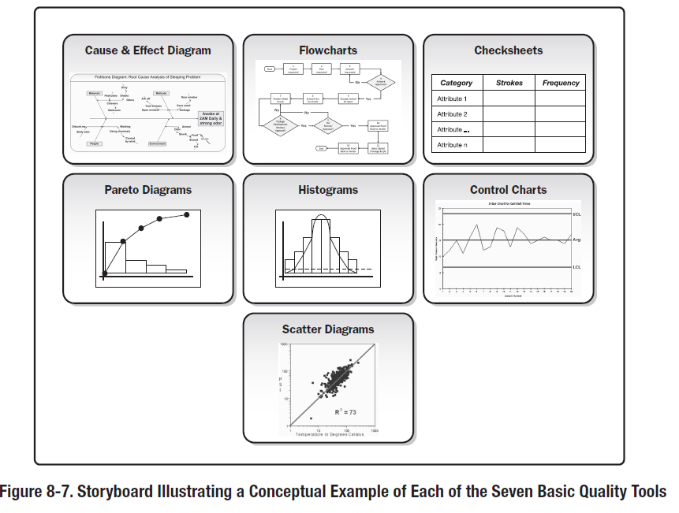
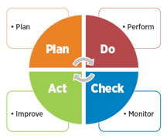
Overview of Tools
Seven Basic Quality Tools
Planning?
Do?
Check
Data Collection
(6) Check sheets
(1)Histograms
(4) Control Charts
Act
Cause analysis Tools
(2) Cause and Effect Diagrams (Fishbone)
(7) Pareto Diagrams
(3) Scatter Diagrams
Analysis Tools
(5)Flowcharts
Planning
Idea Creation
Affinity
Brainstorming
Nominal Group Technique
Benchmarking
Nine Window Technique
TRIZ
Evaluation Decision making
Survey
Decision
Delphi Method
Affinity Diagram
Multi-voting
Do
Project Planning
Network
Arrow, Precedence, Pert
Gnatt
Project Management
Affinity
Interrelationship
Tree
Matrix
House of Cards
Process Decision Program Chart
Check
Data Analysis
Box and Whisker
Check sheet
Control Chart
Design of Experiment
Five Whys & Hows
Histograms
Scatter
Stratification
Survey
Act
Cause Analysis
Fishbone
Pareto
Scatter
Process
Flowchart
Failure mode effect analysis
Mistake-proofing
Spaghetti
Workflow

Slide 13
Section 9 Tools and Techniques
Step 1: Section Introduction
Provide a brief overview of ASQ’s tools, techniques, and methodologies.
Seven Basic Quality Tools,
Idea Creation Method
Seven Management and Planning Tools,
Project Planning and Implementation Tools
Step 2: 9.1 Tools
Based on the following ASQ’s categories, identify each of the tools, namely any spreadsheets, software, or any other electronic media mention from ASQ or from other resources.
Step 3: 9.2 Techniques
In each of the categories there are topics that have to be done in order. Some of the topics specify an order other imply. For each category, identify the technique by specifying the order and how each step helps the next step. For example, Brainstorming comes before Cause and Effect Diagrams, after which Scatter and Control Charts.
Step 4: 9.3 Methodologies
This section will specify PDCA cycle. This is our current methodology for QA, we will update this section as we move through the semester. You will need to provide a summary of this cycle. Please provide an example of how one or two of the topics fits in to the PDCA.

Slide 14
Plan-Do-Check-Act (PDCA) Cycle
Plan: Recognize an opportunity and plan a change.
Do: Test the change. Carry out a small-scale study.
Check: Review the test, analyze the results, and identify what you’ve learned.
Act: Take action based on what you learned in the study step. If the change did not work, go through the cycle again with a different plan.
If you were successful, incorporate what you learned from the test into wider changes. Use what you learned to plan new improvements, beginning the cycle again.
Spiral
Plan: Objectives
Test: Risk/Prototype
Check: Implement
Act: Reflect

Slide 15
Seven Basic Quality Tools
Planning?
Do?
Check
Data Collection
(6) Check sheets
(1)Histograms
(4) Control Charts
Act
Cause analysis Tools
(2) Cause and Effect Diagrams (Fishbone)
(7) Pareto Diagrams
(3) Scatter Diagrams
Analysis Tools
(5)Flowchart

Slide 16
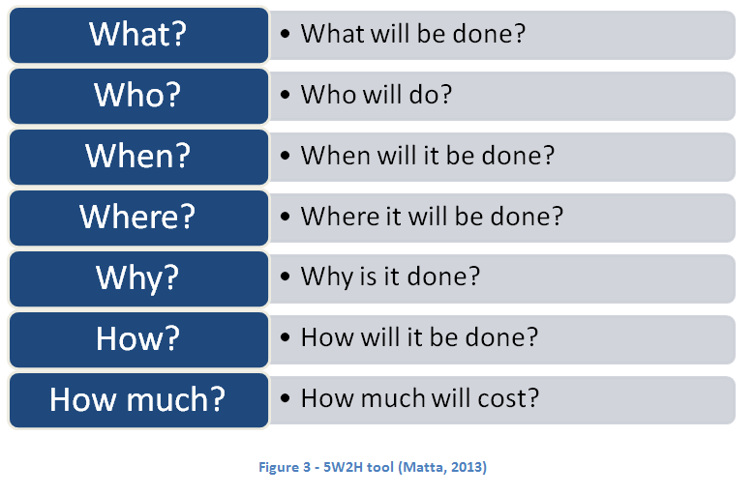
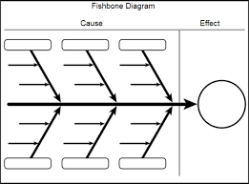
CAR with the use of Tool/Techniques
Fishbone, 5W-2H, etc
Why do you do, when you know what you know

Slide 17
Seven Basic Quality Tools
Planning?
Do?
Check
Data Collection
(6) Check sheets
(1)Histograms
(4) Control Charts
Act
Cause analysis Tools
(2) Cause and Effect Diagrams (Fishbone)
(7) Pareto Diagrams
(3) Scatter Diagrams
Analysis Tools
(5)Flowchart

Slide 18
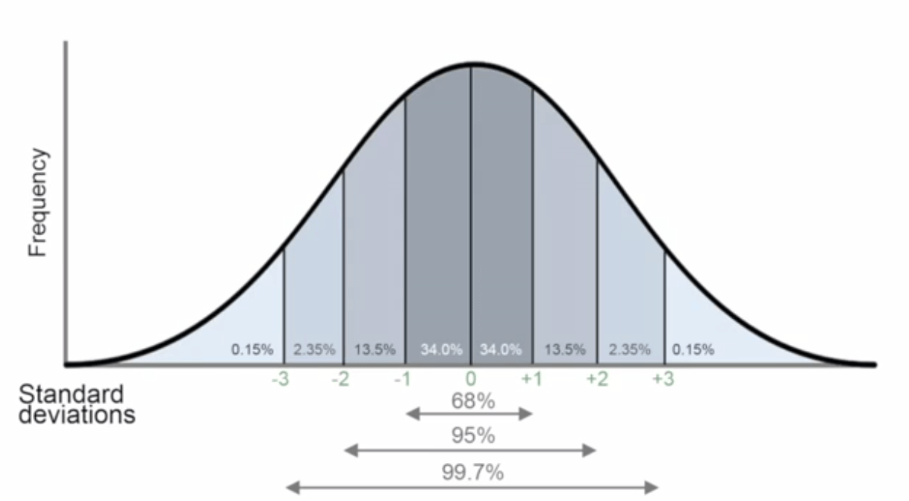
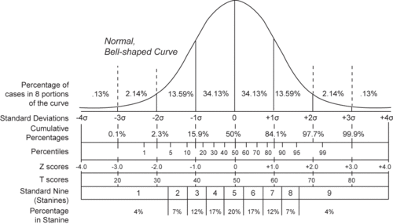

Slide 19
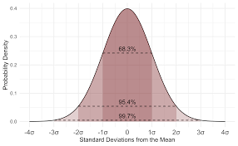
Control Chart

Slide 20
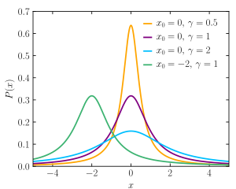
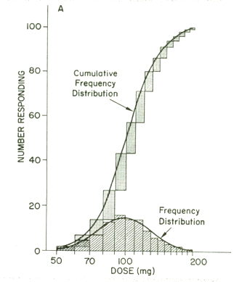
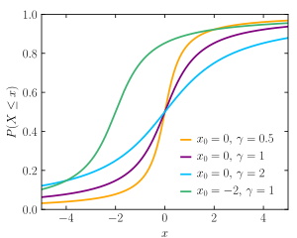

Slide 21
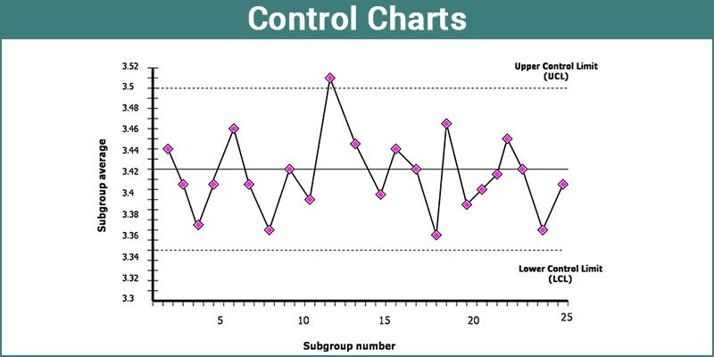

Slide 22
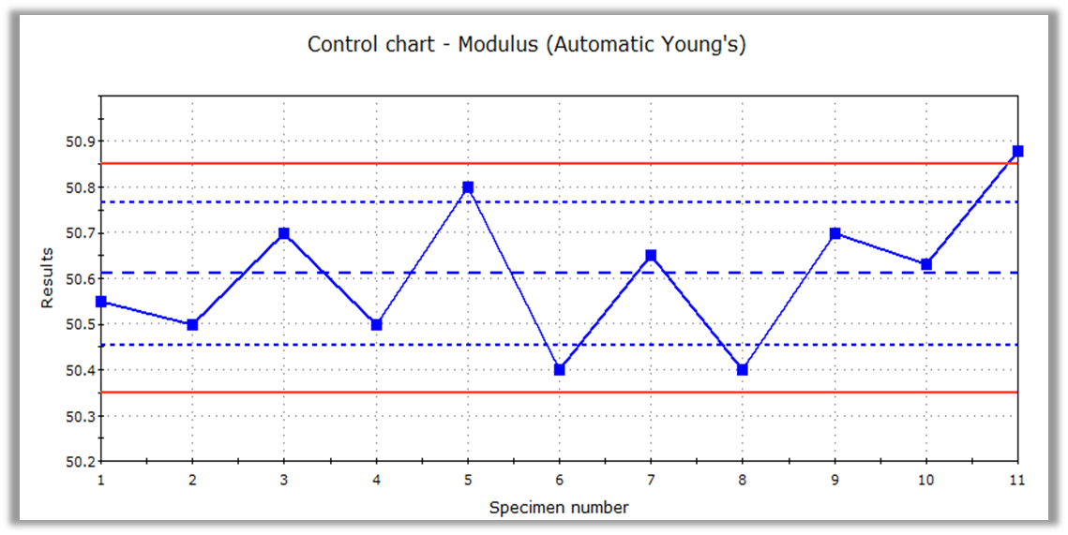
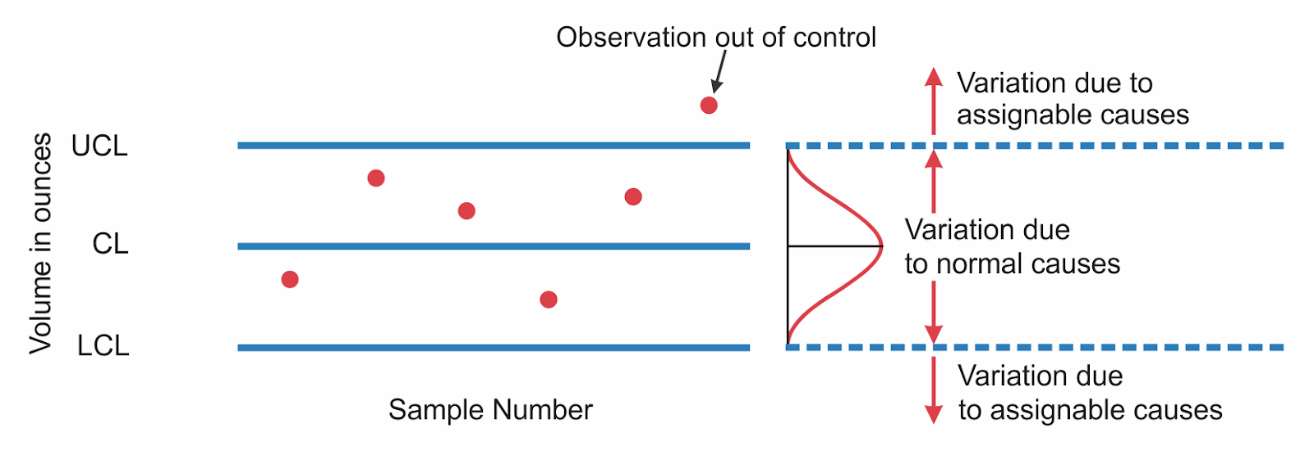

Slide 23
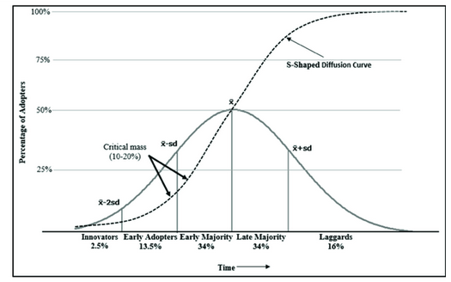
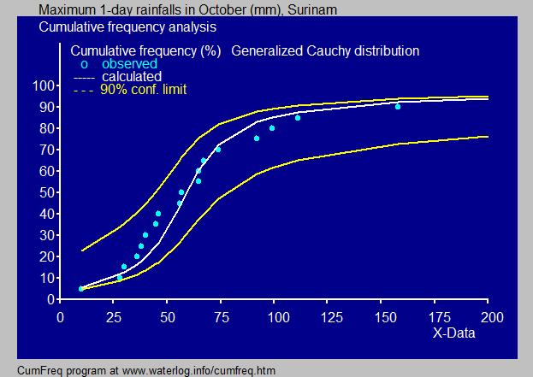
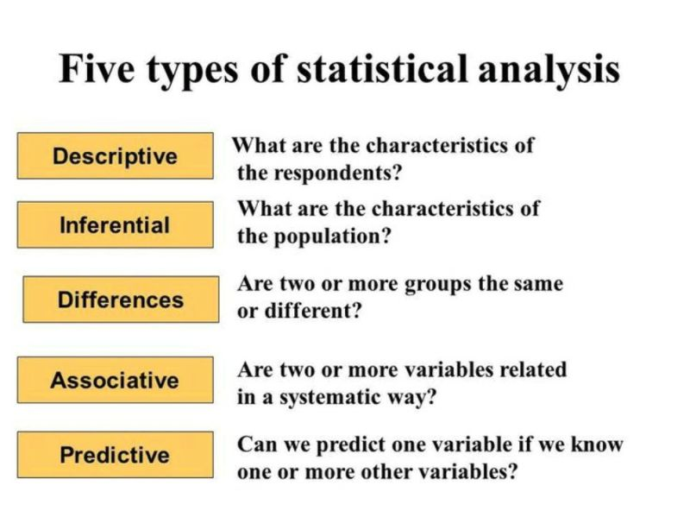

Slide 24
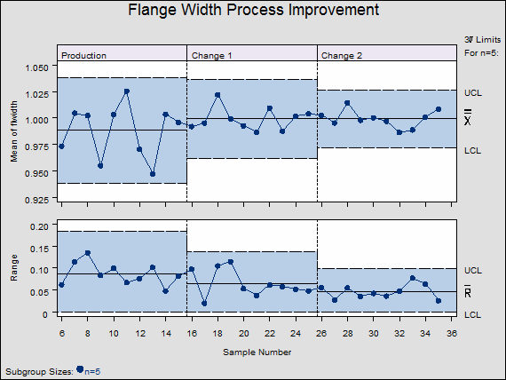
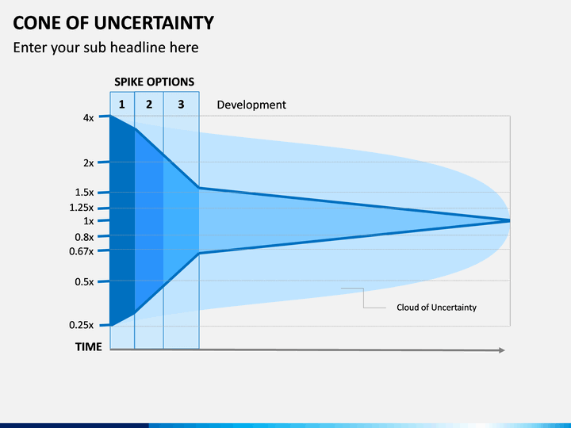
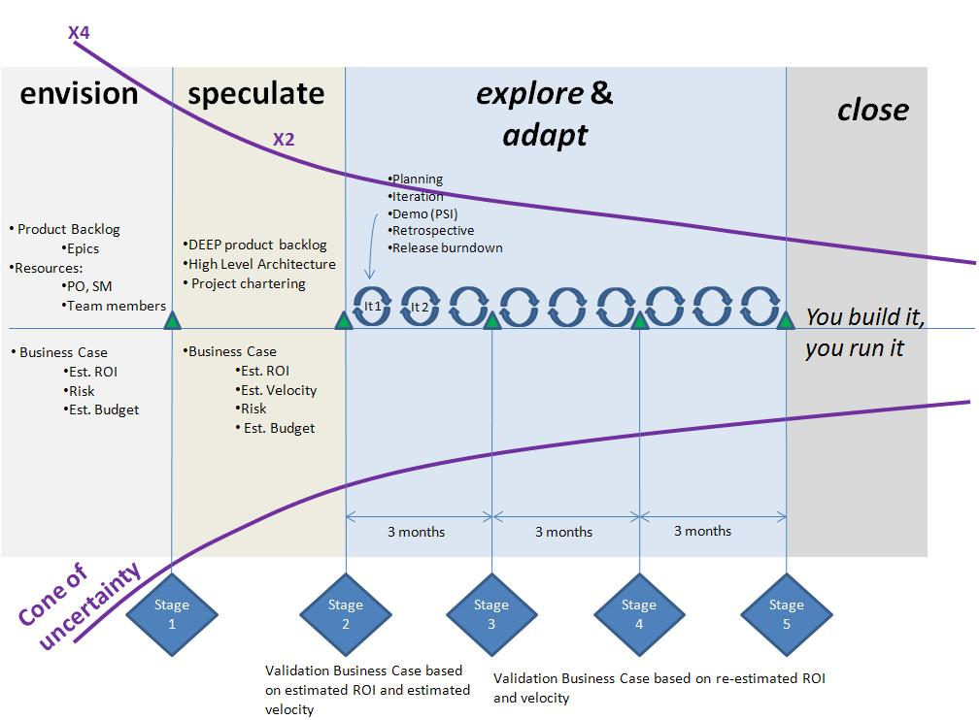
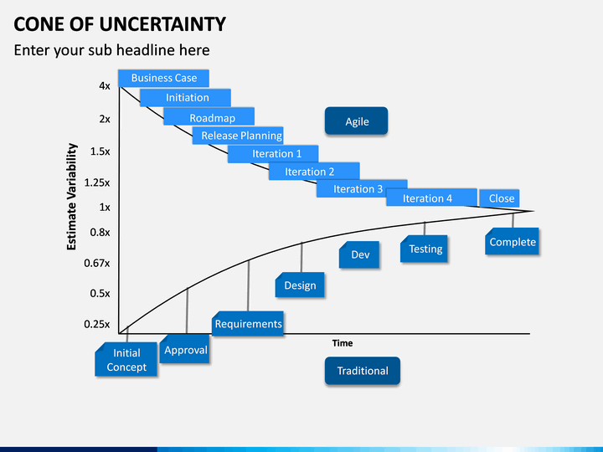
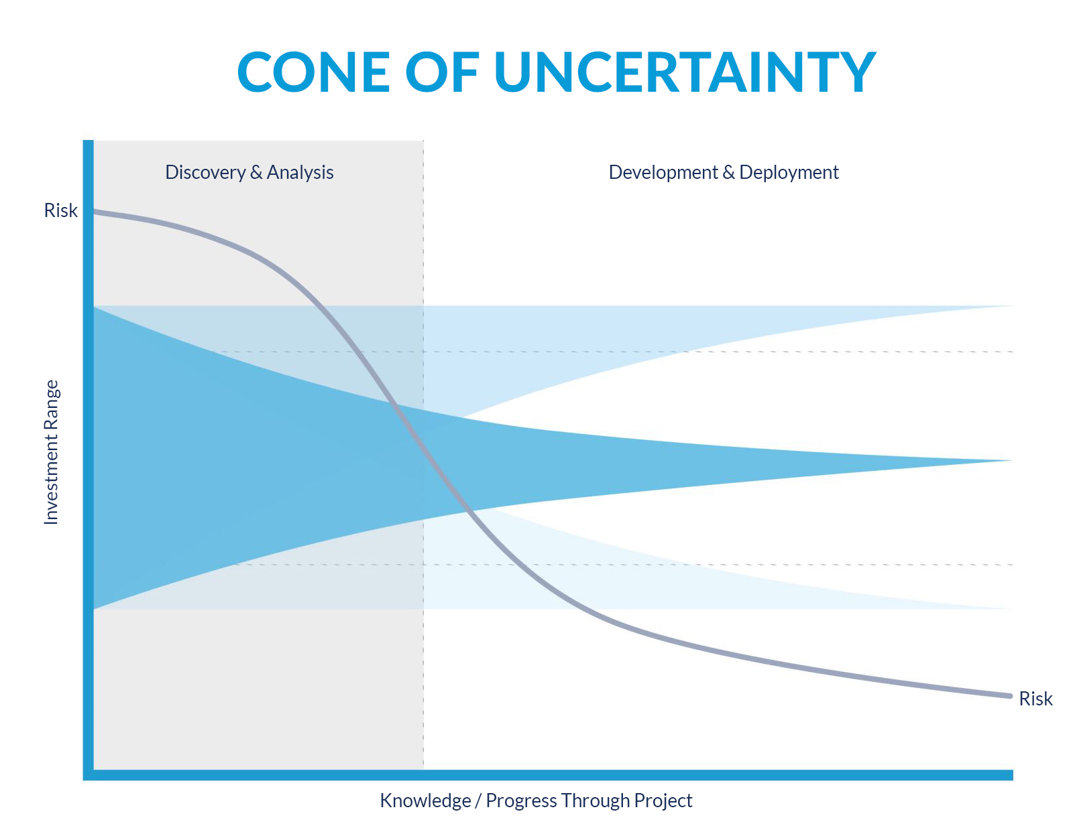

Slide 25
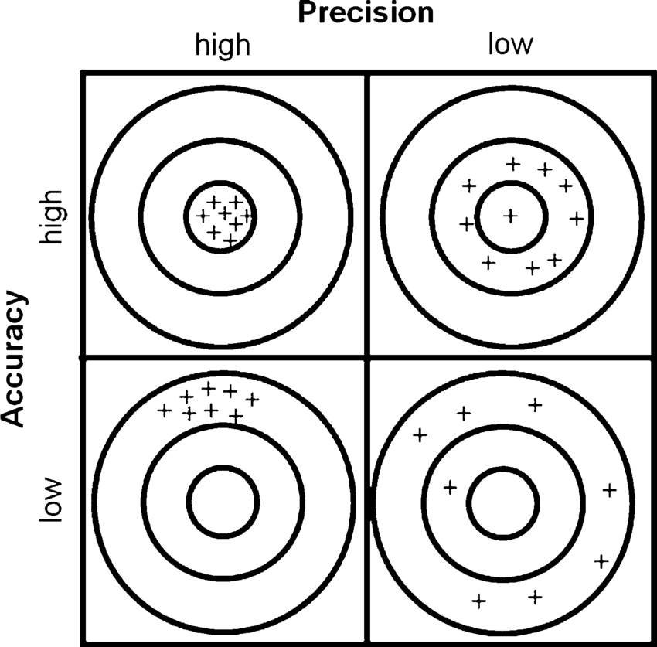
Process Improvement
Higher Precision
Increase Productive
Process Improvement
Higher Accuracy
Decrease Error

Slide 27
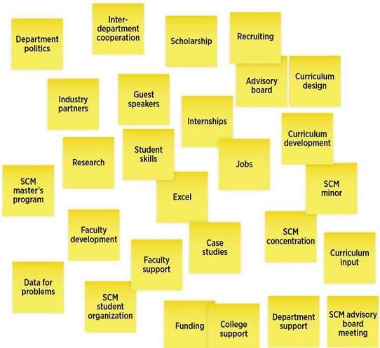
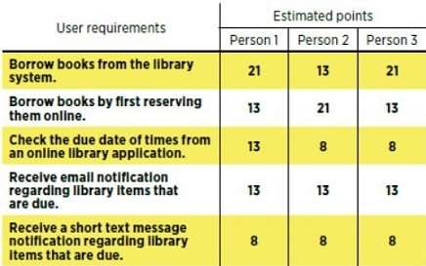
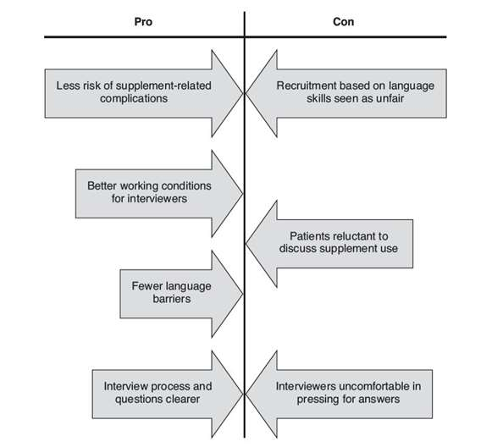
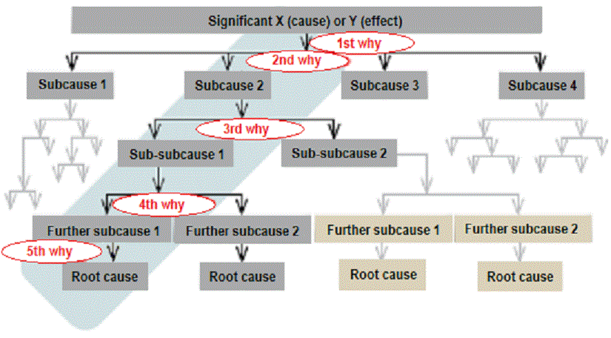
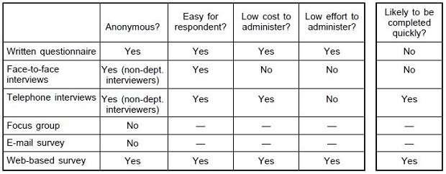
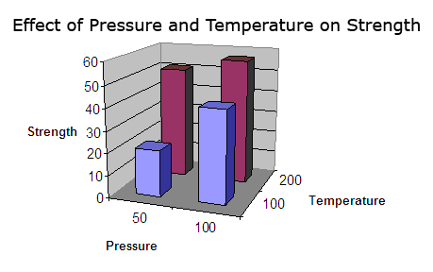
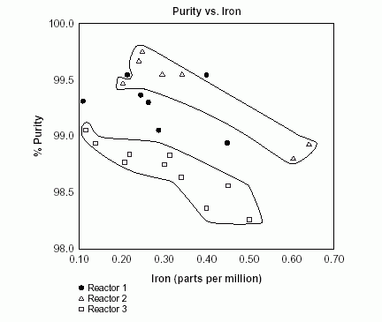
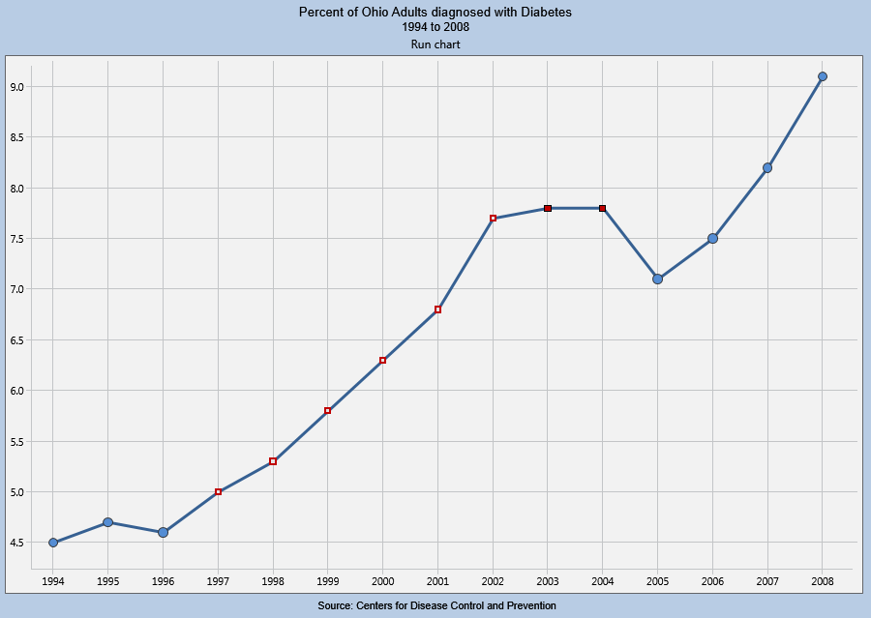
Seven Basic Quality Tools
Cause analysis Tools
(2) Cause and Effect Diagrams (Fishbone)
Brainstorming
Nominal Group Technique
Force Field Analysis
Five Whys and Five Hows
(7) Pareto Diagrams
(3) Scatter Diagrams
Data Collection
Survey
Design of Experiments (DOE)
(6) Check sheets
Analysis Tools
Stratification () - sorting data, people, and objects into distinct groups or layers
(5)Flowcharts
Run Chart
(1) Histograms
Control chart
Box and Whisker plot
(4) Control Charts

Slide 28
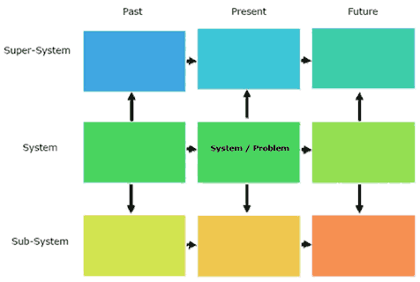
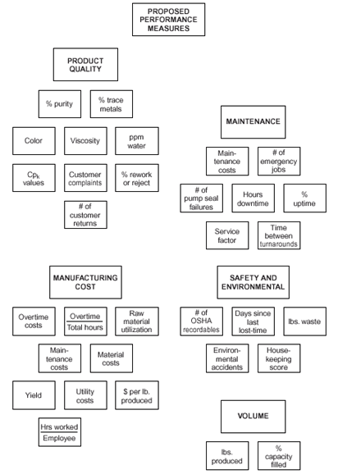
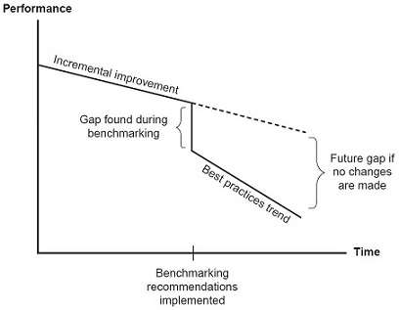
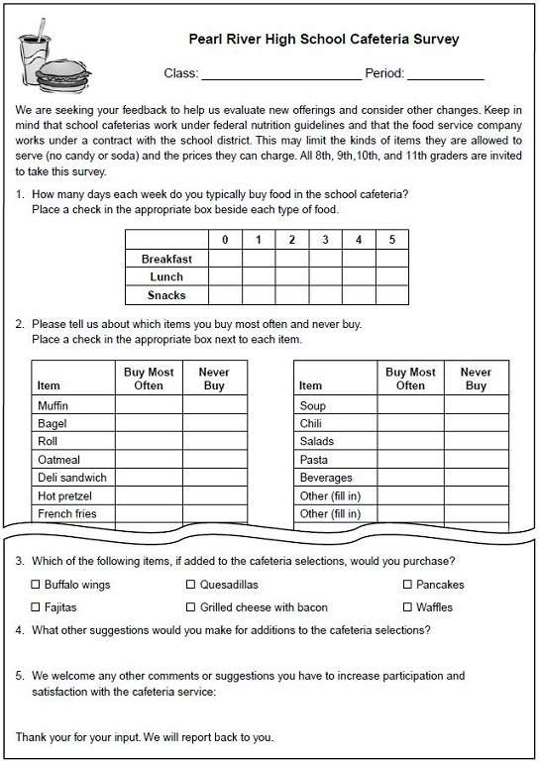
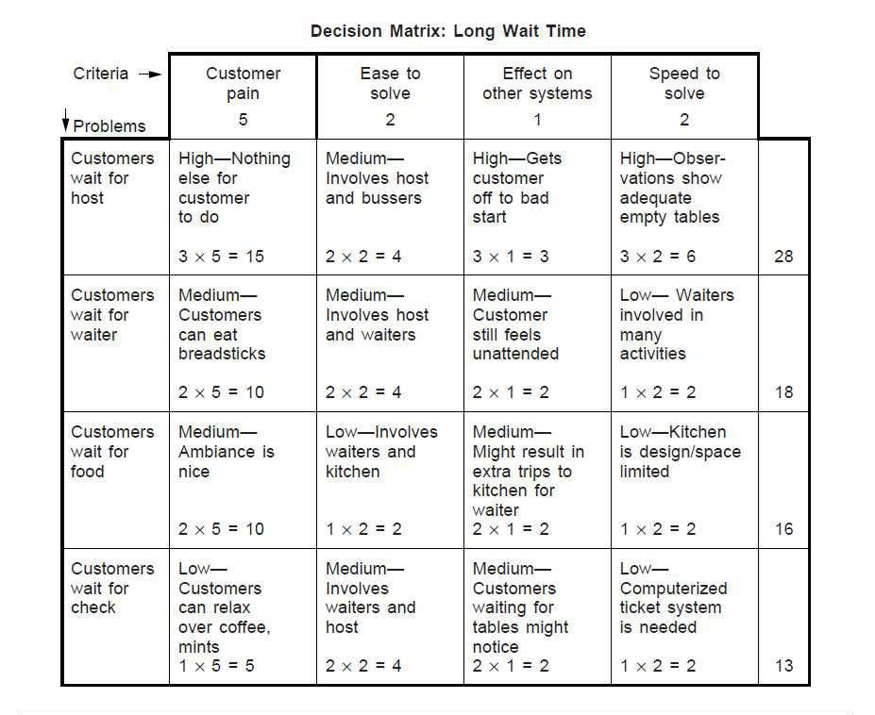
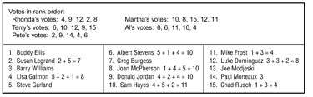
Planning
Idea Creation
Brainstorming - Generating a large number of creative ideas in a short period of time
Nominal Group Technique - best idea prioritization
Affinity
Benchmarking - comparing with best practices
Nine Window Technique – innovation technique
past, present, future vs
super-system, system and sub-system
TRIZ (teoriya resheniya izobretatelskikh zadatch, theory of inventive problem solving[TIPS]),
Evaluation Decision making
Survey
Decision
Delphi Method
Affinity Diagram
Multi-voting

Slide 29
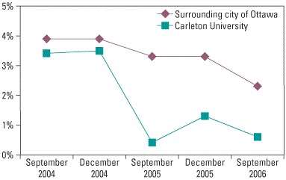
Idea Creation Method
Encourage thinking, organization about issues, opportunities, with people or individually.
Brainstorming - Generating a large number of creative ideas in a short period of time.
Nominal Group Technique - best idea prioritization
Dephi Method – group consensus, precursor to sprint planning
Affinity Diagram - organizes a large number of ideas into their natural relationships.
Benchmarking - comparing with best practices
Nine Window Technique – innovation technique
past, present, future vs
super-system, system and sub-system.
TRIZ- (teoriya resheniya izobretatelskikh zadatch, theory of inventive problem solving[TIPS]),

Slide 30
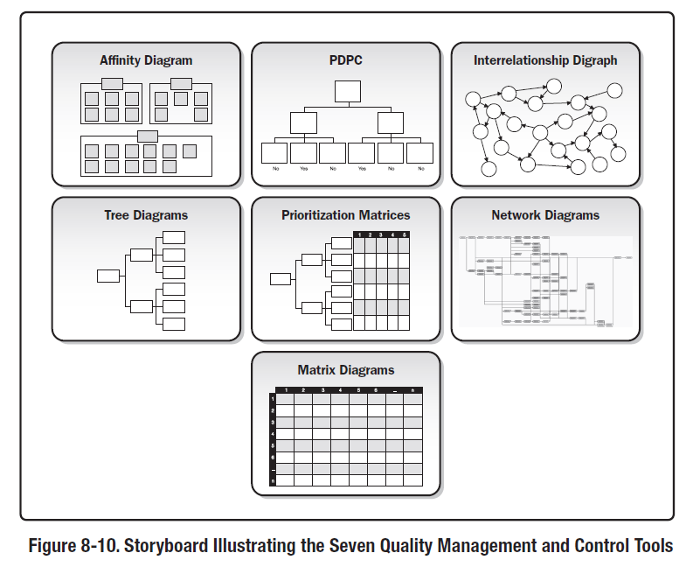
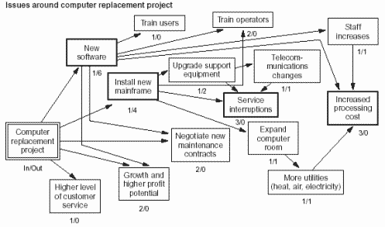
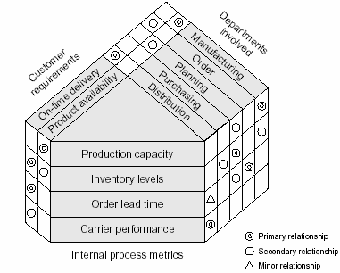
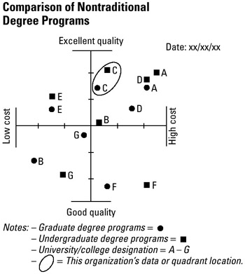
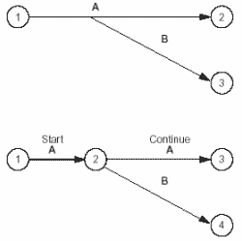
DO:Management and Plan Development
(1) Affinity Diagram - organizes a large number of ideas into their natural relationships.
(2) Interrelationship Digraph
Prioritization Matrix
(3) Tree Diagram
Matrix Diagrams
(4) Process decision program chart (PDPC)
Matrix Data Analysis
Arrow Diagram

Slide 31
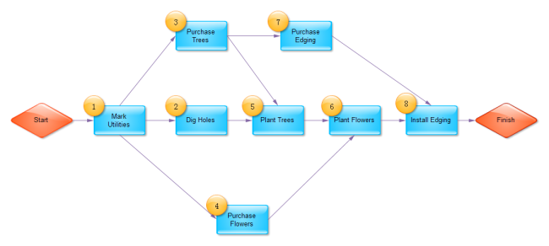
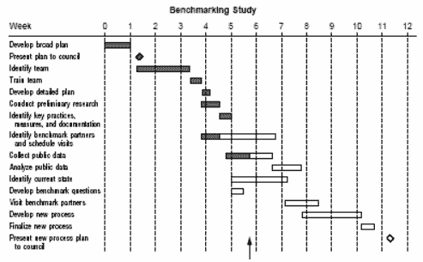
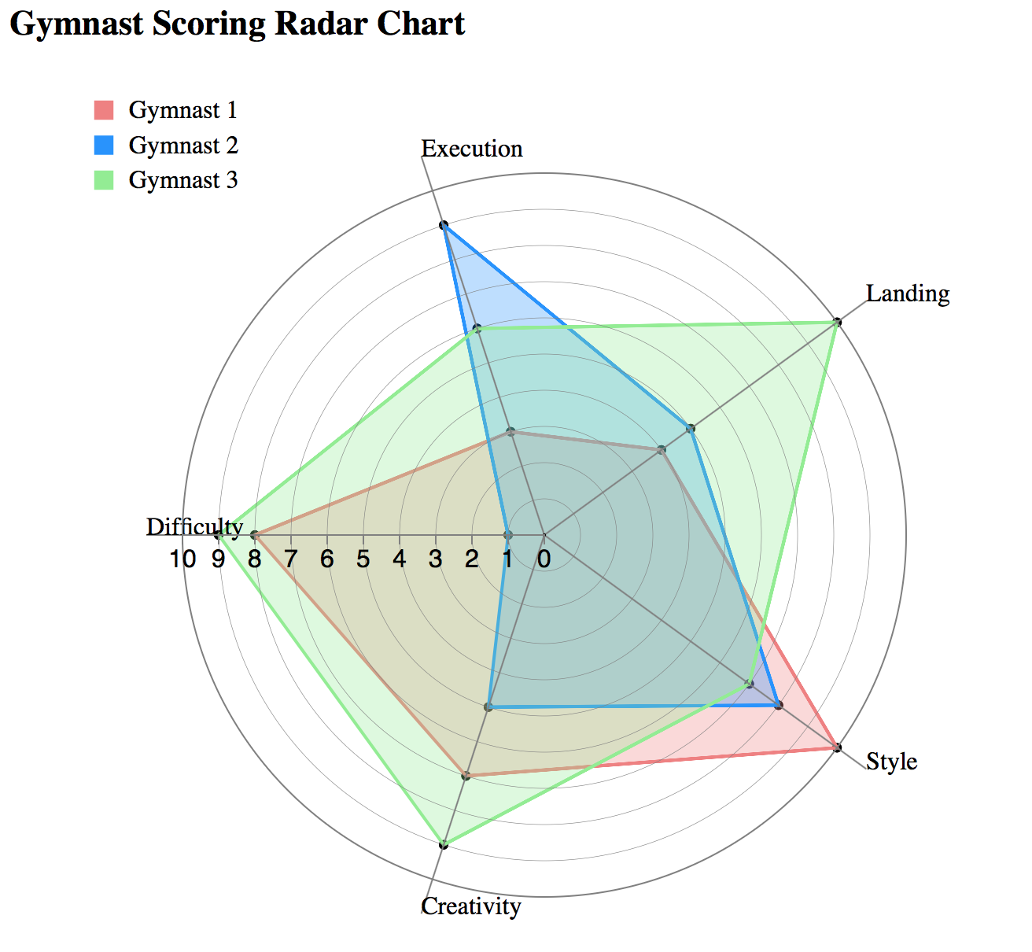
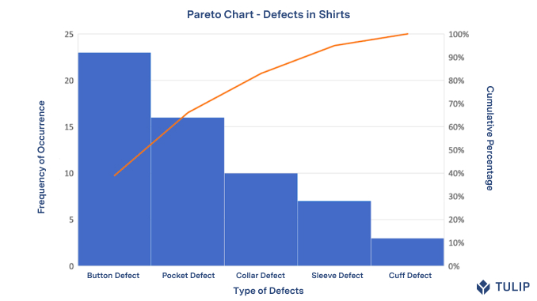
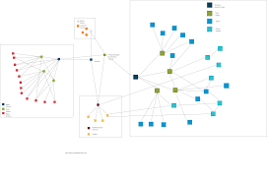
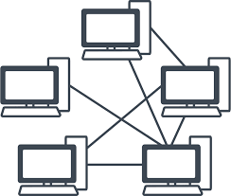
DO: Project Planning and Implementation Tools
Gantt Chart
Network Diagrams
Pert Chart
Radar Chart

Slide 32
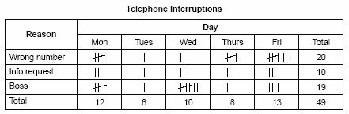
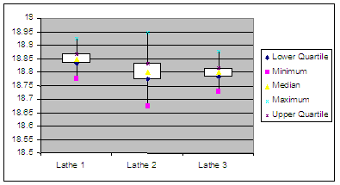





Check
Check
Data Analysis
Box and Whisker
Check sheet
Control Chart
Design of Experiment
Five Whys & Hows
Histograms
Scatter
Stratification
Survey
5S

Slide 33




Act
Cause Analysis
Fishbone
Pareto
Scatter
Process
Flowchart
Failure mode effect analysis
Mistake-proofing (Poka-Yoka)
Spaghetti
Workflow

Slide 34
Overview of Tools
Seven Basic Quality Tools
Planning?
Do?
Check
Data Collection
(6) Check sheets
(1)Histograms
(4) Control Charts
Act
Cause analysis Tools
(2) Cause and Effect Diagrams (Fishbone)
(7) Pareto Diagrams
(3) Scatter Diagrams
Analysis Tools
(5)Flowcharts
Planning
Idea Creation
Affinity
Brainstorming
Nominal Group Technique
Benchmarking
Nine Window Technique
TRIZ
Evaluation Decision making
Survey
Decision
Delphi Method
Affinity Diagram
Multi-voting
Do
Project Planning
Network
Arrow, Precedence, Pert
Gnatt
Project Management
Affinity
Interrelationship
Tree
Matrix
House of Cards
Process Decision Program Chart
Check
Data Analysis
Box and Whisker
Check sheet
Control Chart
Design of Experiment
Five Whys & Hows
Histograms
Scatter
Stratification
Survey
Act
Cause Analysis
Fishbone
Pareto
Scatter
Process
Flowchart
Failure mode effect analysis
Mistake-proofing
Spaghetti
Workflow

