Slide 1
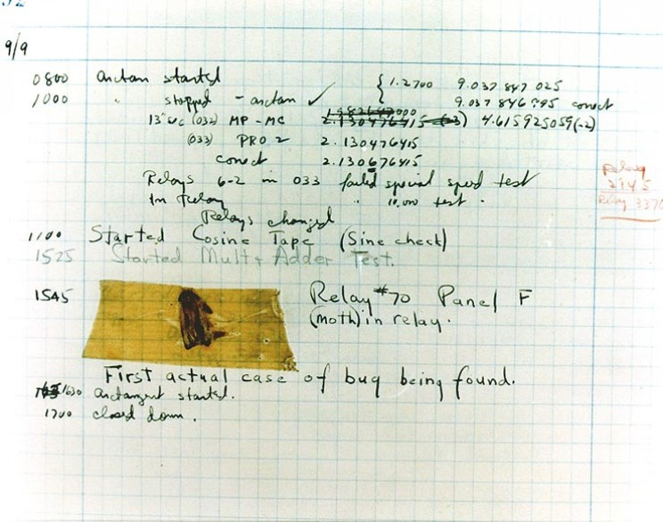
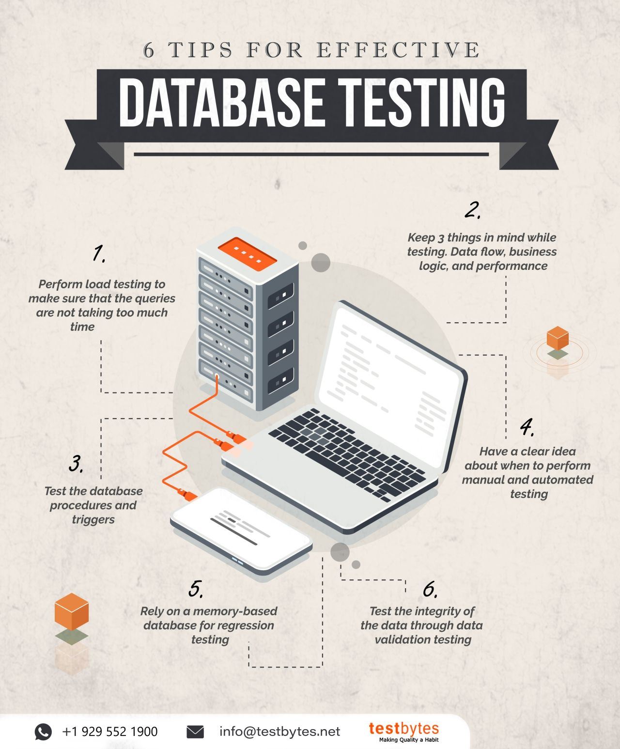
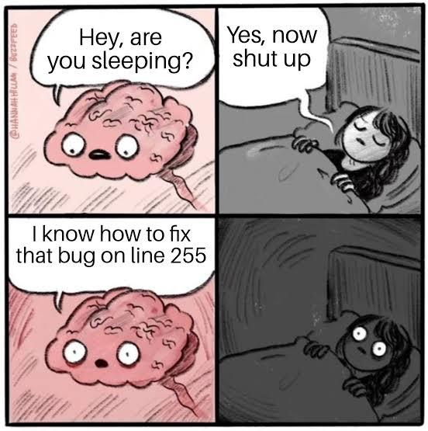
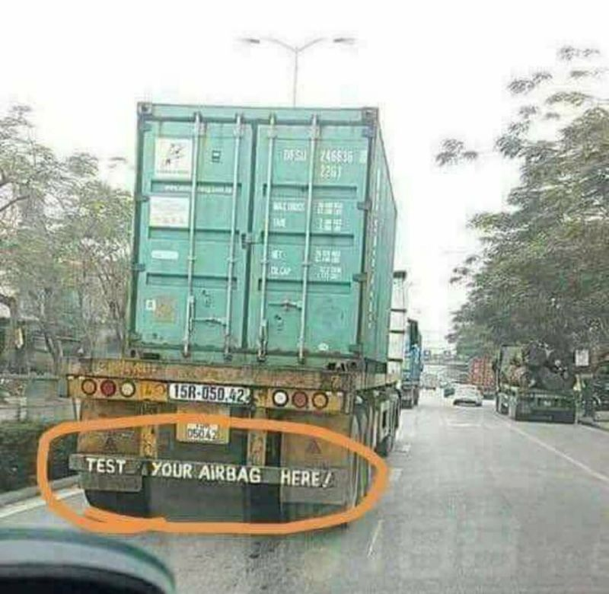
Intentionally left blank
This is vision test

Slide 2
Welcome to Week 07 QA Verification & Validation
CSE 474 Quality Assurance
Brother W. Clements

Slide 3
5. QA Processes
(V&V, Reviews, Audits)
8. Reviews & Audits
(Tech, Mngt., Inspection, walk-throughs, checklist)
10. Configuration Management
1. Fundamentals & Business Case for Quality Assurance
(IEEE SWBok)
9. Maturity
(CMM, Process, Product, ISO)
11. Risk/Mission Assurance
(Training, CAR, Mitigation)
6. QA Tools
(Fishbone, check, Histograms, Pareto, Scatter, Stratification)]
12. Security/ Legal/ Ethics
(Regulations, Code, Legal, Safety)
2. QA’s Role in SW Lifecycle, Methodologies,
Architecture
[Responsibilities & Roles]
7. QA Attributes
(Verification and Validation )
13 . Project Management
(CoQ, WBS, DevOps )
[VDD, Version, DM, DI]
14. Careers Path
3. QA Techniques
(Dyn, Static, and Testing)
[]
4. Quality Metrics
(Characteristic & Models)
[Measuring]
Know
Do
Become
SWE 474: Quality Assurance Class

Slide 4
Reading
"IEEE Standard for System, Software, and Hardware Verification and Validation," in IEEE Std 1012-2016 (Revision of IEEE Std 1012-2012/ Incorporates IEEE Std 1012-2016/Cor1-2017) , vol., no., pp.1-260, 29 Sept. 2017, doi: 10.1109/IEEESTD.2017.8055462.
https://ieeexplore-ieee-org.byui.idm.oclc.org/document/8055462
1. Overview (pages 4)
4. Relationships between verification and validation and life cycle process (pages 5)
5. Integrity levels (pages 2)
6. V&V process overview (pages 3)
7. Common V&V process (pages 23)
9. Software V&V process (pages 45)
L. Westfall Certified Software Quality Engineer Handbook, ASQ Quality Press, 2009-09-01, https://ebookcentral.proquest.com/lib/byui/detail.action?docID=3002591
Chapter 21: A. Theory (of V&V) (pages 9)
Chapter 22: B. Test Planning and Design (pages 50)
What is a Functional Requirement? (5 minutes)
https://www.youtube.com/watch?v=wbCAiLzOE30

Slide 5
Agenda
Homework Overview:
Validation: How do Non-Functional Requirements (Validation) work within the SW Lifecycle?
Verification: How does Functional Requirements (Verification) in the SW Lifecycle process?
Prove: Complete SQAP Section 7: Tests
Concepts found in the Reading
Activities
In class participation of Homework

Slide 6
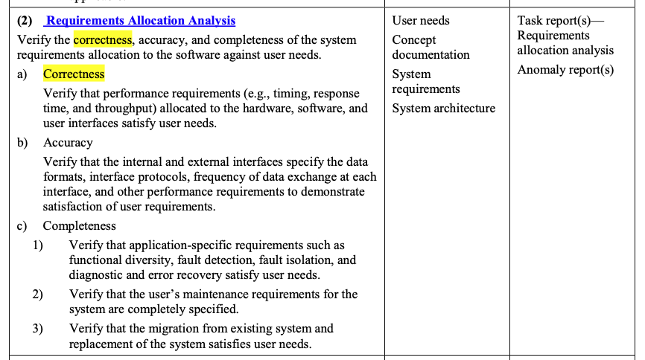
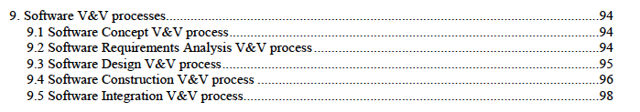
Validation: How do Non-Functional Requirements (Validation) work within the SW Lifecycle?
Find the corresponding section in table 1.c, identify the quality characteristics found in that section. The totals in row identify how many of that quality characteristic are found in the tables. Complete the following table:

Slide 7
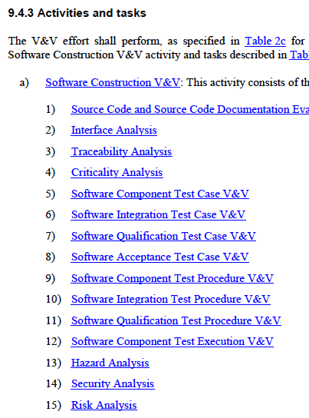
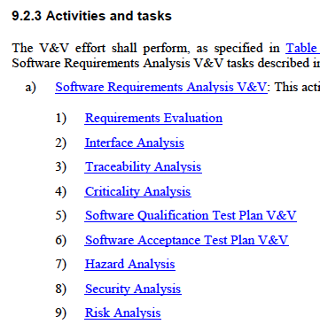
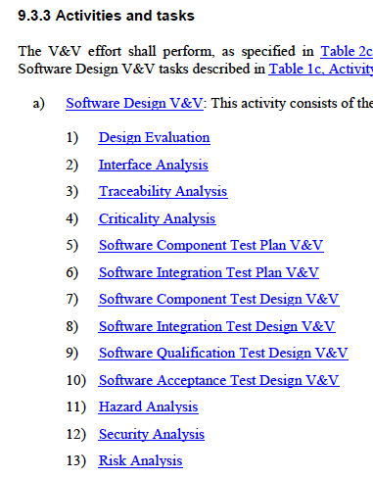
Verification: How does Functional Requirements (Verification) in the SW Lifecycle process?
Part 1: Make a list of all the V&V Tasking for each Process
Part 2: Understanding the workflow of the Tasking.
V&V Process | V&V Tasking
Concept | None
Requirements | Example: Software Qualification Test Plan V&V Software Acceptance Test Plan V&V
Design
Construction
Qualification
Acceptance
Install & Checkout
Validation
Maintenance
Concept
 | V&V Process Phases
V&V Processes | Plan | Design | Test Case | Procedure | Execution
Qualification
Acceptance |  |  | i.e. Construction
Integration
Component

Slide 8
Prove: Complete SQAP Section 7: Tests
Part 1. Overview of Section 7.
Provide an overview of this section using Chapter 22 section 1 Strategies. Provide a brief summary of each strategy.
Part 2: Testing planning Section 7.1
Provide a summary of Chapter 22 section 2 Test Plans.
Cross reference with the different IEEE Std 1012-2016 Software Design V&V process’s Software Component Test Plan V&V (page 113-114)
Part 3. Testing design Section 7.2
Provide a summary of Chapter 22 section 3 Test Design.
Cross reference with the different IEEE Std 1012-2016 Software Design V&V process’s Software Component Design V&V (page 115)
Part 4. Test Cases
Provide a summary of Chapter 22 section 4 Software Tests.
Cross reference with the different IEEE Std 1012-2016 Software Construction V&V process’s Software Component Test Case V&V (page 119-120)
Part 5. Procedures
Provide a summary of Chapter 22 section 6 Test Coverage.
Cross reference with the different IEEE Std 1012-2016 Software Construction V&V process’s Software Component Procedures V&V (page 121)
Part 6. Execution
Provide a summary of Chapter 22 section 7 Code Coverage Technology.
Cross reference with the different IEEE Std 1012-2016 Software Construction V&V process’s Software Component Execution V&V (page 122)

Slide 9
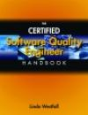
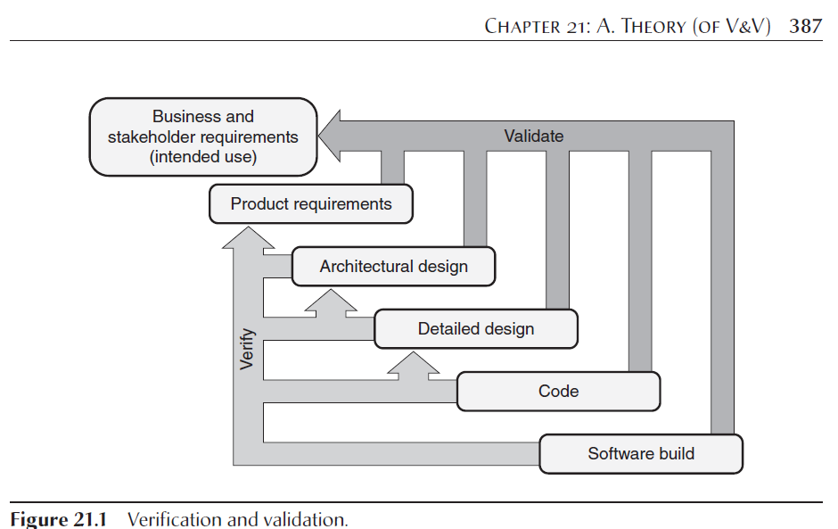
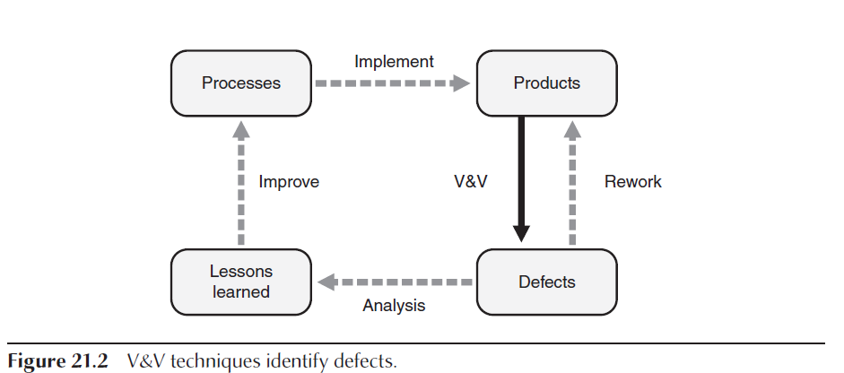
Certified Software Quality Engineer Handbook, Chapter 21: A. Theory (of V&V)
1. V&V Methods
Static Analysis
Static analysis methods perform V&V by evaluating a software work product to assess its quality and identify defects without actually executing that work product.
Analysis, reviews, and mathematical proofs are all forms of static analysis.
Dynamic Analysis
Dynamic analysis includes methods of performing V&V by evaluating a software component or product by executing it and comparing the actual results to expected results.
Testing and simulations are forms of dynamic analysis.
Product Audits
Product audits throughout the life cycle can evaluate the product against the requirements and against required standards (coding standards, naming conventions, required document formats).
What are some examples of functional static vs dynamic analysis?
What are some examples of non-functional(-ilities) static vs dynamic analysis?

Slide 10
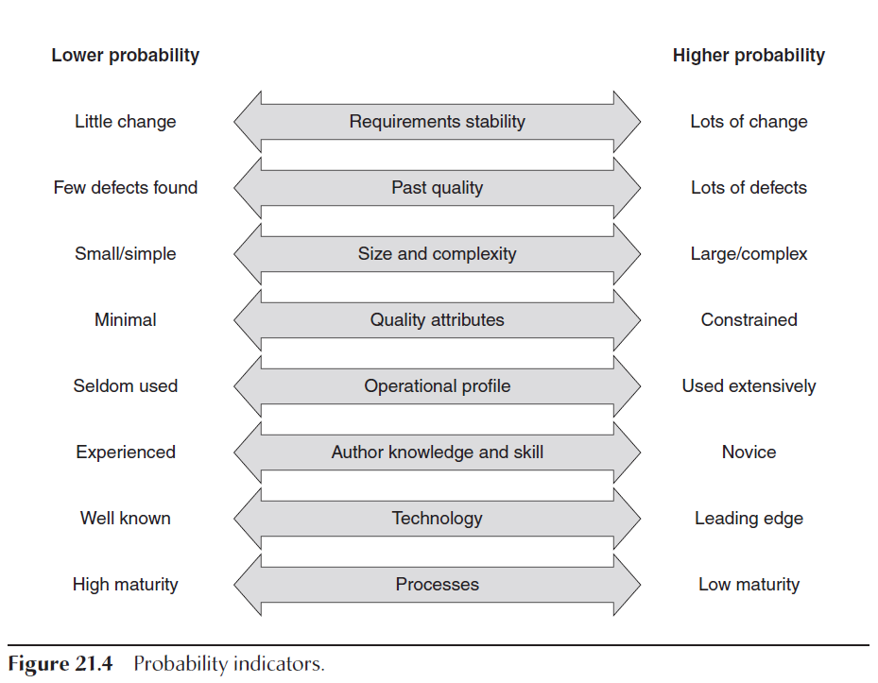
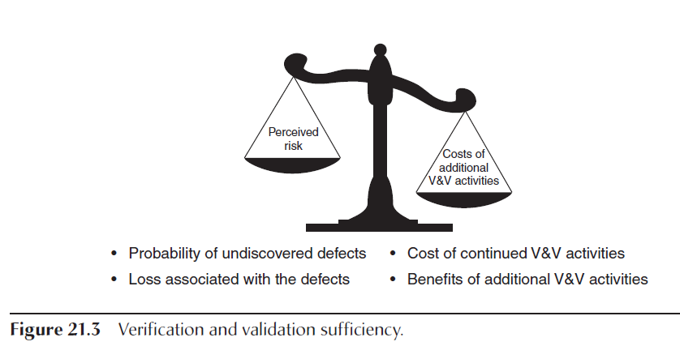
Certified Software Quality Engineer Handbook, Chapter 21: A. Theory (of V&V)
Risk

Slide 11
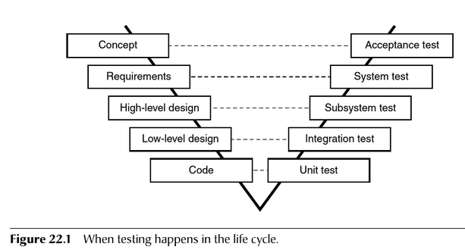
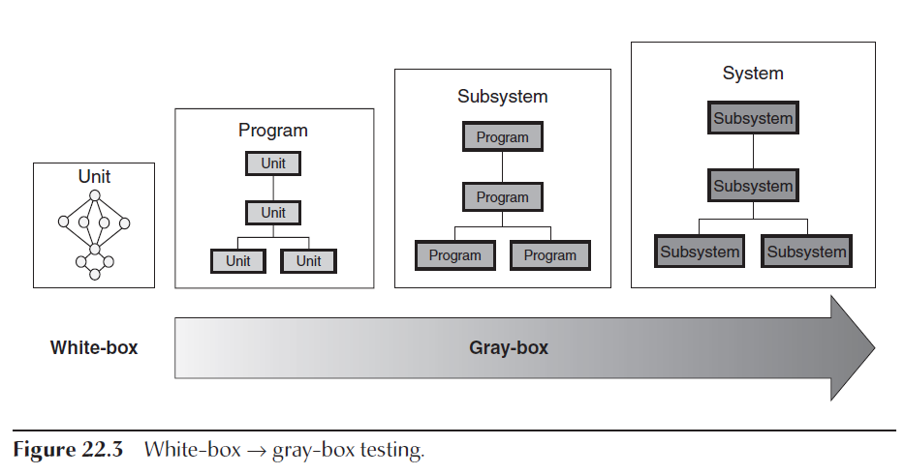
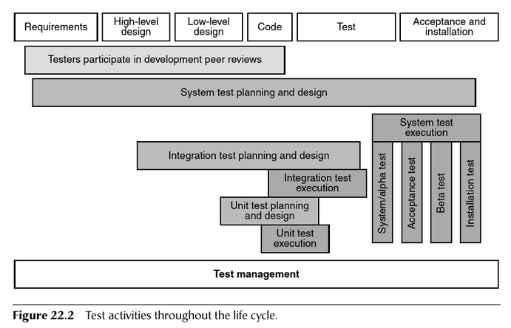
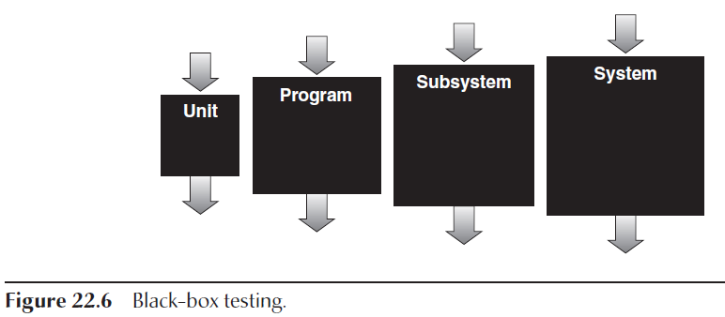
Certified Software Quality Engineer Handbook, Chapter 22: B. Test Planning and Design
White-Box Testing
White-box testing, also known as structural, clear-box, or glass-box testing, is testing that is based on the internal structure of the software and looks for issues in the framework, construction, or logic of the software.
Gray-Box Testing
When larger numbers of units or components are integrated together, it usually becomes unwieldy to perform pure white-box testing. In any complex system there are just too many possible paths through the software. … at some point testing typically progresses into various levels (shades) of graybox testing (a blending of the white-box and black-box testing strategies).
Bottom-Up vs Top-Down
Black-Box Testing
Black-box testing, also known as data-driven, input/output-driven, or functional testing, ignores the internal structure of the software and tests the behavior of the software from the perspective of the users.
TDD – Test Driven Development
Risk-Based Testing, Time-Box Testing, and Good-Enough Software
Risk-based testing focuses on identifying software items (for example, work products, product components, features, functions) with the highest risk.
time box is a fixed amount of calendar time allocated to complete a given task like testing.
Doing good-enough software analysis has to do with making conscious, logical decisions about the trade-offs between the level of quality and integrity that the stakeholders need in the software and the basic economic fact that increasing software quality and integrity typically costs more and takes longer.
Simulation
Test Automation

Slide 12
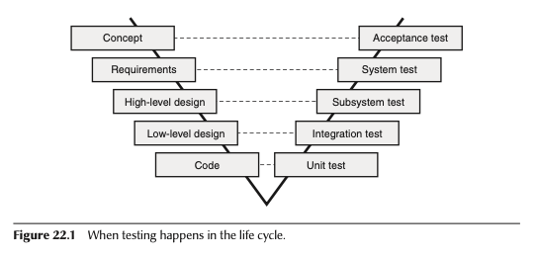
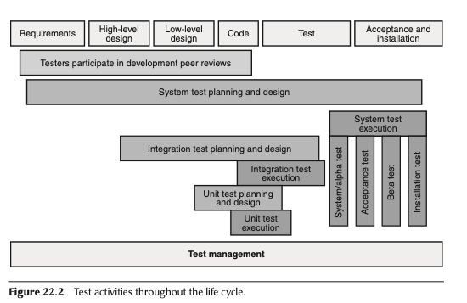
Chapter 22 B. Test Planning and Design
1. Test Strategies
White-Box Testing
Coverage, Flow, Data Integrity, Boundaries, Algorithms
Gray-Box Testing
Black-Box Testing
Test-Driven Design
Risk-Based, Time-Based, Good-Enough
Simulations
Test Automation
2. Test Plans
Item to be tested
Features
Approaches
Pass/Fail Criteria
Suspension Criteria
Resumption requirements (restart)
Test Deliverables
Testing tasks
Environmental needs
Staffing plans/training
Risk Management
3. Test Designs
Evidence Class Partitioning
Boundary Value
Fault Insertion
Fault-Error Handling
Cause-Effect Graphing
4. Software Tests
Levels of Testing
Functional Testing
Performance, Environmental Load, Volume and Stress testing
Recourse Utilization Testing
Usability Testing
Worst-Case Testing
Exploratory Testing
Regression Testing
5. Tests of Supplier Component & Product (Week
6. Test Coverage Specifications
Requirements
Functional
State
Data Domain
Data and Time Domain
Interface
Security
Platform Configuration
Internationalization Configuration
7. Code Coverage Techniques
Statement, Decision, and Condition
Domain and Boundary Testings
McCabe’s Cyclomatic Complexity & Base Path
8. Test Environments
Test Beds
Subs
Drivers
Harnesses
Test Libraries
Controlled Test Environment
9. Test Tools
Test Utilities
Test Diagnostic Tools
Test Management Tools

Slide 13
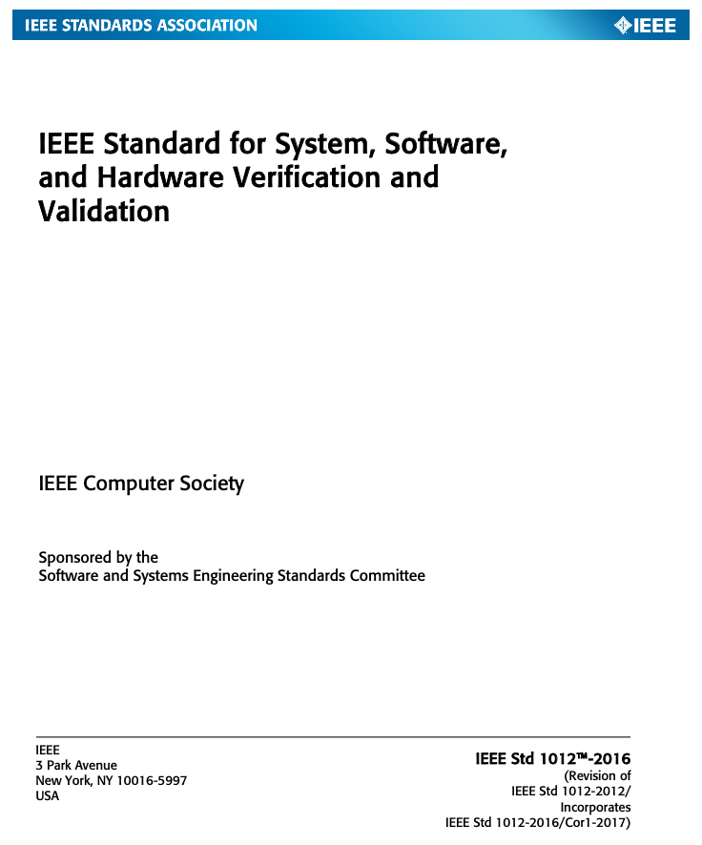
IEEE Standard for System, Software, and Hardware Verification and Validation
1. Overview
1.1 Scope
1.2 Purpose
1.3 Field of application
1.4 V&V objectives
1.5 Organization of the standard
1.6 Audience
1.7 Conformance
1.8 Disclaimer

Slide 14
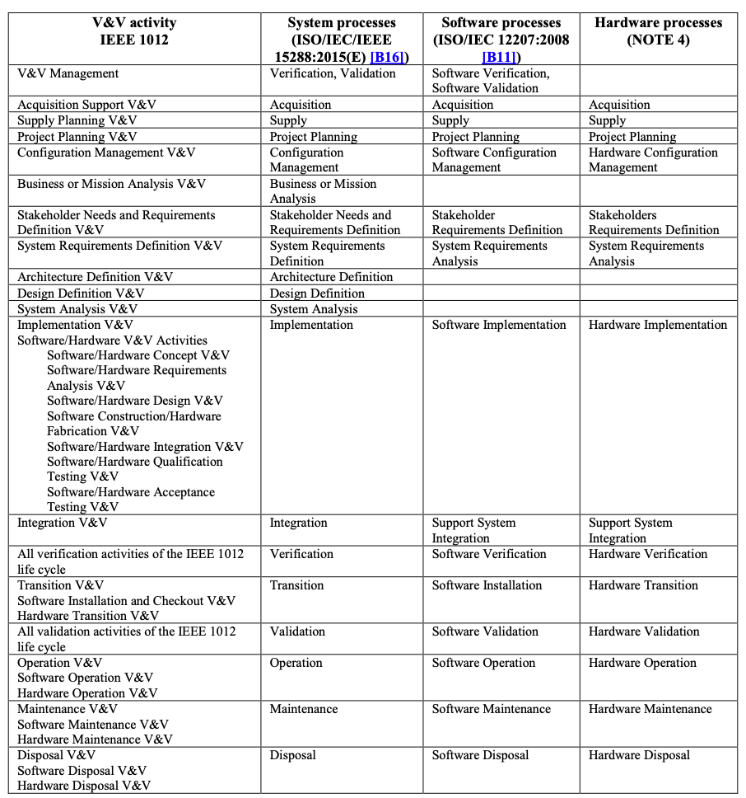
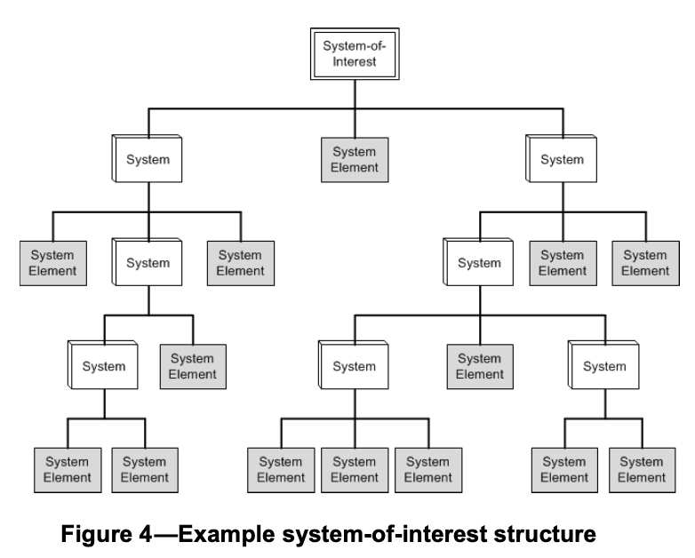
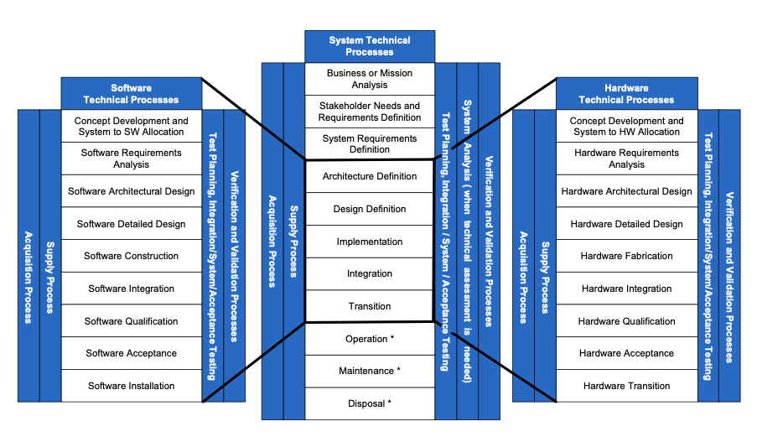
4. Relationships between verification and validation (V&V) and life cycle processes

Slide 15
5. Integrity levels
The following is a result of the integrity level determination:
a) An integrity schema is defined.
b) Integrity levels for all system entities are assigned.
c) Integrity assignments are used to determine V&V activities and tasks using Table 2a through Table 2d.
d) A basis is established to review and revalidate the integrity levels throughout the V&V effort.
Integrity level assignments shall be applied recursively to the components of each system element. Level 3 include 2 and 1

Slide 16
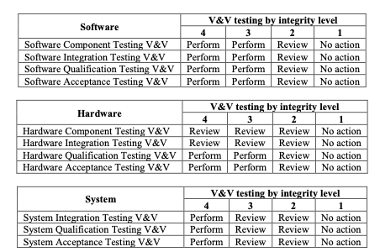
6. V&V process overview
6.1 General
6.2 V&V testing

Slide 17
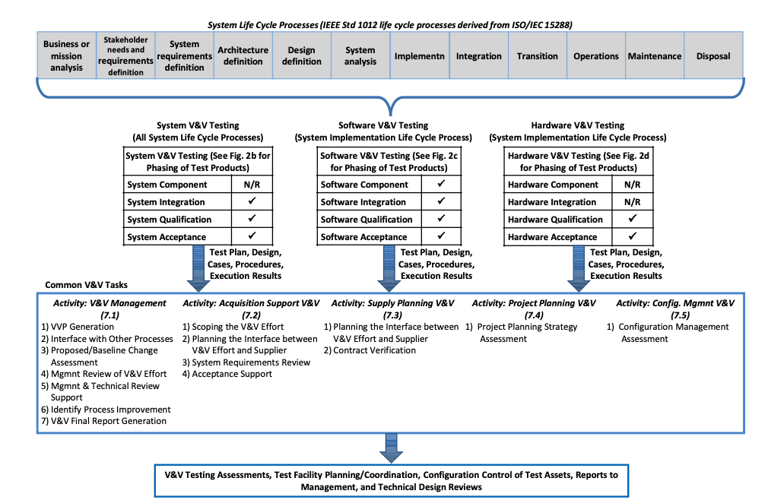
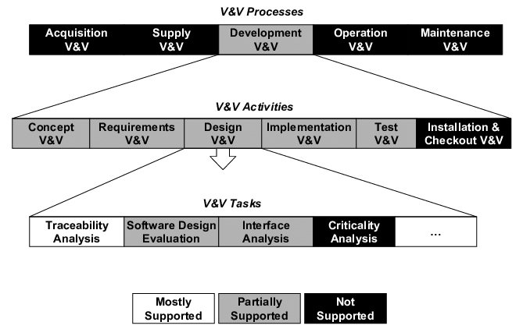
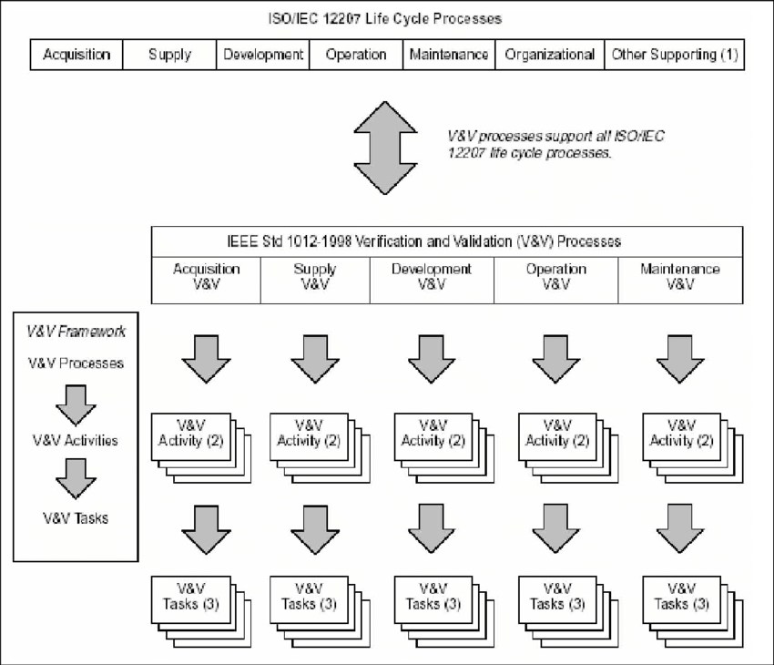
7. Common V&V processes
7.1 V&V management process
7.1.1 Purpose
7.1.2 Outcomes
7.1.3 Activities and tasks
7.2 Acquisition Support V&V process
7.2.1 Purpose
7.2.2 Outcomes
7.2.3 Activities and tasks
7.3 Supply Planning V&V process
7.3.1 Purpose
7.3.2 Outcomes
7.3.3 Activities and tasks
7.4 Project Planning V&V process
7.4.1 Purpose
7.4.2 Outcomes
7.4.3 Activities and tasks
7.5 Configuration Management V&V process
7.5.1 Purpose
7.5.2 Outcomes
7.5.3 Activities and tasks

Slide 18
Other Processes
8. System V&V processes
10. Hardware V&V processes
We are not covering due to scope of the class and time.

Slide 19
9. Software V&V processes
9. Software V&V processes
9.1 Software Concept V&V process
9.1.1 Purpose
9.1.2 Outcomes
9.1.3 Activities and tasks
9.2 Software Requirements Analysis V&V process
9.3 Software Design V&V process
9.4 Software Construction V&V process
9.5 Software Integration V&V process
9.6 Software Qualification Testing V&V process
9.7 Software Acceptance Testing V&V process
9.8 Software Verification process
9.9 Software Installation and Checkout V&V process
9.11 Software Operation V&V process
9.12 Software Maintenance V&V process
9.13 Software Disposal V&V process

Slide 20
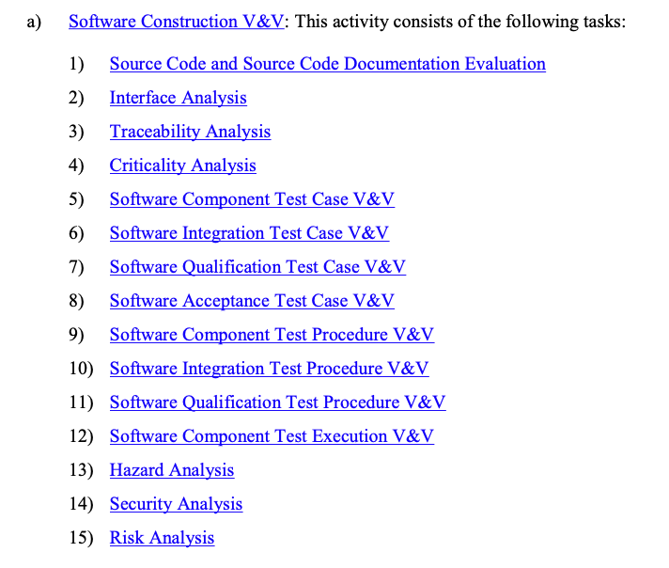
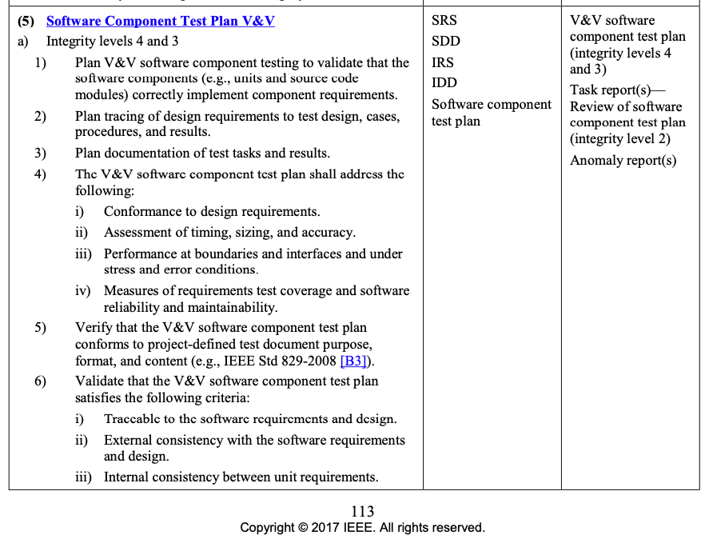
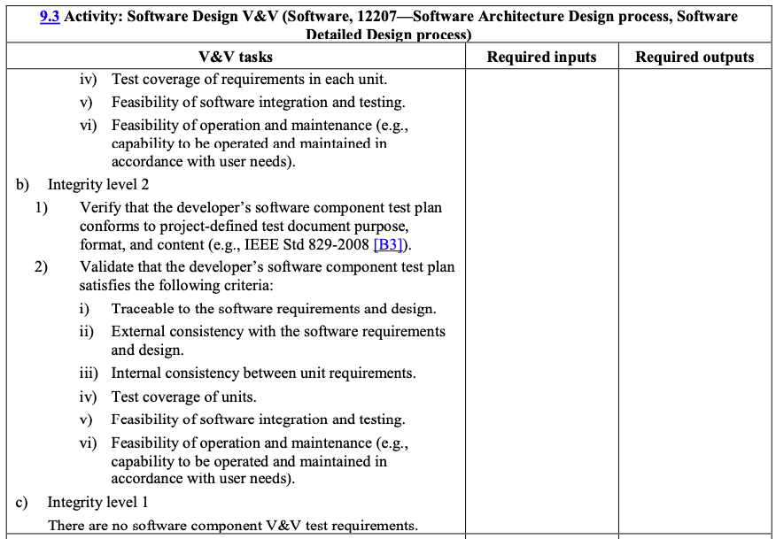
9. Software V&V processes

Slide 22
Validation: How do Non-Functional Requirements (Validation) work within the SW Lifecycle?
Find the corresponding section in table 1.c, identify the quality characteristics found in that section. The totals in row identify how many of that quality characteristic are found in the tables. Complete the following table:
Notes:
TODO: Use these QA Characteristics back in week 04

Slide 23
Verification: How does Functional Requirements (Verification) in the SW Lifecycle process?
Part 1: Make a list of all the V&V Tasking for each Process
Part 2: Understanding the workflow of the Tasking.
V&V Process | V&V Tasking
Concept | None
Requirements | Example: Software Qualification Test Plan V&V Software Acceptance Test Plan V&V
Design
Construction
Qualification
Acceptance
Install & Checkout
Validation
Maintenance
Concept
 | V&V Process Phases
V&V Processes | Plan | Design | Test Case | Procedure | Execution
Qualification
Acceptance |  |  | i.e. Construction
Integration
Component

Slide 24
Verification: How does Functional Requirements (Verification) in the SW Lifecycle process?
Part 1: Make a list of all the V&V Tasking for each Process
Part 2: Understanding the workflow of the Tasking.
V&V Process | V&V Tasking
Concept | None
Requirements | Example: Software Qualification Test Plan V&V Software Acceptance Test Plan V&V
Design
Construction
Qualification
Acceptance
Install & Checkout
Validation
Maintenance
Concept
 | V&V Process Phases
V&V Processes | Plan | Design | Test Case | Procedure | Execution
Qualification
Acceptance |  |  | i.e. Construction
Integration
Component

Slide 25
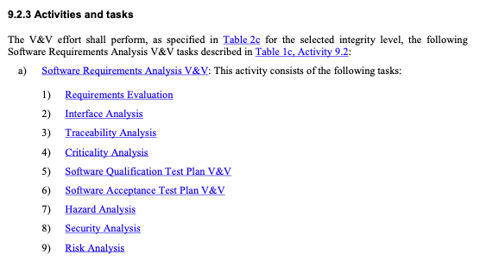
Verification: How does Functional Requirements (Verification) in the SW Lifecycle process?
Under Section 9.4 Software Construction V&V Process at each of the Software Design V&V processes (9.1 – 9.13), look at each of the Activities and Tasks that have to do with Verification Validation
9. Software V&V processes
9.1 Software Concept V&V process
9.2 Software Requirements Analysis V&V process
9.3 Software Design V&V process
9.4 Software Construction V&V process
9.5 Software Integration V&V process
9.6 Software Qualification Testing V&V process
9.7 Software Acceptance Testing V&V process
9.8 Software Verification process
9.9 Software Installation and Checkout V&V process
9.11 Software Operation V&V process
9.12 Software Maintenance V&V process
9.13 Software Disposal V&V process
Each of the V&V tasking descriptions contains a level of testing
Component
Integration
Qualification
Acceptance
And it contains a development phase: Plan, Design, Test Case, Procedure, and Execution

Slide 26
Verification: How does Functional Requirements (Verification) in the SW Lifecycle process?
Part 1: Make a list of all the V&V Tasking for each Process
V&V Process | V&V Tasking
Concept | None
Requirements | Example: Software Qualification Test Plan V&V Software Acceptance Test Plan V&V
Design
Construction
Qualification
Acceptance
Install & Checkout
Validation
Maintenance
Concept

Slide 27
Verification: How does Functional Requirements (Verification) in the SW Lifecycle process?
Part 1: Make a list of all the V&V Tasking for each Process
Part 2: Understanding the workflow of the Tasking
9. Software V&V processes
9.1 Software Concept V&V process
9.2 Software Requirements Analysis V&V process
9.3 Software Design V&V process
9.4 Software Construction V&V process
9.4.3 Activities and tasks
5) Software Component Test Case V&V
6) Software Integration Test Case V&V
7) Software Qualification Test Case V&V
8) Software Acceptance Test Case V&V
9) Software Component Test Procedure V&V
10) Software Integration Test Procedure V&V
11) Software Qualification Test Procedure V&V
12) Software Component Test Execution V&V
9.5 Software Integration V&V process
9.6 Software Qualification Testing V&V process
9.7 Software Acceptance Testing V&V process
9.8 Software Verification process
9.9 Software Installation and Checkout V&V process
9.11 Software Operation V&V process
9.12 Software Maintenance V&V process
9.13 Software Disposal V&V process
Using the provided table, identify which lifecycle phase (Requirements, Design, Construction, Integration, Qualification, Acceptance) each V&V Process's phase (Plan, Design, Test Case, Procedure, Execution) is implemented.
 | V&V Process Phases
V&V Processes | Plan | Design | Test Case | Procedure | Execution
Qualification
Acceptance |  |  | i.e. Construction
Integration
Component
Which V&V Phases did not have any V&V Tasking?
Identify the difference between each of the V&V Processes (Qualification, Acceptance, Component, Integration). Why is each important?

Slide 28
Prove: Complete SQAP Section 7: Tests
Part 1. Overview of Section 7.
Provide an overview of this section using Chapter 22 section 1 Strategies. Provide a brief summary of each strategy.
Part 2: Testing planning Section 7.1
Provide a summary of Chapter 22 section 2 Test Plans.
Cross reference with the different IEEE Std 1012-2016 Software Design V&V process’s Software Component Test Plan V&V (page 113-114)
Part 3. Testing design Section 7.2
Provide a summary of Chapter 22 section 3 Test Design.
Cross reference with the different IEEE Std 1012-2016 Software Design V&V process’s Software Component Design V&V (page 115)
Part 4. Test Cases Section 7.3
Provide a summary of Chapter 22 section 4 Software Tests.
Cross reference with the different IEEE Std 1012-2016 Software Construction V&V process’s Software Component Test Case V&V (page 119-120)
Part 5. Procedures Section 7.4
Provide a summary of Chapter 22 section 6 & 7 Test Coverage.
Cross reference with the different IEEE Std 1012-2016 Software Construction V&V process’s Software Component Procedures V&V (page 121)
Part 6. Execution Section 7.5
Provide a summary of Chapter 22 section 8 & 9 Code Coverage Technology.
Cross reference with the different IEEE Std 1012-2016 Software Construction V&V process’s Software Component Execution V&V (page 122)

Slide 29
Prove: Complete SQAP Section 7: Tests
 | V&V Process Phases
V&V Processes | Plan | Design | Test Case | Procedure | Execution
Qualification
Acceptance |  |  | i.e. Construction
Integration
Component
Use Process to Determine the Sections and preliminary content
Component Test Plan V&V
Component Test Design V&V
Component Test Case V&V
Component Test Procedures V&V
Component Execution V&V
7 Tests
Description
7.1 Test Planning
7.2 Test Design
7.3 Test Cases
7.4 Test Procedures
7.5 Test Execution
Add more content with SQ Eng Chapter 22
1. Test Strategies
2. Test Plans
3. Test Designs
4. Software Tests
5. Tests of Supplier Component & Product (Week
6. Test Coverage Specifications
7. Code Coverage Techniques
8. Test Environments
9. Test Tools

Slide 30
Prove: Complete SQAP Section 7: Tests
IEEE Std 730-2002
Not much available for the section
4.7 Test (section 7 of the SQAP)
This section shall identify all the tests not included in the software verification and validation plan for the software covered by the SQAP and shall state the methods to be used. If a separate test plan exists it shall be referenced.
Part 1. Overview of Section 7
Provide an overview of this section using Chapter 22 section 1 Strategies. Provide a brief summary of each strategy.

Slide 31
Chapter 22 B. Test Planning and Design
1. Test Strategies
White-Box Testing
Coverage, Flow, Data Integrity, Boundaries, Algorithms
Gray-Box Testing
Black-Box Testing
Test-Driven Design
Risk-Based, Time-Based, Good-Enough
Simulations
Test Automation
2. Test Plans
Item to be tested
Features
Approaches
Pass/Fail Criteria
Suspension Criteria
Resumption requirements (restart)
Test Deliverables
Testing tasks
Environmental needs
Staffing plans/training
Risk Management
3. Test Designs
Evidence Class Partitioning
Boundary Value
Fault Insertion
Fault-Error Handling
Cause-Effect Graphing
4. Software Tests
Levels of Testing
Functional Testing
Performance, Environmental Load, Volume and Stress testing
Recourse Utilization Testing
Usability Testing
Worst-Case Testing
Exploratory Testing
Regression Testing
5. Tests of Supplier Component & Product (Week
6. Test Coverage Specifications
Requirements
Functional
State
Data Domain
Data and Time Domain
Interface
Security
Platform Configuration
Internationalization Configuration
7. Code Coverage Techniques
Statement, Decision, and Condition
Domain and Boundary Testings
McCabe’s Cyclomatic Complexity & Base Path
8. Test Environments
Test Beds
Subs
Drivers
Harnesses
Test Libraries
Controlled Test Environment
9. Test Tools
Test Utilities
Test Diagnostic Tools
Test Management Tools

Slide 32
Prove: Complete SQAP Section 7: Tests
Part 2: Testing planning Section 7.1
Provide a summary of Chapter 22 section 2 Test Plans.
Cross reference with the different IEEE Std 1012-2016 Software Design V&V process’s Software Component Test Plan V&V (page 113-114)
Chapter 22 B. Test Planning and Design
2. Test Plans
Item to be tested
Features
Approaches
Pass/Fail Criteria
Suspension Criteria
Resumption requirements (restart)
Test Deliverables
Testing tasks
Environmental needs
Staffing plans/training
Risk Management
 | V&V Process Phases
V&V Processes | Plan | Design | Test Case | Procedure | Execution
Qualification
Acceptance |  |  | i.e. Construction
Integration
Component | Design

Slide 33
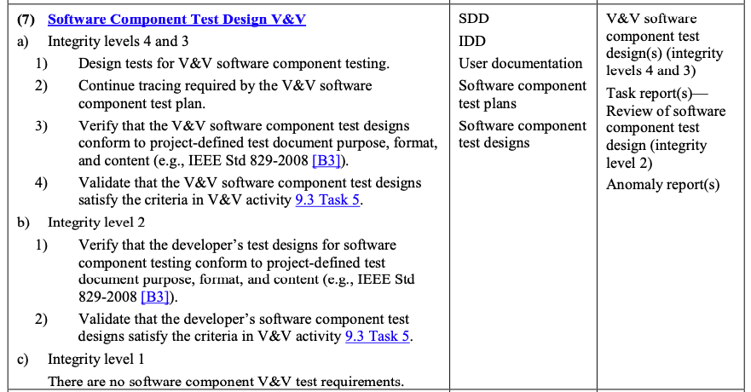
Prove: Complete SQAP Section 7: Tests
Part 3. Testing design Section 7.2
Provide a summary of Chapter 22 section 3 Test Design.
Cross reference with the different IEEE Std 1012-2016 Software Design V&V process’s Software Component Test Design V&V (page 115)
Chapter 22 B. Test Planning and Design
3. Test Designs
Evidence Class Partitioning
Boundary Value
Fault Insertion
Fault-Error Handling
Cause-Effect Graphing
 | V&V Process Phases
V&V Processes | Plan | Design | Test Case | Procedure | Execution
Qualification
Acceptance |  |  | i.e. Construction
Integration
Component | Design | Design

Slide 34
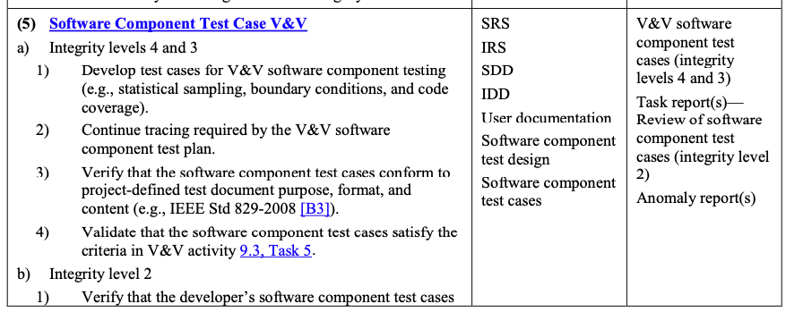
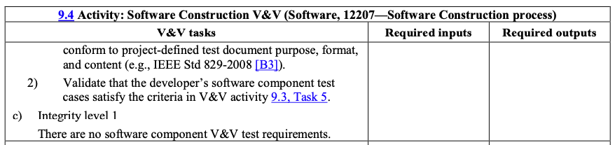
Prove: Complete SQAP Section 7: Tests
Part 4. Test Cases
Provide a summary of Chapter 22 section 4 Software Tests.
Cross reference with the different IEEE Std 1012-2016 Software Construction V&V process’s Software Component Test Case V&V (page 119-120)
Chapter 22 B. Test Planning and Design
4. Software Tests
Levels of Testing
Functional Testing
Performance, Environmental Load, Volume and Stress testing
Recourse Utilization Testing
Usability Testing
Worst-Case Testing
Exploratory Testing
Regression Testing
 | V&V Process Phases
V&V Processes | Plan | Design | Test Case | Procedure | Execution
Qualification
Acceptance |  |  | i.e. Construction
Integration
Component | Design | Design | Construction

Slide 35
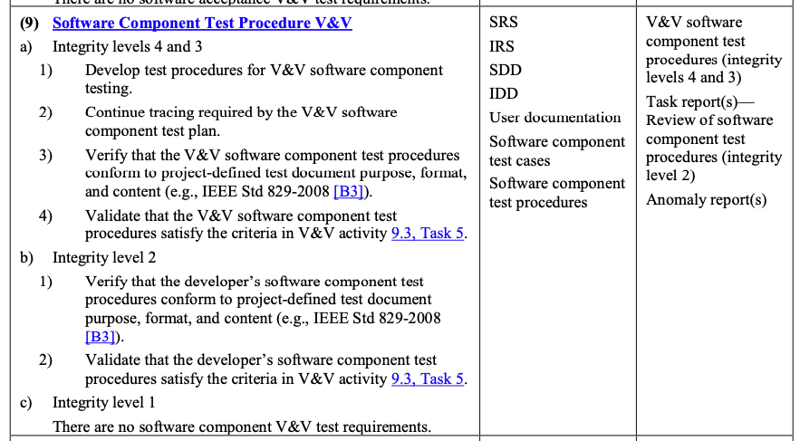
Prove: Complete SQAP Section 7: Tests
Part 5. Procedures
Provide a summary of Chapter 22 section 6 & 7 Test Coverage.
Cross reference with the different IEEE Std 1012-2016 Software Construction V&V process’s Software Component Test Procedures V&V (page 121)
Chapter 22 B. Test Planning and Design
6. Test Coverage Specifications
Requirements
Functional
State
Data Domain
Data and Time Domain
Interface
Security
Platform Configuration
Internationalization Configuration
7. Code Coverage Techniques
Statement, Decision, and Condition
Domain and Boundary Testings
McCabe’s Cyclomatic Complexity & Base Path
 | V&V Process Phases
V&V Processes | Plan | Design | Test Case | Procedure | Execution
Qualification
Acceptance |  |  | i.e. Construction
Integration
Component | Design | Design | Construction | Construction

Slide 36
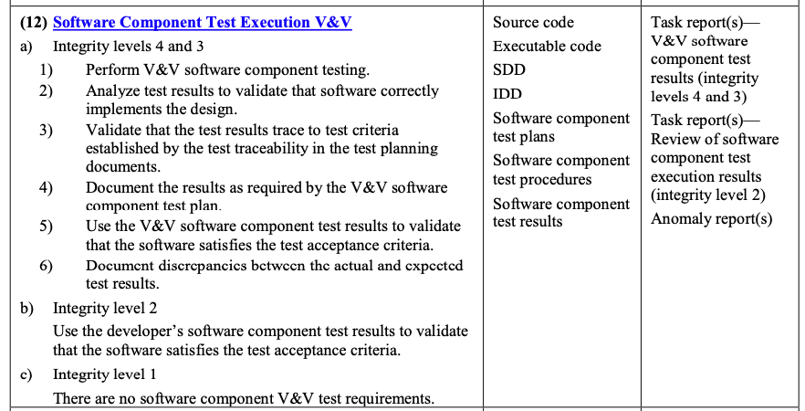
Prove: Complete SQAP Section 7: Tests
Part 6. Execution
Provide a summary of Chapter 22 section 8 & 9 Code Coverage Technology.
Cross reference with the different IEEE Std 1012-2016 Software Construction V&V process’s Software Component Execution V&V (page 122
Chapter 22 B. Test Planning and Design
8. Test Environments
Test Beds
Subs
Drivers
Harnesses
Test Libraries
Controlled Test Environment
9. Test Tools
Test Utilities
Test Diagnostic Tools
Test Management Tools
 | V&V Process Phases
V&V Processes | Plan | Design | Test Case | Procedure | Execution
Qualification
Acceptance |  |  | i.e. Construction
Integration
Component | Design | Design | Construction | Construction | Construction

