Slide 1
CSE 474 QA-Tests Reviews and Audits
Brother W. Clements

Slide 2
5. QA Processes
(V&V, Reviews, Audits)
8. Reviews & Audits
(Tech, Mngt., Inspection, walk-throughs, checklist)
10. Configuration Management
1. Fundamentals & Business Case for Quality Assurance
(IEEE SWBok)
9. Maturity
(CMM, Process, Product, ISO)
11. Risk/Mission Assurance
(Training, CAR, Mitigation)
6. QA Tools
(Fishbone, check, Histograms, Pareto, Scatter, Stratification)]
12. Security/ Legal/ Ethics
(Regulations, Code, Legal, Safety)
2. QA’s Role in SW Lifecycle, Methodologies,
Architecture
[Responsibilities & Roles]
7. QA Attributes
(Verification and Validation )
13 . Project Management
(CoQ, WBS, DevOps )
[VDD, Version, DM, DI]
14. Careers Path
3. QA Techniques
(Dyn, Static, and Testing)
[]
4. Quality Metrics
(Characteristic & Models)
[Measuring]
Know
Do
Become
SWE 474: Quality Assurance Class

Slide 3
Reading
"IEEE Standard Software Reviews and Audits," in IEEE Std 1028-1988 , vol., no., pp.1-36, 30 June 1989, doi: 10.1109/IEEESTD.1989.81607. (page 38)
https://ieeexplore-ieee-org.byui.idm.oclc.org/document/29123
L. Westfall Certified Software Quality Engineer Handbook, ASQ Quality Press, 2009-09-01, https://ebookcentral.proquest.com/lib/byui/detail.action?docID=3002591
Chapter 8: Audits (pages 20)
Chapter 23: Reviews and Inspections (pages 22)
Chapter 16: B. Tracking and Controlling – Section 3 & 4 (pages 24)
A. Aurum et al., "State-of-the-art: Software inspections after 25 years," Software Testing, Verification and Reliability, vol. 12, no. 3, pp. 133-154, Feb. 2002, (pages 22)

Slide 4
This weeks tasking
Teach: What should be in a V&V QA Checklist?
Teach: How do I conduct a Review or Audit?
Prove: Complete SQAP Section 6

Slide 5
What should be in a V&V QA Checklist?
Software construction V&V (pg 119)
Software Component Test Case V&V
Software Integration Test Case V&V
Software Qualification Test Case V&V
Software Acceptance Test Case V&V
Software Component Test Procedure V&V
Software Integration Test Procedure V&V
Software Qualification Test Procedure V&V
Software Component Test Execution V&V
Software integration Test V&V (pg 123)
Software Integration Test Execution V&V
Software qualification Test V&V (pg 124)
Software Qualification Test Execution V&V
Software Acceptance Test V&V (pg 125)
Software Acceptance Test Procedure V&V
Software Acceptance Test Execution V&V
Create a checklist for each of the lifecycle phase’s V&V Process, by looking at the task found in the V&V Process tables.
Each check list should contain:
A brief description of its purpose
When the checklist will be used, i.e. the lifecycle phase.
At least 5 items in the checklist, and should cover every element found at Integrity Level 3 & 4.
Software Requirements V&V (pg 109)
Software Qualification Test Plan V&V
Software Acceptance Test Plan V&V
Software design V&V (pg 114)
Software Component Test Plan V&V
Software Integration Test Plan V&V
Software Component Test Design V&V
Software Integration Test Design V&V
Software Qualification Test Design V&V
Software Acceptance Test Design V&V

Slide 6
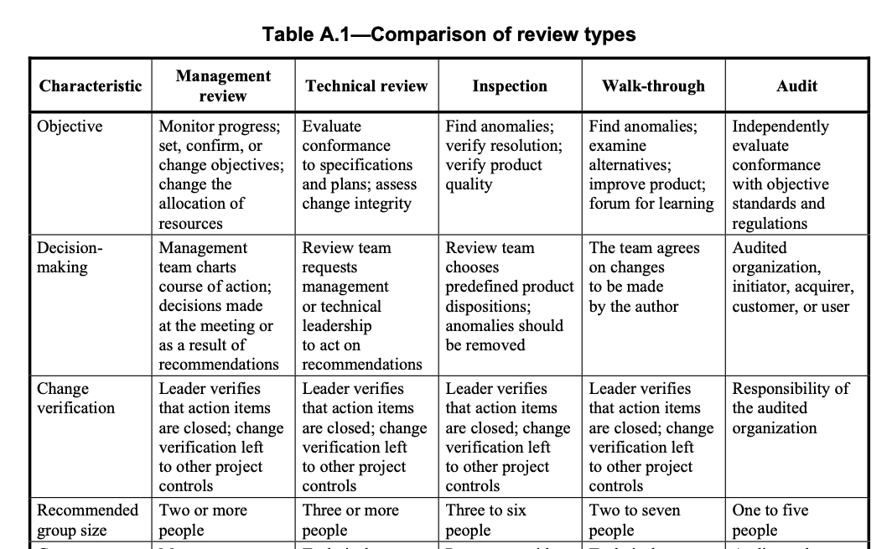
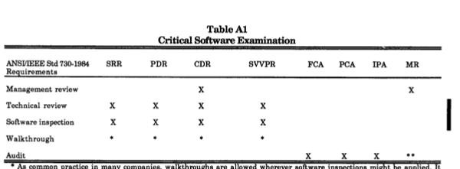
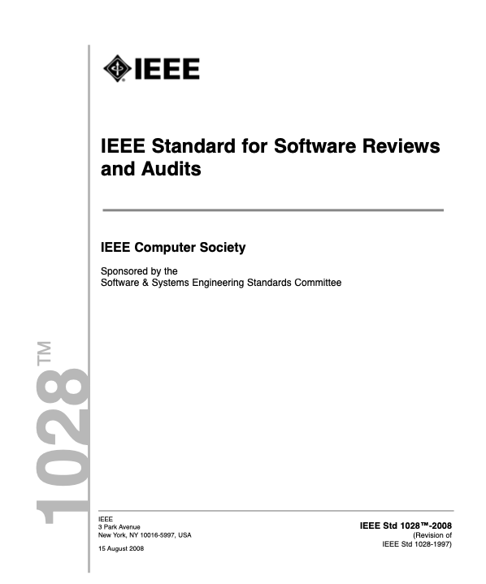
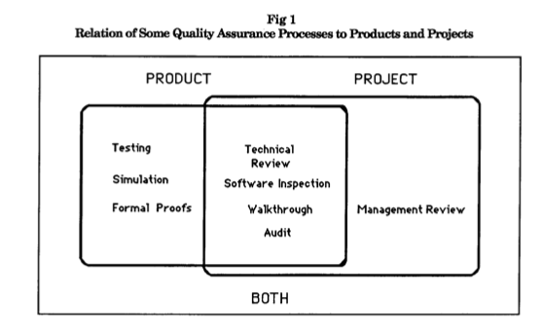
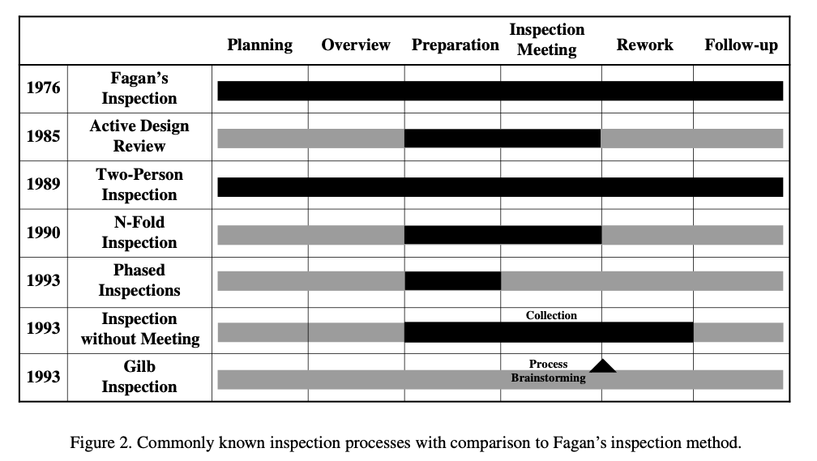
How do I conduct a Review or Audit?
Overview
In this assignment you are going to compare the reading on the different types of reviews, inspections, and audits.
Part 1: Comparing Inspections and Reviews
Compare the
“State-of-the-art: software inspection after 25 years” and the
IEEE 1028-2008 Standard for Software Reviews and Audits (Management, Technical, Inspections, and Walkthroughs, Audits).
Start with the list of “State-of-the-art” Figure 2, as listed, determine which review or audit would best fit the inspection process. Provide your reasoning.
State-of-the-art Inspection Processes | IEEE 1028-2008 Std SW Reviews & Audits | Reason for choice
Fagan's Inspection
Active Design Review
Two-Person Inspection
N-Fold Inspection
Phased Inspection
Inspection w/o Meeting
Gilb Inspection
Management reviews
Technical reviews
Inspections
Walk-throughs
Audits

Slide 7
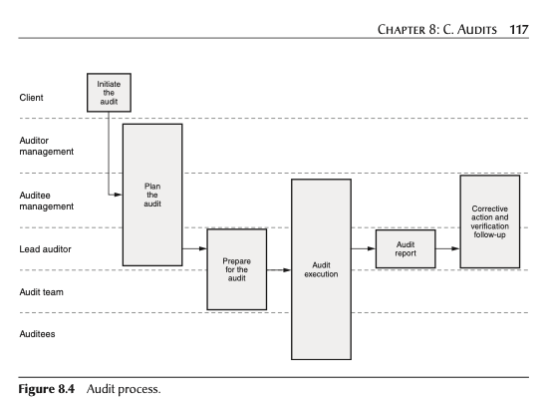
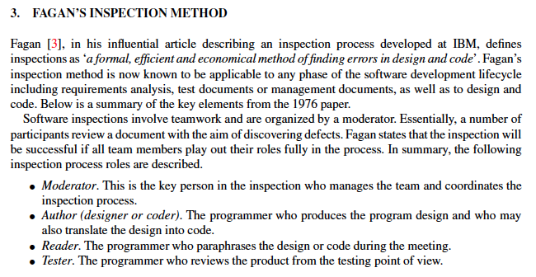
How do I conduct a Review or Audit?
Part 2: Creating Review and Audit process Create a diagram like Figure 8.4, from Certified Software Quality Engineer Handbook for each of the following each of the IEEE 1028-2008 Std SW Reviews & Audits review types.
Management reviews
Technical reviews
Inspections
Walk-throughs
Audits
Steps
Step 1: Identify the roles. Using Figure 8.4 as an example, put the roles in the left column.
Step 2: Identify the process. Reading the IEEE document, id the process and what roles are covered. You may have to re-arrange the roles so they are cluster similar to what is in Figure 8.4.
Step 3: Update the process or roles from “Software Inspection after 25 Years” reading.
State-of-the-art Inspection Processes | IEEE 1028-2008 Std SW Reviews & Audits | Reason for choice
Fagan's Inspection
Active Design Review
Two-Person Inspection
N-Fold Inspection
Phased Inspection
Inspection w/o Meeting
Gilb Inspection
Management reviews
Technical reviews
Inspections
Walk-throughs
Audits

Slide 8
Complete SQAP Section 6
Complete the Section 6 of the QA Plan. Section 6 will contain 4 sections.
6.1 Purpose
Complete in Week 05
6.2 Required Reviews
6.2.1 Software specifications review (SSR)
This section will contain a list of reviews associated with Software Requirements V&V.
6.2.3 Detailed design review (DDR)
This section will contain a list of reviews associated with Software Design V&V
6.2.4 Verification and validation plan review
This section will contain a list of reviews associated with Software Construction
6.2.10 Post-implementation reviews
This section will contain a list of reviews associated Integration and Acceptance V&V
Each sub-section will contain a brief description of the purpose of the sub-section based on what is found in the IEEE 730-2002 Standards for Software Quality Assurance Plans. Each item in the list will have a 1-2 sentence summary of the purpose of the review.
Make sure you include all the reviews from the readings.
Next week we will be adding to this section for audits.
4.6.2.5 Functional audit
4.6.2.6 Physical audit
4.6.2.7 In-process audits
4.6.2.8 Managerial reviews
4.6.2.9 Software configuration management plan review (SCMPR)

Slide 10
IEEE Standard for Software Reviews and Audits
Pages 1-12: Dead Poet Society
Page 13
This standard provides minimum acceptable requirements for systematic software reviews, where “systematic” includes the following attributes:
⎯ Team participation
⎯ Documented results of the review
⎯ Documented procedures for conducting the review
Reviews that do not meet the requirements of this standard are considered to be non-systematic reviews. The standard is not intended to discourage or prohibit the use of non-systematic reviews.
The definitions, requirements, and procedures for the following five types of reviews are included within this standard:
a) Management reviews
b) Technical reviews
c) Inspections
d) Walk-throughs
e) Audits

Slide 11
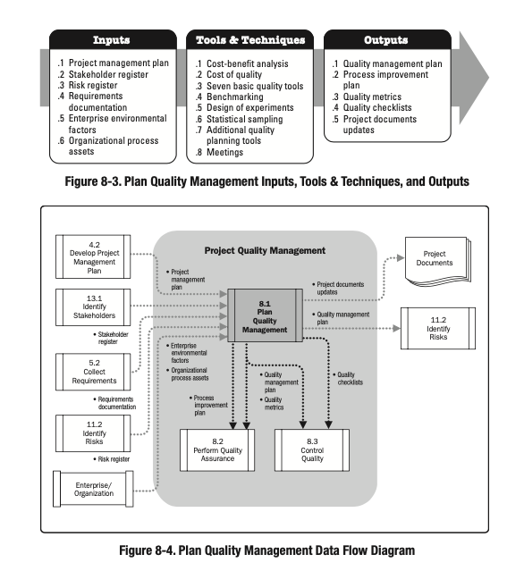
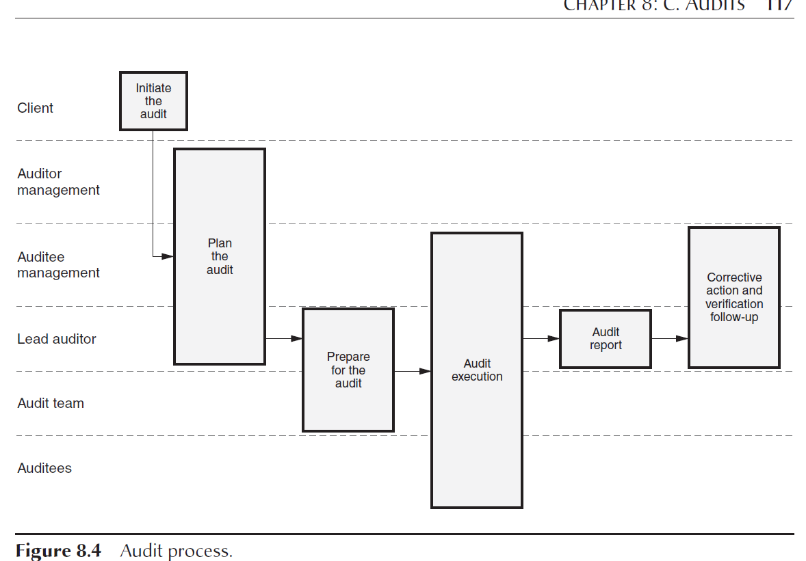
IEEE Standard for Software Reviews and Audits
⎯ Anomaly reports
⎯ Audit reports
⎯ Backup and recovery plans
⎯ Build procedures
⎯ Contingency plans
⎯ Contracts
⎯ Customer or user representative complaints
⎯ Disaster plans
⎯ Hardware performance plans
⎯ Inspection reports
⎯ Installation plans
⎯ Installation procedures
⎯ Maintenance manuals
⎯ Maintenance plans
⎯ Management review reports
⎯ Operations and user manuals
⎯ Procurement and contracting methods
⎯ Progress reports
⎯ Release notes
⎯ Reports and data (for example, review, audit, project status, anomaly reports, test data)
⎯ Request for proposal
⎯ Risk management plans
⎯ Software quality assurance plans (see IEEE Std 730TM-2002 [B2])
⎯ Software configuration management plans (see IEEE Std 828TM-2005 [B3])
⎯ Software test documentation (see IEEE Std 829TM-2008 [B4])
⎯ Software requirements specifications (see IEEE Std 830TM-1998 [B5])
⎯ Software verification and validation plans (see IEEE Std 1012TM-2004 [B6])
⎯ Software design descriptions (see IEEE Std 1016TM-1998 [B7])
⎯ Software project management plans (see IEEE Std 1058TM-1998 [B9])
⎯ Software user documentation (see IEEE Std 1063TM-2001 [B10])
⎯ Software safety plans (see IEEE Std 1228TM-1994 [B13])
⎯ Software architectural descriptions (see IEEE Std 1471TM-2000 [B14])
⎯ Source code
⎯ Specifications
⎯ Standards, regulations, guidelines, and procedures
⎯ System build procedures
⎯ Technical review reports
⎯ Vendor documents
⎯ Walk-through reports
Organization
Introduction
Responsibilities
Input
Entry Criteria
Procedure
Exit Criteria
Output
Seen this pattern before
In the PM BoK
and how in IEEE and
SQAP Cert Handbook
Software Products (inputs)

Slide 12
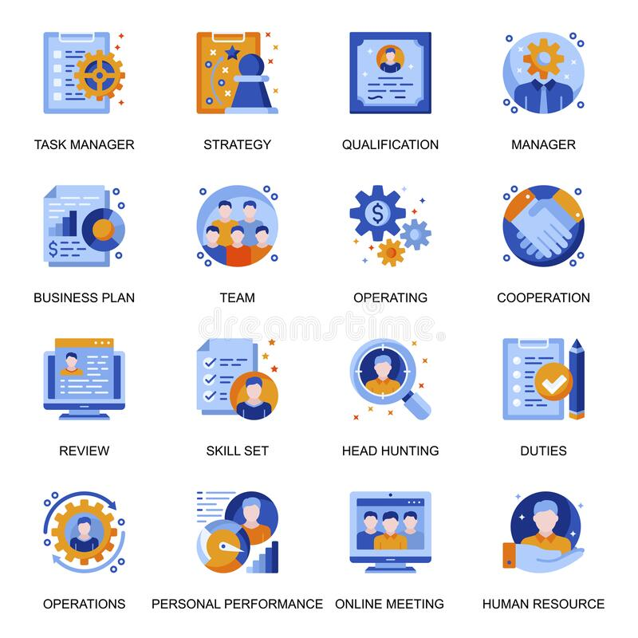


















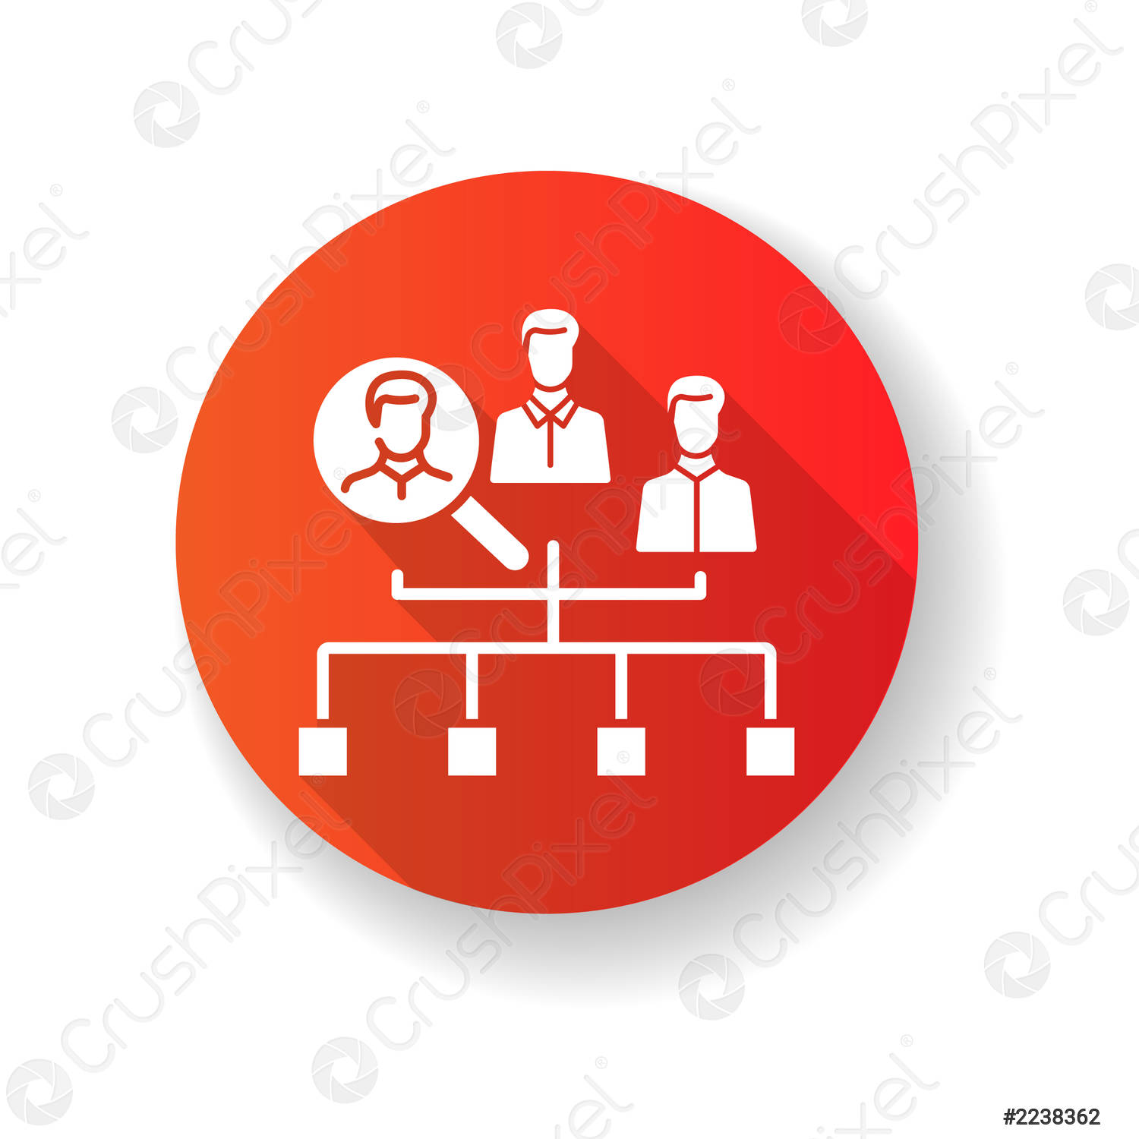





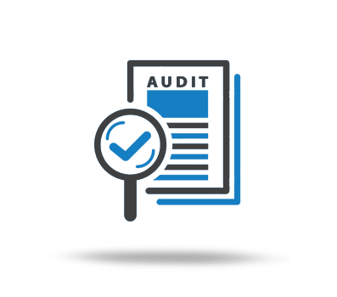


Review Leader
Recorder
Management
Technical Staff
Decision Maker
Reader
Customer Rep
User Rep
technical reviewer
Other Team
Author
Reader
Auditor
Audited organization
Notes:
https://thumbs.dreamstime.com/b/management-icons-set-flat-style-headhunting-qualification-online-meeting-team-cooperation-personal-performance-signs-task-186808977.jpg

Slide 13
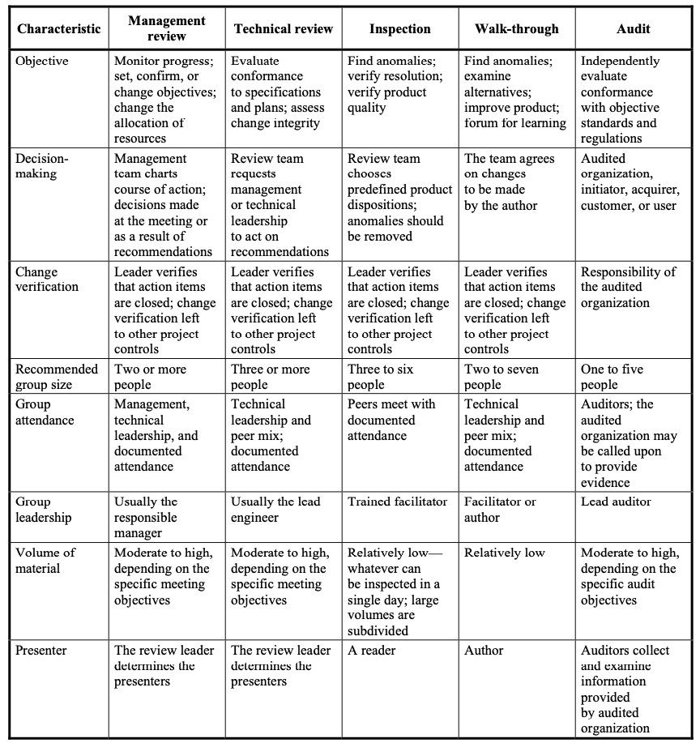

Slide 14
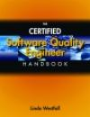
Chapter 3: Audits
“a systematic, independent and documented process for obtaining audit evidence and evaluating it objectively to determine the extent to which the audit criteria are fulfilled.” - ASQ Audit Division (Russell 2005)
“an independent examination of a software product, software process, or set of software processes performed by a third party to assess compliance with specifications, standards, contractual agreements, or other criteria.” - IEEE (2008a)
ISO (2008), internal audits are a required part of a quality management system.
The Software Engineering Institute’s Capability Maturity Model Integration (CMMI) for Development includes formal audits as one of the ways to perform objective evaluations in the Process and Product Assurance process area.
Software audits are planned activities—there are no surprise software audits. Software audits use a set of agreed-to criteria to conduct these evaluations.

Slide 15
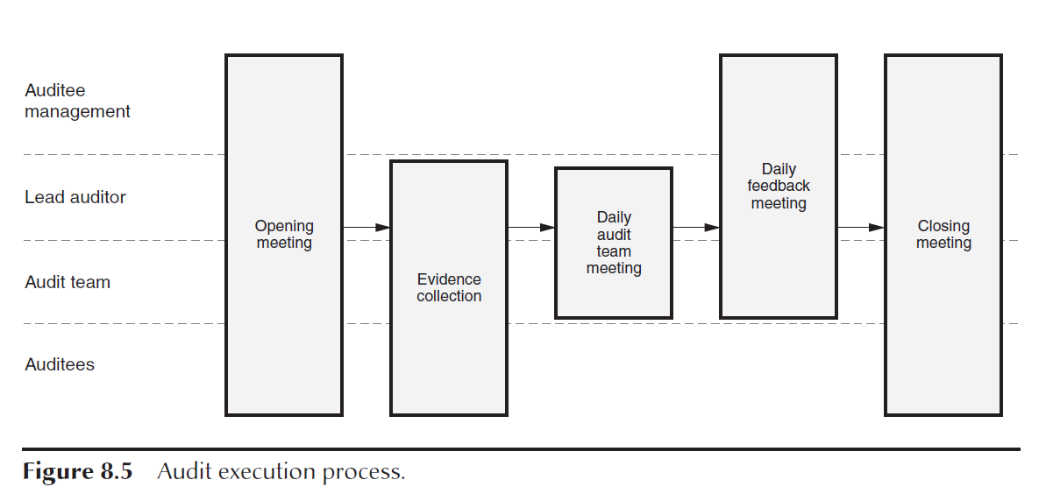
Chapter 8: Audits
Objectives:
Adequate and Meets organization’s standards, processes, policies
Work activities Comply to Organization
Effective and being meet
Resource are efficiently and effectively utilized
Product Conforms to requirements and standards
Types:
Internal (1st party)
External (2nd party – supplier)
External (3rd party – gov regulator)
System Audits
Process Audits
Product Audits
Project Audits
Follow-up Audits
Desk Audits
Roles and responsibilities
Client (initiator, customer, owner)
Auditor Management
Lead Auditor
Auditors
Auditee Management
Auditee
Escort
Process
“The job of the auditors is to collect factual information, analyze and evaluate it in terms of the specified requirements, draw conclusions from this comparison, and report results to management” (Arter 1994).
Examining quality records
Reviewing documents
Witnessing an event or process
Finding patterns
Interviewing auditees.
Examining physical properties
Tracing
Audit Reporting
Audit Corrective Action and Follow-Up
• The audit plan
• Opening and closing meeting minutes, including attendance lists
• Completed working papers such as checklists and auditor notes
• The audit report
• Corrective action, follow-up, and closeout documentation for each nonconformance

Slide 16
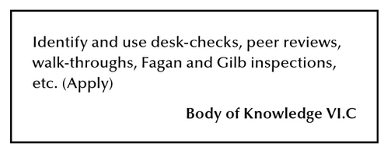
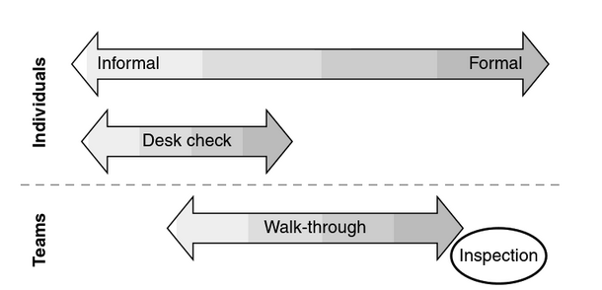
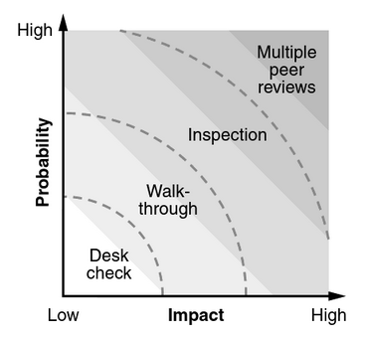
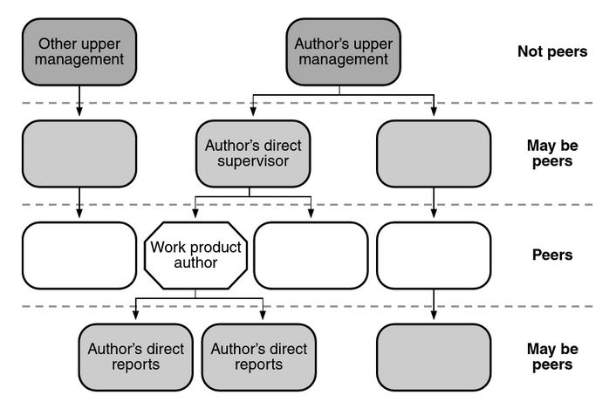
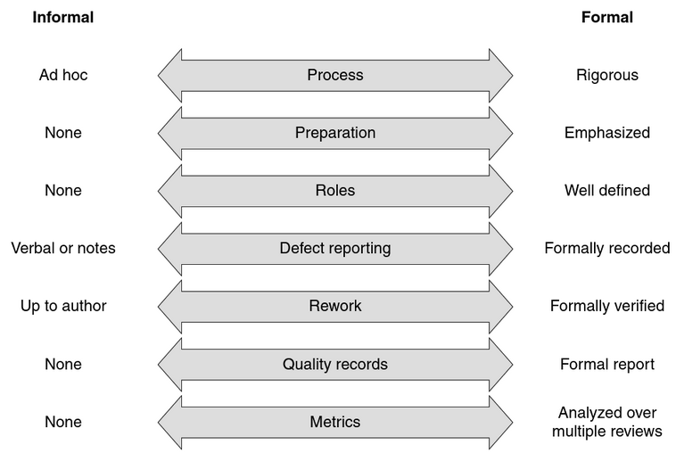
Certified Software Quality Engineer Handbook Chapter 23: Reviews and Inspections
Peer Reviews
Types: Desk Checks, Walk-throughs, Inspections
What: Every work product
Why: 50%-70% defect removal, 3.5 hours vs 15-25 hours during tests
Who:
Notes:
https://ebookcentral.proquest.com/lib/byui/reader.action?docID=3002591&query=Software+Quality+#

Slide 17
Certified Software Quality Engineer Handbook Chapter 23: Reviews and Inspections
Desk Checks
process where one or more peers of a work product’s author review that work product individually.
Mental execution
Mental walk through the code, imaging that you are the compiler or OS
Test Case Review
Run through test cases
Paper and Pen
Track variables and steps on paper of code execution
{
bool done = false;
int number = 1;
while (!done)
{
cout << number << endl;
number *= 2;
//<----|-----o---->
// 4 number
if (number > 4)
done = true;
}
}
Notes:
Westfall, Linda. Certified Software Quality Engineer Handbook, ASQ Quality Press, 2009. ProQuest Ebook Central, http://ebookcentral.proquest.com/lib/byui/detail.action?docID=3002591. Created from byui on 2021-06-17 20:53:02.

Slide 18
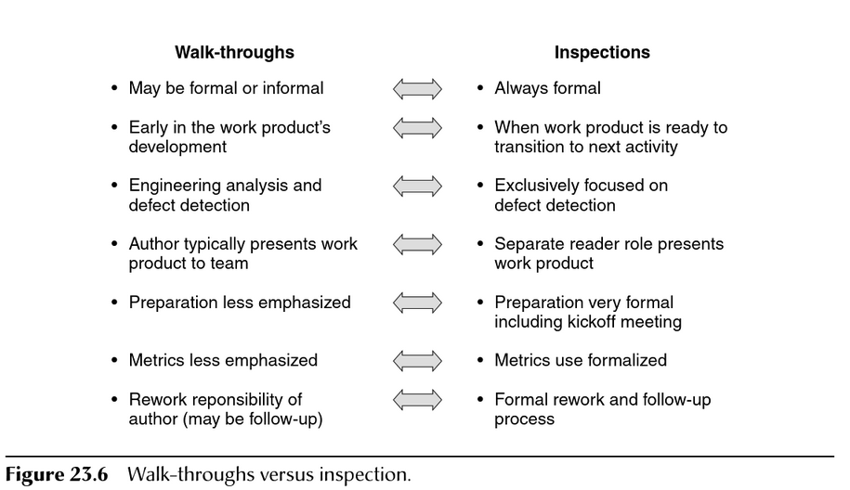
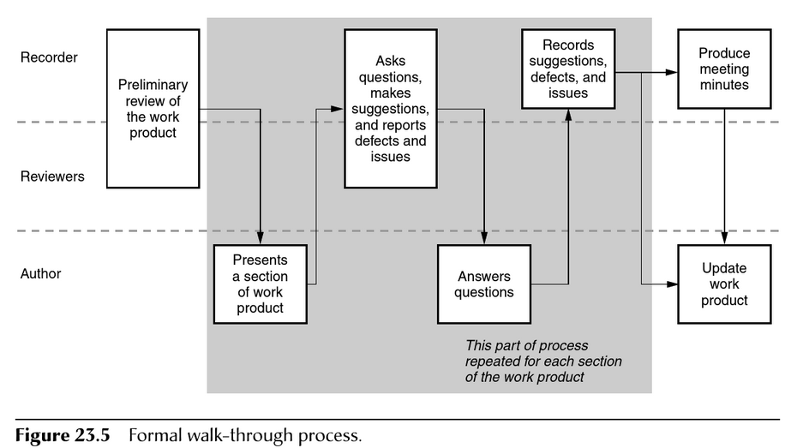
Certified Software Quality Engineer Handbook Chapter 23: Reviews and Inspections
Walkthroughs
process where one or more peers of a work product’s author meet with that author to review that work product as a team.

Slide 19
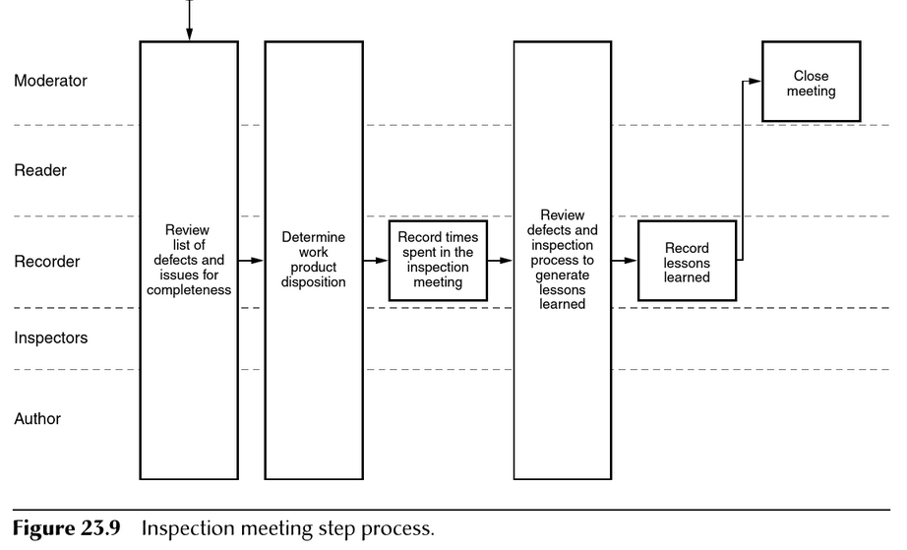
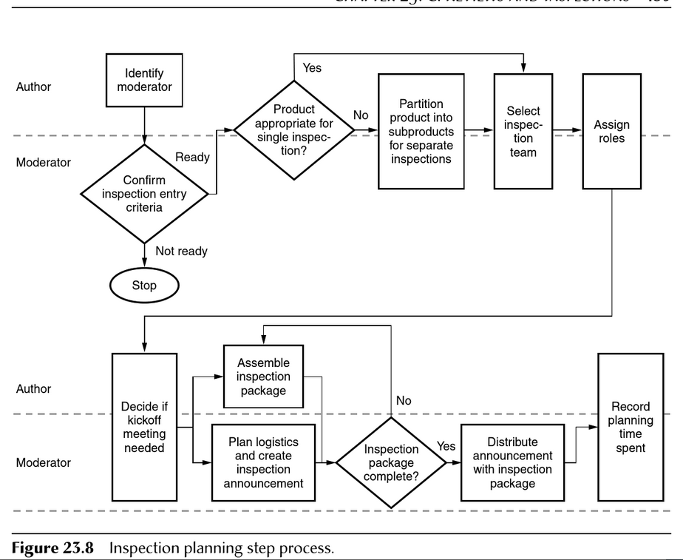
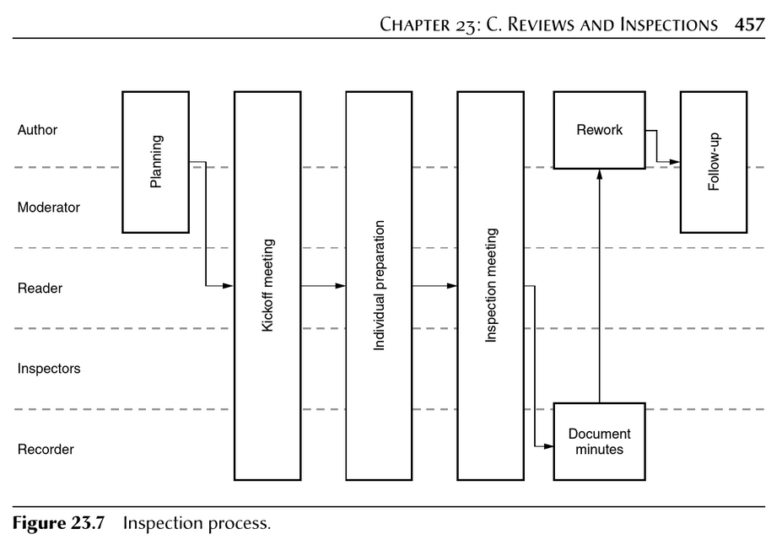
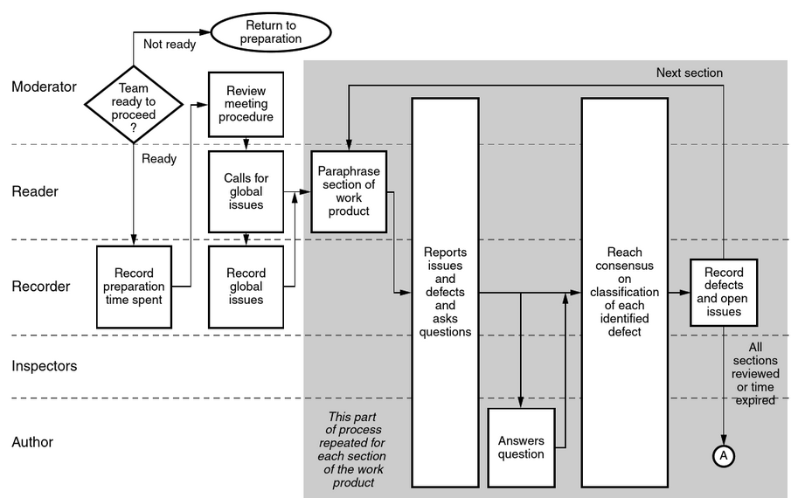
Inspections
Very formal method of peer review where a team of peers, including the author, performs detailed preparation and then meets to examine a work product.
Author
Moderator (Inspection Leader)
Notes:
Westfall, Linda. Certified Software Quality Engineer Handbook, ASQ Quality Press, 2009. ProQuest Ebook Central, http://ebookcentral.proquest.com/lib/byui/detail.action?docID=3002591. Created from byui on 2021-06-17 20:56:57.

Slide 20
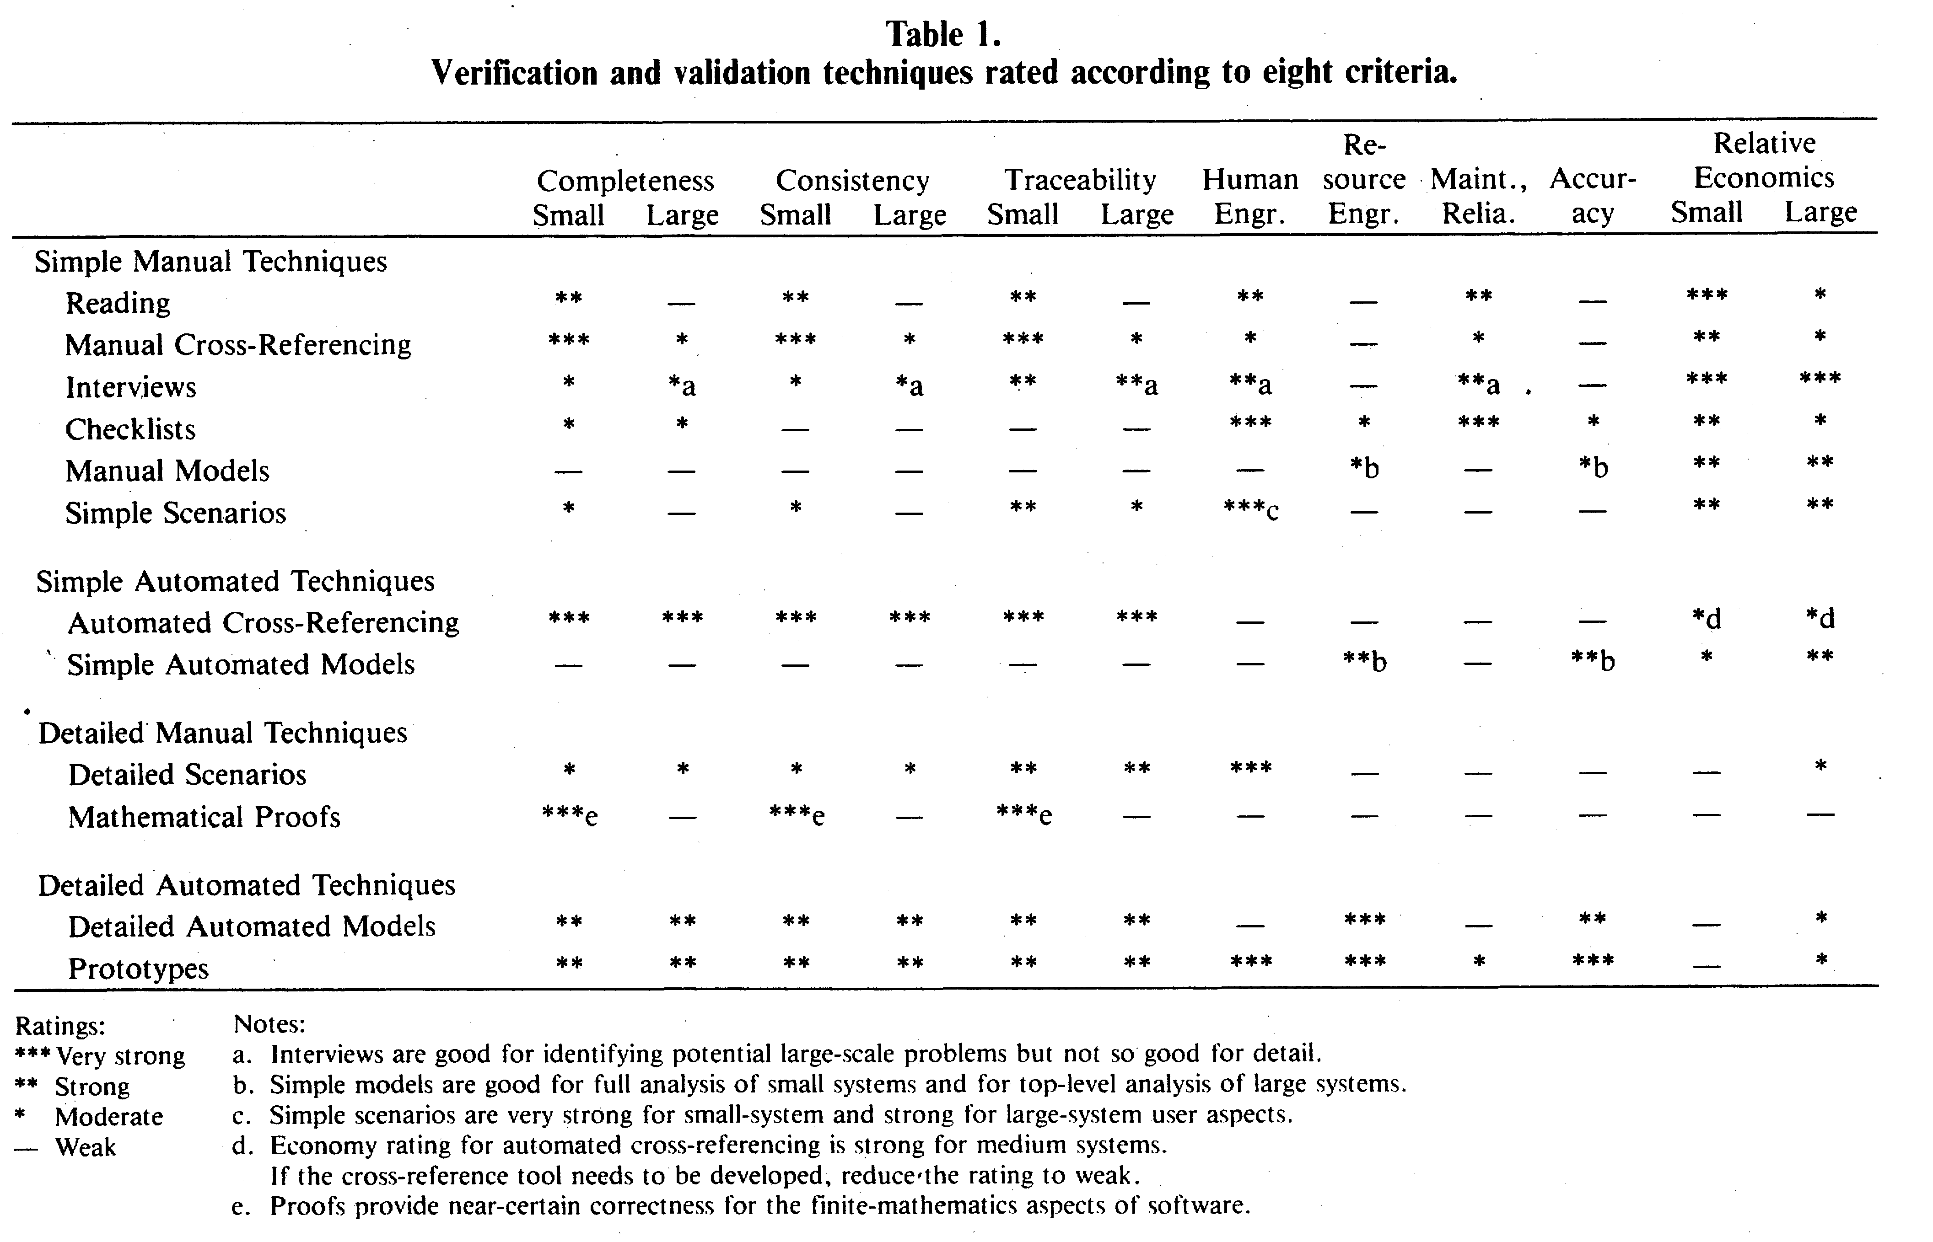
What is the best Technique for the Best Characteristic?

Slide 21
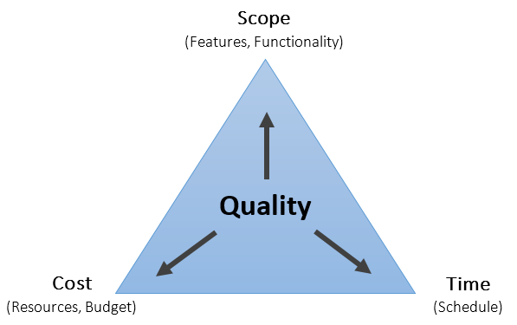
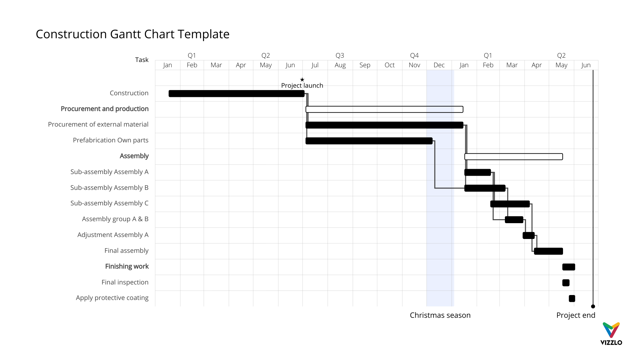
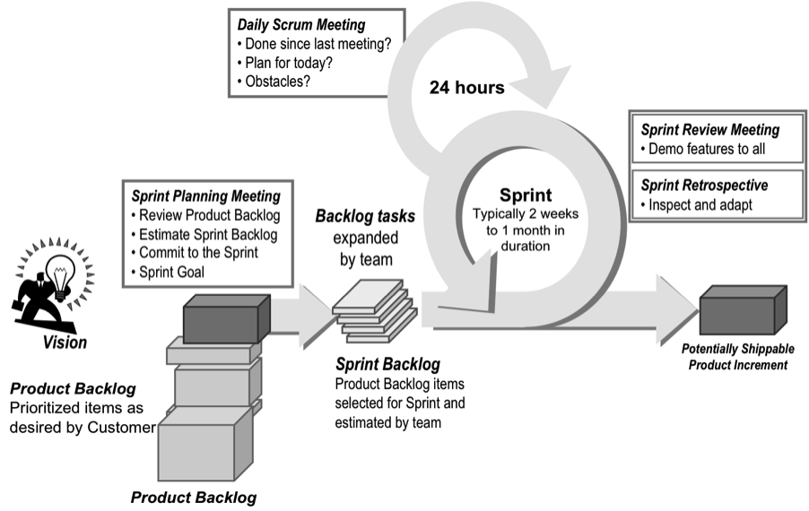
Chapter 16 B. Tracking and Controlling
Section 3: Project Reviews
Section 4: Program Reviews
Phase gate reviews
phase-end, phase transition, or major milestone reviews,
Software requirements review
Architectural design review
Detailed design reviews
Test readiness reviews
Ready-to-ship review
Project team reviews
Management reviews
Post-Project reviews and retrospectives
Program accomplishments for the reporting period
Changes to the program objectives or business climate, if any
Current program status:
– Schedule and milestone status from individual projects and non-project-related program activities
– Late activities—why they are late, what the impact is, what recovery plan and help are needed
– Dependencies between projects and groups
– Staffing and other resource availability
– Technical status: functionality and quality
– Cost or budget status
– Program risks and current risk-handling activities
– Current corrective action status
Issues, conflicts, or problems that can not be handled at the individual project level
Review of assigned action items

Slide 22
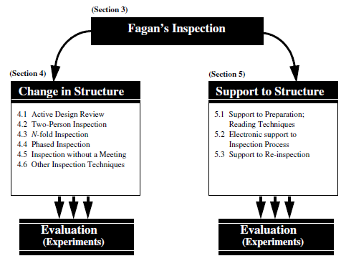
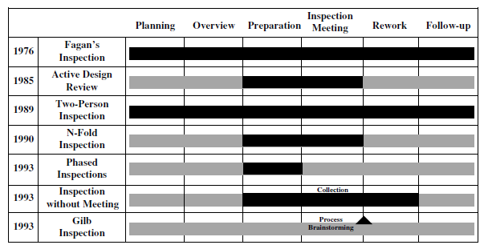
Reading: State-of-the-art: Software inspections after 25 years
Recall Testing Tech: test, inspection, analysis, demonstration
Outline
1. Introduction
1.1 Terminology:
2. Software Inspection Process
2.x Objectives and benefits, Roles, Documents, Inspection pace, Team size in software inspection
3. Fagan’s Inspection Method
Roles: Moderator, Author, Reader, Tester
Steps: Planning, Overview, Preparation, Examination, Rework, Follow-up
4. Changes to the Inspection Process
4.1. Active design review
4.x. Two-person, N-fold inspection, Phased,
4.5 Inspection without a meeting
4.6. Other techniques
5. Support to Structure
5.1 Support for preparation: reading technique
5.2.x: Ad-hoc, checklist, stepwise, scenario/defect, perspective/stakeholder
5.2 Electronic support for the inspection process
5.3. Support for reinspection
Inspection metrics, estimation of remaining defects (defect density, subjective, historical, capture/recapture (overlap))
6. Summary and Conclusion
3. Fagan’s Inspection Method
Roles: Moderator, Author, Reader, Tester
Steps:
Planning: Form a team and roles
Overview, Briefing
Preparation: Inspect
Examination: Pool findings
Rework: Solutions & Reinspection
Follow-up: Signatures & Recording
What years did these come out?
What is not the manager not used in the Inspection Method?
What are some other view points?
“The metrics themselves are the lifeblood of inspections” - ?
Knowing a bit about S/W methodologies, does anything ring a bell?
Questions for further research?

Slide 23
3. Fagan’s Inspection Methods
Recall Testing Tech: test, inspection, analysis, demonstration
4.1. Active design review
Several brief reviews with list of questions
4.2. Two-person
Peer Review (author and reviewer)
4.3 N-fold inspection
Multiple teams looking at the same
4.4 Phased
Sequential
4.5 Inspection without a meeting
Single vs multiple phase,
4.6. Other techniques

Slide 24
Inspection Plan vs Testing Plan
Recall Testing Tech: test, inspection, analysis, demonstration
Inspection Plan
Walk Through/Static Analysis
Ad hoc
Checklist
Stepwise
Scenario
Perspective
Review
Meeting
No-Meeting
Test

Slide 25
Peer Reviews
Recall Testing Tech: test, inspection, analysis, demonstration
What is a Peer Review?
Scenario:
You are on your 1st project and your manager asks you to peer review on of your teammates code. How would you review it?
What should be in a Peer Review?
Who should be involved with a Peer Review?
What type of deliverables?
Roles: Peer, System Architect, QA, Tester, CM/DM, PM
Programming Standards, Compliance, Requirements, Design, Test, Performance, UX, Documentation

Slide 27
What should be in a V&V QA Checklist?
Software construction V&V (pg 119)
Software Component Test Case V&V
Software Integration Test Case V&V
Software Qualification Test Case V&V
Software Acceptance Test Case V&V
Software Component Test Procedure V&V
Software Integration Test Procedure V&V
Software Qualification Test Procedure V&V
Software Component Test Execution V&V
Combined
Software Integration Test V&V (pg 123)
Software Integration Test Execution V&V
Software Qualification Test V&V (pg 124)
Software Qualification Test Execution V&V
Software Acceptance Test V&V (pg 125)
Software Acceptance Test Procedure V&V
Software Acceptance Test Execution V&V
Create a checklist for each of the lifecycle phase’s V&V Process, by looking at the task found in the V&V Process tables.
Each check list should contain:
A brief description of its purpose
When the checklist will be used, i.e. the lifecycle phase.
At least 5 items in the checklist, and should cover every element found at Integrity Level 3 & 4.
Software Requirements V&V (pg 109)
Software Qualification Test Plan V&V
Software Acceptance Test Plan V&V
Software design V&V (pg 114)
Software Component Test Plan V&V
Software Integration Test Plan V&V
Software Component Test Design V&V
Software Integration Test Design V&V
Software Qualification Test Design V&V
Software Acceptance Test Design V&V

Slide 28
How do I conduct a Review or Audit?
Overview
In this assignment you are going to compare the reading on the different types of reviews, inspections, and audits.
Part 1: Comparing Inspections and Reviews
Compare the “State-of-the-art: software inspection after 25 years” and the IEEE 1028-2008 Standard for Software Reviews and Audits (Management, Technical, Inspections, and Walkthroughs, Audits).
Start with the list of “State-of-the-art” Figure 2, as listed, determine which review or audit would best fit the inspection process. Provide your reasoning.
State-of-the-art Inspection Processes | IEEE 1028-2008 Std SW Reviews & Audits | Reason for choice
Fagan's Inspection
Active Design Review
Two-Person Inspection
N-Fold Inspection
Phased Inspection
Inspection w/o Meeting
Gilb Inspection

Slide 29
How do I conduct a Review or Audit?
Overview
In this assignment you are going to compare the reading on the different types of reviews, inspections, and audits.
Part 1: Comparing Inspections and Reviews
Compare the “State-of-the-art: software inspection after 25 years” and the IEEE 1028-2008 Standard for Software Reviews and Audits (Management, Technical, Inspections, and Walkthroughs, Audits).
Start with the list of “State-of-the-art” Figure 2, as listed, determine which review or audit would best fit the inspection process. Provide your reasoning.
State-of-the-art Inspection Processes | IEEE 1028-2008 Std SW Reviews & Audits | Reason for choice
Fagan's Inspection
Active Design Review
Two-Person Inspection | ie. Technical | ?
N-Fold Inspection
Phased Inspection
Inspection w/o Meeting
Gilb Inspection

Slide 30
How do I conduct a Review or Audit?
Overview
In this assignment you are going to compare the reading on the different types of reviews, inspections, and audits.
Part 1: Comparing Inspections and Reviews
Compare the
“State-of-the-art: software inspection after 25 years” and the
IEEE 1028-2008 Standard for Software Reviews and Audits (Management, Technical, Inspections, and Walkthroughs, Audits).
Start with the list of “State-of-the-art” Figure 2, as listed, determine which review or audit would best fit the inspection process. Provide your reasoning.
State-of-the-art Inspection Processes | IEEE 1028-2008 Std SW Reviews & Audits | Reason for choice
Fagan's Inspection
Active Design Review
Two-Person Inspection
N-Fold Inspection
Phased Inspection
Inspection w/o Meeting
Gilb Inspection
Management reviews
Technical reviews
Inspections
Walk-throughs
Audits

Slide 31
How do I conduct a Review or Audit?
Part 2: Creating Review and Audit process Create a diagram like Figure 8.4, from Certified Software Quality Engineer Handbook for each of the following each of the IEEE 1028-2008 Std SW Reviews & Audits review types.
Management reviews
Technical reviews
Inspections
Walk-throughs
Audits
Steps
Step 1: Identify the roles. Using Figure 8.4 as an example, put the roles in the left column.
Step 2: Identify the process. Reading the IEEE document, id the process and what roles are covered. You may have to re-arrange the roles so they are cluster similar to what is in Figure 8.4.
Step 3: Update the process or roles from “Software Inspection after 25 Years” reading.
State-of-the-art Inspection Processes | IEEE 1028-2008 Std SW Reviews & Audits | Reason for choice
Fagan's Inspection
Active Design Review
Two-Person Inspection
N-Fold Inspection
Phased Inspection
Inspection w/o Meeting
Gilb Inspection
Management reviews
Technical reviews
Inspections
Walk-throughs
Audits

Slide 32
How do I conduct a Review or Audit?
Part 2: Creating Review and Audit process Create a diagram like Figure 8.4, from Certified Software Quality Engineer Handbook for each of the following each of the IEEE 1028-2008 Std SW Reviews & Audits review types.
Management reviews
Technical reviews
Inspections
Walk-throughs
Audits
Steps
Step 1: Identify the roles. Using Figure 8.4 as an example, put the roles in the left column.
Step 2: Identify the process. Reading the IEEE document, id the process and what roles are covered. You may have to re-arrange the roles so they are cluster similar to what is in Figure 8.4 and Figure 23.5, 23.7, 23.8, 23.9
Step 3: Update the process or roles from “Software Inspection after 25 Years” reading.

Slide 33
Complete SQAP Section 6
Complete the Section 6 of the QA Plan. Section 6 will contain 4 sections.
6.1 Purpose
Complete in Week 05
6.2 Required Reviews
6.2.1 Software specifications review (SSR)
This section will contain a list of reviews associated with Software Requirements V&V.
6.2.3 Detailed design review (DDR)
This section will contain a list of reviews associated with Software Design V&V
6.2.4 Verification and validation plan review
This section will contain a list of reviews associated with Software Construction
6.2.10 Post-implementation reviews
This section will contain a list of reviews associated Integration and Acceptance V&V
Each sub-section will contain a brief description of the purpose of the sub-section based on what is found in the IEEE 730-2002 Standards for Software Quality Assurance Plans. Each item in the list will have a 1-2 sentence summary of the purpose of the review.
Make sure you include all the reviews from the readings.
Next week we will be adding to this section for audits.
4.6.2.5 Functional audit
4.6.2.6 Physical audit
4.6.2.7 In-process audits
4.6.2.8 Managerial reviews
4.6.2.9 Software configuration management plan review (SCMPR)

