Slide 1
CSE 474 Quality Assurance
Week 14: QA Career
W. Clements

Slide 2


Slide 3
Agenda
Teach: I am a Software QA. Where do I go from here?
Prove: Software Quality Assurance Plan

Slide 4
I am a Software QA. Where do I go from here?
What type of skills, experiences, and projects for a QA would be good on a resume?
Find five job posting on software QA. What skills are needs as a QA?
What are the different career paths of a QA? (Following questions help you pick one, or use your own.)
What are the ways of moving from QA positions to a software development position?
What are the ways of moving from QA positions to lead?
What are the ways of moving from other career paths?
What is the perception of a QA?
How can we overcome the perception?
Submit Summary Document

Slide 5
Software Quality Assurance Plan
Part I
You will need to find at least ten different job descriptions from at least five other companies from at least three different field domains (Module 12). After reading ten different job descriptions, create a job opening description for ACME, Inc for three new employees joining your team.
Part II
Research 10 different related fields. Create a career path map and identify what career opportunities you would like to achieve in the next five years.
Part III
What conference, training, and research material will you need to make your career happen?
Part IV
What is the perception of a Tester? How can we overcome that perception?

Slide 6
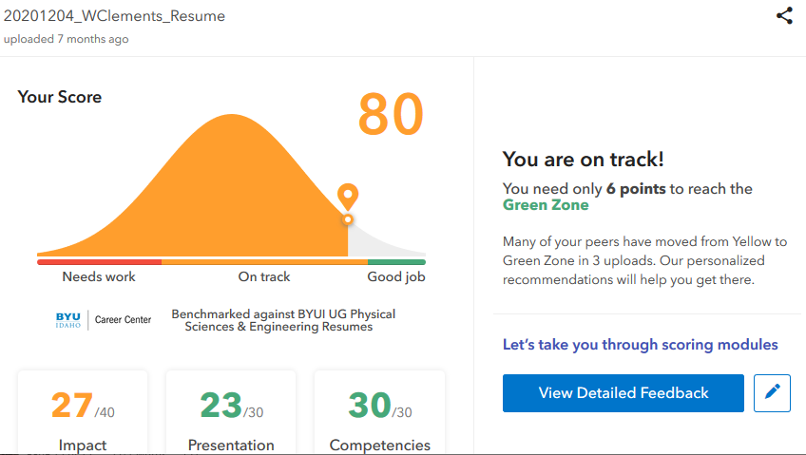
Your Resume
Resume Building
Avoid
Contact information: name, phone#, email
Education –
class’s topics, projects, start and expected grade date
Experience – jobs, jobs, jobs
Doesn’t matter what the job is right now, frame the responsibilities with soft skills
Dates matter, it is a bibliography and timeline
Statistics and Numbers
Personal Projects
#1 influencer, what did you do outside of class.
Societies, Sr Project, Competitions, Non-profit
Portfolium, GitHub, etc -> tiny url.
Skills & Knowledge list
Get past the AI filters and HR Intern
Must be specifically support (dup) in other sections.
GPA: Unless specially asked for
History gaps
Long paragraphs
No more than 2 pages, most important on the 1st page
Use MS Word magic: Font size, margins, white space
Do this
On the back side of 1-page, include photos, talking points, etc of projects.
Use a different color paper, that is easily copiable. (Not red, etc)
Be prepare to have a STAR story for every point on your resume
Use V-Mock to review your resume

Slide 7
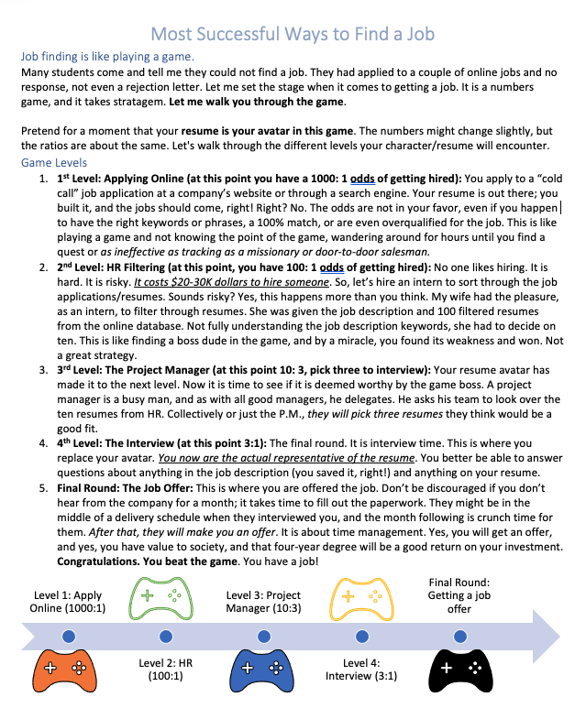
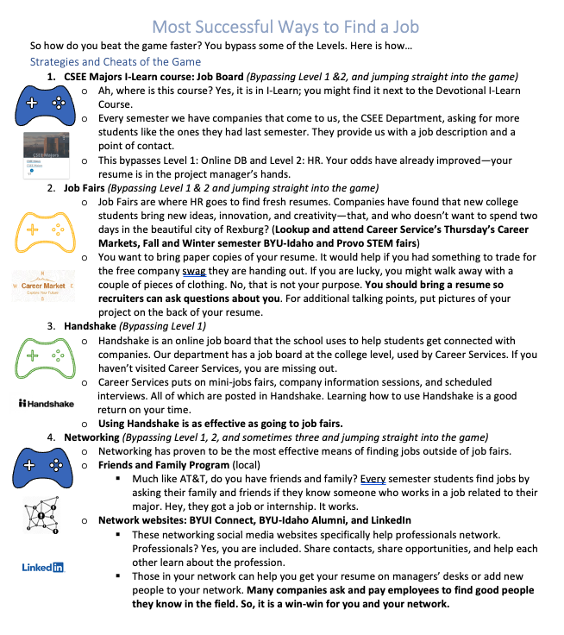

Slide 8
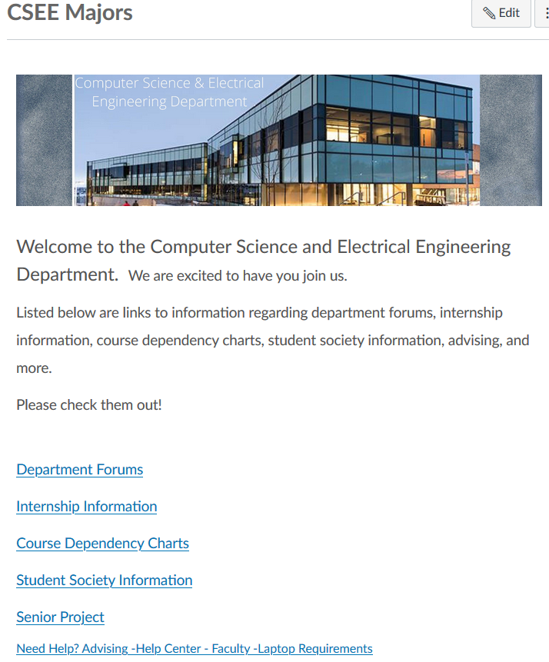
Finding a Job
Where to go for finding a job:
Previous Internships
CSEE Majors iLearn Course
Handshake
https://byui.joinhandshake.com/
LinkedIn
Indeed
Networking
Friend & Family
iConnect
Format of a Job Description
About the company
Legal
Responsibilities – what you will be doing
Qualifications – what you need to have – 80%-90% match, otherwise you are over qualified
Amazon | Seattle | Washington | Quality Assurance Engineer
Allucent | Rexburg | Idaho | Quality Assurance Engineer/Programmer
The Church of Jesus Christ of Latte-day Saints | Rexburg | Idaho | Quality Assurance Intern
Labstats | Idaho Falls | Idaho | QA Intern
Pitch59 | Rexburg | Idaho | UI/UX/QA Intern
ICON Health and Fitness | Logan | Utah | Junior QA Web Tester
Byuiconnection.edu
https://ces.peoplegrove.com/hub/byuidaho/home-v3

Slide 9
Continuous Improvement
Quality Assurances
(Built the Product Right)
Process ->
Q-Contrl/HMI
Value/Cost
Audit/Review/Std
Integrity/Sec
Testing
<- Product
Software Development
QA vs
Test vs
DevOp vs
Cont. Improvement
Support Roles (CM, DM, Code Mngr, etc)
Program/Project Manager
Development
QA-Tester
Acceptance Tester
System Tester
Integration Tester
Regression Tester
Unit Tester
(Sometime Developer)
Concept of Operations
Acceptance Test
Validation
Requirements
System Test
Verification
Architecture
Integration Test
Design
Regression Test
Implementation
Implementation
Unit Test
(Built the Right Product)
Dev Ops
Environment
Software Tools
Hardware
Network
Infrastructure
Test Zone (sandboxes)
Operation

Slide 10
Strategies
Year 1
Year 2
Year 3
Year 4
S1-on
S2-on
off
S1-on
S2-on
off
S1-on
S2-on
off
S1-on
S2-on
Start looking for a internship job
CSE 398 full-time
Ideal time to get an internship
Extending your Internship, some company require that for their internship they need you to take it for credit.
CSE 498R full-time
S1-on
S2-on
If you are International student, you must work part time during your on-semester.
CSE 398 full-time
CSE 498R part-time
S1-on
S2-on
This would be a better
CSE 398 full-time
CSE 498R full-time
Work Experience
Non-tech campus job
Lab Assistant
non-tech job
Teacher Assistant
Off campus tech job
On-campus tech job
CSE 398 full-time
Off-Campus tech job
Projects
Assist Society Projects
Lead Society Projects
Expeditions
ALP-Basic
ALPS Adv
Sr. Proj.
Personal Projects
Attend Competitions
Attend Professional Conferences

Slide 11
5. QA Processes
(V&V, Reviews, Audits)
8. Reviews & Audits
(Tech, Mngt., Inspection, walk-throughs, checklist)
10. Configuration Management
1. Fundamentals & Business Case for Quality Assurance
(IEEE SWBok)
9. Maturity
(CMM, Process, Product, ISO)
11. Risk/Mission Assurance
(Training, CAR, Mitigation)
6. QA Tools
(Fishbone, check, Histograms, Pareto, Scatter, Stratification)]
12. Security/ Legal/ Ethics
(Regulations, Code, Legal, Safety)
2. QA’s Role in SW Lifecycle, Methodologies,
Architecture
[Responsibilities & Roles]
7. QA Attributes
(Verification and Validation )
13 . Project Management
(CoQ, WBS, DevOps )
[VDD, Version, DM, DI]
14. Careers Path
3. QA Techniques
(Dyn, Static, and Testing)
[]
4. Quality Metrics
(Characteristic & Models)
[Measuring]
Know
Do
Become
SWE 474: Quality Assurance Class

Slide 12
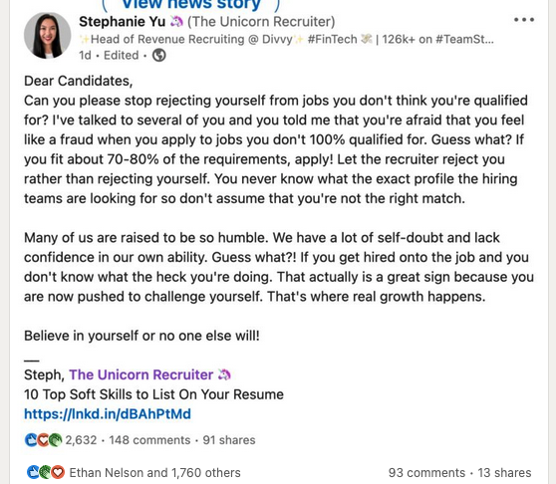

Slide 13
QA Job Search Engines
Search Websites
Handshake
https://byui.joinhandshake.com/
https://www.linkedin.com/jobs/search/?keywords=Quality%20Assurance
https://www.linkedin.com/jobs/view/2981875589/?alternateChannel=search&refId=2%2BFf7P7kW7slDP6zZ0k6rQ%3D%3D&trackingId=P8SxP66f2qqzpiiOGBak4A%3D%3D&trk=d_flagship3_search_srp_jobs
www.indeed.com
Software Quality Engineer Lean Six Sigma
https://www.indeed.com/jobs?q=Software%20Quality%20Engineer%20Lean%20Six%20Sigma&from=mobRdr&utm_source=%2Fm%2F&utm_medium=redir&utm_campaign=dt&vjk=5c93a099584161e1
www.dice.com
https://www.dice.com/jobs/detail/402ef7064c0e178789d003a5215f46dc?searchlink=search%2F%3Fq%3Dquality%2520assurance%2520analyst%26countryCode%3DUS%26radius%3D30%26radiusUnit%3Dmi%26page%3D1%26pageSize%3D20%26filters.employmentType%3DFULLTIME%26language%3Den%26eid%3DS2Q_&searchId=066b06d3-a0d1-4257-80f4-8ee13cedb50b
www.salary.com
https://www.salary.com/job/kuubix-global-llc/quality-assurance-specialist/j202203170324471176646
Software Quality Assurance Analyst I

Slide 14
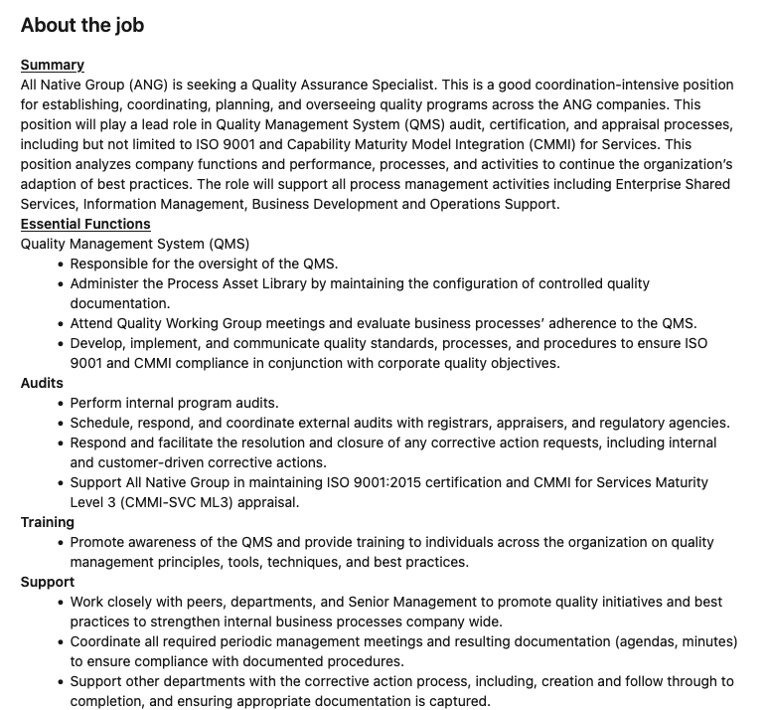
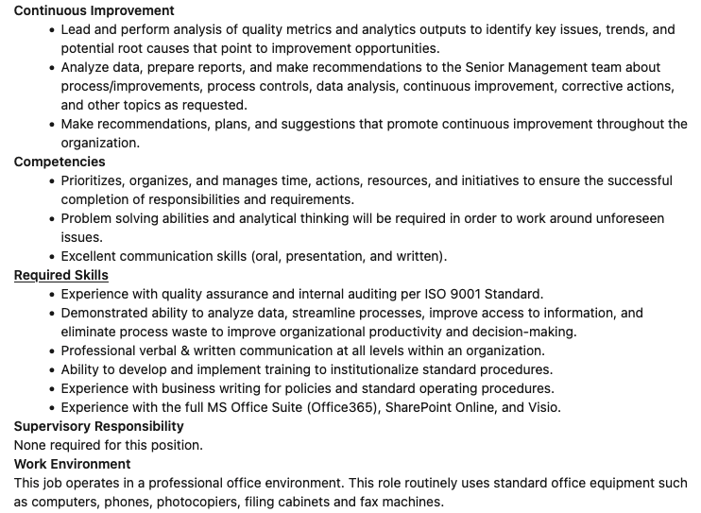
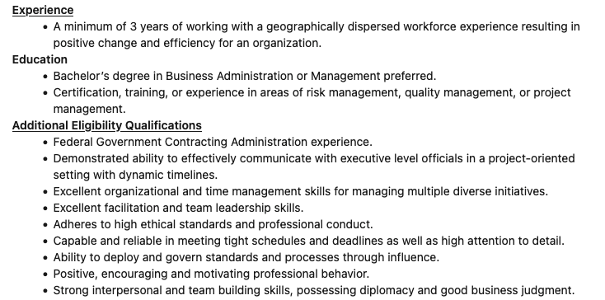
https://www.linkedin.com/jobs/view/2981875589/?alternateChannel=search&refId=2%2BFf7P7kW7slDP6zZ0k6rQ%3D%3D&trackingId=P8SxP66f2qqzpiiOGBak4A%3D%3D&trk=d_flagship3_search_srp_jobs

Slide 15
