Slide 1
Welcome to Week 04 QA Characteristics and Models
CSE 474 Quality Assurance
Brother W. Clements

Slide 2
5. QA Processes
(V&V, Reviews, Audits)
8. Reviews & Audits
(Tech, Mngt., Inspection, walk-throughs, checklist)
10. Configuration Management
1. Fundamentals & Business Case for Quality Assurance
(IEEE SWBok)
9. Maturity
(CMM, Process, Product, ISO)
11. Risk/Mission Assurance
(Training, CAR, Mitigation)
6. QA Tools
(Fishbone, check, Histograms, Pareto, Scatter, Stratification)]
12. Security/ Legal/ Ethics
(Regulations, Code, Legal, Safety)
2. QA’s Role in SW Lifecycle, Methodologies,
Architecture
[Responsibilities & Roles]
7. QA Attributes
(Verification and Validation )
13 . Project Management
(CoQ, WBS, DevOps )
[VDD, Version, DM, DI]
14. Careers Path
3. QA Techniques
(Dyn, Static, and Testing)
[]
4. Quality Metrics
(Characteristic & Models)
[Measuring]
Know
Do
Become
SWE 474: Quality Assurance Class

Slide 3
Agenda
Overview of this weeks assignments
Talk about Metrics and Measurements
Functional Requirements – Work Breakdown Schedule
Non-Functional Requirements – Quality Characteristics
Non-Functional Requirement Models – Quality Models
Detailed analysis of assignments

Slide 4
Reading
J. Miguel et al. "A review of software quality models for the evaluation of software products," International Journal of Software Engineering & Applications, vol. 5, no. 6, pp. 31-54, Nov. 2014. (pages 24) [Online] Available: http://airccse.org/journal/ijsea/papers/5614ijsea03.pdf
PMBOK: Chapter 5.4: Create WBS (Pages 8)
https://eds.a.ebscohost.com/eds/ebookviewer/ebook/bmxlYmtfXzU2NTg2OV9fQU41?sid=46eb2060-3bcf-4808-8467-f70d9c9069e1@sessionmgr4006&vid=0&format=EB
SWEBOK: Chap 13: Computing Foundations (pages 33)
https://www.computer.org/education/bodies-of-knowledge/software-engineering
SWEBOK: Chap 10: SW Quality: 1.3 Models and Quality Characteristics (pages .5)
L. Westfall Certified Software Quality Engineer Handbook, ASQ Quality Press, 2009-09-01, https://ebookcentral.proquest.com/lib/byui/detail.action?docID=3002591
Chapter 18: A. Metrics and Measurement Theory (pages 18)
Chapter 19: Process and Product Measurement (pages 37)
Video 14 - Nonfunctional Requirements (5 minutes)
https://www.youtube.com/watch?v=ITS8sAkwRvQ
Functional and Non Functional Requirements (13 minute)
https://www.youtube.com/watch?v=9_JQUMhTzUw

Slide 5
Week 03 Assignments
Objectives:
Produce (6 - creating) Quality Models
Rank (5 - Evaluate) each attribute in the models by measurable characteristics
Assess (5 - Evaluate) Models for different scenarios
Assess (5 - Evaluate) a project's defect/fault density and Failure intensity
What are non-functional requirements?
How to build a quality model?
Create a QA Models

Slide 6
What are non-functional requirements?
Identify four characteristics that are common among all of your models. Research the characteristic and determine the best method to measure it.
Part 1: Determine which characteristics are shared in the Basic Models but used in the Tailored and the Open Source.
Compare and Contrast the Basic Models with the Tailored and Open-Source models.
Create a Venn diagram or table that categories the characteristics, characteristics that are reserved for Basic Models, those that are shared, and those that are only in Tailored/Open-Source models. (Highlight or Bold those characteristics that are shared).
As an exceptional expectation, separate the Tailored and Open Models and determine shared characteristics between all three. (Highlight or Bold for all three, green font for Basic and Tailored, Orange for Basic and Open, and Blue for Tailored and Open).

Slide 7
What are non-functional requirements?
Part 2: Determine how to measure characteristics.
Pick four characteristics found in both the Basic and Tailored/Open Source.
Research the characteristic and determine how to measure that characteristic using the context of the models.
Provide an example of how to use the measurements.
Part 3: Determine the scale (Nominal, Ordinal, Interval, Ratio), include the unit if applicable.
Research each of the terms: Nominal, Ordinal, Interval, Ratio
For each of the four characteristics, determine the scale to measure that characteristic. Also, justify why you choose that scale and not the others, either with an example or explanation.

Slide 8
What are non-functional requirements?
Part 4: Determine characteristic uses as an internal (static analysis), external (dynamic analysis), or Quality in Use (dynamic).
On page 33, the author mentions identifying the scope of the characteristics as internal, external, and quality of Use. Define each.
Identify your four quality characteristics as internal, external, or quality of use. The models may help you determine this, but some will not be easy. Justify your answers. Provide an example of use.
Internal see page 40
External
Quality in Use

Slide 9
What are non-functional requirements?
Part 5: Determine the best way to test the characteristics, either by inspection, demonstration, analysis, or a test.
Verification of testing fall into four test categories
Inspection - and examination of the item against applicable documentation to confirm compliance with requirements.
Analysis (including modeling and simulation) - analytical data or simulations under defined conditions to show theoretical compliance.
Demonstration - a qualitative exhibition of functional performance, usually accomplished with minimal instrumentation or test equipment.
Test - an action by which an item’s operability, supportability, or performance capability is quantitatively verified when subjected to controlled conditions that are real or simulated.
For each of your four qualities, determine the best testing category. Give a brief explanation of the test. Namely, what are the prerequisites, and what is the expected outcome?

Slide 10
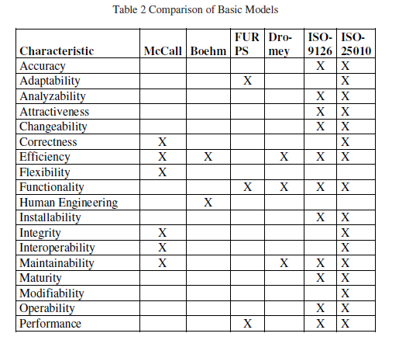
How to build a quality model?
Part 1: Build hierarchy structure of Maps
Using PowerPoint or a similar draw application, create a hierarchy of the different models. Starting with McCall as the parent, including all the Basic, Tailored, and Open-Source Models.
Part 2: How far off (%) are the models from each other?
In section 6, the author lists all the quality characteristics found in each of the models. Transfer those table’s information into a spreadsheet.
Create an equation that calculates a percentage of coverage of the listed characteristics for each model. Explain your equation.
Using your hierarchy, determine how much change was made from the parent model(s).

Slide 11
How to build a quality model?
Part 3: Pick the best model for a situation.
Determine a type or example of software or software package that implements one of the categories below.
Front-End Applications: Project can be developed on any platform: PC, Mac, Web, Mobile, GUI, etc.
Language: You can research or create a new language or analysis old.
Requirements/Design: This should be customer driven project.
Patterns: Understanding design patterns, anti-patterns, structures
Back-End applications: Highly robust applications require back-end work including: Servers, hardware, architecture, distributed systems.
Database: Uses of databases from flat files to DB management system, and DB modeling & structuring.
Security: Information, Technology, and Programming security
AI, Machine Learning, Data Mining: Data manipulation and presentation
Pick one model from the different models found in Miguel's reading that best fits your example. Provide a reason for each characteristic found in the model. Some characteristics will not fit, identify them and describe why it would not be a match.
Rate the matching by proving a percentage of match, based on your equation from Part 2.

Slide 12
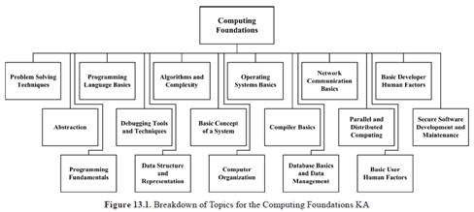
How to build a quality model?
Part 4: Build a model
Using the example/type and model from Part 3, derive a model that will match at 100%. It will help to use the Work Breakdown Structure (WBS) found in the SWEBoK and PMBoK)
Explain each of the new characteristics.
Many of the models have additional branches or layers. You may derive additional layer from previous the models or create your own layers. Identify each by the uses (Internal, External, or Quality)
Using Figure 13.1 from the SWEBoK, identify 2-3 quality characteristic that best fit each topic.
Items to keep in mind:
Which Quality Characteristics do you think should be in the model?
How many layers and sub-categories should there be in your model?
What parts of the software will your quality model cover? For example, ISO 9126/2510 has three model trees one for internal (static analysis), one for external (dynamic), and quality in use (maintainability).

Slide 13
Prove: Create a QA Models
You will create three models. Model 1: Mobile Quality Model
You will derive a model based on the ISO 25010 Basic Model.
First, pick a Mobile application that you have recently used.
Next, you need to determine if your application fits the model by looking at each model's characteristics and determining which characteristics fit the application.
Provide a percentage fit.
Find five characteristics that are not include in the ISO 25010 model, that you believe should be in the model. Update the model.
Model 2: IDE Quality Model
Pick an IDE (Visual Basic, Eclispe, etc).
Determine which Tailored Model best fits your IDE choice.
Do a complete analysis of each of the characteristics, explain why it fits.
Using the parent model, determine which characteristics are no longer needed (or up to three from other models that should not be in the model),
remove them from the model.
For each of those characteristics, identify how to measure based on the IDE.

Slide 14
Prove: Create a QA Models
Model 3 Messaging Service
Pick Messaging service (Discord, Zoom, Slack, MS Teams, etc.).
Determine if you should use Basic, Tailored, or Open-Source models as your parent model. Provide reasons why you choose that model category and didn’t choose the other two.
Complete a compatibility analysis of the model. For each characteristic quality of the model, determine if it is relevant to the Messaging Service application. What percentage of the model covers the application?
Using the defects of that model, create a new model that overcomes that defect. Use at least 4-5 more new characteristics not found in the parent model. You might have to re-arrange or add new categories. You might even want to remove some quality characteristics.

Slide 15
Create a QA Models
For each new quality characteristic, determine how it will be tested and measured.
Summary of the Test
Provide an over summary or description of test approach.
Tested:
Inspection - an examination of the item against applicable documentation to confirm compliance with requirements.
Analysis (including modelling and simulation) - use of analytical data or simulations under defined conditions to show theoretical compliance.
Demonstration - a qualitative exhibition of functional performance, usually accomplished with no or minimal instrumentation or test equipment.
Test - an action by which the operability, supportability, or performance capability of an item is quantitatively verified when subjected to controlled conditions that are real or simulated.
Measured
Scale (Nominal, Ordinal, Interval, Ratio)
Characteristic uses as an internal (static analysis), external (dynamic analysis) or Quality in Use (dynamic)

Slide 16
Agenda
Talk about Metrics and Measurements
Functional Requirements – Work Breakdown Schedule
Non-Functional Requirements – Quality Characteristics
Non-Functional Requirement Models – Quality Models

Slide 17

Chapter 18 A. Metrics and Measurement Theory
Roles (reasons) for collecting data implement software metrics
To understand
To evaluate
To control
To predict
1. Terminology
Metrics Defined
Measurement Defined (Internal and External attributes
Reliability and Validity
Explicit Measures
Derived Measures

Slide 18
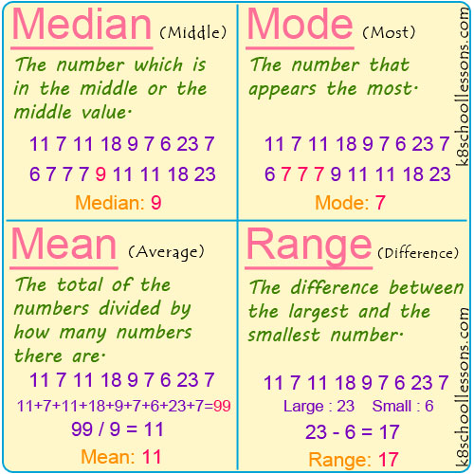
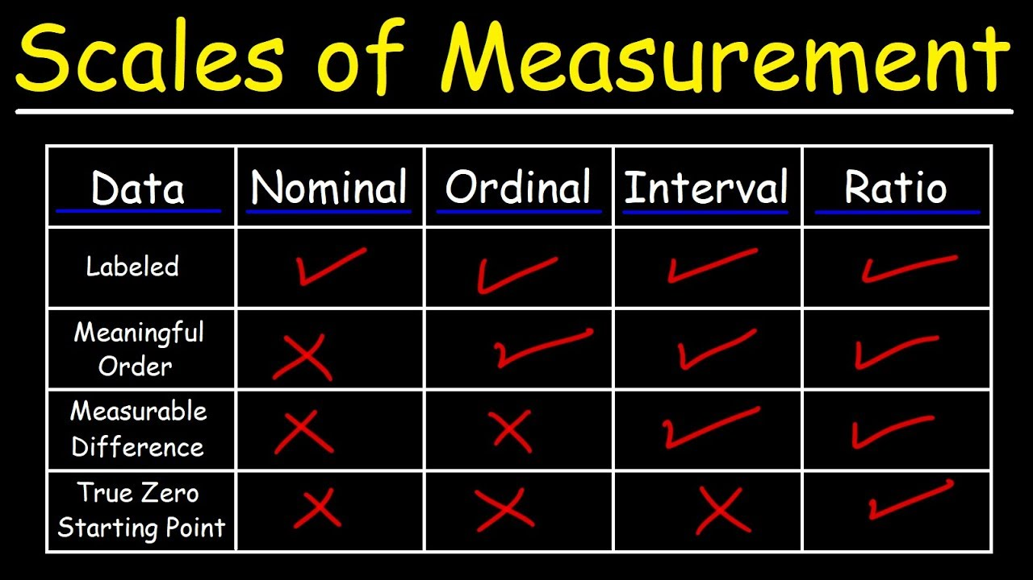
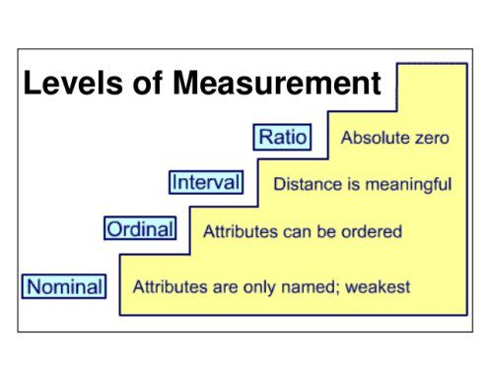
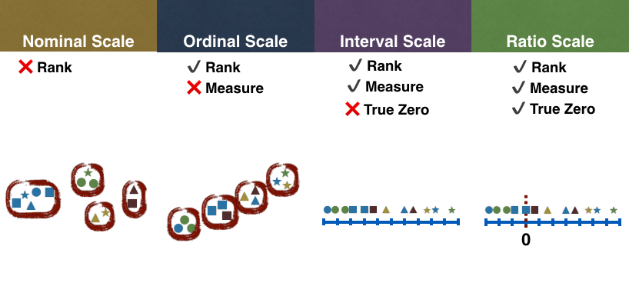
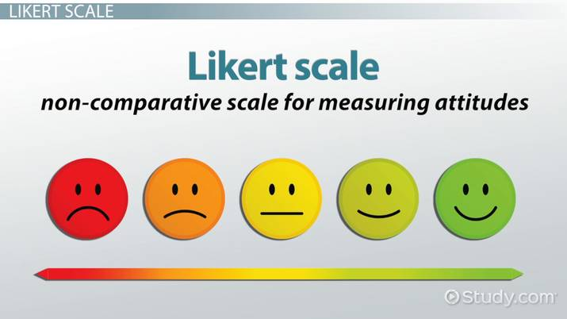
Chapter 18 A. Metrics and Measurement Theory
2. Basic Measurement Theory and Statistics
Central Limit Theorem
Mean, Median, and Mode
Range, Standard Deviation, and Variance
Nominal Scale Measurements
Ordinal Scale Measurement
Interval Scale Measurement
Ratio Scale Measurement
3. Psychology of Metrics
Metrics and Measuring Affect People
People Affect Metrics and Measuring
Metric and Measurement Do’s and Don’ts
Other Human Factors
Colors of fruit
How are you going?
Not bad vs Not too bad

Slide 19
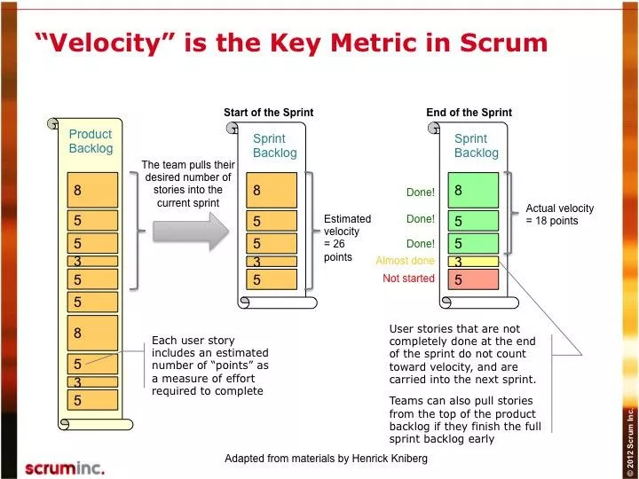
Metric and Measurement Do’s and Don’ts
Don’t measure individuals.
Don’t use metrics as a stick.
Don’t ignore the data.
Don’t use only one metric.
Do align metrics with goals.
Do focus the metrics on processes, products, and services.
Do provide feedback to the data providers.
Do obtain buy-in for the metrics.

Slide 20
Chapter 19 B. Process and Product Measurement
Customer metrics include
Functional Manager
Project Managers
Individuals' software practitioners
Specialists
Customers and users
1. Software Metrics
Size—Lines of Code
Size—Function Points
Other Size Metrics
Cyclomatic Complexity
Structural Complexity
Defect Density
Arrival Rates
Problem Report Backlogs
Amount of Test Coverage Needed
Requirements Volatility
Reliability
Availability
System Performance
Maintainability
2. Process Metrics
Cost
First-Pass Yield
Cycle Time
Customer Impact—Customer Satisfaction
Customer Impact—Responsiveness to Problem Reports
Defect Detection
Defect Containment and Total Defect Containment
Effectiveness (TDCE)
Defect Removal Efficiency
Defect Removal Efficiency
Process Capability
3. Metrics Reporting Tools
Charts and Graphs
Stoplight Charts
Kiviat Chart

Slide 22
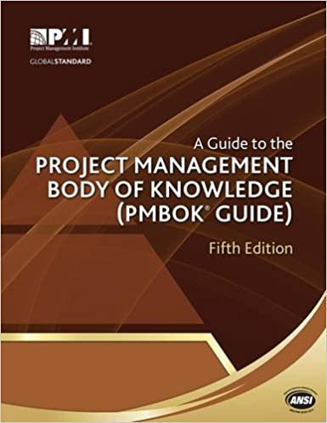
PMBoK
Work Breakdown Structure (WBS). A hierarchical decomposition of the total scope of work to be carried out by the project team to accomplish the project objectives and create the required deliverables.
Practice Standard for Work Breakdown Structures – Second Edition [7].
WBS.
The WBS is a hierarchical decomposition of the total scope of work to be carried out by the project team to accomplish the project objectives and create the required deliverables.
Each descending level of the WBS represents an increasingly detailed definition of the project work.
The WBS is finalized by assigning each work package to a control account and establishing a unique identifier for that work package from a code of accounts.
These identifiers provide a structure for hierarchical summation of costs, schedule, and resource information.
A control account is a management control point where scope, budget, actual cost, and schedule are integrated and compared to the earned value for performance measurement. Control accounts are placed at selected management points in the WBS.
Each control account may include one or more work packages, but each of the work packages should be associated with only one control account. A control account may include one or more planning packages.
A planning package is a work breakdown structure component below the control account with known work content but without detailed schedule activities

Slide 23
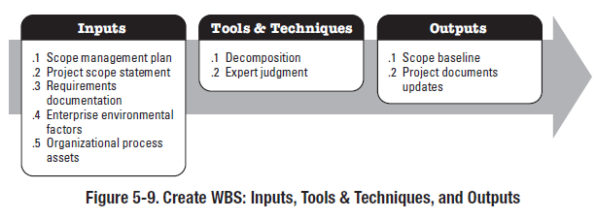
PMBoK 5.4.2 Create WBS: Tools and Techniques
Decomposition is a technique used for dividing and subdividing the project scope and project deliverables into smaller, more manageable parts. The work package is the work defined at the lowest level of the WBS for which cost and duration can be estimated and managed. The level of decomposition is often guided by the degree of control needed to effectively manage the project. The level of detail for work packages will vary with the size and complexity of the project. Decomposition of the total project work into work packages generally involves the following activities:
Identifying and analyzing the deliverables and related work;
Structuring and organizing the WBS;
Decomposing the upper WBS levels into lower-level detailed components;
Developing and assigning identification codes to the WBS components; and
Verifying that the degree of decomposition of the deliverables is appropriate.
A portion of a WBS with some branches of the WBS decomposed down through the work package level is shown in Figure 5-11.

Slide 24
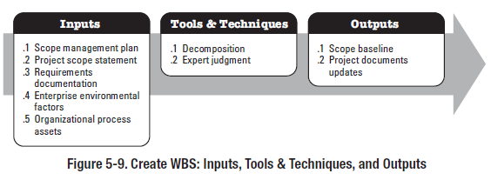
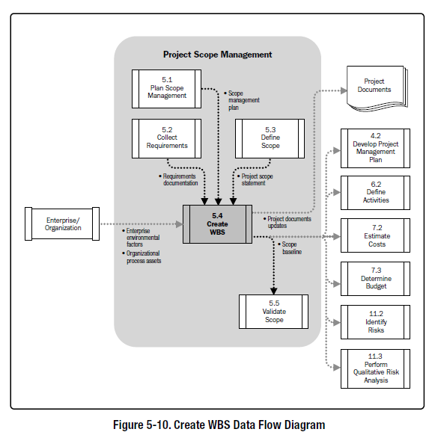
5.4 Create WBS
5.4.1 Create WBS: Inputs
5.4.1.2 Project Scope Statement
5.4.1.3 Requirements Documentation
5.4.1.4 Enterprise Environmental Factors
5.4.1.5 Organizational Process Assets
5.4.2 Create WBS: Tools and Techniques
5.4.2.1 Decomposition
5.4.2.2 Expert Judgment
5.4.3 Create WBS: Outputs
5.4.3.1 Scope Baseline
5.4.3.2 Project Documents Updates

Slide 25
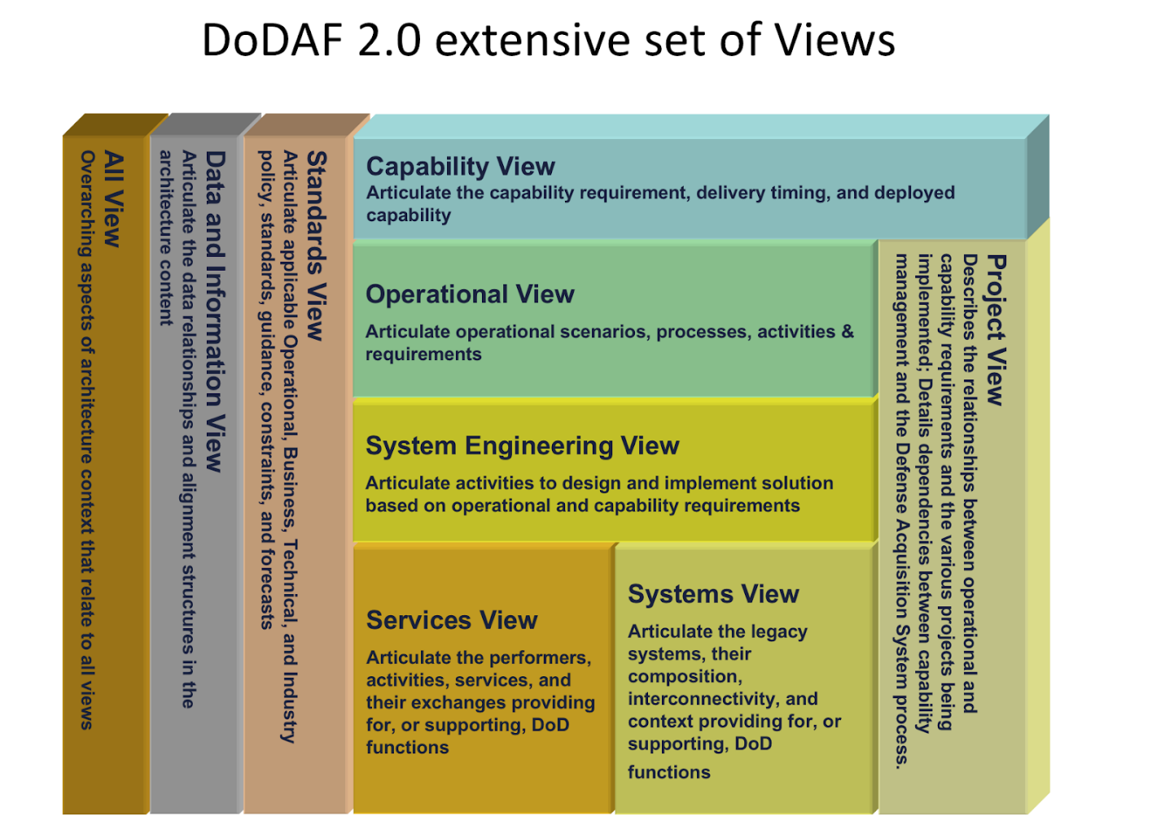
CSE 372: Requirements Elicitation Techniques (CS 364 SWE 1)
Discovery & Empathizing
Stakeholders: Interviews: Introspection
Stakeholders: Structured: Questionnaires
Stakeholders: Group Work: Brainstorming
Analysis & Designing
User: Ethnography: Scenarios, Profiles
User: Card Sort
User: Repertory Grid
Documentation and Prototyping
User: Prototyping
Domain: Card Sort: CRC
Domain: Laddering
Domain: Viewpoints: Goal-Based Approach
Domain: Viewpoints: Top Down: Task Analysis
Expert Judgement Tool #1: Requirements

Slide 26
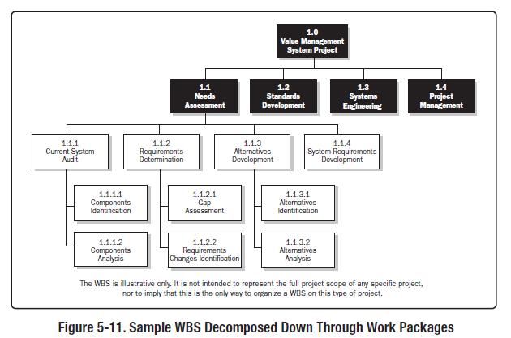
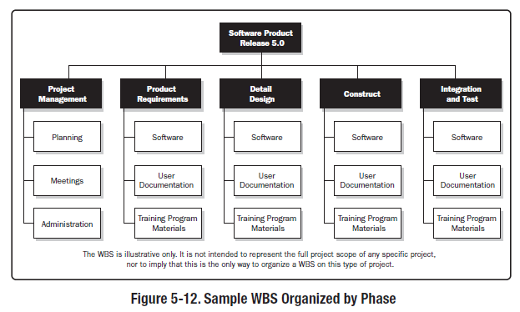
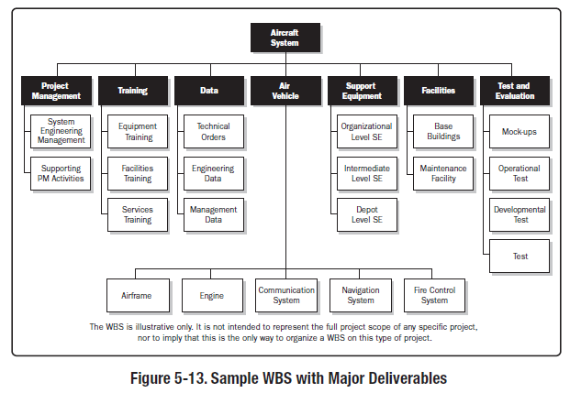
PMBoK

Slide 27
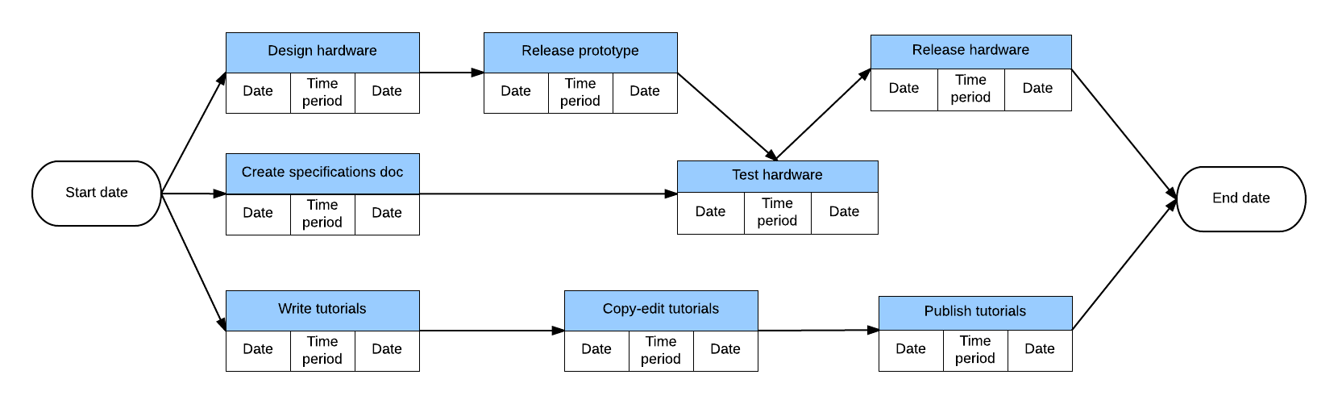
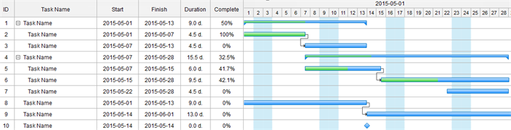
PMBoK
WBS dictionary. The WBS dictionary is a document that provides detailed deliverable, activity, and scheduling information about each component in the WBS. The WBS dictionary is a document that supports the WBS. Information in the WBS dictionary may include, but is not limited to:
Code of account identifier,
Description of work,
Assumptions and constraints,
Responsible organization,
Schedule milestones,
Associated schedule activities,
Resources required,
Cost estimates,
Quality requirements,
Acceptance criteria,
Technical references, and
Agreement information.

Slide 28
SWEBOK: Chap 13: Computing Foundations (pages 33)
https://www.computer.org/education/bodies-of-knowledge/software-engineering
SWEBOK: Chap 10: SW Quality: 1.3 Models and Quality Characteristics (pages .5)

Slide 29

SWEBoK: CHAPTER 10 SOFTWARE QUALITY
1. Software Quality Fundamentals
1.1. Software Engineering Culture and Ethics
1.2. Value and Costs of Quality
1.3. Models and Quality Characteristics
1.3.1. Software Process Quality
1.3.2. Software Product Quality
1.4. Software Quality Improvement
2. Software Quality Management Processes
2.1. Software Quality Assurance
2.2. Verification & Validation
2.3. Reviews and Audits
2.3.1. Management Reviews
2.3.2. Technical Reviews
2.3.3. Inspections
2.3.4. Walkthroughs
3. Practical Considerations
3.1. Software Quality Requirements
3.1.1. Influence Factors
3.1.2. Dependability
3.1.3. Integrity Levels of Software
3.2. Defect Characterization
3.3. Software Quality Management Techniques
3.3.1. Static Techniques
3.3.2. Dynamic Techniques
3.3.3. Testing
3.4. Software Quality Measurement
4. Software Quality Tools

Slide 30
1.3. Models and Quality Characteristics
1.3.1. Software Process Quality
1.3.2. Software Product Quality
Terminology for software quality characteristics differs from one taxonomy (or model of software quality) to another, each model perhaps having a different number of hierarchical levels and a different total number of characteristics. Various authors have produced models of software quality characteristics or attributes that can be useful for discussing, planning, and rating the quality of software products.
Determine the real purpose of the software
stakeholder requirements are paramount
include quality requirements in addition to functional requirements
responsibility to elicit quality requirements
All software development processes (e.g., eliciting requirements, designing, constructing, building, checking, improving quality)
Development costs help ensure that quality obtained can be traded off against the anticipated benefits

Slide 31
1.3. Models and Quality Characteristics
1.3.2. Software Product Quality
The term work-product means any artifact that is the outcome of a process used to create the final software product.
Examples of a work-product include a
system/subsystem specification,
a software requirements specification for a software component of a system,
a software design description,
source code,
software test documentation, or reports.
Examples of a work-product include a
system/subsystem specification,
a software requirements specification for a software component of a system,
a software design description,
source code,
software test documentation, or reports.
While some treatments of quality are described in terms of
final software and system performance,
sound engineering practice requires that intermediate work-products relevant to quality be evaluated throughout the software engineering process

Slide 32
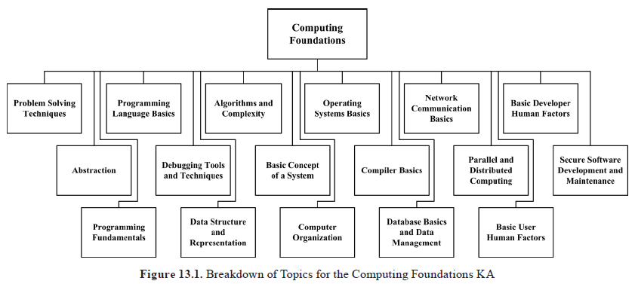
SWEBOK: Chapter 17
Functional SW Characteristics
Expert Judgement Tool #2: Requirements

Slide 33
CHAPTER 13 COMPUTING FOUNDATIONS
INTRODUCTION
BREAKDOWN OF TOPICS FOR COMPUTING FOUNDATIONS
1. Problem Solving Techniques
1.1. Definition of Problem Solving
1.2. Formulating the Real Problem
1.3. Analyze the Problem
1.4. Design a Solution Search Strategy
1.5. Problem Solving Using Programs
2. Abstraction
2.1. Levels of Abstraction
2.2. Encapsulation
2.3. Hierarchy
2.4. Alternate Abstractions
3. Programming Fundamentals
3.1. The Programming Process
3.2. Programming Paradigms
4. Programming Language Basics
4.1. Programming Language Overview
4.2. Syntax and Semantics of Programming Languages
4.3. Low-Level Programming Languages
4.4. High-Level Programming Languages
4.5. Declarative vs. Imperative Programming Languages
5. Debugging Tools and Techniques
5.1. Types of Errors
5.2. Debugging Techniques
5.3. Debugging Tools
6. Data Structure and Representation
6.1. Data Structure Overview
6.2. Types of Data Structure
6.3. Operations on Data Structures
7. Algorithms and Complexity
7.1. Overview of Algorithms
7.2. Attributes of Algorithms
7.3. Algorithmic Analysis
7.4. Algorithmic Design Strategies
7.5. Algorithmic Analysis Strategies
8. Basic Concept of a System
8.1. Emergent System Properties
8.2. Systems Engineering
8.3. Overview of a Computer System
9. Computer Organization
9.1. Computer Organization Overview
9.2. Digital Systems
9.3. Digital Logic
9.4. Computer Expression of Data
9.5. The Central Processing Unit (CPU)
9.6. Memory System Organization
9.7. Input and Output (I/O)
10. Compiler Basics
10.1. Compiler/Interpreter Overview
10.2. Interpretation and Compilation
10.3. The Compilation Process
11. Operating Systems Basics
11.1. Operating Systems Overview
11.2. Tasks of an Operating System
11.3. Operating System Abstractions
11.4. Operating Systems Classification
12. Database Basics and Data Management
12.1. Entity and Schema
12.2. Database Management Systems (DBMS)
12.3. Database Query Language
12.4. Tasks of DBMS Packages
13. Network Communication Basics
13.1. Types of Network
13.2. Basic Network Components
13.3. Networking Protocols and Standards
13.4. The Internet
13.5. Internet of Things
13.6. Virtual Private Network (VPN)
14. Parallel and Distributed Computing
14.1. Parallel and Distributed Computing Overview
14.2. Difference between Parallel and Distributed Computing
14.3. Parallel and Distributed Computing Models
14.4. Main Issues in Distributed Computing
15. Basic User Human Factors
15.1. Input and Output
15.2. Error Messages
15.3. Software Robustness
16. Basic Developer Human Factors
16.1. Structure
16.2. Comments
17. Secure Software Development and Maintenance
17.1. Software Requirements Security
17.2. Software Design Security
17.3. Software Construction Security
17.4. Software Testing Security
17.5. Build Security into Software Engineering Process
17.6. Software Security Guidelines

Slide 34
SWEBOK: Chapter 17
1. Problem Solving Techniques
1.1. Definition of Problem Solving
1.2. Formulating the Real Problem
1.3. Analyze the Problem
1.4. Design a Solution Search Strategy
1.5. Problem Solving Using Programs
2. Abstraction
2.1. Levels of Abstraction
2.2. Encapsulation
2.3. Hierarchy
2.4. Alternate Abstractions
3. Programming Fundamentals
3.1. The Programming Process
3.2. Programming Paradigms: Unstructured Programming, Structured/Procedural/Imperative Programming, Object-Oriented Programming, Aspect-Oriented Programming, Functional Programming
4. Programming Language Basics
4.1. Programming Language Overview
4.2. Syntax and Semantics of Programming Languages
4.3. Low-Level Programming Languages
4.4. High-Level Programming Languages
4.5. Declarative vs. Imperative Programming Languages
5. Debugging Tools and Techniques
5.1. Types of Errors
5.2. Debugging Techniques: Single-stepping, Breakpoints, Watch points
5.3. Debugging Tools
6. Data Structure and Representation
6.1. Data Structure Overview
6.2. Types of Data Structure
6.3. Operations on Data Structures: Create, Read, Update, Delete
7. Algorithms and Complexity
7.1. Overview of Algorithms
7.2. Attributes of Algorithms
7.3. Algorithmic Analysis: Analysis of algorithms, worst-case analysis, average-case analysis, best-case analysis, amortized analysis, competitive analysis
7.4. Algorithmic Design Strategies
7.5. Algorithmic Analysis Strategies
8. Basic Concept of a System
8.1. Emergent System Properties
8.2. Systems Engineering
8.3. Overview of a Computer System

Slide 35
SWEBOK: Chapter 17
13. Network Communication Basics
13.1. Types of Network: Personal, Local, Campus, Wide Area, Internet
13.2. Basic Network Components
13.3. Networking Protocols and Standards
13.4. The Internet
13.5. Internet of Things
14. Parallel and Distributed Computing
14.1. Parallel and Distributed Computing Overview
14.2. Difference between Parallel and Distributed Computing
14.3. Parallel and Distributed Computing Models
14.4. Main Issues in Distributed Computing
15. Basic User Human Factors
15.1. Input and Output
15.2. Error Messages
15.3. Software Robustness 16. Basic Developer Human Factors
16.1. Structure
16.2. Comments
17. Secure Software Development and Maintenance
17.1. Software Requirements Security
17.2. Software Design Security
17.3. Software Construction Security
17.4. Software Testing Security
17.5. Build Security into Software Engineering Process
17.6. Software Security Guidelines
1. Validate input.
2. Heed compiler warnings.
3. Architect and design for security policies.
4. Keep it simple.
5. Default deny.
6. Adhere to the principle of least privilege.
7. Sanitize data sent to other software.
8. Practice defense in depth.
9. Use effective quality assurance techniques.
10. Adopt a software construction security standard.
9. Computer Organization
9.1. Computer Organization Overview
9.2. Digital Systems
9.3. Digital Logic
9.4. Computer Expression of Data
9.5. The Central Processing Unit (CPU)
9.6. Memory System Organization
9.7. Input and Output (I/O)
10. Compiler Basics
10.1. Compiler/Interpreter Overview
10.2. Interpretation and Compilation
10.3. The Compilation Process: Lexical, Syntax, Semantic Analysis; Code Generation
11. Operating Systems Basics
11.1. Operating Systems Overview
11.2. Tasks of an Operating System
11.3. Operating System Abstractions
11.4. Operating Systems Classification: Batching, Multiprogrammed, Time-sharing, Real-time, Distribution, Embedded, Mainframe, Server, Multicomputer, Personal, Mobile
12. Database Basics and Data Management
12.1. Entity and Schema
12.2. Database Management Systems (DBMS)
12.3. Database Query Language
12.4. Tasks of DBMS Packages: DB development, interrogation, maintenance; application development
12.5. Data Management
12.6. Data Mining

Slide 37
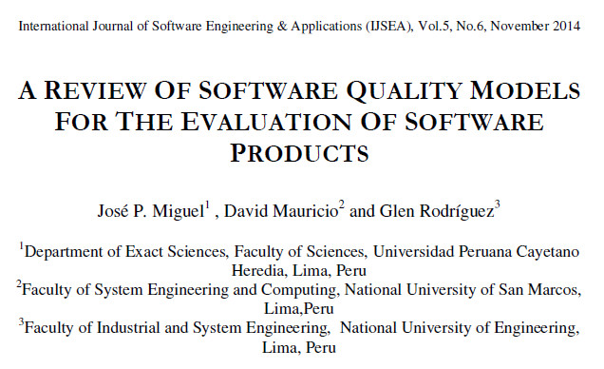
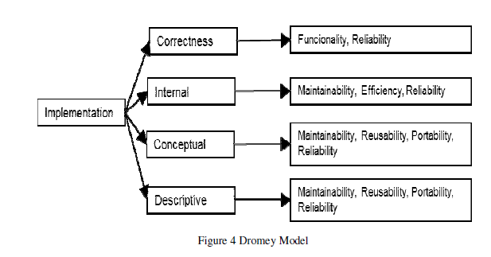
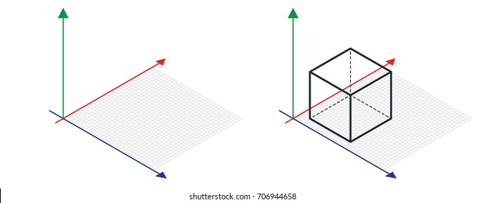
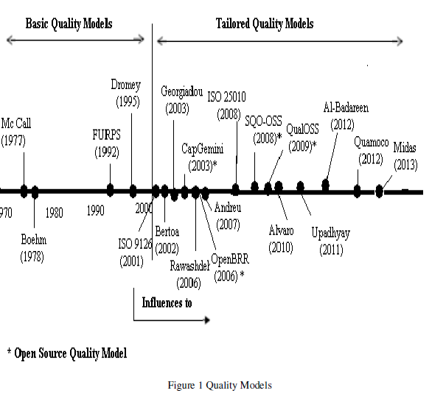
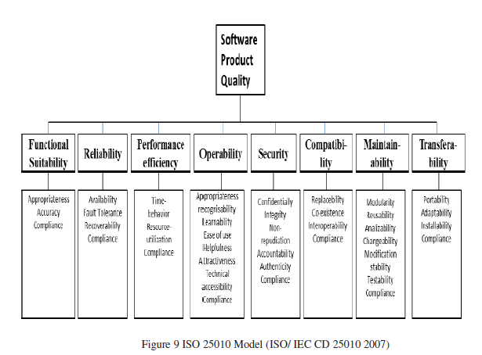
Functional Vs Non-Functional Requirements
Functional Requirements (WBS: Req & SW Char)
Non-Functional Requirements (Quality characteristics)
Models -> Test Trees
Program
Groups
Characteristic/ Requirement
Characteristic/ Requirement
Groups
Characteristic/ Requirement
Application
Design Non-Functional Requirements
Non-Functional Requirements

Slide 38
A review of software quality models for the evaluation of software products
1. Introduction
2. Methodology
2.1 Search strategies
2.2 Inclusion and exclusion criteria
3. Basic quality models
3.1 Mc Call Model
3.2 Boehm Model
3.3 Dromey Model
3.4 FURPS Model
3.5 ISO 9126 Model
3.6 ISO 25010Model
4. Tailored Quality Models
4.1 Bertoa Model
4.2 GEQUAMO
4.3 Alvaro Model
4.4 Rawashdeh Model
5. Open Source Models
5.1 CapGemini Open Source Maturity Model
5.2 OpenBRR Model
5.3 SQO-OSS Model.
5.4 QualOSS Model
6. Model Comparison
7. Conclusions
Notes:
Additional Resources
http://www.professionalqa.com/comparison-quality-models

Slide 39
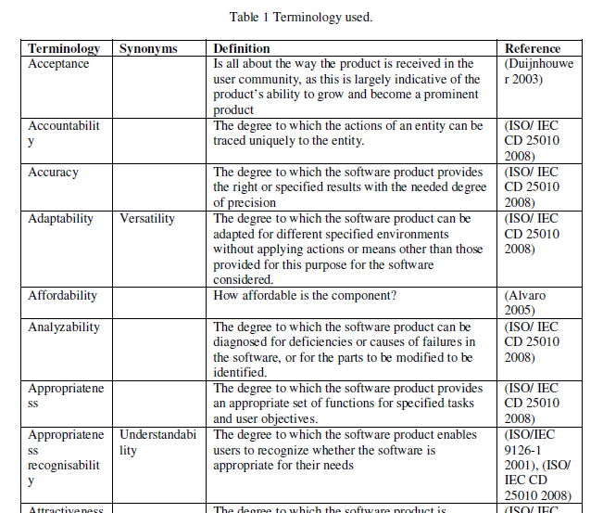
A review of software quality models for the evaluation of software products
1. Introduction
2. Methodology
2.1 Search strategies
2.2 Inclusion and exclusion criteria
Class Activity
Categorize the terminonlogy

Slide 40
Why Study Quality Models?
In groups:
Research two quality models found in the reading.
Why are they used?
What do they measure?
Notes:
This eventually gives rise to the need for reassuring that the product so built meets at least the expected standards.

Slide 41
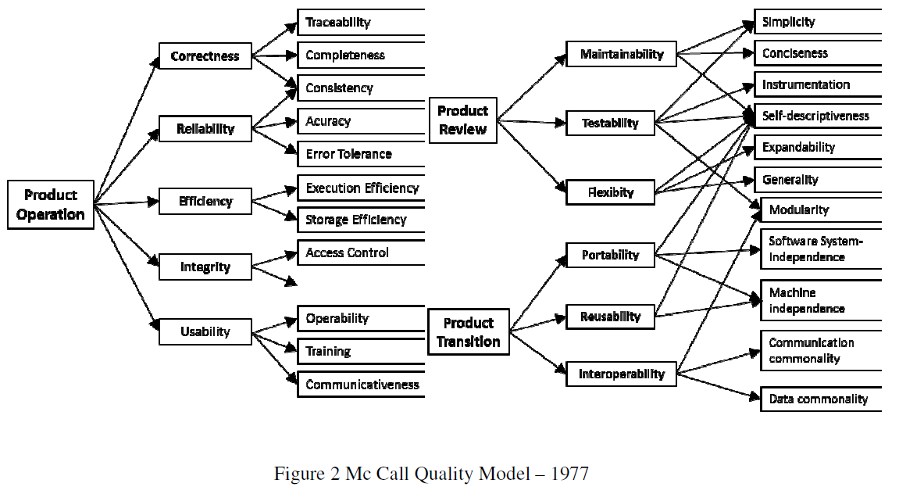
3. Basic quality models
3.1 Mc Call Model
Three Perspectives:
Product Review
maintenance, flexibility, and testing
Product Operation
correct, reliable, efficient, integrity and usability
Product Transition
portability, reusability and interoperability
Relationships between quality characteristics and metrics.
Base for the creation of others quality models
The main drawback of the Call Mac model is the accuracy in the measurement of quality, as it is based on responses of Yes or No

Slide 42
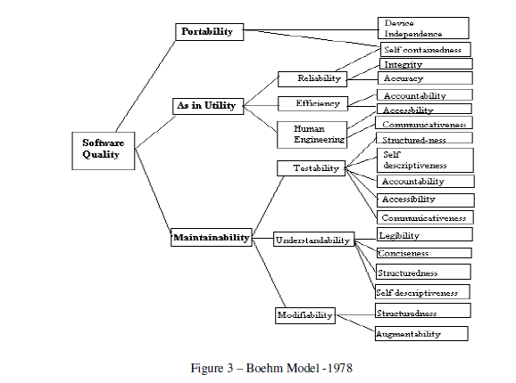
3. Basic quality models
3.2 Boehm Model
Improvement over the Mc Call
The high-level factors are:
a) Utility indicating the easiness, reliability and efficiency of use of a software product;
b) Maintainability that describe the facilities to modify, the testability, and the aspects of understanding;
c) Portability in the sense of being able to continue being used with a change of environment.

Slide 43
3. Basic quality models
3.3 Dromey Model
Perspective of product quality.
Theoretical model is used to design other more specific, models

Slide 44
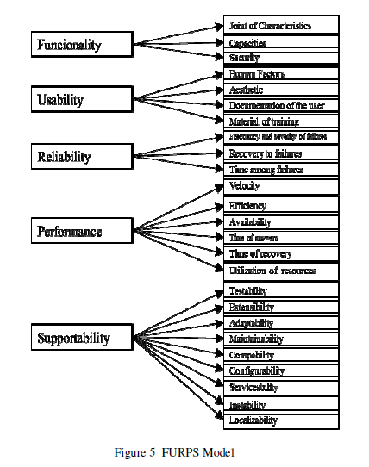
3. Basic quality models
Functional vs Non-Functional Char.
3.4 FURPS Model
Functional Requirements (RF)
The RF are defined by the inputs and outputs expected
Non-functional (NF)
Usability (U), Reliability (R), Performance (P) and product support (S)
Portability – not considered

Slide 45
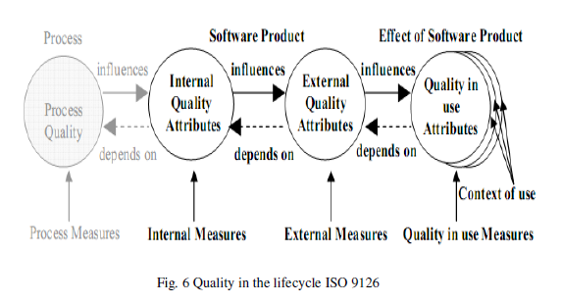
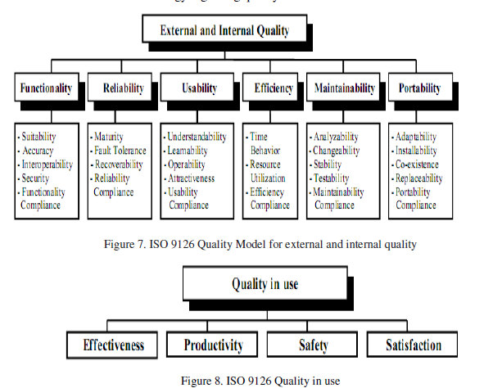
3. Basic quality models
based on the McCall and Boehm models
3.5 ISO 9126 Model
3.6 ISO 25010Model
basis for Tailored Quality Models
standards based on ISO 9126
development of software products
Internal (non-exec) vs
External
(during execution)
Quality in Use (satisfaction of user)
Both use three view
perspective

Slide 46
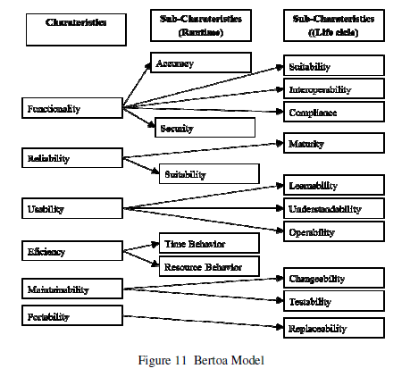
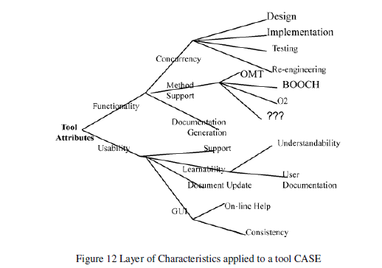
4. Tailored Quality Models (COTS)
4.1 Bertoa Model (for COTS)
4.2 GEQUAMO (user requirements)

Slide 47
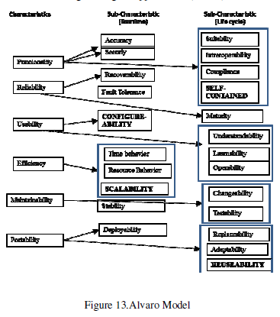
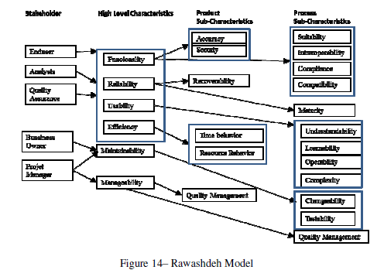
4. Tailored Quality Models
4.3 Alvaro Model (certification framework)
4.4 Rawashdeh Model (different types of users)

Slide 48
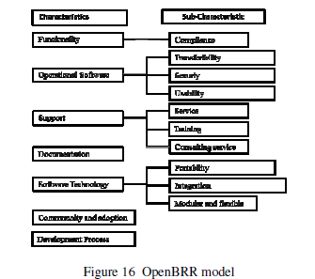
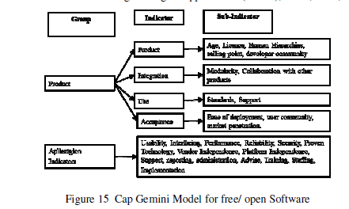
5. Open Source Models
5.1 CapGemini Open Source Maturity Model (project maturity indicators)
5.2 OpenBRR Model (Business Readiness Framework)

Slide 49
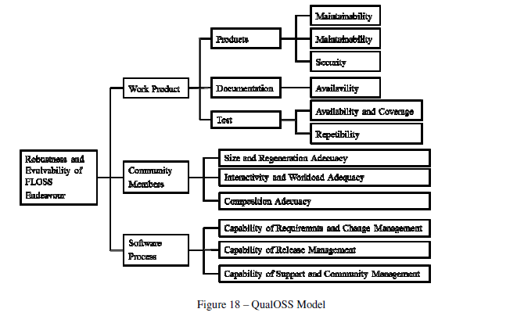
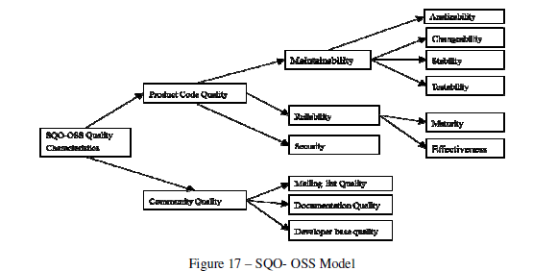
5. Open Source Models
5.3 SQO-OSS Model (source code and process).
5.4 QualOSS Model (Product, Community, Software)

Slide 50
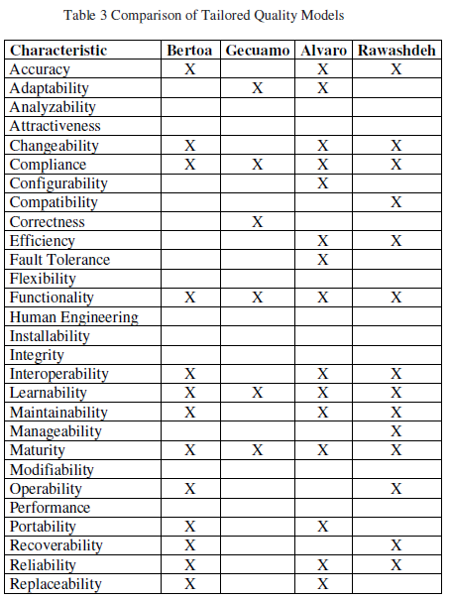
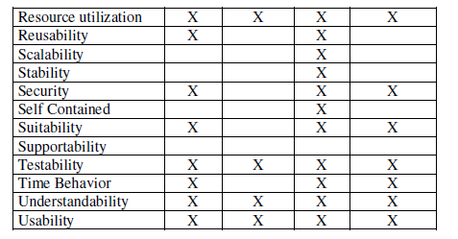
6. Model Comparison

Slide 51
Week 03 Assignments
Objectives:
Produce (6 - creating) Quality Models
Rank (5 - Evaluate) each attribute in the models by measurable characteristics
Assess (5 - Evaluate) Models for different scenarios
Assess (5 - Evaluate) a project's defect/fault density and Failure intensity
What are non-functional requirements?
How to build a quality model?
Create a QA Models

Slide 52
What are non-functional requirements?
Identify four characteristics that are common among all of your models. Research the characteristic and determine the best method to measure it. Part 1: Determine which characteristics are shared in the Basic Models but used in the Tailored and the Open Source.
Compare and Contrast the Basic Models with the Tailored and Open-Source models.
Create a Venn diagram or table that categories the characteristics, characteristics that are reserved for Basic Models, those that are shared, and those that are only in Tailored/Open-Source models. (Highlight or Bold those characteristics that are shared).
As an exceptional expectation, separate the Tailored and Open Models and determine shared characteristics between all three. (Highlight or Bold for all three, green font for Basic and Tailored, Orange for Basic and Open, and Blue for Tailored and Open).

Slide 53
How to build a quality model?
Part 1: Build hierarchy structure of Maps
Using PowerPoint or a similar draw application, create a hierarchy of the different models. Starting with McCall as the parent, including all the Basic, Tailored, and Open-Source Models.
Part 2: How far off (%) are the models from each other?
In section 6, the author lists all the quality characteristics found in each of the models. Transfer those table’s information into a spreadsheet.
Create an equation that calculates a percentage of coverage of the listed characteristics for each model. Explain your equation.
Using your hierarchy, determine how much change was made from the parent model(s).

Slide 54
How to build a quality model?
Part 3: Pick the best model for a situation.
Determine a type or example of software or software package that implements one of the categories below.
Front-End Applications: Project can be developed on any platform: PC, Mac, Web, Mobile, GUI, etc.
Language: You can research or create a new language or analysis old.
Requirements/Design: This should be customer driven project.
Patterns: Understanding design patterns, anti-patterns, structures
Back-End applications: Highly robust applications require back-end work including: Servers, hardware, architecture, distributed systems.
Database: Uses of databases from flat files to DB management system, and DB modeling & structuring.
Security: Information, Technology, and Programming security
AI, Machine Learning, Data Mining: Data manipulation and presentation
Pick one model from the different models found in Miguel's reading that best fits your example. Provide a reason for each characteristic found in the model. Some characteristics will not fit, identify them and describe why it would not be a match.
Rate the matching by proving a percentage of match, based on your equation from Part 2.

Slide 55
How to build a quality model?
Part 4: Build a model
Using the example/type and model from Part 3, derive a model that will match at 100%. It will help to use the Work Breakdown Structure (WBS) found in the SWEBoK and PMBoK)
Explain each of the new characteristics.
Many of the models have additional branches or layers. You may derive additional layer from previous the models or create your own layers. Identify each by the uses (Internal, External, or Quality)
Using Figure 13.1 from the SWEBoK, identify 2-3 quality characteristic that best fit each topic.
Items to keep in mind:
Which Quality Characteristics do you think should be in the model?
How many layers and sub-categories should there be in your model?
What parts of the software will your quality model cover? For example, ISO 9126/2510 has three model trees one for internal (static analysis), one for external (dynamic), and quality in use (maintainability).

Slide 56
Prove: Create a QA Models
You will create three models. Model 1: Mobile Quality Model
You will derive a model based on the ISO 25010 Basic Model.
First, pick a Mobile application that you have recently used.
Next, you need to determine if your application fits the model by looking at each model's characteristics and determining which characteristics fit the application.
Provide a percentage fit.
Find five characteristics that are not include in the ISO 25010 model, that you believe should be in the model. Update the model.
Model 2: IDE Quality Model
Pick an IDE (Visual Basic, Eclispe, etc).
Determine which Tailored Model best fits your IDE choice.
Do a complete analysis of each of the characteristics, explain why it fits.
Using the parent model, determine which characteristics are no longer needed (or up to three from other models that should not be in the model),
remove them from the model.
For each of those characteristics, identify how to measure based on the IDE.

Slide 57
Prove: Create a QA Models
Model 3 Messaging Service
Pick Messaging service (Discord, Zoom, Slack, MS Teams, etc.).
Determine if you should use Basic, Tailored, or Open-Source models as your parent model. Provide reasons why you choose that model category and didn’t choose the other two.
Complete a compatibility analysis of the model. For each characteristic quality of the model, determine if it is relevant to the Messaging Service application. What percentage of the model covers the application?
Using the defects of that model, create a new model that overcomes that defect. Use at least 4-5 more new characteristics not found in the parent model. You might have to re-arrange or add new categories. You might even want to remove some quality characteristics.

