Slide 1
Welcome to Week 05 Processes
CSE 474 Quality Assurance
Brother W. Clements

Slide 2
5. QA Processes
(V&V, Reviews, Audits)
8. Reviews & Audits
(Tech, Mngt., Inspection, walk-throughs, checklist)
10. Configuration Management
1. Fundamentals & Business Case for Quality Assurance
(IEEE SWBok)
9. Maturity
(CMM, Process, Product, ISO)
11. Risk/Mission Assurance
(Training, CAR, Mitigation)
6. QA Tools
(Fishbone, check, Histograms, Pareto, Scatter, Stratification)]
12. Security/ Legal/ Ethics
(Regulations, Code, Legal, Safety)
2. QA’s Role in SW Lifecycle, Methodologies,
Architecture
[Responsibilities & Roles]
7. QA Attributes
(Verification and Validation )
13 . Project Management
(CoQ, WBS, DevOps )
[VDD, Version, DM, DI]
14. Careers Path
3. QA Techniques
(Dyn, Static, and Testing)
[]
4. Quality Metrics
(Characteristic & Models)
[Measuring]
Know
Do
Become
SWE 474: Quality Assurance Class

Slide 3
Agenda
Overview of this week’s assignments
Discuss Audits and Reviews
Work on Assignments

Slide 4
Reading
"IEEE Standard for Software Quality Assurance Processes," in IEEE Std 730-2014 (Revision of IEEE Std 730-2002) , vol., no., pp.1-17, 13 June 2014, doi: 10.1109/IEEESTD.2014.6835311. (pages 17)
https://ieeexplore-ieee-org.byui.idm.oclc.org/document/6835311 (Links to an external site.)
"IEEE Standard for Software Quality Assurance Plans," in IEEE Std 730-2002 (Revision of IEEE Std 730-1998) , vol., no., pp.1-8, 23 Sept. 2002, doi: 10.1109/IEEESTD.2002.94130. (pages 8)
https://ieeexplore-ieee-org.byui.idm.oclc.org/document/1040117 (Links to an external site.)
L. Westfall Certified Software Quality Engineer Handbook, ASQ Quality Press, 2009-09-01, https://ebookcentral.proquest.com/lib/byui/detail.action?docID=3002591 (Links to an external site.)
Chapter 8: Audits (pages 12)

Slide 5
Week 05 Assignments
Objectives:
Breakdown (4 -Analyze) Verification and Validation techniques for Quality Assurance
Examine (4-Analyze) plans for V&V and Audits
Assess (5 - Evaluate) products using QA Audits
How do I create a software quality plan?
What reviews and audits do I need as a QA professional?
Complete SQAP Section 6

Slide 6
How do I create a software quality plan?
Section 1-3 added
Section 9 added
Section 7 added
Section 6 added
Section 11 added, Section 3 updated
Section 10 & 12 added
Section 8 & 14 added
Section 13 added
In order to follow a QA process, you need a plan. The plan will be developed in different stages throughout the semester, each week will update each section. This week will assemble a general 1st draft from what we already have worked on.
Plan consists of 14 sections
Each week we will be adding sections and revising previous.

Slide 7
SQAP Outline
Title Page
Revision History and TOC
Software Quality Assurance Plan
Purpose:
Authors:
Approved by: (Professor for CSE 474)
Date | Authors | Revision | Description
Week 5 date |  | 0.05 | Section 1-3 added
Week 6 date |  | 0.06 | Section 9 added
Week 7 date |  | 0.07 | Section 7 added
Week 8 date |  | 0.08 | Section 6 added
Week 9 date |  | 0.09 | Section 11 added, Section 3 updated
Week 10 date |  | 0.10 | Section 4, 10 & 12 added
Week 11 date |  | 0.11 | Section 8 & 14 added
Week 12 date |  | 0.12 | Section 5 & 13 added
Week 13 date |  | 1.0 | Final version submitted
Week 13 date |  | 1.1 | Internal audit
Week 13 date |  | 1.2 | External audit
Week 13 date |  | 1.3 | Internal audit

Slide 8
SQAP Outline
Starting Sections
Section 5-14
Complete Section 1: Purpose
For this project, you are going to pick a fictitious project.
Complete Section 2: Reference documents
Create a table that contains the name of the reference document and the location.
This is where you list the 730-2002 IEEE document.
Complete Section 3: Management
3.1 Organizational Chart
3.2 Tasking
3.3 Roles and Responsibilities
3.4 Estimated Resources (Week 13)
Complete Section 4: Documentation
Leave black for now, although Section 6 will be completed as part of this week’s Prove.

Slide 9
What reviews and audits do I need as a QA professional?
Task: Prepare content for Section 6 of the SQAP, by creating a list of needed reviews and audits.
Purpose: Collect information about review and audits that are needed as part of the software quality assurance process.
In section 6 of the SQAP, covers software reviews. Using the reading and previous assignments create a list of Reviews and Audits that need to be completed by a project. This will include reviews and audits of project and product deliverables.

Slide 10
What reviews and audits do I need as a QA professional?
Part 1: Look through Week 02 Lifecycles and determine a list of deliverables from each of the methodologies. Include deliverables from Waterfall, Spiral, XP and Agile, label accordantly.
Part 2: Look through the 730-2002 IEEE Standards for Software Quality Assurance Plans, Cert. SW Quality Engr Handbook chapters, and the SWBOK, and PMBOK. Update your list of missing deliverables, marking your sources for each deliverable.
Part 3: For each deliverable determine if it should be reviewed or audited.
A review is typically a meeting going over a product, and an audit determines if a process was followed.
For example, a Software Requirements Specification (deliverable) should be reviewed, and the meeting minutes are evidence the process was followed and is auditable. You might have to update the list.
Part 4: Update the list to indicate how the review or audit will be accomplished, implemented or verified.
Part 5: Organize the list you made in the Teach activity into four categories:
Static Verification
Dynamic Verification
Static Validation
Dynamic Validation
Part 6: Establish a logical order for the deliverables, reviews, and audits. Create a dependence schedule, a schedule of events without actual dates. Determine significate milestones.
Part 7: Determine the possible outputs of the reviews and audits. Besides the meeting minutes, what other possible outputs might be recorded that need to be recorded or tracked.

Slide 11
Complete SQAP Section 6
Using the information, you gathered in the teach activity update the SQAP Section 6.
Create sub-sections that logically make sense. Explain each sub-section with a brief description of the sub-section. Do not use “This sub-section...”, instead of naming the sub-section and describing its purpose.
Add in the different reviews and audits into the subsections, explain the purposes of the review, how it will be accomplished, implemented, and verified.
In 730-2002 IEEE Standards for Software Quality Assurance Plans, section 4.6.1, the section’s purpose is explained. In the notes of the assignment, indicate how you fulfilled each of the four purposes.
Include additional reviews specifically spelled out in this week’s assignments, such as
Other reviews and audits
Managerial reviews
Walk-throughs
Inspections
Technical reviews
Supplier reviews.

Slide 12
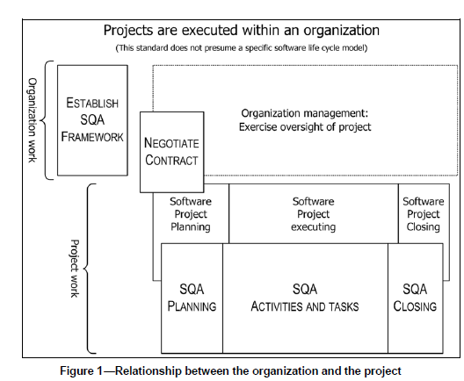
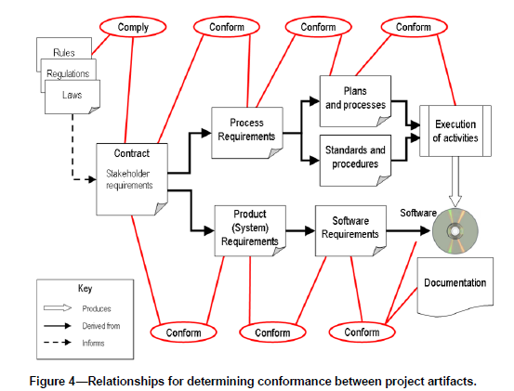
IEEE Standard for Software Quality Assurance Processes
1.1 Scope
This standard establishes requirements for initiating, planning, controlling, and executing the Software Quality Assurance (SQA) processes of a software development or maintenance project
1.2 Purpose
produce and collect evidence that form the basis for giving a justified statement of confidence that the software product conforms to its established requirements
uniform, minimum acceptable requirements for SQA processes
1.3 Field of application
standard guides SQA activities
4. Key concepts of Software Quality Assurance
4.1 Organizational management responsibility
4.2 Organization and project relationship
4.3 Software quality and relationship to requirements
4.4 Overview of SQA activities
4.5 Acquirer and supplier perspectives
4.6 Key concepts of this standard
4.6.1 Defining the software quality assurance role
4.6.2 Software product risks
4.6.3 Relationship between systems and software
4.7 Software process improvement
4.8 Maintaining quality management system consistency

Slide 13
IEEE Standard for Software Quality Assurance Processes
5. Software Quality Assurance process
5.1 Purpose
5.2 Organization of SQA process outcomes
5.3 SQA process implementation activities
5.3.1 Establish the SQA processes
5.3.2 Coordinate with related software processes
5.3.3 Document SQA planning
5.3.4 Execute the SQA Plan
5.3.5 Manage SQA records
5.3.6 Evaluate organizational independence and objectivity
5.4 Product assurance activities
5.4.1 Defining product assurance
5.4.2 Evaluate plans for conformance to contracts, standards, and regulations
5.4.3 Evaluate product for conformance to established requirements
5.4.4 Evaluate product for acceptability
5.4.5 Evaluate product life cycle support for conformance
5.4.6 Measure products
5.5 Process assurance activities
5.5.1 Defining process assurance
5.5.2 Evaluate life cycle processes and plans for conformance
5.5.3 Evaluate environments for conformance
5.5.4 Evaluate subcontractor processes for conformance
5.5.5 Measure processes
5.5.6 Assess staff skill and knowledge

Slide 14
IEEE Standard for Software Quality Assurance Plans
Date | Authors | Revision | Description
Week 5 date |  | 0.05 | Section 1-3 added
Week 6 date |  | 0.06 | Section 9 added
Week 7 date |  | 0.07 | Section 7 added
Week 8 date |  | 0.08 | Section 6 added
Week 9 date |  | 0.09 | Section 11 added, Section 3 updated
Week 10 date |  | 0.10 | Section 4, 10 & 12 added
Week 11 date |  | 0.11 | Section 8 & 14 added
Week 12 date |  | 0.12 | Section 5 & 13 added
Week 13 date |  | 1.0 | Final version submitted
Week 13 date |  | 1.1 | Internal audit
Week 13 date |  | 1.2 | External audit
Week 13 date |  | 1.3 | Internal audit
1.1 Scope
1.2 Purpose
4. Software quality assurance plan
1) Purpose
2) Reference documents
3) Management
4) Documentation
5) Standards, practices, conventions, and metrics
6) Software reviews
7) Test
8) Problem reporting and corrective action
9) Tools, techniques, and methodologies
10) Media control
11) Supplier control
12) Records collection, maintenance, and retention
13) Training
14) Risk management
15) Glossary
16) SQAP change procedure and history

Slide 15
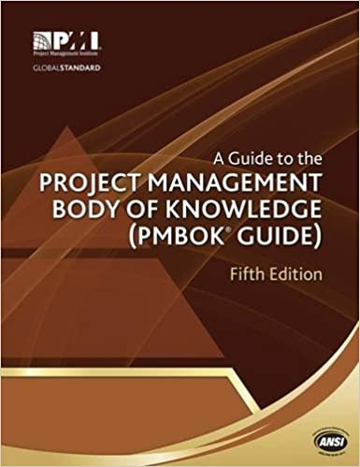
PMBoK: Audits
8.2.2.2 Quality Audits
A quality audit is a structured, independent process to determine if project activities comply with organizational and project policies, processes, and procedures. The objectives of a quality audit may include:
• Identify all good and best practices being implemented;
• Identify all nonconformity, gaps, and shortcomings;
• Share good practices introduced or implemented in similar projects in the organization and/or industry;
• Proactively offer assistance in a positive manner to improve implementation of processes to help the team raise productivity; and
• Highlight contributions of each audit in the lessons learned repository of the organization
The subsequent effort to correct any deficiencies should result in a reduced cost of quality and an increase in sponsor or customer acceptance of the project’s product. Quality audits may be scheduled or random, and may be conducted by internal or external auditors.
Quality audits can confirm the implementation of approved change requests including updates, corrective actions, defect repairs, and preventive actions.

Slide 16
8.2.2.3 Process Analysis
Process analysis follows the steps outlined in the process improvement plan to identify needed improvements.
This analysis also examines problems experienced, constraints experienced, and non-value-added activities identified during process operation.
Process analysis includes root cause analysis—a specific technique used to identify a problem, discover the underlying causes that lead to it, and develop preventive actions.

Slide 17

SWBok
2.3. Reviews and Audits
2.3.1. Management Reviews
The purpose of a management review is to monitor progress, determine the status of plans and schedules, and evaluate the effectiveness of management processes, tools and techniques. Management reviews compare actual project results against plans to determine the status of projects or maintenance efforts. The main parameters of management reviews are project cost, schedule, scope, and quality. Management reviews evaluate decisions about corrective actions, changes in the allocation of resources, or changes to the scope of the project.
2.3.2. Technical Reviews
The purpose of a technical review is to evaluate a software product by a team of qualified personnel to determine its suitability for its intended use and identify discrepancies from specifications and standards. It provides management with evidence to confirm the technical status of the project.
2.3.3. Inspections
The purpose of an inspection is to detect and identify software product anomalies
2.3.4. Walkthroughs
The purpose of a systematic walk-through is to evaluate a software product. A walkthrough may be conducted for the purpose of educating an audience regarding a software product.
2.3.5. Process Assurance and Product Assurance Audits
The purpose of a software audit is to provide an independent evaluation of the conformance of software products and processes to applicable regulations, standards, guidelines, plans, and procedures.

Slide 18
Chapter 3: Audits
“a systematic, independent and documented process for obtaining audit evidence and evaluating it objectively to determine the extent to which the audit criteria are fulfilled.” - ASQ Audit Division (Russell 2005)
“an independent examination of a software product, software process, or set of software processes performed by a third party to assess compliance with specifications, standards, contractual agreements, or other criteria.” - IEEE (2008a)
ISO (2008), internal audits are a required part of a quality management system.
The Software Engineering Institute’s Capability Maturity Model Integration (CMMI) for Development includes formal audits as one of the ways to perform objective evaluations in the Process and Product Assurance process area.
Software audits are planned activities—there are no surprise software audits. Software audits use a set of agreed-to criteria to conduct these evaluations.

Slide 19
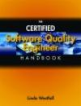
Chapter 8: Audits
Objectives:
Adequate and Meets organization’s standards, processes, policies
Work activities Comply to Organization
Effective and being meet
Resource are efficiently and effectively utilized
Product Conforms to requirements and standards
Types:
Internal (1st party)
External (2nd party – supplier)
External (3rd party – gov regulator)
System Audits
Process Audits
Product Audits
Project Audits
Follow-up Audits
Desk Audits
Roles and responsibilities
Client (initiator, customer, owner)
Auditor Management
Lead Auditor
Auditors
Auditee Management
Auditee
Escort

Slide 20
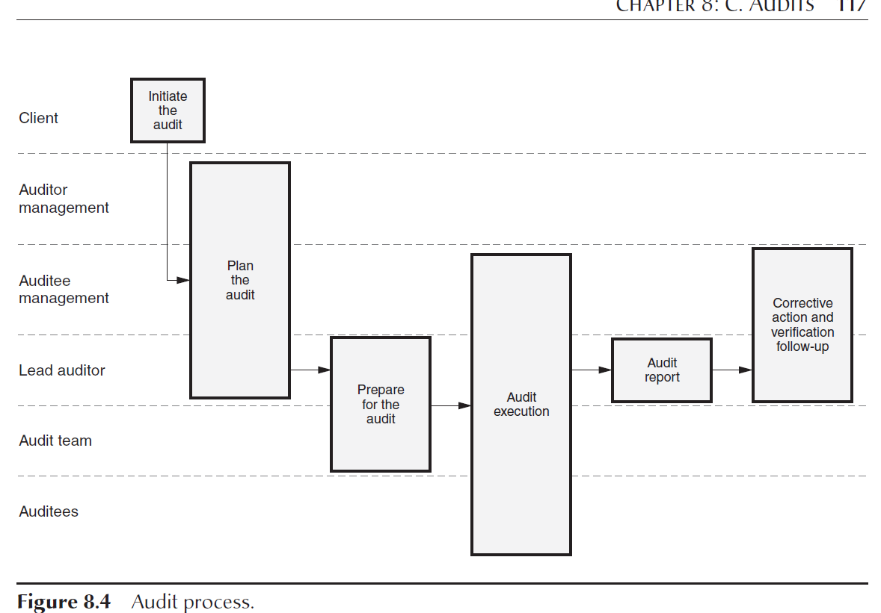
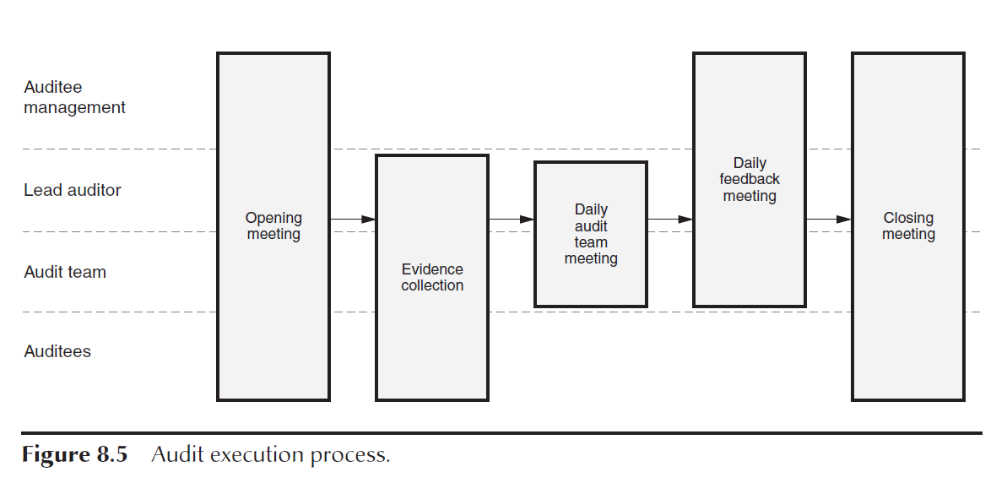
Chapter 8: Audits
Process
“The job of the auditors is to collect factual information, analyze and evaluate it in terms of the specified requirements, draw conclusions from this comparison, and report results to management” (Arter 1994).
Examining quality records
Reviewing documents
Witnessing an event or process
Finding patterns
Interviewing auditees.
Examining physical properties
Tracing
Audit Reporting
Audit Corrective Action and Follow-Up
• The audit plan
• Opening and closing meeting minutes, including attendance lists
• Completed working papers such as checklists and auditor notes
• The audit report
• Corrective action, follow-up, and closeout documentation for each nonconformance

Slide 21
SQAP Outline
Title Page
Revision History and TOC
Software Quality Assurance Plan
Purpose:
Authors:
Approved by: (Professor for CSE 474)
Date | Authors | Revision | Description
Week 5 date |  | 0.05 | Section 1-3 added
Week 6 date |  | 0.06 | Section 9 added
Week 7 date |  | 0.07 | Section 7 added
Week 8 date |  | 0.08 | Section 6 added
Week 9 date |  | 0.09 | Section 11 added, Section 3 updated
Week 10 date |  | 0.10 | Section 4, 10 & 12 added
Week 11 date |  | 0.11 | Section 8 & 14 added
Week 12 date |  | 0.12 | Section 5 & 13 added
Week 13 date |  | 1.0 | Final version submitted
Week 13 date |  | 1.1 | Internal audit
Week 13 date |  | 1.2 | External audit
Week 13 date |  | 1.3 | Internal audit

Slide 22
SQAP Outline
Starting Sections
Section 5-14
Complete Section 1: Purpose
For this project, you are going to pick a fictitious project.
Complete Section 2: Reference documents
Create a table that contains the name of the reference document and the location.
This is where you list the 730-2002 IEEE document.
Complete Section 3: Management
3.1 Organizational Chart
3.2 Tasking
3.3 Roles and Responsibilities
3.4 Estimated Resources (Week 13)
Complete Section 4: Documentation
Leave black for now, although Section 6 will be completed as part of this week’s Prove.

Slide 23
What reviews and audits do I need as a QA professional?
Part 1: Look through Week 02 Lifecycles and determine a list of deliverables from each of the methodologies. Include deliverables from Waterfall, Spiral, XP and Agile, label accordantly.
Part 2: Look through the 730-2002 IEEE Standards for Software Quality Assurance Plans, Cert. SW Quality Engr Handbook chapters, and the SWBOK, and PMBOK. Update your list of missing deliverables, marking your sources for each deliverable.
Part 3: For each deliverable determine if it should be reviewed or audited.
A review is typically a meeting going over a product, and an audit determines if a process was followed.
For example, a Software Requirements Specification (deliverable) should be reviewed, and the meeting minutes are evidence the process was followed and is auditable. You might have to update the list.
Part 4: Update the list to indicate how the review or audit will be accomplished, implemented or verified.
Part 5: Organize the list you made in the Teach activity into four categories:
Static Verification
Dynamic Verification
Static Validation
Dynamic Validation
Part 6: Establish a logical order for the deliverables, reviews, and audits. Create a dependence schedule, a schedule of events without actual dates. Determine significate milestones.
Part 7: Determine the possible outputs of the reviews and audits. Besides the meeting minutes, what other possible outputs might be recorded that need to be recorded or tracked.

Slide 24
Known vs Don’t known
 | Know |  | Don’t Know
Know | Know what we know |  | Know what we don’t know
Don’t Know | Don’t Know what we know |  | Don’t Know what we don’t know | Risk

Slide 25
Know what we know
Part 1: Look through Week 02 Lifecycles and determine a list of deliverables from each of the methodologies. Include deliverables from Waterfall, Spiral, XP and Agile, label accordantly
Methodology | Or Lifecycle Phase | Deliverable

Slide 26
Royce’s “Waterfall” Managing the Development of Large Software Systems
Introduction
Computer Program Development Functions
Step 1: Program Design Comes First
Step 2: Document the Design
Step 3: Do it Twice
Step 4: Plan, Control, and Monitor Testing
Step 5: Involve the Customer
Summary
Risk: Money to fund the extra is worth mitigating the risk?

Slide 27
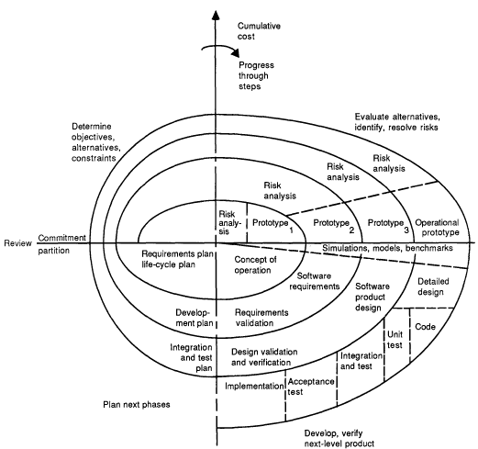
Spiral: Model
I
II
Spiral Model - Overview
A typical cycle
Initiating and terminating a cycle
Evolved from Waterfall, special case of
Typical Cycle:
I – Determine Objectives
II – Evaluate Alt/Risks and Mitigation
III – Develop, Verify
IV – Plan next
Explanation
Radial -> Cost
Angular -> Progress
Meetings
Documents
Model: Order of Stages
Does this work for the entire life cycle of the product?
IV
III

Slide 28
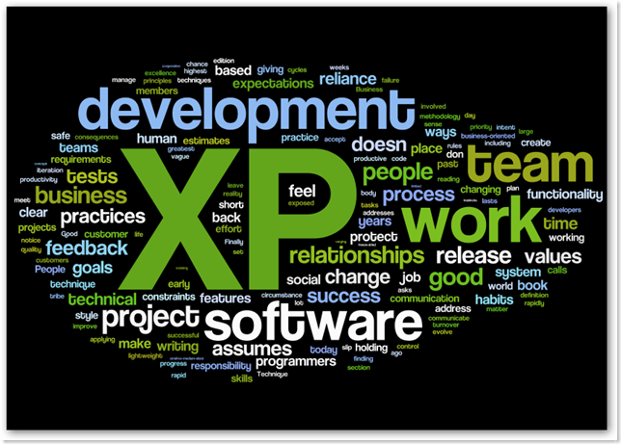
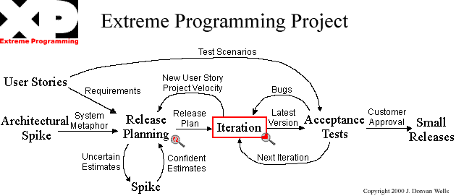
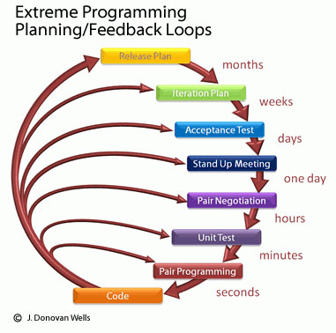
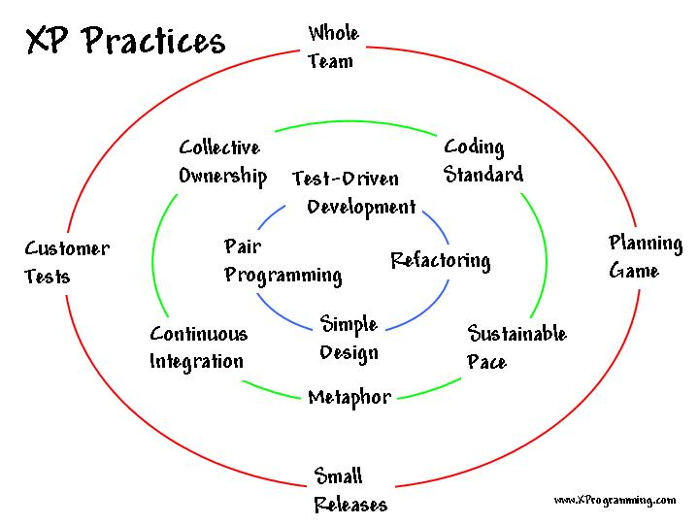
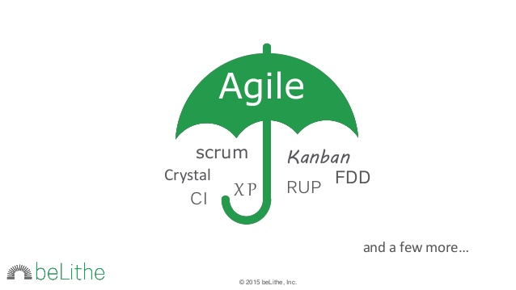
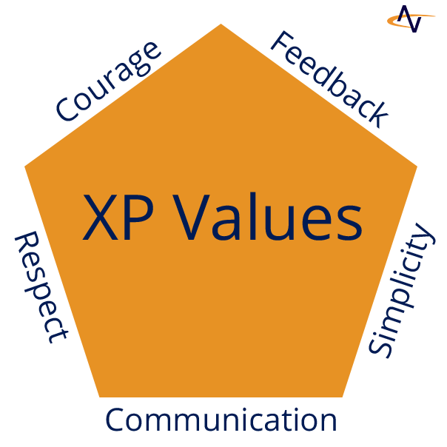
XP Overview/Approach

Slide 29
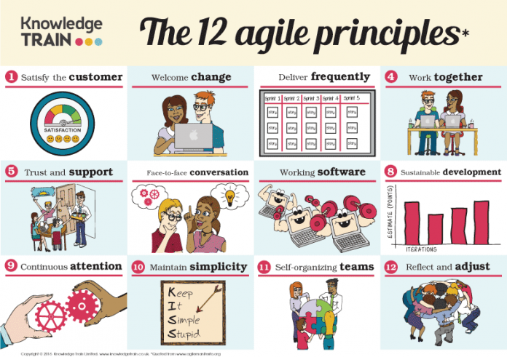
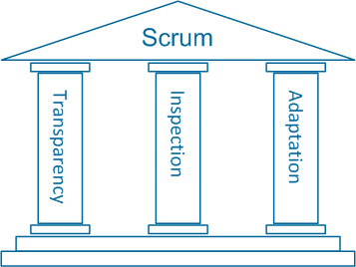
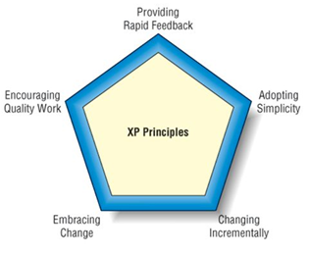
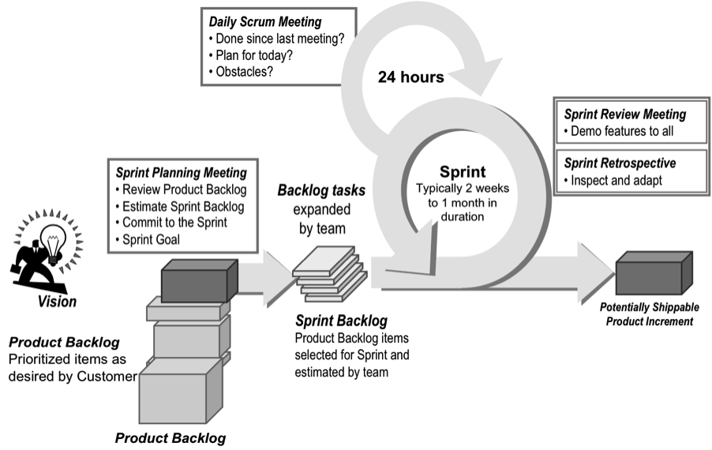
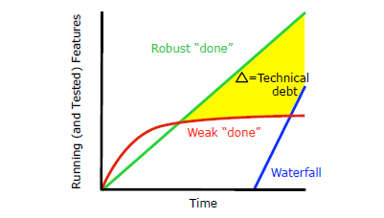
Agile Theory

Slide 30
What reviews and audits do I need as a QA professional? Don’t know what we know
Part 2: Look through the
730-2002 IEEE Standards for Software Quality Assurance Plans,
Cert. SW Quality Engr Handbook chapters, and the
SWBOK, and PMBOK.
Update your list of missing deliverables, marking your sources for each deliverable.

Slide 31
Chapter 8: Audits
Objectives:
Adequate and Meets organization’s standards, processes, policies
Work activities Comply to Organization
Effective and being meet
Resource are efficiently and effectively utilized
Product Conforms to requirements and standards
Types:
Internal (1st party)
External (2nd party – supplier)
External (3rd party – gov regulator)
System Audits
Process Audits
Product Audits
Project Audits
Follow-up Audits
Desk Audits
Roles and responsibilities
Client (initiator, customer, owner)
Auditor Management
Lead Auditor
Auditors
Auditee Management
Auditee
Escort

Slide 32
What reviews and audits do I need as a QA professional?
Part 3: For each deliverable determine if it should be reviewed or audited.
A review is typically a meeting going over a product, and
an audit determines if a process was followed.
For example, a Software Requirements Specification (deliverable) should be reviewed, and the meeting minutes are evidence the process was followed and is auditable. You might have to update the list.

Slide 33
What reviews and audits do I need as a QA professional?
Part 4: Update the list to indicate how the review or audit will be accomplished, implemented or verified.
Part 5: Organize the list you made in the Teach activity into four categories:
Static Verification
Dynamic Verification
Static Validation
Dynamic Validation
Part 6: Establish a logical order for the deliverables, reviews, and audits. Create a dependence schedule, a schedule of events without actual dates. Determine significate milestones.
Part 7: Determine the possible outputs of the reviews and audits. Besides the meeting minutes, what other possible outputs might be recorded that need to be recorded or tracked.

Slide 34
What reviews and audits do I need as a QA professional?
Part 4: Update the list to indicate how the review or audit will be accomplished, implemented, or verified.

Slide 35
What reviews and audits do I need as a QA professional?
Part 5: Organize the list you made in the Teach activity into four categories:
Static Verification Product Verification – code reviews
Dynamic Verification Product Testing
Static Validation Process and Customer Validation - pre
Dynamic Validation Process and Customer Validation - post

Slide 36
What reviews and audits do I need as a QA professional?
Part 6: Establish a logical order for the deliverables, reviews, and audits. Create a dependence schedule, a schedule of events without actual dates. Determine significate milestones.
When is each of these events going to happen?
Are there pre-conditions? Dependencies?
Do some come before or after others?

Slide 37
What reviews and audits do I need as a QA professional?
Part 7: Determine the possible outputs of the reviews and audits. Besides the meeting minutes, what other possible outputs might be recorded that need to be recorded or tracked.
How do you prove that it was completed?

Slide 38
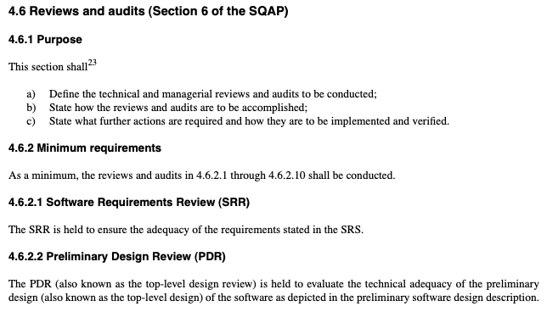
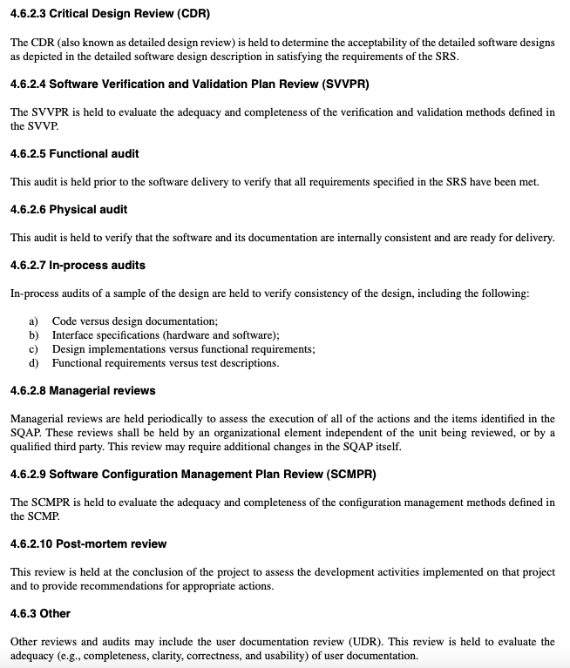
Complete SQAP Section 6
Using the information, you gathered in the teach activity update the SQAP Section 6.
Create sub-sections that logically make sense. Explain each sub-section with a brief description of the sub-section. Do not use “This sub-section...”, instead of naming the sub-section and describing its purpose.
Add in the different reviews and audits into the subsections, explain the purposes of the review, how it will be accomplished, implemented, and verified.
In 730-2002 IEEE Standards for Software Quality Assurance Plans, section 4.6.1, the section’s purpose is explained. In the notes of the assignment, indicate how you fulfilled each of the four purposes.
Include additional reviews specifically spelled out in this week’s assignments, such as
Other reviews and audits
Managerial reviews
Walk-throughs
Inspections
Technical reviews
Supplier reviews.

Slide 39
Next Week Assignments

Slide 40
5. QA Processes
(V&V, Reviews, Audits)
8. Reviews & Audits
(Tech, Mngt., Inspection, walk-throughs, checklist)
10. Configuration Management
1. Fundamentals & Business Case for Quality Assurance
(IEEE SWBok)
9. Maturity
(CMM, Process, Product, ISO)
11. Risk/Mission Assurance
(Training, CAR, Mitigation)
6. QA Tools
(Fishbone, check, Histograms, Pareto, Scatter, Stratification)]
12. Security/ Legal/ Ethics
(Regulations, Code, Legal, Safety)
2. QA’s Role in SW Lifecycle, Methodologies,
Architecture
[Responsibilities & Roles]
7. QA Attributes
(Verification and Validation )
13 . Project Management
(CoQ, WBS, DevOps )
[VDD, Version, DM, DI]
14. Careers Path
3. QA Techniques
(Dyn, Static, and Testing)
[]
4. Quality Metrics
(Characteristic & Models)
[Measuring]
Know
Do
Become
SWE 474: Quality Assurance Class

Slide 41
Overview of Tools
Seven Basic Quality Tools
Cause analysis Tools
(2) Cause and Effect Diagrams (Fishbone)
Brainstorming
Nominal Group Technique
Force Field Analysis
Five Whys and Five Hows
(7) Pareto Diagrams
(3) Scatter Diagrams
Data Collection
Survey
Design of Experiments (DOE)
(6) Check sheets
Analysis Tools
Stratification () - sorting data, people, and objects into distinct groups or layers
(5)Flowcharts
Run Chart
(1) Histograms
Control chart
Box and Whisker plot
(4) Control Charts
Idea Creation Method
Brainstorming - Brainstorming is defined as an idea creation method for generating a large number of creative ideas in a short period of time.
(1) Affinity Diagram - The affinity diagram organizes a large number of ideas into their natural relationships.
Benchmarking
Nine Window Technique (TRIZ)
Nominal Group Technique

Slide 42
Management and Plan Development
(1) Affinity Diagram - The affinity diagram organizes a large number of ideas into their natural relationships.
(2) Interrelationship Digraph
Prioritization Matrix
(3) Tree Diagram
Matrix Diagrams
(4) Process decision program chart (PDPC)
Matrix Data Analysis
Arrow Diagram
Project Planning and Implementation Tools
Gantt Chart
Network Diagrams
Pert Chart
Radar Chart
Plan-Do-Check-Act (PDCA) Cycle

Slide 43
Dividing the topics
3-6 – groups:
3 groups
7 Basic-Cause & Idea, 7 Basic-Data & Analysis, Management & Planning
4 groups
7 Basic-Cause, 7 Basic-Data & Analysis, Idea, Management & Planning
5 group
7 Basic-Cause, 7 Basic-Data, 7 Basic-Analysis, Idea, Management & Planning
6 groups
7 Basic-Cause, 7 Basic-Data, 7 Basic-Analysis, Idea, Management, Planning
7+ group
Divide Tools into smaller based on grouping sizing.

