Slide 1
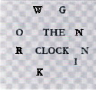

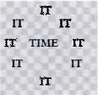

CSE 170 Tech Teamwork
Conflict

Slide 2
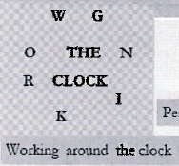

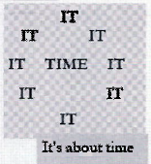
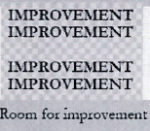
CSE 170 Tech Teamwork
Conflict

Slide 3
Conflicting Understanding
Is a tomato a fruit?
Is a hot dog a sandwich?
Is water wet?
Is cereal soup?
Which is more pie?: Pizza or Shepherd’s Pie?
Is a dragon an insect?
Is an egg roll a Chimichanga?
Is Y a vowel? Is W a vowel?
i before e, except after c…?
NASA is taking volunteers for a one-way trip to colonize Mars. Do you go?

Slide 4
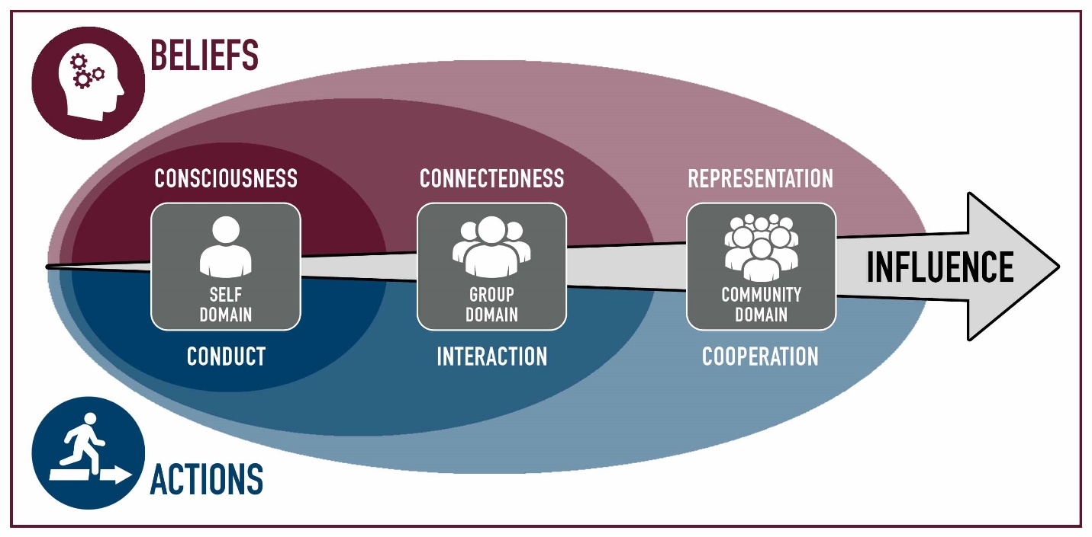
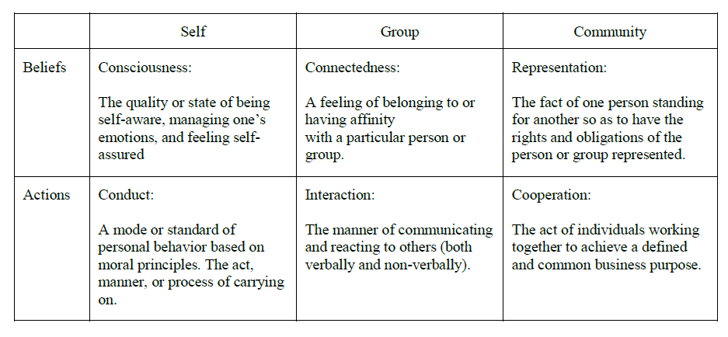
Commitment, Estimation, Stewardship
 | Module | Domain | Competency
1 | Teamwork
2 | Influence
3 | Personality | Self | Consciousness
4 | Motivation | Self | Consciousness
5 | Professionalism | Self | Conduct
6 | Pressure | Self | Conduct
7 | Commitment | Group | Connectedness
8 | Conflict | Group | Connectedness
9 | Integrity, Trust & Honesty | Group | Interaction
10 | Communication | Group | Interaction
11 | Leadership | Community | Representation
12 | Loyalty | Community | Representation
13 | Cooperation | Community | Cooperation
14 | Synergism | Community | Cooperation
Why is commitment so hard?
Why is estimation hard?
Why is stewardship hard?

Slide 5
Commitment, Estimation, Stewardship
 | Module | Domain | Competency
1 | Teamwork
2 | Influence
3 | Personality | Self | Consciousness
4 | Motivation | Self | Consciousness
5 | Professionalism | Self | Conduct
6 | Pressure | Self | Conduct
7 | Commitment | Group | Connectedness
8 | Conflict | Group | Connectedness
9 | Integrity, Trust & Honesty | Group | Interaction
10 | Communication | Group | Interaction
11 | Leadership | Community | Representation
12 | Loyalty | Community | Representation
13 | Cooperation | Community | Cooperation
14 | Synergism | Community | Cooperation
Why is commitment so hard?
Why is estimation hard?
Why is stewardship hard?

Slide 6
Coming Up
Acorn Project – 7 & 8
Week 06 Group assignments
Week 07 Proposal Due
Week 08 Approval Due
Week 09 Either 1 of 4 done or 25% of each done
Week 10 Either 2 of 4 done or 50% of each done
Week 11 Either 3 of 4 done or 75% of each done
Week 12 Project Due
Week 13 Project Presentations
Beginning with the end in mind – S.R. Covey

Slide 7


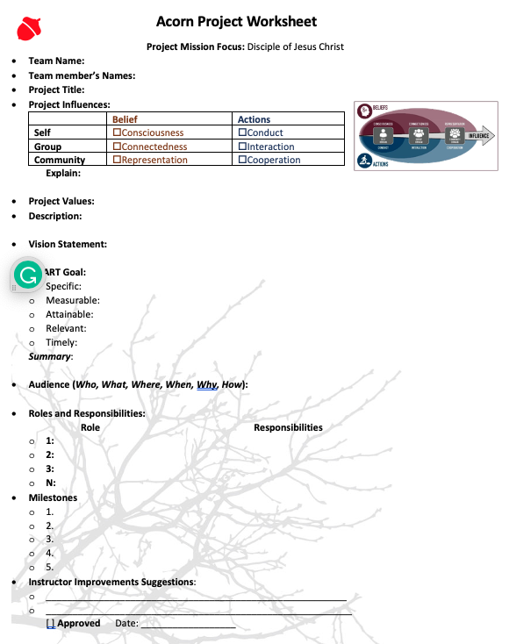




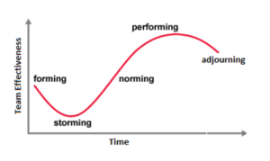

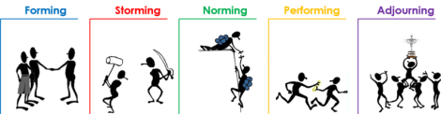
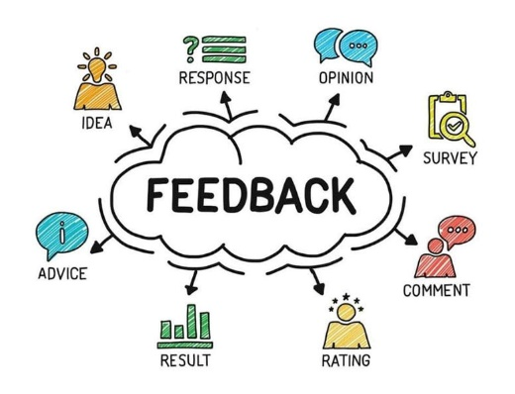
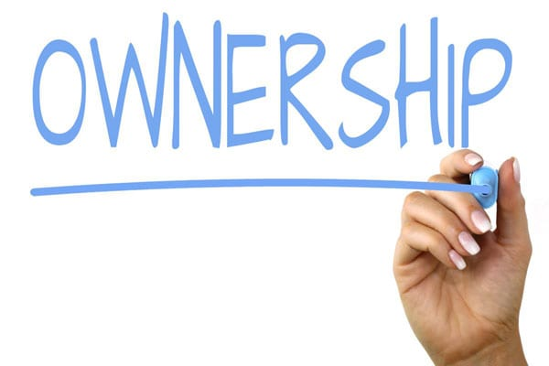




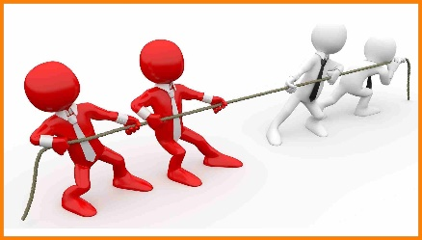


Acorn Project Approval
Turn in the last 4 pages of the workbook.

Slide 8
Ideas
Attend a Career Services event as a team and work on a deliverable
Ropes Course
Mentoring Certificate
Participate in “Get Involved”: Recreation, Ushering, Get Connected, I-Serve, Peer Mentoring, Rep Council, Tutoring
Participate in a service project, service information, training that will help other students at BYU-Idaho.
Attend a Society Event such as a Hack-A-Thon, participate as a team
Join a Department Society and work together to contribute to a project
Create a program together, use a collaborative tool and resource repository.
Participate in a Sport, Sporting Event, or Team activity
Attend a Leadership conference/activity produced by Student Services
Participate in an Escape Room, Rope Course, or similar activity
Discover 4+ campus building activities: for example Geology, Animal, Garden tour, Planetarium
Plan three group date, with at least 3 activities
Play 5 different players vs the board, 2-3 times, or an RPG game

Slide 9
Class Activity – Everyone Up

Slide 10
Class Activity – Everyone Up
Play a teamwork game—experience working together and cooperating as a group.
Pair up - people of approximately the same size to sit on the floor or ground facing one another, toe to toe, knees bent, and their hands tightly grasped.
From this position, ask the duo to try to pull themselves into an upright standing position without moving their feet.
Once they are successful, add two more people, and continue until the entire group is included.

Slide 11
What is Conflict?
What is difference between:
Conflict
Disagreement
Contention
Anger
Assertive
Agressive

Slide 12

Why We Should Be Disagreeing More at Work
Dealing with disagreements
Marguerite’s email : Opps, don’t send until sure
Fess up, apologize, and move on.
We’ve come to equate saying “I see it differently” or “I don’t agree” with being angry, rude, or unkind, so it makes most people horribly uncomfortable
Disagreements are an inevitable, normal, and healthy part of relating to other people.
Advantages
Better work outcomes.
Opportunities to learn and grow.
Improved relationships.
Higher job satisfaction.
A more inclusive work environment.
Understand what is needed
Conflict: Mangers need to make decisions, no conflict no choice
Let go of needing to be liked
Focus on the big picture.
Don’t equate disagreement with unkindness.
Find a role model and emulate them.

Slide 13
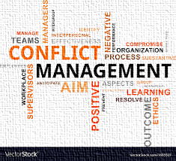
Mange Conflict: The Six Skills
1. Soften Startup
2. Accept Influence
3. Make Effective Repairs During Conflict
4. De-escalate
5. Psychological Soothing of Self and Partner
6. Compromise
Soften Startup.
Complain but don’t blame.
Make statements that start with “I” instead of “You.”
Describe what is happening, but don’t evaluate or judge.
Be polite and appreciative.
Don’t store things up!
Don’t let the situation escalate!

Slide 14
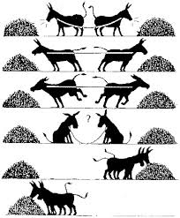
Mange Conflict
Sound Relationship Workplace
criticism, contempt, defensiveness, and stonewalling
The Masters are compassionate and take personal accountability when in conflict. They minimize defensiveness and are careful in how they express their frustration.
Carl the Criticizer
Softened start-up, complain without blame
Contemptuous Cara
culture of appreciation and respect
Defensive Deborah
responsibility
Stan the Stonewaller
self-soothe.

Slide 15
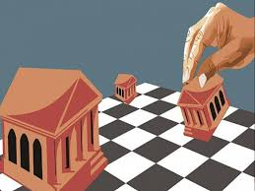
Beleaguered Manager
Follow on from last week:
Mistake #10: Don’t Think That Logic Has Any Role in Some Management Decisions.
Mistake #11: Don’t Think That You are Invulnerable Just Because You are Doing the “Right” Thing for the Company
One of the messages of this essay is that it is better
to do the right thing (and be able to sleep well at night) than
have a job (and sleep poorly because you are worried about having done the wrong thing).
Is this always the case? Can you construct a situation where having a job is more important than your ethical stand?

Slide 16
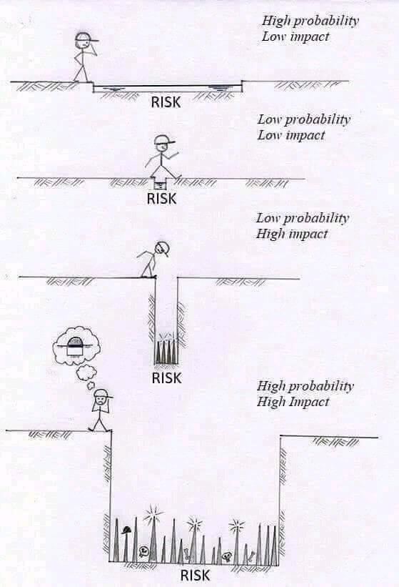
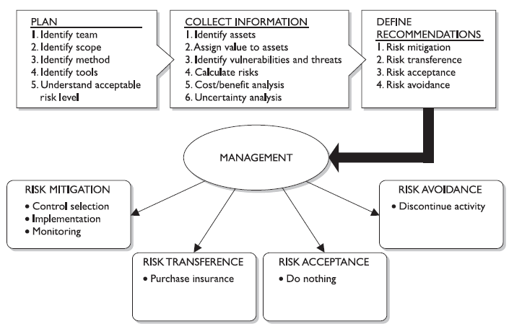
Risk Management
Different Mitigation
Prevention: Countermeasures
Transference: Insurance
Acceptance: Do Nothing
Avoidance/ Reject: Stop Activity
Prevention
------------
Probability of Occurrence
Consequences of Occurrence

Slide 17
Multiply your time by asking 4 questions about the stuff on your to-do list
Can I eliminate this task?
If I can’t eliminate this task, can I automate it?
Can it be delegated, or can I teach someone else how to do this?
Should I do this task now, or can I do it later?
Different Mitigation
➔ Prevention: Countermeasures
 Transference: Insurance
★ Acceptance: Do Nothing
 Avoidance/ Reject: Stop Activity
https://ideas.ted.com/multiply-your-time-by-asking-4-questions-about-the-stuff-on-your-to-do-list/

Slide 18

NYLT Leadership Skills Handout
Resolving Conflict
What Is Conflict?
1. Discuss several ways that good leadership can minimize conflict.
2. Describe how to use EAR (Express, Address, Resolve) as a tool for resolving conflict.
3. List several communication skills important for resolving conflict.
4. Explain when it is appropriate to involve adult Scout leaders in conflict resolution.
Conflicts occur when people disagree and seem unable to find a solution.
As a leader, you sometimes will need to resolve conflicts.
Conflicts can be minor or so large that they can damage unit spirit.

Slide 19

Phillip Walker: Part B
1. Teamwork
2. Influence
3. Personality
4. Motivation
5. Professionally
6. Pressure
7. Commitment
“No, Ryan, that’s a nine-month job,” he replied.
“Marketing is planning on six months,” he said.
“They should have talked to us first. We can’t agree to that,” argued Phillip.
“We already have,” replied Ryan.
Phillip furrowed his brows before responding, “Ok, look, I’ll get with the team and create a new estimate. I’m telling you though, we need nine months at least.”
“The board of directors expects MyCare in six,” Ryan countered.
“That’s not likely to happen,” Phillip stated firmly.
“There has to be a way to reduce the time. Can we work smarter?” he asked.
“We’ve been doing this for a while. We already work smarter,” replied Phillip.
“We could work overtime,” stated Ryan.
“I don’t think that will help. The guys just work slower and burn out quicker,” Phillip replied.
“We’ll figure something out,” stated Ryan.
Phillip was getting frustrated. “No, we won’t. We can get some of it done in six months but there will be a lot of missing features. That’s just how it is.”
“Ok, but you’ve worked miracles before. I’ll bet you can do it again if you try,” responded Ryan. “You’ve always been a team player.”
Point out things we have learned the last two weeks about this conversation…

Slide 20
Day 2

Slide 21
Paradoxes
THE SENTENCE ON THE OTHER SIDE OF THIS CARD IS TRUE.
THE SENTENCE ON THE OTHER SIDE OF THIS CARD IS FALSE.
I always lie.
Nobody goes to that restaurant; it's too crowded.
Don't go near the water 'til you have learned how to swim.
The man who wrote such a stupid sentence can not write at all.
If you get this message, call me, and if you don't get it, don't call.
Your mission is not to accept the mission. Do you accept?
If the temperature this morning is 0 degrees and the Weather Channel says, "it will be twice as cold tomorrow", what will the temperature be?
Answer truthfully (yes or no) to the following question: Will the next word you say be 'no'?
What happens if you are in a car going the speed of light and you turn the headlights on?

Slide 22
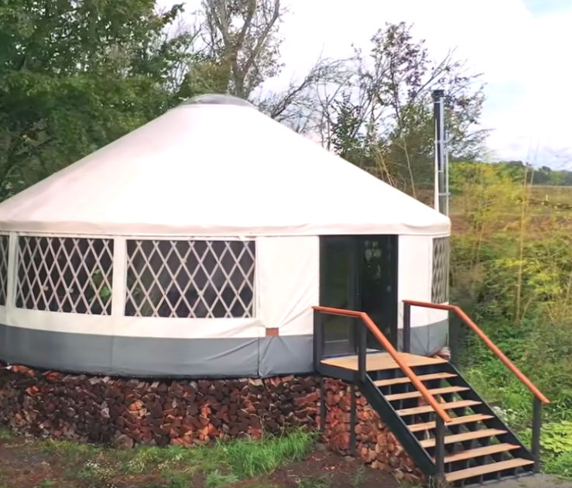

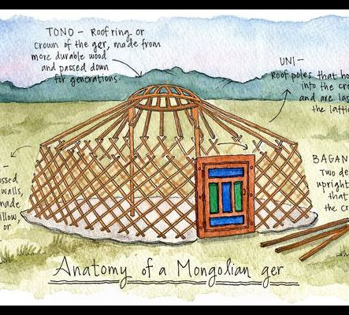
Background
Background
A yurt is a circular tent of felt or skins on a collapsible framework, originated by nomads in central Asia. While most types of tents are supported by rigid members under compression—making them inflexible—the structural members of a yurt pull away from each other under tension, making it flexible yet strong.

Slide 23
How to Play
Ask an even number of participants (add or subtract a trainer as needed) to stand in a circle facing the middle and join hands.
Have them expand the circle outward until all participants feel some gentle pull on their arms from each side.
Ask them to spread their feet to shoulder width and in line with the ircumference of the circle.
Have them assign the number 1 or 2 to each member.
Then ask all of the “ones” to slowly lean in toward the center of the circle,
while all of the “twos” slowly lean out without bending at the waist and without moving their feet.
If the group works together, each person can accomplish a remarkable forward or backward lean.
Now ask the group to slowly reverse positions

Slide 24
Lessons Learned
Much like Risk and Opportunity are made of the same coin, how is conflict and teamwork of the coin?
What is the purpose and value of working together?

Slide 25

Assertive Communication

Slide 26
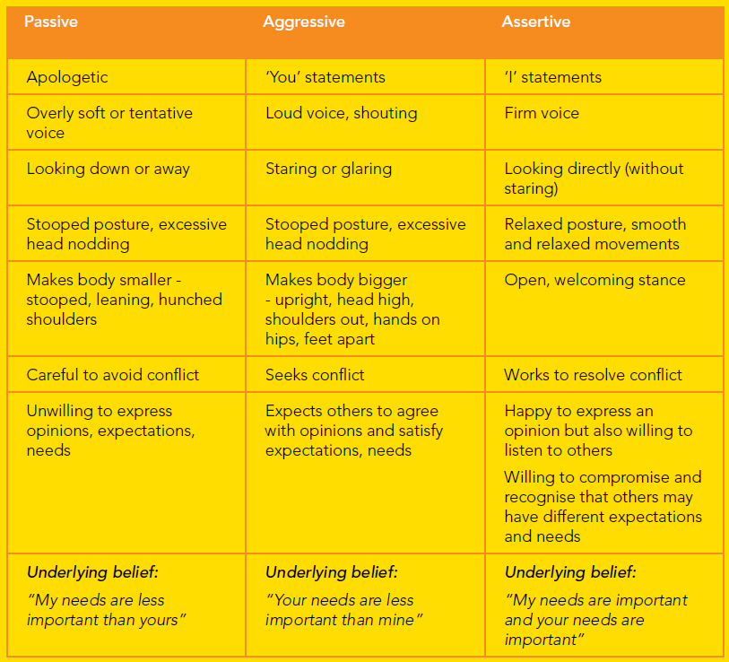
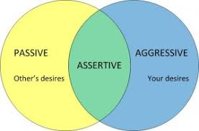
Assertive Communication
Defensive
Stonewalling
Criticizing
Contemptuous

Slide 27

Assertive Communication
‘I’ statements are made up of four parts:
1. “I feel ...”
(taking responsibility for your own feelings)
2. “when ...”
(stating the behavior that is a problem)
3. “because ...”
(what it is about the behavior or its consequences that you don’t like)
4. “I would really like it if ...”
(offering a preferred alternative or compromise)
Using this formula, the statement “You never want to do anything nice with me” can be reframed as:
1. “I feel sad and insecure
(taking responsibility for your own feelings)
2. “when you don’t go out with me”
(stating the behavior that is a problem)
3. “because I want to spend time with you and be close”
(what it is about the behavior or its consequences that you don’t like)
4. “I would really like it if we could do something together that we both enjoy”
(offering a preferred alternative or compromise)

Slide 28

Assertive Communication
Common errors in constructing ‘I’ statements
Assertiveness Techniques
Avoid
Avoid inserting “that” or “like”
Avoid
Avoid disguised ‘you’ statements
Avoid
Avoid accentuating your negative feelings
Avoid
Avoid undershooting the intensity of your feelings
1. Broken record - repeat
2. Disagree – simply state
3. Emphasize feelings – repeat I statement
4. Agree ... But – acknowledge viewpoint
5. Dismiss detours – ignore sidetracks
6. Redefine – don’t accept neg. labels
7. Question – Ask for clearification

Slide 29
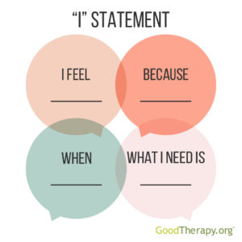
“I” Message
“I” Statements in Therapy
Examples of “I” Messages
A father wants his young child to stop calling him rude names during playtime.
Common response: “Hey! If you call me a rude name one more time, I’m going to send you straight to bed!” Graphic containing sample I statements
“I” statement response: “I feel very sad when I hear rude words because they hurt my feelings. I like playing with people who use nice words.”
A woman becomes angry when her sister borrows her favorite coat and returns it with stains and a tear.
Common response: “You ruined my jacket! Are you ever going to grow up?!”
“I” statement response: “I am upset that my coat was damaged because I can’t afford to replace it. I really appreciate it when the things I loan out are taken care of.”
A teenage boy is annoyed with his parents, who ask him several times each night if he has completed his homework.
Common response: “Lay off me!”
“I” statement response: “I feel frustrated and annoyed when I am reminded over and over to do my homework. I am old enough now to complete my homework without reminders.”

Slide 30

How and When to Use "I" Statements
What Your "I" Statement Isn’t:
Your "I" statement is not about being polite. It's not to do with 'soft' or 'nice', nor should it be rude. It's about being clear.
It's a conversation opener, not the resolution. It's the opener to improving rather than deteriorating relationships.
If you expect it to be the answer and to fix what's not working straight away - you may have an unrealistic expectation.
If you expect the other person to respond as you want them to immediately, you may have an unrealistic expectation.
What you can realistically expect is that an appropriate "I" statement made with good intent:
Is highly unlikely to do any harm
Is a step in the right direction
Is sure to change the current situation in some way
Can/will open up to possibilities you may not yet see
When to Use:
When we need to confront others about their behavior
When we feel others are not treating us right
When we feel defensive or angry
When others are angry with us

Slide 31

The Problem with Using “I Statements” at Work
They can be seen as expressions of emotionalism.
They can appear to be about what’s best for you personally.
They can put you at risk of appearing weak.

Slide 32
Empowering Others

Slide 33
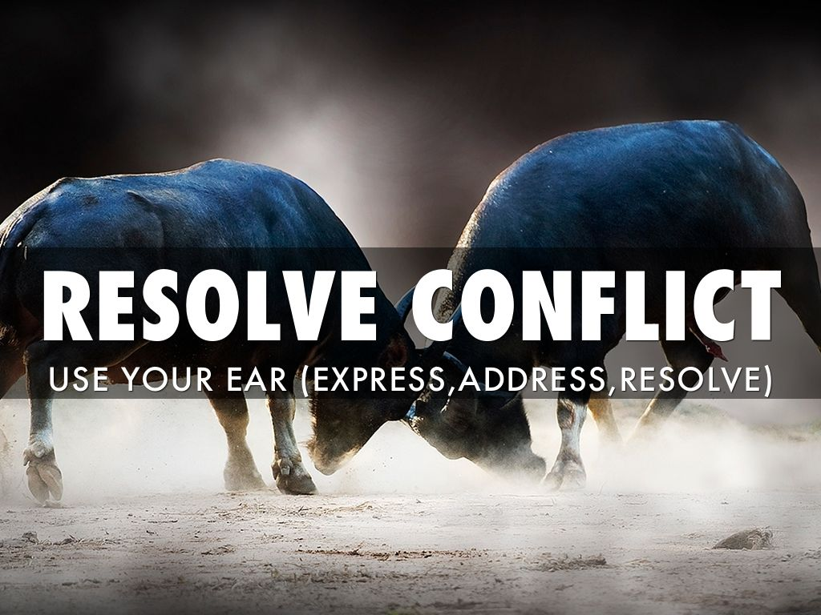
NYLT Leadership Skills Handout
EAR
Communication Skills
EAR is a tool for resolving conflict. Ask the people involved to:
Express – What you want and what you are doing to get it – I-Statement
Address – Why it is working or not working
Resolve – What ways there are to solve the situation
Good communication skills are important in resolving conflict. Remember the neutral position: feet, hands, mouth, eyes, and ears.
Listening is the most important communication skill for conflict resolution.
Use your ears more than your mouth.
Encourage others to talk but offer no judgments.
Make sure you hear the message and put it in your own words.
Use EAR – Express, Address, Resolve – to find answers to conflicts that work for everyone.

Slide 34

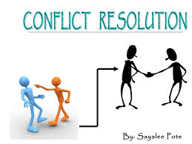
Conflict Resolution – BYU-Idaho Leadership Dev.
Key Points to Consider:
Conflict Resolution and Problem Solving: (EAR?)
Perceptions: perceive a threat
Reactions: respond on the basis of their perceptions of the situation
Negotiations: conflicts contain substantive, procedural, and psychological dimensions
Learning Experiences: predictable and expectable situations that naturally arise
Creative Problem-solving strategies are essential
a. Identify and Define the Problem: Use I-message
b. Generate Alternate Solutions
c. Evaluate Alternate Solutions
d. Make Decisions
e. Implement the Solution
f. Follow Up with an Evaluation of the Solution

Slide 35

Empowering Others
Benefits
a. To the followers:
1) Increased motivation
2) Higher degree of learning
3) Improved tolerance of stress
b. To the leaders:
1) Increased organizational commitment
2) Less role ambiguity
3) Increased satisfaction with roles and the organization
c. To the organization:
1) More flexibility
2) Better sense of community
3) Requests/problems handled with increased speed
4) Group coordination and development
Guidelines
a. There is no single "right way" to empower others
b. Lend a helping hand
c. Facilitate accomplishments to the extent possible
d. Acknowledge others’ abilities
Tools
a. Provide Information
b. Provide Resources
c. Provide Support
d. Connect to Outcomes
e. Arouse Positive Emotions
“I teach them correct principles, and they govern themselves.” – J. Smith

Slide 36
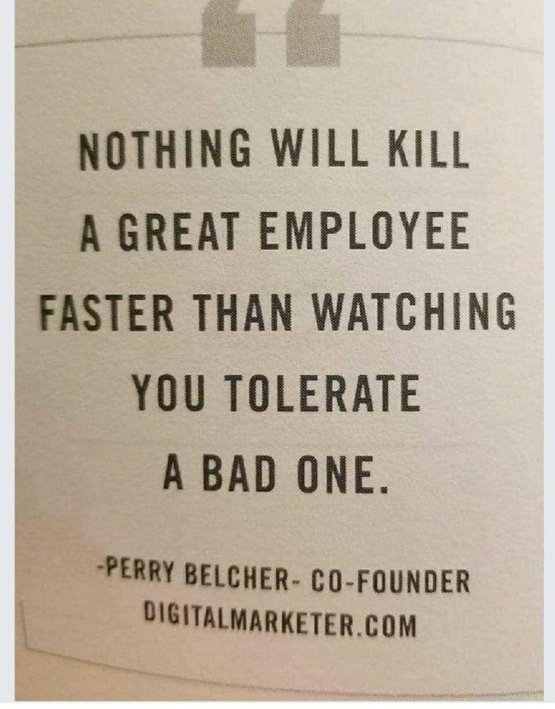
When toxic employees’ negative behaviors are tolerated, it can have a hugely detrimental effect on the culture of any company, decrease collaboration between teams, affect the way customers are treated, and so much more.

