Slide 1
CSE 170 Tech Teamwork
Week 09 Day 1
W. Clements

Slide 2
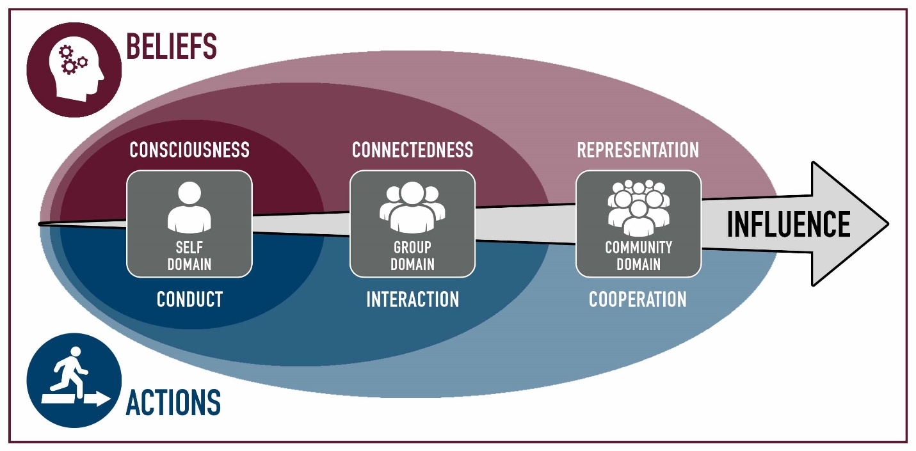
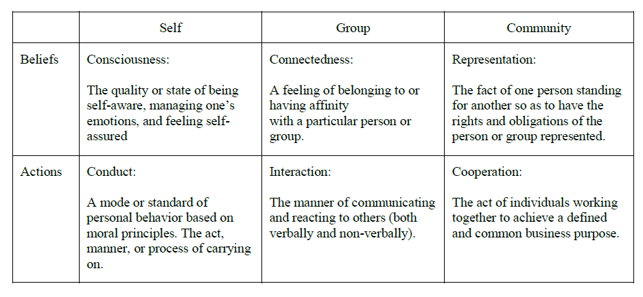
Commitment, Estimation, Stewardship
 | Module | Domain | Competency
1 | Teamwork
2 | Influence
3 | Personality | Self | Consciousness
4 | Motivation | Self | Consciousness
5 | Professionalism | Self | Conduct
6 | Pressure | Self | Conduct
7 | Commitment | Group | Connectedness
8 | Conflict | Group | Connectedness
9 | Integrity, Trust & Honesty | Group | Interaction
10 | Communication | Group | Interaction
11 | Leadership | Community | Representation
12 | Loyalty | Community | Representation
13 | Cooperation | Community | Cooperation
14 | Synergism | Community | Cooperation

Slide 3
Coming Up
Acorn Project – 7 & 8
Week 06 Group assignments
Week 07 Proposal Due
Week 08 Approval Due
Week 09 Either 1 of 4 done or 25% of each done
Week 10 Either 2 of 4 done or 50% of each done
Week 11 Either 3 of 4 done or 75% of each done
Week 12 Project Due
Week 13 Project Presentations
Beginning with the end in mind – S.R. Covey

Slide 4


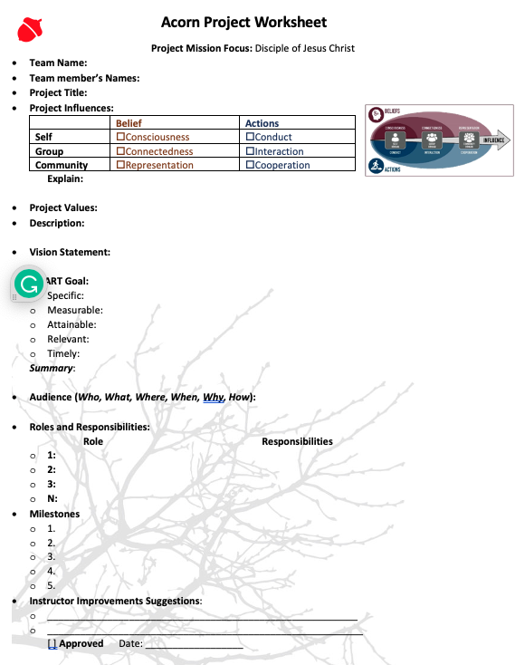

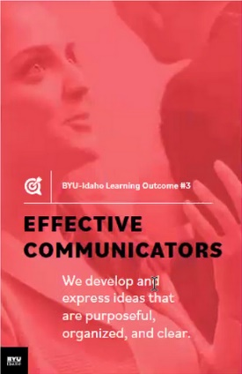
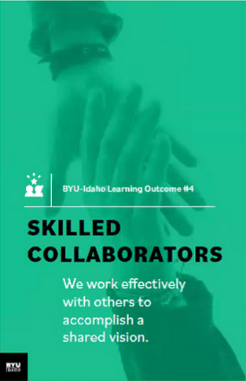

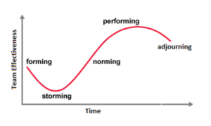

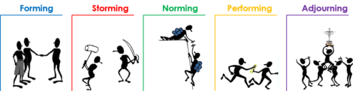
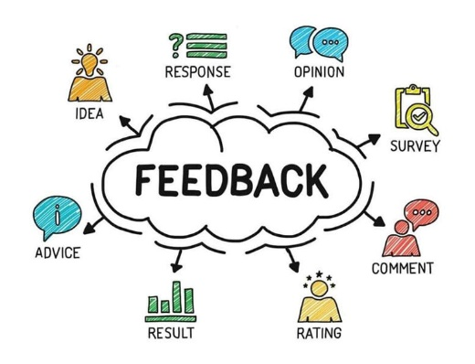





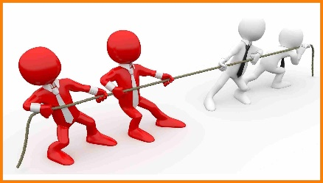


Acorn Project Approval
Turn in the last 4 pages of the workbook.

Slide 5
Activity – (modified) “I dissent”
Each of you get 2 agree (black checker) and 2 disagree votes (red checkers)
Be careful, once used, you are stuck with the reminder.
Determine majority vs minority
You get
1000 Points majority
2000 Points minority

Slide 6
Clean Coder – Chap 1 Professionalism
Be Careful What You Ask For
Badge of Honor & Pride, but maker for responsibility and accountability
Can you take pride and honor if you don’t have responsibility or accountability?
Taking Responsibility
Story: Shipping of tapes
How do we become responsible?
Do No Harm Bugs? Risk? – QA? Not Bug Catchers
Must know it works What is the demand?
Automate QA
Flexibility As a structure
Work Ethic Your career 1st 40 employers, do the math (10%)
Know your field 50 years of knowledge repeating history
Continuous Learning Change Risk Mitigation
Practice Sharpen the Saw
Collaboration Paired Programming – don’t just share keyboards
Mentoring Best way to learn is teach
Know your Domain Diagram
Id with Employees/Customers We are people problem solvers, understand, build relationship of trust
Humility Act of Creation

Slide 7
Clean Coder – Chap 1 Professionalism
Be Careful What You Ask For
Badge of Honor & Pride, but maker for responsibility and accountability
Can you take pride and honor if you don’t have responsibility or accountability?
Taking Responsibility
Story: Shipping of tapes
How do we become responsible?
Do No Harm Bugs? Risk? – QA? Not Bug Catchers
Must know it works What is the demand?
Automate QA
Flexibility As a structure
Work Ethic Your career 1st 40 employers, do the math (10%)
Know your field 50 years of knowledge repeating history
Continuous Learning Change Risk Mitigation
Practice Sharpen the Saw
Collaboration Paired Programming – don’t just share keyboards
Mentoring Best way to learn is teach
Know your Domain Diagram
Id with Employees/Customers We are people problem solvers, understand, build relationship of trust
Humility Act of Creation

Slide 8
Key
Aeronautic
Academic
History/Archaeology
Software Engineering
Material Design
Auto Machine
Degree
Engineering
Skills/Jobs
Maintenance
Quality Assurance
Requirement
Drones
Research
Computer Science
SW Lifecycles
Multi-Tier Systems
Design
Computer Architecture
Electrical Engineering
Data Structures
Demographic
Estimation
Testing
Computer Engineering
Math
Design Patterns
Internet of Things
Computer Hardware
Circuits
Electricity
Sensing
You are not just a coder!
Artificial Intelligence
Algorithms
Geo Analytics
Geographic Info Systems
Geology
Theory
Programming
Database Theory
Accounting
Computer Aid Drafting
Sciences
Data Science
Computational Chemistry
Chemistry
Database Management
Security
Computational Biology
Biology
Application Management
Lang of Languages.
Mobile
Computational Vision
Computer Info. Systems
Tech Writing
Networking
Modeling
Film
Website Design
Web Design
Graphic Arts
Biz Accounting
Computer Graphics
Business Automation
Journaling
Weather
Project Management
Human Machine Interface
Disciple
Art
Biz/Comp Law
Problem Solving
Mentoring
Game Design
Imaging
Business
Religion
Leadership
Computational Audio
English
Language
Dance
Psychology
Sociology
Music
Communication
Relationship of Programming to
Academic Departments, Degrees, and Jobs/Skills
W. Clements
Version 181210

Slide 9
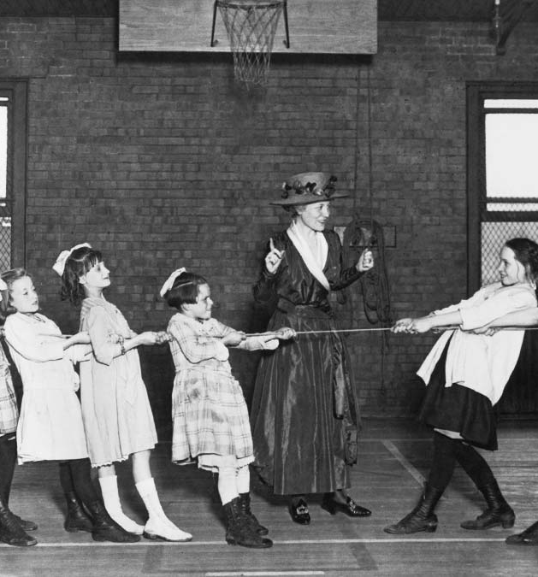
The Pros and Cons of Competition Among Employees
Competition and Creativity
Motivation? Coin
Anxiety and Excitement
How do we lower one with out the other?
My code? Our code?

Slide 10
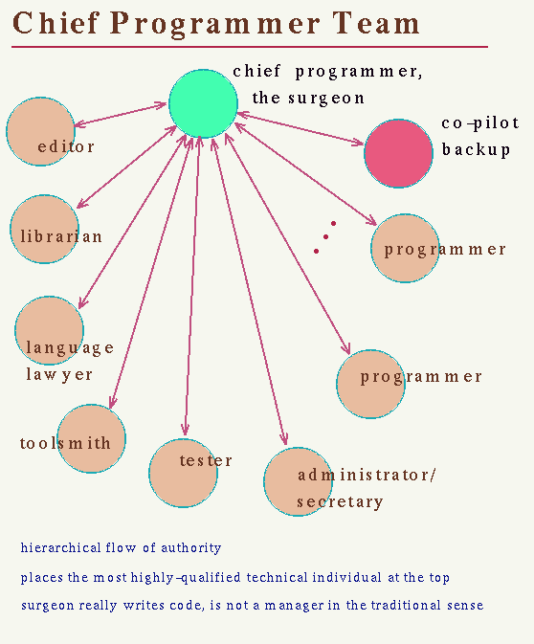
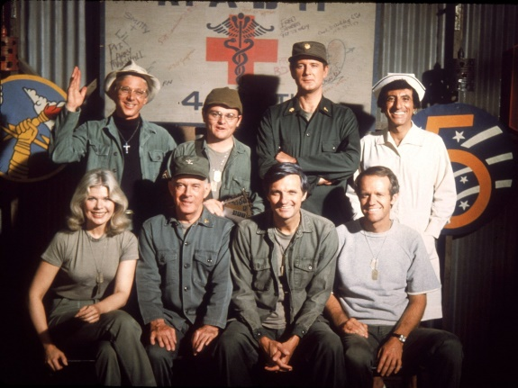
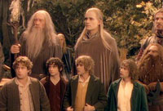

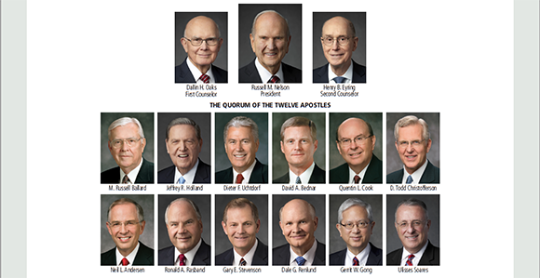
The Mindset Change You Need if You Work in a Competitive Company
Evaluate the Playing Field
Diverse range of skill sets
Identify Your position
Your strengths, enjoy, strong suites
Shoot for the Goal
The Why, Your goal vs teams goal
Play your Position to the Best of Your Ability
Leverage your strengths, Record your successes, complimenting each other

Slide 11

The Oath – Clean Coder
I solemnly pledge,
first, to do no harm to the software entrusted to me;
to not knowingly adopt any harmful practice, nor to adopt any practice or tool that I do not fully understand.
With fervor, I promise to abstain from whatever is deleterious and mischievous.
I will do all in my power to expand my skills and understanding and will maintain and elevate the standard of my profession.
With loyalty will I endeavor to
aid the stakeholders,
to hold in confidence all information that comes to my knowledge in the practice of my calling, and
to devote myself to the welfare of the project committed to my care.
deleterious :harmful often in a subtle or unexpected way

Slide 12
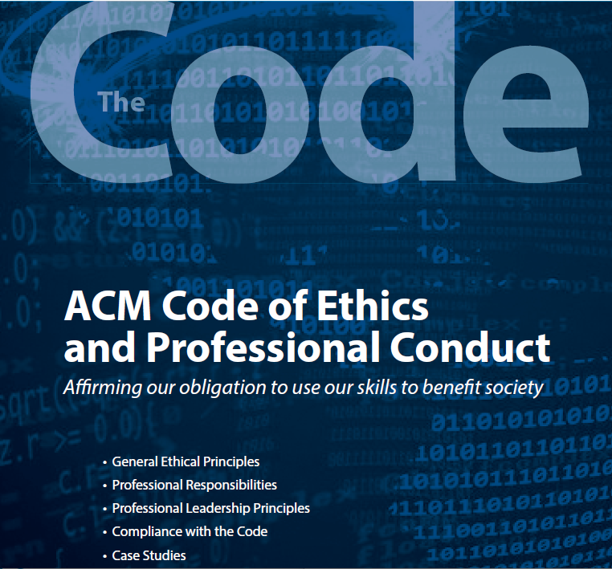
ACM Code of Ethics and Professional Conduct Handout
1. General Ethical Principles
2. Professional Responsibilities
Contribute to society and to human well-being, acknowledging that all people are stakeholders in computing
Avoid harm.
Be honest and trustworthy.
Be fair and take action not to discriminate.
Respect the work required to produce new ideas, inventions, creative works, and computing artifacts.
Respect privacy.
Honor confidentiality.
Strive to achieve high quality in both the processes and products of professional work.
Maintain high standards of professional competence, conduct, and ethical practice.
Know and respect existing rules pertaining to professional work.
Accept and provide appropriate professional review.
Give comprehensive and thorough evaluations of computer systems and their impacts, including analysis of possible risks.
Perform work only in areas of competence.
Foster public awareness and understanding of computing, related technologies, and their consequences.
Access computing and communication resources only when authorized or when compelled by the public good.
Design and implement systems that are robustly and usably secure.

Slide 13
ACM Code of Ethics and Professional Conduct
3. Professional Leadership Principles
4. Compliance with the Code
Ensure that the public good is the central concern during all professional computing work.
Articulate, encourage acceptance of, and evaluate fulfillment of social responsibilities by members of the organization or group.
Manage personnel and resources to enhance the quality of working life.
Articulate, apply, and support policies and processes that reflect the principles of the Code.
Create opportunities for members of the organization or group to grow as professionals.
Use care when modifying or retiring systems.
Recognize and take special care of systems that become integrated into the infrastructure of society.
Uphold, promote, and respect the principles of the Code.
Treat violations of the Code as inconsistent with membership in the ACM.

Slide 14
Ethic Scenarios
As a group
In these analyses, we applied a four-step process denoted by the acronym CARE:
Consider (stakeholders and consequences),
Analyze (how the Code applies to the context),
Review (possible actions), and
Evaluate (decisions and future impact).
Identify Principles(X.x) in the case analysis.
1. Read the scenario to yourself (5 minutes)
2. Discuss the Analysis (5 min)
3. Present (1 min)
Summary of Scenario
Lessons Learned
Why is code ethics important?

Slide 15
Day 2

Slide 16
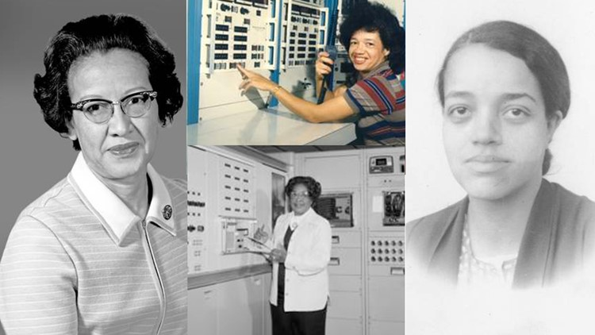

Scenario: Astrid Angevin
Software Engineer – World Sentinel – software app
Associates: Govind Bhave (he), co-worker
Associates: Rita Dunkeld – Manager
software app: point your phone at a person you could instantly retrieve their name, position and the news associated with them
War Room – open, competition, synergy
Software app:
point your phone at a person you could instantly retrieve their name, position and the news associated with them
Facial recognition
Divided the team: Consequences?
Situation: Spyware?

Slide 17

Scenario: Astrid Angevin
Software Engineer – World Sentinel – software app
Associates: Govind Bhave (he), co-worker
Associates: Rita Dunkeld – Manager
software app: point your phone at a person you could instantly retrieve their name, position and the news associated with them
War Room – open, competition, synergy
Software app:
point your phone at a person you could instantly retrieve their name, position and the news associated with them
Facial recognition
Divided the team: Consequences?
Situation: Spyware?

Slide 18
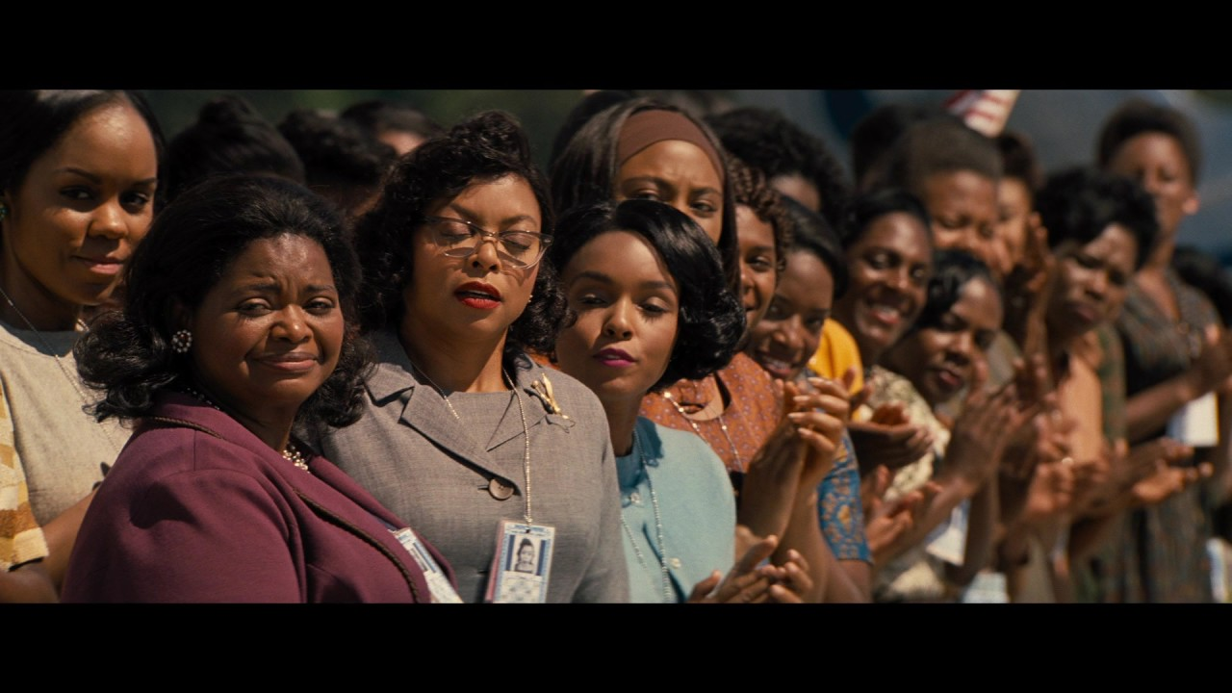
Scenario: Astrid Angevin
As a group, discuss… 5-10 minutes
Team competition:
1st Project 2nd Project
Working in a team?
Management Styles?
Ethical Issues?
Read up to Organization Changes
With your team, discuss each of the topics on Before the Split.
What was the effect of competition on Astrid's first team? Why?
What did Rita do to help ensure good outcomes?
What did Astrid do to ensure she thrived in this environment?
Everyone move, to a different table, except for one
Read up to A Falling Out, then discuss With your team, discuss each of the topics on After the Split.
What was the effect of the competition after the split? Why?
What did the editors do that lead to such adverse outcomes?
What did Astrid do to survive in this environment?
As a class finish the article, Discussion: Rita and Govind
Why did Astrid and Govind respond so differently?
What was Astrid's main focus? What was Govind's main focused?
What was the most significant factor leading to this situation?

Slide 19

5 Types of Imposter Syndrome and How to Stop Them
Sometimes why we don’t react when we should… “Thinking we are not good enough”
The Perfectionist
Micromanager, Delegating, 100%
The Superwoman/man
Stay Later, Downtime wasteful, haven’t earned your title, workaholics
The Natural Genius
Excel without effort, Straight As, “Smart One”, On your own, Feel of shame, avoid challenges
The Soloist
Own your own, “Don’t need help”, requirements vs needs
The Expert
Must meet every educ job requirement, seeking training/certif., still don’t know enough, shutter: someone says: ’You’re the expert’
LL: celebrate achievements (avoid burnout), find contentment
LL: Internal Validation, ease off the gas, reasonable
LL: Work in progress, work on weakness
LL: Ask for help
LL: Put yourself in a learn situation
https://www.ted.com/talks/elizabeth_cox_what_is_imposter_syndrome_and_how_can_you_combat_it?language=en

Slide 20
BYU-Idaho: The Four Points of Practical Leadership Coaching and Improving Others
Sometimes why we don’t react when we should… “not enough support”
What is Coaching?
Two-way process
Positive, supportive, emotional bond
Focus: Performance & Learning
Ongoing process
Building Others
Observe, Listen, Ask Questions, Explore, Goals, Sessions, Feedback, Action Plan
Build Yourself (Be a mentor)
Build a Relationship, Re-energy, Learn more by talking and teaching, Better at your own skills

Slide 21

The Best Mentors Ask These 8 Questions
An essential part of being a good mentor is asking the right questions. Here’s a cheat sheet to get you started.
Fast CompanyGwen Moran
What Does Success Look Like To You?
What Is The Outcome You Want?
What Do You Want To Be Different In Three To Five Years?
What Are The Obstacles You’re Facing?
What Can You Control?
What Are The Options You’ve Come Up With?
What Are You Reading?
Tell Me More
There are typically three versions of every story—your story, their story, and the truth,’ – the rest of the story
https://getpocket.com/explore/item/the-best-mentors-ask-these-8-questions?utm_source=pocket-newtab

Slide 22
Earning the Trust of The Lord and Your Family
Sometimes why we don’t react when we should… “Holding on to Integrity”
Earning the Lord’s trust is a blessing that comes through great effort on our part.
Integrity,
1. Trust him…#2?
“We live after the manner of happiness”
Show respect and love, peace, enjoy raising our family
Fear and Doubt vs Faith and Trust (peace, love, and growth)

Slide 23

Prove: Case Studies
Provide a Summary of Each Case Study
Identify Principles(X.x) in the case analysis
Pick One case study, and do for or against CARE
Consider, Analyze, Review, Evaluate
ID two other ACM code principles

Slide 24
Example: Malware Distribution
2. Summary
Rouge ISP is providing open servers, that allow clients to distribute malware. Security teams mount a DoS work attack.
Consider: Affect of clients, Risks (Spread and failure)
Analyze: Code 1.2 and 2.8
Review: Cooperation would have changed the output.
Evaluate: Ethical justification.
3. Principles
1.2 Avoid harm.
2.8 Access computing and communication resources only when authorized or when compelled by the public good.
1.1 Contribute to society and to human well-being, acknowledging that all people are stakeholders in computing.
4. Pic 3, 4 or 5
Make an argument for or against using CARE.
Identify 2 additional principles, not mentioned in the case.
ACM Code | Case 1
1.1 Contribute to society and to human well-being, acknowledging that all people are stakeholders in computing. | X
1.2 Avoid harm. | X
2.8 Access computing and communication resources only when authorized or when compelled by the public good. | X

Slide 25
5 Cases
Malware Disruption
Linking Public Data Sets
Medical Implant Risk Analysis
Abusive Workplace Behavior
Malicious Input to Content Filters

