Slide 1
Week 12 Loyalty

Slide 2
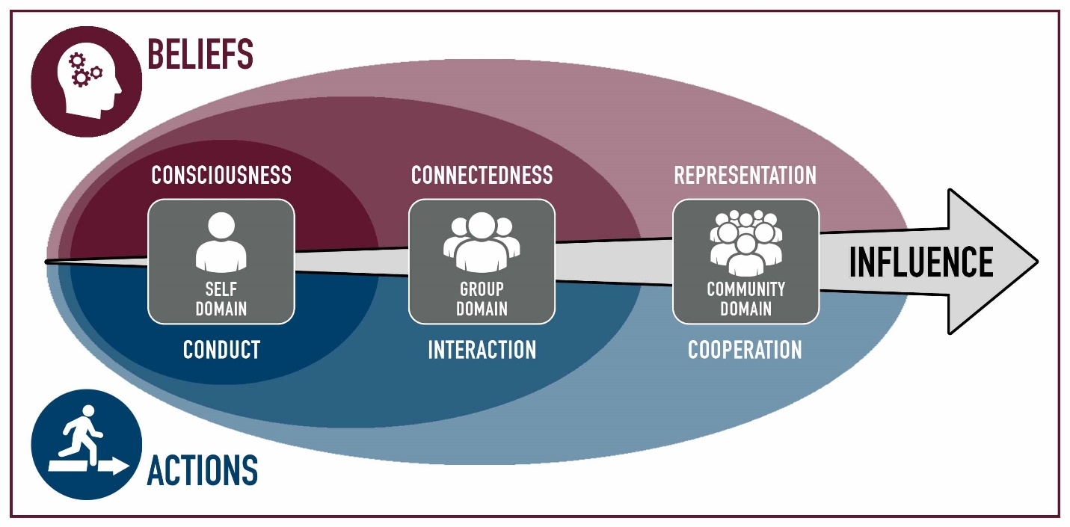
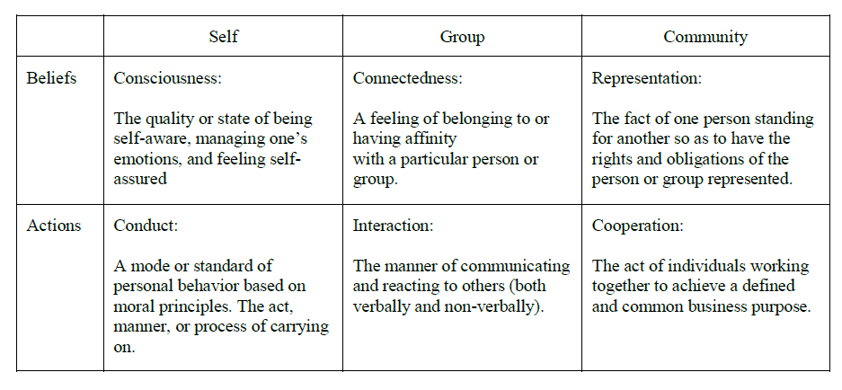
Commitment, Estimation, Stewardship
 | Module | Domain | Competency
1 | Teamwork
2 | Influence
3 | Personality | Self | Consciousness
4 | Motivation | Self | Consciousness
5 | Professionalism | Self | Conduct
6 | Pressure | Self | Conduct
7 | Commitment | Group | Connectedness
8 | Conflict | Group | Connectedness
9 | Integrity, Trust & Honesty | Group | Interaction
10 | Communication | Group | Interaction
11 | Leadership | Community | Representation
12 | Loyalty | Community | Representation
13 | Cooperation | Community | Cooperation
14 | Synergism | Community | Cooperation

Slide 3
Different aspects of Loyalty
Workplace loyalty – Morale
Company Loyalty - generation gaps
Spiritual Loyalty
Customer Loyalty

Slide 4
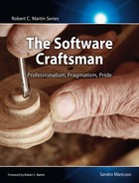
12. The Cost of Low Morale
What is Agile, TDD, XP?
The Agile Hangover: Low Morale
Modified agile = Code and Fix
The Cost of Employing 9-to-5 Developers
Eight million pounds, five years: that is what passionate and talented professionals could have saved for the company
Constrained by Lack of Motivation
common reasons
They don’t feel they are empowered to do it.
They don’t want to be the ones pushing it.
Nah! Too much hassle.
They don’t believe that things could be changed.
No one agrees on what the better thing is.
They don’t care. It’s just a job.
Are they motivated to do a good job?
Injecting Passion
Has anyone learned anything since our last stand-up meeting?
Programming Book Club
Summary
Low morale can destroy a company
Agile should be synonymous with doing things right, improving communication, delivering value to customers, shortening the feedback loop, and working effectively as a team.
What frustrates you as developer?
What motivates? motivates!
What motivates you?

Slide 5
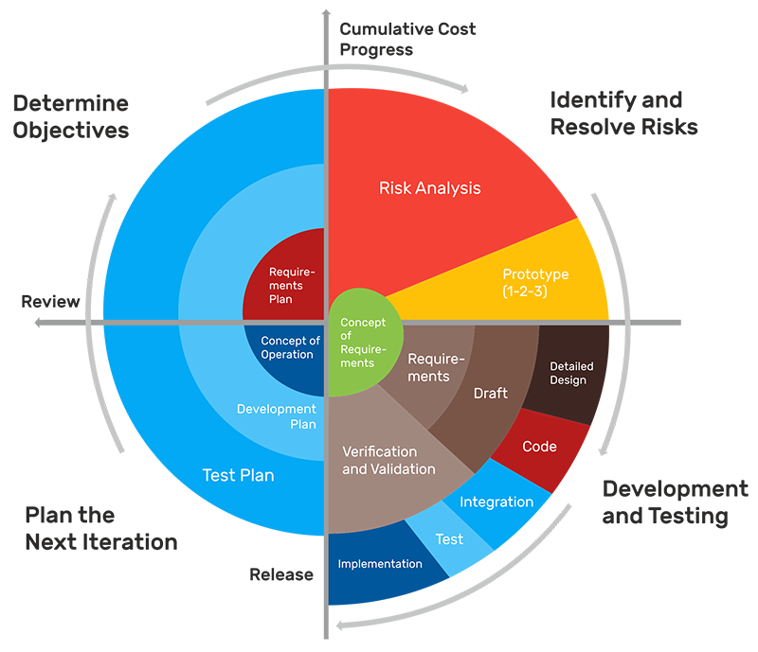
I
II
IV
III

Slide 6
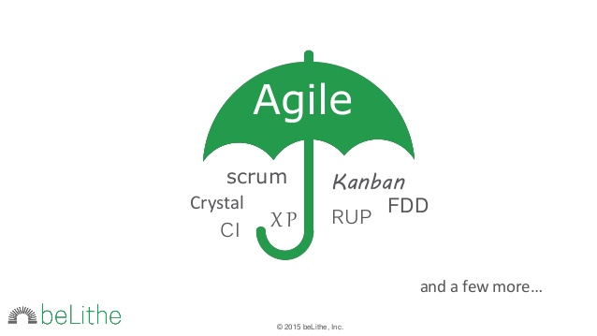
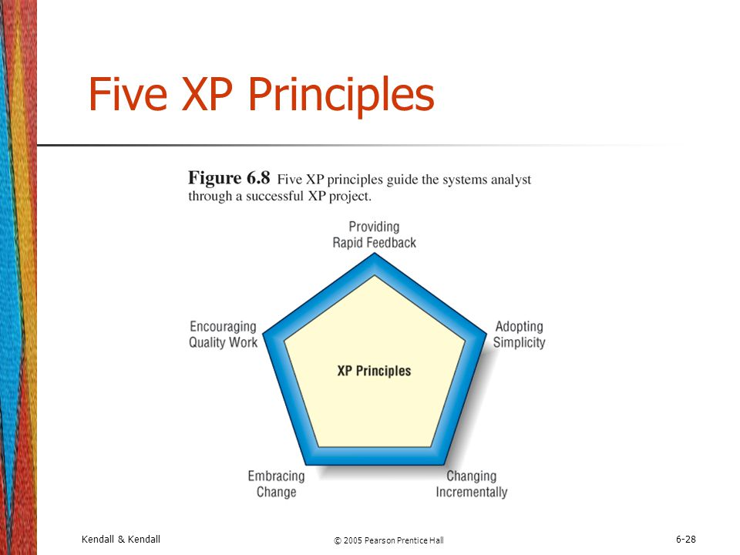
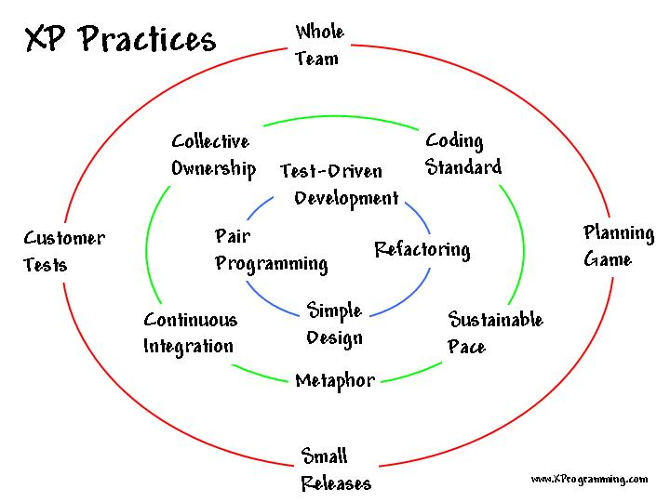
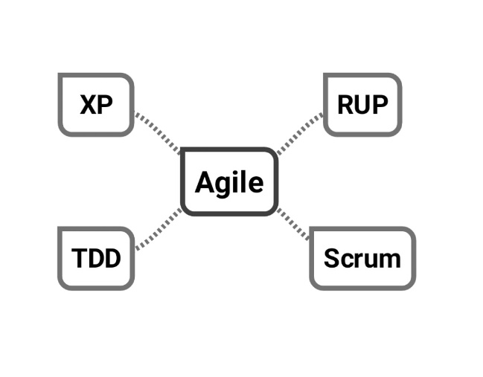
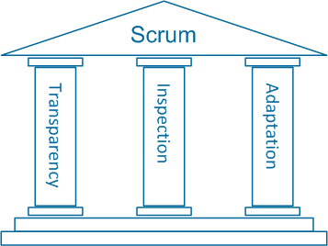
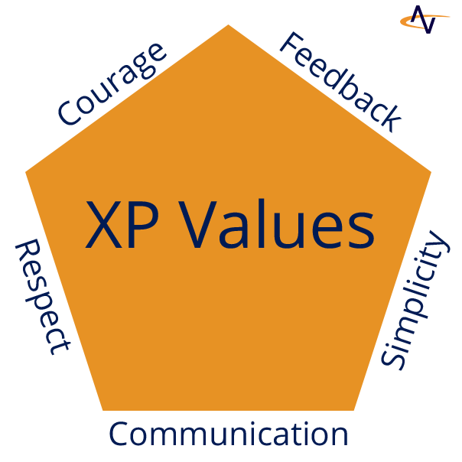
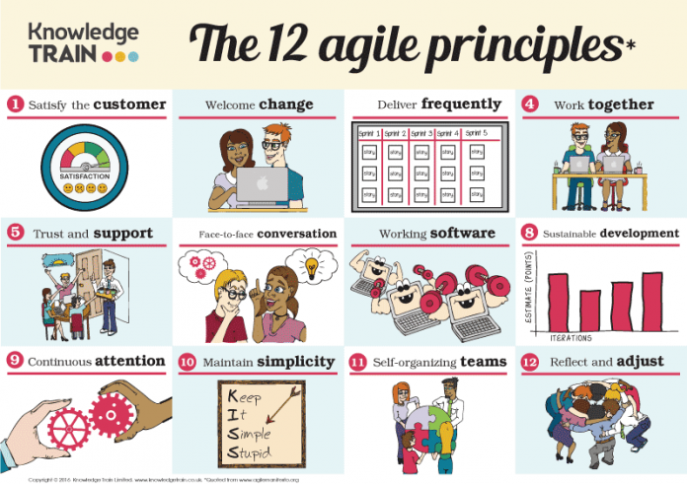
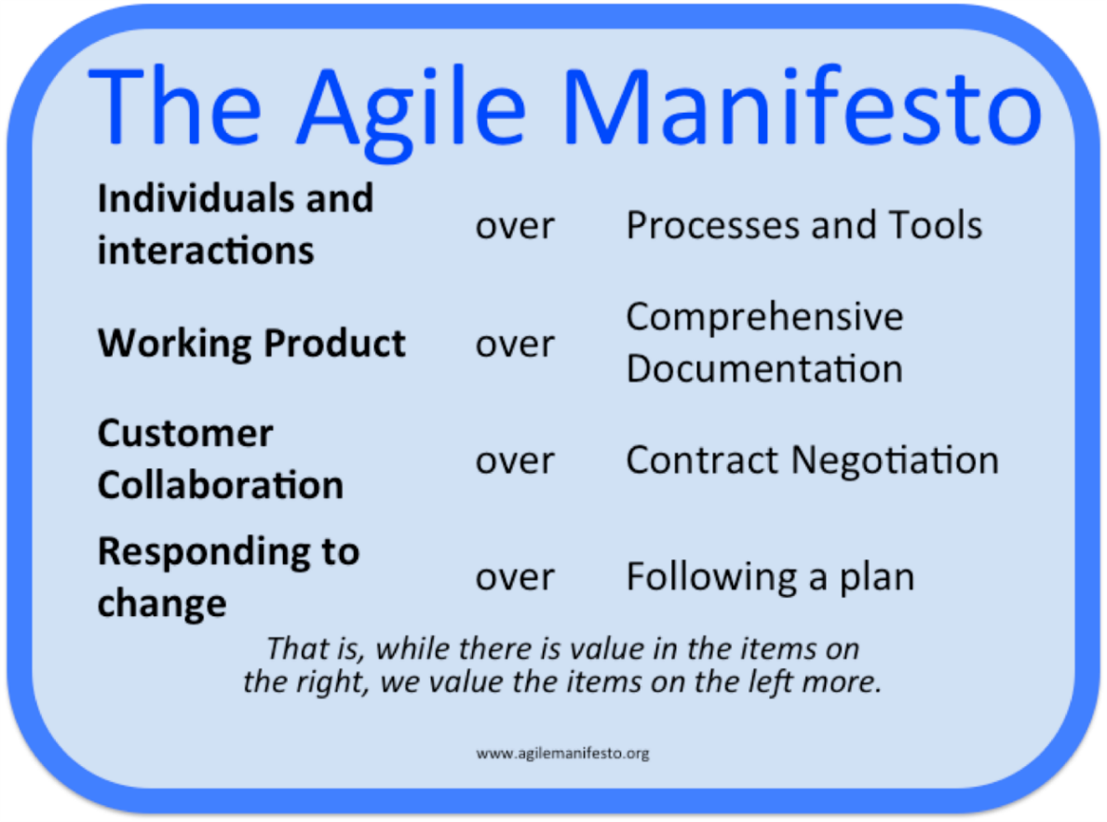

Slide 7
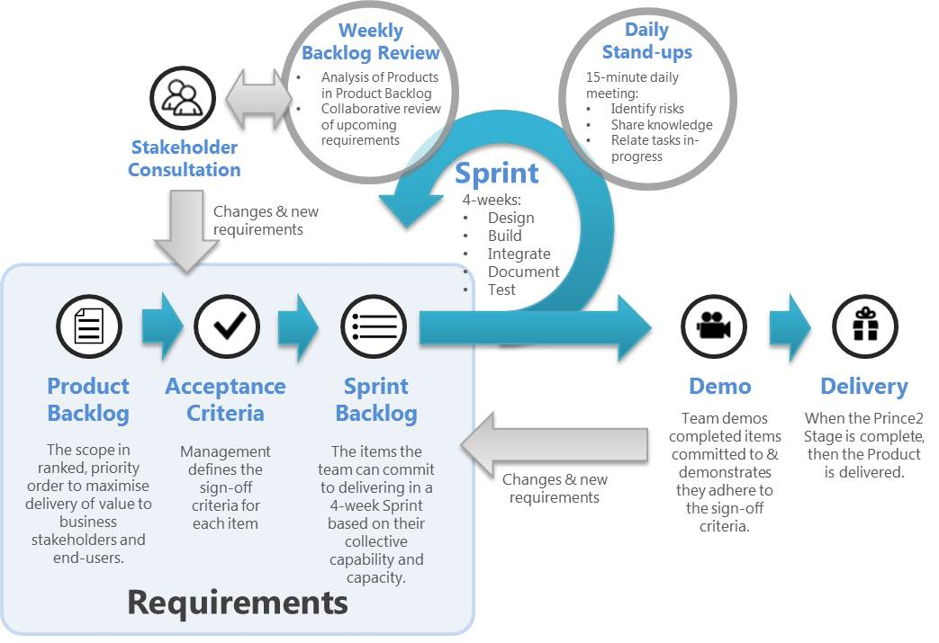
I
II
IV
III
Concept of Operation
Requirements
Design
Implementation
Test
Delivery

Slide 8
Company Loyalty
What type of jobs don’t have loyalty? What one need it to survive?
Should employee be loyal to their company? Should companies be loyal to their employees?
What are reason employees are not loyal to their company?

Slide 9
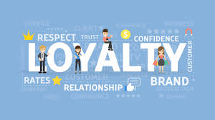
Company Loyalty
Two Kinds of Loyalty
narrow company loyalty and
A loyal employee sticks with the company instead of looking for work elsewhere, especially during economic booms when jobs are plentiful and moving on is easy.
broad company loyalty
employee’s willingness to sacrifice income, leisure time, personal relationships, family responsibilities, and general life aspirations in the name of the organization
Three Degrees of Loyalty
Obedience loyalty - the worker exists to serve the organization’s interests
Balanced loyalty - workers and organizations share interests
Free agency - the organization exists to serve the worker’s interests

Slide 10
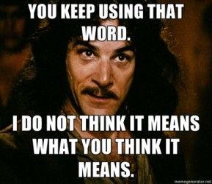
Generational differences in the workplace
Four generation of American workers
Traditional (1922-1945)[Depression, WWW I] – hard work, savers, loyal
Baby Boom Generation (1943-1965) [WWW II, Vietnam] – respect figures, sacrifice = success
Generation X (1968 – 1982)[Cold War, Gulf] – family and friends, continuous learning and skill development, ruled by accomplishment not clock
Generation Y (1978 – 1999) {Millenials, Nexters, Generation www, the Digital generation, Generation E, Echo Boomers, N-Gens and the Net Generation } – confident, less process focus, highly educated
Comparison – name does matter but the mentality
Is it the age, not the generation?
Is it the education level, full/part-time, income, marital status
Perception of Loyalty
Job security,
reasons for staying,
economy, company vs employee perspective
Reason to stay:
co-workers,
advancement/promotions,
learn new skills,
challenges,
compensation/benefits,
job activities,
values

Slide 11
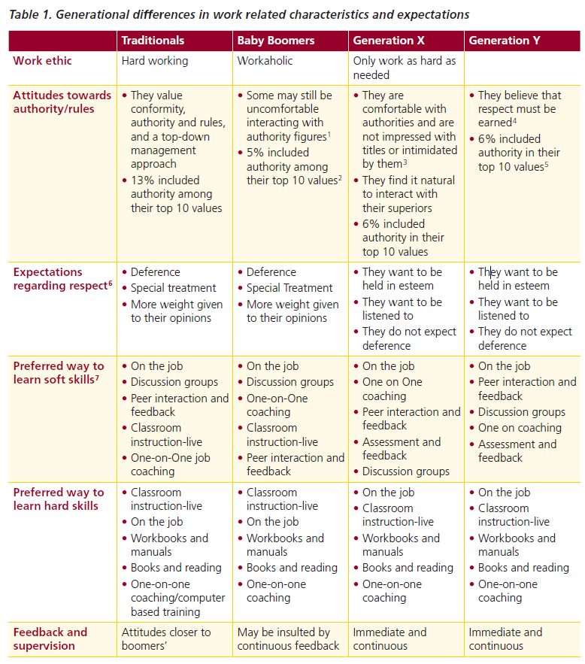
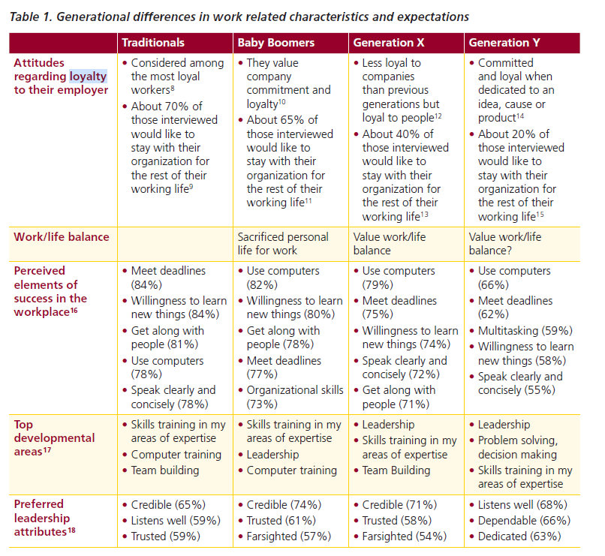
Generational differences in the workplace

Slide 12
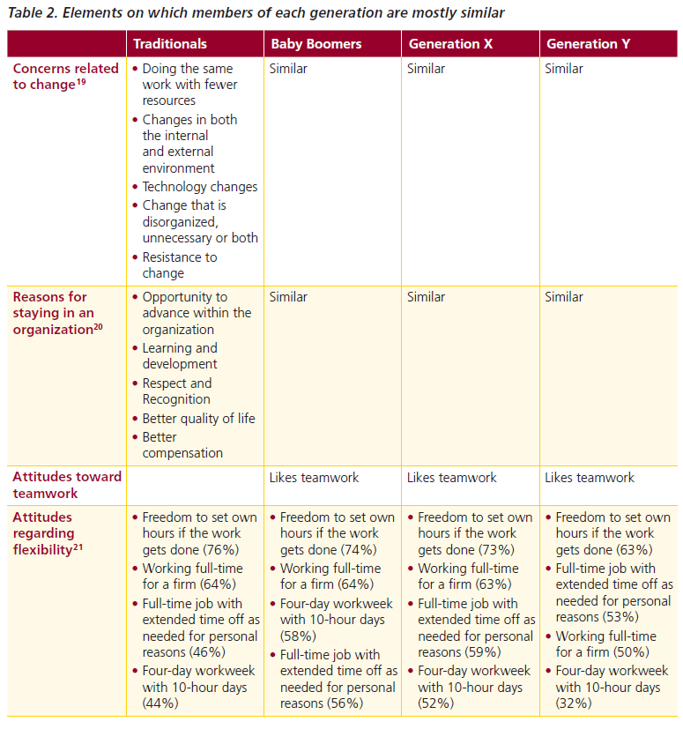
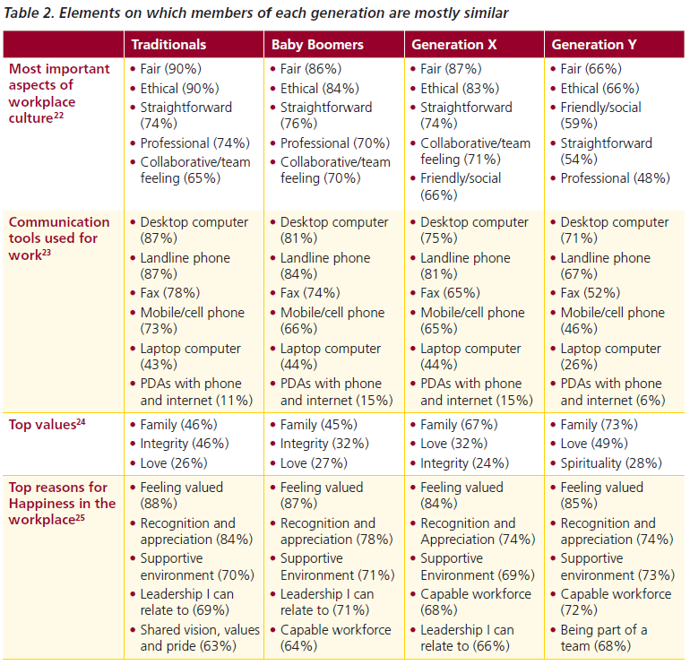

Slide 13
Generational differences in the workplace
Implications for employers
Management
Communication and respect
Training and learning
Retention

Slide 14
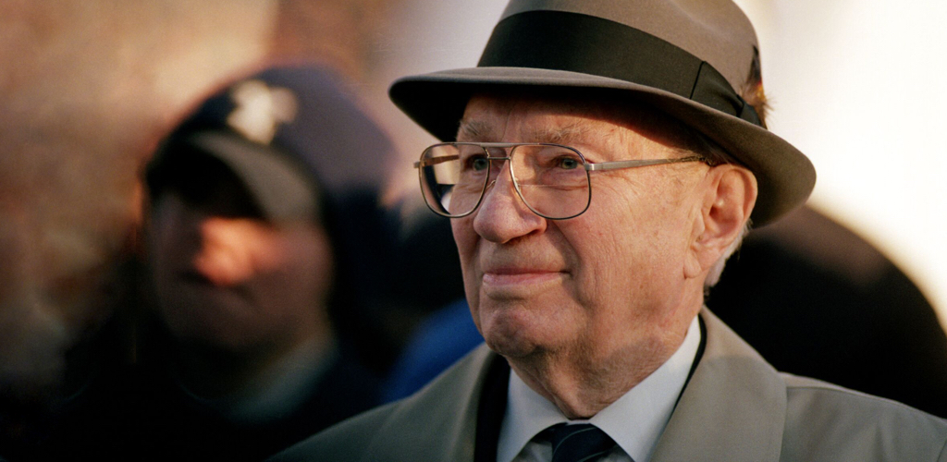
Loyalty – Pres Hinckley
Be
Be loyal to your body Word of Wisdom
Be
Be loyal to your mind ?
Be
Be Loyal to your better self ?
Be
Be Loyal to your spouse (your best investment) & family relationships
Be
Be Loyal to the Church – points the way
Be
Be Loyal to God our Eternal Father and His Beloved Son Jesus Christ
Notes:
When I was a university student, I said to my father on one occasion that I felt the General Authorities had overstepped their prerogatives when they advocated a certain thing.

Slide 15
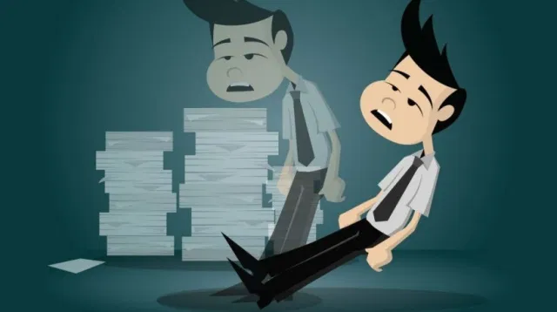
Job Loyalty is Dead, And It’s Better That Way
Risk: Loyalty (too long) or Attrition (too short)
What reason did you give them to stay? How long did the company show loyalty?
If you look at your employees like commodities, then you cannot be surprised when they look at your company the same way.
Stay at a job 10 years vs every 2 year – 50% more
When should you move jobs/companies: 2, 3, 5, 8, 10 years?
What would make you leave? What would make you stay?

Slide 16
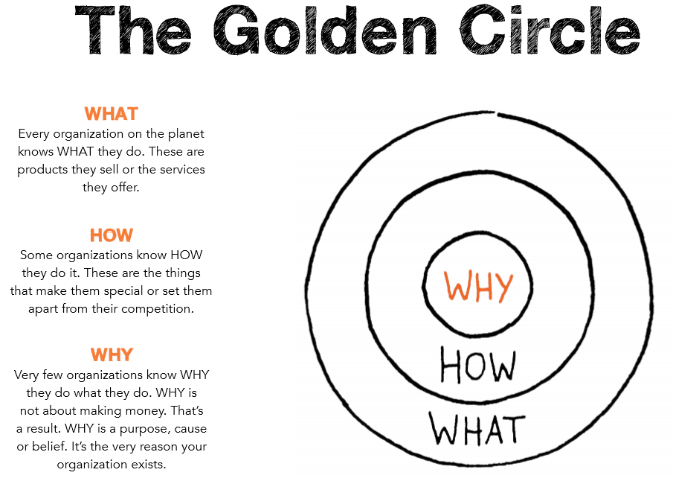
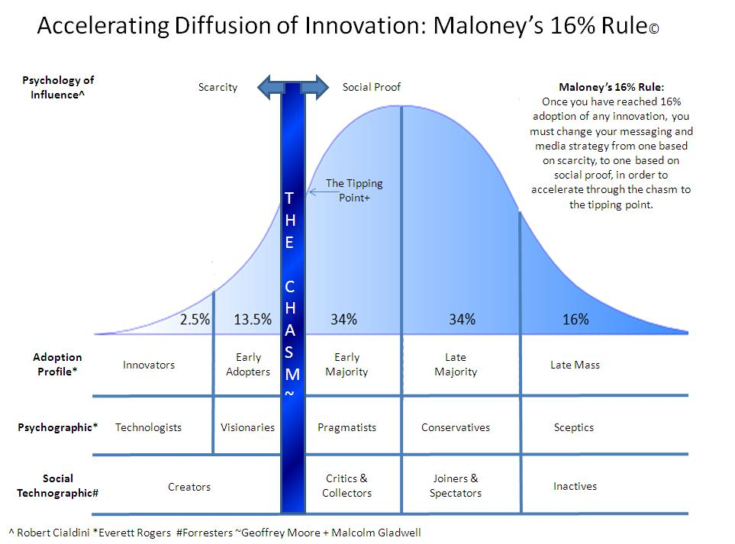
How great leaders inspire action
https://www.ted.com/talks/simon_sinek_how_great_leaders_inspire_action?language=en
Why, How, What
Law of Diffusion of Innovation
And it's those who start with "why" that have the ability to inspire those around them or find others who inspire them.

