Slide 2
Week 12 Cooperation

Slide 3
Presentation – Section 01
Ask Us Later
Back Corner
Group ATE
Me, Myself and Eye
Team 6
We are team 4
When we come up with an idea
Yes Ma’am

Slide 4
Presentation – Section 01
Ask Us Later
Tanner Carter
Savannah Roscher
Steven Sellers
Jacob South
Back Corner
Jackson Clarke
Noah Lloyd
Franck Sokora
Spencer Wilson
Group ATE
Kevin Allred
Tyler Aston
Joshua Ellis
Me, Myself and Eye
Derek Earl
Penelope Sanchez
Vishnu Soranam
Team 6
Joanna Gohnert
Dolores Karina Cuadra Mendoza
Jacob Roundy
We are team 4
Nate Hathaway
Jayd Hill
Levi Larson
Logan Ray
Mitzi Vite Hernandez
When we come up with an idea
Aaron Fox
Bryer Johnson
Mickey Nelson
Yes Ma’am
Benjamin Isac Gundersen
Caleb Tubbs
Josh Whith
Jared Wolff

Slide 5
Presentation – Section 02
Acorn Project Team 9
Anna Arutyunova
Mitch Coleman
Joseph Harris
Ynno Plucena
Emily Raventos
Acorn Project Team 10
Daniel Gomez
Karla Morga
Garrett Stanger
Brigham Young Fan Club
Carson McBride
Nolan Monnier
David Schaad
Garrison Williams
Dunder-Mifflin Tech Support
Greg Elbl
Caleb Finkle
Nick Muncie
Collin Squires
Merrick Ward
Import Witty_name
Ethan Chalupa
Justin Homer
Alexander Howard
Jessica Payne
Not assigned
Nathan Reynolds
Michael Tompkins
Yggdrasil
Benjamin Bell
Zane Dayton
Jared Alexander Linares
Gabe Lytle

Slide 6
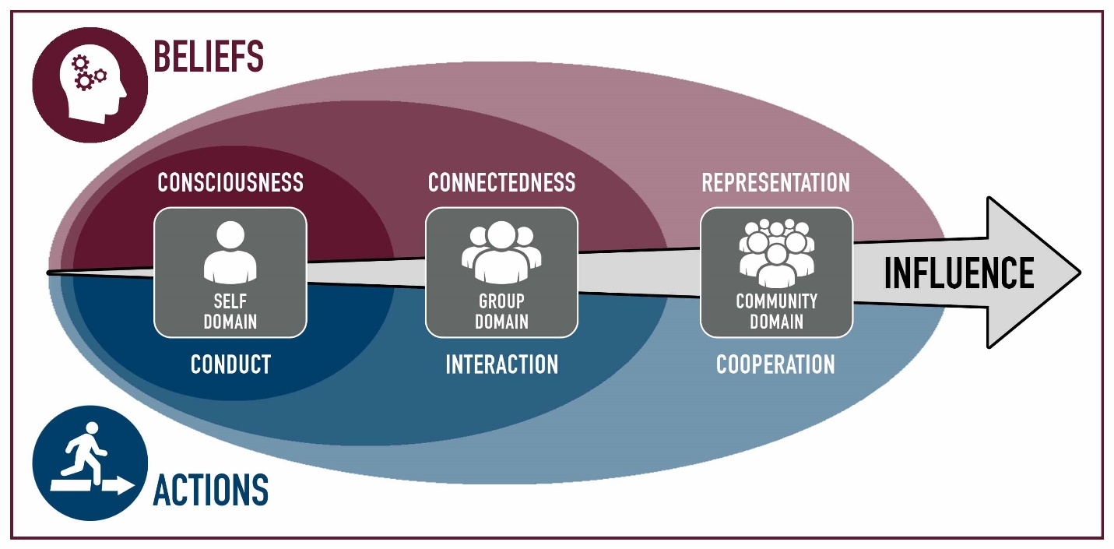
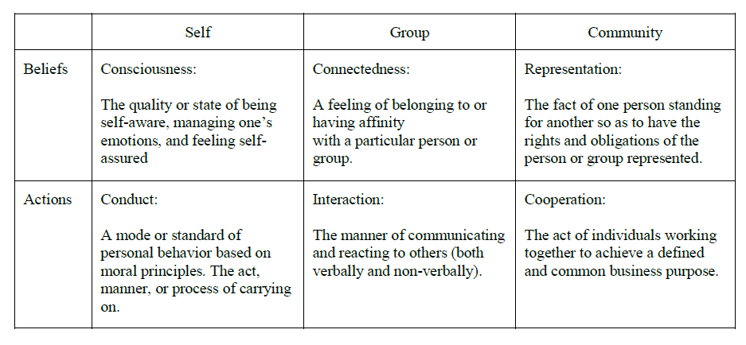
Cooperation
 | Module | Domain | Competency
1 | Teamwork
2 | Influence
3 | Personality | Self | Consciousness
4 | Motivation | Self | Consciousness
5 | Professionalism | Self | Conduct
6 | Pressure | Self | Conduct
7 | Commitment | Group | Connectedness
8 | Conflict | Group | Connectedness
9 | Integrity, Trust & Honesty | Group | Interaction
10 | Communication | Group | Interaction
11 | Leadership | Community | Representation
12 | Loyalty | Community | Representation
13 | Cooperation | Community | Cooperation
14 | Synergism | Community | Cooperation

Slide 7
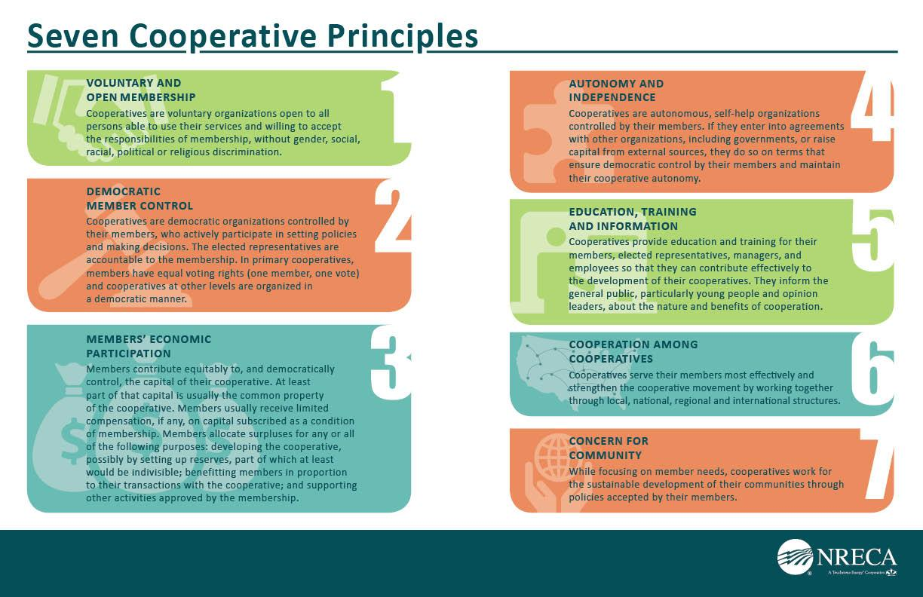

Slide 8
Cooperation
Activity
Helium Stick

Slide 9
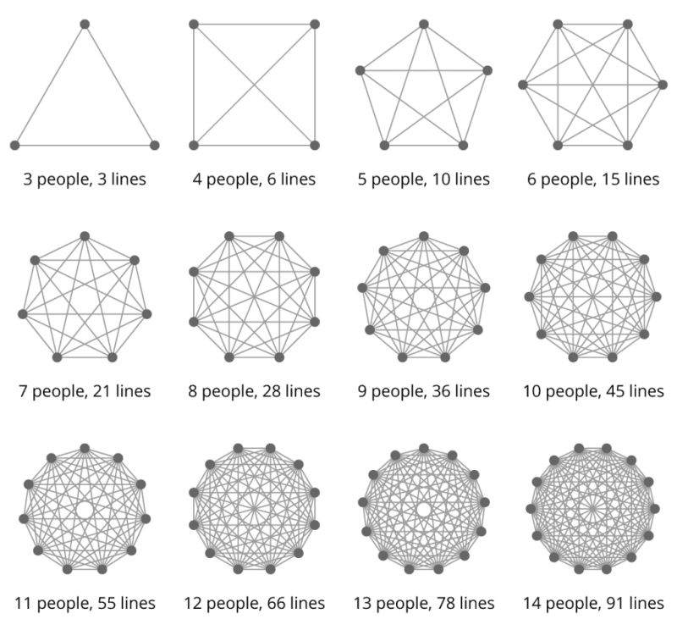

Slide 10
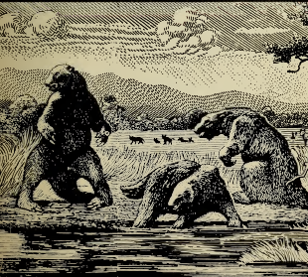
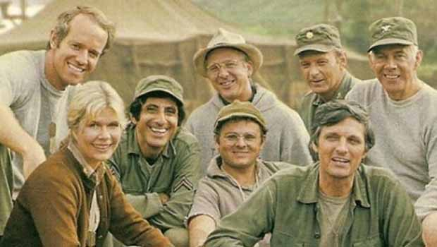
Brookes: The Surgical Team
The Problem
Mills’s Proposal
How it works
Scaling Up

Slide 11
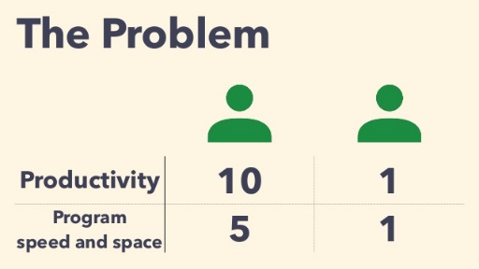
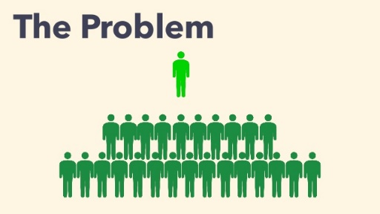
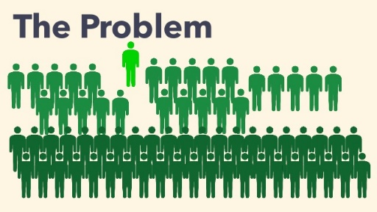
The Surgical Team: The Problem
What is the problem?
How to use ineffective people effectively?
Who do you promote?
Then what is a good s/w career path?
When does a development project be obsolete?
Math
How many lines of code can you develop
How big of a project can you build?
Scale: Small vs Large
What does Small mean
i.e Working with Volunteers
Pick 2: Budget, Resources, Schedule

Slide 12
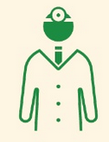
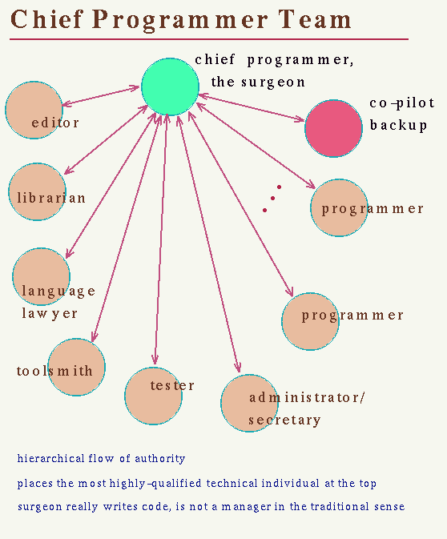
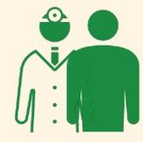






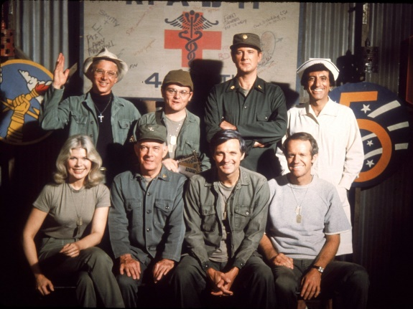
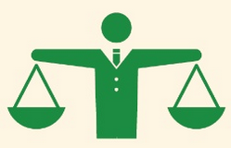
The Surgical Team: Mill’s Proposal
The surgeon - chief programmer/arch
Copilot
Administrator – financial, time/pay
Editor – Docs, User Man, Training
Two secretaries Administrator
Program clerk: CM/DM
Tool Smith – IT
Tester – Integration & Test
Lawyer – Licenses
Notes:
https://www.slideshare.net/ssuser874b3b1/the-mythical-manmonth-3-the-surgical-team

Slide 13

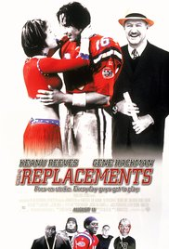
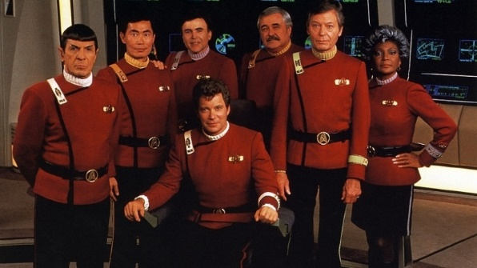
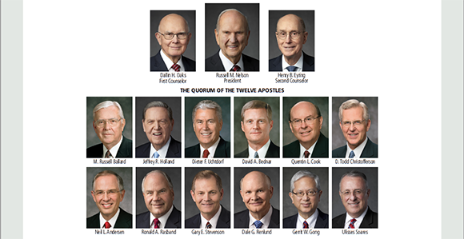
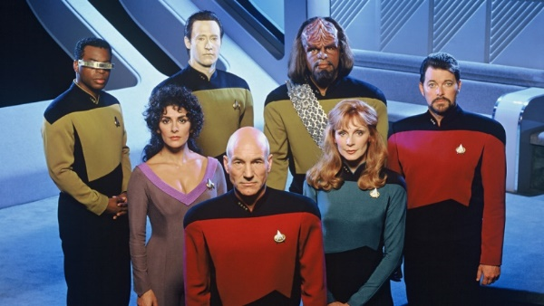

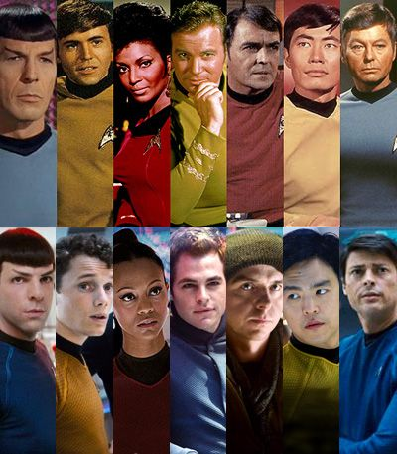
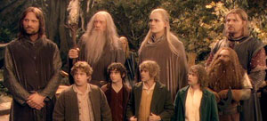
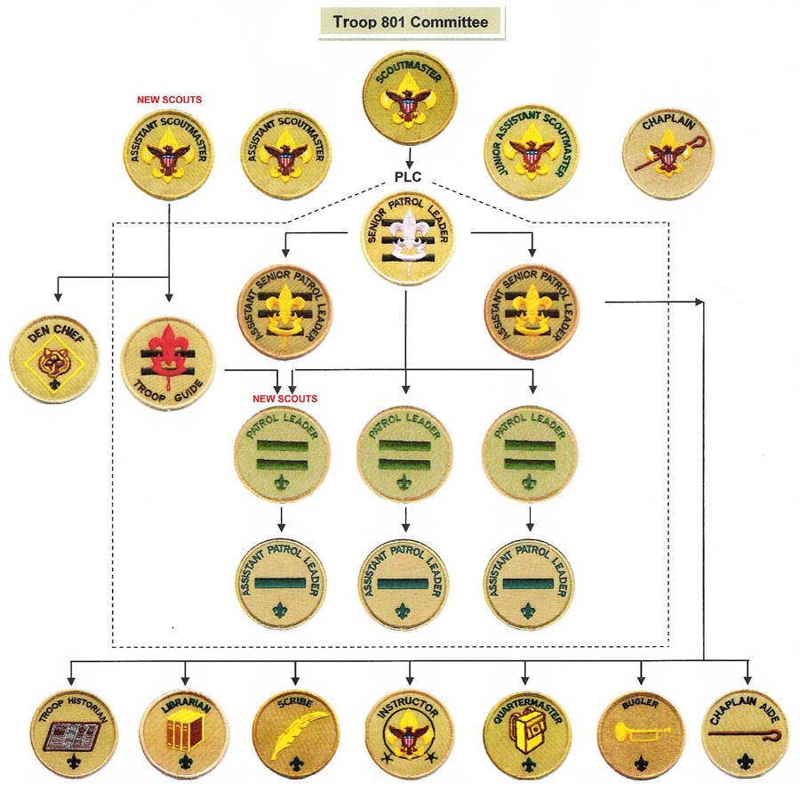
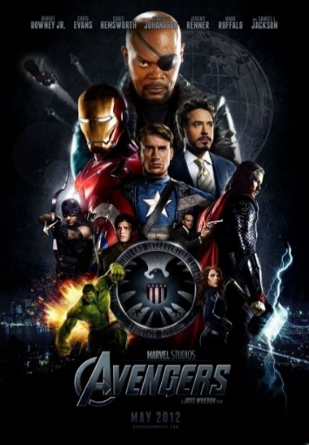
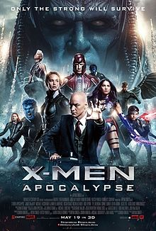

Other Teams?

Slide 14
The Surgical Team: How it Works
Pg 35: How it works
10 people, 7 professionals? Who is not?
Risks
Hit by a bus – single point of failure
Good to be king
Importance of Cross training
“Judgement are settled by the surgeon unilaterally”

Slide 15
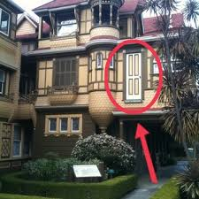
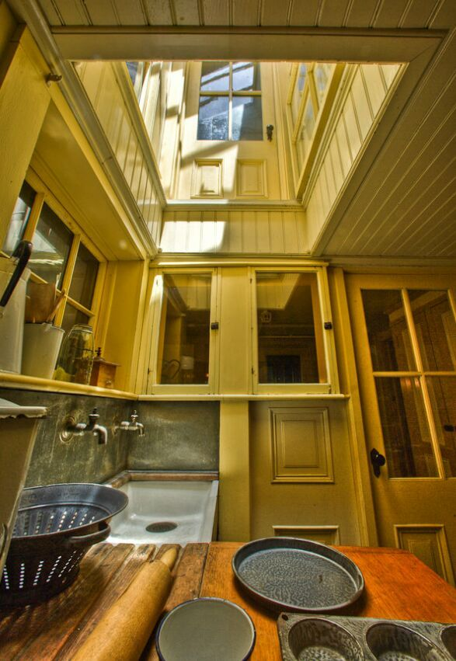
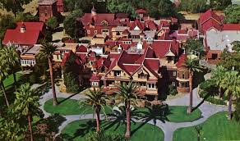
The Surgical Team: Scale Up
Problem: How to build things that take 5000 man hours or more?
Conceptual Integrity
Sys Arch designs it all, top down
Confined to only architecture, not programming
How to over come Entropy?
Conceptual, Code, Architecture/Design, etc
Compare to Chap 11: Plan to Throw One Away

Slide 16
Amoeba Advance
This game requires splitting the class up into two equal teams.
Once you’ve done that, invite half the team to form a circle by joining their elbows, and have the rest of the team wedge themselves inside the circle.
When both teams have formed their makeshift amoebas, blow a whistle to signify the start of play.
The teams will then attempt to make it to the finish line without breaking up the group.
If the amoeba should dissolve during the attempt, the team must repair itself before it can move forward.

Slide 17
Marshmallow-and-noodle challenge

Slide 18
Syngergy
 | Module | Domain | Competency
1 | Teamwork
2 | Influence
3 | Personality | Self | Consciousness
4 | Motivation | Self | Consciousness
5 | Professionalism | Self | Conduct
6 | Pressure | Self | Conduct
7 | Commitment | Group | Connectedness
8 | Conflict | Group | Connectedness
9 | Integrity, Trust & Honesty | Group | Interaction
10 | Communication | Group | Interaction
11 | Leadership | Community | Representation
12 | Loyalty | Community | Representation
13 | Cooperation | Community | Cooperation
14 | Synergism | Community | Cooperation

Slide 19
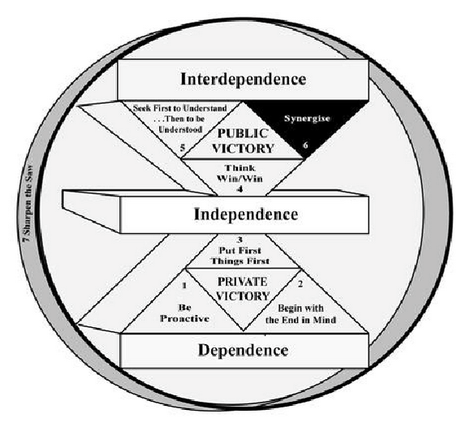
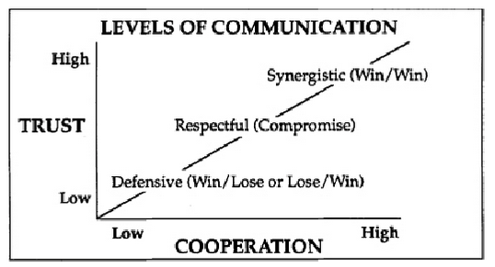
Synergy
Habit 6 Synergy:
Highest activity in all life: principle-centered leadership
Synergistic Communication
Synergy in the Classroom
Synergy in the Business
Synergy and Communication
Valuing the Difference
Force Field Analysis
All Nature is Synergistic

Slide 20
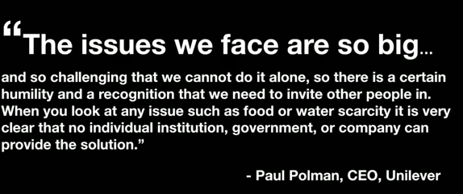
Teaming
Ted Talk:How to turn a group of strangers into a team
What is teaming?
What makes a good hospital, make a movie
Jargon? Professional Culture Clash
Soft Skill: Leadership, Humility,
Issues
Hard to know if you already know
Sacristy
How quickly can you find…

