Slide 1


Course Introduction
CS 170 – Tech. Teamwork
William Clements
"Those graduates of BYU-Idaho will become—and this is a prophesy that I am prepared to make and make solemnly—those graduates of BYU-Idaho will become legendary for their capacity to build the people around them and to add value wherever they serve."
—Henry B. Eyring, A Steady Upward Course
© 2018 Brigham Young University–Idaho

Slide 2
Welcome to BYU-Idaho

Slide 3




BYU-Idaho Learning Outcomes

Slide 4
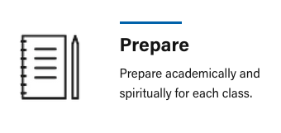

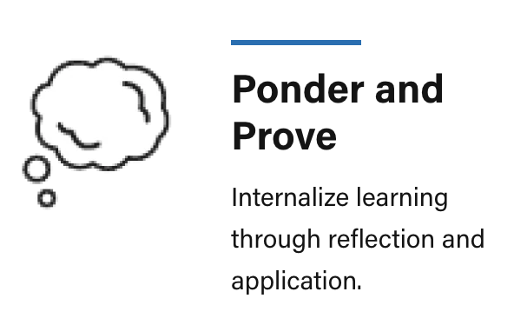

BYU-Idaho Learning Model

Slide 5


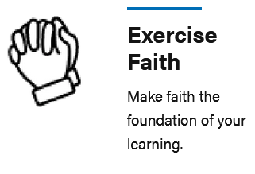
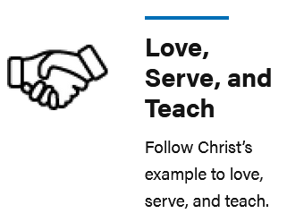
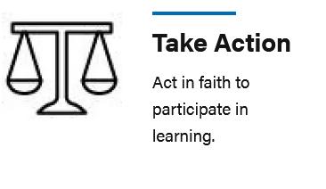
The 5 Principles of Effective Teaching and Learning

Slide 6
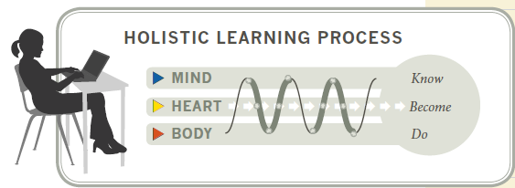
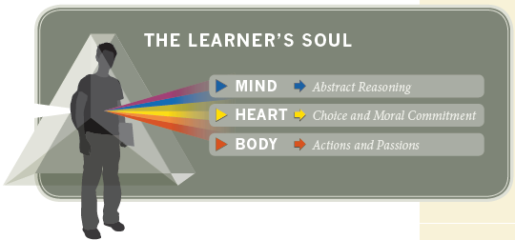
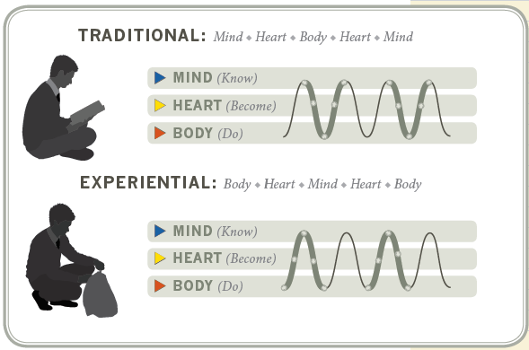
Learning @ BYU

Slide 7
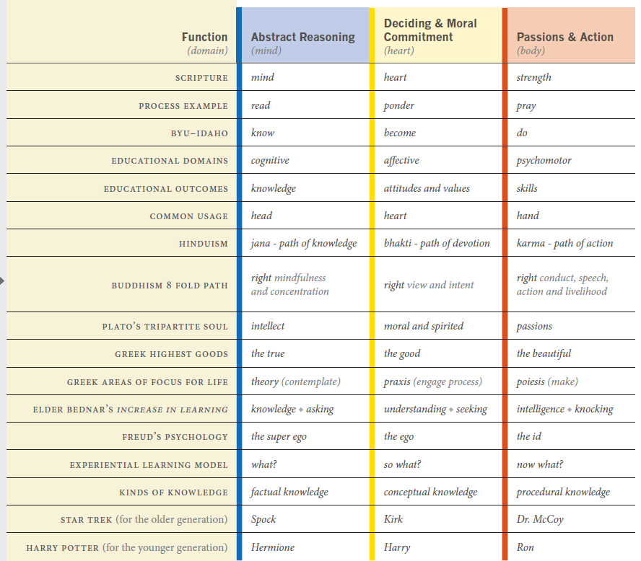
Learning @ BYU

Slide 8
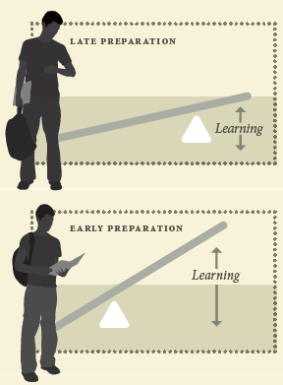
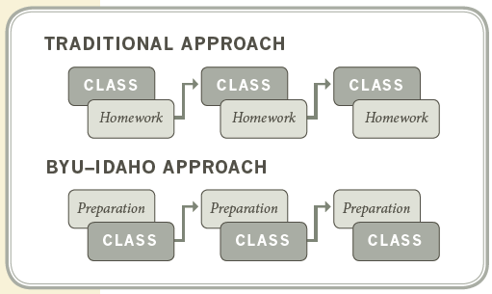
Learning @ BYU

Slide 9
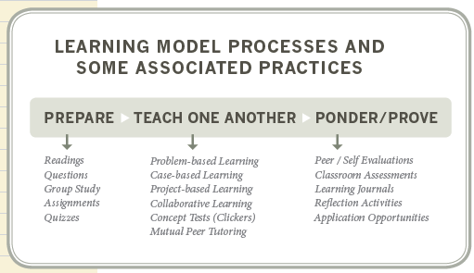
Learning @ BYU

Slide 10
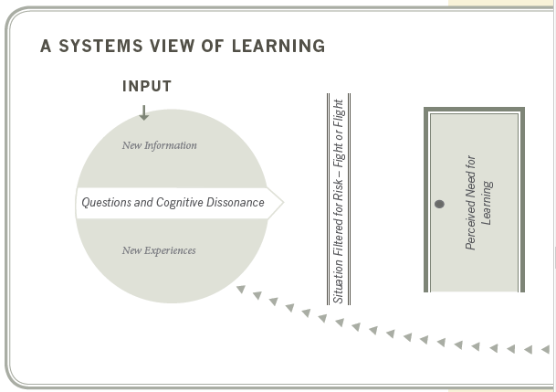
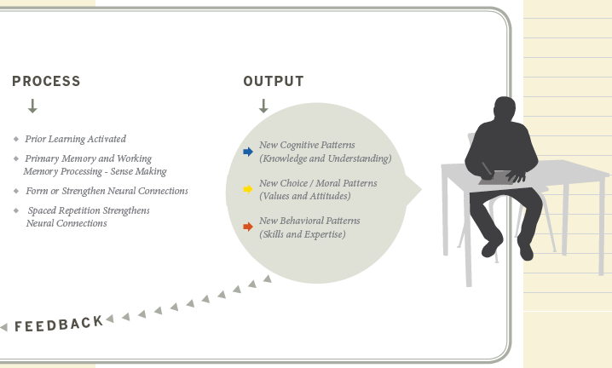
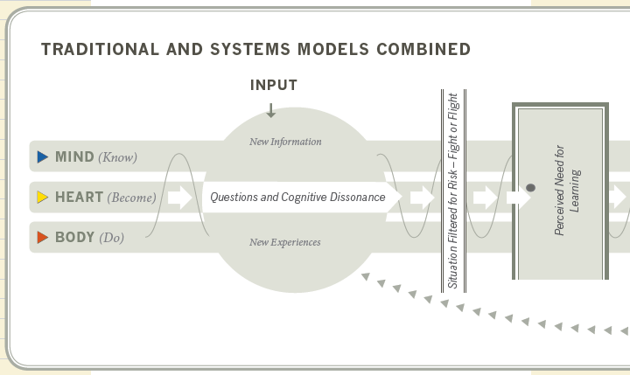
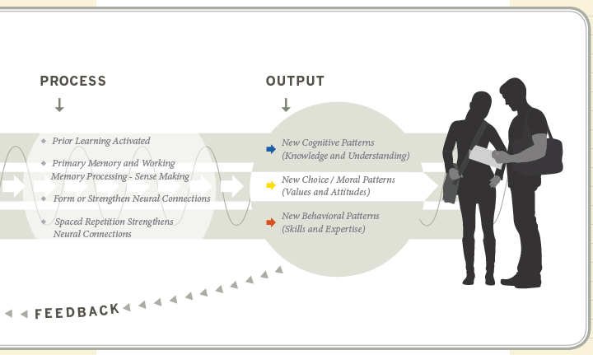
Learning @ BYU

Slide 11
Learning
Who bears the primarily responsibility for learning? Why?
What are you responsible for in this course? Instructor? TAs?
What can you do to ensure to make sure you succeed?

Slide 12
Honor Code – What does it mean
Be honest.
Live a chaste and virtuous life, including abstaining from any sexual relations outside a marriage between a man and a woman.
Respect others, including the avoidance of profane and vulgar language.
Obey the law and follow campus policies.
Abstain from alcoholic beverages, tobacco, tea, coffee, vaping, and substance abuse.
Participate regularly in Church services (required only of Church members).
Observe BYU-Idaho’s dress and grooming standards.
Encourage others in their commitment to comply with the Honor Code.

Slide 13

Be honest Syllabus – Policies - Honor Code
School and Department
For this Class
You may work with your classmates, but all submitted work must be original.
The penalty for copying or plagiarizing of assignments might be one or more of the following: zero on an assignment, being asked to withdraw from the class, a failing grade in the class, or disciplinary action by the university.
Homework assignments are to be completed as scheduled.
Late work is generally not accepted. However, assignments may be rescheduled for a limited number of emergency situations if you discuss your situation with me before (not on and especially not after) the scheduled due date. There will be no routine extensions of due dates; be prepared to justify any requests for extensions.
What is a grade?
Feedback to qualify for the next class
In 5 years, what will matter
Provide Sources.
It is ok to use the internet, but document, and make the assignment your own.
One - Two sources is plagiarism
3+ sources is a research paper
Put it in the comments, at the end
Assignment
You must turn something in on time.
Even if it is a letter, take ownership of when you will turn it in.
You can resubmit as many times to get the grade – this is a learning class.

Slide 14

Accessibility
BYU-Idaho is committed to providing a working and learning atmosphere that reasonably accommodates qualified persons with disabilities. Reasonable academic accommodations are reviewed for all students who have qualified documented disabilities. Services are coordinated with the student and instructor by BYU-Idaho Disability Services. If you need assistance or feel you have been unlawfully discriminated against on the basis of disability, you may seek resolution through established policy and procedures.
If you have any disability that may impair your ability to complete this course successfully, please contact Disability Services as soon as possible, preferably before the beginning of the semester, in order to ensure that you receive appropriate accommodations.
Disability Services Contact Information:
Phone: (208) 496-9210
Email: disabilityservices@byui.edu
Fax: (208) 496-5210
Website: http://www.byui.edu/disabilities/disability-services

Slide 15
Honor Code – What does it mean
Be honest.
Live a chaste and virtuous life, including abstaining from any sexual relations outside a marriage between a man and a woman.
Respect others, including the avoidance of profane and vulgar language.
Obey the law and follow campus policies.
Abstain from alcoholic beverages, tobacco, tea, coffee, vaping, and substance abuse.
Participate regularly in Church services (required only of Church members).
Observe BYU-Idaho’s dress and grooming standards.
Encourage others in their commitment to comply with the Honor Code.

Slide 16
Respect.
Treat everyone with respect... Sexual Harassment
BYU-Idaho is committed to promoting and maintaining a safe and respectful environment for the campus community. Sexual misconduct is
against the law,
contrary to the teachings of The Church of Jesus Christ of Latter-day Saints and
the Honor Code, and
inconsistent with the life and teachings of Jesus Christ, which we hope are embodied on our campus.
The university prohibits sexual misconduct perpetrated by or against university students, university employees, participants in university programs, or visitors to its campus, whether the behavior occurs on or off campus.
Read Title IX for more information.
Risk Mitigation
Office Hours
Open door policy – our office hours will be open door unless you need to close the door.
Avoidance of profane and vulgar language
There is more than 4 letter words

Slide 17
Family Education Rights & Privacy Act (FERPA)
The United States Congress passed the Family Educational Rights and Privacy Act (FERPA) in 1974 to afford certain rights to students concerning their education records.
The primary rights afforded to students who attend a postsecondary school such as Brigham Young University-Idaho are the right to inspect and review their education records, the right to seek to have their records amended, and the right to have some control over the disclosure of information from the records.
Brigham Young University-Idaho may not disclose the information contained in education records without the student's written consent except under certain limited conditions
If your parents call me, I will not, can not tell them how YOU are doing in class, or if you are enrolled in the class.
I will ask them to ask you.
I can tell them and provide a link to the class assignments so they can help you.
https://www.byui.edu/student-records/ferpa/family-education-rights-and-privacy-act-(ferpa)

Slide 18
Blended
Safety and Quality
Learning take place in safe
At any point where safety is a concern, we will be going Remote
Quality of being taught, better than CBT.
Class will be Zoomed, but you are expected to be here
$15 charge for every day you miss?
If quarantined, we will be meeting via Zoom.
Communication will happen in iLearn and in MS Teams

Slide 19
Honor Code – What does it mean
Be honest.
Live a chaste and virtuous life, including abstaining from any sexual relations outside a marriage between a man and a woman.
Respect others, including the avoidance of profane and vulgar language.
Obey the law and follow campus policies.
Abstain from alcoholic beverages, tobacco, tea, coffee, vaping, and substance abuse.
Participate regularly in Church services (required only of Church members).
Observe BYU-Idaho’s dress and grooming standards.
Encourage others in their commitment to comply with the Honor Code.

Slide 20
Situations in real-life
At a company party, and they offer you a drink/smoke?
At work and someone says an off joke?
Incorrect responses?
Correct responses?

Slide 21
Honor Code – What does it mean
Be honest.
Live a chaste and virtuous life, including abstaining from any sexual relations outside a marriage between a man and a woman.
Respect others, including the avoidance of profane and vulgar language.
Obey the law and follow campus policies.
Abstain from alcoholic beverages, tobacco, tea, coffee, vaping, and substance abuse.
Participate regularly in Church services (required only of Church members).
Observe BYU-Idaho’s dress and grooming standards.
Encourage others in their commitment to comply with the Honor Code.

Slide 22
Starting each class with a Prayer
This is a religious institution.
We learn by study and prayer.
You can opt-out in two ways.
1. Email me, and I will remove you from the list.
2. I will go through the role, and ask you if I have called on you to say a prayer
If you don’t, tell me I have already asked
If you have no problem, then I will ask if you can say it.
Prayer can be given in any language.

Slide 23
Honor Code – What does it mean
Be honest.
Live a chaste and virtuous life, including abstaining from any sexual relations outside a marriage between a man and a woman.
Respect others, including the avoidance of profane and vulgar language.
Obey the law and follow campus policies.
Abstain from alcoholic beverages, tobacco, tea, coffee, vaping, and substance abuse.
Participate regularly in Church services (required only of Church members).
Observe BYU-Idaho’s dress and grooming standards.
Encourage others in their commitment to comply with the Honor Code.

Slide 24
Dress and Grooming Standards
Men and women should be neat and clean in appearance avoiding extreme clothing and hairstyles. Pants, slacks or jeans should not be frayed or torn and must be ankle length.
Hats should not be worn in buildings.
Shoes should be worn in all public areas. Flip-flops and shorts are not appropriate campus attire.
Men
Women
A clean and well-cared-for appearance should be maintained.
Hairstyles should be clean and neat, avoiding extreme styles or colors, and trimmed above the collar leaving the ear uncovered. Sideburns should not extend below the earlobe or onto the cheek. If worn, mustaches should be neatly trimmed and may not extend beyond or below the corners of the mouth.
Men are expected to be clean-shaven; beards are not acceptable.
Earrings and other body piercing are unacceptable.
Shoes should be worn in all public campus areas.
A clean and well-cared-for appearance should be maintained.
Clothing is inappropriate when it is sleeveless, strapless, backless, or revealing, has slits above the knee, or is formfitting.
Dresses and skirts must be knee length or longer. Hairstyles should be clean and neat, avoiding extreme styles and colors.
Excessive ear piercing (more than one per ear) and all other body piercings are inappropriate.
Shoes should be worn in all public campus areas.
https://www.byui.edu/student-honor-office/ces-honor-code#dress-and-grooming-standards

Slide 25
Dress and Grooming Standards
Common Issues
No hats, shorts, or sandals.
Hair: Head, shoulders, knees, and toes
Professional Dress
Presentations: Slacks and Collared shirts – no ties
Classroom: Business or Business Casual attire
Modesty is a universal gospel principle that we should all adhere to no matter the setting.
Dress and grooming standards have no bearing on righteousness
Perception in the workforce?
Teach, remind, encourage and invite our students to abide by the dress and grooming standards they have agreed to, we can help establish and maintain a learning environment and patterns of behavior that will be a blessing to all.
https://www.byui.edu/student-honor-office/ces-honor-code#dress-and-grooming-standards

Slide 26
Syllabus
Found in iLearn
The grading breakdown for the course is:
40% - Reflections (Prepare, Teach, Ponder)
60% - Prove (Projects)

Slide 27
Class Objectives
Successful graduates for CSE 170 will:
build positive professional working relationships with those they serve
be recognized as a valuable asset within their team and organization
By the end of the semester, students will have the opportunity to become more:
aware of how personal beliefs and actions influence others
informed of the career paths represented by computer science certificates
skillful in negotiating expectations with colleagues
creative in finding solutions to interpersonal problems in work settings
perceptive of personality and leadership factors in work situations

Slide 28
Time Commitment
This is a 2-credit class
Expectation is that you spend 2 hours for every class hour, so for a given week: 2 class hours + (2*2 class hours) = 6 hours/week
1st Hour: Read & Complete Summary
2nd Hour: Class: Team Activities, Scenario
3rd Hour: Class: Q&A, Kahoot, Review
4th Hours: Team submission
5th Hour: Prove
6th Hour: Ponder

Slide 29
Schedule
Day | Sun | Mon | Tue | Wed | Thu | Fri | Sat
Out of Class |  | Reading Prep
In Class |  | Class Team Discussion |  | Class Discussion
Out of Class |  |  | Work with Team |  |  |  | Ponder Due
 |  |  |  |  | Work on Prove |  | Prove Due

Slide 30

Course Organization
Each lesson is organized as follows:
Prepare :
Read the case study and related articles. Complete summary.
Teach One Another Team Activities
Participate in a team activity designed to help you build confidence in your response to the case. Complete a self-assessment of your participation.
Teach One Another Class Activities
Participate in a class discussion designed to help you face the complex problem imposed by the case. Complete a self-assessment of your participation.
Prove 60%:
Written assignment summarizing learning
Ponder 40%: Reflection
Complete a questionnaire of short-answer questions writing assignment designed to help you apply your conclusions from the case to yourself.

Slide 31
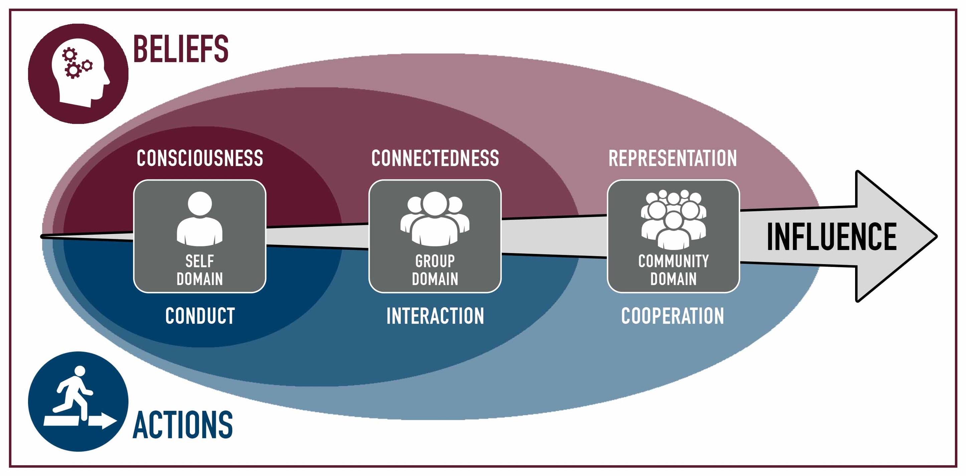
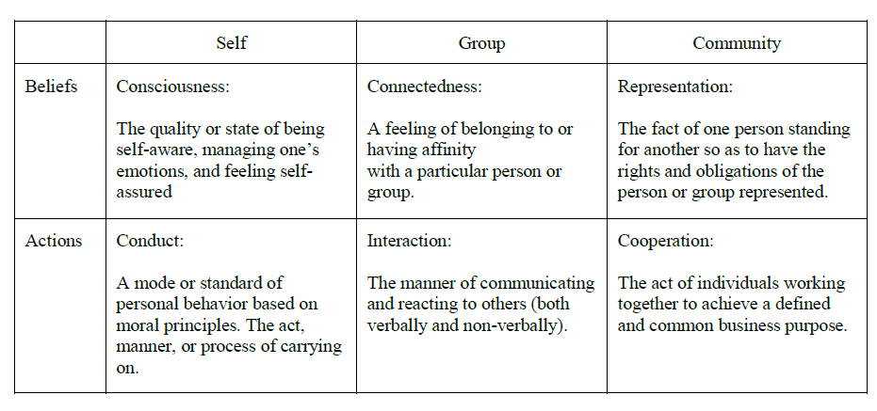
Class Organization
The class will be covering 4 modules/domains
Overview (Weeks 1-2)
Individual (Weeks 3-6) Personality, Motivation, Professionalism, Pressure
Group (Week 7-10) Commitment, Conflict, Technical Roles, Communication
Community (Week 11-14) Leadership, Loyalty, Cooperation, Synergism
Major projects
Personal Project 50 pts
User Manual 50 pts
Acorn Project
Proposals/Status 50 pts each
Presentations 200 pts

Slide 32
Reflection
Based on Service-Learning and SQ3R (Survey, Question, Read, Recite, Review)
Answering questions dealing with:
5 pts Questions Affect: (What?, So What?...Return, Report, Reflect and Regroup.)
What? (Return and Report)
So What? (Reflect and Regroup)
10 pts Questions Behavior: (What now?...my ideas are starting to emerge!)
20 pts Questions Cognitive: (Wow, I learn?... Ok that is deep!)

Slide 33

Acorn Projects
As part of the class, you will be organized into teams of 3-4 to work on 4 acorn projects.
Each acorn project will represent one section of our class
Each acorn project will fulfill one of the ILO of the school.
Each project should be worked on through out the semester.
Projects will be approved during the 3rd and 4th week.

Slide 34
Technology
iLearn
See announcement for more link info
22Fall CSE 170 Tech Teamwork
Zoom

Slide 35
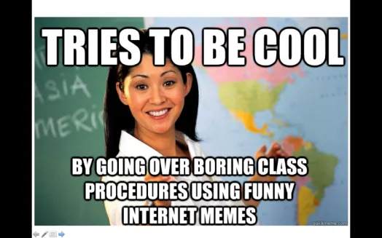
A little about me…
20+ Years experience
Worked for Northrop Grumman (TRW) for 13 years, Raytheon for 5 years
Computer Science:
Masters: Univ of CO @ Denver; Bachlors; BYU-Provo; Associates: Ricks College
Teaching
Been teaching for 8 years: Online, Hybrid, and Campus for Community Colleges of Colorado, BYU-Online, and BYU-Idaho
Passion:
I love computing, I have since I saw my first for-loop fill the screen with my name.
Other
I have moved over 20x, CA, UT, ID, MO, OK, TX, CO
Countries: Russia, England, Baltic states, Finland
Hobbies: Board Games, Family outings
Food: Indian, Tex-mex, Italian, and everything but lima beans and liver and onions.

Slide 36
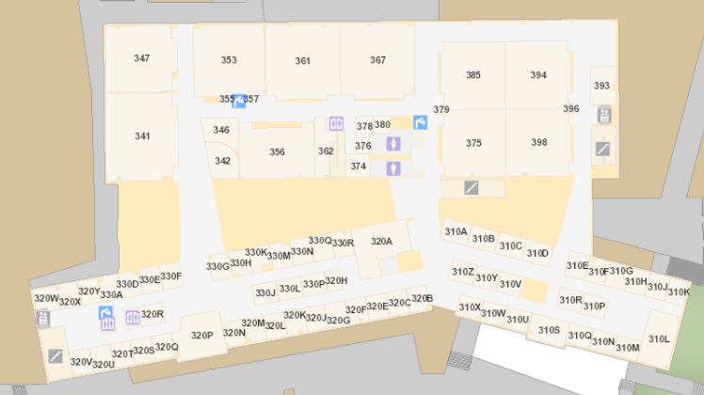
Bro Clements
William Clements
Email: ClementsW@byui.edu
Google Phone: (208) 557-4333
Office Phone: 208-496-7617
Office Rm: 320 T (Mark Twain with a T – Samuel Clemens)
Office hours: M-F 09:00 AM - 10:00 AM

Slide 37
Before Next Time…
Get signed up for MS Teams
Finish/Submit Reading
Introduction Discussion – Due Thursday
Provo: 10 Principles of Teamwork - Saturday
Ponder: Reflection
Saturday

