Slide 1


CSE 170 Technical Teamwork
W. Clements
Week 05: Individual Professionalism

Slide 2
Overview
Where are we in the class?
What should I have prepared for?
What are we going to discuss this week?

Slide 3
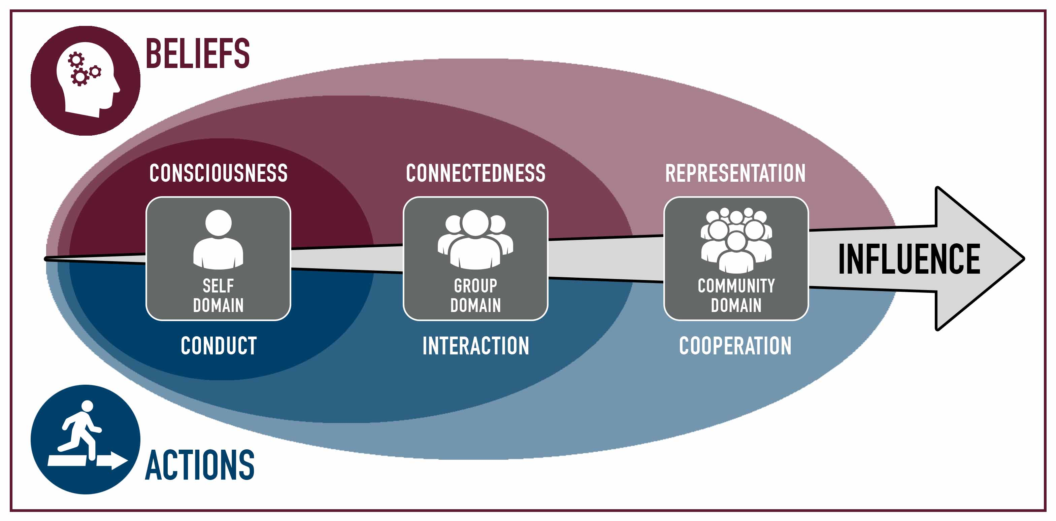
Multidimensional Influence Model (MIM)

Slide 4
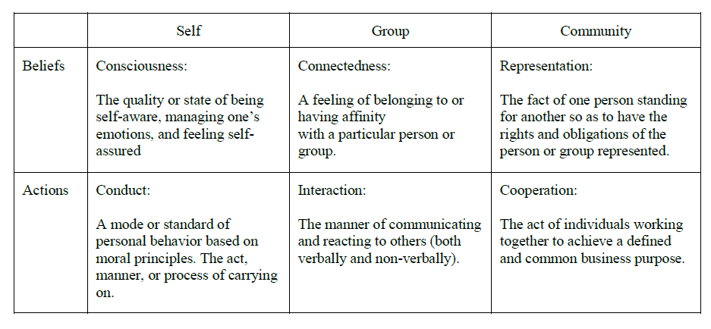
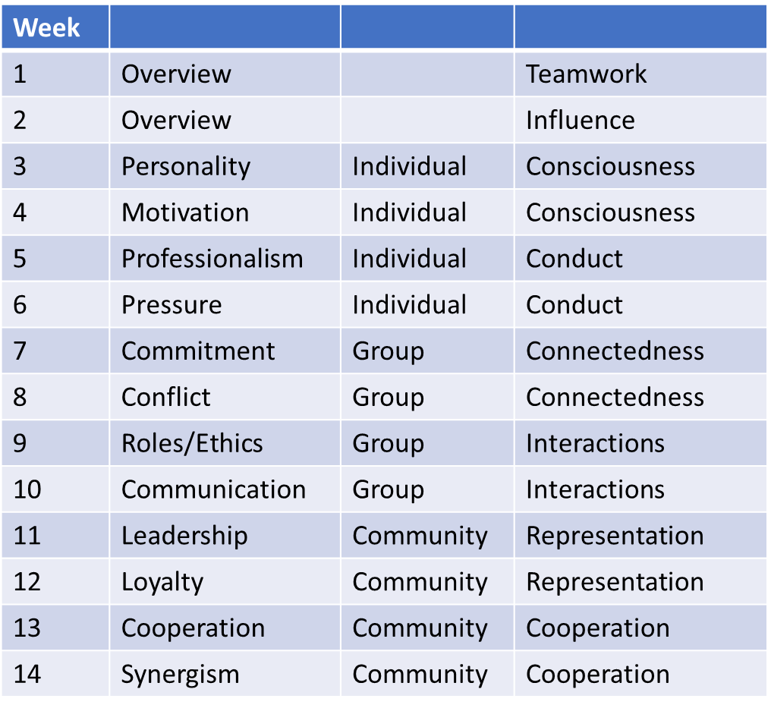
Multidimensional Influence Model (MIM)

Slide 5
What have you learned so far?
About
Individual: Belief
Personality
Motivation

Slide 6
Coming Up
Personal User Manual - 5 & 6
What we are going to include
Personality: Introvert/Extravert, Color Test, and Myers Briggs results
Motivation: Theory X/Y
Consciousness: Professionalism & Personal Ethics statement
Pressure: Performance Evals, 360, Stress
Acorn Project – 7 & 8
Week 06 Group assignments
Week 07 Proposal Due
Week 08 Approval Due
Week 09 Either 1 of 4 done or 25% of each done
Week 10 Either 2 of 4 done or 50% of each done
Week 11 Either 3 of 4 done or 75% of each done
Week 12 Project Due
Week 13 Project Presentations
Beginning with the end in mind – S.R. Covey
User Manual template
My Style
Values
Patience and Strength
Communication Methods
Best Way to help me help you
Common Misunderstanding

Slide 7
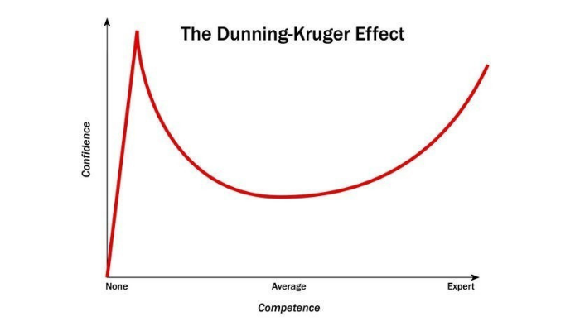
Dunning–Kruger effect
https://www.ispot.tv/ad/7oMF/holiday-inn-express-the-solution
The Dunning-Kruger effect is a cognitive bias in which people wrongly overestimate their knowledge or ability in a specific area. This tends to occur because a lack of self-awareness prevents them from accurately assessing their own skills.
https://www.psychologytoday.com/us/basics/dunning-kruger-effect

Slide 8

Introducing Steven Hinkle
Works at Oak Trail School District as Help Desk Technician
Married to Melissa, expecting
Work experience:
Weak portfolio, lack of experience
Didn’t apply himself at school, skipped group projects
Food delivery, while Melissa worked at clothing store
Read up on the Issues 1-3

Slide 9
Activity: Cup Stacking
Rules
Can’t directly touch the cups or the rubberband
The cup is radioactive and the rubberband is an insulator, so also radioactive but won’t transfer radioactive to other objects.
Can only use what is in the envelope.
10 pts everyone participated
10 pts for using everything in envelope

Slide 10
Prepared 05
Leaders Need User Manuals...
Another example of a personal user manual
16 Personalities free personality test
Read the following article.
How to be a Professional For Today's Workforce (Links to an external site.)
11 Ways to Be Professional at Work (Links to an external site.)
The Ultimate Guide to Professionalism (Links to an external site.)
10 Tips to Improve Your Follow Through at Work (Links to an external site.)
4 Points of Leadership Professionalism & Meetings

Slide 11
Personal User Manual
Copy this down:
My style
What I value
What I don’t have patience for
How best to communicate with me
How to help me
What people misunderstand about me
Chapter 1

Slide 12
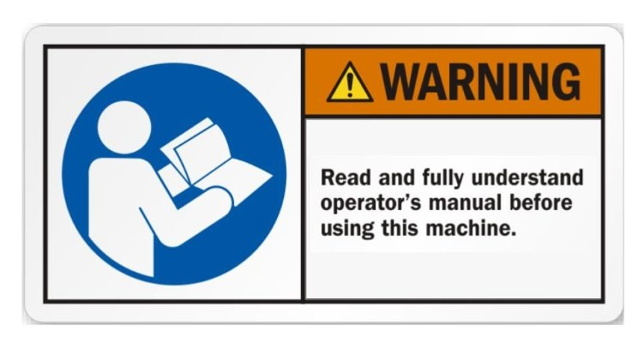
Leaders need “User Manuals” – and what I learned by writing mine
“What if you had to write a ‘User Manual’ about your leadership style?”
Abby’s User Manual
My style
What I value
What I don’t have patience for
How best to communicate with me
How to help me
What people misunderstand about me
What If You Had to Write a "User Manual" About Your Leadership Style?
Can you give some examples of what your 'user manual' says?
Can you elaborate on why you developed the user’s manual?
Five Steps to Create a Personal User Manual
Step One: Rough Cut
What is your style?
When do you like people to approach you and how?
What do you value?
How do you like people to communicate with you?
How do you make decisions?
How can people help you?
What will you not tolerate in others?
Step Two: First Draft
Step Three: Input & Workshop
Step Four: Finalize
https://www.linkedin.com/pulse/leaders-need-user-manuals-what-i-learned-writing-mine-abby-falik/

Slide 13
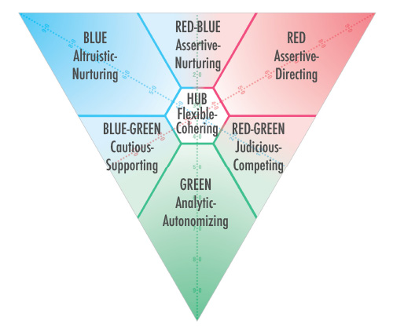
Christopher Bailey - ‘User Manual’
My Style – MVS: Blue-Green
What I value
What I don’t have patience for
How best to communicate with me
How to help me
What people misunderstand about me
Motivational Value System
Another example of a personal user manual
https://www.corestrengths.com/sdi-2-0-methodology-and-meaning/

Slide 14

16 Personality (Revisited) MBTI
If you didn’t save the results, retake it.
Have someone or two, take the quiz about you.
How do they perceive you?
https://www.16personalities.com/

Slide 15
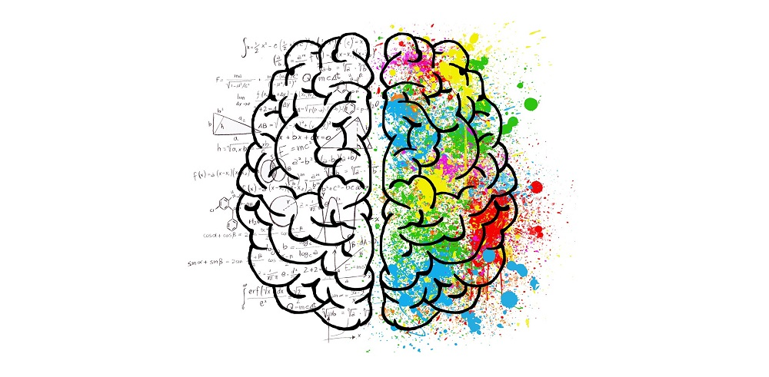
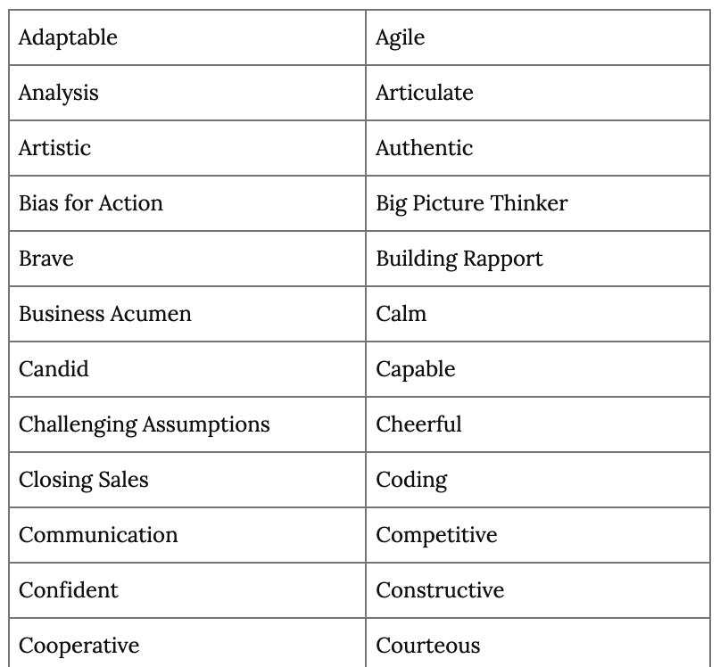
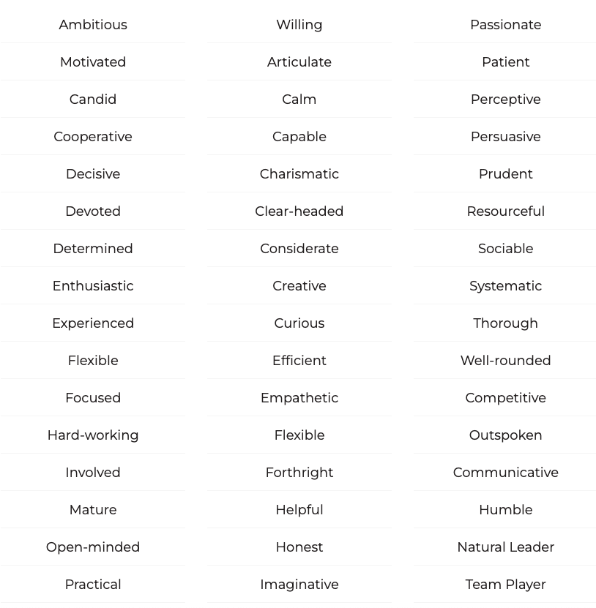
Other Resources
https://simplicable.com/en/personal-strengths
What is SWOT Analysis
https://simplicable.com/new/swot-analysis
Strength, Weakness, Opportunities, and Threats.
List of Personal Strengths – 81 Examples of Personal Strengths and Weaknesses You Can Use in Job Interviews
https://high5test.com/personal-strengths-list/

Slide 16
Teach One Another 05 - Personal Project
User Manual template
My Style
Values
Patience and Strength
Communication Methods
Best Way to help me help you
Common Misunderstanding
What were the results of each person's personality test?
Are there any questions about what the results mean?
What information is the most useful for completing your personal user manual?
What other questions can you ask yourselves to help complete your personal user manual?

Slide 17
Personal Project
Take no more than an hour to answer the following questions with the first thing that comes to mind:
What is your style?
When do you like people to approach you and how?
What do you value?
How do you like people to communicate with you?
How do you make decisions?
How can people help you?
What will you not tolerate in others?
You may format your document in whatever way seems attractive to you as long as it conforms to the following minimum requirements. The title should be your name.
The following sections must be included:
My style
What I value
What I don't have patience for
How best to communicate with me
How to help me
What people misunderstand about me

Slide 18
Day 2

Slide 19
Professionalism
Each table come up with 10 characteristics of a professional?
Each table come up with 10 things that are not professional?

Slide 20
Career, Professional Development How to Be a Professional for Today’s Workforce
1. Accountability:
2. Consideration:
3. Humility:
4. Communication:
5. Tidiness:
6. Kindness:
7. Consistency:
8. Treat Others with Respect.
9. Keep Your Word.
Want to Be Seen as Professional? 3 Important Tips
Discussion vs. Gossip:
Be positive:
Stay focused:

Slide 21
11 Ways to Be Professional at Work
1. Respect Company Policies
2. Treat Company Property with Care and Respect
3. Be Organized
4. Be Punctual
5. Be Dependable
6. Be an Ace at Your Job
7. Excel at Communication
8. Be Intellectually Honest
9. Avoid Office Politics and Gossip
10. Dress for Success
11. Stay Positive
The Top 10 Soft Skills in Demand
1. Communication
2. Organization
3. Teamwork Skills
4. Punctuality
5. Critical Thinking
6. Social Skills
7. Creativity
8. Interpersonal Communication
9. Adaptability
10. Friendly Personality

Slide 22
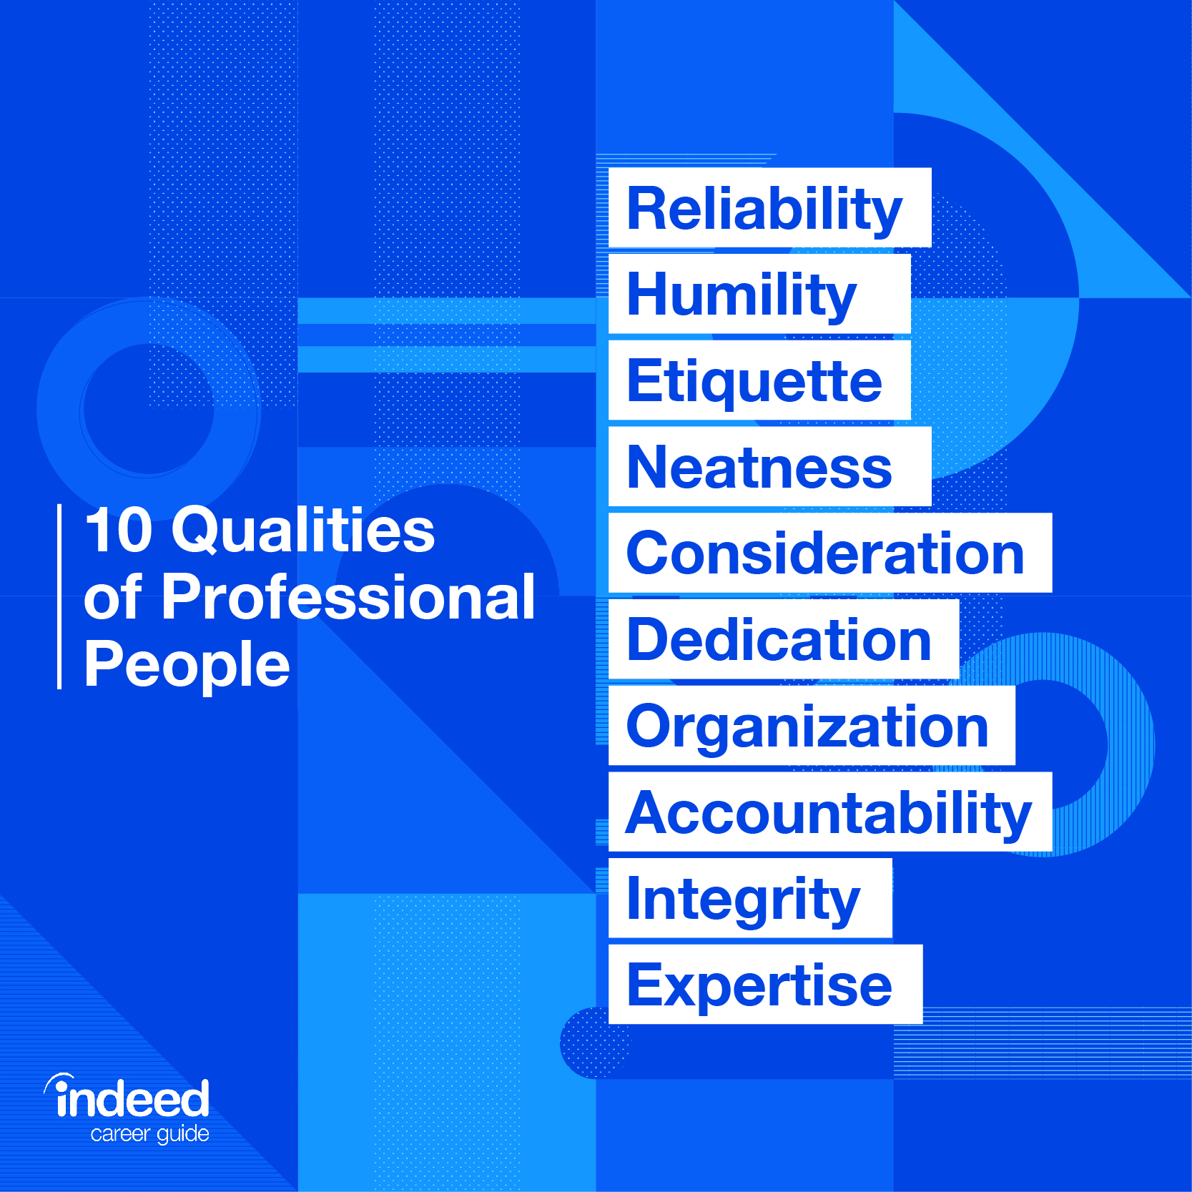
Guide to Professionalism in the Workplace
Why is professionalism important?
1. Be reliable
2. Demonstrate humility
3. Demonstrate etiquette
4. Be neat
5. Show consideration
6. Demonstrate a strong work ethic
7. Be organized
8. Be accountable
9. Demonstrate integrity
10. Acquire expertise
Tips for being professional in different workplace situations
Professionalism in an interview
Professionalism with customers
Professionalism with colleagues

Slide 23
10 tips to improve your follow-through work - Mark Goulston, M.D.
follow-through (noun): The completion of a motion, as in the stroke of a tennis racket. The portion of such a motion after the ball has been hit. The act of continuing a plan, project, scheme or the like to its completion.
Make sure it’s not just important, but that you care enough about it.
Be careful what you promise.
Expect your mind to change.
If following through causes some people to push back against it, how will you stand up against them?
Don’t confuse reasonable with realistic.
Write it down on your calendar.
Use the buddy system.
Ask someone to help you keep your promises.
Get a 3rd party verification
Eliminate energy vampires.
Stick with it. (12, 30, 180 Habit) follow through to the end

Slide 24
The Four Points of Practical Leadership - BYUI
Professionalism
Punctuality
Dress and Groom
Language
Gossip
Conduct
Making the Most of Meetings
Put it on Paper
Give Notice
Welcome People
Maintain the Environment
Control the Tempo
Keep a Record
Stay in Touch

Slide 25
Characteristic of Professional
Today’s Professional Miller | 11 ways Prof. Share | Ultimate Prof | Professionalism Half | The Four Points of Practical Leadership
Accountability, Consideration, Humility, Communication, Tidiness, Kindness, Consistency, Treat Others with Respect, Keep Your Word | Respect Company Polices, Treat Company Property with Care and Respect, Be Organized, Punctual, Dependable Be an Ace, Communication, Intellectually Honest Avoid Office Politics and Gossip, Dress for Success Stay Positive | Reliability, Humility, Etiquette, Neatness, Consideration, Dedication, Organization, Accountability, Integrity, Expertise | Accountability. Consideration. Humility. Communication. Tidiness. Kindness. Consistency. | Punctuality Dress and Groom Language Gossip Conduct

Slide 26
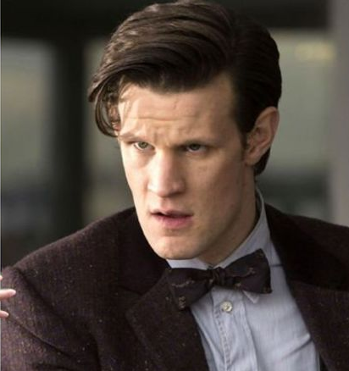
Steven Hinkle’s Issues
History
Issue 1:
Update patch, skipped a step, student found vulnerability and share it.
Honest error
Issue 2
House call, Showed up late, forgot name tag, snapped at customer
Issue 3
Complaint:
“Posting Negative Memes to unofficial channel,
Watching TV from his phone”
He was unreliable to meetings, coming prepared, resolving tickets, meeting deadlines
Being called in again…

Slide 27
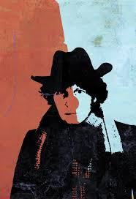
Beliefs and Perceptions
Who identifies with Steven?
With your team discuss each of the topics on Beliefs and Perceptions:
What factors do you think led to Steven's current situation?
Which of these factors is the most significant and why?
What could Steven have done differently?
With your team discuss each of the topics on Self-awareness and Decision Making:
What are some of the things that Steven didn’t do Professionally?
What are some things that Steven did professionally?
With your team discuss each of the topics on What Should Steven Do?:
What professional decisions should Steven do?
What do you think the discussion will be with Steven’s boss? Does his boss have reason to fire him? Keep him?
Explain the code?

Slide 28
Steven Hinkle - Analysis
Problem/Choices | Self-awareness and Professionalism | What Should Steven Do
Team 1
Team 2
Team 3
Team 4
Team 5

Slide 29
Let’s flip the situation…what if you were the boss…
Teamwork | Influence | Personality | Motivation
Team 1
Team 2
Team 3
Team 4
Team 5

Slide 30
Personal Project
Take no more than an hour to answer the following questions with the first thing that comes to mind:
What is your style?
When do you like people to approach you and how?
What do you value?
How do you like people to communicate with you?
How do you make decisions?
How can people help you?
What will you not tolerate in others?
You may format your document in whatever way seems attractive to you as long as it conforms to the following minimum requirements. The title should be your name.
The following sections must be included:
My style
What I value
What I don't have patience for
How best to communicate with me
How to help me
What people misunderstand about me

