Slide 1
THE
SPORTSMANSHIP

Slide 2
Sportsmanship is dead. Winning is everything?
Winning has become another one of those things where the ends doesn't justify the means. I always wondered how people could cheat, lie other people and still be proud of winning. In my opinion, these behaviors are shameful.
BUT I don’t think the Sportsmanship is dead , Here are some examples.

Slide 3
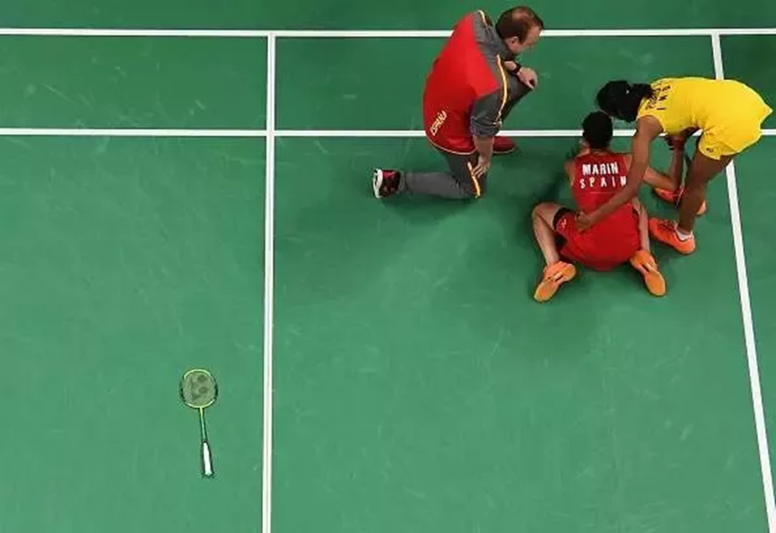
Badminton
Many of us have the tendency of switching off the television set when our favorite player or team loses, so we may have missed this. When PV Sindhu lost the final match against Spain's Marin, she went up to her side of the court to congratulate Marin. But before that can, Marina had flung her racquet away out of excitement. After congratulating Marin, Sindhu picked up Marin’s racquet and placed it on the side of the court, showing her immense respect for the game.

Slide 4
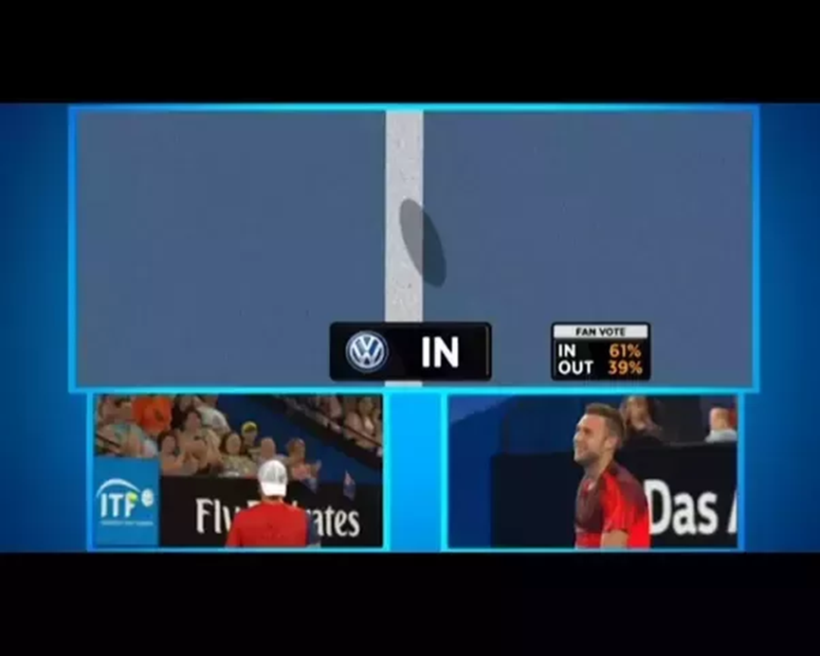
Tennis
The day was 5th of January 2016 it was a match between Hewitt and Jack Sock. At the beginning Hewitt's serve was called out by the referee. While he was going for his second serve, Sock called out and said that the ball was in and asked Hewitt to check it . Then Hewitt went on to review it, and the television replay showed that the ball was well in.
The crowd erupted with applause, for what they had seen was a great gesture of respect shown in one of the most popular sports in the world.

Slide 5
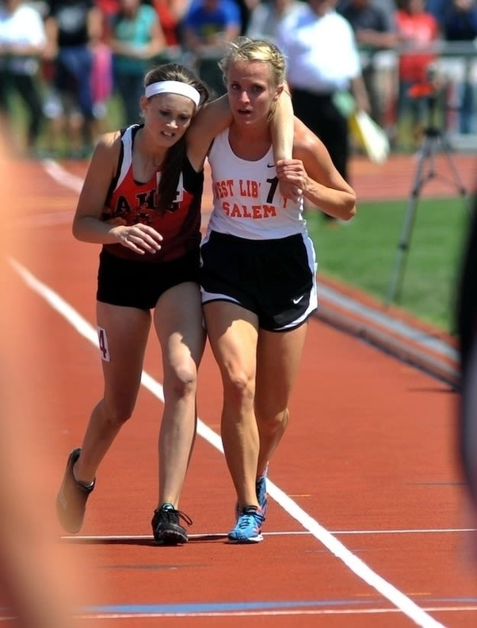
Running
Meghan Vogel was in last place of the 3200 meter finals when the runner ahead of her, Arden McMath began to collapse. Rather than continuing past McMath and avoid a last place finish, Vogel stopped, picked up her injured competitor and carried her the final 20 meters of the race and then across the finish line. Ahead of herself.

Slide 6
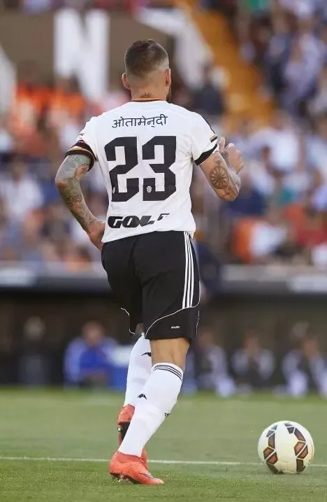
When the earthquake struck Nepal in 2015, many people lost their lives, and many more, their homes. In order to raise money for the people affected by the earthquakes, almost 8000 kilometers away from Nepal, a club in Spain did something that won hearts of people from all over the world.
The players of Valencia F.C wore jerseys with their names written in Nepali language. The jerseys were later sold and the earning from the selling was given to the those affected by the earthquakes
Football

Slide 7
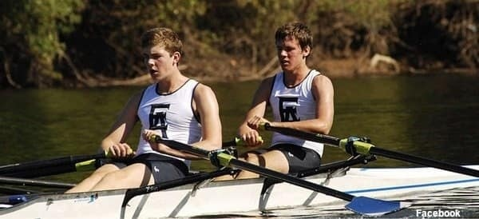
Rowing
The rowers, Konopka and Mead were well on their way to medaling in a race last November when one of the opposing boats capsized. As this was the area in November with temperatures only reaching about 45 degrees.
Konopka and Mead decided to abandon their medal hopes and help their opponents out of the freezing water. After the two fallen rowers were out of the water, the heroes decided that they still should finish the race. So they did.

Slide 8
THANK YOU
FOR WATCHING

