Slide 1

Airline Reservation & Management Web Application(Echo Flights)
Developed By:
Vikas Dhiman (Team lead)
Prajjwal Jaiswal
Prateek Sharma
Yogesh Bora

Slide 2

INTRODUCTION:
Transport is an integral part of our social living. The modern society cannot run without transport facilities.
Echo Flights is an airline reservation website where admin can add, view, delete, update Flights and user can book a flight, view flights, view transition history with Echo, & give Feedback.
Developing Front End User Interface and Application
01
Developing and Deploying by Servers and Databases
02
Developing Backend Architecture
03
Key Job Activities:

Slide 3
DESCRIPTION
The Objective is to:
Provide Customer/User the freedom to Search/Book Flights,Register/Login,etc
Maintain the accuracy of the database.
Provide security features from the unauthorized access.
Admin can Add/Update Flights, Airport,Company,etc

Slide 4
DESIGN ARCHITECTURE
Data Access Layer
Handle all the database activity implemented by Spring Boot.
Business Logic Layer
Provides all the business logic to implement the system.
Presentation Layer
Contains all the web pages as well as user interactions with the system.

Slide 5




SYSTEM REQUIREMENTS
Database : MySQL5
Java : SDK/JRE 1.8 or higher
Disk Space & RAM : 1 GB/+ & 2 GB/+
IDE : Apache Eclipse Enterprise
Browser : Any standard browser

Slide 6





TECHNOLOGIES USED
Mockito
Jasmine
JPA
NPM
Spring Boot
Angular 8
HTML5
CSS3

Slide 7
MODULES
Dashboard(Admin Only)
Login
Registration
Update Profile
Book Tickets
Payment
Flight Management

Slide 8
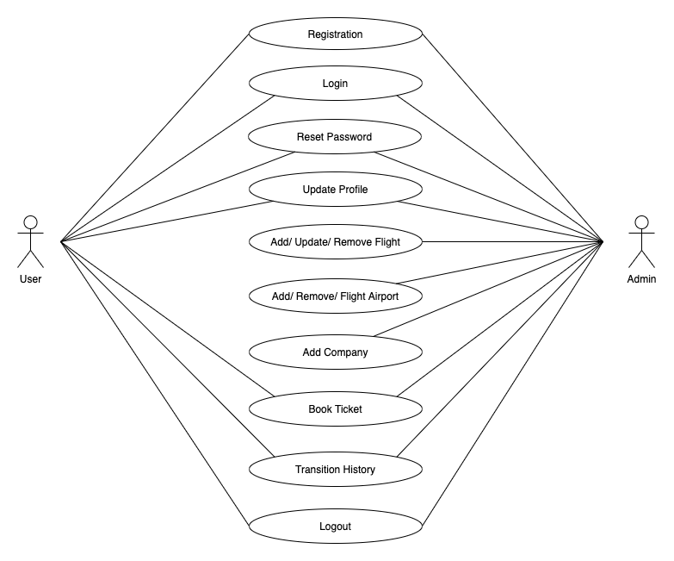
Use Case Diagram

Slide 9
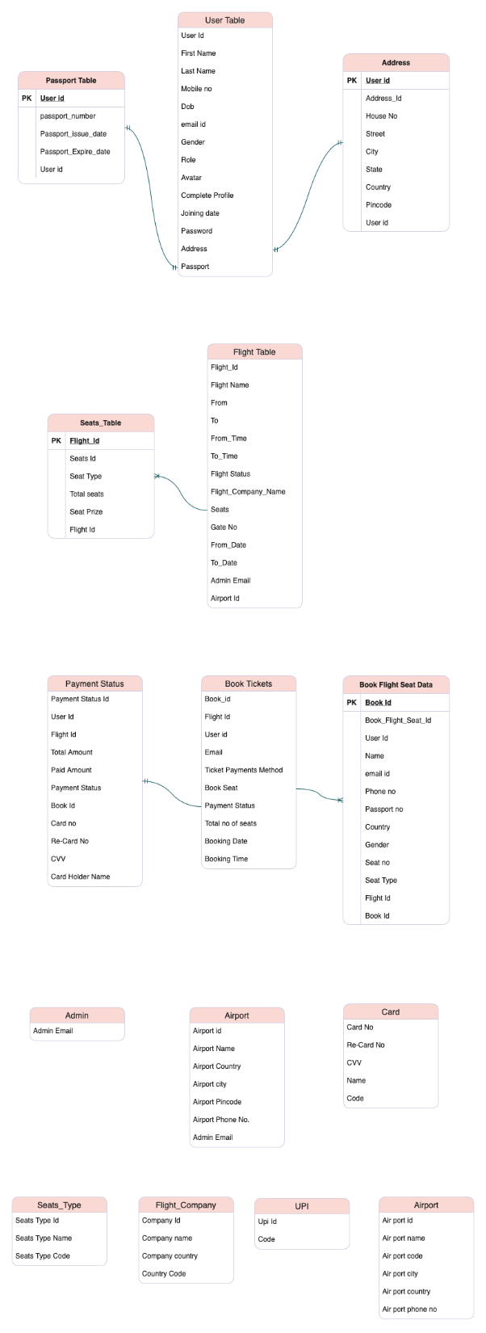
T A B L E S

Slide 10
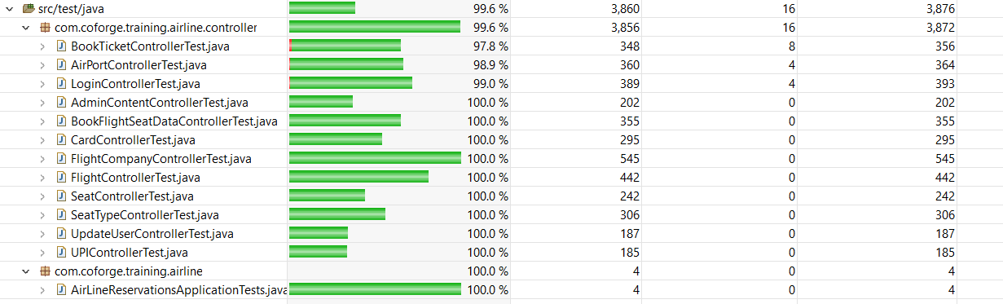
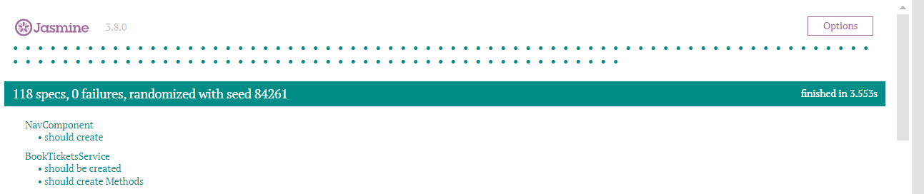
Code Coverage & Testing

Slide 11

Thank You!
-Team

