Slide 1

Airline Reservation & Management Web Application(Echo Flights)
Developed By:
Prajjwal Jaiswal
Prateek Sharma
Vikas Dhiman
Yogesh Bora

Slide 2

INTRODUCTION:
Transport is an integral part of our social living. The modern society cannot run without transport facilities.
Echo Flights is An airline reservation website where admin can add, view, delete, update Flights and user can book a flight, view flights, view transition history with Echo, & give Feedback.
Developing Front End User Interface and Application
01
Developing and Deploying by Servers and Databases
02
Developing Backend Architecture
03
Key Job Activities:

Slide 3
DESCRIPTION
The Objective is to:
Provide Customer/User to Search/Book Flights,Register/Login,etc
Maintain the accuracy of the database.
Provide security features from the unauthorized access.
Admin can Add/Update Flights, Airport,Company,etc

Slide 4
DESIGN ARCHITECTURE
Data Access Layer
Handle all the database activity implemented by JPA
Business Logic Layer
Provides all the business logic to implement the system using SpringBoot
Presentation Layer
Contains all the web pages as well as user interactions with the system using Angular

Slide 5




SYSTEM REQUIREMENTS
Database : MySQL5
Java : SDK/JRE 1.8 or higher
Disk Space & RAM : 1 GB/+ & 2 GB/+
IDE : Apache Eclipse Enterprise
Browser : Any standard browser

Slide 6





TECHNOLOGIES USED
Mockito 4.21
Jasmine 3.10.1
JPA
Node
Spring Boot 2.5
Angular 11
HTML5
CSS3

Slide 7
MODULES
Dashboard(Admin)
Login
Registration
Update Profile
Book Tickets(User)
Payment(User)
Flight Management(Admin)

Slide 8
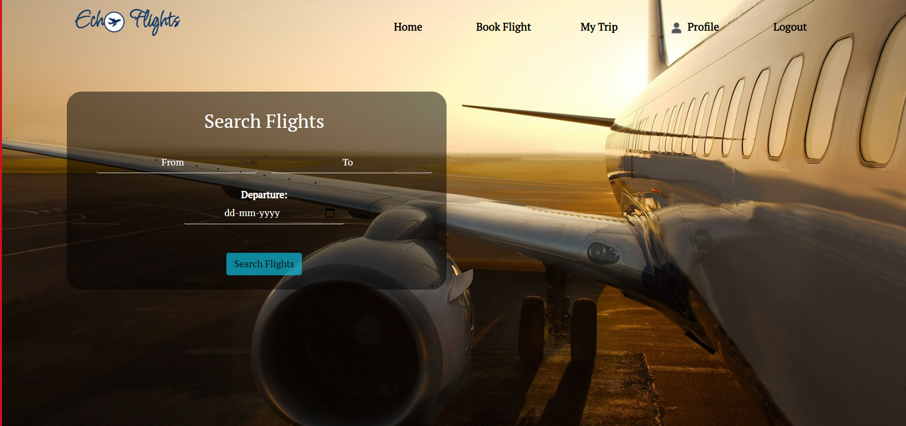
Screenshot 1 (HomePage)

Slide 9
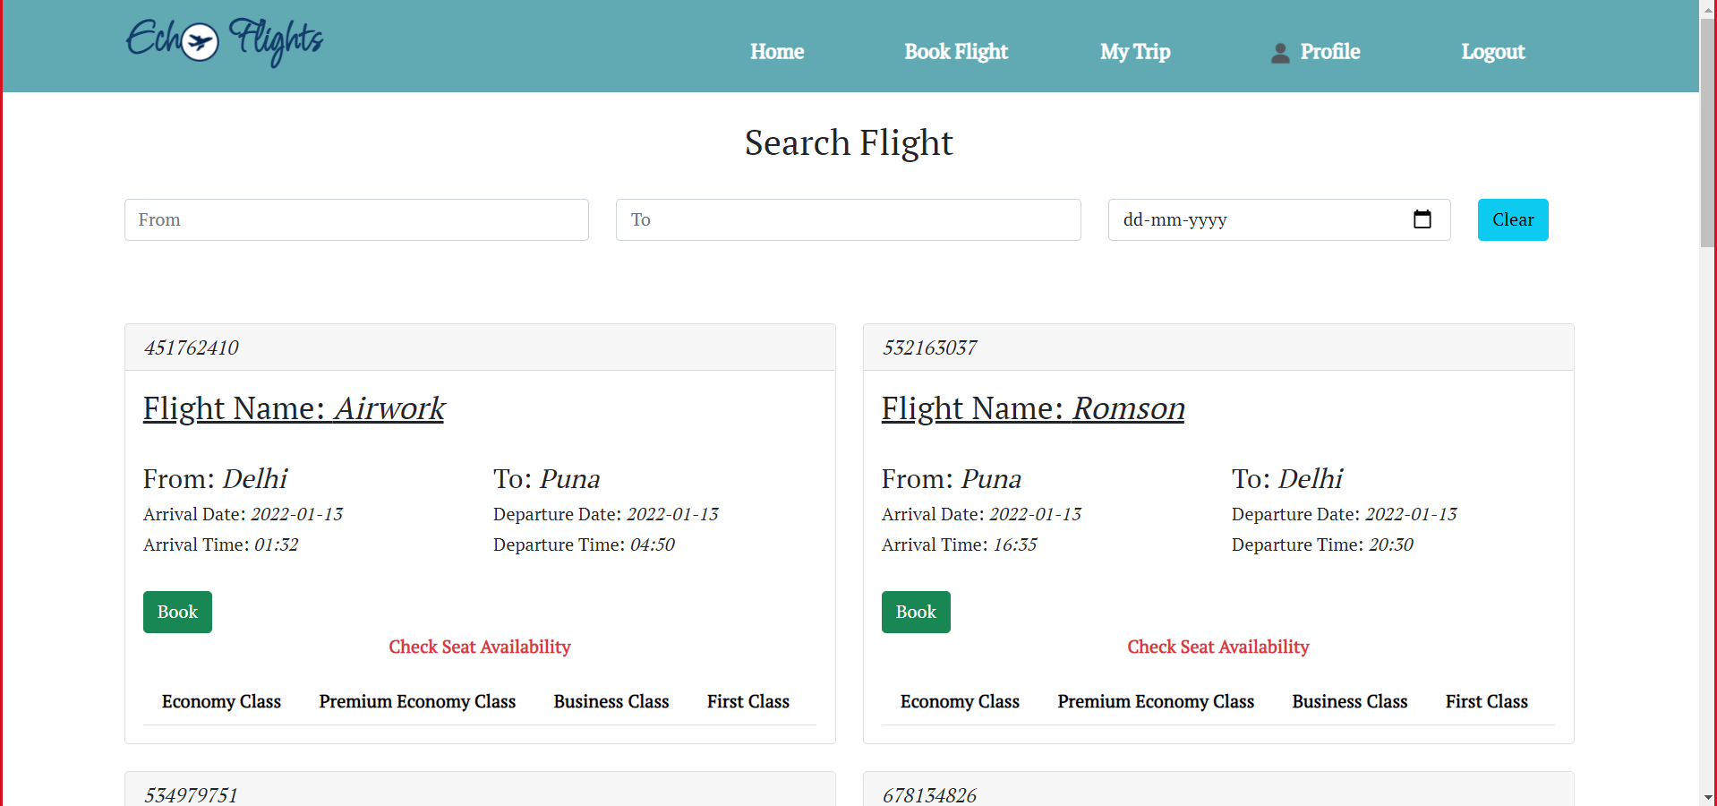
Screenshot 2 (Search Flight)

Slide 10
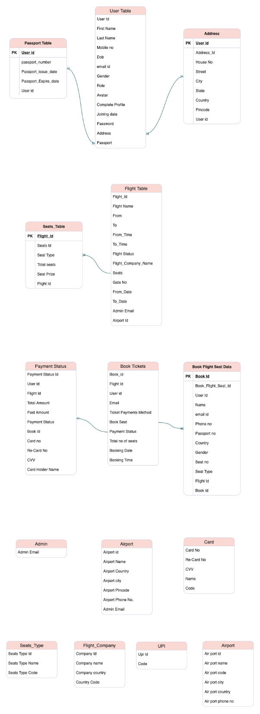
T A B L E S

Slide 11
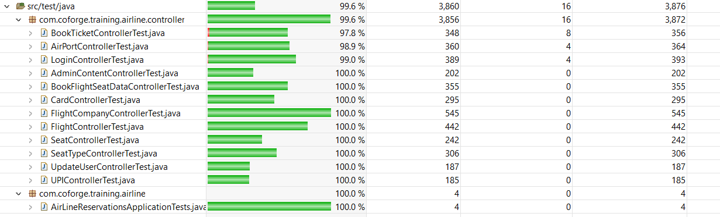
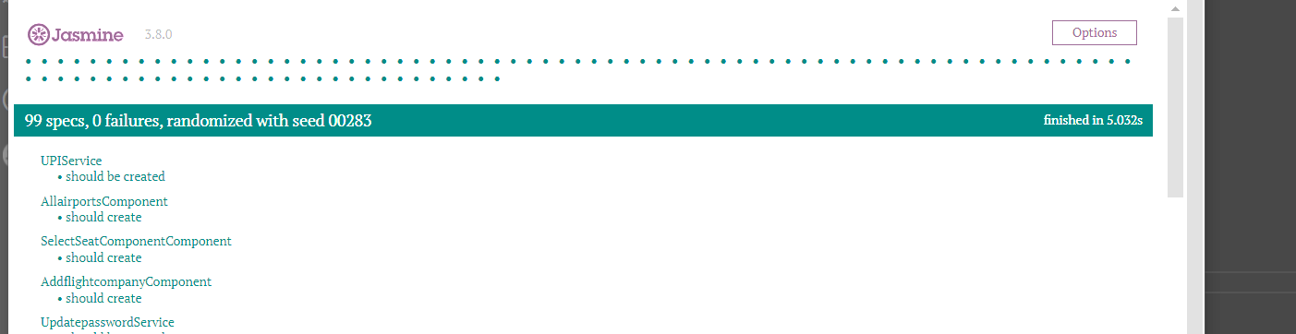
Code Coverage & Testing

Slide 12

Thank You!
-Team

