Slide 1
Git: The Basics
In-House Training Workshop
National Environmental Standards and Regulations Enforcement Agency (NESREA)
25 April 2017

Slide 2
What is git?
Git is all about:
Version control
Collaboration
Storage
It is an extremely useful tool being used by professionals who generate files on computers, particularly those that involve some form of coding.

Slide 3
Getting started
First we have to install Git to our computers from this page.
Though it’s relatively simple, one may encounter some minor hiccups. Ask for help!

Slide 4
The 2 Key Aspects of Git
Version Control
Collaboration

Slide 5
How to use Git
Command Line (recommended!!!)
Integrative (with major applications like IDEs)
GUI

Slide 6
Command Line Basic Basics
Depending on your OS
Windows: Command prompt, Powershell
macOS: Terminal (bash)
Linux…
To use git you’ll like need to know how to
Change directory (cd)
Check directory contents (dir, ls)
Delete a file (del, rm)
Copy/move a file (cp)
Write to file (echo, cat)
Read a file (various commands)
You can still use GUI-based folder management (at the beginning) but this is really cumbersome and time-consuming.
Notes:
bash – Bourne-again shell, a multiplatform command line utility that is often used on Apple computers.

Slide 7
Git in action
Open your command line interface of choice
Run git.exe
Type and run git
Now try git help
Note that EVERY command run in the utility is preceded by the keyword “git”.

Slide 8
Create a Git repository
A git repository (“repo”) is a folder that has been initialized to work with the utility.
Let try something out:
Create and open a blank folder called GitLesson in your favourite GUI e.g. Windows Explorer. (Make sure it is configured to show hidden files/folders.)
Open the CLI and navigate to that folder/directory
Start Git and make sure its running
Run this command: git init
Look at your GUI. What did you notice?

Slide 9
A brief explanation…
Git essentially takes snapshots of files in the repo.
2 steps to snapshotting:
Staging
Committing

Slide 10
git add: Staging your changes
git commit: Taking that snapshot
git push: Sending your files’ new state to remote
git pull: Collect your own copy of remotely stored changes

Slide 11
git add
The command used for staging the changes made in the file for commit
Prepares the stage for the commit
Allows you to review which files to include

Slide 12
git commit
With this command, a snapshot of the file in its current state is made
Has a unique ID – the SHA key
Must be accompanied with a message to describe your changes to help
Other people
Your future self

Slide 13
git push
The committed changes are sent to a remote server where the repository resides
This is usually at GitHub, but now exclusively so.
You will need to use password authentication to push the changes.
This step is purely optional.

Slide 14
git pull
Involves 2 operations:
Fetching
Merging
git fetch enables you to ‘collect’ changes found in the remote repo
git merge incorporates the changes into your repo (branch)

Slide 15
A note about .gitignore
.gitignore is a text file that carries the list of stuff you do not want be committed.
Important for utility files that change frequently & whose details add no real value
Also files related to privacy or security

Slide 16
Conclusion
There’s actually a lot more to Git that is better to learn on the fly
branch, reset, rebase, diff, mv, log, remote, …
But the ones discussed here are all you need to get started.

Slide 17
Resources
git help
http://git-scm.com/documentation
http://gitref.org/basic/ - very easy to use site
https://www.atlassian.com/git/ - powerful tutorials
Of course GitHub’s help pages
Bonus: Git Cheatsheet

Slide 18
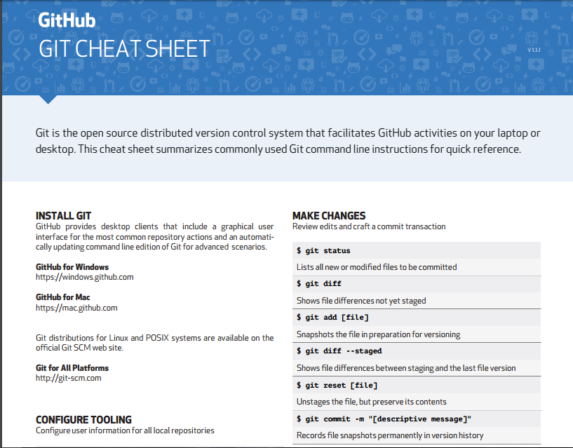

Slide 19
Thanks again!

