Slide 1

GitHub: An Intro
In-House Capacity Building Session
NESREA HQ
Abuja, Nigeria
30th March 2017

Slide 2
Outline
What is GitHub?
Why Use GitHub?
NESREA on GitHub
How to Start
What’s Next?

Slide 3
What is GitHub?
It’s a website
It’s an open-source repository
It’s a social network
It’s a collaborative tool
It’s a peer-review mechanism
It’s a marketing platform
It’s a backup system
It’s an archive

Slide 4
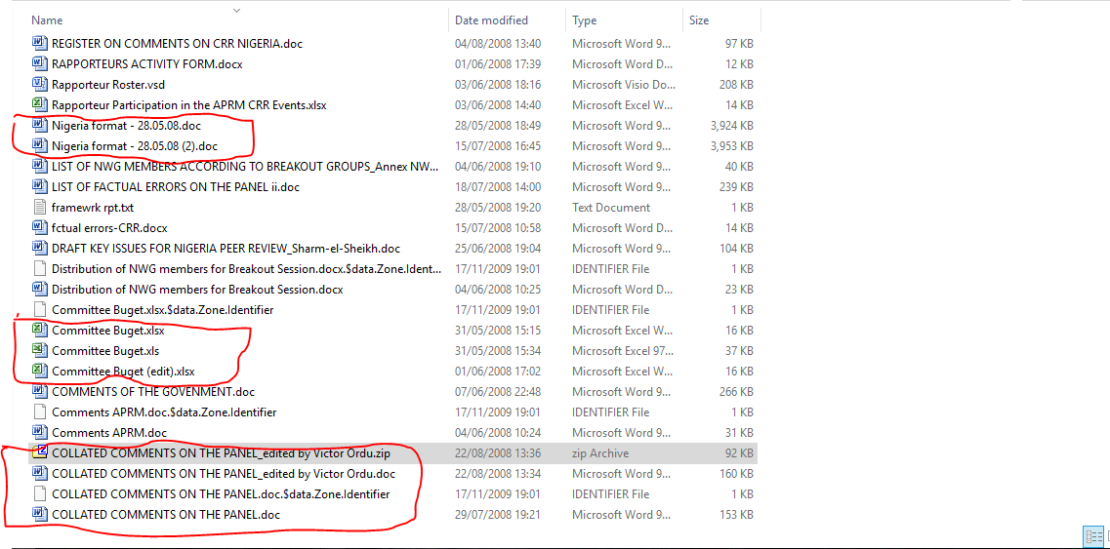
Why Use GitHub?

Slide 5
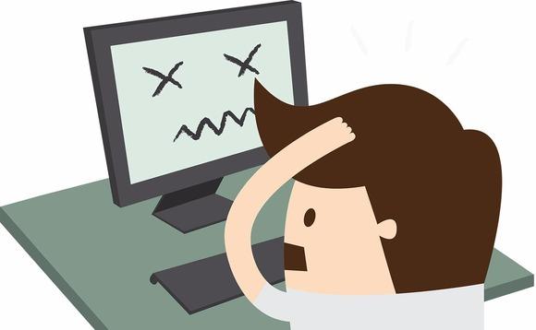

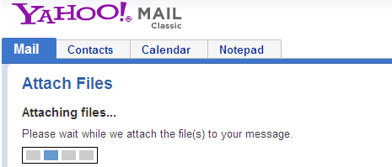
Why Use GitHub?

Slide 6
Why Use GitHub?
The leading online collaboration platform being used by individuals and corporate bodies
Microsoft, Google, Facebook, etc.
Being used by academics & researchers from diverse fields
Major businesses are using it
Government agencies have joined the train

Slide 7
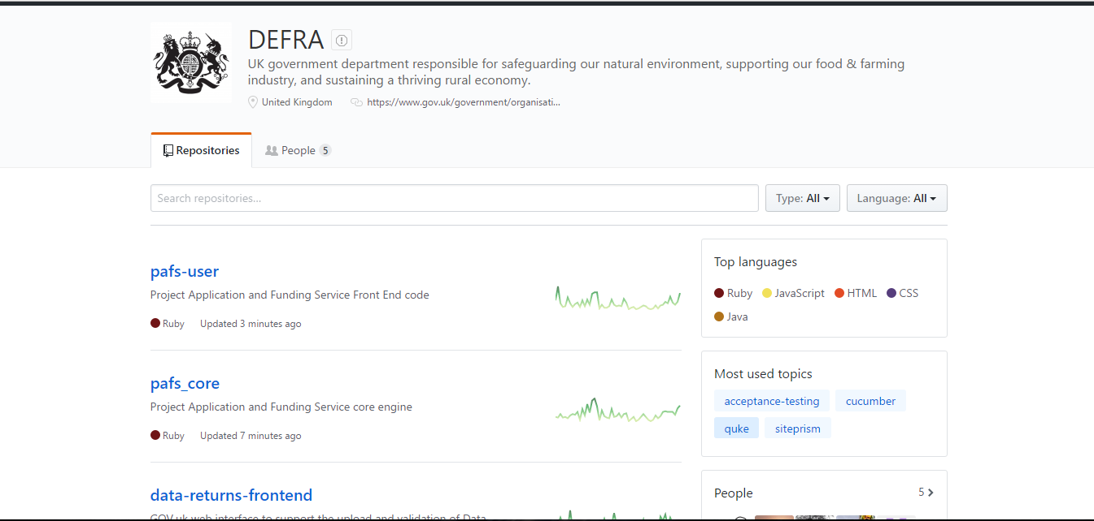

Slide 8
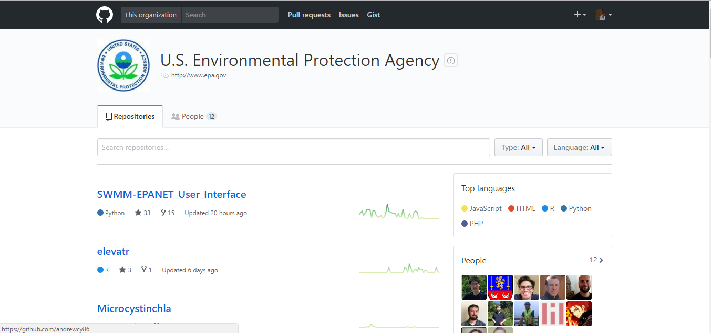

Slide 9
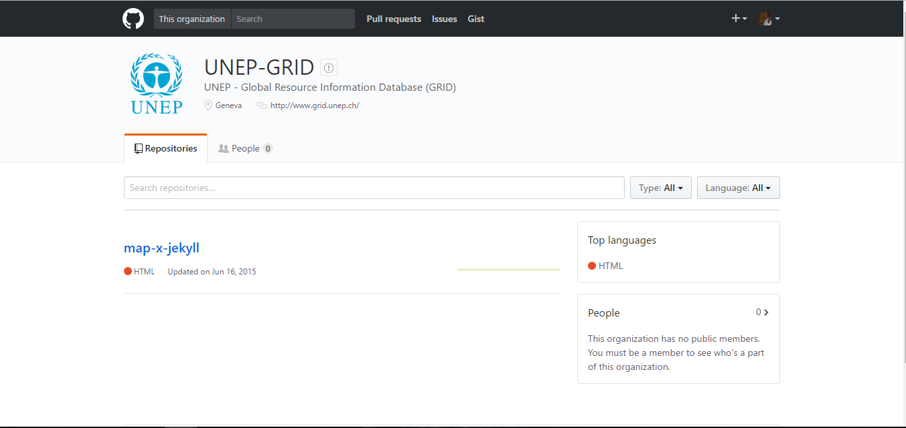

Slide 10
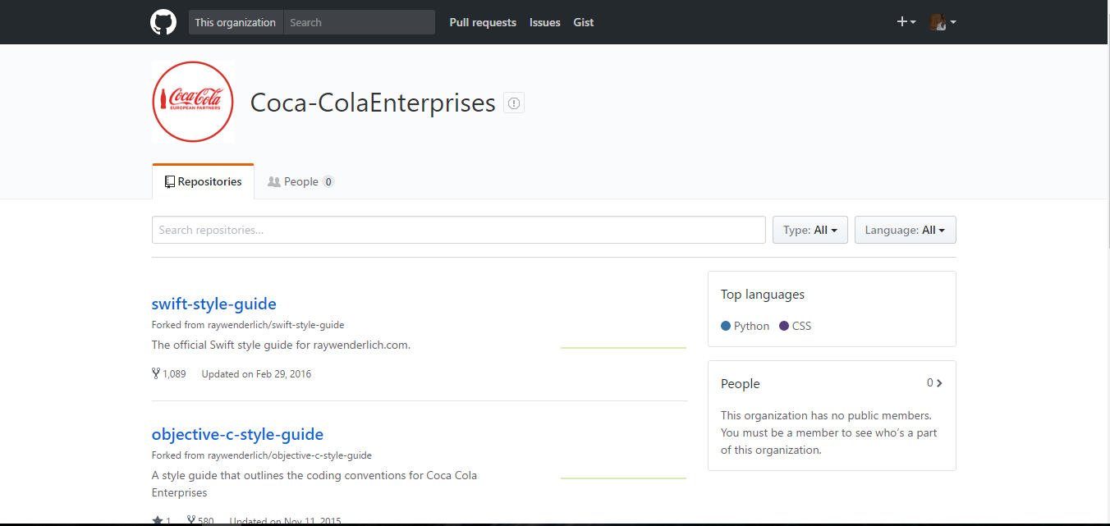

Slide 11
NESREA on GitHub
NESREA has created its own GitHub account and some projects are already hosted there.
Small ideas can turn into large impactful projects – if we build together.

Slide 12
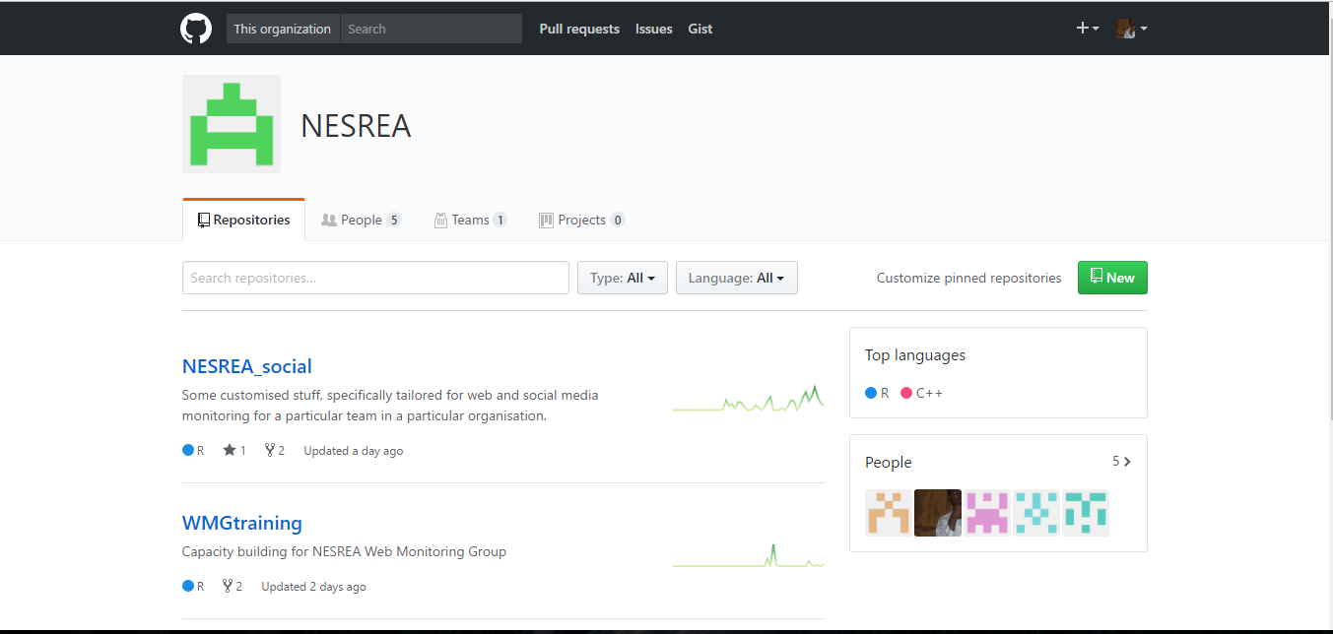

Slide 13
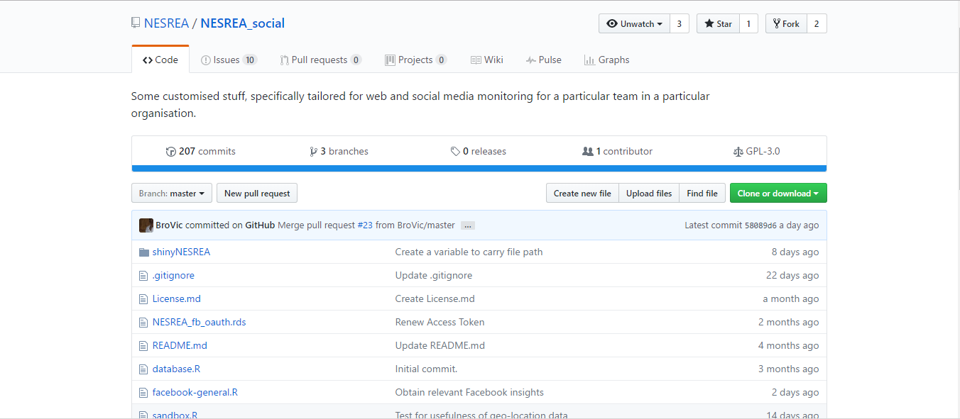

Slide 14
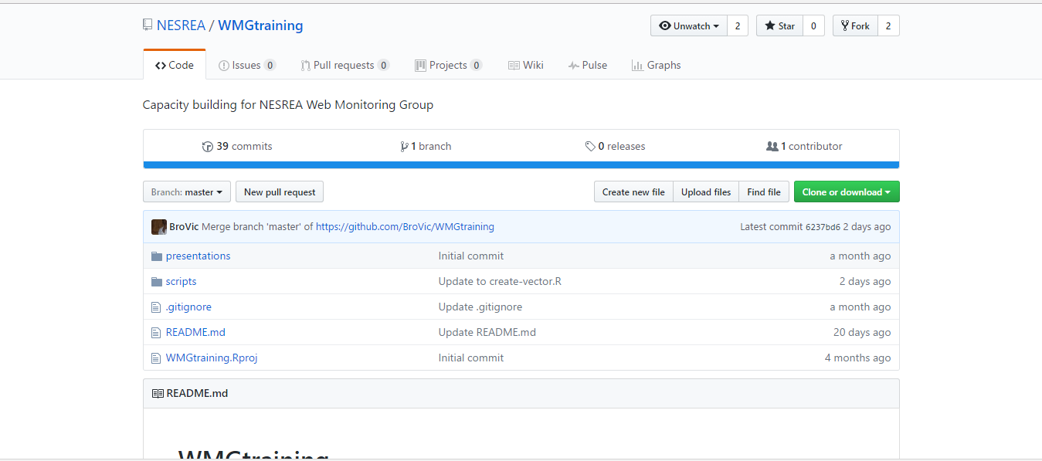

Slide 15
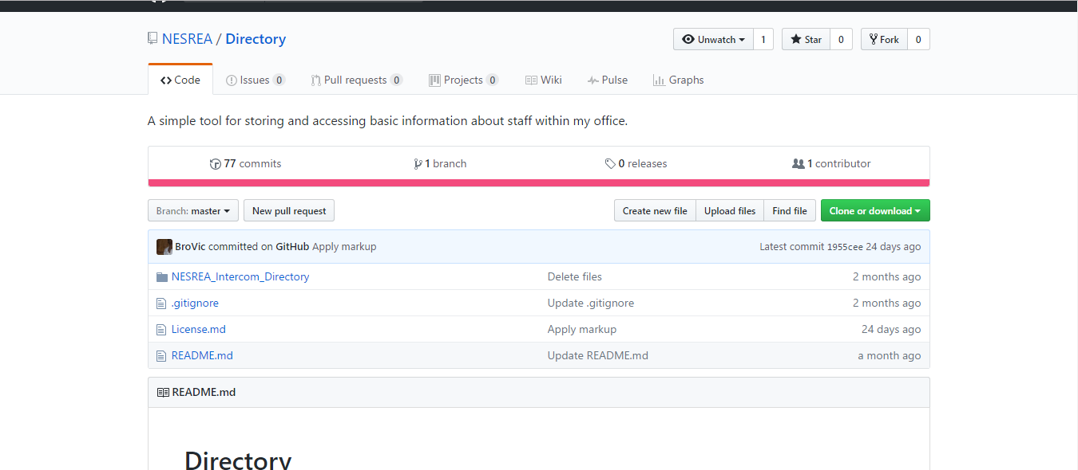

Slide 16
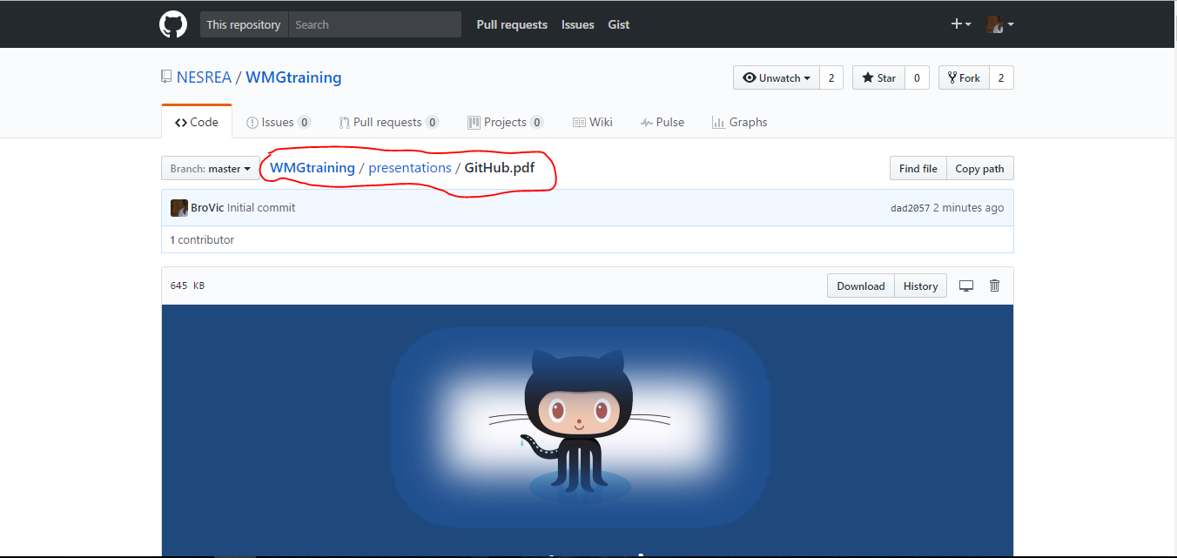

Slide 17
How to Start
Sign up for a personal account
Create your profile
‘Fork’ any repository of interest
‘Follow’ any account of interest
Read through the documentation

Slide 18
Hands On…

Slide 19
What’s Next?
GitHub is based on the distributed version control system developed in 2005 by Linus Torvalds, the famous creator of Linux OS
This program is called Git.
By distributed, we mean that different machines can have local copies of a repository
To actualize the real power of the system, we need to install Git on local computers

Slide 20
What’s Next?
Go to http://git-scm.com/
Download and install Git – one that is appropriate to your system.
Visit NESREA’s WMGTraining repo to access this presentation
Any questions/issues should be via the ‘Issues’ tab

Slide 21
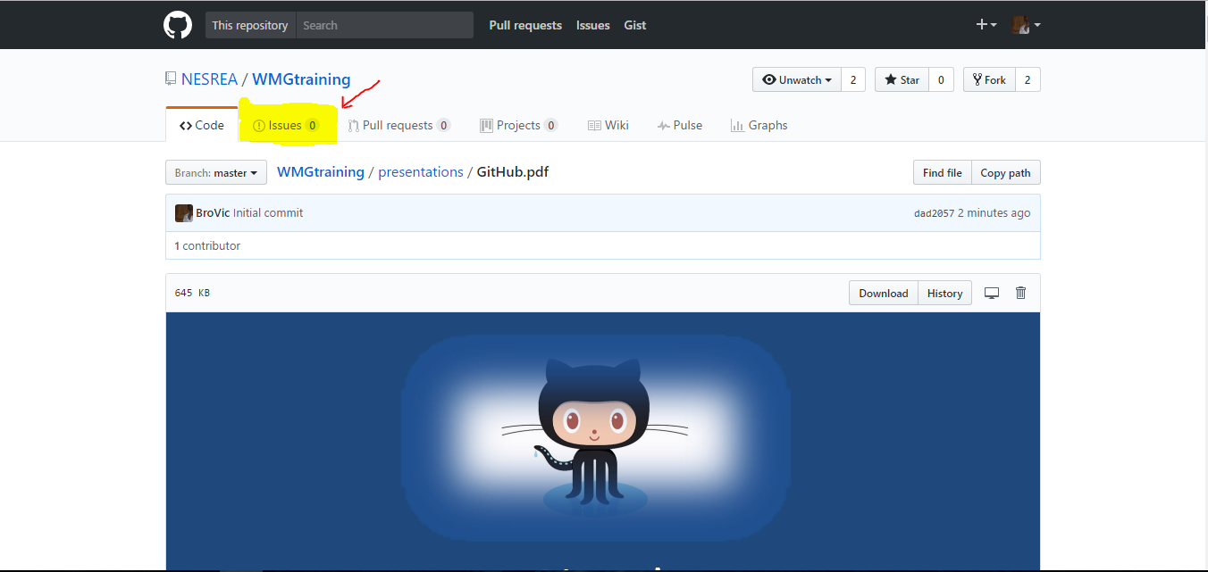

Slide 22
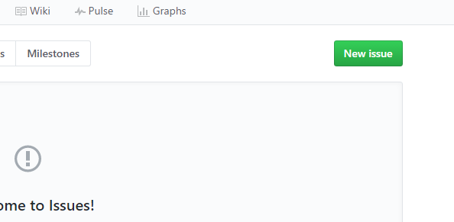

Slide 23
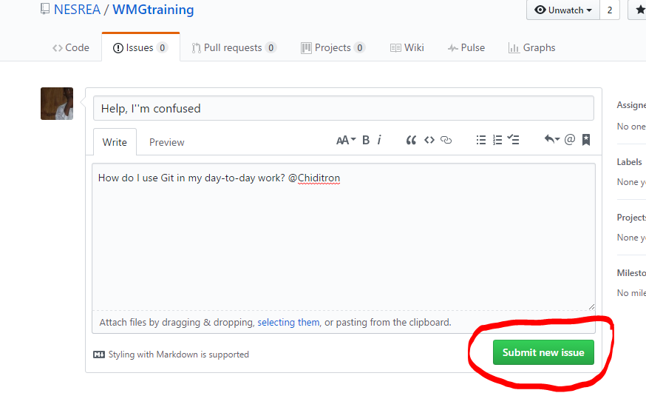

Slide 24
What’s Next?
Go to http://git-scm.com/
Download and install Git – one that is appropriate to your system.
Visit NESREA’s WMGTraining repo to access this presentation
Any questions/issues should be via the ‘Issues’ tab
Emails on this particular session will be redirected to GitHub Issues

Slide 25
Final thought…

Slide 26


Slide 27
Thanks for listening.

