Slide 1
Introduction to R Programming
Capacity building course for
Web Monitoring Group
Developed by
Victor Ordu

Slide 2
Prerequisites
Be able to see at a computer screen
Be able to hit the keys of a computer keyboard
Be willing and eager to learn
Be adventurous and courageous

Slide 3
R is a programming language
developed in the 1980s for the purpose of running statistical analyses
has become a widely used tool by data scientists and is growing in popularity.

Slide 4
Advantages
R is great because:
It is free
easy to download and install
has a vibrant global community
produces publication grade graphics
easy to learn
highly extensible (ask what this means!)
ensures reproducibility of results
encourages transparency in methodology

Slide 5
Disadvantages
R, like everything in life, has its own issues:
It has a steep learning curve i.e. difficult to master
Solution: Practice, practice, practice!
It is a quirky language as it is not that intuitive [e.g. in English – read (present tense) and read (past tense)]
Solution: More practice!

Slide 6
R Console
Operations in R are through a command line interface (CLI)
Different from point-and-click software

Slide 7
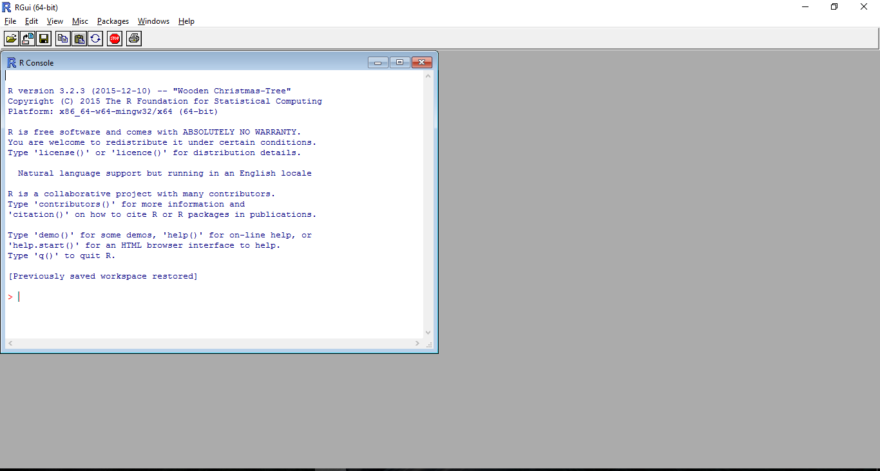
R-console
Prompt: You pass your instructions to the program here!

Slide 8
When you type your code at the prompt you hit ENTER key to run the code
R reads code from left to right and from top to bottom

Slide 9

Exercise
Type in the following code and hit ENTER:
NOTE: The prompt “>” only shows you where to type.
Now type ‘x’ again and hit ENTER
Congrats, you have created an R object called x containing data ranging from 1 to 10!

Slide 10
Conclusion
Welcome to the world of R!
Next topic will be on R Objects…

