Slide 1
R Data Structures
WMG Training
Sept - Oct 2016
National Environmental Standards and Regulations Enforcement Agency (NESREA)
Facilitator: Victor Ordu

Slide 2
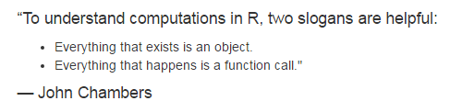
Source: H Wickham (2014). Advanced R. Chapman & Hall, Boca Raton. http://adv-r.had.co.nz/

Slide 3
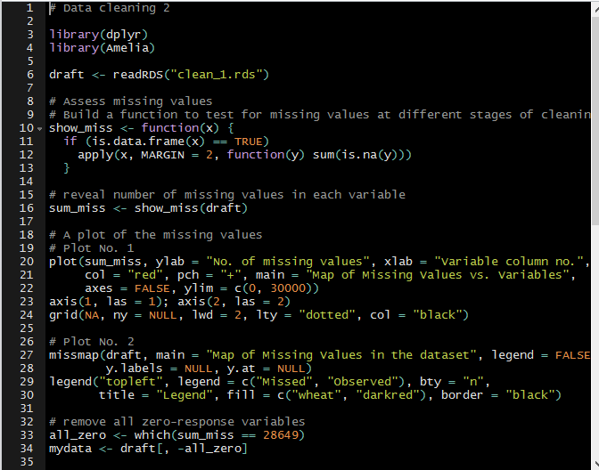
Recap

Slide 4
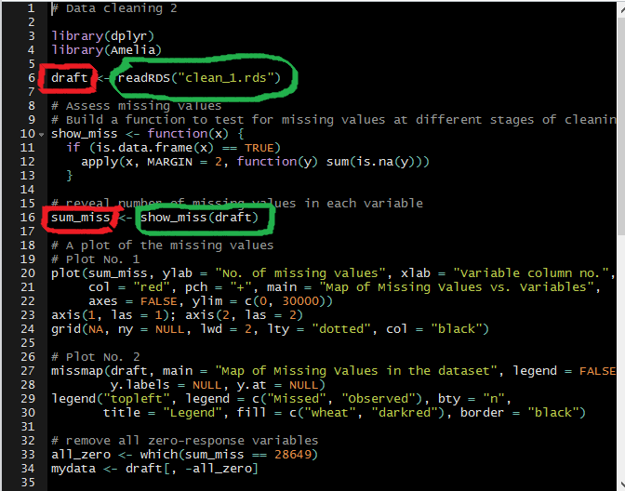
Recap

Slide 5
Caveat
Not everything I will tell you will be 100% correct
Why?
Stupid mistakes
Updates
New knowledge
Multiple approaches, some better than others
Continuous learning
Moral: commit to personal growth

Slide 6
Notation
Regular text with look like this…
Highlighted items will look like this…
this <- R_code(“will look like”)

Slide 7
Types of Data Structures
Vectors
Data frames
Matrices
Lists
Arrays

Slide 8
Types of Data Structures
Vectors
Data frames
Matrices
Lists
Arrays

Slide 9


Slide 10
Kinds of Vectors
Six (6) kinds:
Character
Integer
Double (or numeric)
Logical

Slide 11
Vectors
Common characteristics
All elements are of a particular data type (in lay language, “type” would be numbers, words, etc.)
One-dimensional
The lowest vector is of length 1
The largest … well, depends on the .Machine

Slide 12
Making vectors
By assignment
The concatenate function
Latin: con – caten – atus (chain)
Some call it “combine” function
Indispensible in creating vectors
You can ‘grow’ a vector
You may ask how, much, much, much, much later

Slide 13
Character vectors
Strings are always placed in quotation marks when coding i.e. “boy”, “NESREA”, “R is easy to learn”, “A string can be a whole sentence!”, “9”.
Some character vectors are inbuilt into R e.g. letters, LETTERS, month.abb, month.name
Remember use quotation marks: “ ” or ‘ ’.
We can create empty vectors with specific lengths e.g. character(length = 10) or character(10)
Limit approx. 2³¹ (about 2 billion) characters!
Notes:
In the Bible (presumably KJV):
3,566,480 letters
31,102 verses
1,189 chapters

Slide 14
Exercise
Start a clean slate with rm(list = ls())
Make a character vector Name containing full names (both Surname and Given Name) of 10 adults
Make a second vector Facility of names of 10 facilities (imaginary, please!)
Use typeof() to check what type of vector Name is
Confirm the type of Facility using is.character()
Note: We can use as.character() to convert another vector to a character vector.

Slide 15
Integer vectors
1L, 2L, 3L
Why the ‘L’?
Not numerical per se
Wide range – max up to 2,147,483,647
Exercise
Make an integer vector Age of 10 adult subjects
Make an integer vector StaffStrength for 10 facilities

Slide 16
Numeric (double) vectors
These are real numbers
Story of the term double
Some numeric vectors are inbuilt – mathematical constants e.g. pi, exp(1),

Slide 17
Logical vectors
TRUE/FALSE (not true/false); T/F
Zero is FALSE; any non-zero is TRUE
Exercise
Make a logical vector PermitSighted for 10 facilities.
Make another one usingPPE for 10 individuals.
Use str(), typeof(), is.logical(), to explore them.

Slide 18
Stats brief
Types of variables
Quantitative
Qualitative
Levels of measurement
Nominal
Ordinal
Interval
Ratio

Slide 19
Factors
Integer values that are mapped to “strings”
Used to represent categorical data
Each category is called a level
One of the most powerful uses of R
Exercise
Make a vector industryType using 3 categories – small, medium, large – for 10 facilities only.
Make a factor industryCategory by calling the function factor() on industryType.
Now use typeof(), is.factor, is.character, is.integer() to review these 2 objects.

Slide 20
Things to note…
Legal names
Coercion
Limits
Common mistakes
Confusing factors with characters

Slide 21
 | Homogenous | Heterogeneous
1-dimension | Atomic vectors | Lists
2-dimensions | Matrices | Data frames
N-dimensions | Arrays

Slide 22
> R toolbox
help() or ?
getwd(); setwd()
ls()
rm()
save(); load()

Slide 23
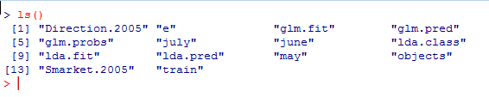
> R toolbox
An example – ls()
It’s relatively easy to see all the objects at a glance
Note that this function is called without any arguments

Slide 24
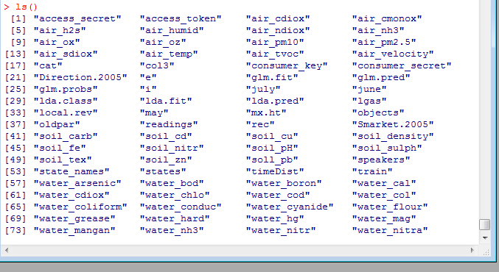
> R toolbox
But how do you deal with this?
Long list beyond screen

Slide 25
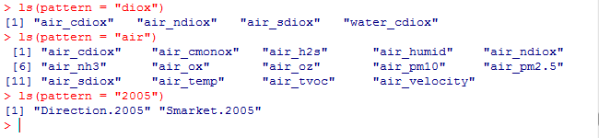
> R toolbox
Extend use of functions by defining other parameters (optional)
Use ? to learn about a function’s uses & arguments
When more familiar, use others like args()

Slide 26
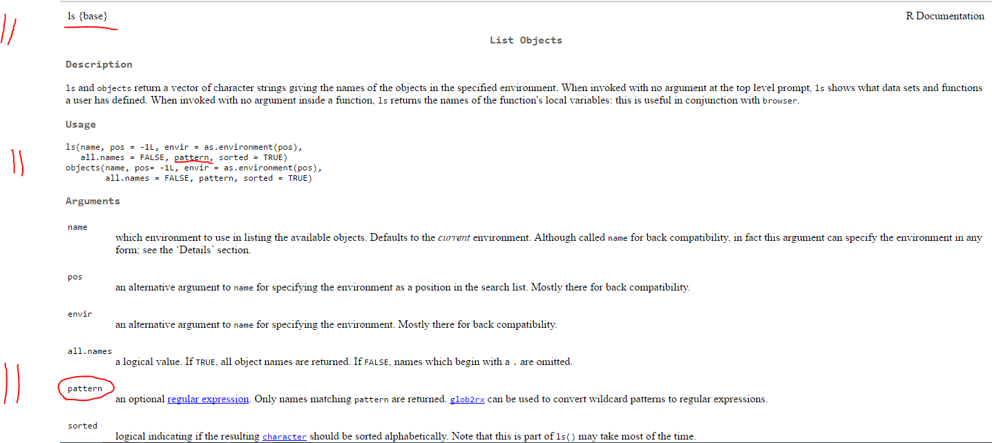
> R toolbox

Slide 27
Types of Data Structures
Vectors
Data frames
Matrices
Lists
Arrays

Slide 28
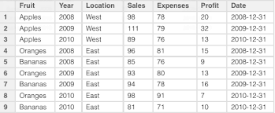

Slide 29
Data frames
Commonly used R object
You will either:
Get a data frame
Make your own data frame
Have columns and rows. Usually represent
Columns variables
Rows observations
Each column is actually a vector!

Slide 30
header
row
column

Slide 31
Making a data frame
A data frame can be built from scratch inside R using the function data.frame()
Combines vectors with same length
Vectors with different lengths are built using expand.grid() – used for simulations

Slide 32
Importing data (simplified)
An important skill
Many datasets are imported as data frames
A useful file format is .csv
Key function is read.table() & its variants
Data can also be imported from other formats e.g. .xls/.xlsx, .spv, .tab,…
Easiest way to start –> save Excel files as CSV
Many useful R packages for diff. data formats

Slide 33
Exploring data frames
A few functions
Check dimensions – dim()
View in spreadsheet format – View()
Examine structure – str()
See first/last records – head()/tail()
Summarise variables – summary()
See/set names of variable – colnames()
Check if – is.data.frame()
Change to – as.data.frame()
Make changes to data using edit()

Slide 34
Stats brief
Grouping data
tabulation
Measures of central tendency
Mean
Median
Mode
Measures of dispersion
Range, IQR
Variance, Standard deviation

Slide 35
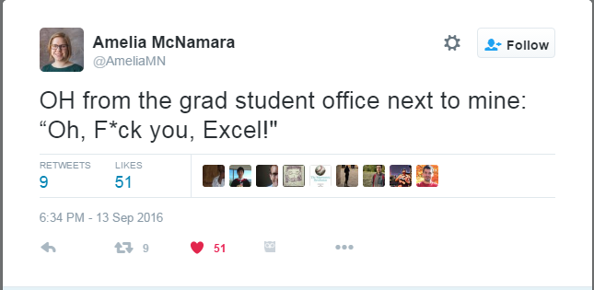

Slide 36
Example with Twitter data
Preliminaries
R package called twitteR; access Twitter data
Call install.packages(“twitter”)
Use library(help = “twitteR”) to access package’s DESCRIPTION file
Documentation: help(package = “twitteR”)
Many packages have vignette()s – show you how to use package

Slide 37
More preliminaries
Authenticate i.e. log on through Twitter OAuth
Our details are found in authentication.R
Establish connection with setup_twitter_oauth()
This gives us access to the Twitter data
Download the data with searchTwitter()
Convert to data frame with twListToDF()

Slide 38
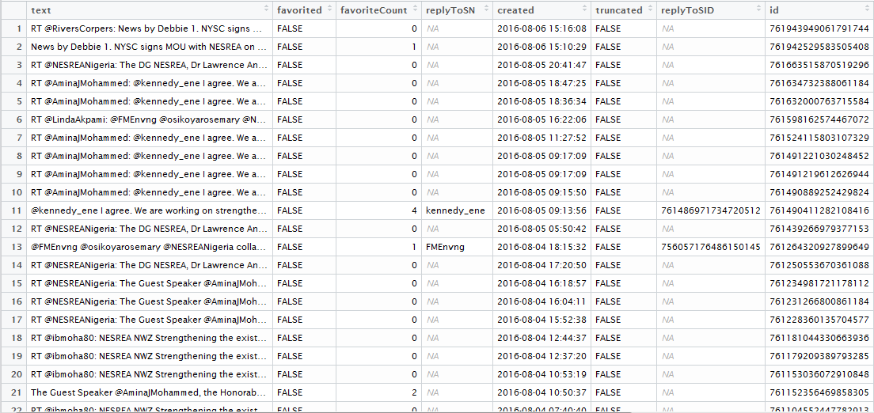

Slide 39
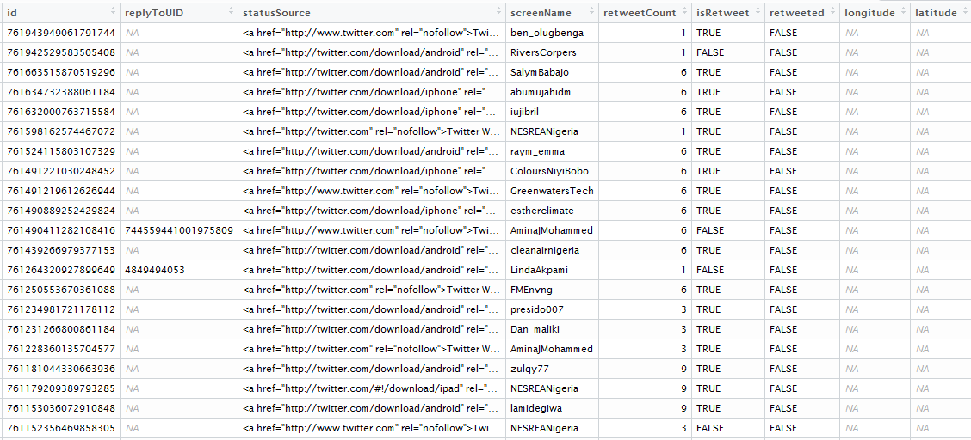

Slide 40
Subsetting
The $ operator
Look at str() again
Note the $ in the output
You can pick out individual columns with syntax dataframe$columnname
Same thing as a vector
Get to get or set variables

Slide 41
> R toolbox
search()
detach()
library()
require()
saveRDS()
readRDS()
file.edit()

Slide 42
 | Homogenous | Heterogeneous
1-dimension | Atomic vectors | Lists
2-dimensions | Matrices | Data frames
N-dimensions | Arrays

Slide 43
Types of Data Structures
Vectors
Data frames
Matrices
Lists
Arrays

Slide 44
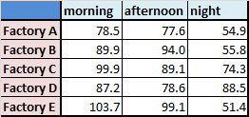

Slide 45
Matrices
Like data frame are 2-dimensional
rows & columns
Like vectors, only of particular type
integer, character, numeric, logical, etc.
Can be built using matrix()
Others include rbind(), cbind()
Matrix arithmetic possible in R but not our focus

Slide 46
Matrix creation is also useful in other operations such as drawing multiple plots
Exploring a matrix is somewhat similar to that of a data frame
dim()
typeof()
class()

Slide 47
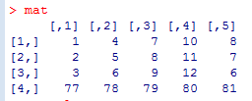
Run the script create-matrix.R to create a matrix, mat
- bracket operator is also used for data frames

Slide 48
Indexing
This is a crucial aspect of R programming
Enable you to get or set elements of a data structure
Bracket operator “[ ]” is used for indexing
For vectors: [ ]
For matrices & data frames: [ , ]
For lists: [ ] and [[ ]]

Slide 49
The format for indexing is [row, column]
[1, 2] means “first row, second column”
This notation is like mapping the location of an element in a 2-dimensional data structure.

Slide 50
If you want to get a matrix value on the 4th row and the 3rd column, you run
matrix[4, 3]

Slide 51
If you want to change a matrix value on the 4th row and the 3rd column, you run
matrix[4, 3] <- <new value>

Slide 52
Ranges also work well with indexing
First 3 rows of column 2 is written as [1:3, 2]

Slide 53
Row 4 of columns 2 to 4 is coded as [4, 2:4]

Slide 54
Note the indices (or is it indexes?) of the matrix along the margins of the output
(also, learn that there is no trivial or frivolous output in R. Studying it can teach you a lot!)

Slide 55
Nit-picking is also possible
To select rows 2 & 4 of columns 3 & 5 write
[c(2, 4), c(3, 5)] # concatenate function

Slide 56
An empty value means ‘ALL’
E.g. [, 5] (all rows in column 5)

Slide 57
Negative indexing is there too
Row 2 except column 5 is written as [2, -5]

Slide 58
Indexing works for vectors, too!
Bracket notation applies to vectors
Because they have 1 dimension, there will be no comma inside the brackets
i.e. [ ] and not [ , ]
Try it out!

Slide 59
 | Homogenous | Heterogeneous
1-dimension | Atomic vectors | Lists
2-dimensions | Matrices | Data frames
N-dimensions | Arrays

Slide 60
Lists
R lists are unique data structures – very versatile
Heterogenous – can hold any kind of R object in memory, singly or in combination
A list can also contain lists

Slide 61
Making a list
The function list() is used to form a list
Download the sample script create-list.R to see how lists can be formed
Go run each line of code and carefully study the output.
Observe that the code constructs list(s) of all the R objects studied thus far (and more!)

Slide 62
Quiz
How many list elements are there in mumbo_jumbo?
List the different types of R objects you can find among the elements.

Slide 63
Indexing lists
The bracket operator [] is also used to extract elements of a list
Single []
Will give you a list
Double [[]]
Will give you the element
Looking at str(), you may notice that $ also identifies each element of the list.
To access them the elements must be named – easily done with the function names()

Slide 64
Exercises
Run mumbo_jumbo[1], and then mumbo_jumbo[[1]]
Now call typeof() on each of them e.g. typeof(mumbo_jumbo[1])
Discuss the output.
A well-known expert recently shared a photo on Twitter to help understanding of R list indexing. Click here to view it. Discuss.

Slide 65
Data frames are lists!
Recall that $ is used to mark named columns of a data frame
Also recall that each column in a data frame can stand alone as a vector
A data frame is essentially a list with these characteristics
Made up of vectors
All the vectors are of equal length
Run typeof() on any data frame to check.

Slide 66
Challenge
Name the elements of mumbo_jumbo with the names() function as follows:
Calcium
EAR_done
Bin.code
Bin.code_expt
filesOnFlash
Circle
table_def
MS_simul
NESREA_hex
NESREA_bits
Use the name and $ to extract any element from the list.
What is the type of the extracted element? What does that tell you about the nature of indexing done with $.

Slide 67
Conclusion
The aim of this training session is to equip you with skills and tools to begin basic analysis of social media data.
Social media sites offer an API for easy access to organised data.
Facebook & Twitter data are downloaded as objects that can be handled in R i.e. lists, data frames, etc.
To make use of these data, we will use the R packages called twitteR and Rfacebook, developed by Jeff Gentry & Pablo Barbera, respectively.
We will start with Twitter first. To prepare for the next session:
Run install.packages(“twitteR”), to get the package (requires internet connection)
If curious, you can look through the documentation by running help(package = “twitteR”)

Slide 68
Thanks for your kind attention.

