Slide 1
R Data Structures
WMG Training
Sept - Oct 2016
National Environmental Standards and Regulations Enforcement Agency (NESREA)
Facilitator: Victor Ordu

Slide 2
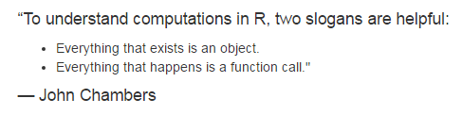
Source: H Wickham (2014). Advanced R. Chapman & Hall, Boca Raton. http://adv-r.had.co.nz/

Slide 3
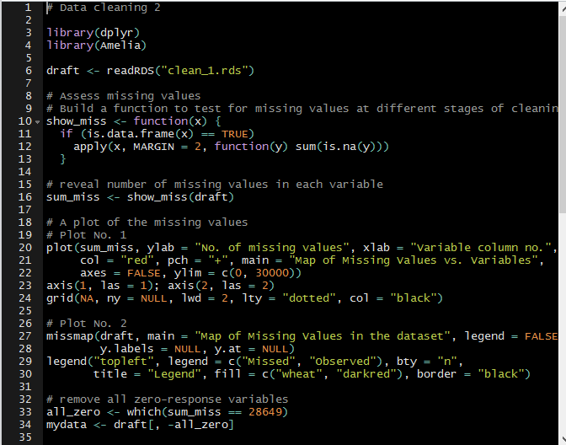
Recap

Slide 4
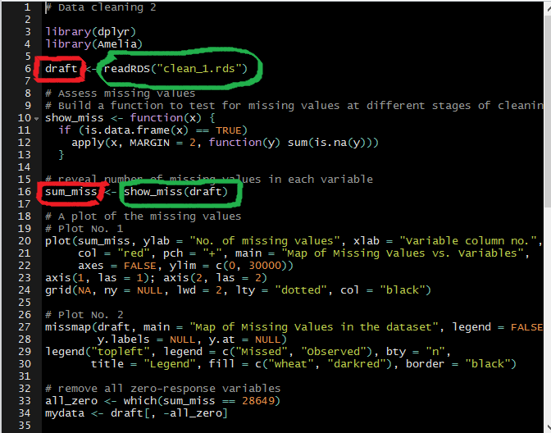
Recap

Slide 5
Caveat
Not everything I will tell you will be 100% correct
Why?
Stupid mistakes
Updates
New knowledge
Multiple approaches, some better than others
Continuous learning
Moral: commit to personal growth

Slide 6
Notation
Regular text with look like this…
Highlighted items will look like this…
this <- R_code(“will look like”)

Slide 7
Types of Data Structures
Vectors
Data frames
Matrices
Lists
Arrays

Slide 8
Types of Data Structures
Vectors
Data frames
Matrices
Lists
Arrays

Slide 9


Slide 10
Kinds of Vectors
Six (6) kinds:
Character
Integer
Double (or numeric)
Logical

Slide 11
Vectors
Common characteristics
All elements are of a particular data type (in lay language, “type” would be numbers, words, etc.)
One-dimensional
The lowest vector is of length 1
The largest … well, depends on the .Machine

Slide 12
Making vectors
By assignment
The concatenate function
Latin: con – caten – atus (chain)
Some call it “combine” function
Indispensible in creating vectors
You can ‘grow’ a vector
You may ask how, much, much, much, much later

Slide 13
Character vectors
Strings are always placed in quotation marks when coding i.e. “boy”, “NESREA”, “R is easy to learn”, “A string can be a whole sentence!”, “9”.
Some character vectors are inbuilt into R e.g. letters, LETTERS, month.abb, month.name
Remember use quotation marks: “ ” or ‘ ’.
We can create empty vectors with specific lengths e.g. character(length = 10) or character(10)
Limit approx. 2³¹ (about 2 billion) characters!
Notes:
In the Bible (presumably KJV):
3,566,480 letters
31,102 verses
1,189 chapters

Slide 14
Exercise
Start a clean slate with rm(list = ls())
Make a character vector Name containing full names (both Surname and Given Name) of 10 adults
Make a second vector Facility of names of 10 facilities (imaginary, please!)
Use typeof() to check what type of vector Name is
Confirm the type of Facility using is.character()
Note: We can use as.character() to convert another vector to a character vector.

Slide 15
Integer vectors
1L, 2L, 3L
Why the ‘L’?
Not numerical per se
Wide range – max up to 2,147,483,647
Exercise
Make an integer vector Age of 10 adult subjects
Make an integer vector StaffStrength for 10 facilities

Slide 16
Numeric (double) vectors
These are real numbers
Story of the term double
Some numeric vectors are inbuilt – mathematical constants e.g. pi, exp(1),

Slide 17
Logical vectors
TRUE/FALSE (not true/false); T/F
Zero is FALSE; any non-zero is TRUE
Exercise
Make a logical vector PermitSighted for 10 facilities.
Make another one usingPPE for 10 individuals.
Use str(), typeof(), is.logical(), to explore them.

Slide 18
Stats brief
Types of variables
Quantitative
Qualitative
Levels of measurement
Nominal
Ordinal
Interval
Ratio

Slide 19
Factors
Integer values that are mapped to “strings”
Used to represent categorical data
Each category is called a level
One of the most powerful uses of R
Exercise
Make a vector industryType using 3 categories – small, medium, large – for 10 facilities only.
Make a factor industryCategory by calling the function factor() on industryType.
Now use typeof(), is.factor, is.character, is.integer() to review these 2 objects.

Slide 20
Things to note…
Legal names
Coercion
Limits
Common mistakes
Confusing factors with characters

Slide 21
 | Homogenous | Heterogeneous
1-dimension | Atomic vectors | Lists
2-dimensions | Matrices | Data frames
N-dimensions | Arrays

Slide 22
> R toolbox
help() or ?
getwd(); setwd()
ls()
rm()
save(); load()

Slide 23
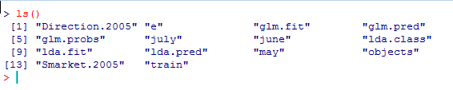
> R toolbox
An example – ls()
It’s relatively easy to see all the objects at a glance
Note that this function is called without any arguments

Slide 24
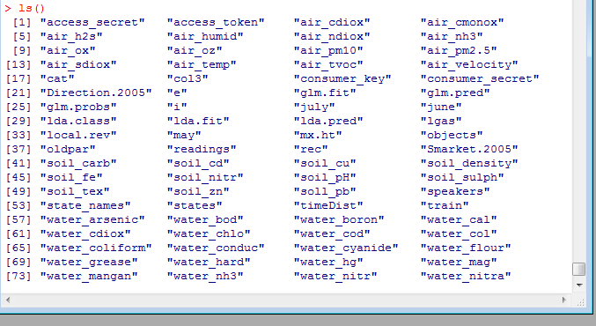
> R toolbox
But how do you deal with this?
Long list beyond screen

Slide 25
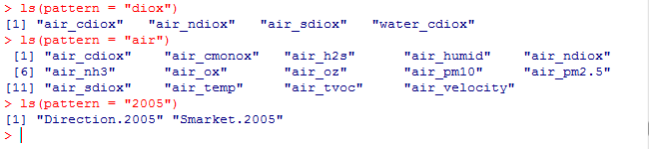
> R toolbox
Extend use of functions by defining other parameters (optional)
Use ? to learn about a function’s uses & arguments
When more familiar, use others like args()

Slide 26
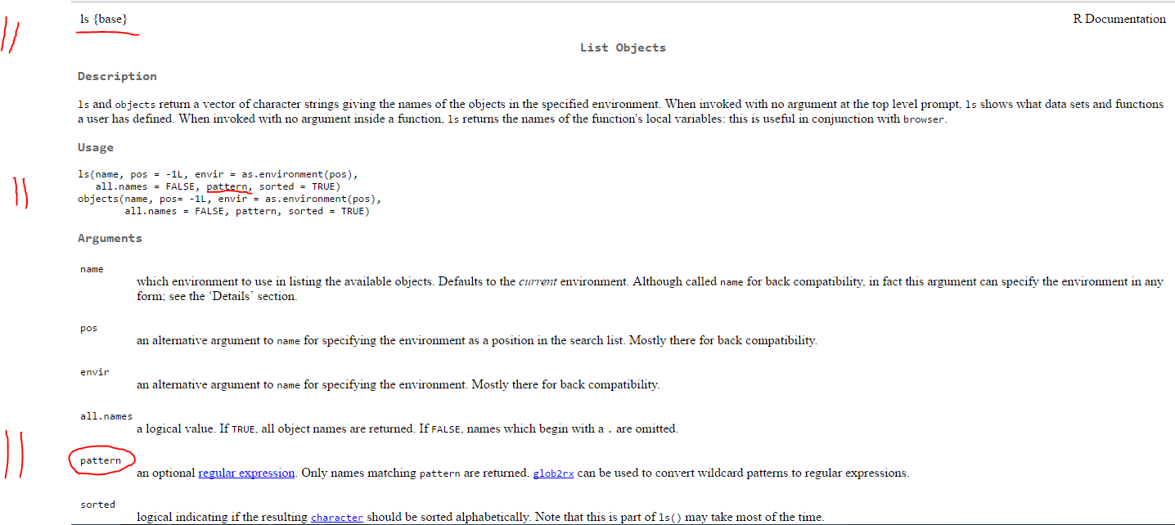
> R toolbox

Slide 27
Types of Data Structures
Vectors
Data frames
Matrices
Lists
Arrays

Slide 28
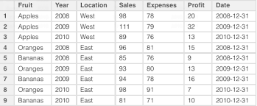

Slide 29
Data frames
Commonly used R object
You will either:
Get a data frame
Make your own data frame
Have columns and rows. Usually represent
Columns variables
Rows observations
Each column is actually a vector!

Slide 30
header
row
column

Slide 31
Making a data frame
A data frame can be built from scratch inside R using the function data.frame()
Combines vectors with same length
Vectors with different lengths are built using expand.grid() – used for simulations

Slide 32
Importing data (simplified)
An important skill
Many datasets are imported as data frames
A useful file format is .csv
Key function is read.table() & its variants
Data can also be imported from other formats e.g. .xls/.xlsx, .spv, .tab,…
Easiest way to start –> save Excel files as CSV
Many useful R packages for diff. data formats

Slide 33
Exploring data frames
A few functions
Check dimensions – dim()
View in spreadsheet format – View()
Examine structure – str()
See first/last records – head()/tail()
Summarise variables – summary()
See/set names of variable – colnames()
Check if – is.data.frame()
Change to – as.data.frame()
Make changes to data using edit()

Slide 34
Stats brief
Grouping data
tabulation
Measures of central tendency
Mean
Median
Mode
Measures of dispersion
Range, IQR
Variance, Standard deviation

Slide 35
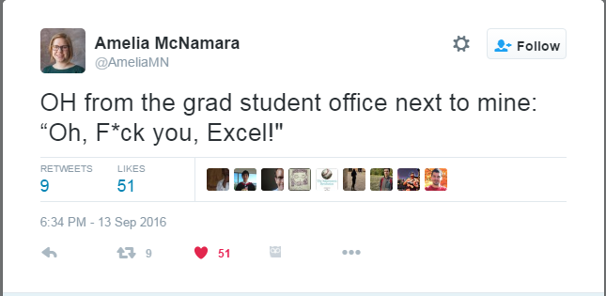

Slide 36
Example with Twitter data
Preliminaries
R package called twitteR; access Twitter data
Call install.packages(“twitter”)
Use library(help = “twitteR”) to access package’s DESCRIPTION file
Documentation: help(package = “twitteR”)
Many packages have vignette()s – show you how to use package

Slide 37
More preliminaries
Authenticate i.e. log on through Twitter OAuth
Our details are found in authentication.R
Establish connection with setup_twitter_oauth()
This gives us access to the Twitter data
Download the data with searchTwitter()
Convert to data frame with twListToDF()

Slide 38
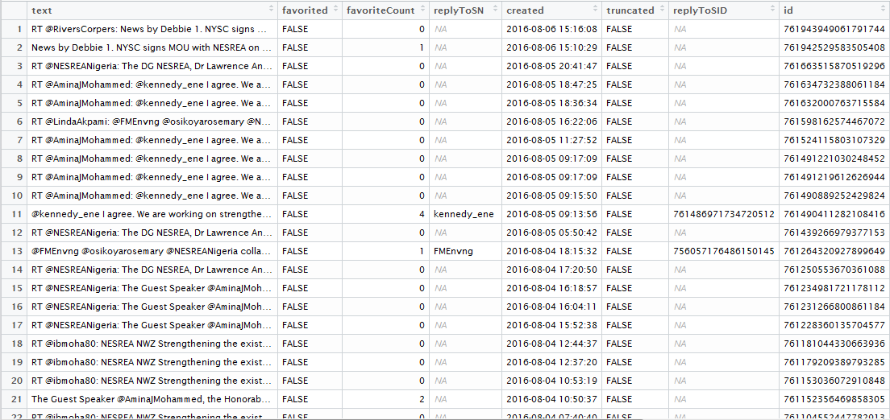

Slide 39
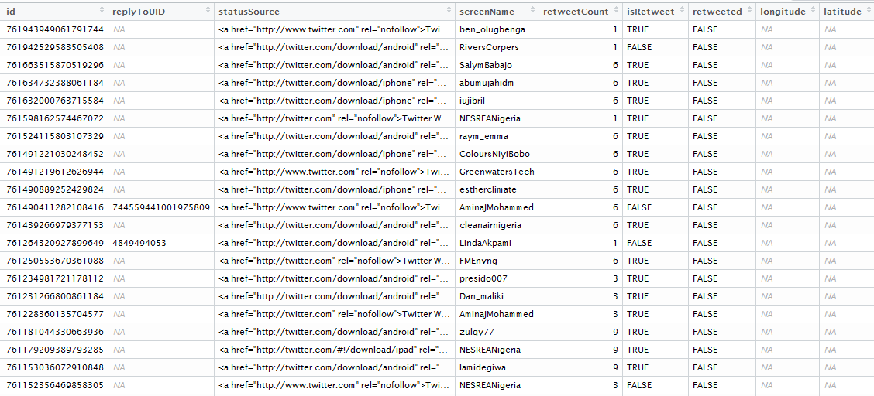

Slide 40
Subsetting
The $ operator
Look at str() again
Note the $ in the output
You can pick out individual columns with syntax dataframe$columnname
Same thing as a vector
Get to get or set variables

Slide 41
> R toolbox
search()
detach()
library()
require()
saveRDS()
readRDS()
file.edit()

Slide 42
 | Homogenous | Heterogeneous
1-dimension | Atomic vectors | Lists
2-dimensions | Matrices | Data frames
N-dimensions | Arrays

Slide 43
Types of Data Structures
Vectors
Data frames
Matrices
Lists
Arrays

Slide 44
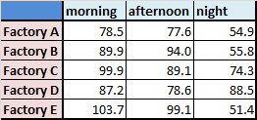

Slide 45
Matrices
Like data frame are 2-dimensional
rows & columns
Like vectors, only of particular type
integer, character, numeric, logical, etc.
Can be built using matrix()
Others include rbind(), cbind()
Matrix arithmetic possible in R but not our focus

Slide 46
Matrix creation is also useful in other operations such as drawing multiple plots
Exploring a matrix is somewhat similar to that of a data frame
dim()
typeof()
class()

Slide 47
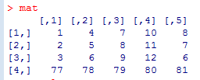
Run the script create-matrix.R to create a matrix, mat
- bracket operator is also used for data frames

Slide 48
Indexing
This is a crucial aspect of R programming
Enable you to get or set elements of a data structure
Bracket operator “[ ]” is used for indexing
For vectors: [ ]
For matrices & data frames: [ , ]
For lists: [ ] and [[ ]]

Slide 49
The format for indexing is [row, column]
[1, 2] means “first row, second column”
This notation is like mapping the location of an element in a 2-dimensional data structure.

Slide 50
If you want to get a matrix value on the 4th row and the 3rd column, you run
matrix[4, 3]

Slide 51
If you want to change a matrix value on the 4th row and the 3rd column, you run
matrix[4, 3] <- <new value>

Slide 52
Ranges also work well with indexing
First 3 rows of column 2 is written as [1:3, 2]

Slide 53
Row 4 of columns 2 to 4 is coded as [4, 2:4]

Slide 54
Note the indices (or is it indexes?) of the matrix along the margins of the output
(also, learn that there is no trivial or frivolous output in R. Studying it can teach you a lot!)

Slide 55
Nit-picking is also possible
To select rows 2 & 4 of columns 3 & 5 write
[c(2, 4), c(3, 5)] # concatenate function

Slide 56
An empty value means ‘ALL’
E.g. [, 5] (all rows in column 3)

Slide 57
Negative indexing is there too
Row 2 except columns 5 is written as [2 , 5]

Slide 58
Indexing for is vectors too!
Bracket notation applies to vectors
Because they have 1 dimension, there will be no comma inside the brackets
i.e. [ ] and not [ , ]
Try it out!

Slide 59
 | Homogenous | Heterogeneous
1-dimension | Atomic vectors | Lists
2-dimensions | Matrices | Data frames
N-dimensions | Arrays

Slide 60
Types of Data Structures
Vectors
Data frames
Matrices
Lists
Arrays

Slide 61
What’s a list?
Uni-dimensional data structure
Can contain just about any kind of data structure
Vectors
Data frames
Matrices
Lists
Others…

Slide 62
Making a list
The function list()
Quite similar to c() in that it joins its arguments into a ‘chain’
Difference:
c() is type-specific
list() combines varied types
Download the script create-lists.R from the WMGtraining GitHub repository

Slide 63
Use of lists
Lists are extremely useful
Orderly
Unordered
Very useful for iterative operations
Data downloaded via the Twitter API is organised as a list

Slide 64
Subsetting
The $ is used to subset lists
Examine str() of the sample list
Also examine the str() of the data frame in the list
Note the similarities.
Now call typeof() on the data frame
What do you notice?
FACT: A data frame is actually a list – a list of vectors that all have the same length.
Thus the approaches to subsetting data frames and lists are virtually identical.
Named lists are needed for effective subsetting

Slide 65
Indexing
Recall the bracket operator…
For lists we can use either [] or [[]]
Use of [] will yield a list
Using [[]] will yield the list’s component i.e. vector, etc.
Try typeof() on portions of the list indexed with [] and [[]] e.g. typeof(LIST[2])

Slide 66
Arrays
These are n-dimensional objects, where n > 2
h

