Slide 1
R Data Structures
Presenter: Victor A. Ordu

Slide 2
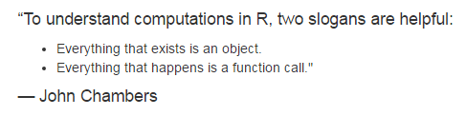
Source: H Wickham (2014). Advanced R. Chapman & Hall, Boca Raton. http://adv-r.had.co.nz/

Slide 3
Types of Data Structures
Atomic Vectors
Data frames
Matrices
Lists

Slide 4
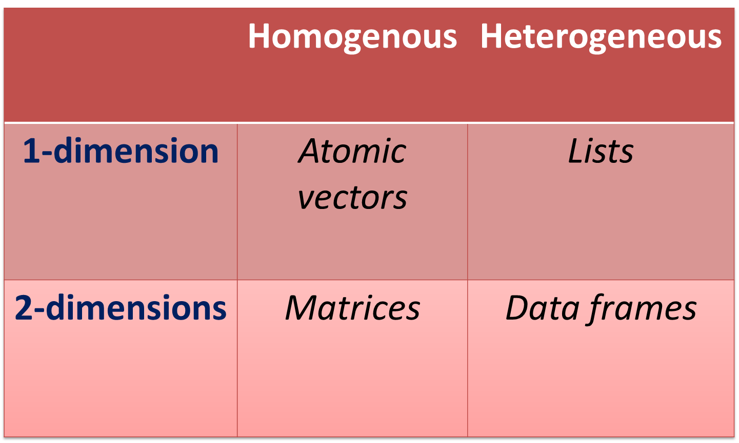
Dimensionality vs Sameness

Slide 5
6 Kinds of Atomic Vectors
Character
Integer
Double (or numeric)
Logical
Raw
Complex

Slide 6
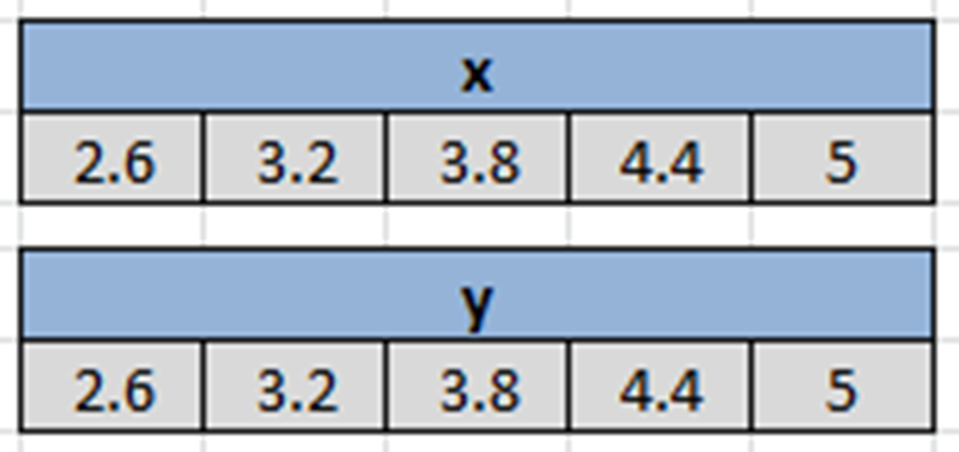
Memory model

Slide 7
Characteristics of Atomic Vectors
All elements are of a particular data type (in lay language, “type” would be numbers, words, etc.)
One-dimensional
Scalars are actually vectors of length 1

Slide 8
Making atomic vectors
By assignment
The concatenate function, c()
Latin: con – caten – atus (chain)
Some call it “combine” function
Indispensible in creating vectors
You can ‘grow’ a vector
append()

Slide 9
Character vectors
Strings are always placed in quotation marks when coding i.e. “boy”, “Health”, “R is easy to learn”, “A string can be a whole sentence!”, “9”.
Some character vectors are inbuilt into R e.g. letters, LETTERS, month.abb, month.name
Remember use quotation marks: “ ” or ‘ ’.
We can create empty vectors with specific lengths e.g. character(length = 10) or character(10)
Limit: Approx. 2³¹ (about 2 billion) characters!

Slide 10
Exercise
If you have any objects in the workspace, clear it with rm(list = ls())
Make a character vector name containing the full names (both Surname and Given Name in each element) of 10 adults
Make a second vector facility of names of 10 imaginary facilities
Make a third vector id of serial identifiers ranging from 1 through 10.
Use typeof() to check what type of vector name is
Confirm the type of facility using is.character()
Note: We can use as.character() to convert another vector to a character vector.

Slide 11
Integer vectors
1L, 2L, 3L
Why the ‘L’?
Wide range – max up to 2,147,483,647
Exercise
Make an integer vector age of 10 adult subjects
Make an integer vector staffStrength for 10 facilities

Slide 12
Numeric (double) vectors
These are real numbers
Existence of inbuilt numeric vectors i.e. mathematical constants e.g. pi

Slide 13
Logical vectors
TRUE/FALSE (not true/false); T/F
Zero is FALSE; any non-zero is TRUE
Exercise
Make a logical vector permitSighted for 10 facilities.
Make another one usingPPE for 10 individuals.
Use str(), typeof(), is.logical(), to explore them.

Slide 14

Named vectors
Each element of an atomic vector can be named e.g.

Slide 15
Coercion
Remember: All elements of atomic vectors are of the same type
This is why they are called atomic.
When we mix elements that are usually interpretable as a different type, R will attempt coercion.
Where this is not feasible, an error is signalled.

Slide 16
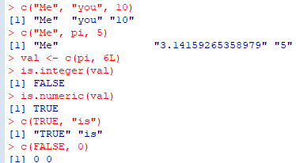
Implicit coercion
Governed by precedence rules
Character >> numeric >> integer >> logical

Slide 17
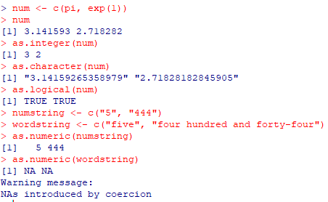
Explicit coercion
Use functions to force elements to a given type.
Can fail when it doesn’t make sense

Slide 18
Factors
Integer values that are mapped to “strings”
Used to represent categorical data
Each category is called a level
One of the most powerful uses of R, especially for modelling
Exercise
Make a vector industryType using 3 categories – small, medium, large – for 10 facilities only.
Make a factor industryCategory by calling the function factor() on industryType.
Now use typeof(), is.factor, is.character, is.integer() to review these 2 objects.

Slide 19
Vector operations
Various operations can be carried out on vectors
Includes
Arithmetic
Logical
Comparisons
Other function calls
Operations on a whole vector usually apply to each element
E.g. to add 5 to a vector means to add it to each element
For 2 vectors of the same size, each operand is applied to the corresponding counterpart
If one vector is smaller, the operations are recycled

Slide 20
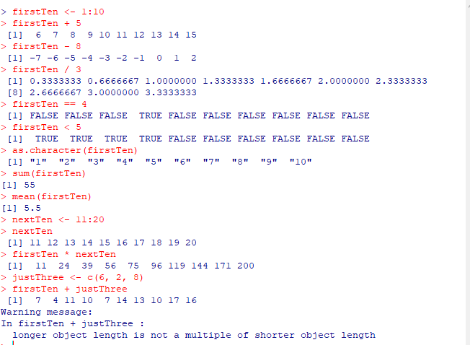

Slide 21
Indexing
A crucial aspect of R programming
Enables one to get or set elements of a data structure
Bracket operator “[ ]” is used for indexing vectors
Can use:
positional values => 4 gives the 4th element
named => applies only to named vectors
logical TRUE/FALSE
predicate statements

Slide 22
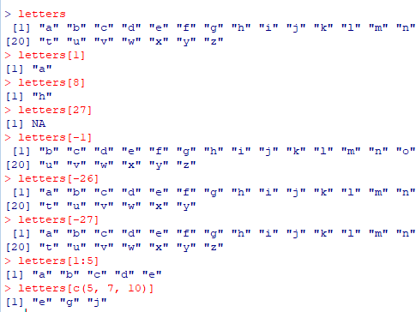

Slide 23
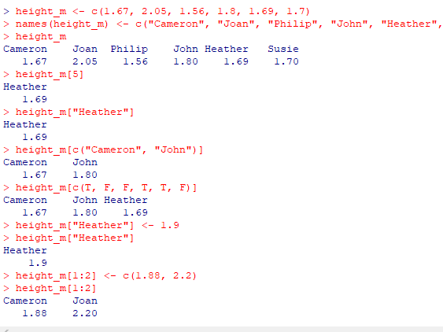

Slide 24
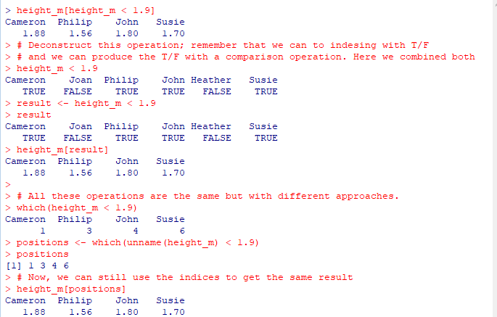

Slide 25
Types of Data Structures
Atomic Vectors
Data frames
Matrices
Lists
Arrays

Slide 26
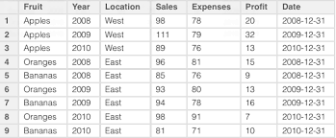

Slide 27
Data frames
Commonly used R object
You will either:
Get a data frame
Make your own data frame
Have columns and rows. Usually represent
Columns variables
Rows observations
Each column is a vector!

Slide 28
Making a data frame
A data frame can be built from scratch inside R using the function data.frame()
Arguments are vectors with of same length

Slide 29
Exploring data frames
A few functions
Check dimensions – dim()
View in spreadsheet format – View()
Examine structure – str()
See first/last records – head()/tail()
Summarise variables – summary()
See/set names of variable – colnames()
Check if – is.data.frame()
Change to – as.data.frame()
Make changes to data using edit()

Slide 30
Subsetting
The $ operator
Look at the output of str() again - note the ‘$’
You can pick out individual columns with syntax dataframe$columnname
Same thing as a vector
Use to get or set variables

Slide 31
Types of Data Structures
Atomic Vectors
Data frames
Matrices
Lists

Slide 32
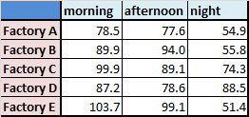

Slide 33
Matrices
Like data frame are 2-dimensional
rows & columns
Like vectors, only of particular type
integer, character, numeric, logical, etc.
Can be built using matrix()
Others include rbind(), cbind()
Matrix arithmetic / linear algebra can also be done; useful in machine learning

Slide 34
Matrix creation is also useful in other operations such as drawing multiple plots
Exploring a matrix is somewhat similar to that of a data frame
dim()
typeof()
class()

Slide 35
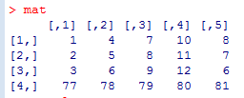
Run the script create-matrix.R to create a matrix, mat
- bracket operator is also used for data frames

Slide 36
Indexing
This is a crucial aspect of R programming
Enable you to get or set elements of a data structure
Bracket operator “[ ]” is used for indexing
For vectors: [ ]
For matrices & data frames: [ , ]
For lists: [ ] and [[ ]]

Slide 37
The format for indexing is [row, column]
[1, 2] means “first row, second column”
If you want to get a matrix value on the 4th row and the 3rd column, you run
matrix[4, 3]
If you want to change a matrix value on the 4th row and the 3rd column, you run
matrix[4, 3] <- <new value>

Slide 38
Ranges also work well with indexing
First 3 rows of column 2 is written as [1:3, 2]

Slide 39
Row 4 of columns 2 to 4 is coded as [4, 2:4]

Slide 40
Note the indices (or is it indexes?) of the matrix along the margins of the output
(also, learn that there is no trivial or frivolous output in R. Studying it can teach you a lot!)

Slide 41
Nit-picking is also possible
To select rows 2 & 4 of columns 3 & 5 write
[c(2, 4), c(3, 5)] # concatenate function

Slide 42
An empty value means ‘ALL’
E.g. [, 5] (all rows in column 5)

Slide 43
Negative indexing is there too
Row 2 except column 5 is written as [2, -5]

Slide 44
Lists
R lists are unique data structures – very versatile
Heterogenous – can hold any kind of R object in memory, singly or in combination
A list can also contain lists

Slide 45
Making a list
The function list() is used to form a list
Download the sample script create-list.R to see how lists can be formed
Go run each line of code and carefully study the output.
Observe that the code constructs list(s) of all the R objects studied thus far (and more!)

Slide 46
Quiz
How many list elements are there in mumbo_jumbo?
List the different types of R objects you can find among the elements.

Slide 47
Indexing lists
The bracket operator [] is also used to extract elements of a list
Single []
Will give you a list
Double [[]]
Will give you the element
Looking at str(), you may notice that $ also identifies each element of the list.
To access them the elements must be named – easily done with the function names()

Slide 48
Exercises
Run mumbo_jumbo[1], and then mumbo_jumbo[[1]]
Now call typeof() on each of them e.g. typeof(mumbo_jumbo[1])
A well-known expert recently shared a photo on Twitter to help understanding of R list indexing. Click here to view it.

Slide 49
Data frames are lists!
Recall that $ is used to mark named columns of a data frame
Also recall that each column in a data frame can stand alone as a vector
A data frame is essentially a list with these characteristics
Made up of vectors
All the vectors are of equal length
Run typeof() on any data frame to check.

Slide 50
Homework
Name the elements of mumbo_jumbo with the names() function as follows (Hint: First, visit the help file with ?names)
Calcium
EAR_done
Bin.code
Bin.code_expt
filesOnFlash
Circle
table_def
MS_simul
my_hex
my_bits
Use the name and $ to extract any element from the list.
What is the type of the extracted element? What does that tell you about the nature of indexing done with $.
Run and review file create-vector.R

Slide 51
Questions?

