Slide 1
R Data Structures
Presenter: Victor A. Ordu

Slide 2
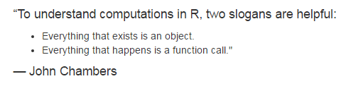
Source: H Wickham (2014). Advanced R. Chapman & Hall, Boca Raton. http://adv-r.had.co.nz/

Slide 3
Types of Data Structures
Atomic Vectors
Data frames
Matrices
Lists

Slide 4
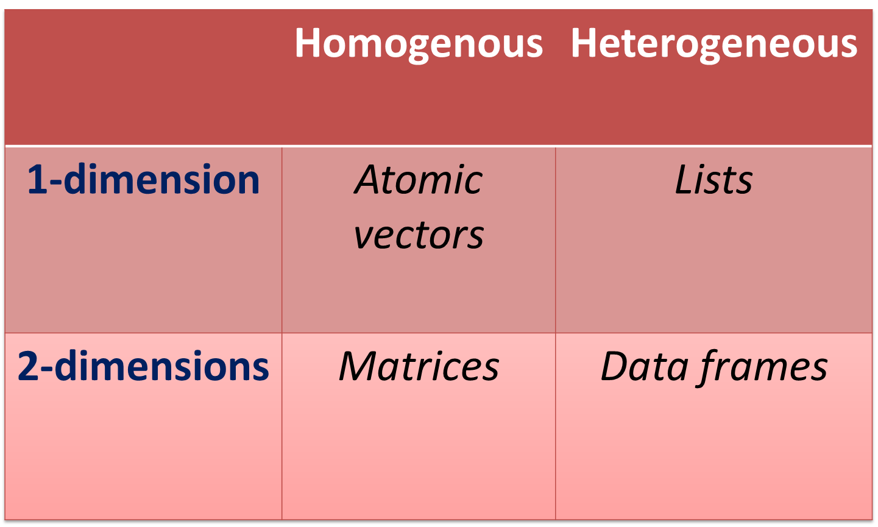
Dimensionality vs Sameness

Slide 5
6 Kinds of Atomic Vectors
Character
Integer
Double (or numeric)
Logical
Raw
Complex

Slide 6
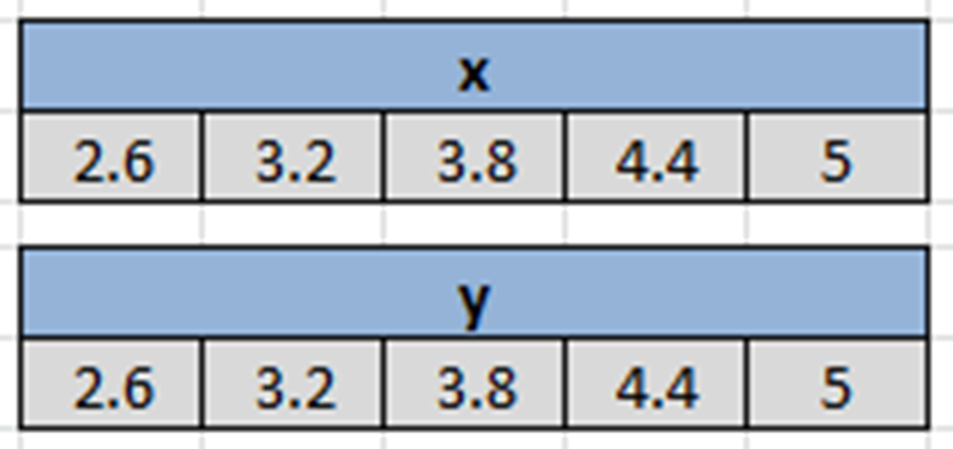
Memory model

Slide 7
Characteristics of Atomic Vectors
All elements are of a particular data type (in lay language, “type” would be numbers, words, etc.)
One-dimensional
Scalars are actually vectors of length 1

Slide 8
Making atomic vectors
By assignment
The concatenate function, c()
Latin: con – caten – atus (chain)
Some call it “combine” function
Indispensible in creating vectors
You can ‘grow’ a vector
append()

Slide 9
Character vectors
Strings are always placed in quotation marks when coding i.e. “boy”, “Health”, “R is easy to learn”, “A string can be a whole sentence!”, “9”.
Some character vectors are inbuilt into R e.g. letters, LETTERS, month.abb, month.name
Remember use quotation marks: “ ” or ‘ ’.
We can create empty vectors with specific lengths e.g. character(length = 10) or character(10)
Limit: Approx. 2³¹ (about 2 billion) characters!

Slide 10
Exercise
If you have any objects in the workspace, clear it with rm(list = ls())
Make a character vector name containing the full names (both Surname and Given Name in each element) of 10 adults
Make a second vector facility of names of 10 imaginary facilities
Make a third vector id of serial identifiers ranging from 1 through 10.
Use typeof() to check what type of vector name is
Confirm the type of facility using is.character()
Note: We can use as.character() to convert another vector to a character vector.

Slide 11
Integer vectors
1L, 2L, 3L
Why the ‘L’?
Wide range – max up to 2,147,483,647
Exercise
Make an integer vector age of 10 adult subjects
Make an integer vector staffStrength for 10 facilities

Slide 12
Numeric (double) vectors
These are real numbers
Existence of inbuilt numeric vectors i.e. mathematical constants e.g. pi

Slide 13
Logical vectors
TRUE/FALSE (not true/false); T/F
Zero is FALSE; any non-zero is TRUE
Exercise
Make a logical vector permitSighted for 10 facilities.
Make another one usingPPE for 10 individuals.
Use str(), typeof(), is.logical(), to explore them.

Slide 14

Named vectors
Each element of an atomic vector can be named e.g.

Slide 15
Coercion
Remember: All elements of atomic vectors are of the same type
This is why they are called atomic.
When we mix elements that are usually interpretable as a different type, R will attempt coercion.
Where this is not feasible, an error is signalled.

Slide 16
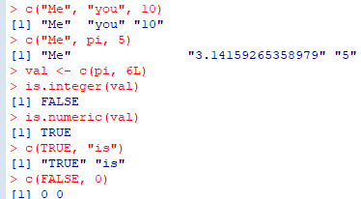
Implicit coercion
Governed by precedence rules
Character >> numeric >> integer >> logical

Slide 17
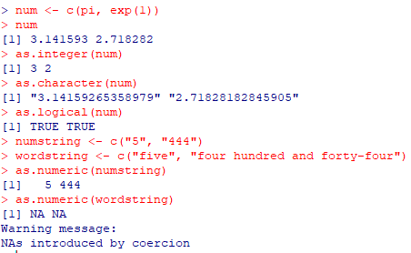
Explicit coercion
Use functions to force elements to a given type.
Can fail when it doesn’t make sense

Slide 18
Factors
Integer values that are mapped to “strings”
Used to represent categorical data
Each category is called a level
One of the most powerful uses of R, especially for modelling
Exercise
Make a vector industryType using 3 categories – small, medium, large – for 10 facilities only.
Make a factor industryCategory by calling the function factor() on industryType.
Now use typeof(), is.factor, is.character, is.integer() to review these 2 objects.

Slide 19
Vector operations
Various operations can be carried out on vectors
Includes
Arithmetic
Logical
Comparisons
Other function calls
Operations on a whole vector usually apply to each element
E.g. to add 5 to a vector means to add it to each element
For 2 vectors of the same size, each operand is applied to the corresponding counterpart
If one vector is smaller, the operations are recycled

Slide 20
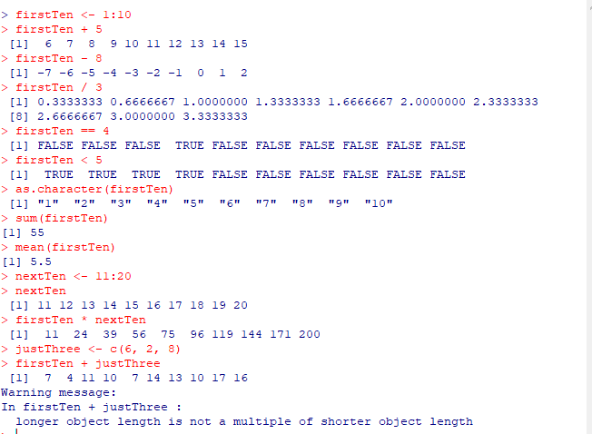

Slide 21
Indexing
A crucial aspect of R programming
Enables one to get or set elements of a data structure
Bracket operator “[ ]” is used for indexing vectors
Can use:
positional values => 4 gives the 4th element
named => applies only to named vectors
logical TRUE/FALSE
predicate statements

Slide 22
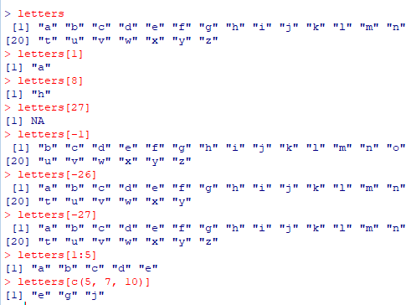

Slide 23
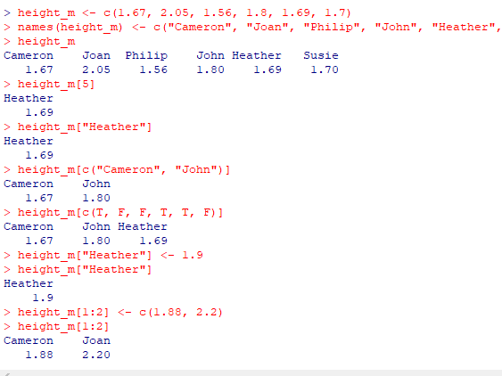

Slide 24
