Slide 1
AngularJS + TypeScript
Preparing for v2/AtScript

Slide 2
Overview
What is TypeScript?
How does it work?
How to write AngularJS app?
Why should I care?
How this will prepare me for v2

Slide 3
What is TypeScript?

Slide 4
TypeScript
Superset of JavaScript
Syntax based upon ES6
Adds type notations (optional)
Code-time feedback (via IDE)
Compiles to ES3 ES5

Slide 5
Compare
ES5
ES6
TypeScript
var Square = function (width){
this.width = width;
}
Square.prototype = {
getArea: function(){
return this.width * this.width;
}
};
var square = new Square(4);
square.getArea();
class Square {
constructor(width) {
this.width = width;
}
getArea() {
return this.width * this.width;
}
}
let s = new Square(4);
s.getArea();
class Square {
constructor (width: number) {
this.width = width;
}
private width: number;
public getArea:number (){
return this.width * this.width;
}
}
var square = new Square(4);
square.getArea();

Slide 6
How does it work?
DEMO

Slide 7
Angular + TypeScript
How to write AngularJS app?

Slide 8
Why should I care?
I know JavaScript

Slide 9
ngEurope – v2
What they did well
Technology explanations
Opened communication channels regarding v2
What they did poorly
Delivery of information
Explanation of plan
Lack of information
Controlling of public panic

Slide 10
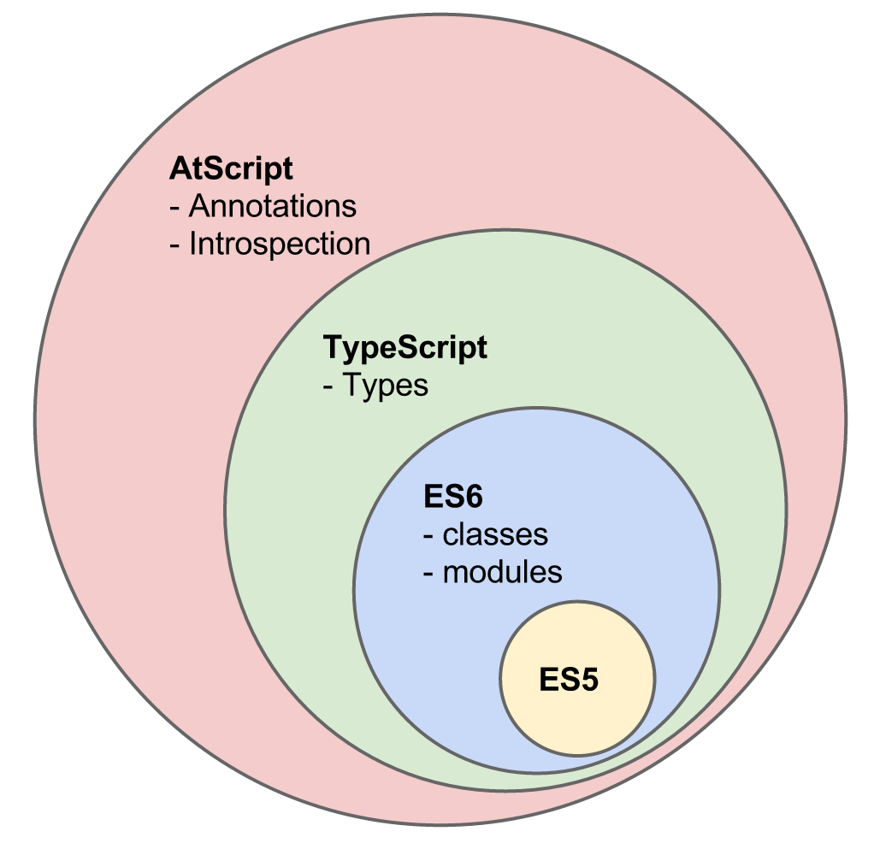
v2 Technology

Slide 11
Disclaimers
I do not work for Google
I do work “near” Google
I do not work on AngularJS
I only work with AngularJS
What I am about to talk about is purely speculation

Slide 12
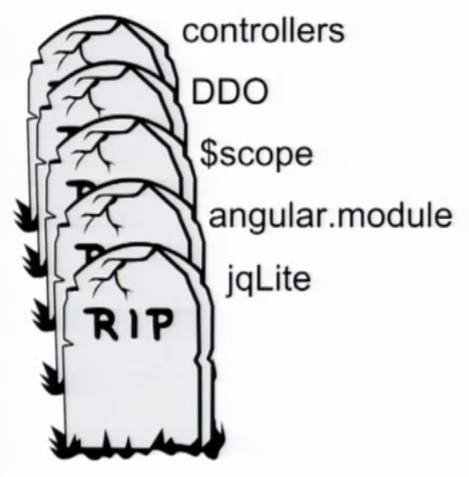
v2 Scare

Slide 13

v2 Casualty

Slide 14

v2 Casualty

Slide 15

v2 Casualty

Slide 16

v2 Casualty?

Slide 17
$scope
Mostly dead as of v1.3
Due to controllerAs syntax
Still used for:
Events ($on, $broadcast, $emit)
Triggering digest loops ($apply)

Slide 18

v2 Casualty?

Slide 19
Write for v2?
DEMO

Slide 20
Resources
TypeScript
typescriptlang.org
github.com/borisyankov/DefinitelyTyped
npmjs.com/package/gulp-typescript
pluralsight.com/courses/transcript/typescript
Angular v2
eisenbergeffect.bluespire.com/all-about-angular-2-0/
vimeo.com/111117420
Bonus
http://swapi.co/

Slide 21
Mike Brocchi
@brocco mbrocchi@gmail.com

